Slide 1
Building Colorado energy future Clean, safe, reliable
Carrie Simpson | Director, Western Markets – Public Service Company of Colorado
October 21, 2021
Notes:
Add presenter’s name/title/date, as appropriate.

Slide 2
Xcel Energy
Serving eight states
3.7 million electricity customers
2.1 million natural gas customers
Nationally recognized leader:
Wind energy
Energy efficiency
Carbon emissions reductions
Innovative technology
Storm restoration
Notes:
Xcel Energy has been a national leader in wind energy since 2005/for more than a decade
Since the early 1990s, we’ve supported energy efficiency and offer a leading portfolio of programs with options for all types of customers.
We’ve led the industry in initiating voluntary emissions reductions efforts with our generating plants, helping our states meet their clean air requirements (MN MERP, CO CACJ)
We have several leading demonstrations and pilots underway to test advanced technologies (Panasonic partnership, drone technology, Advanced Grid, Robotic Process Automation, Energy Impact Partners, Google Assistant
Hydrogen Production)
Storm restoration -- Recognized with the Edison Electric Institute's Emergency Recovery Award for outstanding storm restoration efforts.

Slide 3
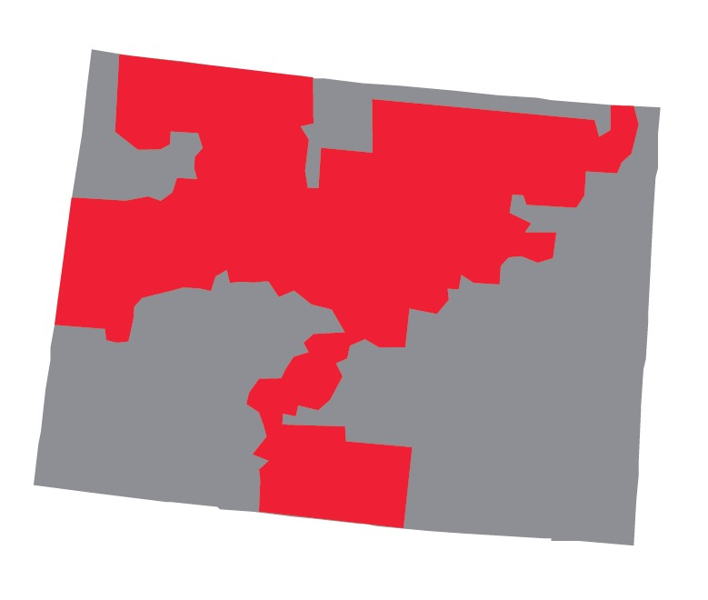
Colorado Customers
1.5 million Electric Customers
1.4 million Natural Gas Customers
99.9% Electric Reliability
1.3 million Electric Customers
460,000 Natural Gas Customers
Notes:
Data Source: customer information & reliability is from the Corp. Responsibility Report
We provide electricity to 1.5 million customers and natural gas service to 1.4 million customers.
Reliability is at the core of all that we do. 99.9%

Slide 4
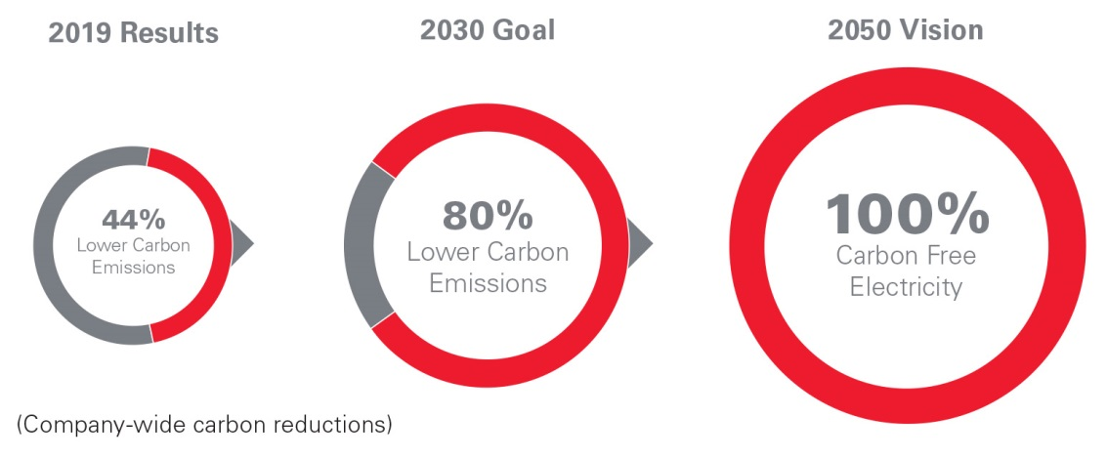
A Bold Vision for a Carbon-free Future
2020 National Climate Leadership Award for Organizational Leadership
Notes:
We have an ambitious plan to aggressively reduce carbon emissions companywide by 80% by 2030, compared to 2005, and put us on the path to achieve our vision of 100% carbon-free electricity by 2050.
We were the first large utility to announce such an ambitious vision
Our Upper Midwest Energy Plan will set a path for how we achieve our 2030 milestone.
But, serving customers with 100% carbon-free electricity will require technologies not yet commercially available. Even though our carbon-free aspiration is decades away, we're beginning work now with stakeholders to help develop these technologies, as well as the policies and support, that will make this aspiration achievable.
Xcel Energy received a national Climate Leadership Award in 2020 for top Organizational Leadership from the Center for Climate and Energy Solutions and The Climate Registry. The award recognizes our company’s industry-leading carbon reduction efforts, as well as our support for customers and communities in achieving their clean energy goals.

Slide 5
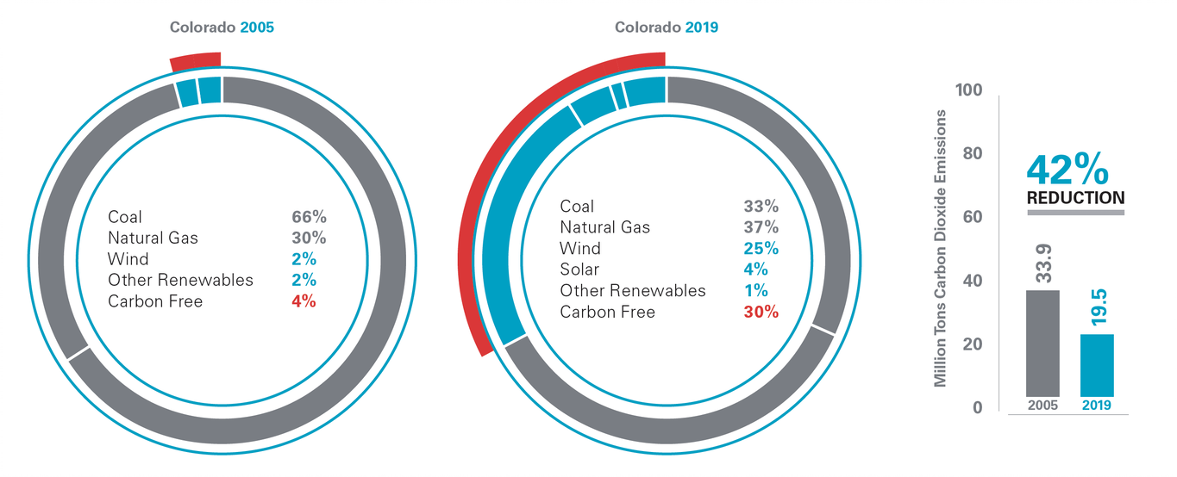
A Cleaner Energy Mix
Notes:
Our corporate forecast for increased renewables, on track for 60% by 2030.

Slide 6
Colorado energy plan resource additions
250/125 MW solar plus battery storage
200/100 MW solar plus battery storage
Note: Battery systems that are charged by the renewable energy system 100% of the time on an annual basis can claim the full value of the Federal Investment Tax Credit

Slide 7
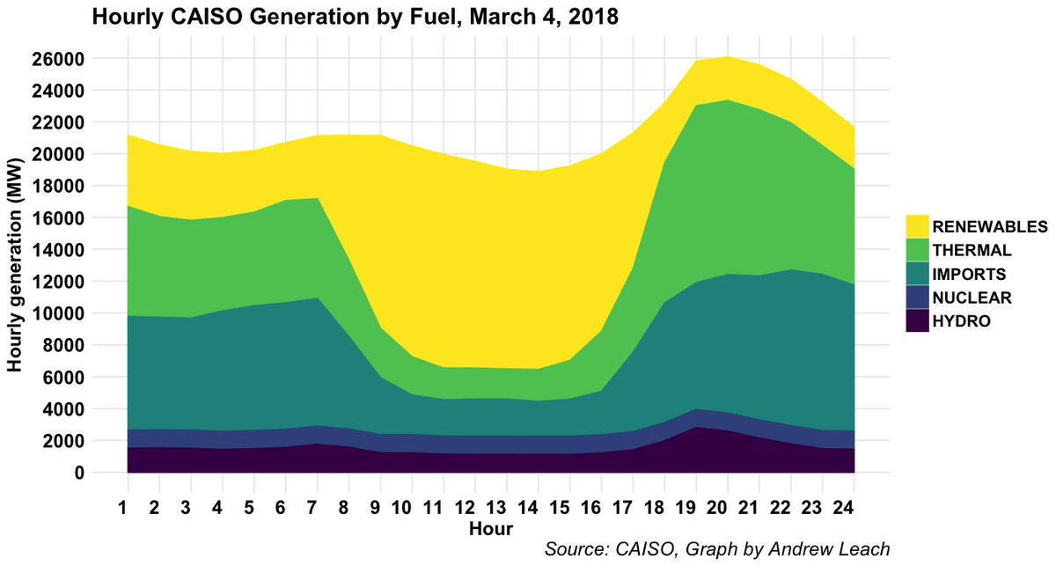
Trends in Ancillary Services
As more variable generation is added to the grid, Balancing Authorities and power markets are adjusting to become more flexible and responsive.
Year 2000: Generation stack had virtually no renewable generation besides hydro.
Year 2018: Generation stack includes solar and wind. Intermittent generation changes the use of thermal generation and balancing services.

Slide 8
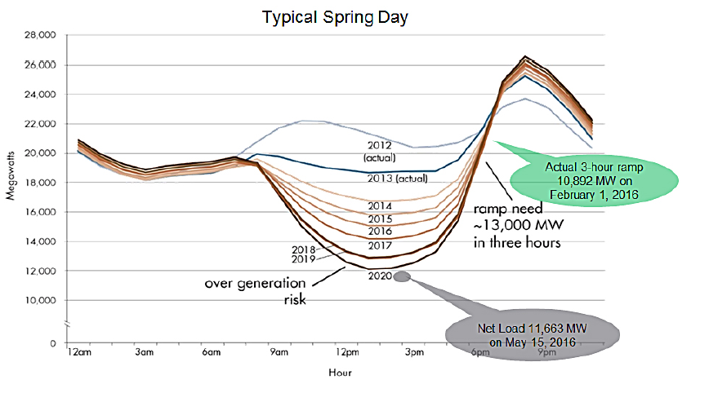
Trends in Ancillary Services
California ISO’s Depiction of Steep Ramping and Oversupply
Ramp products are in place or in development at all of the RTO/ISOs to capture and incent additional flexibility to the system.
Wind and solar forecasting tools are now critical to plan for day-ahead and real-time energy procurement.
New ancillary services like Flex Reserve products designed to address sudden changes in variable output are being added
Battery storage is becoming price competitive and providing fast-regulation products and other ancillary services depending on the region.

Slide 9
Regulating & Contingency Reserve
Must be online within 15 minutes
NERC establishes and enforces reliability standards for the bulk electric system.
Supplemental Reserve
Contingency Reserve
Spinning Reserve
Services used to balance in real-time
Regulating Reserve
Energy
Generation online and “held-back” but ready to go
Automatic Generation Control, every 4 seconds

Slide 10
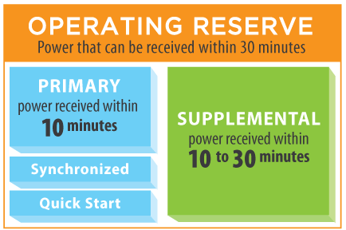
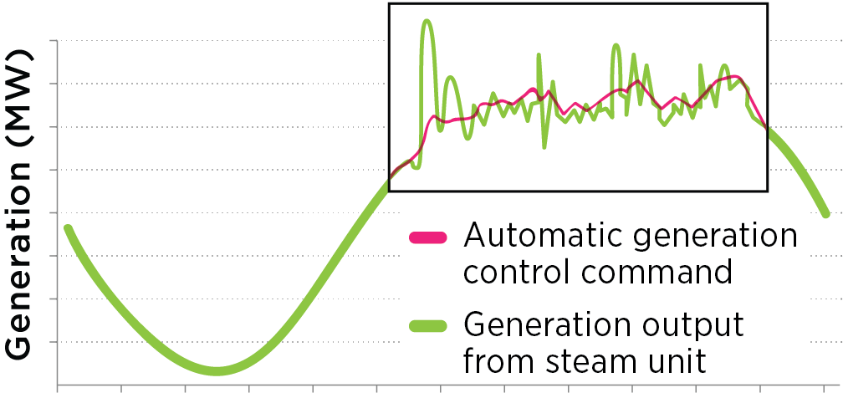
Types of Ancillary Services in U.S.
Regulating Reserve
Voltage Support
Graphic credits: PJM.com and SPP.org

Slide 11
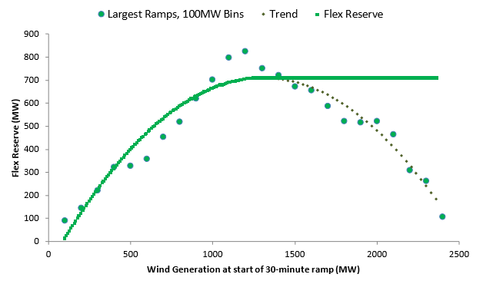
Types of Ancillary Services in U.S.
Flex Reserve
Additional contingency reserve procured to cover large 30-minute wind down ramps.
Used in the BA of Public Service Company of Colorado, which has operated reliably with over 70% of load being served by wind in a given hour.
Graphic credit: xcelenergy.com

