Slide 1
Non-Li technologies and solar integration
2021 Southern Africa Energy Storage Systems
Valerio De Angelis
Energy Storage Tech & Systems
Sandia National Laboratories
vdeange@sandia.gov
Sandia National Laboratories is a multimission laboratory managed and operated by National Technology & Engineering Solutions of Sandia, LLC, a wholly owned subsidiary of Honeywell International Inc., for the U.S. Department of Energy’s National Nuclear Security Administration under contract DE-NA0003525.
SAND2021-13004 C

Slide 2
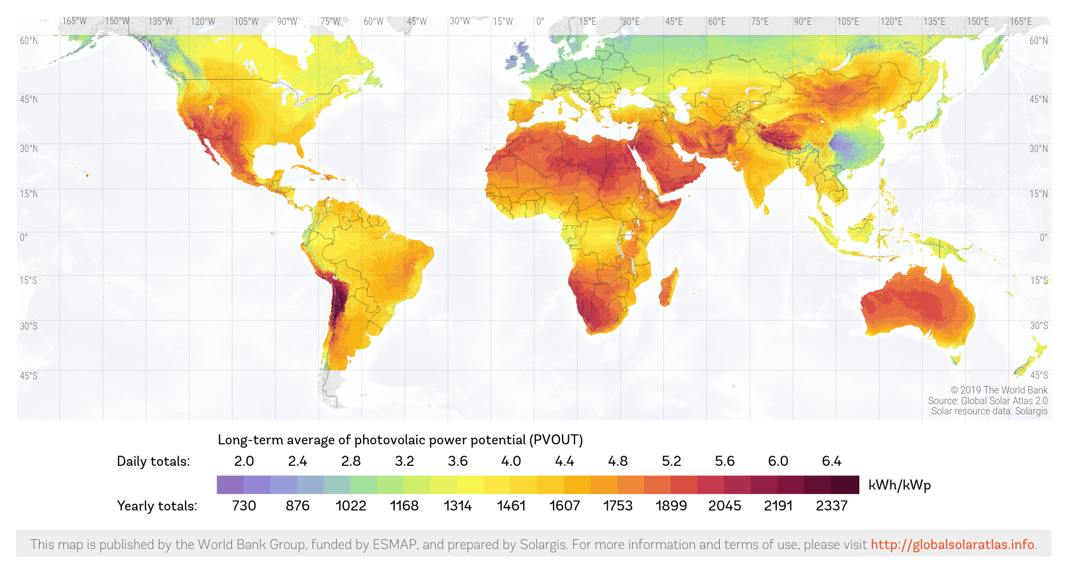
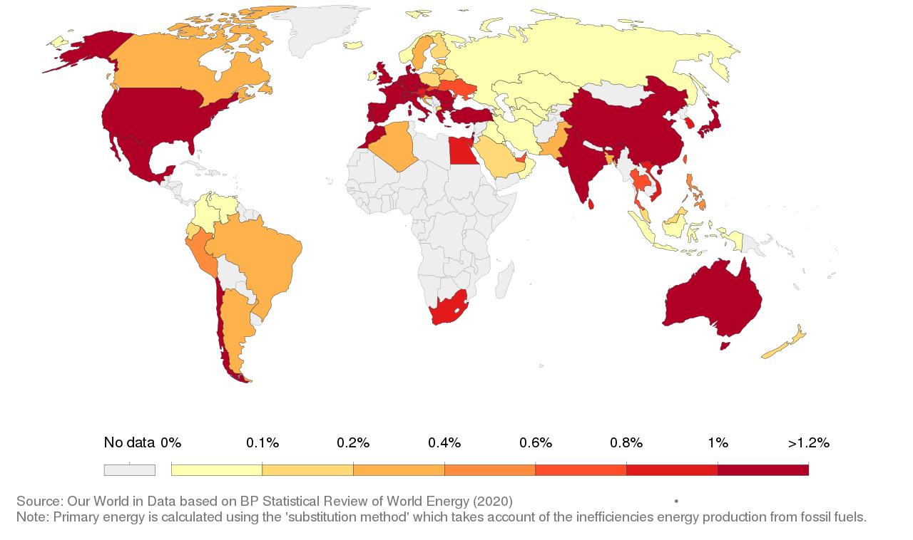
Solar energy is available and inexpensive
Potential solar power
% of solar generation in each country

Slide 3
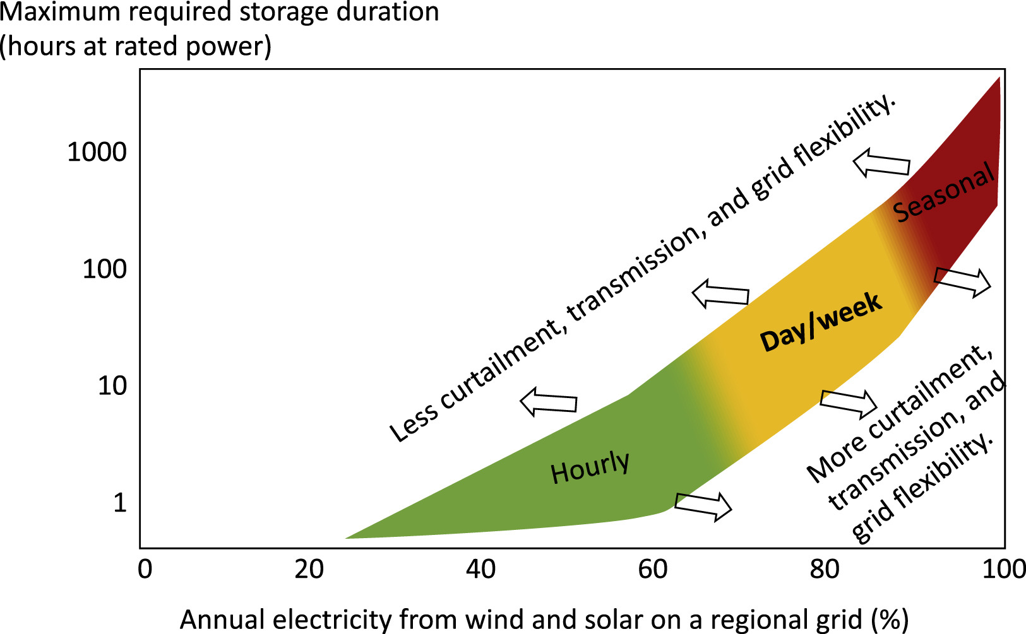
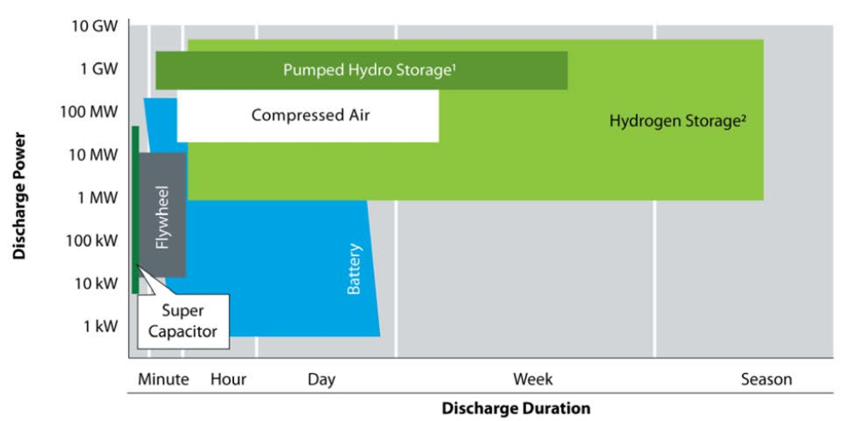
Long duration storage is needed to firm solar and other sources of renewable generation
https://doi.org/10.1016/j.joule.2019.11.009

Slide 4
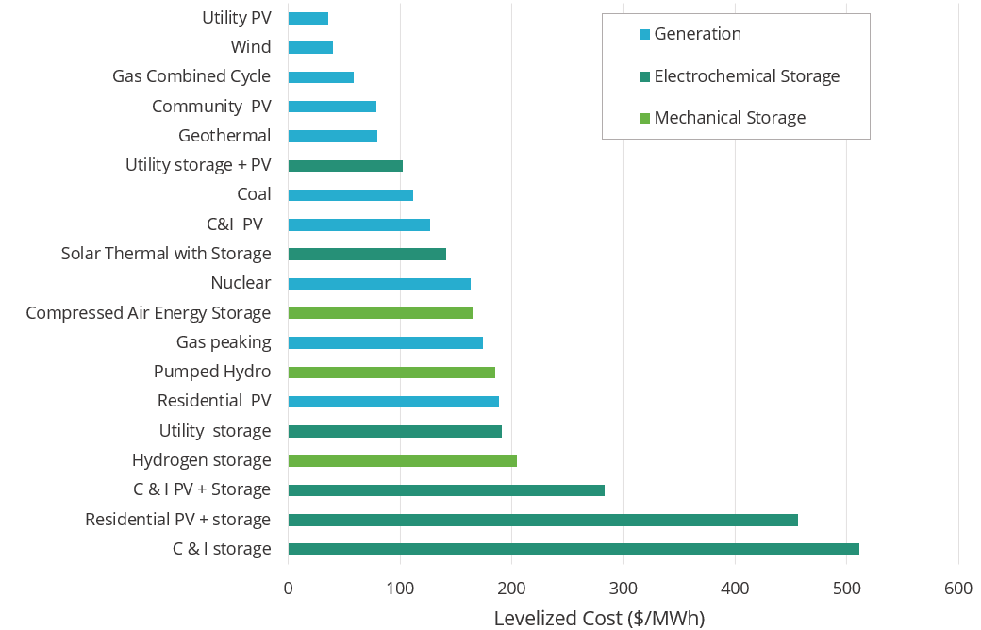
Energy storage is competitive in some cases with conventional generation
Advantages of solar generation
Solar enables a distributed infrastructure
A decentralized infrastructure can be easier to operate and maintain
Source: Lazard

Slide 5
Battery technologies take time to develop
Battery manufacturing
Growing Li-ion market (EV, Portable)
Stable and mature Lead-Acid market
Established primary Alkaline market
Other battery technologies are not well developed
Supply chains take decades to develop
Source: Avicenne Energy

Slide 6
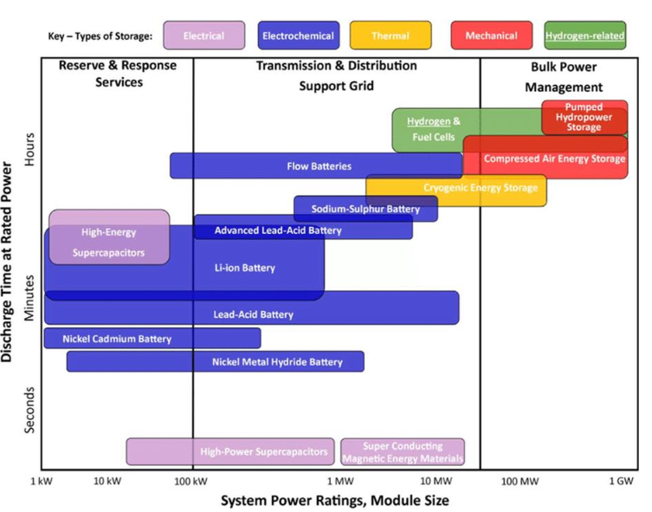
Several options for energy storage are available
Grid scale
Flexible
Modular

Slide 7
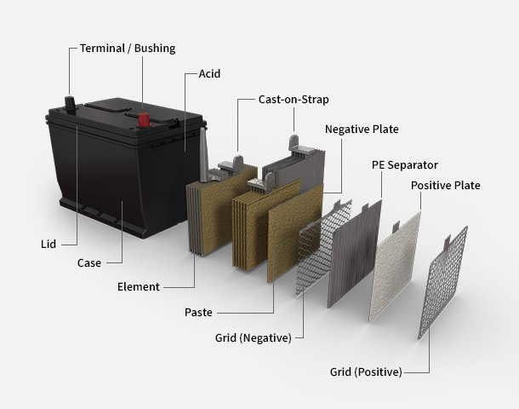
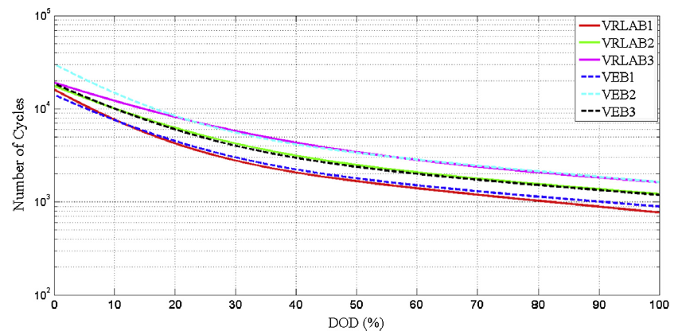
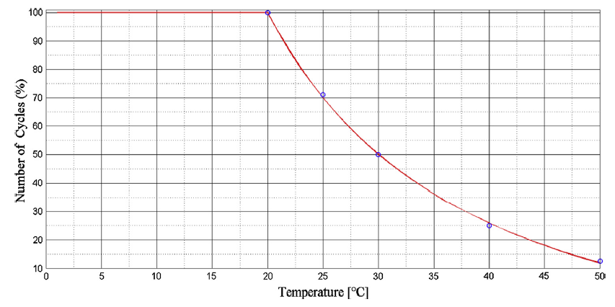
Lead Acid is used for UPS and for solar firming
Simple & standardized construction
Performance degrades with temperature

Slide 8
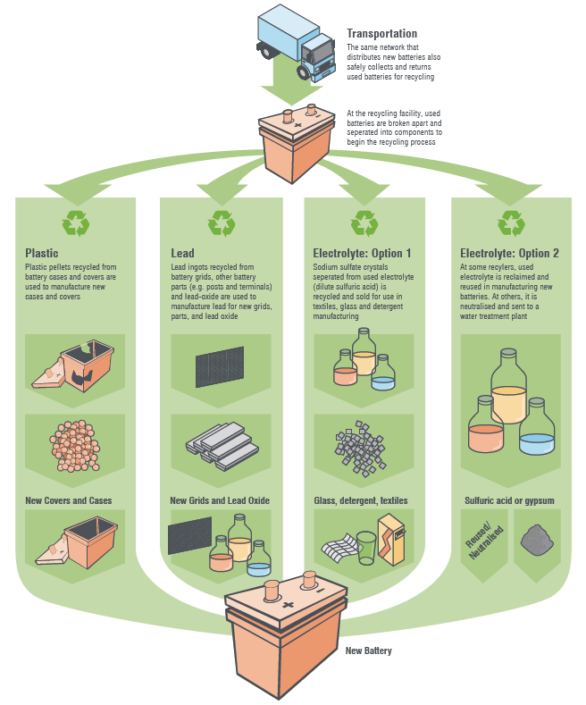
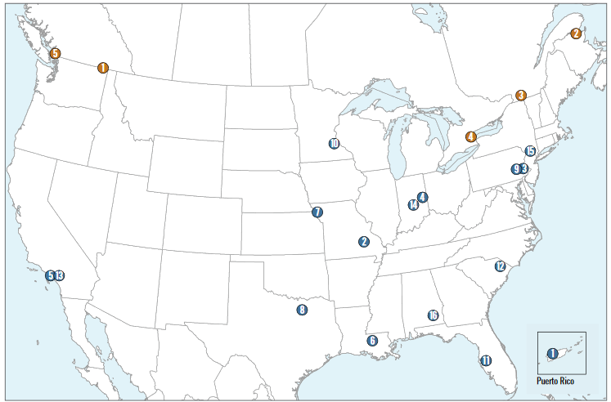
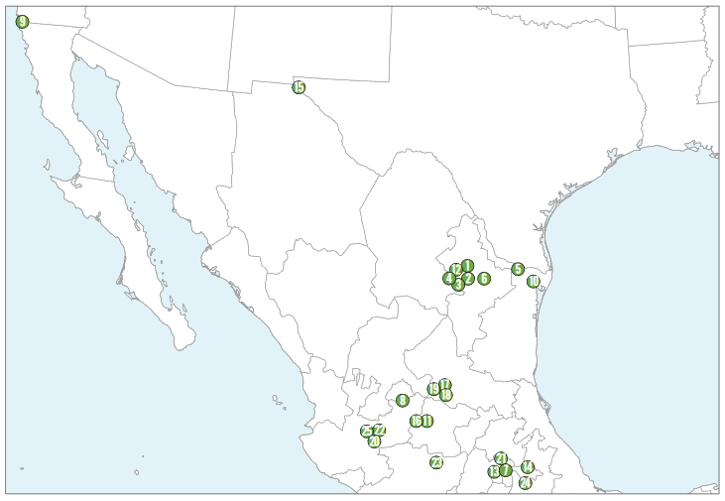
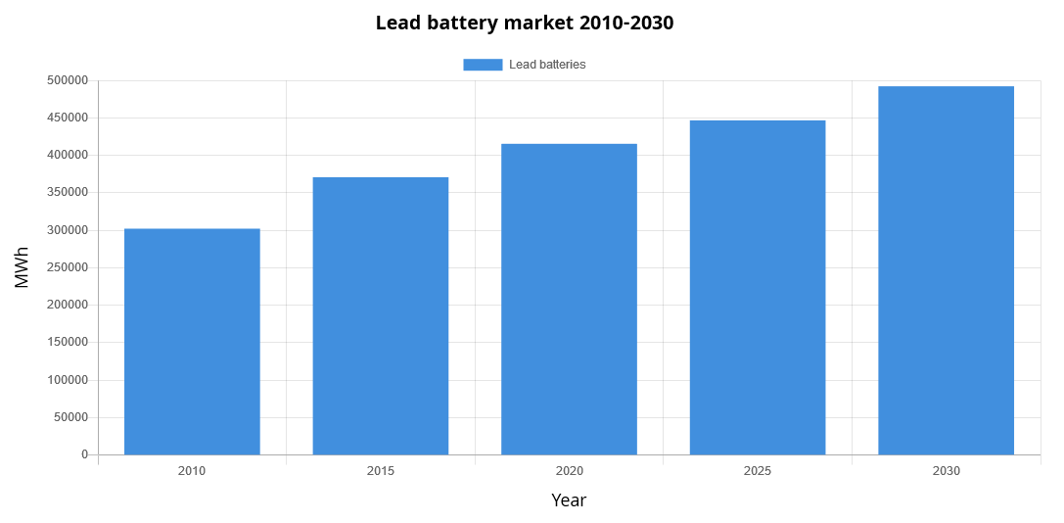
The lead-acid industry has an established recycling infrastructure
Recycling centers in the US and Mexico
https://batteryinnovation.org/resources/lead-battery-market-data/

Slide 9
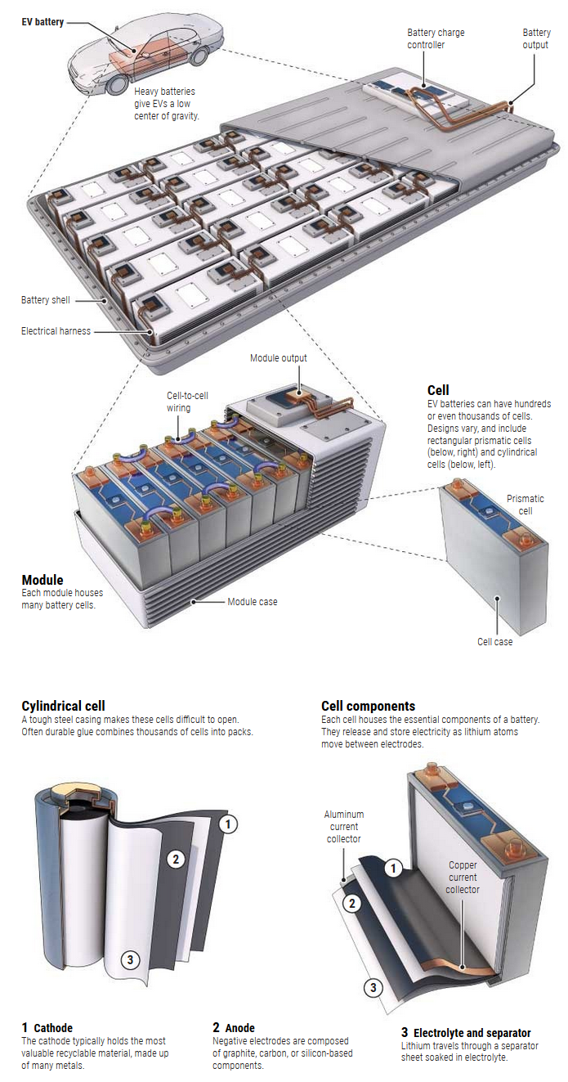
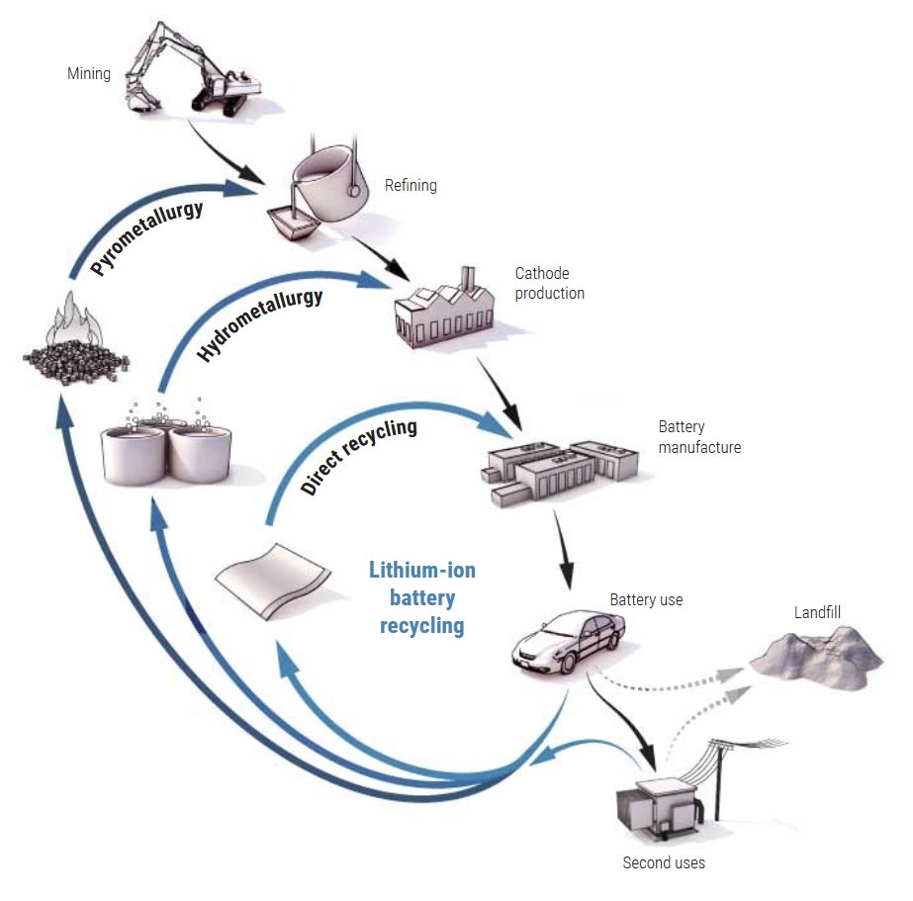
Recycle of lead-acid batteries in imperfect by recycling of Li-ion batteries is harder
Recycling concerns are not unique to lead-acid batteries
https://www.science.org/content/article/millions-electric-cars-are-coming-what-happens-all-dead-batteries
https://www.anl.gov/manufacturing/recycling

Slide 10
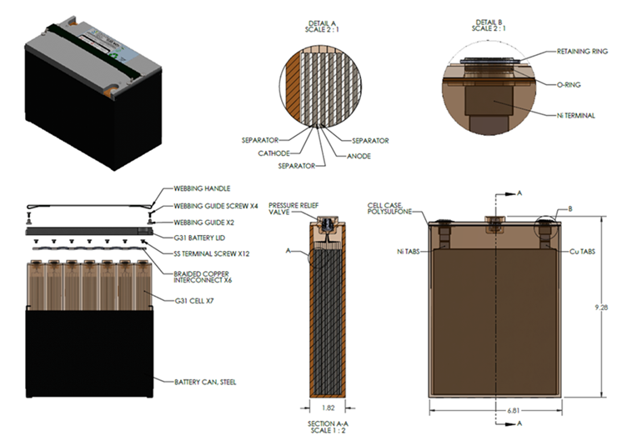
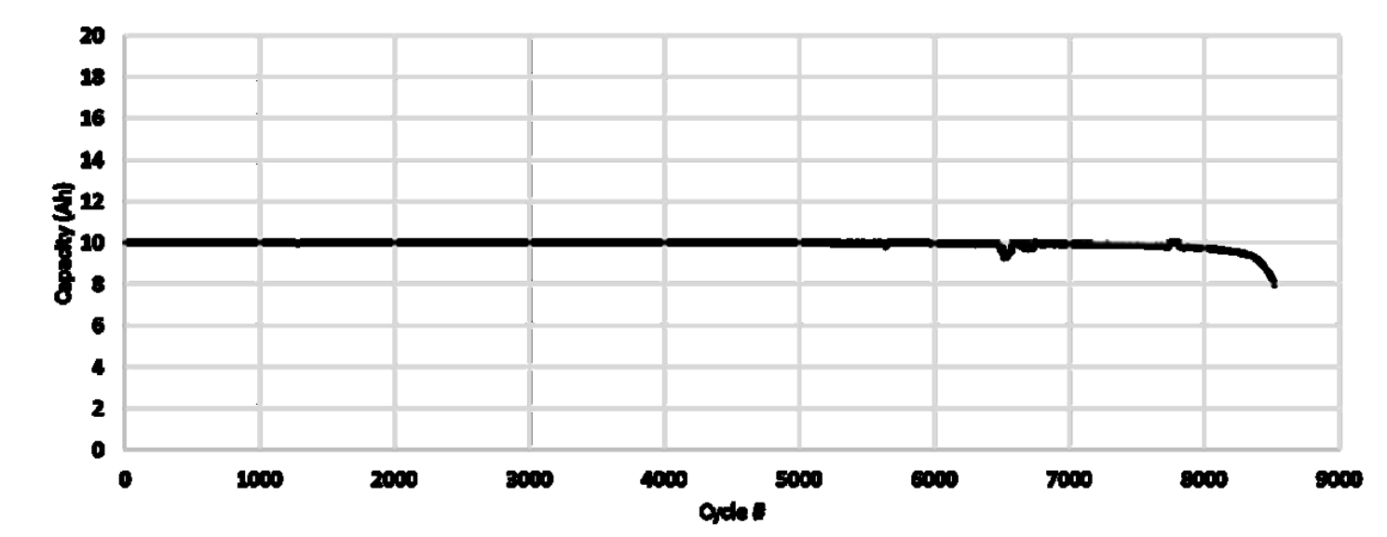
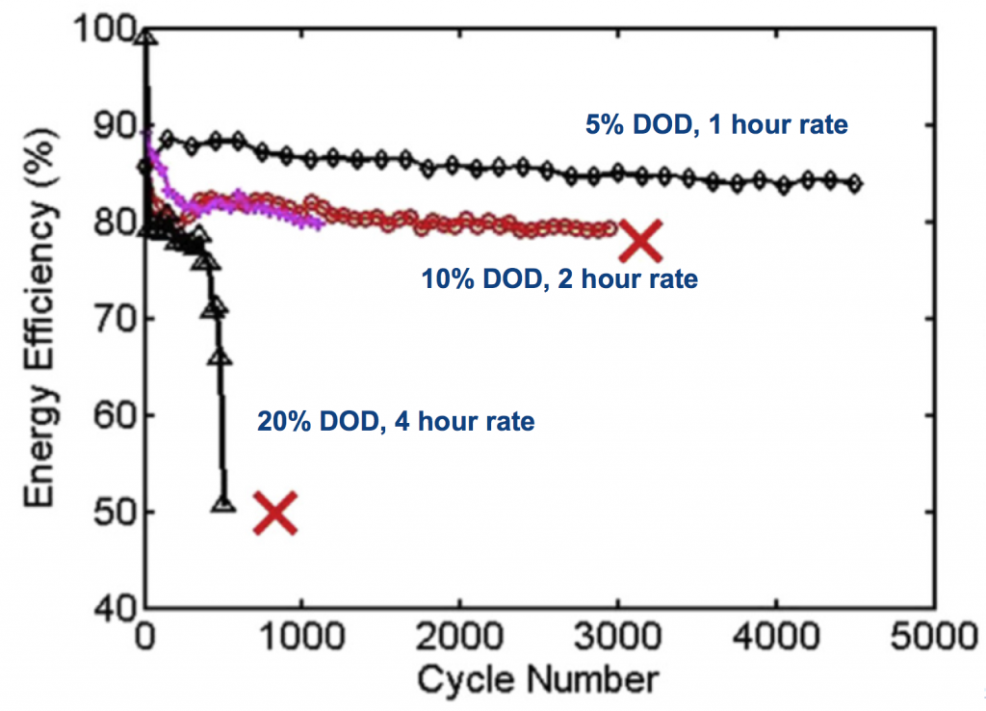
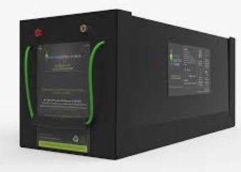
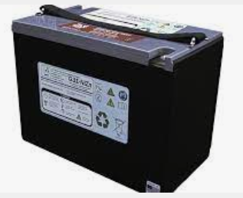
Zn-based batteries are an environmentally friendlier alternative to lead acid
More complex construction
Zn-Ni at 1C charge/discharge
Source: Design and Performance of Large Format Nickel-Zinc Batteries E. Listerud and A. Weisenstein ZAF Energy Systems
Zn-MnO₂ batteries
Source: http://www.joshuagallaway.com/?p=265

Slide 11
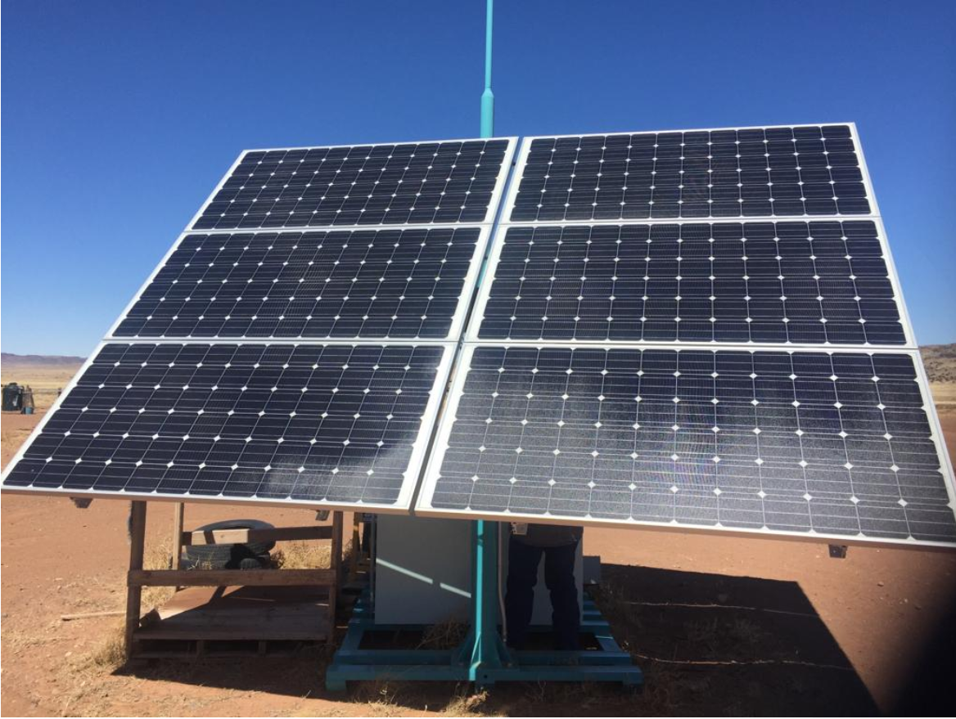
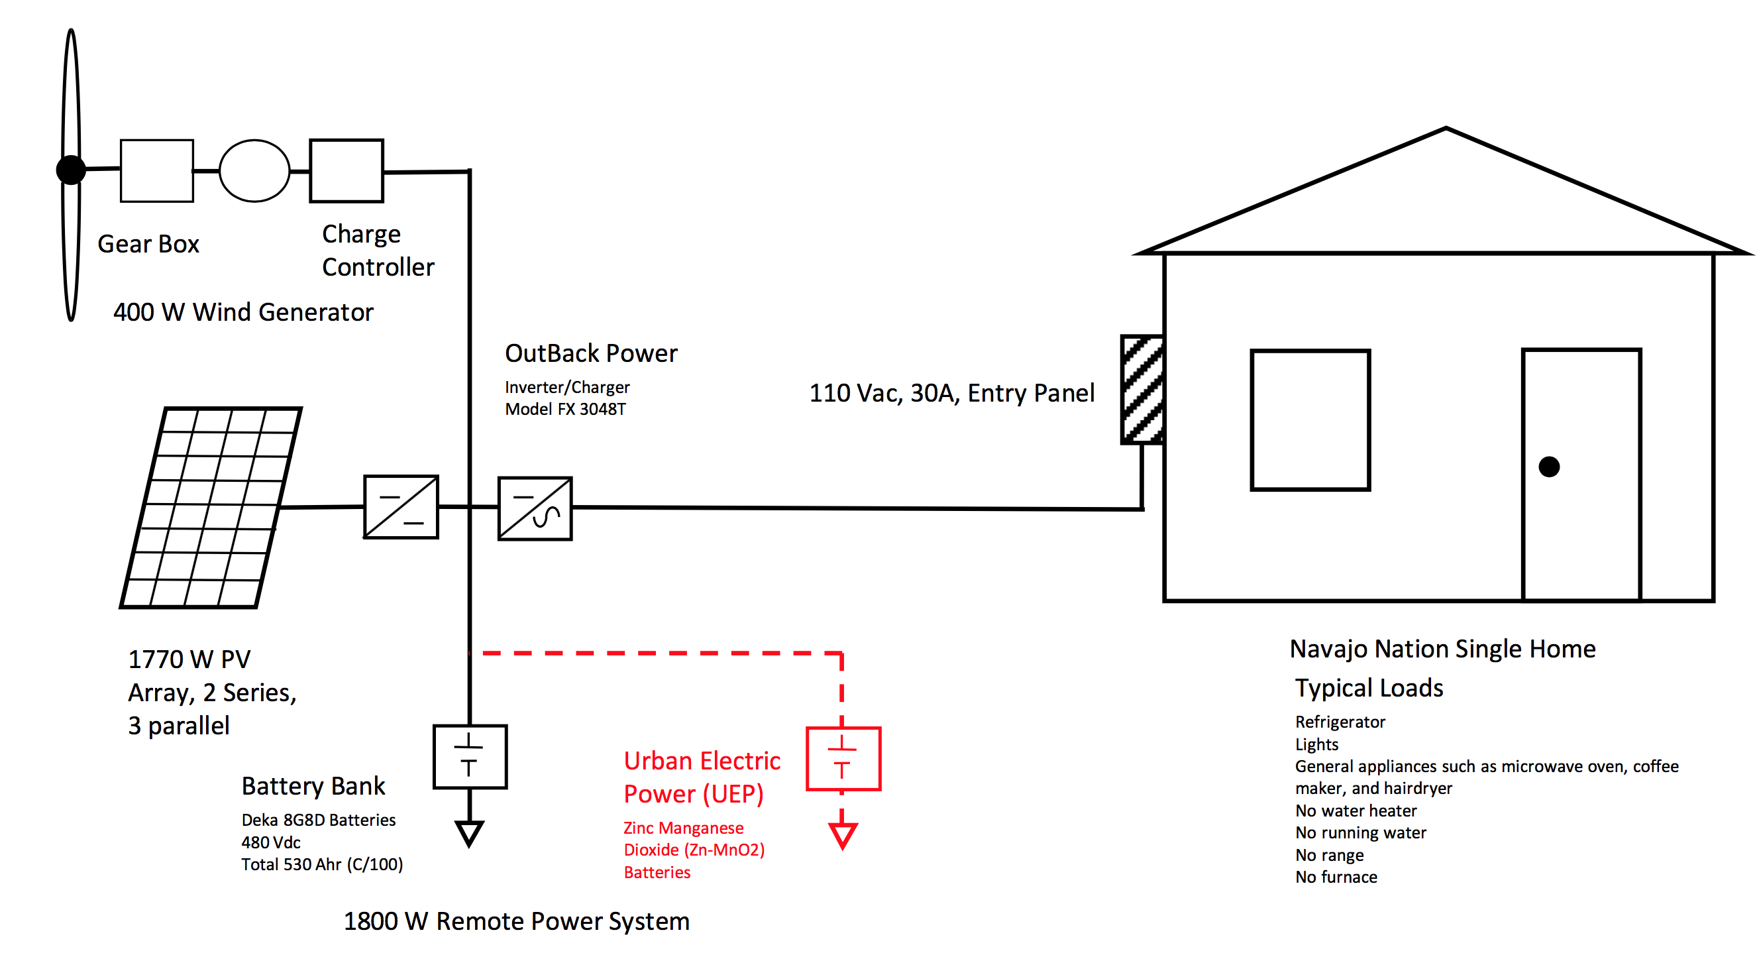
Zn-based batteries can replace lead-acid batteries

Slide 12
Data for the Zn-MnO₂ batteries used with converters designed for lead-acid batteries
DC Voltage
DC Current
Top: Voltage; Bottom: Current: System test for 3 days. The system ran for 3 days paired with solar: charging when the sun was available and discharging during other times
Data from www.urbanelectricpower.com

Slide 13
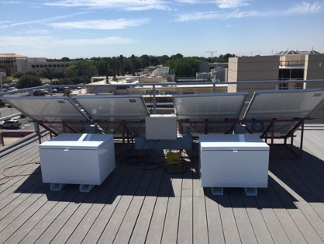
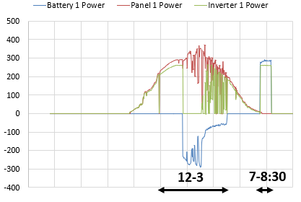
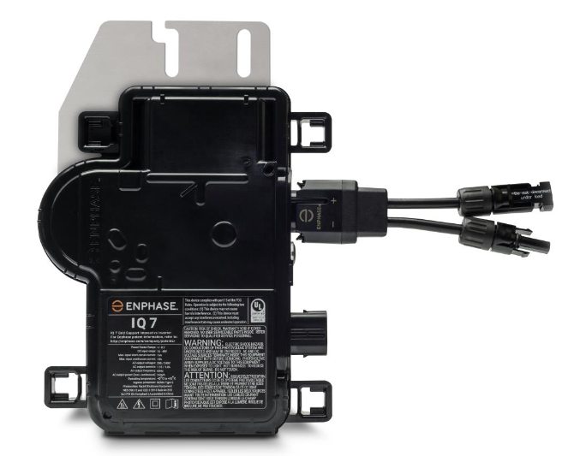
Zinc-based batteries can operate under solar panels
Data from www.urbanelectricpower.com

Slide 14
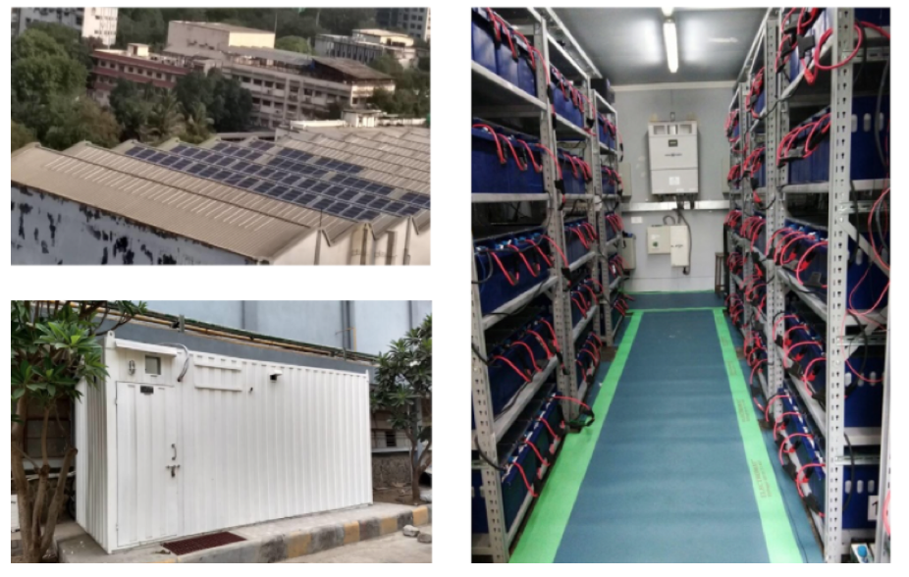
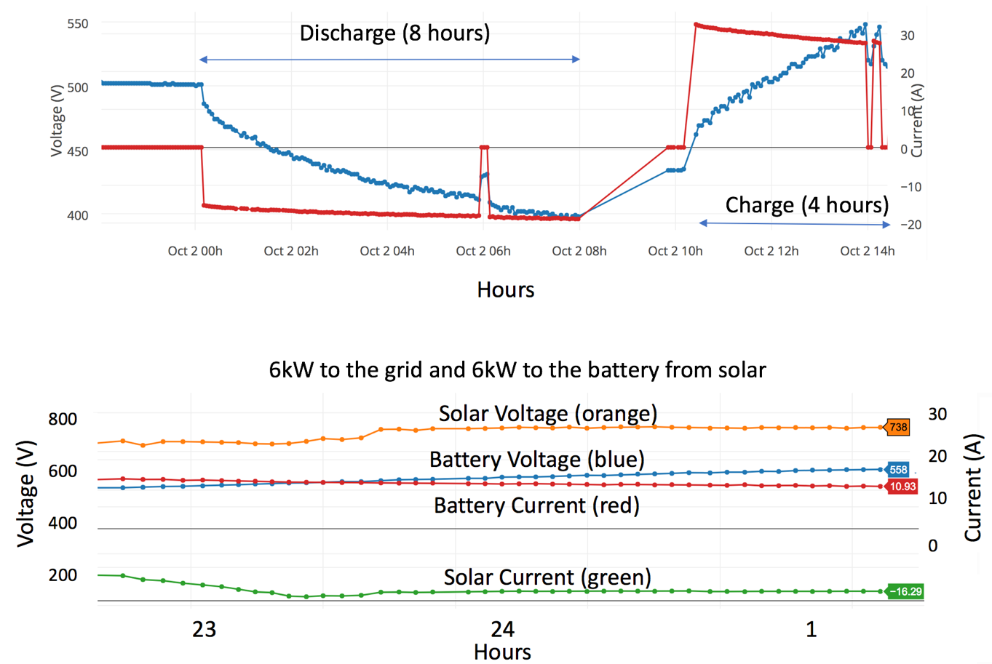
Container-based ZnMnO₂ system built in India using Li-ion BMS and power converter
Data from www.urbanelectricpower.com
14

Slide 15
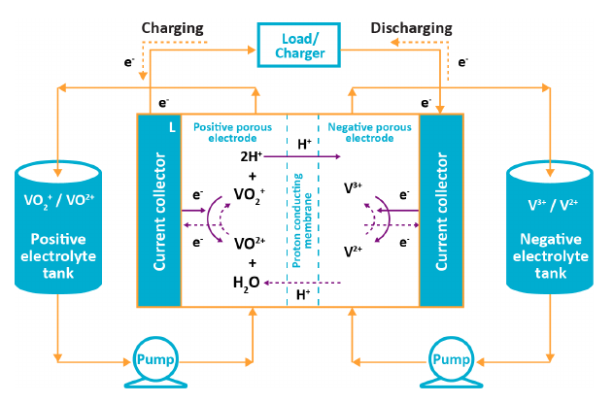
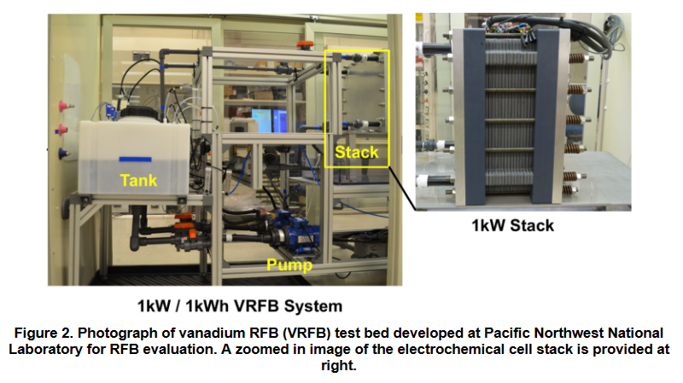
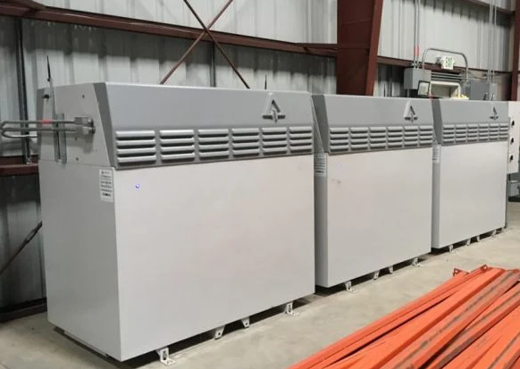
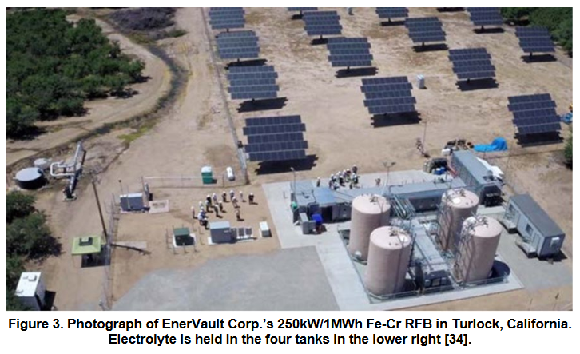
Flow batteries allow decoupling of energy and power
Benefits:
Decouple energy and power
The electrolyte has a long life
Issues:
Costs remain high
Energy density is low
Many mechanical parts
Modular systems (<50kWh)
Utility scale systems

Slide 16
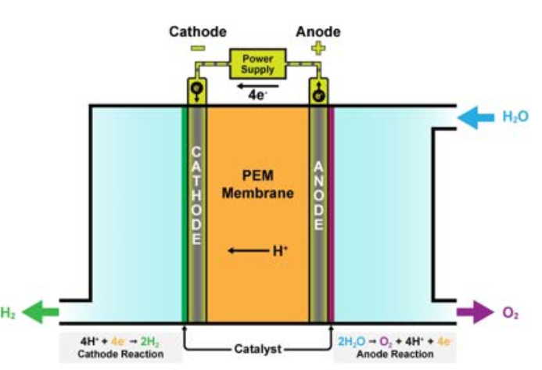
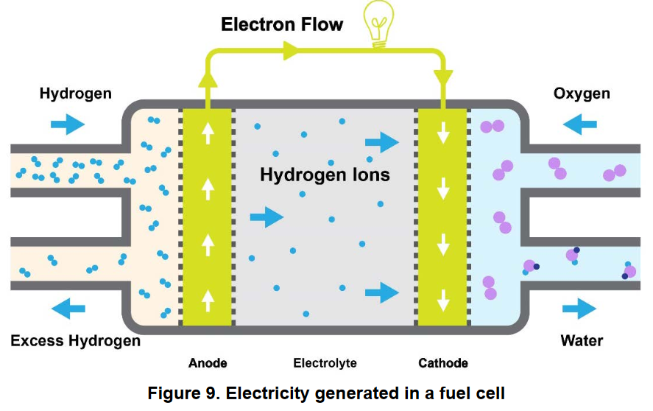
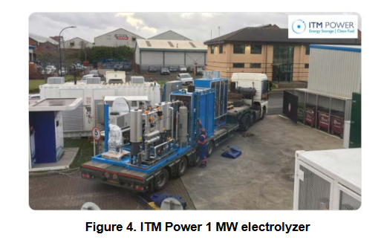
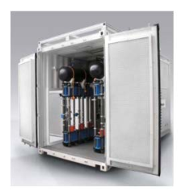
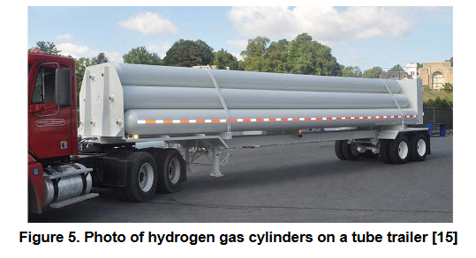
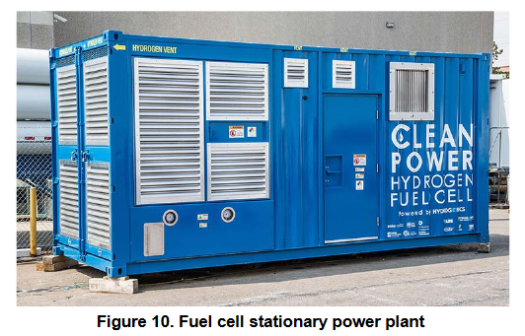
Hydrogen has high energy density but no established supply chain
Benefits:
High density of the fuel
Potential for transport
Reuse of existing infrastructure
Issues:
Proton exchange membranes
Expensive catalyst
Low efficiency
NOx production
Source: Sandia Energy Storage Handbook

Slide 17
Summary
Specifications
Solar technology is mature and inexpensive
The existing grid infrastructure will evolve
Developing countries can take advantage of new decentralized technologies
The competition for Li cells will increase as the penetration of EV’s goes up
Lead-acid and new Zn-technologies can hit low price points and be easy to manage
Other, non-modular options, like flow batteries and H₂ systems are coming to market

Slide 18
Acknowledgements
Funded by the U.S. Department of Energy, Office of Electricity, Energy Storage program. Dr. Imre Gyuk, Program Director.
Sandia National Laboratories is a multimission laboratory managed and operated by National Technology & Engineering Solutions of Sandia, LLC, a wholly owned subsidiary of Honeywell International Inc., for the U.S. Department of Energy’s National Nuclear Security Administration under contract DE-NA0003525.
Sandia Grid Energy Storage Program Manager: Babu Chalamala
Contributors:
Flow batteries: Leo J. Small, Cy H. Fujimoto, Harry D. Pratt III, Travis M. Anderson, Sandia National Laboratories
Hydrogen: Alexander J. Headley (Sandia National Laboratories), Susan Schoenung (Longitude 122 West, Inc.)
For questions about this presentation: vdeange@sandia.gov

