Slide 1
Lithium Ion Chemistry & Case Studies
10/20/2021
Sequoya Cross, Chief Operating Officer
© 2020 SimpliPhi Power | REV202010051018

Slide 2
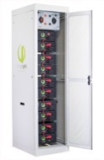
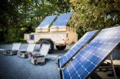
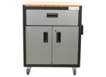
A Timeline of Continued Innovation, Growth & Success
2010
2011-12
2013-14
2015-16
2017-21
Founding of OES Energy
Residential, Military + Emergency Response
Product Line Expansion
Relaunch as SimpliPhi Power
Ramping Up Manufacturing
Leveraging a decade of IP based on lithium ion innovation + successful deployments in the film & broadcast industry.
OES founded to scale proprietary technology and manufacturing, providing superior residential and commercial solutions to key global markets on/off grid.
OES only utilizing LFP Lithium Ion chemistry due to its safety profile and robust performance.
OES LFP batteries subjected to rigorous testing by the Department of Defense, Aberdeen Proving Grounds.
OES introduces first residential market battery, Genny mobile solutions for emergency response and military spec energy storage systems for lead acid/diesel replacement on FOB.
Successful microgrid deployments in Iraq and Afghanistan with the DoD.
PowerBank battery-based generator on wheels expands mobile energy product offerings and rapid deployments of robust long duration and high-power integrated systems.
Expand diverse solutions for military, emergency response and commercial customers across global markets.
Introduce new PHI battery models for scaling on/off grid systems.
OES reincorporated and rebranded as SimpliPhi Power. Marine Corps tests at Camp Lejeune find SimpliPhi batteries outperform other LI batteries by >62%.
Introduces turnkey fully integrated AccESS for residential/ commercial on/off grid to seamlessly optimize grid, generators and renewable energy.
High performance, long life and
low LCOE.
HQ relocated to 25K sq ft manufacturing and R&D facility.
Sales focus transitions to high volume Distributors world-wide. High voltage commercial solutions introduced with dynamic scalable platform for C&I markets. >100 MWh of products shipped to date in >40 countries to >7,500 customers.
AmpliPHI with proprietary BMS and closed loop communications. VPP and enhanced connectivity.
© 2021 SimpliPhi Power | REV202009232243
Notes:
SimpliPhi was founded in 2010 as Optimized Energy Storage in Ojai California, with its roots in the film and broadcast industry. We leveraged over a decade of experience to scale our proprietary technologies and manufacturing into the residential and commercial sector for key global markets for on or off grid applications. Since our beginnings we have only utilized LFP battery chemistry as we believe, based on our core values as a renewable company, that it does not make sense to store clean energy in toxic batteries that contain cobalt, and other questionably sourced materials and fundamentally put customers at risk.
As the company continued to grow and scale using this safer chemisty, we had the opportunity to test the efficacy of our technology with the military, going through rigorous testing at Aberdeen proving ground. OES introduced it’s first residential battery and Genny mobile solutions for emergency response and lead acid/diesel replacement in forward operating bases in some of the most austere environments in Iraq and Afghanistan, all with a zero percent failure rate.
In 2013-2014 we began creating larger fully integrated units that provided more robust and longer duration back-up power, and expanded our military and emergency response solutions. Around this time the first PHI battery models became available to the market for scaling on and offgrid systems.
In 2015 we relaunched as SimpliPhi Power, and continued our testing of battery solutions and our non-toxic battery chemistry with the military. We also introduced our fully integrated turn-key pre assembled and pre programmed AccESS units for residential and small commercial applications. A product that continues to provide benefit in utility planned and unplanned outages in California and across the US, providing distributed storage assets to customers. Most recently SimpliPhi has continued to build on our platform of scalability, providing high voltage solutions to larger commercial sites and microgrids, improving resiliency for customers experiencing outages caused by the effects of climate change. With the latest addition to our product line, the AmpliPHI battery module, we continue to blur the line between utilities and customers with closed loop communications that can optimize battery storage for Demand Response programs and provide functionality for DERs and DERMs

Slide 3
Global Footprint Spanning Across 43 Countries
With a global network of distributers in key growth markets
100 + MWh since 2010

Slide 4
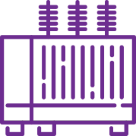
SimpliPhi Power Energy Storage Systems
Accelerating the Energy Transition
Reimagining the Power Grid
Building a More Resilient Energy Future
Delivering Economic Value
Leveraging renewables by decoupling supply and demand on grid and off and reducing atmospheric CO2 & GHG emissions behind climate change.
Supporting new and emerging energy markets that blur the line between in-front-of and behind-the-meter, aligning the interests of the utility and customers.
Creating a more resilient power infrastructure using distributed customer-sited assets along the entire distribution grid for individuals, businesses and whole communities.
Eliminating economic losses due to power outages and reducing daily energy costs through demand charge management, peak shaving and time of use utility charges.
© 2020 SimpliPhi Power | REV202009241631

Slide 5
UL Certifications
UL 1642
UL 1973
UL 9540
Relates to Cell Level Safety
Cell Level Testing for UL-1642 was conducted by Underwriters Lab (UL).
The requirements of this certification are intended to reduce the risk of fire or explosion when lithium batteries are used within a product.
The testing regiment abuses cells with elements generated from electrical, mechanical and environmental sources.
Relates to Module Level Safety
UL-1973 evaluates the battery’s ability to safely withstand abuse conditions like over-voltage and over-current conditions, with and without the BMS safety features intact.
Throughout the wide range of thermal and electrical abuse there have not been any indicators that the component cells and PHI battery modules experience thermal runaway with fire, ignition or propagation across cells
Relates to System Level Safety
Testing conducted by Intertek
Verifies component compatibility of battery and inverter, each of which require their respective UL listings (UL 1973 and UL 1741).
This is an ESS certification, in which both components need to be named
Currently listing include AccESS Sol-Ark & Schneider, as well as BOSS.6 and BOSS.12 with two options for combiner boxes, from 3 batteries up to 136.8kWh
Building and Fire code requirements such as NFPA 855 need to be considered
UL 9540A can influence spatial requirements
Shock
Vibration
Drop
Heating
Temperature Cycling
Low Pressure (Altitude Simulation)
Short Circuit
Heating
Abnormal Charging
Forced Discharge
Crush
Impact
Humidity

Slide 6
UL 9540A Test Process
UL 9540 A
Successfully completed testing for the PHI 3.8 kWh 48V battery modules and its component Lithium Ferro Phosphate (LFP) cells
The cells and battery module were subjected to extreme levels of heat to force into a state of thermal runaway
Test results concluded that the cells and battery modules did not produce fire or cause fire propagation
Recently Completed UL 9540A Unit Level Testing for all UL 9540 Listed Systems

Slide 7
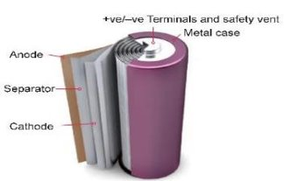
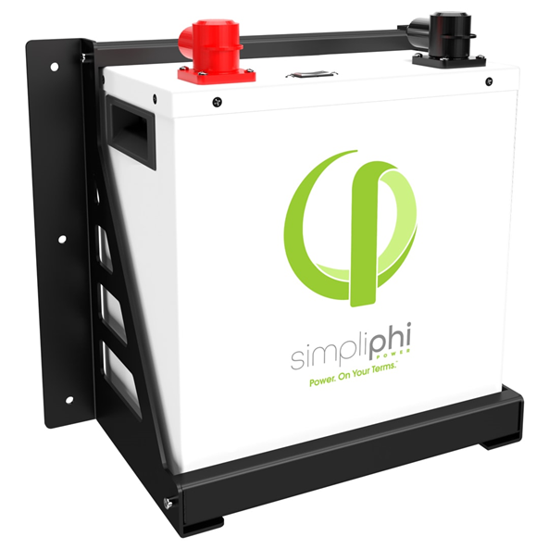
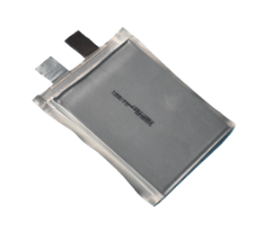
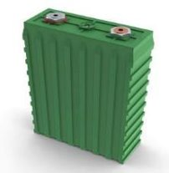
Lithium Ion: Chemistry and Form Factor
Chemistry
Form Factor
LCO​
Lithium Cobalt Oxide​
NMC​
Lithium Nickel Manganese Cobalt Oxide​
LMO​
Lithium Manganese Oxide​
LFP​
Lithium Iron Phosphate​
NCA​
Lithium Nickel Cobalt Aluminum Oxide​
Cylindrical
Pouch
Prismatic

Slide 8
LFP Batteries: Wide Temperature Window
Operating Temp
-4°F
140°F
No need for:
Coolant
HVAC
Ventilation
Charging Temp
32°F
120°F

Slide 9
Levelized Cost of Energy
How to Evaluate True Costs of Storage
What’s the cost of every kWh I can get out of this system?
$$\left(\frac{Price}{Capacity×Cycles×η×DoD}\right)+Ancillary Costs$$
Square Footage → Installation Location
Weight → Shipping Costs
Forklift/Install Equipment → Rental to Site
Maintenance → Truck Rolls
Cooling → Additional Cost + Materials
Ventilation/Setback Requirements → Area
Construction Support → Weight Related
Replacement Costs → Performance Related
© 2020 SimpliPhi Power | REV202009241556

Slide 10
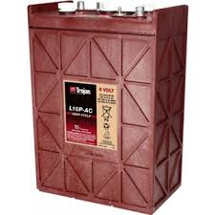
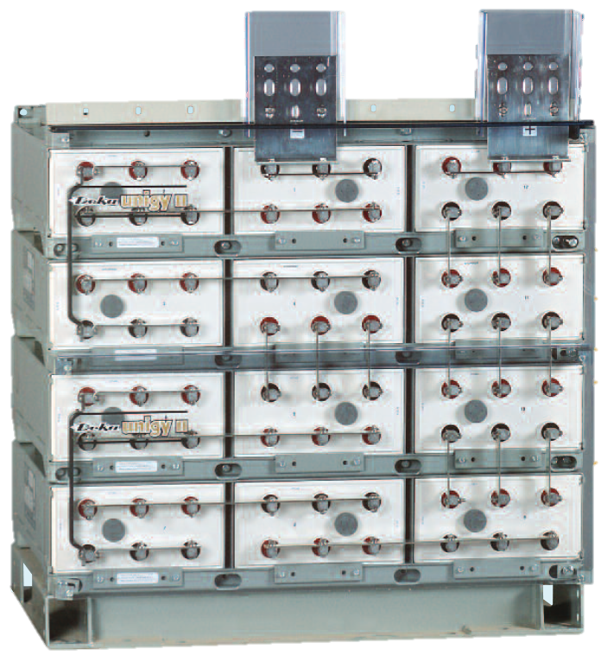
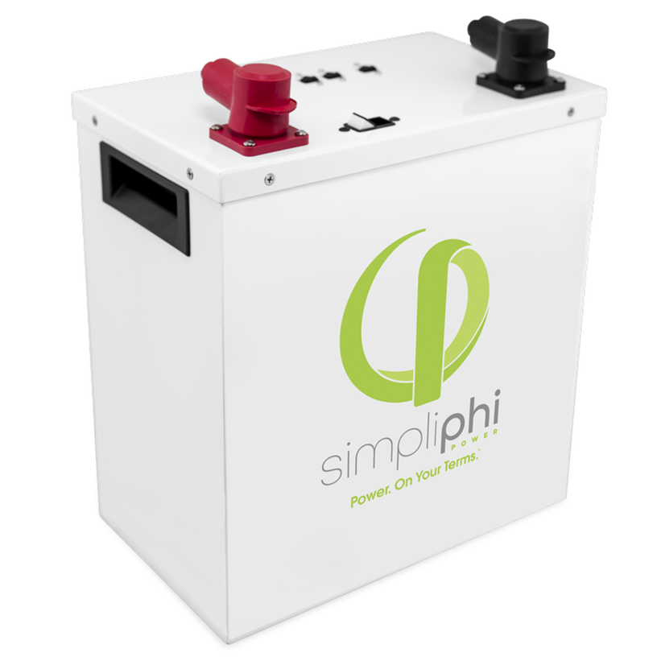
LCOE Comparison: 10 Years- Does Not Include Replacement
PHI 3.8 | FLA | VRLA
QTY 2 | QTY 4 | QTY 12
6.08 usable kWh (@ 80% DOD)/ C/2 | ~4.6 usable kWh (@50% DOD): C/20 | ~7.3 usable kWh (@ 20% DOD): C/8
86 lbs. per battery | 114 lbs. per battery | 211 lbs. per battery cell
172 lbs. total | 456 lbs. total | 2,532 lbs. total
13.9" x 13.5" x 8.1" per battery | 11.66” x 6.94” x 16.74” per battery | 13.3” x 8.04” x 27.12” per battery
3,039.93 total in³ | 5,418.43 total in³ | 34,799.95 total in³
.09/kWh
.27/kWh
.80/kWh
© 2020 SimpliPhi Power | REV202010211000

Slide 11
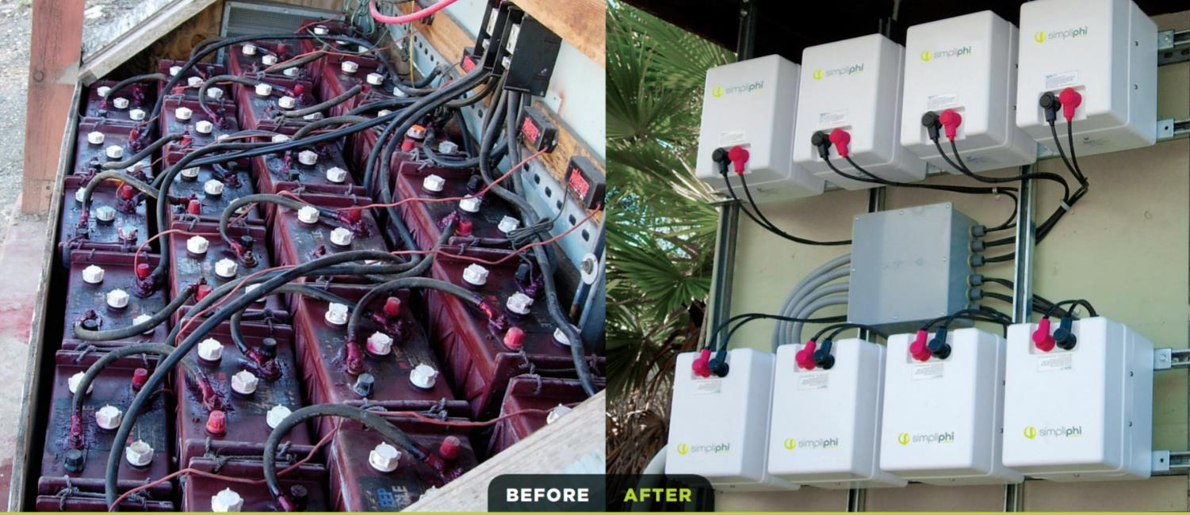
Drop-In Replacement for Lead Acid
© 2020 SimpliPhi Power | REV202009241556

Slide 12
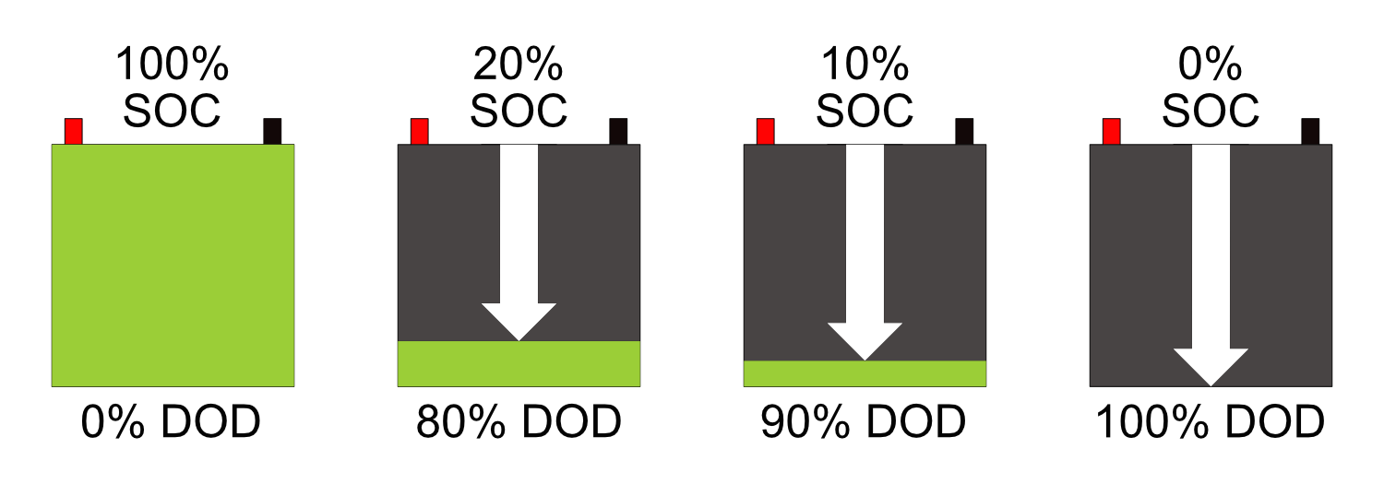
Lifecycle: Warranty Parameters
Warranty:
10 Years
Unlimited Cycles
End of Life (EOL) Capacity: 80%

Slide 13
Cost & Performance Comparison- LAB to LFP
Higher upfront investment for LFP
Lower DOA rates
More usable capacity (100% v 30-50%)
Very low self-discharge
No maintenance
Longer duration between replacement- FLA replaced 3X
Overall lower cost over time (LCOE)
Non-Toxic Chemistry
© 2020 SimpliPhi Power | REV202010211000

Slide 14
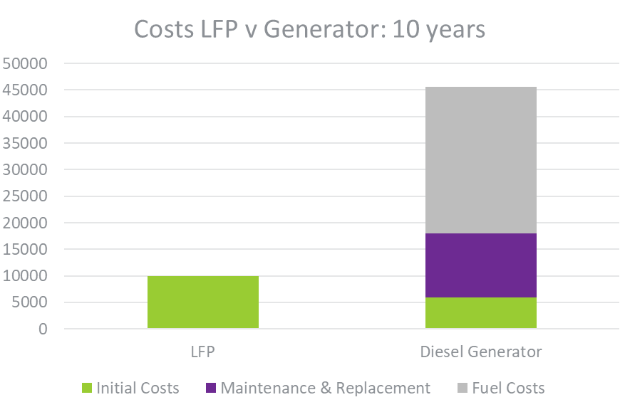
Generator Optimization and Replacement
Reduce Fuel Costs: $2,759.40/year
Extend Life-Span of Generators: Run less
Reduce Maintenance
70% of diesel generators non-operational in field
Fuel can be hard to source
No Noise or Pollution

Slide 15
Diverse Applications in Africa
© 2020 SimpliPhi Power | REV202010051018
Notes:
Static Logo Slide w/Info

Slide 16
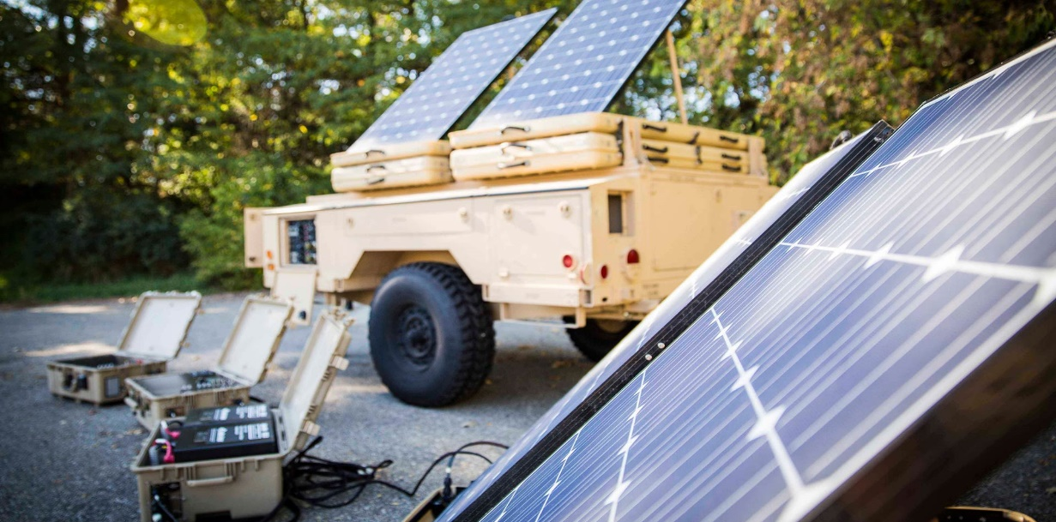
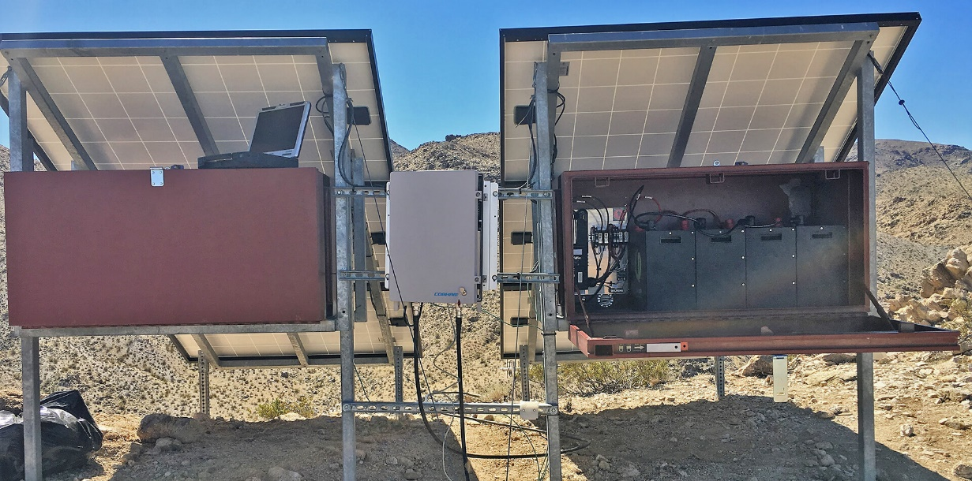
The Department of Defense Testing & Validation
U.S. Army and Marine Corps conducts Expeditionary Energy Concepts (E2C) testing to evaluate energy technologies that enhances safety and provides tactical advantages to U.S. soldiers
This includes a series of rigorous tests over several days in multiple scenarios
Our PHI batteries performed above and beyond expectations in providing both mission critical peak-load power, as well as long duration storage power
In a form factor that is lighter and smaller compared to standard battery formats
Without a heat signature or the need for ventilation or cooling.
Testing resulted in the department wide approval of our technology to be used in mission critical applications for the DoD

Slide 17
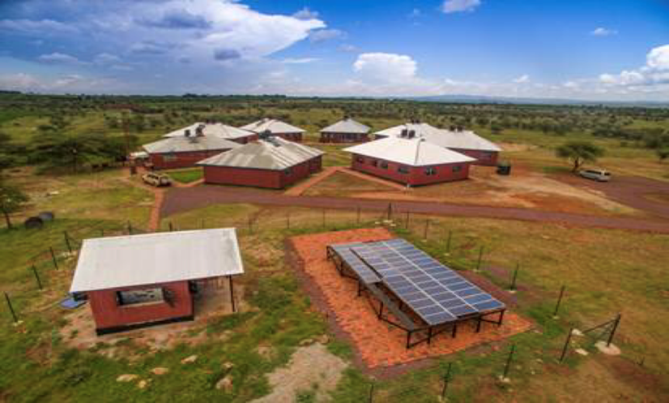
Tanzania: Reliable 24/7 Microgrid for Orphanage

Slide 18
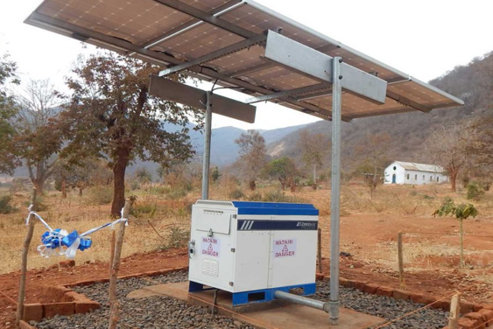
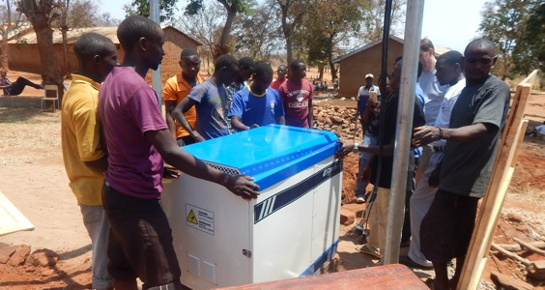
Tanzania: Reliable 24/7 Microgrid for Schools

Slide 19
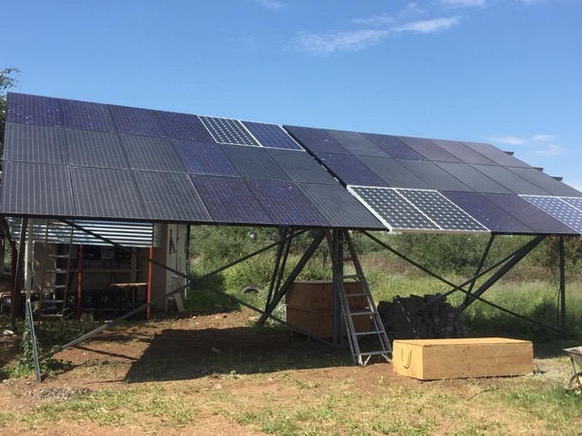
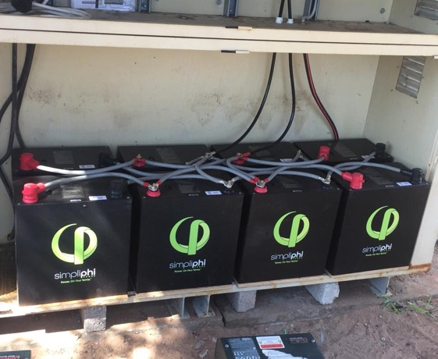
Botswana: Reliable Off-Grid Power for Cheetah Preserve

Slide 20
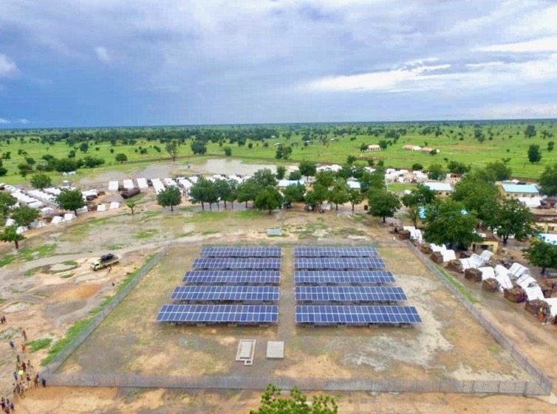
Nigeria: Reliable Power for 34 Hospitals & Clinics

Slide 21
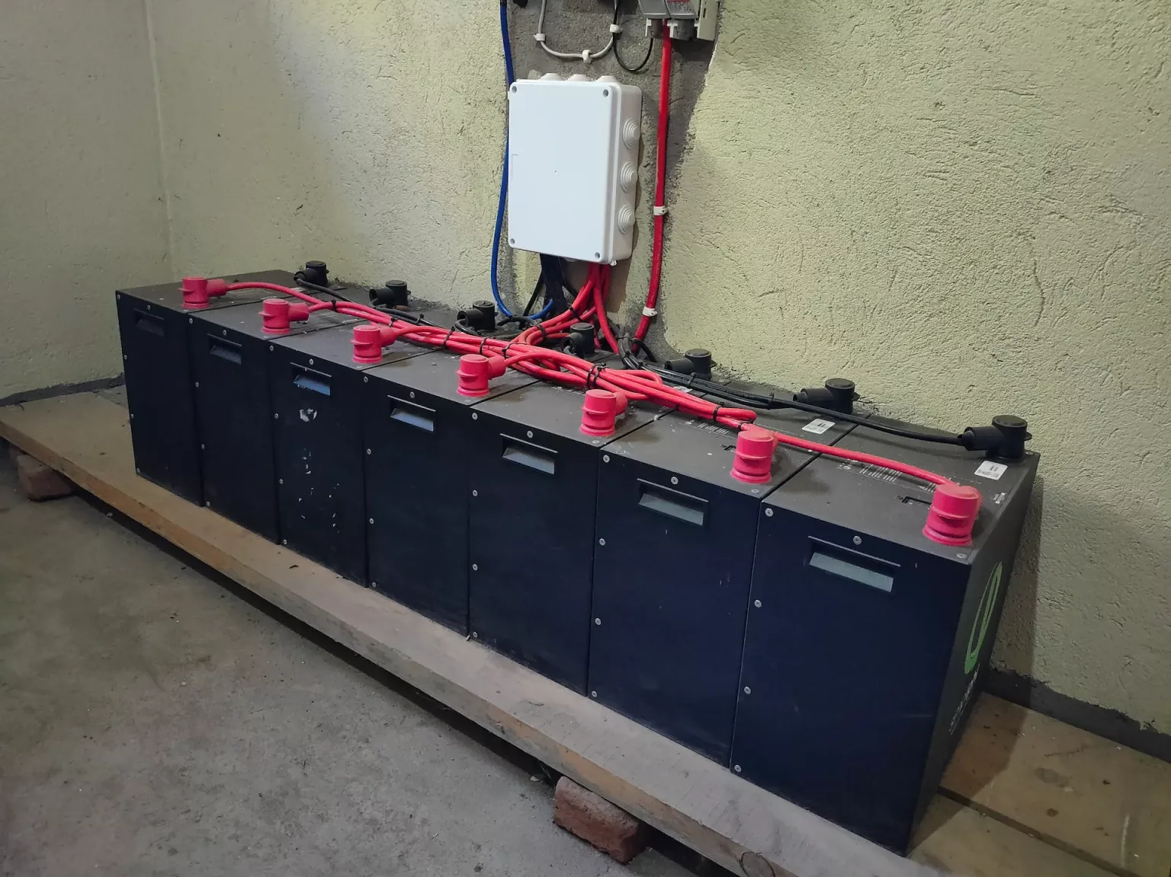
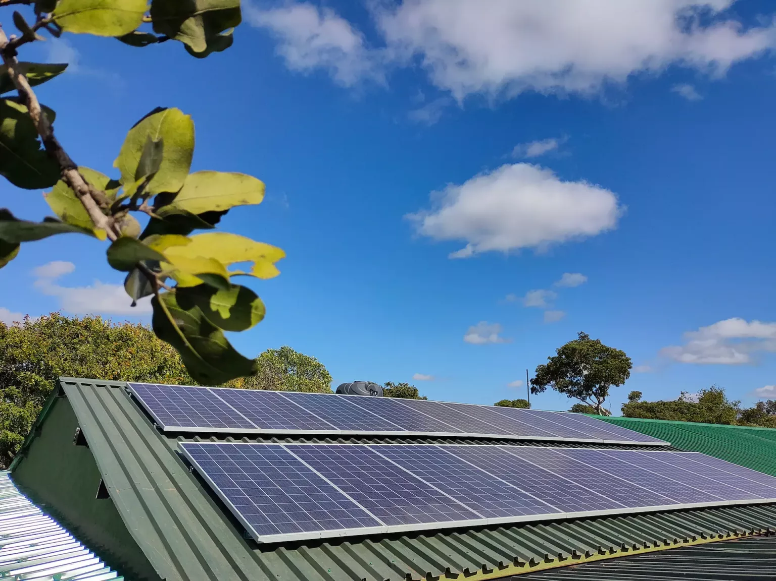
Zimbabwe: Anti-Poaching with Akashinga Rangers

Slide 22
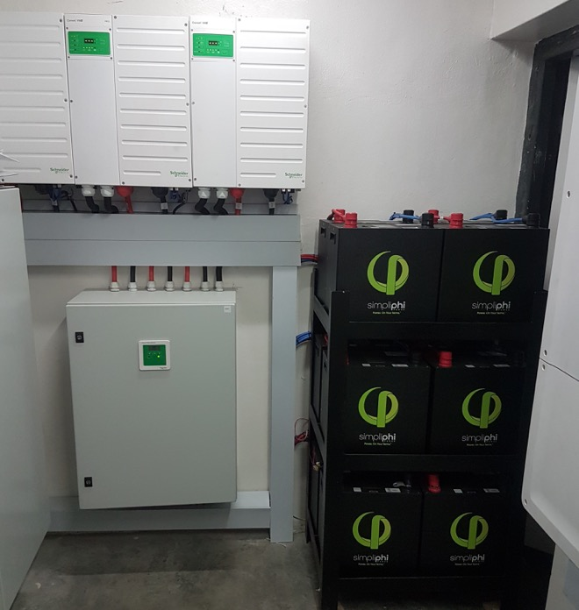
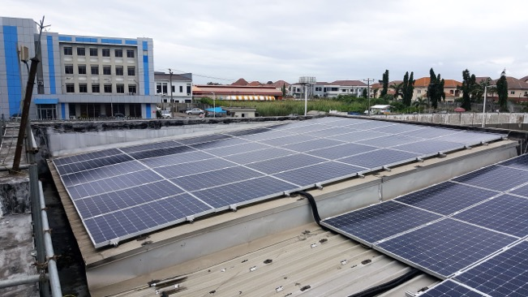
Nigeria: Commercial- Diesel Offset & 60% Utility Reduction

Slide 23
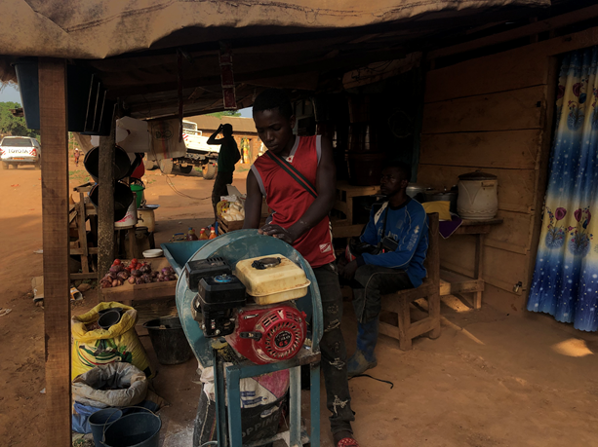
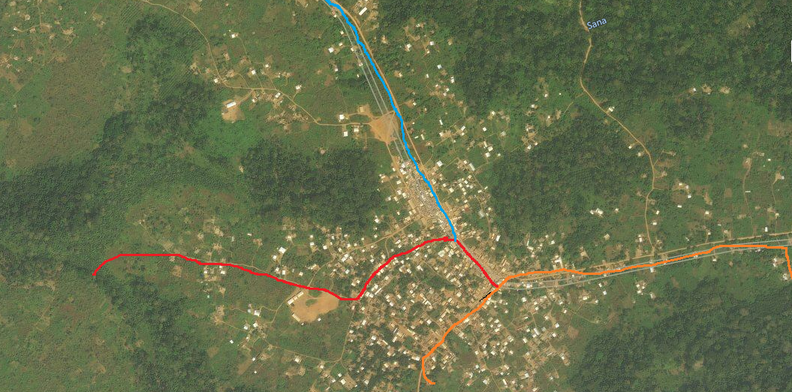
Cameroon: USTDA: Voundou Pilot Project- REIc
Phase II
Phase I
Phase III

Slide 24
Storage Solutions
© 2020 SimpliPhi Power | REV202010051018
Notes:
Static Logo Slide w/Info

Slide 25
SimpliPhi Energy Storage Solutions
Access to Safe, Reliable, Affordable and Sustainable Power – On and Off Grid
Safe
Proven
Simple
Non-toxic, non-hazardous
Cobalt-free chemistry
No risk of thermal runaway with fire propagation
UL certified (1642, 1973, 9540A)
UN DOT Certified (3480, 38.3)
Prohibit child labor in supply chain
Over a decade of experience & growth
Deployed in more than 40 countries
Over 100 MWh installed worldwide
Tested & validated by the U.S. Army and Marine Corps
Business model demonstrates social impact and profitability can co-exist
Special permission by FAA to airship globally
Integrates & optimizes any generation source – grid, solar, wind, generator – on or off grid
Stores energy for critical back up power
Maximizes resilience & energy security
Creates savings on utility bills with TOU, peak shaving & demand charge management
© 2020 SimpliPhi Power | REV202011171505

Slide 26
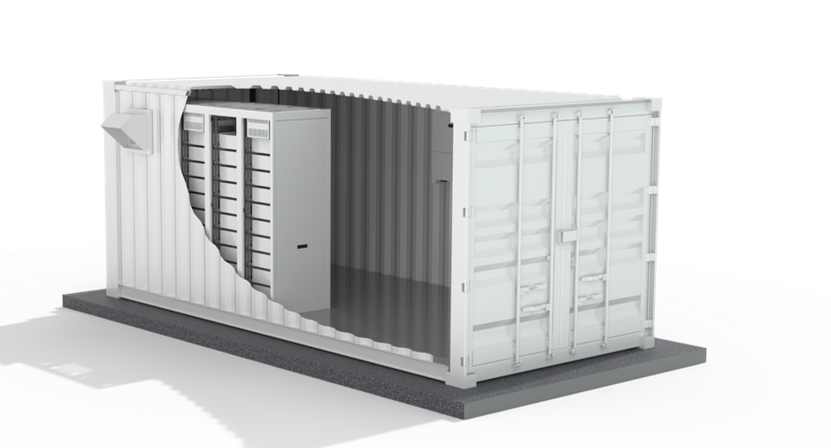
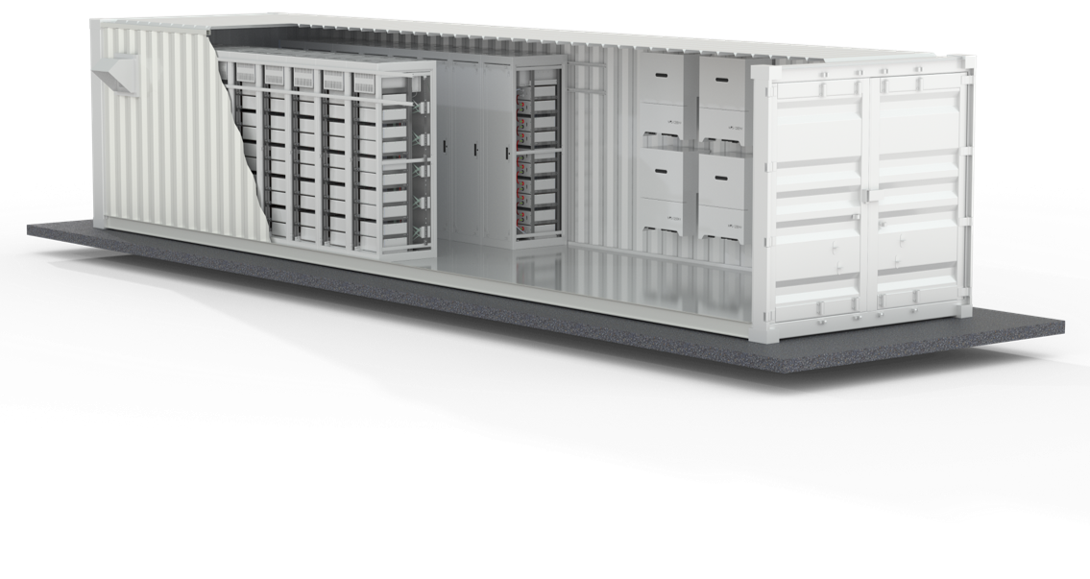
Large Microgrid Solutions
Micro grids
Large scale back up (480V 3-phase)
External BMS
200-1100VDC Nominal
Scale up in energy with voltage stacks
CANbus, Modbus, and Ethernet ready
20 ft containerized solution
40 ft containerized solution

Slide 27
Opportunities Across the Energy Value Chain
Heavy Duty Charging
Demand Side Management
Cities and Workplaces
Distribution Feeder Optimization
Renewables Integration
Multi-Unit Dwellings
Resilient Communities
SimpliPhi’s Energy Storage Systems Creates Access to Safe, Reliable, Affordable and Sustainable Power – On and Off Grid
© 2020 SimpliPhi Power | REV202009241642

Slide 28
IDEA Program: Giving Back
The IDEA: A Simple Promise.
Donate 1% of Annual Revenue every year to High Impact Projects that Deliver Energy Access.

Slide 29
Thank You
Sequoya Cross
sequoyac@simpliphipower.com
© 2020 SimpliPhi Power | REV202010051018
Notes:
Thank you for your time today.

