Slide 1
Value and Use Cases for Energy Storage in Southern Africa

Slide 2
Agenda
01
Evolving energy transition globally and in Southern Africa
02
Grid challenges related to energy transition
03
Grid-scale energy storage as enabler of renewable transition
04
Grid-scale energy storage use cases for grid flexibility
05
GE Energy Storage integration solutions…
© 2021 General Electric Company.

Slide 3
Evolving energy transition globally and in Southern Africa

Slide 4

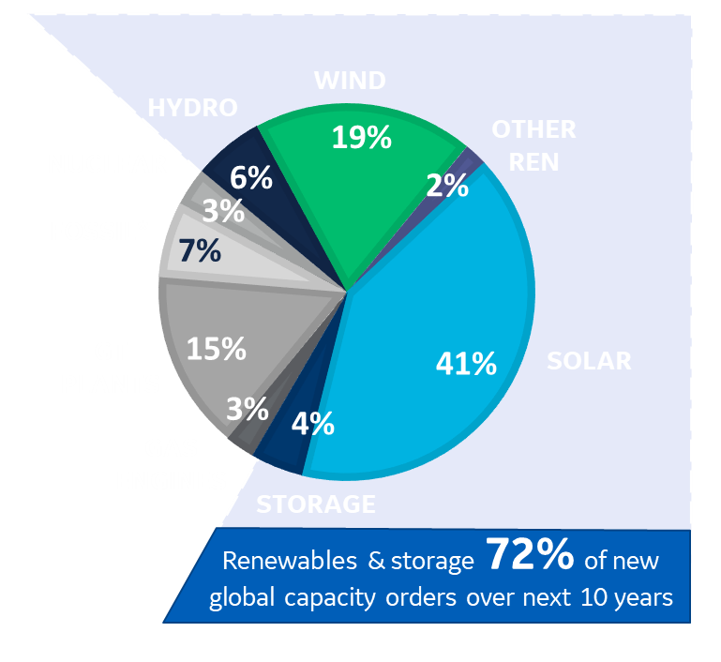
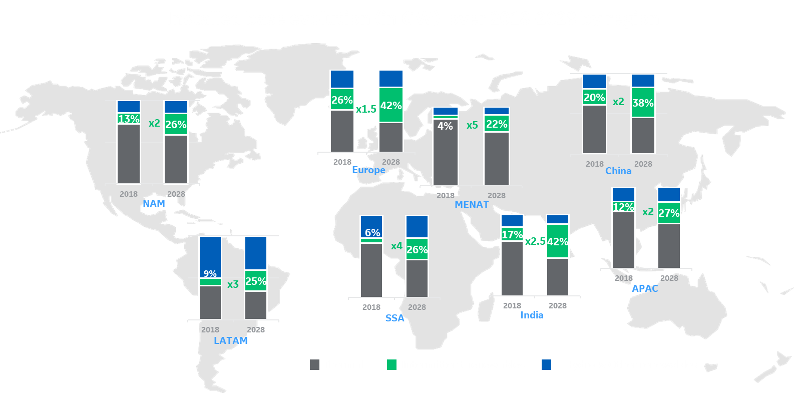
Forecast orders mix in MW (’19-’28)
The Future of the Power Sector
Wind & solar grow fastest over next decade driven by LCOE competitiveness, technology and scale
Storage & hybrid solutions increase, enabling baseload dispatchability of renewables
Grid will play a critical role in enabling the viability of renewables
* Fossil: Coal and oil
Source: GE Internal Forecast GPO19
Installed base evolution (in GW) over 2018-2028 by region
Digital technology is an enabler tying it all together, orchestrating the world’s energy through software
Gas will still play a vital but changing role, providing dispatchable, flexible, resilient, & lower CO₂ power
New business models need to emerge to create customer value and new profit pools
Renewables segment growing at unprecedent pace
To meet climate change and grid imperatives, the model must evolve
Source: GE
© 2021 General Electric Company.
Notes:
We know that electrification is expected to increase significantly, and that the sources of electricity generation are increasingly going to come from renewable energies. You can see from GE’s own forecasts (top left) that Renewables and Storage will account for almost three-quarters of global capacity orders in the next decade. This change in the generation mix is underway on all continents, and whilst it can be seen as a very positive evolution, it is not without its challenges.
The focus of today’s talk is about Pumped Storage, and what role it is playing and could play, to meet these challenges. We’ll start by a quick look at the past and what is going on elsewhere in the world, before zooming in on the US and California.

Slide 5
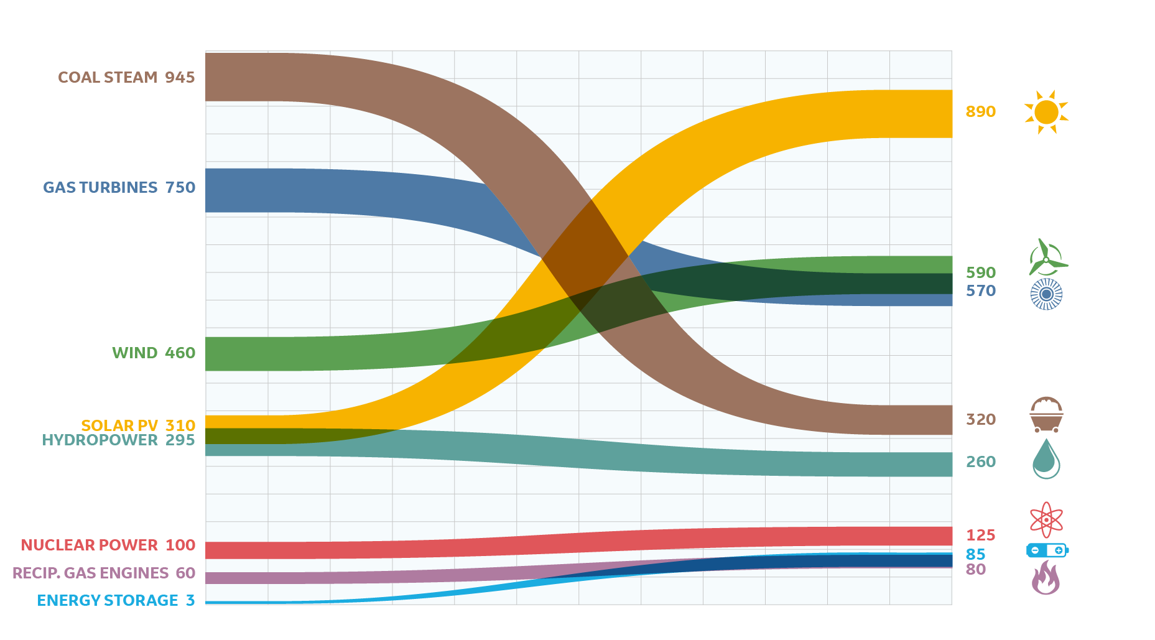
A Lot Can Happen In 10 Years
Source: GE
© 2021 General Electric Company.

Slide 6
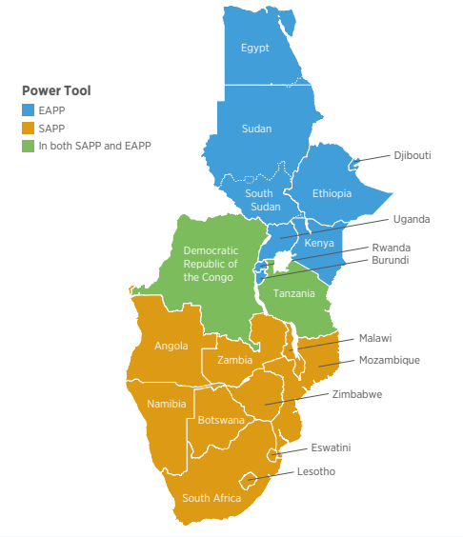
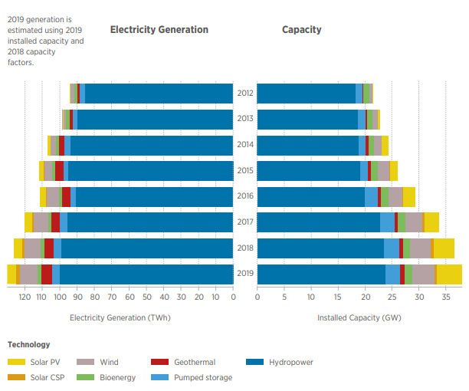
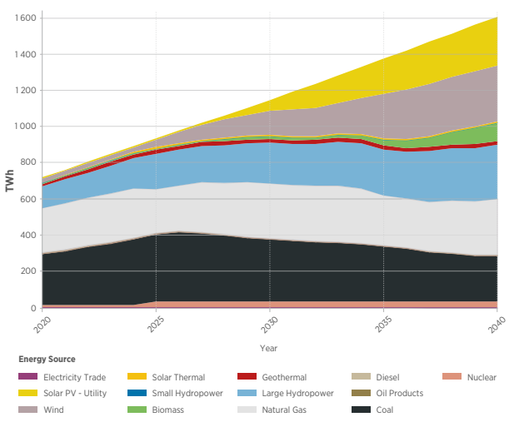
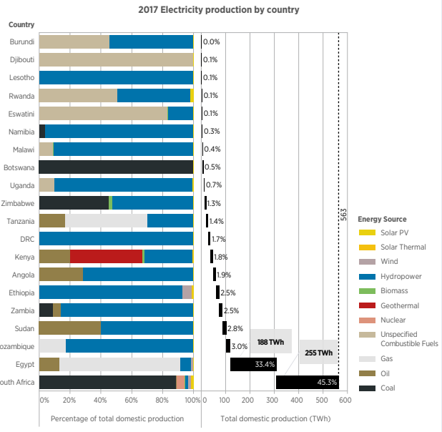
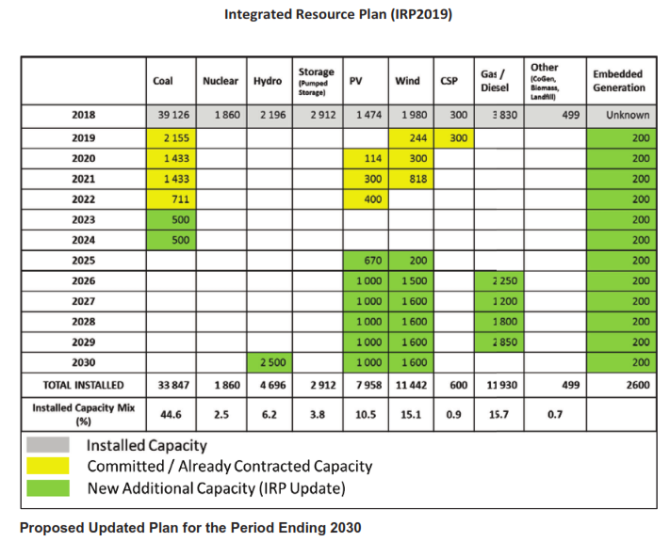
Energy Transition in Southern Africa
Continuous growth of wind and solar deployment
SA IRP2019
PV/Wind plan
Source:
IRENA 2021 report on Planning and Prospects for Renewable Power: Eastern and Southern Africa
Aggressive growth expectation of wind and solar generation over the next few decades…
© 2021 General Electric Company.

Slide 7
Energy Storage as an enabler for RE penetration

Slide 8
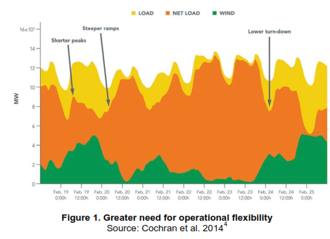
Impact of high Renewable integration on grid operation…
RE Characteristics | Potential Grid Integration Challenges
Variability | Balancing generation with electricity load requires more flexibility.
Uncertainty | System operators could need additional reserves and/or an improved ability to dispatch generation.
Location-Specificity | More transmission and more advanced planning could be needed.
Non-synchronous generation | Voltage and frequency stability from variable RE generators or additional equipment comes at added capital and/or opportunity costs.
Low capacity factor | Existing conventional generators could be needed to meet demand, but run less than originally anticipated, affecting cost recovery.
Source:
NREL report on Grid Integration and the Carrying Capacity of the U.S. Grid to Incorporate Variable Renewable Energy
Flexibility of generating assets is core to achieving high variable renewables on the grid

Slide 9
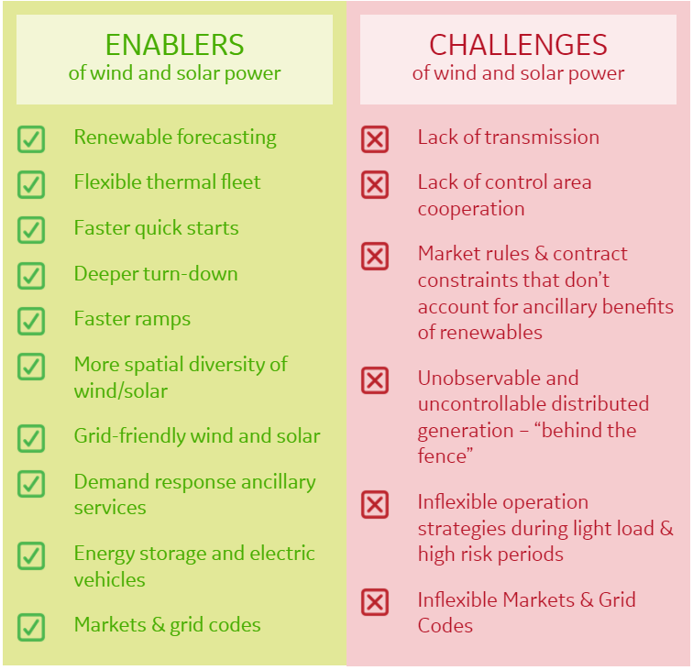
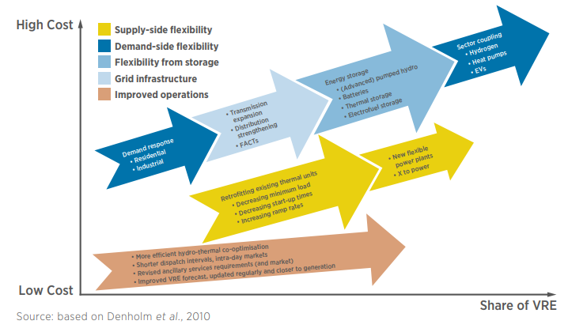
Grid-scale energy storage as an enabler for RE integration…
Energy storage serves as one of the ways to increase grid flexibility and improve the integration of VRE
© 2021 General Electric Company.

Slide 10
Integrated System Planning Studies are key to unlocking resiliency for tomorrow’s grid…
EVERY STUDY INCREASED INDUSTRY’S VIEW OF WHAT’S POSSIBLE
‘04 New York 4%
‘06 California 15%
’09-‘14 WESTERN US 33%
‘10 ISO-NE 30%
‘08 ERCOT 17%
Dispatch
‘14 Minnesota 27%
Expansion
Power flow
‘12 Nova Scotia 40%
‘17 Grand Bahama 30%
CONSTANT FUEL
Operations
‘17 CO Springs 33%
VARIABLE FUEL
‘13 PJM 33%
‘15 Hawaii 40%
Adequacy
Gas supply
‘16 Canada 30%
‘17 Barbados 30%
‘14 Vietnam
‘20 Sask 33%
Operations
~0%
~30%
>60%
WE ARE HERE
variable renewables
Power flow
Physics
Physics
Dynamics
Transients
‘13 UK gas turbine ctrl. upgrade for wind
‘20 ~70GW
wind, solar, battery
ROTATING
MACHINES
‘03 Colorado
100% locally
‘03 Invented low voltage ride-thru
‘10 Invented weak grid ctrls.
‘20 Offshore w/ blackstart battery
‘04 Ireland
1st GE offshore
ELECTRONIC
MACHINES
‘03 New Mex
1st >200MW + HVDC
‘08 Invented wind inertia freq. reg.
‘18 CA 1st blackstart battery
‘03 Invented wind voltage reg.
© 2021 General Electric Company.
10

Slide 11
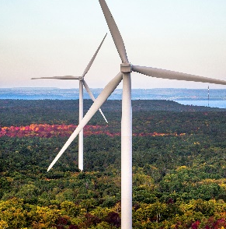
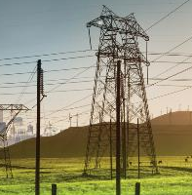
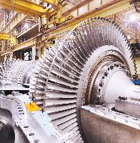
GE Energy Consulting
Power System Experts For >100 Years
~120 grid experts
9 countries
>100 patents
ECONOMIC ANALYSIS
grid value of technology
NETWORK STRATEGY
complex grid interconnection
EQUIPMENT INTEGRATION
voltage & frequency performance
System planning & strategy
Stability studies
Interconnection support
Network risk assessment
Financial modeling & forecasting
Grid code testing & compliance
Grid upgrades
MODELS
Planning
years
Transients
microseconds
SOFTWARE
Capacity
GE MARS*
Energy
GE MAPS*
Power flow
GE PSLF*
TAILORED POWER SYSTEMS AND ENERGY COURSE
Longest running energy executive development program
© 2021 General Electric Company.

Slide 12
Energy Storage use case primer

Slide 13
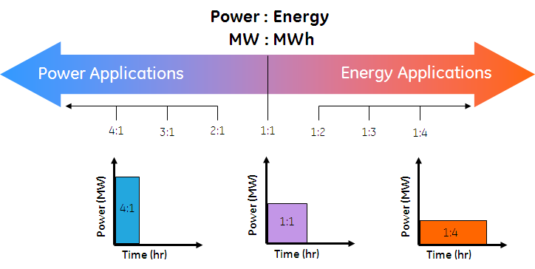
Power vs. Energy … Two attributes of a storage system
Each application defines the power & energy needed for the storage system
© 2021 General Electric Company.

Slide 14
Grid-scale Energy Storage Use Case and Value …
Application | Type | Description | Value
Energy Arbitrage | Energy | Buy low, sell high | Displaces most expensive generation
Generation Capacity | Energy | Time shift energy from off-peak to peak load | Defers investment in new generation
Equipment Capacity | Energy | Reduce flow through overloaded lines and transformers | Defers investment in new equipment
Line Congestion | Energy | Time shift delivery of renewable energy during congestion | Delays transmission line reinforcement
Wind/Solar Smoothing | Power | Reduce ramp rates of wind and solar plants | Contributes to reserve & regulation requirements
Frequency Regulation | Power | Rapidly inject and remove power for short intervals | Contributes to regulation requirements
Reserves | Power | Dispatch power in < 10 minutes | Contributes to system reserves
Governor / Inertial | Power | Provide dynamic equivalents of synchronous generators | Reduces severity of frequency variations
Power
Energy
The cost of storage should be compared against conventional approaches
© 2021 General Electric Company.

Slide 15
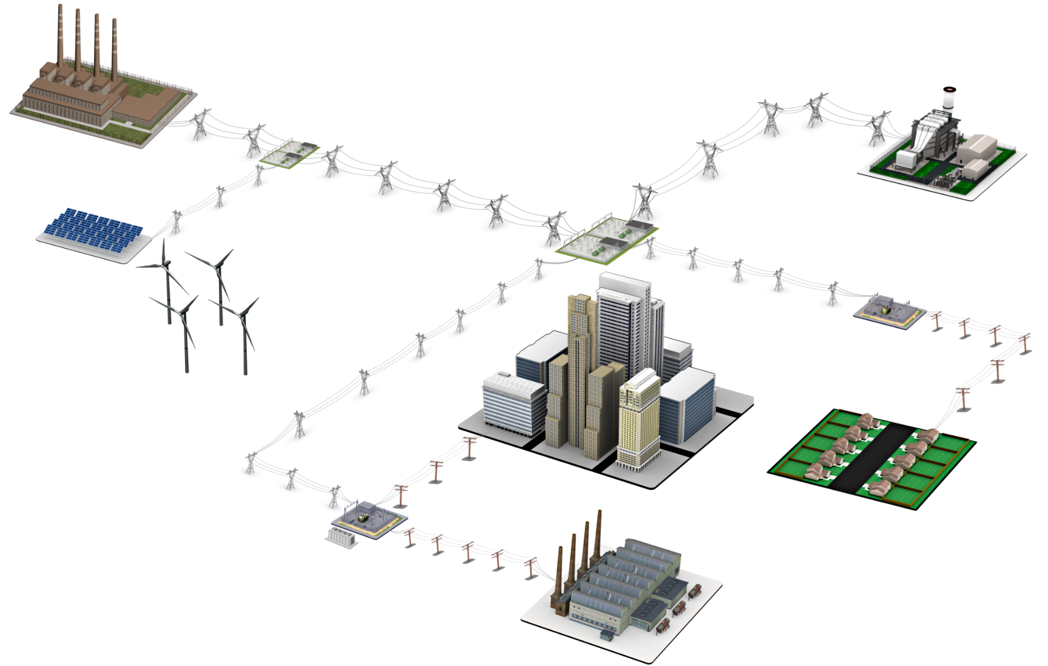
Operations … Capacity, Ancillary Services (Reserve/Regulation)
Energy Arbitrage
Storage system size range: 1 – 500 MW
Discharge duration range: < 1 hour
Minimum cycles/year: 250 +
Generation Capacity Deferment
Storage system size range: 1 – 500 MW
Discharge duration range: 2 – 6 hours
Minimum cycles/year: 5 - 100
Reserves
Storage system size range: 10 - 100MW
Discharge duration range: 15 min. – 1 hour
Minimum cycles/year: 20 - 50
Regulation …
Storage system size range: 10 - 40MW
Discharge duration range: 15 min. – 1 hour
Minimum cycles/year: 250-10,000
Black start…
Storage system size range: 5 - 50MW
Discharge duration range: 15 min. – 1 hour
Minimum cycles/year: 10 - 20
© 2021 General Electric Company.

Slide 16

T&D Investment Deferral … Lines, Subs, Equipment
Transmission Upgrade Deferral
Storage system size range: 10 – 100 MW
Discharge duration range: 2 – 8 hours
Minimum cycles/year: 10 - 50
Transmission Congestion Relief
Storage system size range: 1 – 100 MW
Discharge duration range: 1 – 4 hours
Minimum cycles/year: 50 - 100
Distribution upgrade Deferral
Storage system size range: 500kW – 10MW
Discharge duration range: 1-4 hours
Minimum cycles/year: 50-100
© 2021 General Electric Company.

Slide 17

End User … Back-up, Power Quality, Arbitrage, Demand Charges
Power Quality
Storage system size range: 100kW – 100 MW
Discharge duration range: 10 sec. – 15min.
Minimum cycles/year: 50 - 100
Demand Charge Management
Storage system size range: 50kW – 10MW
Discharge duration range: 1 – 4 hours
Minimum cycles/year: 50 - 100
© 2021 General Electric Company.

Slide 18
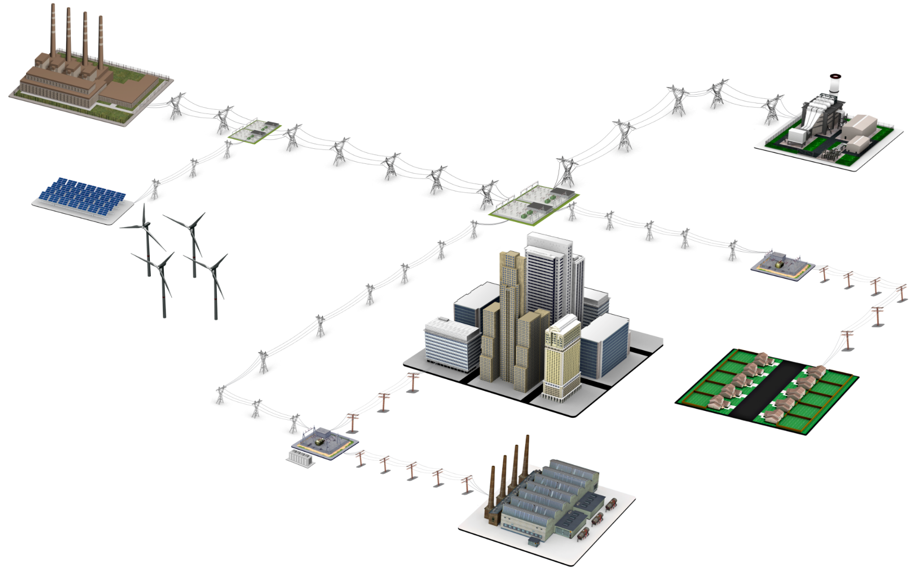
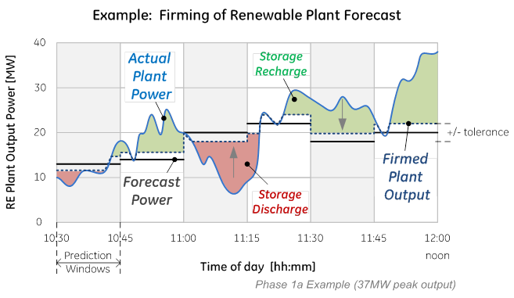
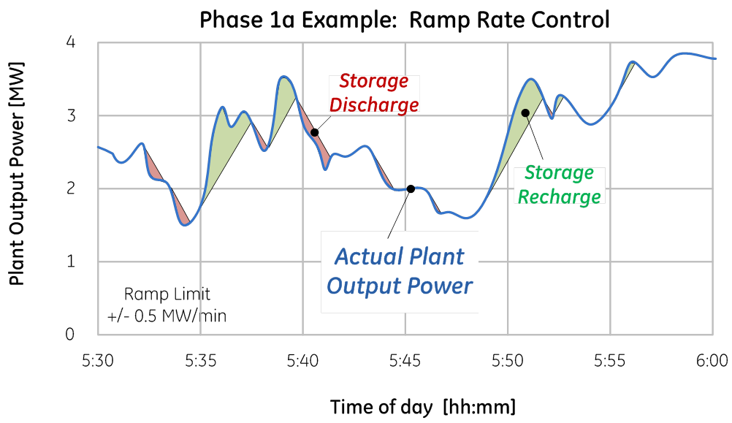
Renewables… Smoothing, Congestion/Curtailment Relief
Renewable firming
Storage system size range: 1 – 100 MW
Discharge duration range: 15min. – 1 hour
Minimum cycles/year: N/A
CAES
Ramp rate control of RE Plants
© 2021 General Electric Company.

Slide 19
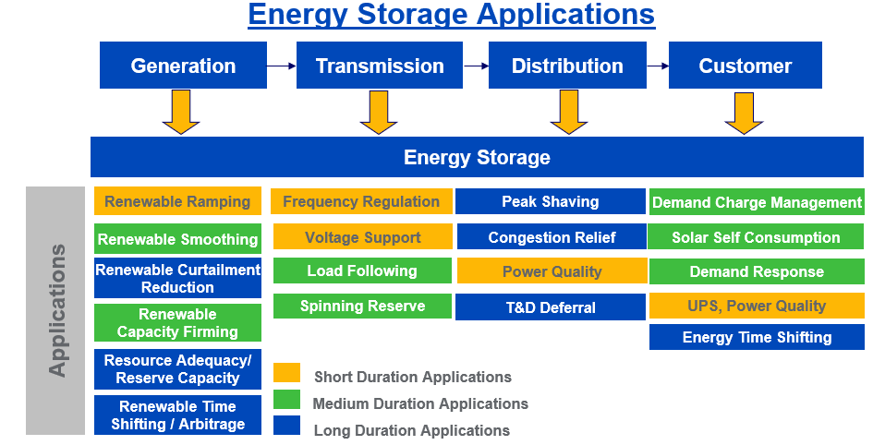
Stackable Value Streams for Energy Storage Systems
Energy Storage can provide all of these services but must choose which few to provide in each application…
© 2021 General Electric Company.

Slide 20
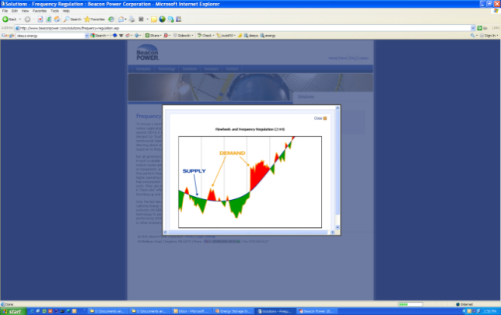
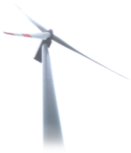
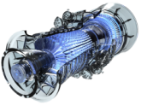

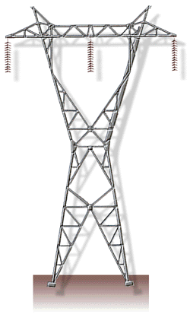
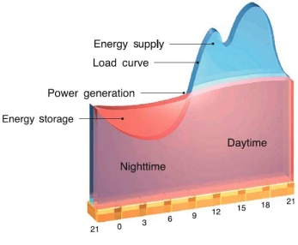
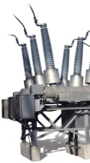
Applications of Grid-Scale Storage
Energy
10 kWh
100 kWh
1 MWh
10 MWh
100 MWh
10 sec
Governor, Inertial, Power Quality
Power Capable
Frequency
Regulation
15 min
Wind/Solar Smoothing
Ultra Caps
Reserves
30 min
Batteries
Flywheel
Discharge Duration
Line Congestion
Energy Capable
1 hour
Generation Capacity
Thermal
Batteries
Equipment Capacity
8 hour
Arbitrage
Comp. Air
Hydro
A wide range of storage technologies needed to cover the wide range of power and energy needs
© 2021 General Electric Company.

Slide 21
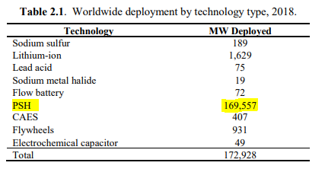
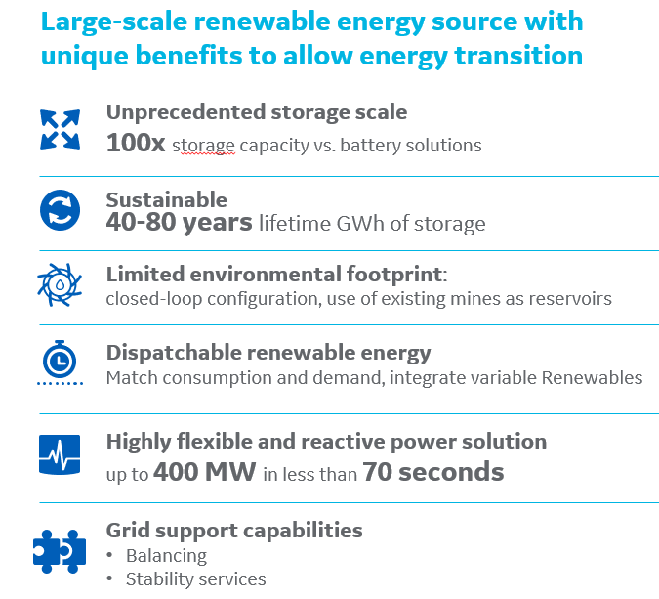
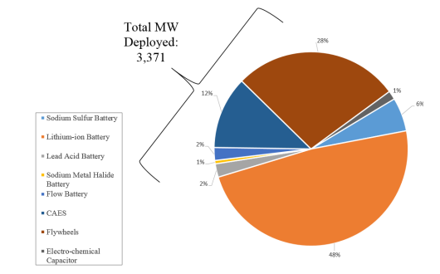
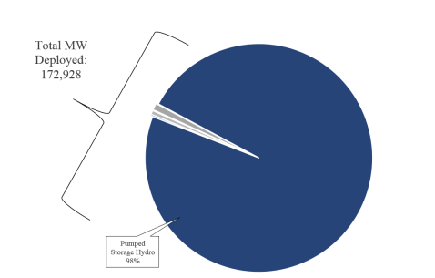
Worldwide Energy Storage Deployment by Technology
Value for Pumped Storage Hydro …
Source:
PNNL-28866 – July 2019 - Energy Storage Technology and Cost Characterization Report
PSH dominates the global deployment of energy storage systems
© 2021 General Electric Company.

Slide 22

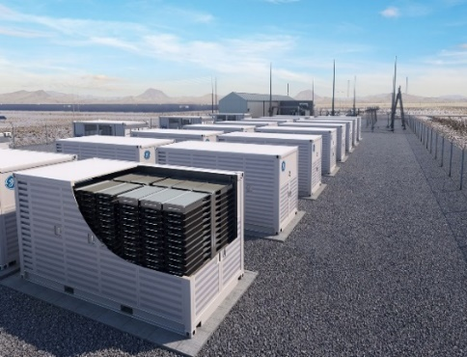

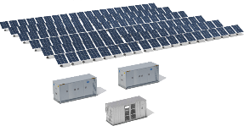
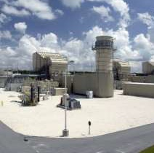
GE has the Energy Storage integration solution to support you
GE Solutions
Pumped Storage Hydro
GE Reservoir
Hybrids
GE Energy Consulting
Giga-scale, long duration bulk storage technology via Hydro & Pumped Storage
Smaller-scale, intra-day battery storage technology via GE Reservoir
Hybrids solutions combining one or more renewable generation assets with storage
GE system planning & modeling expertise provides a roadmap to help achieve renewables and energy storage integration objectives across region
Useful For
Cost competitive large-scale solution
Sustainable & Renewable solution
Flexibility for balancing baseload generation, time-shifting and peaking
Enhanced frequency response and ancillary services (inertia, black start)
High round trip efficiency (~80%)
GE’s value proposition
160 GW installed base, including
~50 GW using GE technology
Response time in milliseconds for Variable Speed technology
Up to 34 GWh of storage capacity
Useful For
All ancillary services (frequency response, blackstart)
Ramp rate control at plant level
Energy shifting; peaking (capacity)
High round trip efficiency (>88%)
Modular & scalable configurations
Quick delivery time (3-6 months)
DC- or AC-coupled solar + storage
GE’s value proposition
Up to 15% extended battery life
Up to 50% more solar energy sales
Up to 10x improved safety by reducing fault current
Useful For
Lower O&M costs
Increase AEP
Lower CAPEX with sharing of existing infrastructure (Substation, Switchgear, access to road and land, Grid Connection)
GE’s value proposition
Energy Storage in the from of Battery or Pumped Storage
Integrated farm with a single Hybrid controls system for plant optimization (lower CAPEX & faster response)
Useful For
Region-wide analysis of wind, solar and energy storage integration
Financial modeling & forecasting
Stability studies
Network risk assessment
Grid code testing and compliance
Equipment interconnection support
GE’s value proposition
GE Energy Consulting’s technical and business experts provides innovative solutions for diverse global clients across the power systems value chain
© 2021 General Electric Company.
22
Notes:
GE has a wide range of energy storage solutions to meet the needs of its customers: either it is large scale or small scale, short duration or bulk storage technology, and stand alone solution or hybridized with other renewable power generation assets.
Pumped Hydro Storage accounts for more than 95% of the energy storage installed base. The technology has been present for the last 60 years, and mainly developed in the USA, Europe, Japan and China.
PSP is more than large-scale storage
Renewable
Long discharge duration for weekly/monthly energy storage applications
Long lifetime (minimum 40 years vs 10 years for batteries)
Multi-purpose solution:
Renewable integration at a regional/national level
Transmission grid performance improvement, “ancillary services”
Fleet optimization
GE is a world leader in pumped storage plant equipment and supplies in-house capabilities not only for turbines and generators but also the full electrical balance of plant.
The Reservoir Solution is an integrated turnkey offering that combines GE’s advanced technologies and expertise in controls, power electronics, battery and operational management systems, and electrical balance of plant – all backed by GE’s performance guarantees.
GE Renewable energy hybrid solutions can comprise any combination of one or more renewable generation assets with either one another and/or the integration of storage (battery or pumped hydro).

