Slide 1
Energy Storage Codes and Standards Activities
Brian Marchionini
Senior Program Manager Connected Systems and Strategic Initiatives
National Electrical Manufacturers Association
brian.marchionini@nema.org
October 20, 2021
Notes:
I will highlight some of the codes and standards activities in the US and internationally via mention of IEC standards and technical specifications.
Please note that this is not a comprehensive presentation on the codes and standards. I would encourage you to obtain final versions of the documents.

Slide 2
Agenda
NEMA standards and documents
Measuring Energy Storage System Performance
Battery Recyclability Standard
Lithium-Ion Battery Fires Guidance Document
IEC TC120 Electrical Energy Storage Systems
Summary

Slide 3
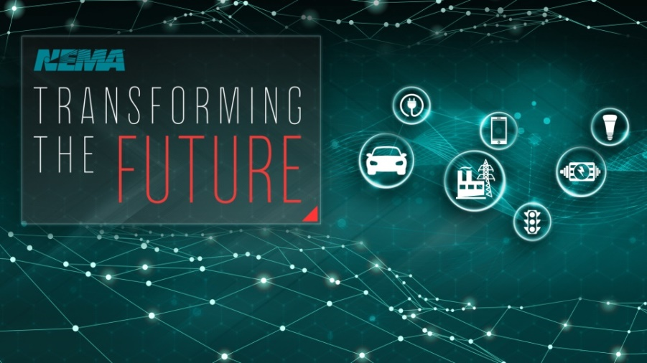
The National Electrical Manufacturers Association (NEMA)
Expand market opportunities, remove business barriers and reduce manufacturing costs through
development and delivery of consensus-based standards and other intellectual property,
effective advocacy, and
decision-quality business information and analytics.​
Notes:
For those of you not familiar with NEMA
It’s a trade association of electrical equipment and medical imaging manufacturers, founded in 1926 and headquartered in Rosslyn, Virginia. Also have offices in Mexico City
Nearly 325 members, our member companies manufacture a diverse set of products including power transmission and distribution equipment, lighting systems, factory automation and control systems, and medical diagnostic imaging systems.
Essentially electrical products from generation to end use.
NEMA
provides a forum for the development of technical standards and related guidelines/white papers that are in the best interests of the end users,
advocates for members on legislative and regulatory matters,
and collects, analyzes and disseminates industry data.
Some of the recent documents we’ve developed that may be of interest to this group
a policy barriers and opportunities document for microgrids, and
a soon to be published cyber hygiene document -- Cybersecurity Hygiene is a means to appropriately protect and maintain IT systems and devices by implementing a number of cybersecurity best practices
Grid modernization cost benefit analysis

Slide 4
NEMA Energy Storage Systems Section
Scope Includes
Storage device/medium
Power conversion systems
Control & management systems
Grid connected or off grid
Utility side or consumer side
Notes:
NEMA has approximately 50 product sections
ESS section is one of these product sections
ESS has members representing a broad range of ES manufacturers
The scope includes
Storage device/medium
Power conversion systems
Control & management systems

Slide 5
NEMA ESS Section Activities
Energy Storage Systems Performance Standard
Lead NEMA member public inputs on related ES codes and standards
National Electric Code (NEC) 706
National Fire Protection Association (NFPA) 855
Serve as secretariat for IEC TC 120
Notes:
NEMA standard
The last bullet relates to NEMA’s help consolidate public inputs for the NEC 706 and NFPA 855 on behalf of our .members
IEC TC 120 TAG secretariat

Slide 6
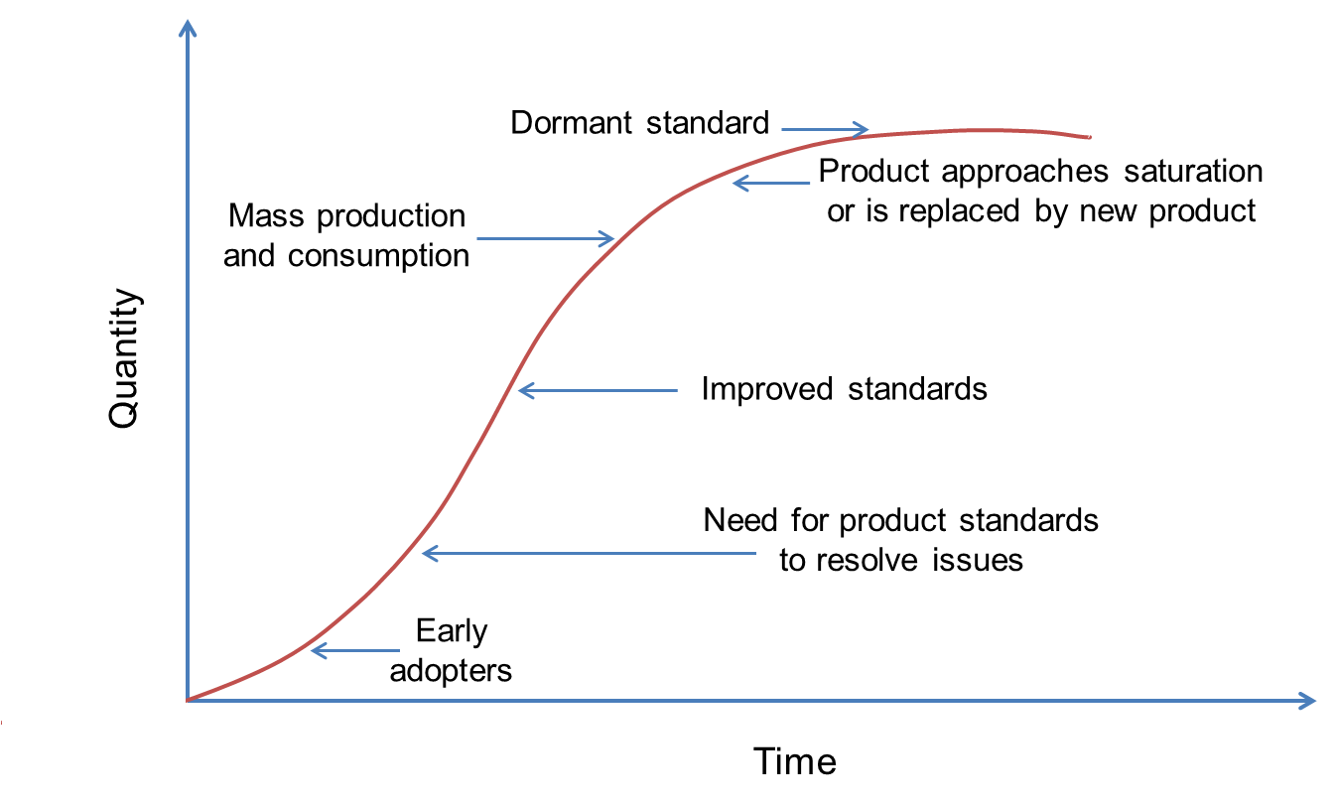
Standards Development Cycle
Notes:
As ESS become accepted and widely deployed in the electric power industry, the rationale for standards becomes more compelling. It is recognized that they contribute to the advancement of the technology and benefits in terms of interoperability and economics.
This is illustrated in the Figure
The goal is to create standards that encourage – and not stifle – innovation, while balancing with the need to deploy new technology and solutions for infrastructure project development.

Slide 7
NEMA ESS-1-2019 Standard for Uniformly Measuring and Expressing the Performance of Electrical Energy Storage Systems
Lack of a uniform and repeatable method for determining and expressing system performance
Project initiated under the Department of Energy
Development of a protocol/pre-standard for immediate use and a basis for US and International standards
NEMA actively participated in the process
Notes:
We heard PNNL allude to this already.
NEMA took the document and made it into a standard

Slide 8
The Association of Electrical and Medical Imaging Equipment Manufacturers
NEMA ESS-1-2019 Standard for Uniformly Measuring and Expressing the Performance of Electrical Energy Storage Systems
Focus is on electrical energy storage systems
Provides a set of “best practices” for characterizing ESS and measuring and reporting their performance
Serves as a basis for assessing how an ESS will perform relevant to different applications
Provides a valid and accurate basis for the comparison of different ESSs
Enables more informed decision-making in the selection of ESSs for various stationary applications
Notes:
Initiated NEMA process to develop an ESS standard based on the PNNL/SNL protocol.
- Focus is on electrical energy storage systems; not thermal systems.
- Provides a set of “best practices” for characterizing ESS and measuring and reporting their performance
Serves as a basis for assessing how an ESS will perform relevant to 8 different applications
- Peak shaving, frequency regulation, islanded microgrids, PV smoothing, volt/VAR, renewables firming, power quality and frequency control.
- Provides a valid and accurate basis for the comparison of different ESSs
Enables more informed decision-making in the selection of ESSs for various stationary applications
So this is an important standard to help with deploying ES systems
- Vish and Dave Schoenwald working on several new applications.
- Frequency Regulation and Peak Shaving Services with var Support; Determination of Duty Cycles for Energy Storage Systems in a Wind Firming Application and in a Combination of Frequency Regulation and Peak Shaving Application
- This NEMA standard could be updated to include them at a later date.

Slide 9
NEMA ESS-1-2019 Applications Addressed
Frequency regulation
Peak shaving
Islanded microgrids
Volt/Var support
Power quality
Frequency control
PV smoothing
PV firming
Describes and defines the application
Develops appropriate duty cycles

Slide 10
Battery Recyclability Standard
Standard methodology to define the amount of recyclable material at the end of battery life.
The standard will establish the “recyclability” of any secondary lithium battery system in scope, based on the amounts of extractable materials.
Metals, Plastics, Etc.
Applicable to EV, residential, commercial and industrial, and utility scale batteries.
Notes:
Read slide:
60+ people on the call today = 60+ interpretations of what this project is
That’s by design: a lot of fundamental decisions that have not been made yet because we want to form a group of interested and committed companies to help make those decisions
Ultimately, NEMA and Argonne agree that the industry needs some standardized, uniform method to assess the economic value of a battery the end-of-life
Market value of materials in the battery
How much of those materials you can get out in a way that facilitates their re-use
What that looks like precisely is better determined by a broad group of industry stakeholders
I envision this to be akin to what our Euro friends call a Recyclability Efficiency Rate, if that means anything to you. But whether or not that’s precisely what we end up doing
More on this to come, but just wanted to address the question that many of you probably have in your minds

Slide 11
Battery Recyclability Standard is NOT…
a way to “pick” the best recycling process
a goal of 100% recyclability
a valuation of environmental aspects above other important aspects

Slide 12
NEMA Energy Storage Council
Membership Categories:
Producers
Users/Integrators
Collectors/Recyclers
General (Academia, Government, Labs, Consultants)
Planning Meeting: Thursday, Nov 11 (2pm EST)
Notes:
Participation
Voting: $2,500/yr
Observer: $1,250/yr

Slide 13
NEMA Lithium-Ion Battery Fires Guidance Document
Provides information on the issues related to
the use of lithium-ion batteries
how fires start in batteries
how fires may be detected, controlled, suppressed, and extinguished
Guidance on post-fire management
Free Download
https://www.nema.org/standards/view/lithium-ion-battery-fires-guidance-document

Slide 14
IEC Technical Committee 120
Standardization in the field of grid integrated EES systems. Focuses on:
Systems rather than devices
Interaction between EES Systems and electric power systems
System aspects and the need for new standards for EES systems
Safety requirements for grid integrated EES systems electrochemical based systems
Notes:
Now I’m going to switch gears and highlight the IEC technical committee (TC) 120 activities.
IEC standards are widely adopted by manufacturers, trade organizations, purchasers, consumers, testing laboratories, governments and regulators and other interested parties.
Adoption is voluntary, although they are often referenced in national laws or regulations around the world.
International standards generally reflect the best experience of industry, researchers, consumers and regulators worldwide and cover common needs in a variety of countries, they constitute one of the important bases for the removal of technical barriers to the trade.
TC 120 focuses on standardization in the field of grid integrated EES systems.
Energy storage systems rather than devices.
Interaction between EES Systems and electric power systems
System aspects and the need for new standards for EES systems.
Safety requirements for grid integrated EES systems electrochemical based systems
NEMA is the technical advisory group secretariart for the US.
South Africa is a P Member of TC120

Slide 15
IEC TC 120 Liaisons to other IEC TCs
TC8: Systems aspects for electrical energy supply
TC21: Secondary cells and batteries
SC21A: Secondary cells & batteries containing alkaline or
other non-acid electrolytes
TC22: Power electronic systems and equipment
SC22E: Stabilized power supplies
TC57: Power systems management & associated information exchange
TC 82: Solar photovoltaic energy systems
TC 88: Wind energy generation systems
TC 105: Fuel cell technologies

Slide 16
IEC Technical Committee 120 Documents
IEC Number | Name | Current Status | Next Stage
62933-1 Edition 1 | EES systems – Part 1: Terminology | International Standard Published 2/27/18 | 5th CD
62933-2-1 Edition 1 | EES systems – Part 2-1: Unit parameters and testing methods – General specifications. | International Standard Published 12/13/17 | -
62933-3-1 Edition 1 | EES systems – Part 3-1: Planning and installation – General specifications. | Registered as a technical specification 6/29/18 | -
62933-4-1 Edition 1 | EES systems – Part 4-1: Guidance on environmental issues. | Technical Specification published 7/26/17 | -
62933-5-1 Edition 1 | EES systems – Part 5-1: Safety considerations related to grid integrated EES systems. | Technical Specification Published 7/12/17 | -
62933-5-2 | EES systems - Part 5-2: Safety considerations related to grid integrated EES systems – Batteries | CC circulated 1/18/19 | CDV (TBD)
62933-2-2 | EES Systems; Part 2-2: Unit parameters and testing methods – Applications and Performance testing | New Work Item Proposal | CD
Notes:
Revision work of 62933-1 will start in 2019-1 under WG1
Including new part of 60050
TS62933-3-1
1)TS upgraded to IS(including SOC and SOH definition, post SAT operation, integration of mobile EESS)
2) Planning and performance assessment of EESS (Short duration applications, FR, Frequency support. Grid voltage support (PL; Yu Zhang CN)
3) Long duration and back-up power applications (PL; Sang-jin Jeong)

Slide 17
IEC 62933-5-1
Technical Specification, specifies safety considerations (e.g. hazards identification, risk assessment, risk mitigation) applicable to EES systems integrated with the electrical grid
Provides criteria to foster the safe application and use of electric energy
Covers storage systems of any type or size intended for grid-integrated applications
Notes:
Section 6.3
During the risk assessment, the impact of the hazards should be considered for all stages of the life cycle (design and planning, transport, installation, commissioning, operation, maintenance and repair, and end of service life).
For the operation of those components, the EES system has a lot of connections between components, such as main circuit connections, control signal wiring, communication signal wiring, pipes, control power lines, fasteners to buildings, trenches, etc.
Additionally, components may be produced or supplied by different manufacturers for an EES system. The combination of those components should not be considered as safe per se and therefore further risk assessment due to the integration is needed. In particular, the risk of incompatibility of some components resulting from the integration shall be assessed by appropriate risk assessment methods. Furthermore, the total energy stored in the EES system and the potentially exposed population in the area

Slide 18
IEC 62933-5-2 (Batteries)
“The safety culture of stakeholders (integrators, operators and end-users) of such systems may vary from a high level to nearly full ignorance”
BESS may have additional safety hazards due to chemicals
BESS are complex at the systems level due to the variety of potential battery options and configurations
Compliance with standards and related material produced specifically for the safety of subsystems does not ensure absolute intrinsic safety of the overall system
Notes:
All EESS shall follow the general safety requirements as described in the technical specification IEC/TS 62933-5-1 that is based upon a systems approach. IEC/TS 62933-5-2 follows the structure of IEC/TS 62933-5-1 and provides additional requirements for battery energy storage systems (BESS).
The additional requirements are provided for the reasons on the slide
“The safety culture of stakeholders (integrators, operators and end-users) of such systems may vary from a high level to nearly full ignorance”
BESS may have additional safety hazards due to chemicals
BESS are complex at the systems level due to the variety of potential battery options and configurations including the combining subsystems (e.g. control system for battery subsystems, battery subsystems, power conversion subsystems and auxiliary subsystems).
Compliance with standards and related material produced specifically for the safety of subsystems does not ensure absolute intrinsic safety of the overall system

Slide 19
Summary and Key Takeaways
Codes and Standards (C&S) provide a basis for the safe installation, application and use of ESS
Newer and traditional battery technologies are of concern to public safety officials, fire departments, and building inspectors.
C&S lag technology development
Equipment manufacturers should be aware of the increased demands for test data, fault data, and fire simulation testing.
End users, consulting design engineers and installers also need an understanding of these codes and standards
Active participation by stakeholder affected by safety code development bodies is greatly encouraged
Notes:
Codes and Standards (C&S) provide a basis for the safe installation, application and use of ESS
Newer and even traditional battery technologies are of concern to public safety officials, fire departments, and building inspectors.
This has led to increasing regulation and criteria as proposed (and under development) by NFPA, IFC, IBC, UL, IEC and others.
- C&S lag technology development and need to be updated to address all ESS technologies and potential applications
Energy storage equipment manufacturers should be aware of the increased demands for test data, fault data, and fire simulation testing to satisfy code officials and meet the new code requirements.
similarly, end users, consulting design engineers and installers also need an understanding of these codes to determine the types of technologies that can be safely deployed in existing structures as well as newer installations and facilities.
Active participation by stakeholder affected by safety code development bodies is greatly encouraged
Collaboration on updating of current C&S to cover more ESS technologies and applications can foster more timely consideration and acceptance of ESS

Slide 20
Thank you for your attention!

