Slide 1
ESS Safety Codes and Explosion Prevention
Matthew Paiss
Technical Advisor
Notes:
Image: Abstract Data Visualization – Stock Photo

Slide 2
Presenter Bio Matthew Paiss | Technical Advisor
PNNL ESS Safety Lead
Primary representative to NFPA 855, UL 9540, UL1974, and IEC TC120
Delivered PV+ESS training to >8,000 AHJ’s, Responders, and Integrators
28 yrs Emergency Response Experience
Solar PV manufacturing (Arco Solar circa 1982)

Slide 3
Notes:
This slide represents the different C&S that directly affect the design, installation, and maintenance of ESS. Beginning at the built environment, there are codes that address the building fire & life safety systems protecting the building and its occupants. These include the suite of codes known as the I Codes. IFC, IBC, IRC, NFPA’s Fire Code, and the National Electric Safety Code followed by many regulated utilities.
Next are product standards that address ESS equipment, and communication standards such as UL 9540 and the new MESA standard for communications with Charlie Vartanian has played a key role in developing.
When ESS are placed into service, there are a variety of C&S that guide the installation such as the NEC (NFPA 70), NFPA 855, NESC, and additional guides for recommended practices from organizations such as DNV-GL, NECA, and FM Global.
ESS must be listed to UL 9540 and that assumes that the batteries are listed to UL 1973, inverters to UL 1741, and interconnection requirements covered by IEEE 1547, and performance criteria under IEEE 1679.
The area of second life use (from EV to stationary use) is addressed in UL 1974 by setting minimum re-certification requirements for facilities performing this work. This is an area in need of more work and clarification to process the expected thousands of batteries at EOL in EV use.

Slide 4
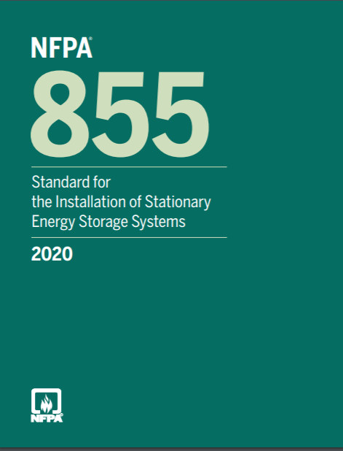
NFPA 855
2020 NFPA 855 Standard for the Installation of ESS
In revision for 2023 update
Covers
Installation
Commissioning
O & M
Emergency Response
Decommissioning
Notes:
This addresses the primary standard addressing ESS. Discuss the gaps in representing all stakeholders, etc…

Slide 5
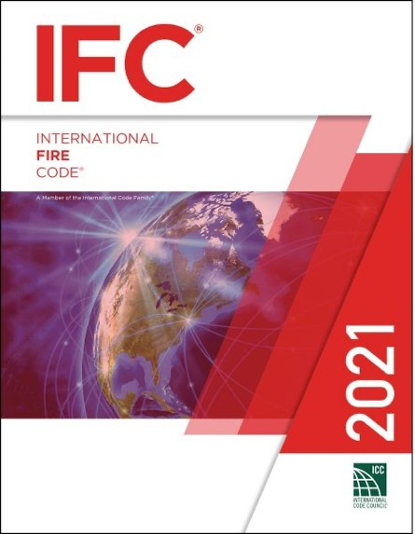
International Fire Code (IFC)
2021 International Fire Code
Section 1207
Changes from 2018
Scope ads O&M, retrofit, commissioning, decommissioning
Exemption for telecom using Pb & NiCd @ < 60VDC
Suppression system based on 9540a
Dedicated/Non-dedicated use buildings
Explosion control: NFPA 68 or 69
Notes:
This addresses the primary standard addressing ESS. Discuss the gaps in representing all stakeholders, etc…

Slide 6
Driver for Listed ESS is Fire Code
NFPA 1 Ch 52
IFC Sec 1207
Both reference NFPA 855
Primary Code for ESS
Requires UL9540
Key ESS product safety Standard
9540a Fire Testing
Explosion Data
+
Bottom line is NFPA 855 is key ESS safety document and require listing to UL 9540

Slide 7
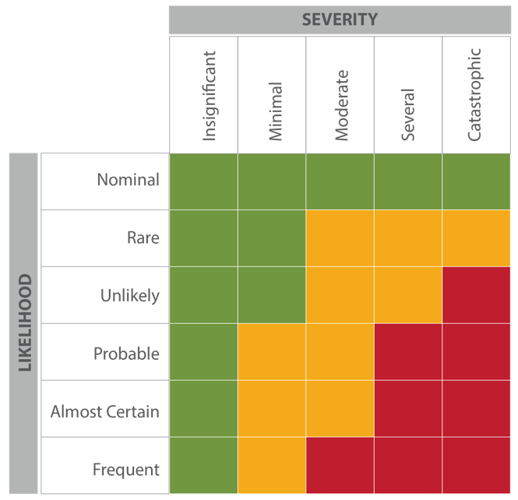
Hazard Mitigation Analysis
The HMA evaluates single fault failures
Thermal runaway in a single battery array
Failure of the energy management system
Failure of ventilation system
Voltage surges on the primary side
Short circuits on the load side of the batteries
Failure of the smoke or gas detection, fire suppression
The fire code official can approve deviations or new ESS technologies based on the HMA.

Slide 8
Size, Separation & MAQ Limits
Other arrangements based on large scale fire testing to UL9540a
Max 50 kWH
Spaced min. 3 ft. from other units and from walls
Max. 600 KWh aggregate/fire area
8

Slide 9
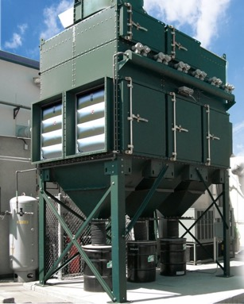
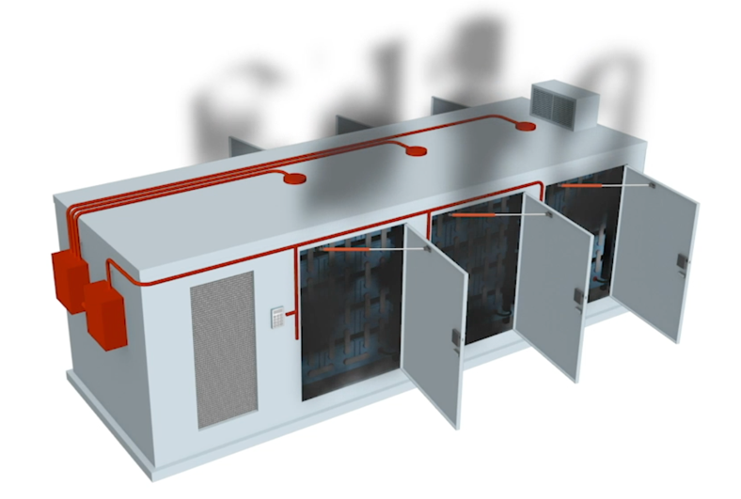
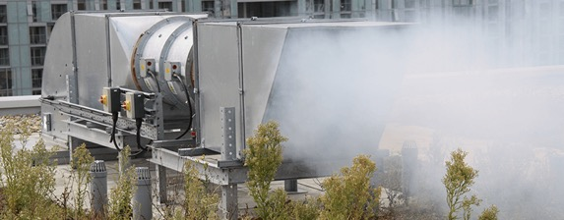
NFPA 855 Explosion Control
Three options for meeting requirement:
NFPA 68 – Deflagration Venting.
Blow-out panels to protect structure from explosion based on max gas production in cell tests.
NFPA 69 – Deflagration Prevention.
Exhaust system designed to keep below 25% of LEL in area.
Engineered Cabinet – Based on Large Scale Fire Test has shown that no pressure waves will occur and no projectiles can be ejected.

Slide 10
Reducing Explosion Risks is Key Gap
Credit: Business Korea.
An energy storage system fire and explosion at a solar power facility in Hongseong, South Chungcheong Province, on April 6.

Slide 11
IntelliVent: ESS Safety Venting System
Notes:
Stock Image

Slide 12
Background
Lack of exhaust ventilation was identified as leading gap in APS incident. Other explosions will occur in similarly designed systems.
Deflagration prevention lacking in most systems.
Listing to 9540 costly for large systems due to 9540a fire testing.

Slide 13
Explosion Control
Providing deflagration venting is a late-stage measure. Does not eliminate flammable gases prior to explosion
Deflagration prevention is the key!
But…smaller volume cabinets make exhaust ventilation even more challenging
Exhausting must occur rapidly

Slide 14
UL Demonstration Summary
https://ulfirefightersafety.org/docs/UL9540AInstallationDemo_Report_Final_4-12-21.pdf
UL AND THE UL LOGO ARE TRADEMARKS OF UL LLC © [YEAR OF PUBLICATION]. ALL RIGHTS RESERVED. THIS DOCUMENT MAY NOT BE COPIED WITHOUT WRITTEN PERMISSION FROM UL AND ONLY IN ITS ENTIRETY. THE DOCUMENT IS FOR GENERAL INFORMATION PURPOSES ONLY AND IS NOT INTENDED TO CONVEY LEGAL OR OTHER PROFESSIONAL ADVICE. THE INFORMATION PROVIDED IN THIS DOCUMENT IS CORRECT TO THE BEST OF OUR KNOWLEDGE, INFORMATION AND BELIEF AT THE DATE OF ITS PUBLICATION

Slide 15
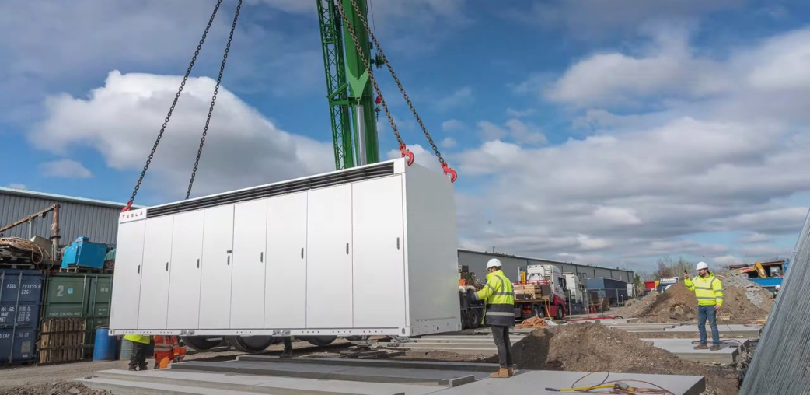
ESS Cabinets Becoming Common
Credit: Tesla Energy
Advantage:
Trending due to modular design flexibility for smaller projects
Safer installation due to less on-site connections
Listing Requirements
Challenges:
Difficult to provide deflagration prevention due to small air volume
Lower energy density for larger projects
Credit: Fluence

Slide 16
PNNL available technology
IntelliVent™

Slide 17
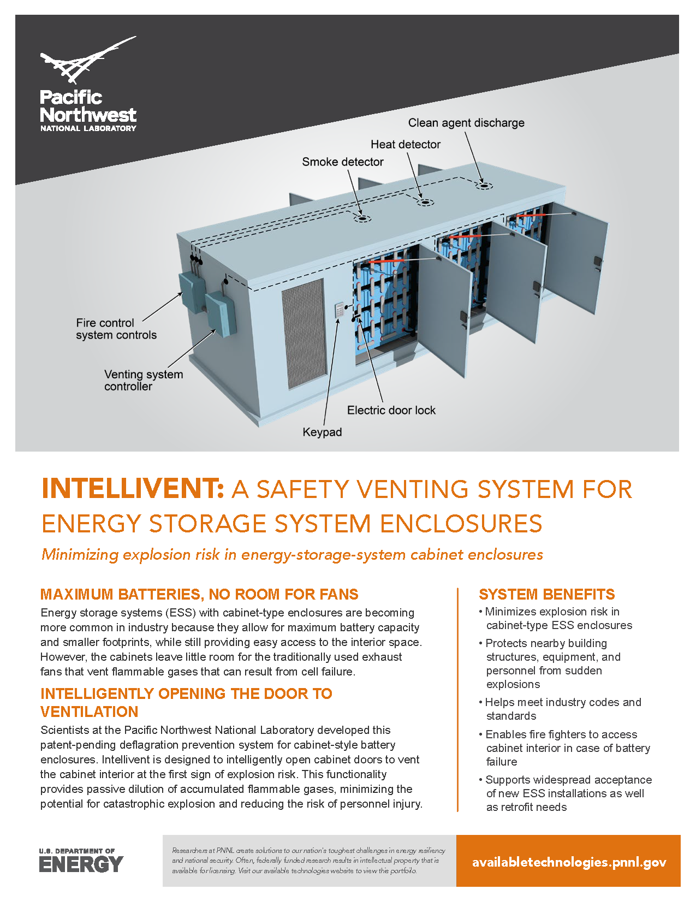
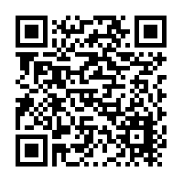
IntelliVent™
https://www.pnnl.gov/news-media/pnnl-invention-reduces-risk-battery-explosions

Slide 18
Thank you
Matthew Paiss, Technical Advisor
Battery Materials & Systems
Matthew.paiss@pnnl.gov
Acknowledgements
Dr. Imre Gyuk, DOE
Office of Electricity

