Slide 1
State of Play in Southern Africa
MK Mathe
Living Energy Lab Platform (LELP)
Southern Africa Energy Storage Systems
October 20-21, 2021
14:00 – 18:00
Virtual Seminar by USTDA

Slide 2
Agenda
Sustainable Development Goal #7
Why choose energy storage?
Characteristics for storage & developing countries
SA Energy Storage Landscape
Testing to your needs

Slide 3
Sustainable Development Goal #7
©ESMAP – wbg_breakout_esp

Slide 4
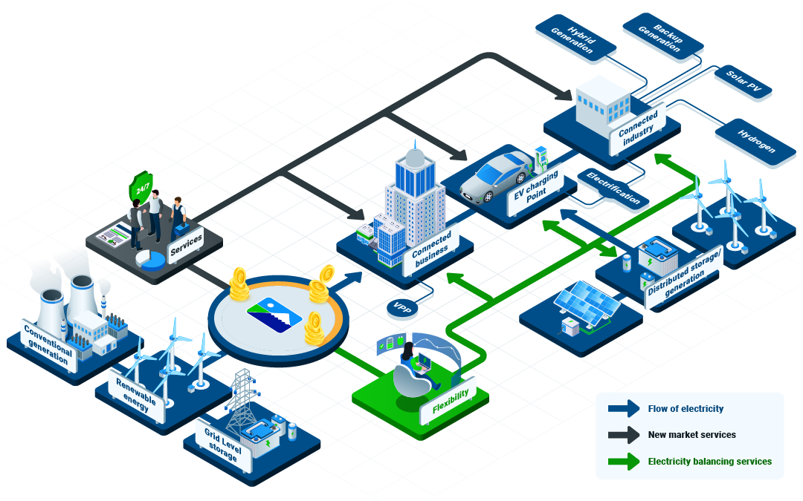
Why choose energy storage?
Reduced expenses for consumers
Greater energy flexibility and reliability
Decreased strain on the grid
Integration of varied power generating sources like solar and wind
Lessened climate impact, especially when used alongside renewable generation sources
https://www.pacificgreen-energystorage.com/technology

Slide 5
Battery Storage Investment Plan (BSIP) & Energy Storage Partnership (ESP)
©ESMAP – wbg_breakout_esp

Slide 6
Characteristics for storage
@DNV GL ©2017 – Energy Storage in Developing Regions, Dr M Rowe 2019

Slide 7
Opportunities in Developing Countries
@DNV GL ©2017 – Energy Storage in Developing Regions, Dr M Rowe 2019

Slide 8
Storage in Developing Regions
@DNV GL ©2017 – Energy Storage in Developing Regions, Dr M Rowe 2019

Slide 9
Storage Market for Africa
DID YOU KNOW
According to a market report by Arthur D. Little (ADL),
the battery market is expected to become a (USD) $90+ billion sector by 2025,
and that new innovations,
such as solid-state electrolyte lithium-ion (Li-ion)
batteries, will eventually replace existing battery technologies.

Slide 10
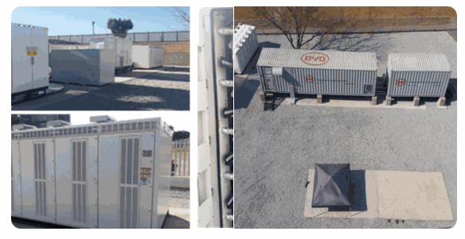
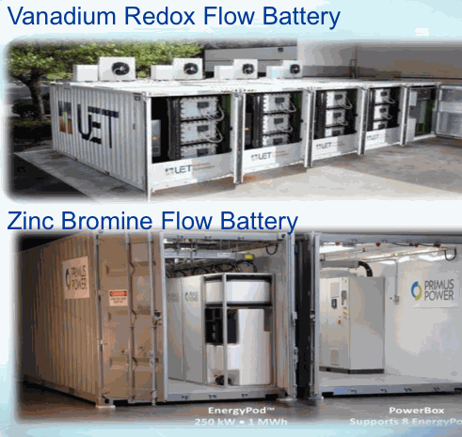
South Africa energy storage landscape
Industrial Development Corporation (IDC)
Eskom – National utility company
  Lithium ion BYD
  VRFB – Bushveld Energy
  Zinc Bromine – Primus Power
Micro grids – EATON, ABB, other
Sources: IDC Parsons USTDA March 2017 – SA Energy Storage Study, Eskom & Bushveld Photos acknowledged

Slide 11
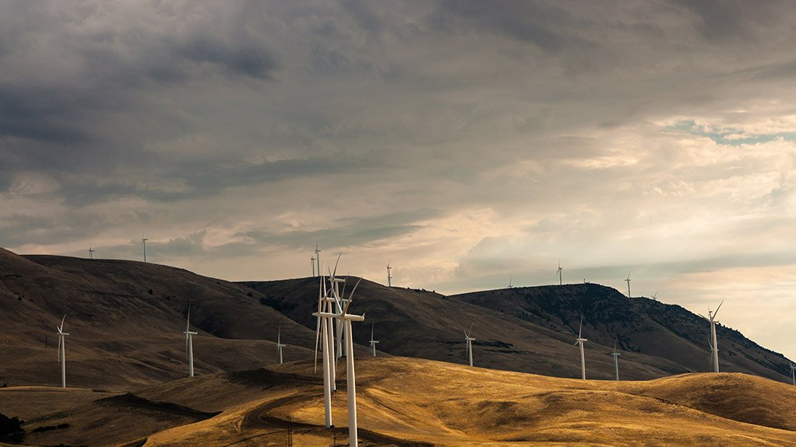
Batteries will enable large-scale dispatchable renewable energy on South Africa’s grid by Andy Colthorpe
March 22, 2021
Image: G7 Renewable Energies.
After a recent tender process, up to 1,300MWh of grid-connected energy storage will be deployed in combination with renewable energy in South Africa through a number of large-scale projects.

Slide 12
Energy storage: South Africa’s new ‘gold rush’
The Energy Transition Opportunities:
  increased beneficiation of minerals associated with the energy transition, such as battery minerals,
  the localisation of energy value chains, including green hydrogen production, that leverage the country’s solar, wind and human capital resources, and
  the repositioning of South Africa as a leader in new and emerging markets.

Slide 13
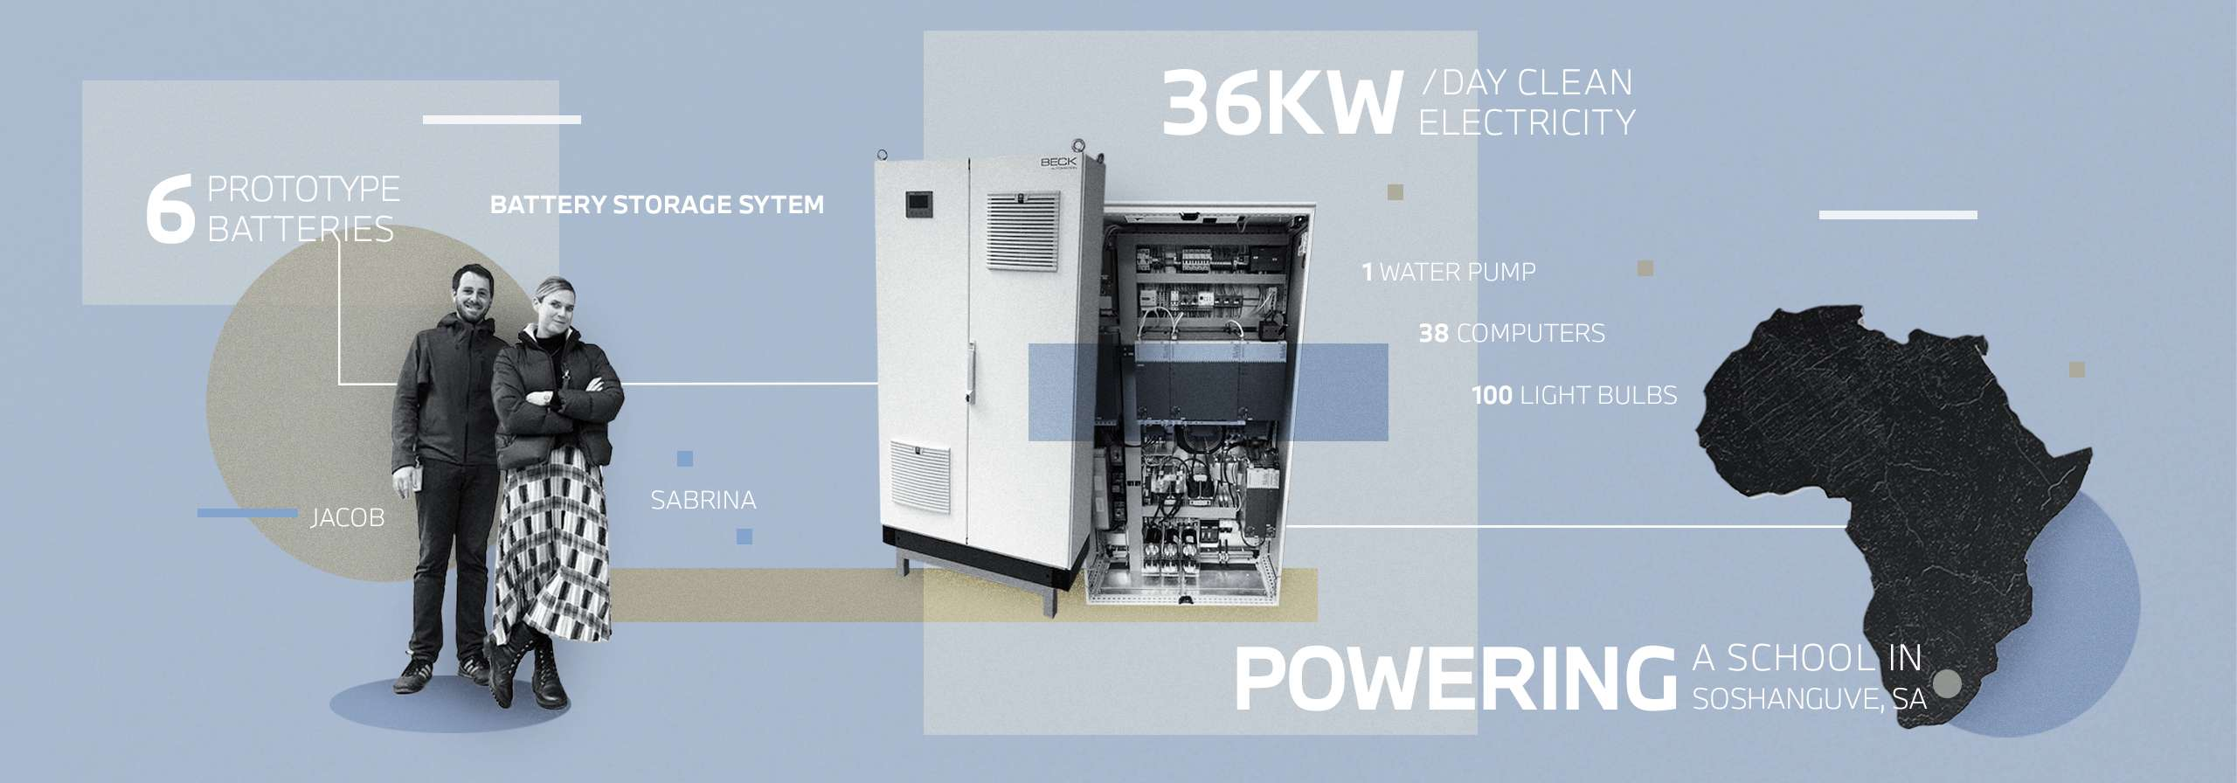
PowerUp to launch in Rosslyn, South Africa - 2022
PowerUp - the idea of creating a powerful energy storage block out of six high-voltage batteries from former development vehicles. These store solar power from the photovoltaic system on the roof and supply the school with 36 kW per day of clean electricity. “That’s enough to run about 38 computers, 100 light bulbs and a water pump,”
https://www.bmwgroup.com/en/news/2021/batteriespeicher.html

Slide 14
Testing to Your Needs
Provide the knowledge and services about standards and conformity assessment
Testing a wide range of battery and energy storage products to enter new markets
Partner in navigating the codes, standards, and regulations
Test efficiency and responsiveness in ultracapacitors to new markets
Third-party Testing
The opportunity to validate a range of product performance tests and compliance
Helps to build trust with consumers and to comply with local requirements.
Energy Storage System | South African Market Requirements
DELIVERABLE | NRCS LoA (Letter of Authority)
REGULATOR | National Regulator for Compulsory Specifications (NRCS)
MANDATORY OR VOLUNTARY | Mandatory
PERIOD OF VALIDITY | 3 years
PRODUCT MARKING REQUIREMENT | No
LOCAL REPRESENTATIVE REQUIRED | Yes
IN-COUNTRY TESTING REQUIRED | No
TEST REPORT(S) ACCEPTED | Safety report will be required IEC standard preferred
SAMPLE(S) REQUIRED | No
INITIAL FACTORY INSPECTION REQUIRED | No
ANNUAL FACTORY INSPECTIONS REQUIRED | No

Slide 15
Analysis in the implementation of storage
©Energy Vault 2019 – Enabling a Renewable World

Slide 16
Testbed plus Battery Cell & Module Test Types
CIRED, 21st International Conference on Electricity Distribution, Frankfurt, 6-9 June 2011, 0674 – KEMA-USA

Slide 17
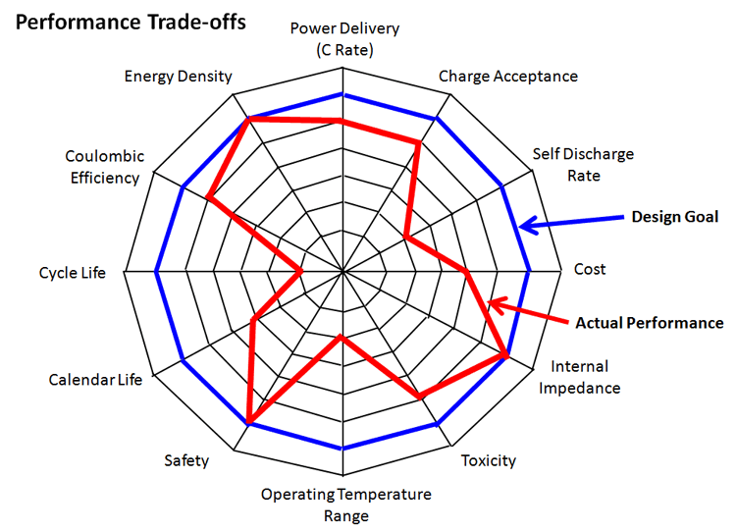
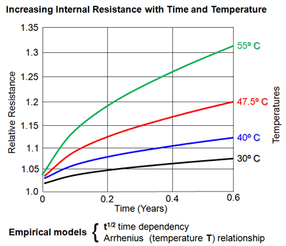
New energy business (Energy Storage Testbed -ESTB)
Battery Testing -Testing is designed to tell us things we want to know about individual cells, modules and batteries.
Performance and reliability testing
Battery Calendar Life
Performance Optimization
Blue is desired performance;
Red is actual measured performance
OTHER TESTS
Specifications
Safety
Abuse & Life tests
NH Research – The Fundamentals of Battery/Module Pack Test

Slide 18

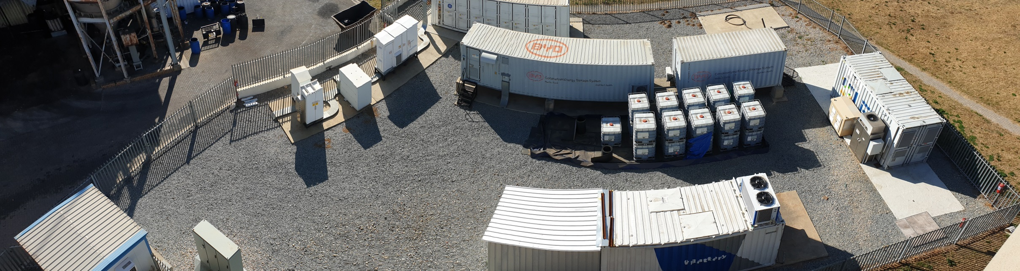
Battery Energy Storage Test Facility
Li-Ion
(Phosphate)
VRFB
Li-Ion (NMC)
VRFB
Control Room
Objectives:
Demonstrate the effectiveness of battery energy storage at a grid scale.
Test individual battery technologies under real operating test regimes
Identify the best technology for various applications
Establish the probable life cycle of each of the various technologies under real working conditions
Establish the round trip efficiencies of the various units
Give Eskom insight into the future installation of commercial battery storage units of the Megawatt scale.
Overview:
Eskom’s Test and Demonstration Facility was designed to accommodate 5 batteries of differing technologies and manufacturers, with the aim to test all under identical load discharge profiles over a minimum period of 3 years.
The output of the test units is then synchronised and fed back into the grid, as if they were a single battery unit, in order to demonstrate the effectiveness of this form of energy storage.

Slide 19
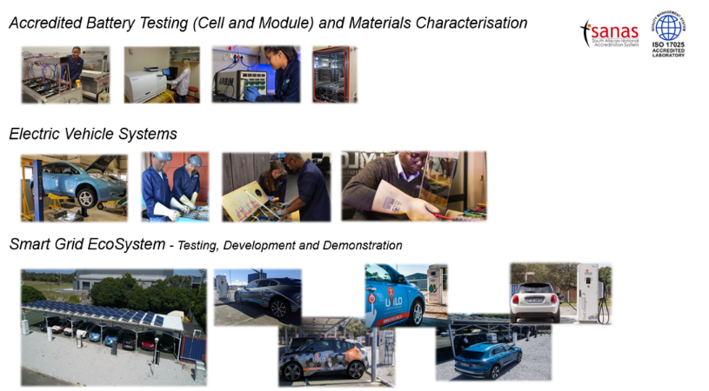
uYilo Facilities

Slide 20
Multi-scale Simulated Synthesis of Electrode Materials

Slide 21
Summary
State of energy storage is increasing coupled with the deployment of renewables
Regulations and policies need to be aligned with the developers
Requisite skills need to be prioritized
Reuse and recycling of batteries will promote the introduction of circular economy
Africa can be the Silicon Valley of Energy for the World

Slide 22
Thank you

