Slide 1
OutBack Power presentation
By John Webber

Slide 2
1. Quality of Install
2. Conductors
3. Install consideration
4. Understand the Power

Slide 3


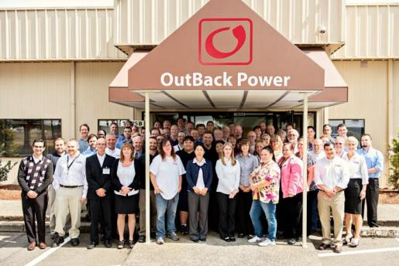

OutBack Power Technologies
Premier developer of off-grid and grid hybrid power conversion systems for renewable & energy systems
Based in Arlington, Washington USA since founding in in 2001
International brand & product quality recognition

Slide 4
Considerations for improved life of an OutBack System
Notes:
The primary concern for installers is to insure that their solution and reputation is top notch
We hope to demonstrate our recommendations for the OB inverter as well as practices which will improve the longevity of the install
Our experience is that it only takes a couple of trips to a site, after the install has been completed to begin losing money on a job.
The North America Market has about 5% of no trouble found when equipment is returned while I contract we see closer to 25% no trouble found in the international market. These next slides are meant to improve the installs and reduce your service calls,

Slide 5


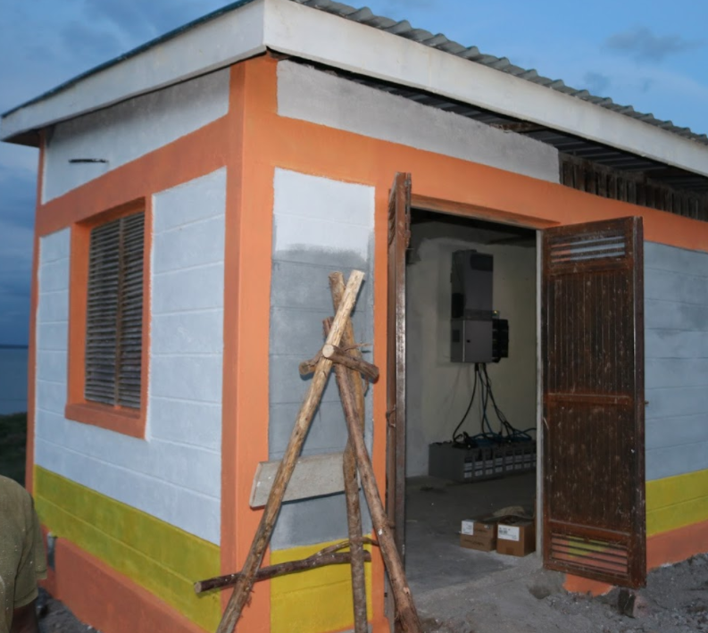
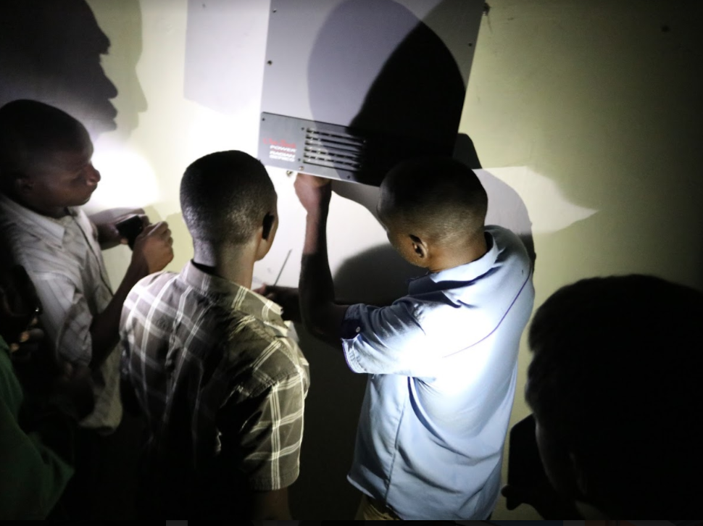

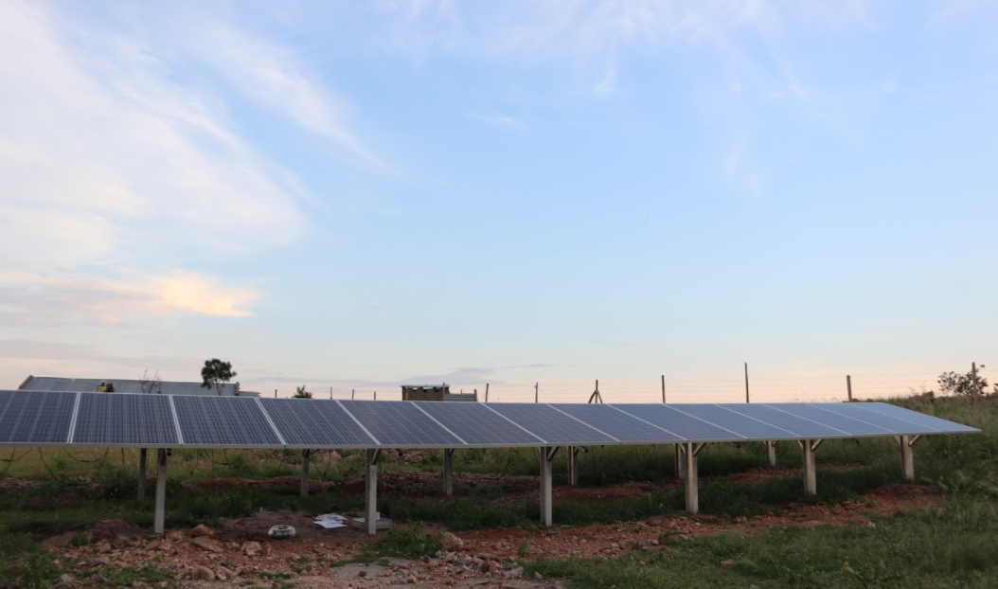

Why Quality Matters
Ndeda Island, Lake Victoria; Kenya
Solar to remote communities
Insure long life of the system
  Batteries
  Electronics
  Power Delivery
Metering Creates Ownership
Grants become endowments
Micro Grid doesn’t mean Megawatts

Slide 6
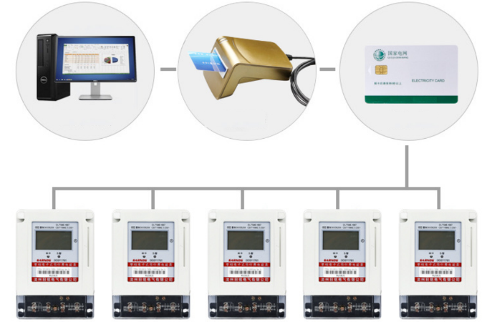
Pay as you go Metering
Low cost cards and meters allow for total power management
Business can collect and monitor each individual system
Theft is easily monitored with collected meter data
Creates ownership for the customer and the business issuing KWh credits

Slide 7
Global Market Drivers
Replacement of traditional lighting
Agriculture projects
‘Last Mile’ infrastructure
Improved Medical Care
Street Lighting
UPS style and Solar Backup
Access to clean water
Access to refrigeration
Rising costs of fossil fuels
Infrastructure Projects

Slide 8
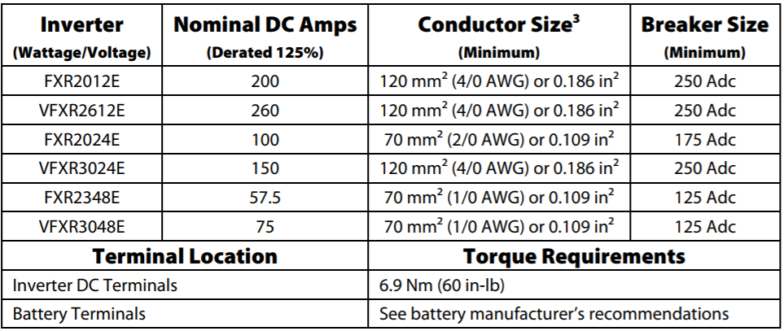
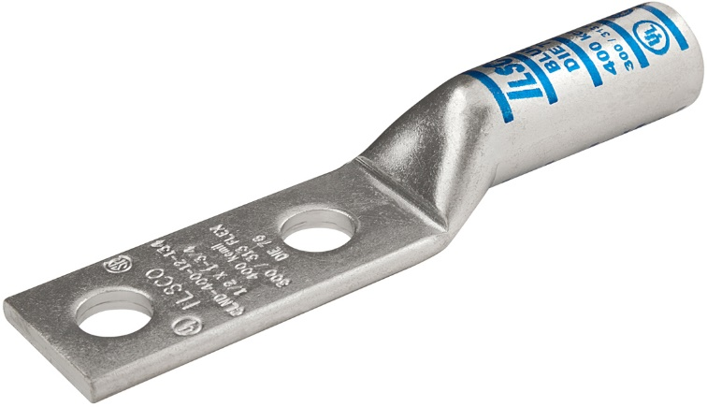
Torque and conductor sizing Inverter
What if my loads are much smaller?
Can I reduce conductor size?
Inrush current
Surge
The human condition
Conductors longer than 3 Meters
Use Ring terminals with compression fittings to insure proper and lasting connection
Notes:
Wires and breaker sizes as recommended by should be adhered to.
Undersized wires lead to an under performing system and possible fire danger.

Slide 9
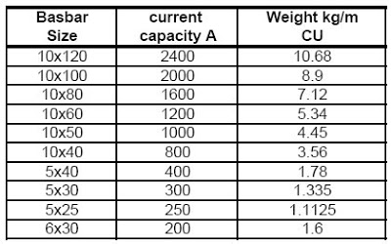
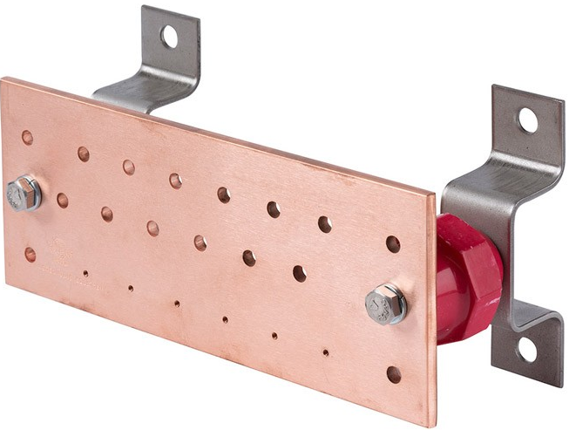
Proper bussing
Use top quality products in every project
Land one conductor per area
Standoffs protect conductors
Insolated and Isolated
Notes:
Bus bars must be properly sized for current and properly spaced.
Isolation from possible shorting events is a must.
All connections must be secured and properly tightened.

Slide 10
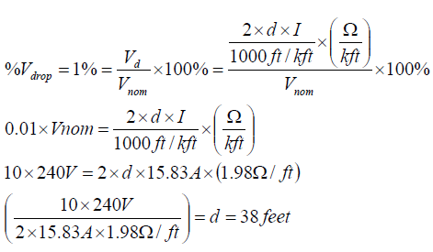
Do you have the right resources?
Your Applications group
Do you have the right resources?
Are they being trained on a regular basis
  Attending CTP at OutBack Power
  Asking for further training
  Calling instead of Email
OutBack Power with Alpha Technologies will provide support with Webinar, and on site visits.

Slide 11
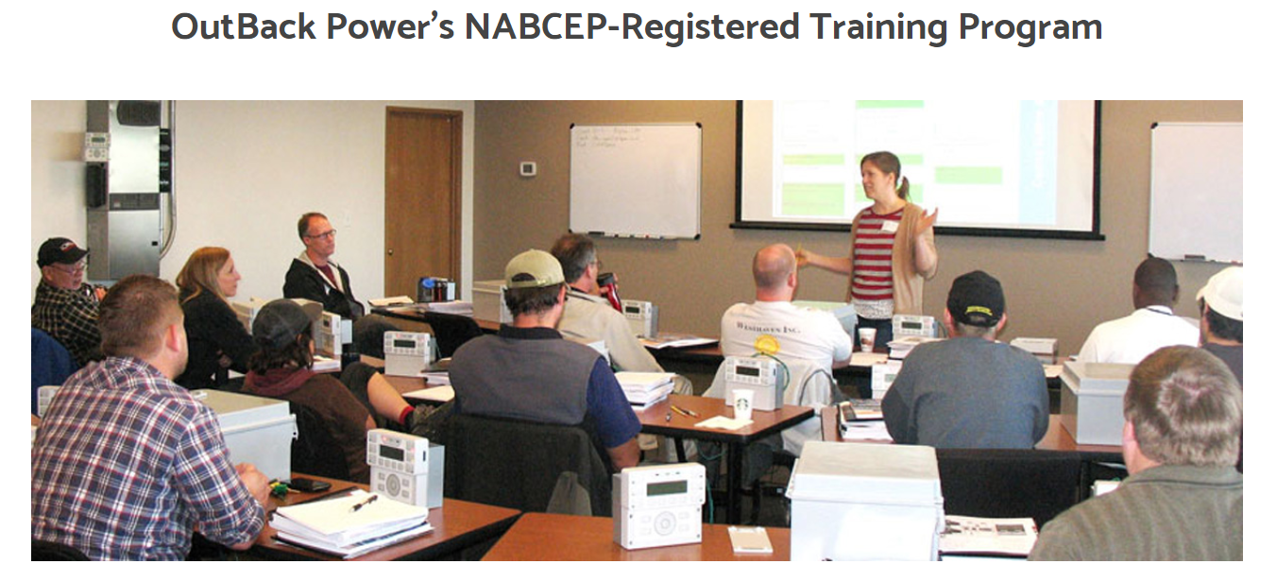
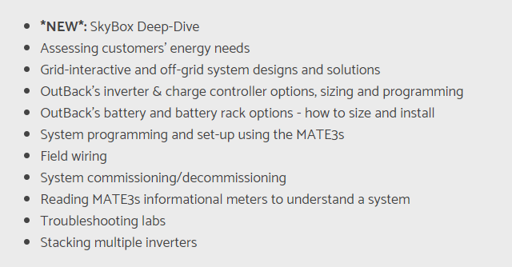
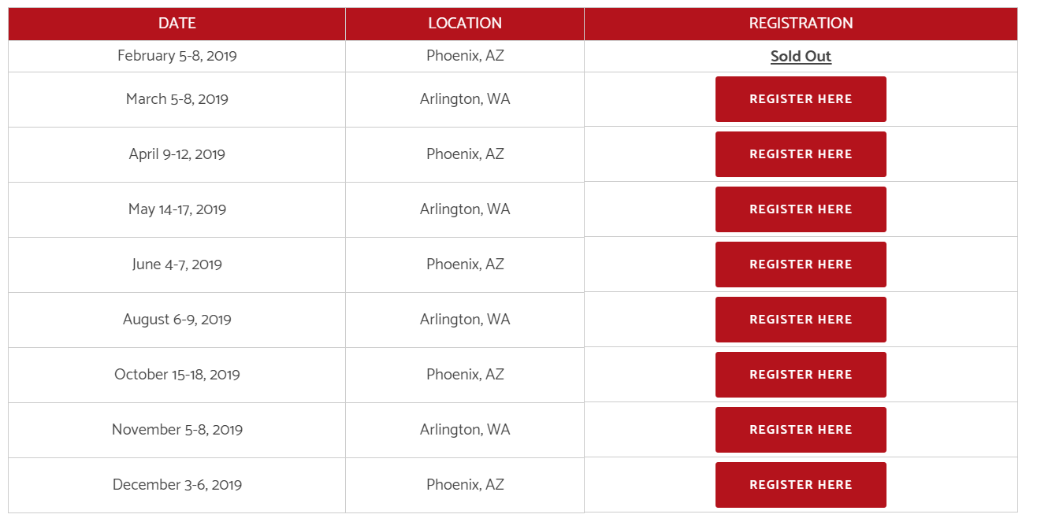

Slide 12
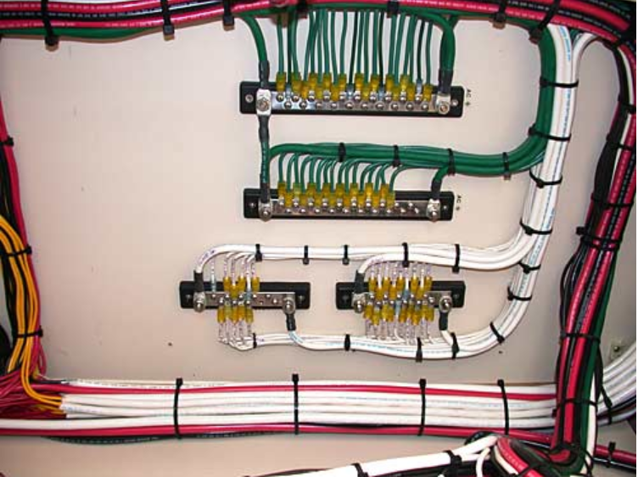
Wiring practices and ‘Looming’
Organized wiring practices
Today, tomorrow and years to come
  Trouble Shooting
  Reduce Damage to wires
  Labeling of conductors
Notes:
Visually pleasing wire management leads to efficient trouble- shooting and ease of workability.
A rats of wires nest leads to miss-wiring issues and a generally unpleasant installation.

Slide 13
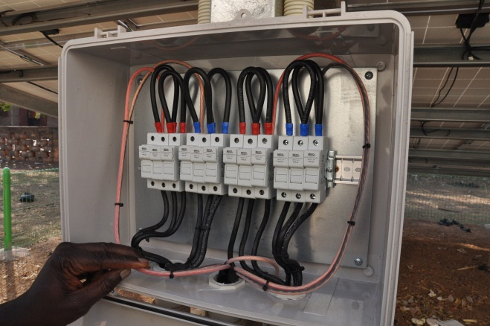
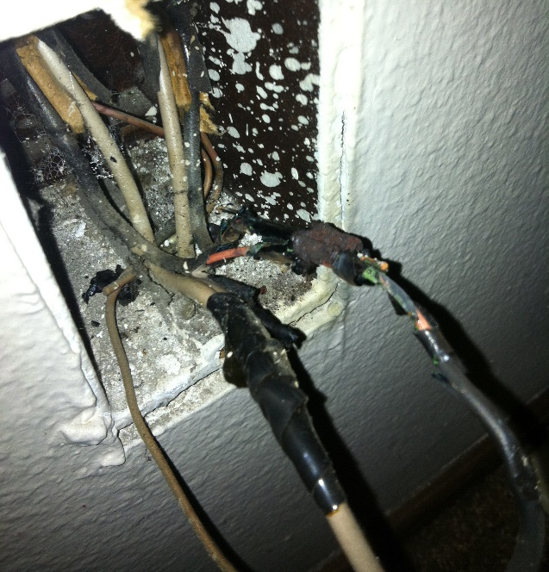
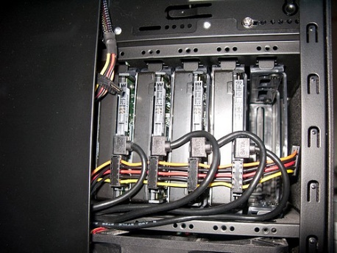
Proper wire management is so important
Take great care in your preparation and you will be rewarded
Notes:
Proper wire techniques make it much easier to find and trouble shoot system errors.
Future repairs or project expansion are greatly complicated if and clean clear wire management is not implemented .
Nothing sells the next job Like a successful last job.

Slide 14
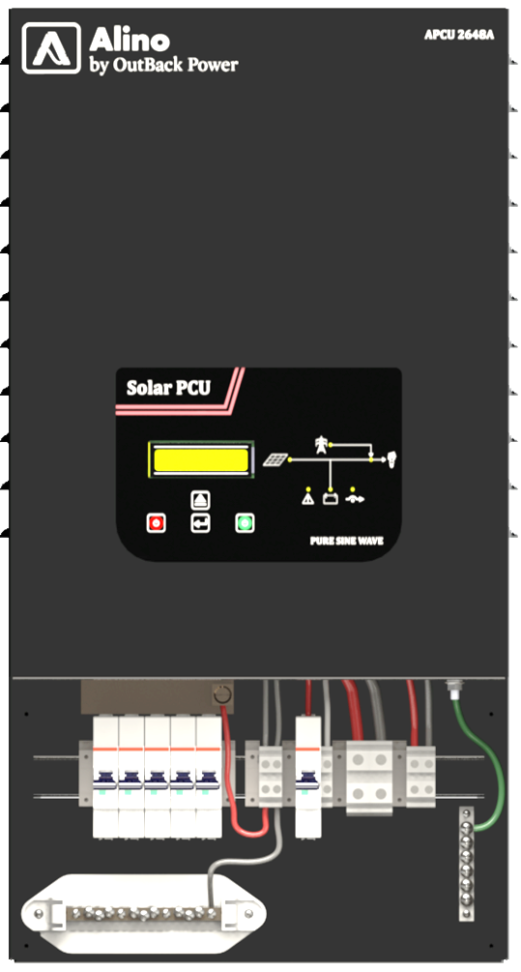
ALINO Overview
Conformal Coating
Power Conditioning and backup unit in a single solution
Front panel LCD
for Monitoring and controlling
System diagram shows where the power is coming from and AC source
Integrated AC breaker
Built in 40A solar charge controller
Built in Wire box with terminals and bus bar
Input and Output terminals
Notes:
Basic call outs for the system
Built in Power Conditioning and Inverter
If the grid is there and if PV is supporting the system is shown with LED display
Unit also has 40A built in solar charge controller
Integrated AC breaker protects the unit from surge and can easily be rest
Built in wire box with DIN RAIL mounted terminals for PV ,batter and AC. Additional space helps to mount extra protection and bus bar for outputs
The primary LCD display is the primary information point with display of production, consumption, battery voltage and AC input settings.
Front panel switches associated with LCD can program a lot of parameters.

Slide 15
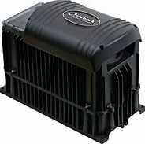
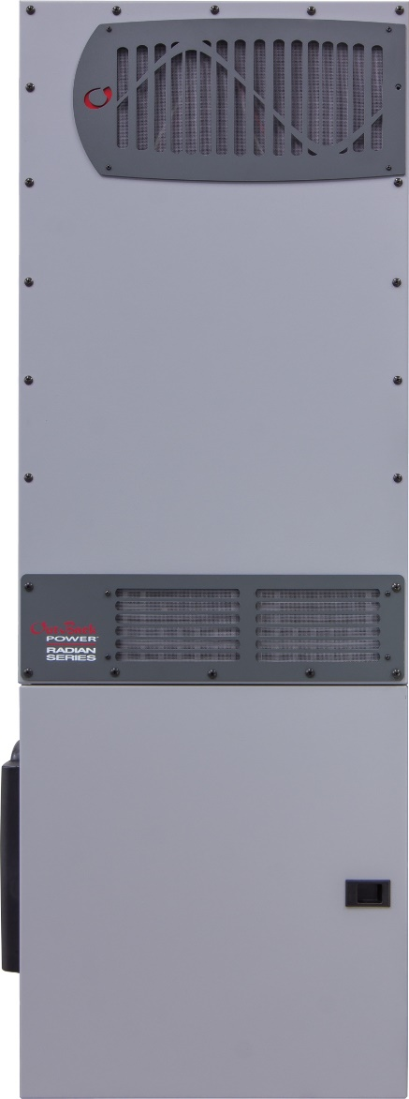
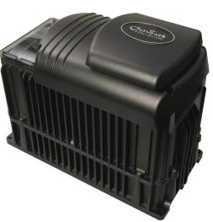
FXR Inverter/Chargers:
Grid-interactive
and stand-alone same model
Preprogrammed operating modes
Advanced Battery Charging profile
Stackable in series, parallel, series/parallel, and three-phase configurations – 10 grid tied and 9 three phase
Passthrough of 30A
Remote monitoring and programming accuracy with Optics RE via Mate3
Operating Efficiency at 93%
Corrosion Resistant Internal Components
Field upgradable software
Power Factor corrected battery charging
5-year warranty
Vented FXR inverter
Sealed FXR inverter
Radian Inverter
With load center

Slide 16
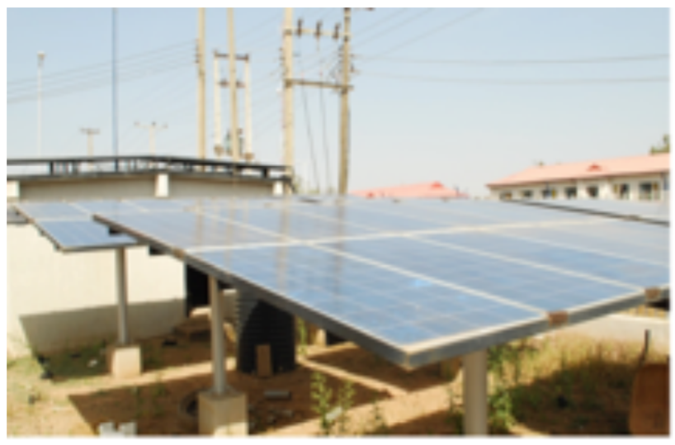
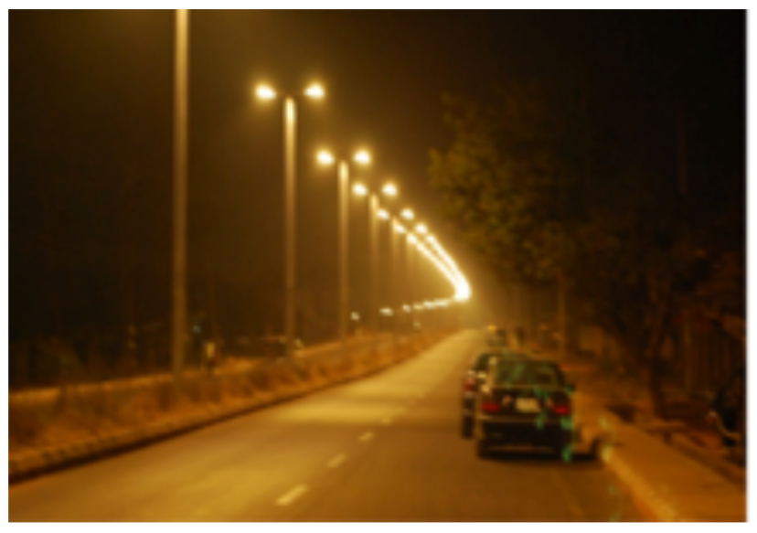
Solar Lighting in Nigeria
Why not use standard AC wiring and lights and drive them from small solar farms located every few kilometers along the roadway? His first “solar bunker” design was installed in March 2013 to supply 2.6 km of roadway in Plateau state. 18 kW of solar array feed Deka gel batteries and Outback inverters, which light 61 LED street light fixtures, for 12 hours per day.

Slide 17
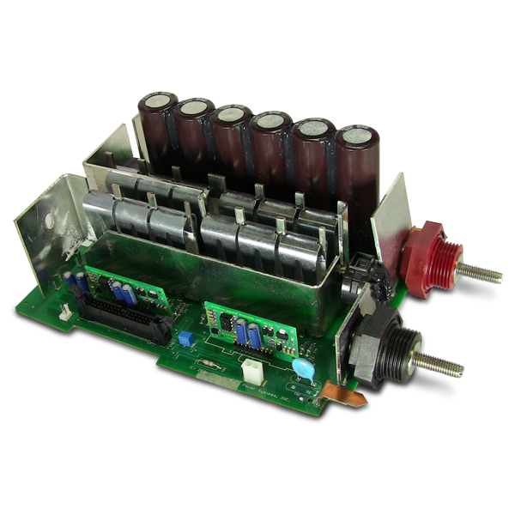
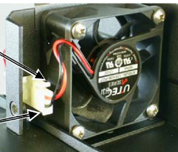
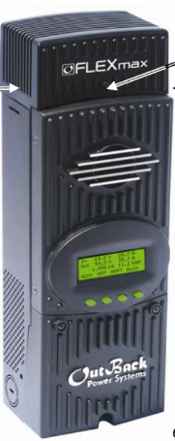
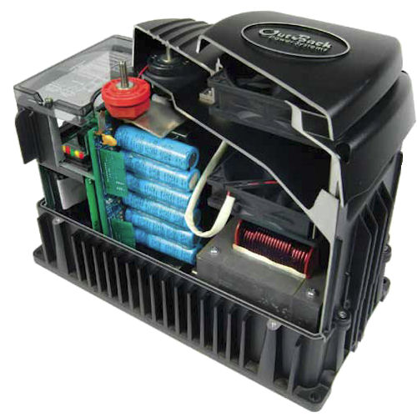
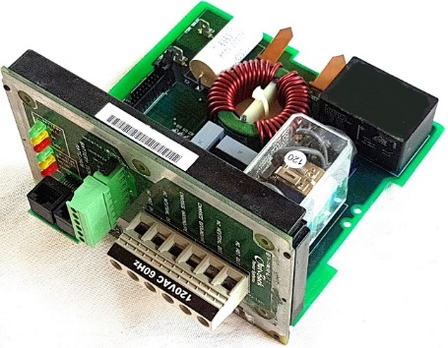
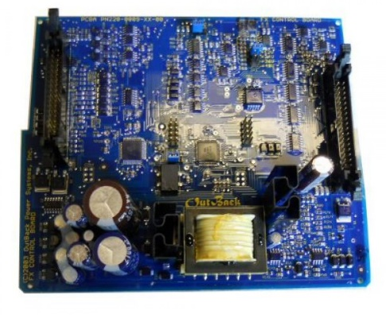
Ability to Service
Keeping Spares for Projects
Improved Service
Turn around of less than an Hour
Online video for board replacements

Slide 18
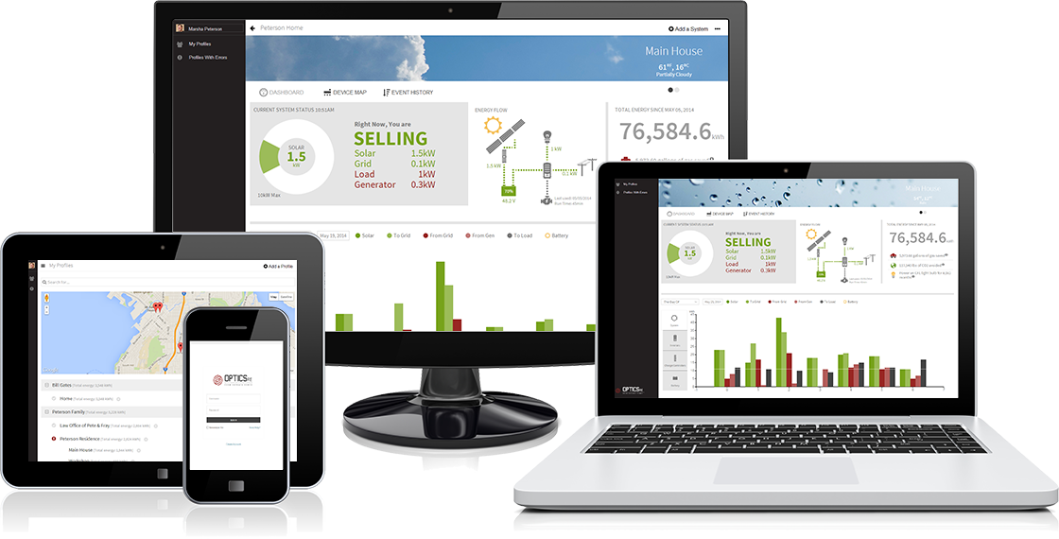
OutBack Product Overview
Optics

Slide 19
How to Manage the Business
500 Individual Site Project
Global Administrator
500 sites
Admin Access
Customer
500 site
View Only Access
Regional Admin
200 Sites
Admin Access
Regional Admin 2
100 Sites
Admin Access
Regional Admin 3
200 Sites
Admin Access
Battery provider
500 sites
View Only Access
Local Admin
75 Site
Admin access
Site Admin
3 Site
Limited Access
Local Customer
1 site
View Only access
Local Admin
75 Sites
Admin Access
Local Admin
75 Site
Admin Access
Local Admin
75 Site
Admin Access
Site Admin
7 Site
Limited Access
Each individual login can see as many or as few of the total systems for a project

Slide 20
9 Radian System
Examination of a quality install
What to look for:
  Proper Bussing
  Conductor lengths
  Circuit Protection
  Access to equipment

Slide 21
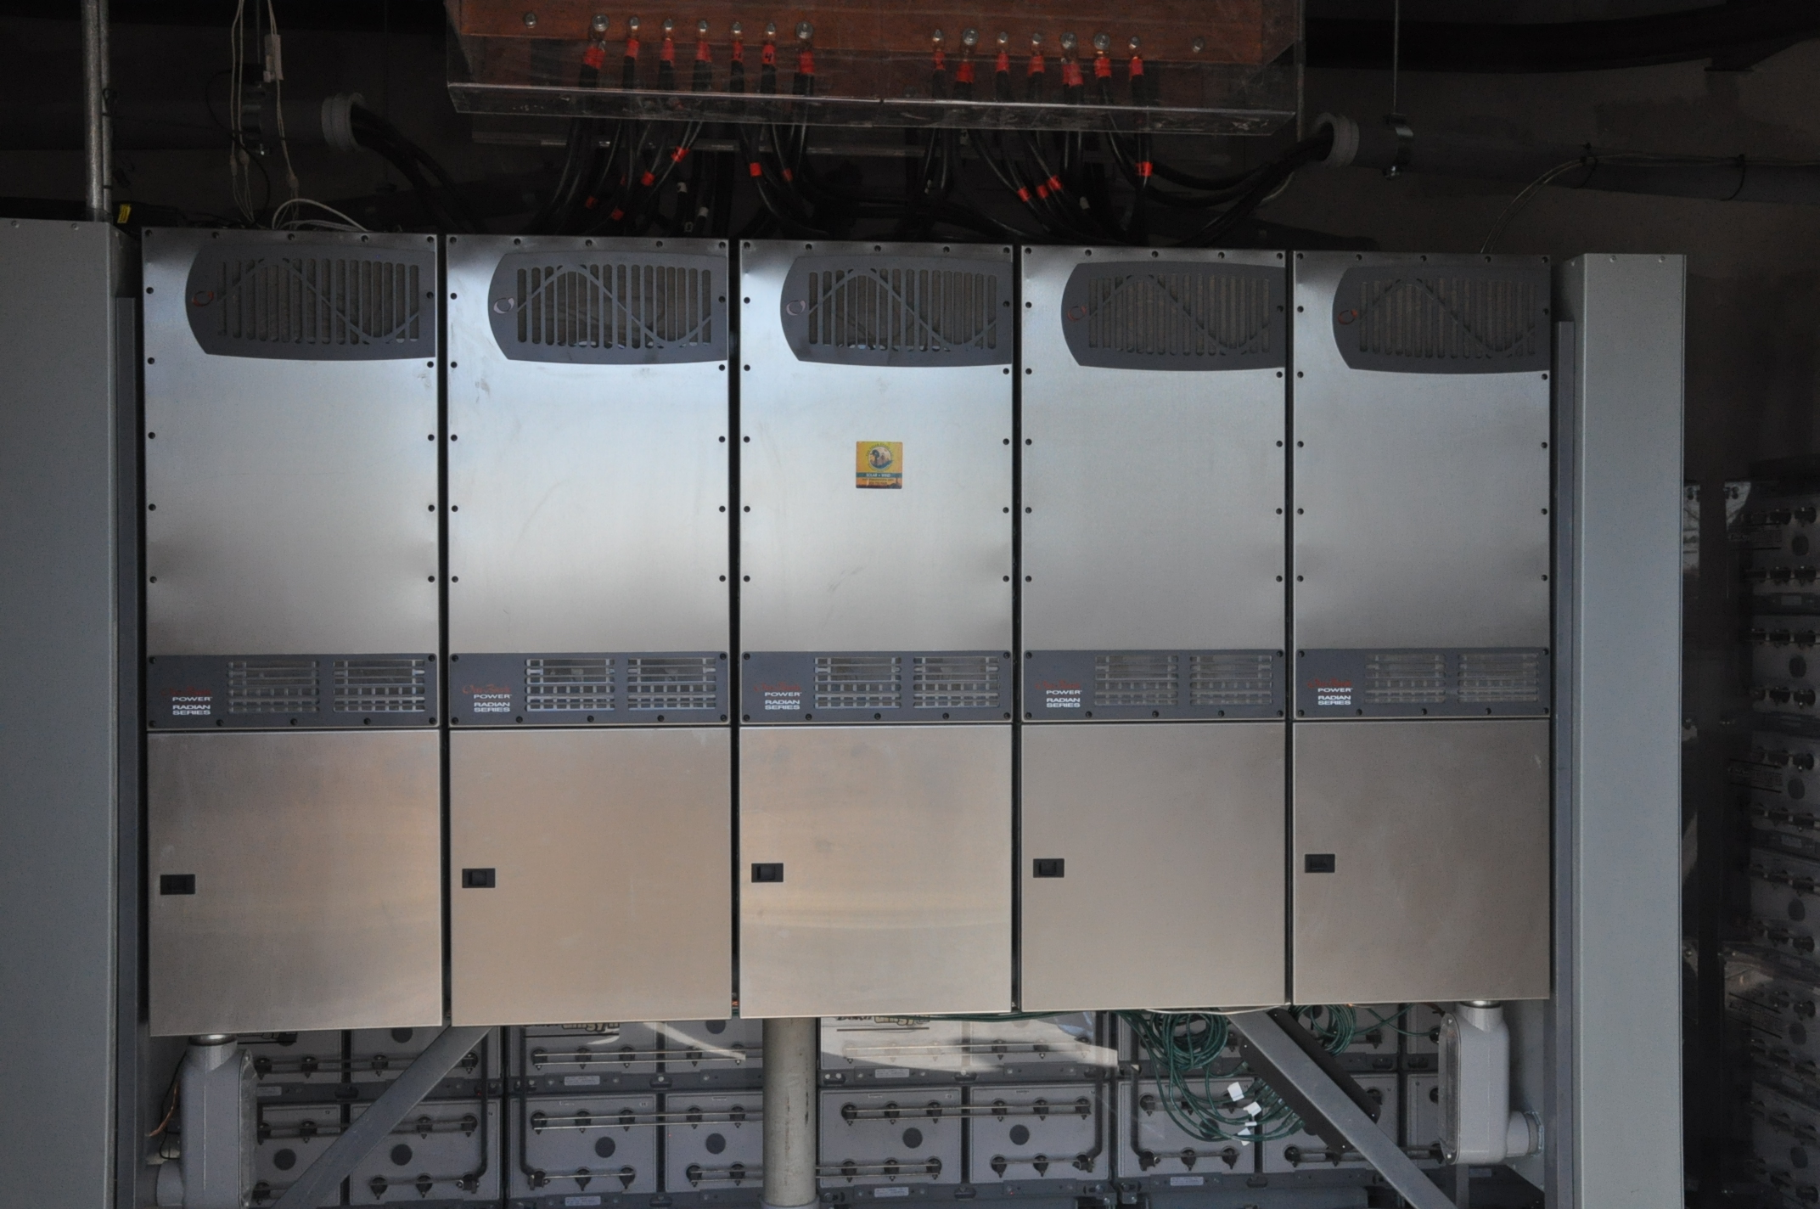
Notes:
Sleeping beauty site shows actual installation

Slide 22
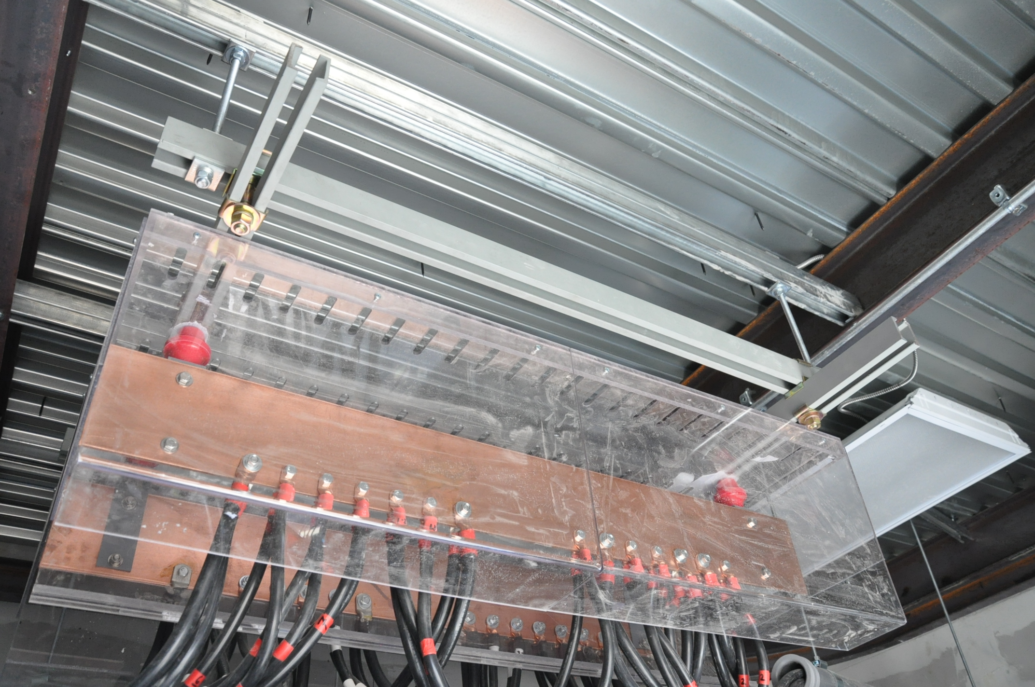
Notes:
Example of Buss bar positive and negative

Slide 23
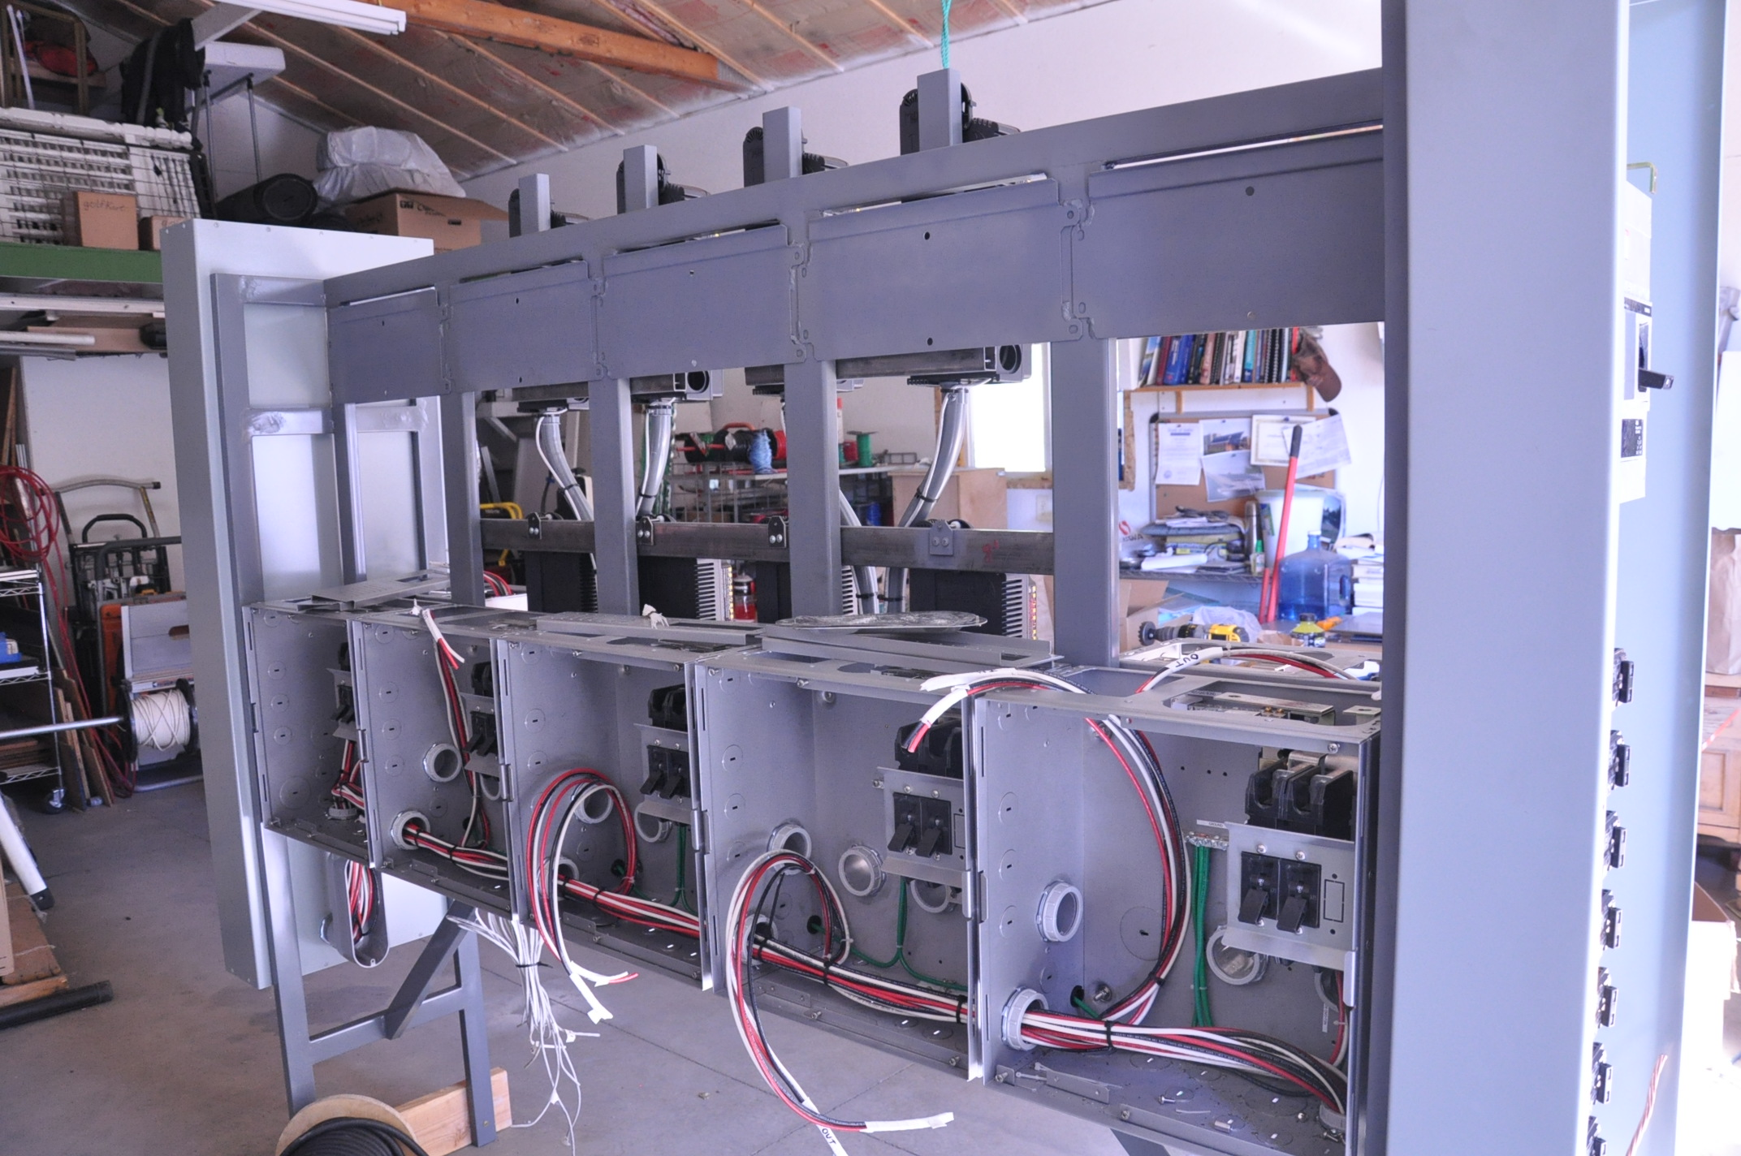
Notes:
This is the prior screen in a live situation

Slide 24
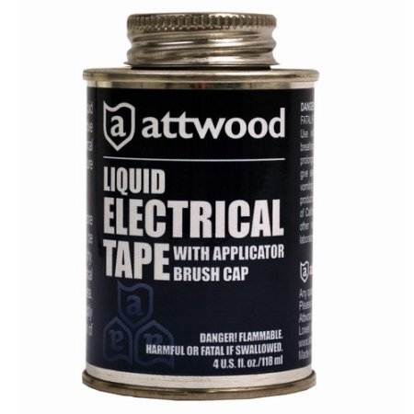
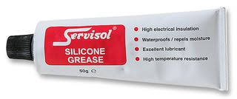
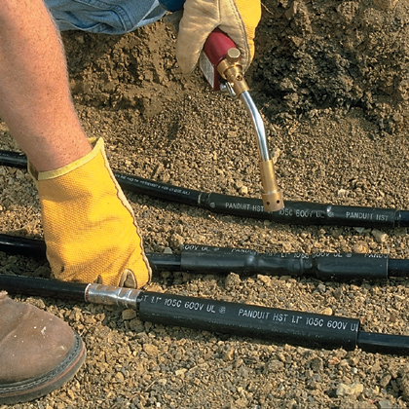
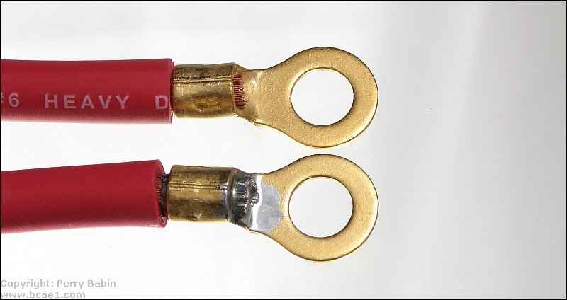
Four ways to protect your conductors
Liquid Electrical Tape
Silicone Grease
Heat Shrink
Solder
“Hey, where is the electrical tape?”
Tape is short term and does not protect against corrosion!
Notes:
It is very important to use these properly.
Any protecting means employed must protect the connections with out hindering current flow or connectivity.
In rework situations all protective coating must be removed and reapplied.

Slide 25
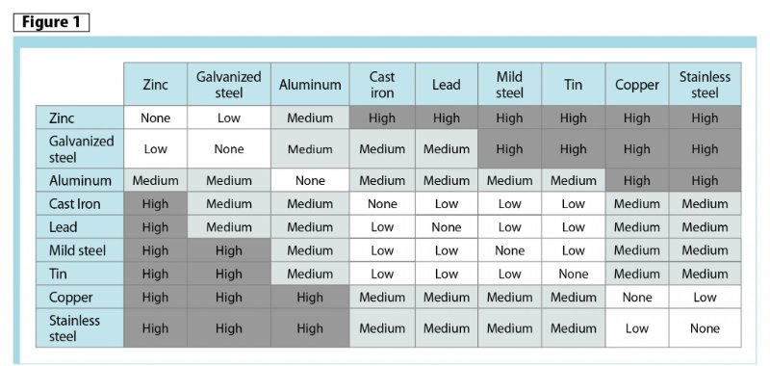
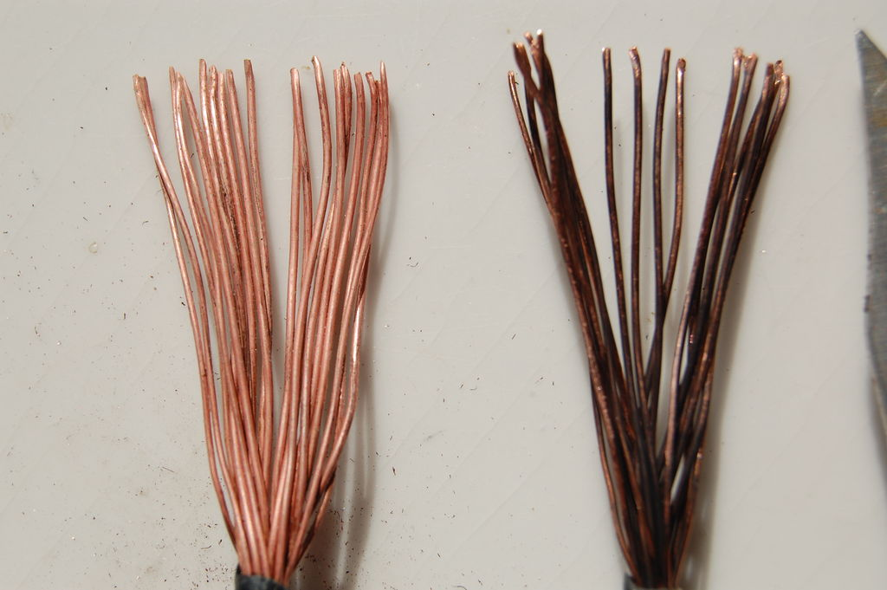
Using improperly matched conductors
Galvanic reactions will ‘consume’ your conductor
Notes:
Galvanic corrosion is a silent killer improperly matched metals will corrode.
This is true in high humidity situations coastal fog being even more problematic.

Slide 26
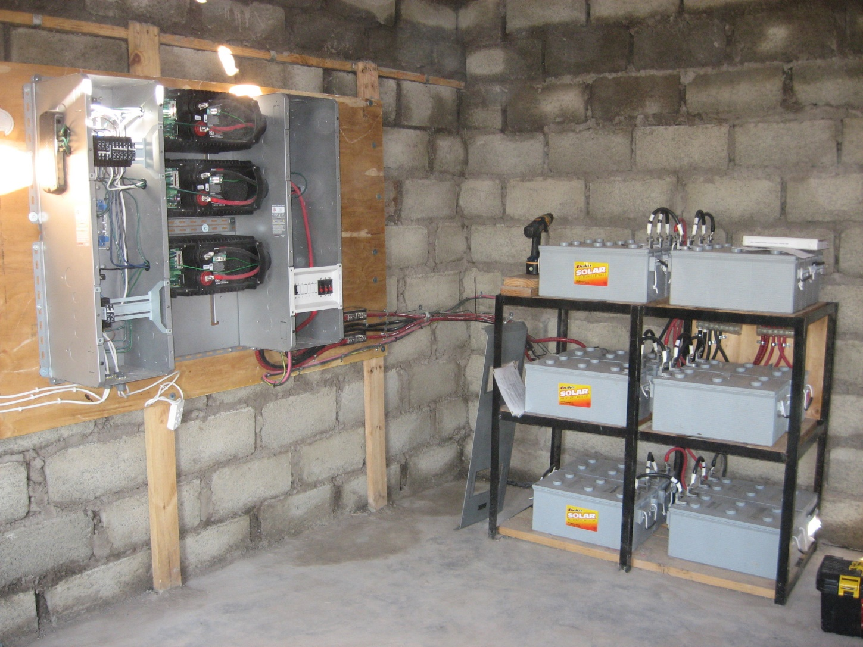
One of Five Systems installed in 2008 in N’Kau Lesotho Africa
Three 3.0 kW Inverter/Chargers - 9.0 kW Total 230/400 VAC Three Phase

Slide 27
Partnering with Outback for Grant Funding
Background and Primer
Copyright © 2018 Alpha Technologies Inc. All Rights Reserved.

Slide 28
The Purpose
Projects have high social impact!
Projects serve communities in need of energy development, and have target populations that will benefit economically or socially from our work!
Capture grant funding and other creative forms of finance to develop projects in off-grid settings
Project ideas are innovative and creative and serve a concrete goal in development for a known market – in other words, they solve a real problem!

Slide 29
What do we need from you?
We need the basic information that will be used to create our concept note. This should include:
  Demographic information of the community – in other words, what is the target population, what are conditions like presently, why is the project necessary?
  What are the predicted outcomes – in other words, what will happen and how will that population benefit from our intervention?
  Company and any partner information – who will perform each part of the work? What kind of company/how is the company structured? Who are the key team members and what are their backgrounds and skillsets? What are the relevant ID numbers (tax, registration, etc.)?
  How much money do we need to make this happen? Please include a basic budget that covers everything (all of the costs), including but not limited to:
    Equipment needed
    Training/installation/implementation costs
    Operations and maintenance
    Logistics and transportation

Slide 30
Who do I contact?
Nicholas Rogerson
International Development Consultant
(email) nrogerson@coppervale.org
(WhatsApp/m) +1 720 237 7945
(Skype) n_rogerson

Slide 31
Thank You!
John Webber
Arlington, WA USA
Jwebber@Alpha.com
Sales@OutBackpower.com

