Slide 1
US Africa Rural Electrification and Smart Metering Standards Workshop
Panel: Safety of Smart Meters and Related Technologies
Itron Distributed Intelligence
Rinaldo Cunha, Jan/2022

Slide 2



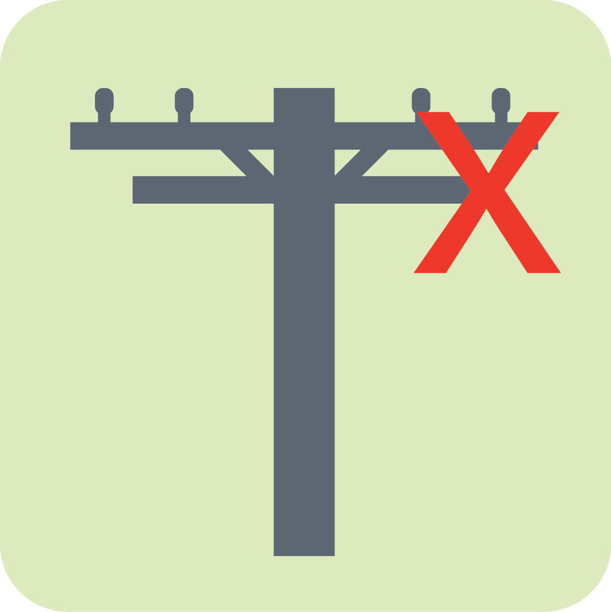
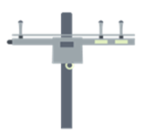





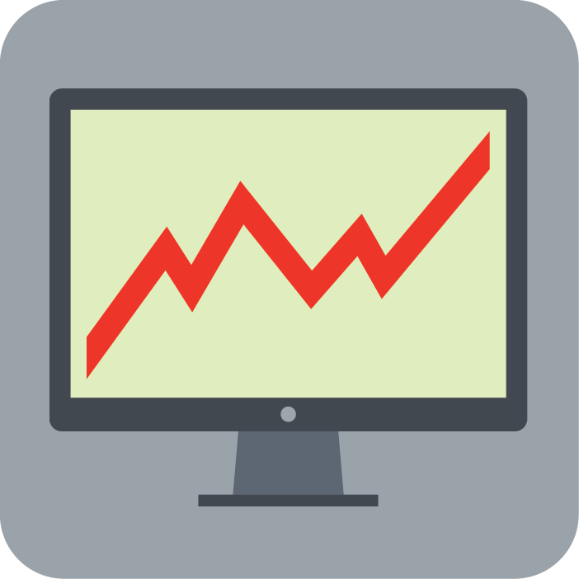






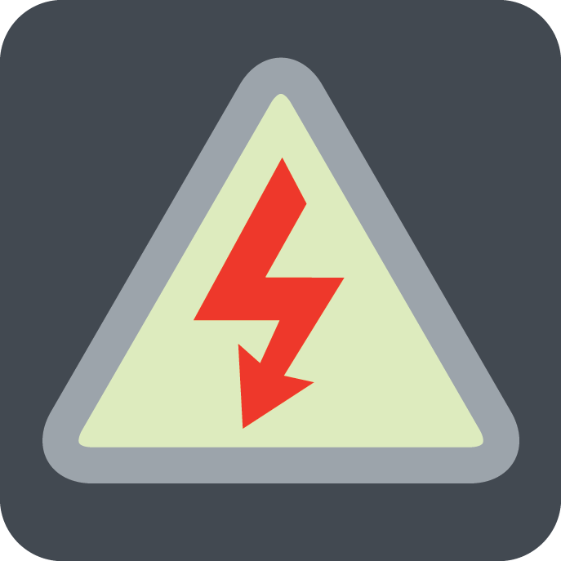
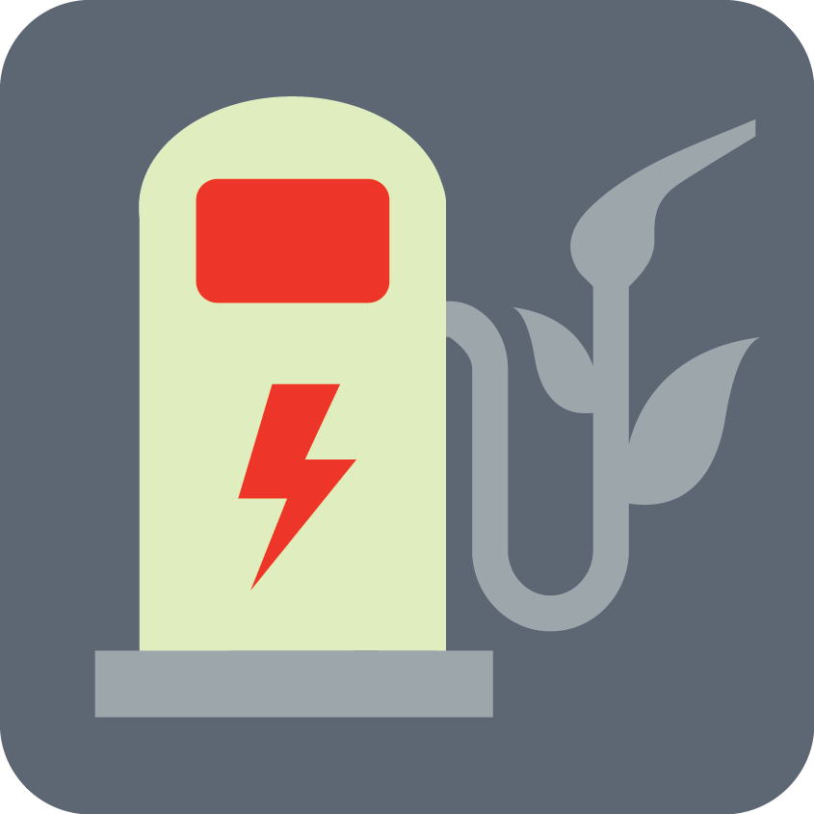
Distributed Intelligence Concept
The Intelligence in the Right Place
Distribution Management
System
Market Operator
Gateway
Real-time Control
DIVERSION DETECTION
TRANSFORMER LOAD MANAGEMENT
HIGH-IMPEDANCE DETECTION
OUTAGE
DEMAND RESPONSE
METROLOGY/ COMMUNICATIONS
IEEE
2030.5
RENEWABLES
CVR
EV CHARGER
ITRON METER:
A computer platform where smart metering is one application
WHAT IS THE REQUIRED BREADTH OF KNOWLEDGE?
WHAT IS THE REQUIRED DATA RESOLUTION?
WHAT RESPONSE TIME IS NEEDED?

Slide 3
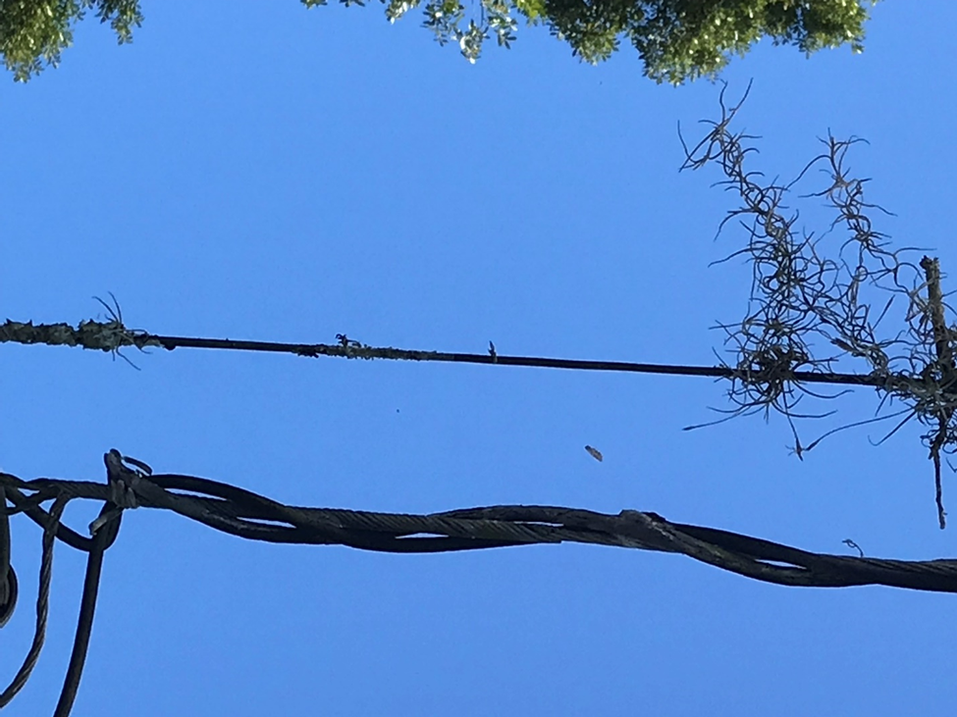
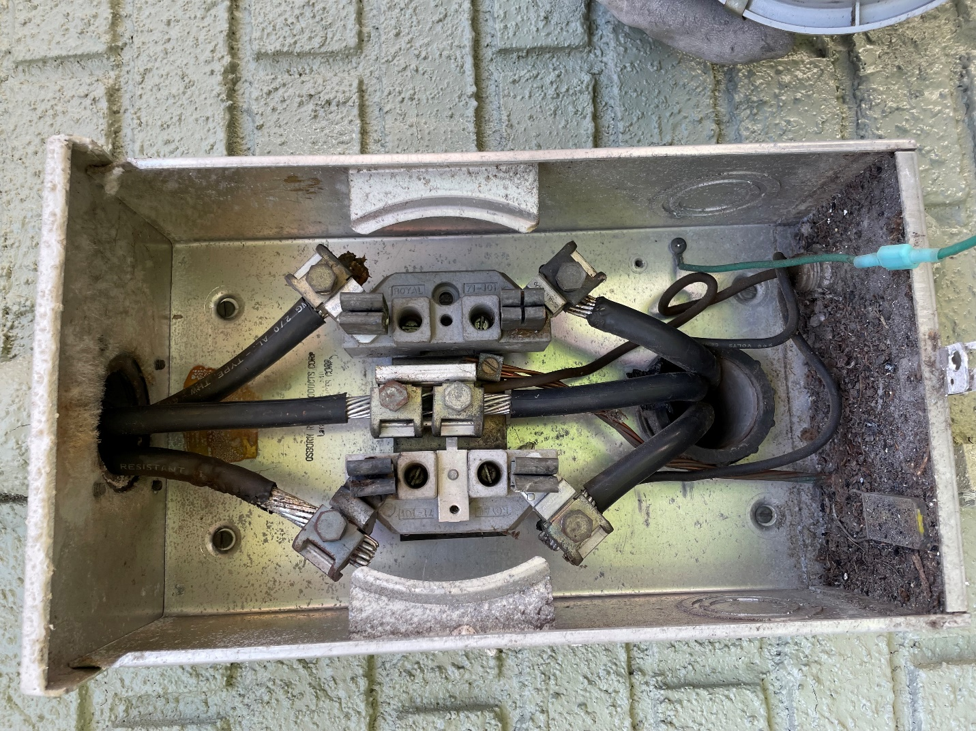
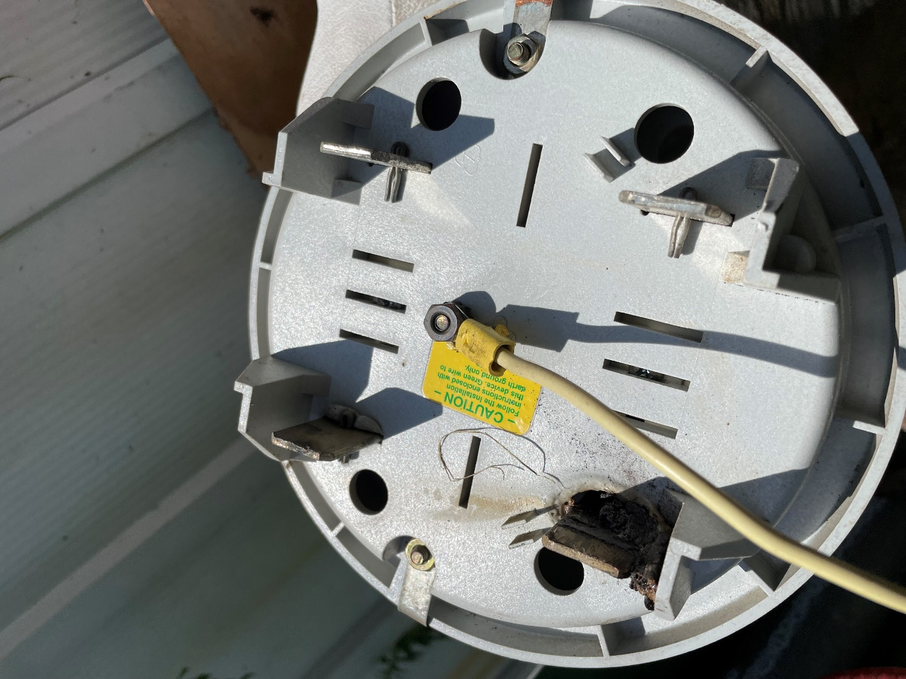
Smart Meters with Apps Used to Improve Grid Safety
  700k meters, 3 Apps → 2.1M apps
  Safety focused application running on smart meters
  Broken Neutral, High Impedance, Meter Bypass/Theft
  Now we are able to run applications on the meter that achieves new outcomes not previously achievable
Meter app predicted early failure on upper left leg
Note early signs of discoloration in upper left jaw and insulation melting on upper left conductor
Meter app predicted high impedance connectivity on all legs
Note insulation breakdown and signs of melting on service entrance conductors
In less damp climates, this would also be an active fire hazard.
Meter app predicted high impedance
Note signs of arcing and melting around jaw of collar-based surge protector
*TECO success criteria is 80% correctly identified
“Not confirmed” does not necessarily mean incorrect result. It means there was no visual evidence.

Slide 4
Panel Discussion…

