Slide 1
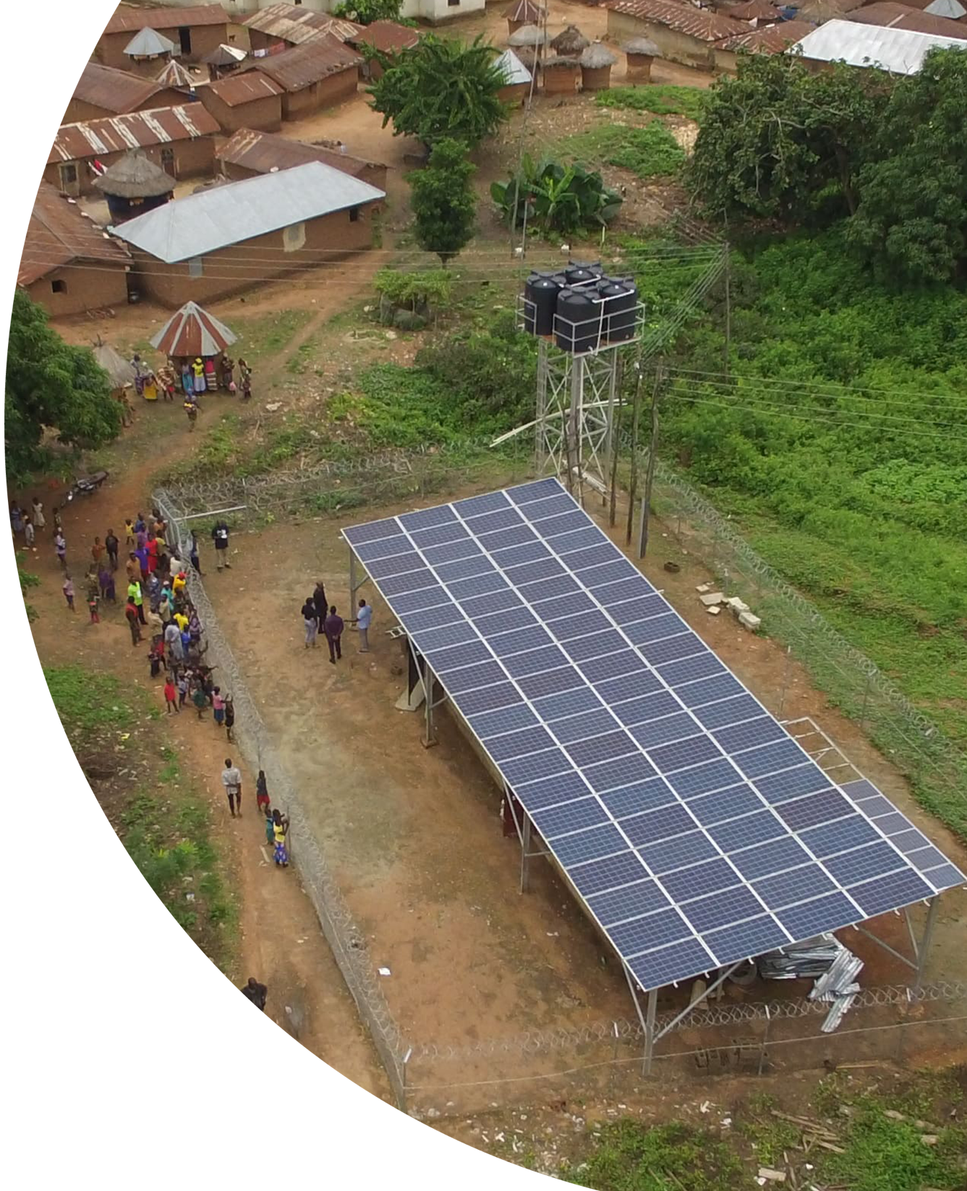
Finance, build & operate distributed infrastructure projects at scale
Notes:
First, a quick introduction:
I’m Emily McAteer, CEO and Co-founder of Odyssey. Just a quick background on me, I’ve been in Climate and Clean Tech my whole career. My journey toward Odyssey started when I was coming out of a joint policy and MBA at Harvard and Stanford in 2015, when I joined my to-be-co-founder Cathy Zoi at SunEdison to launch a new distributed energy subsidiary in India and Africa called SunEdison Frontier Power. Through this work in mini-grid development, Cathy and I realized how little technology had been built to enable development at the scale we were pursuing and so we started formulating the idea of a digital platform for project development, very much based on what we needed at the time to overcome frictions we were facing in financing, building and operating these projects.
And I am Piyush Mathur, Chief Business Officer of Odyssey. My background is mostly in M&A and Private Equity but since 2013, I have been in the Distributed Renewable Energy sector running a PAYG solar Home Systems business in India called Simpa Networks. I led Simpa as the CEO to national scale and we successfully exited to ENGIE in 2019. Working on the frontlines as a financing and distribution business, I was seeing the massive opportunity for DRE every single day but was also dealing with the frictions that existed in financing, procurement, logistics, field service. And we were not alone, these frictions were slowing down everyone in the sector. We may have been fortunate but the sector is stranded. So my excitement about Odyssey and the reason I am here is because I see Odyssey as that ecosystem enabler that can unshackle lots of Simpas and drive scale in the sector. To complete my introduction, I am a Chartered Accountant and MBA from London Business School.

Slide 2
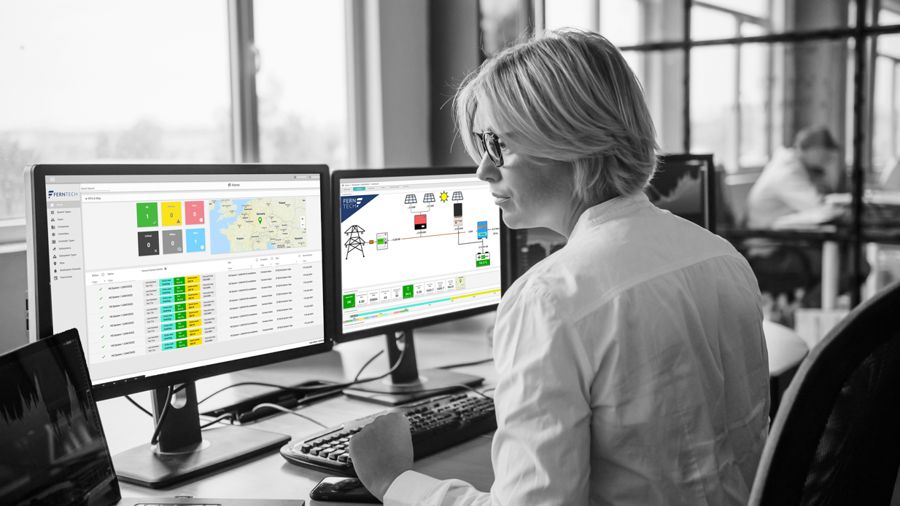
About Odyssey
Odyssey is the only end-to-end data and tech platform for investment and asset management of distributed infrastructure.
We provide the tools required to finance, build, and operate projects at scale.
Notes:
Great. Well we’ve kept our presentation pretty short as we’ve been forewarned that this is an inquisitive group, so I’ll dive in with just a handful of initial slides and then we can devote most of the time for questions. We’d also be happy to give a quick demo of our software if there’s interest.
To cut to the chase on who we are, Odyssey is the only end-to-end data and technology platform for deploying low-carbon, smaller-scale distributed infrastructure.
We’ve built the digital technologies and data tools that are critical to enable scale across the finance, build and operate phases of project development.
I’m guessing you already appreciate the size of the opportunity we are pursuing. Achieving global climate targets is going to require a sea change in global infrastructure particularly new infrastructure in emerging markets, most of which will be powered by distributed renewable energy sources, or DRE projects. Just the mini-grid and commercial/industrial DRE sectors are projected to attract $450B in investment in the next 8 years if we are to meet climate goals.

Slide 3
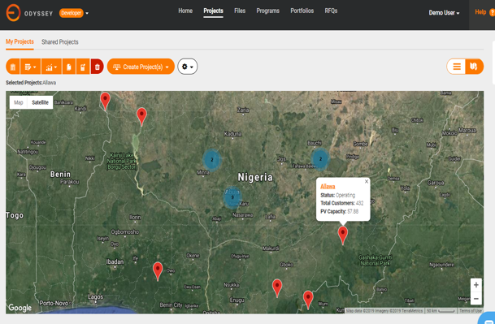
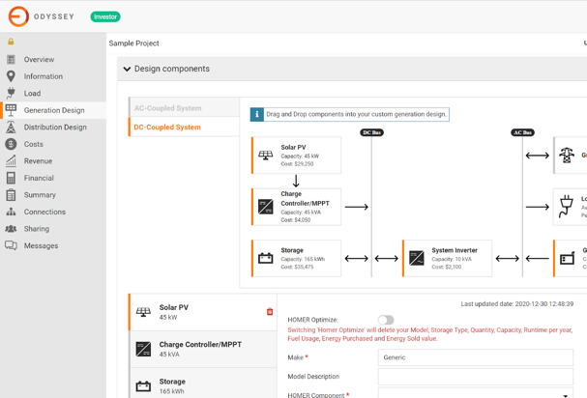
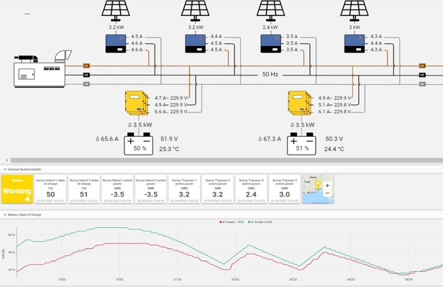
What We Do
We provide data and technology across the entire lifecycle of project development
Feedback Loop
Finance
Build
Operate
Finance Transaction Platform
Aggregated Procurement
Remote Monitoring & Control
Notes:
EM:
Our singular mission at Odyssey is to attract capital to the distributed clean energy sector and to, in turn, scale project deployment. The way that we are doing this is by offering digital products that solve challenges at each key stage.
First, we have a finance transaction platform that is supporting more than $1B of financing for the sector through advanced data and workflow tools for investment diligence and transactions. Putting large amounts of money into portfolios of many distributed projects requires a streamlined and standardized set of investment processes and data, which our platform facilitates.
The second thing that will attract capital into the sector is projects with strong unit economics. We’ve seen that when building projects, developers in the sector are paying 30-50% more for equipment than utility-scale players. Toward this end, we have an aggregated procurement platform that pools equipment orders to drive down costs of procuring equipment and to streamline logistics.
And finally, project developers must have the institutional capacity to operate fleets at scale. We have a remote monitoring and control platform, which includes both a hardware and software product suite, to optimize operations and maintenance of projects, as well as run critical analytics on operating data for investment monitoring and future planning.
Each of the products in this suite interact with one another to drive a coherent, integrated approach to project development that significantly increases the success of the project.

Slide 4
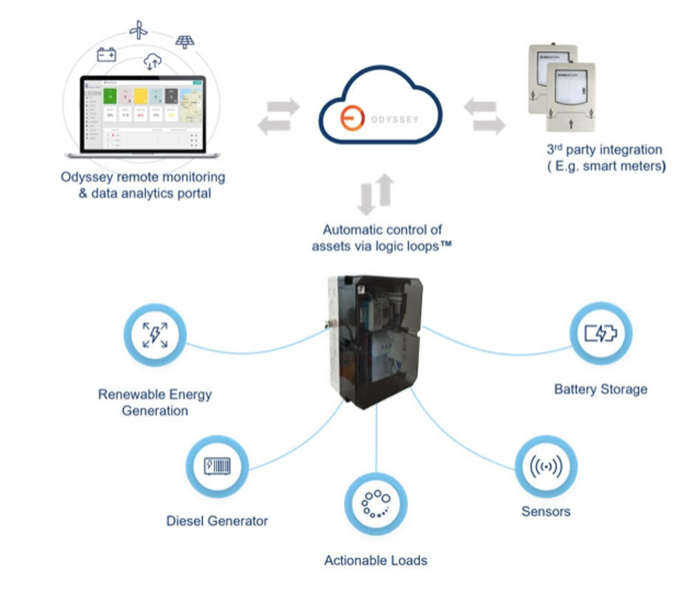
Metering Data & Odyssey
Odyssey offers a unique platform which integrates with smart metering technology to facilitate financing activities
For stakeholders who need sophisticated tools for remotely monitoring and/or managing assets, Odyssey offers monitoring analytics + remote management/control portals to collect, analyze, and act on granular system data.
Odyssey integrates with smart meter platforms to ingest, process and analyze granular customer data

Slide 5
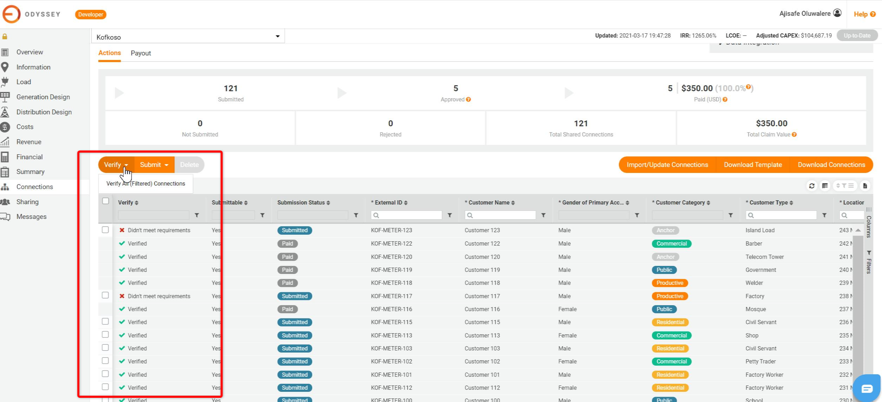
Meter Data for Remote Verification
Smart meters enable remote verifications for streamlined RBFs

Slide 6
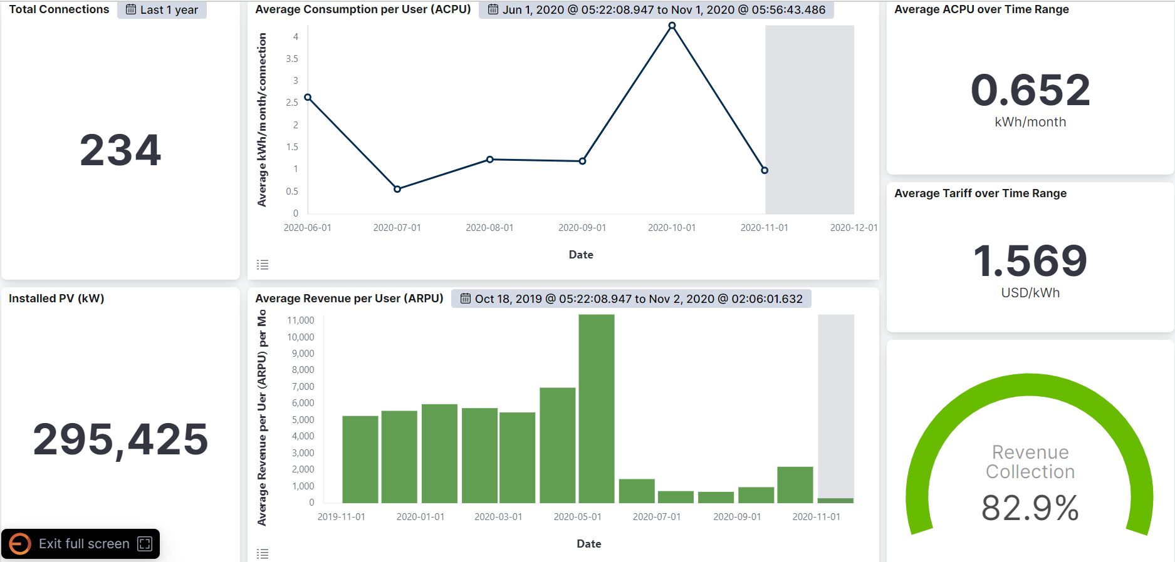
Meter Data for Investment Management:
Odyssey processes high-volume meter data for real-time investment monitoring

Slide 7
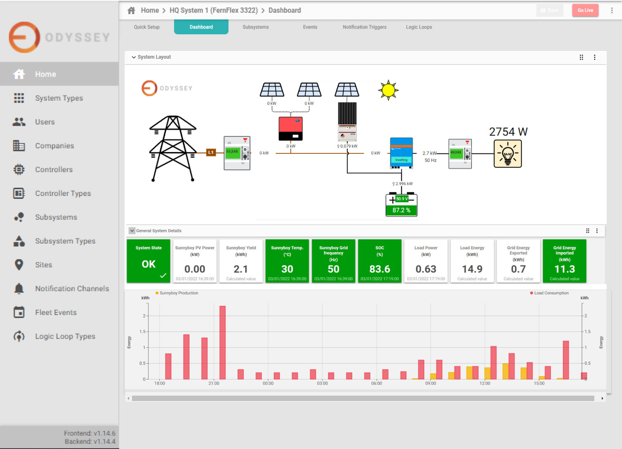
Meter integrations for demand management
By integrating smart meters into the FernView platform, Odyssey enables intelligent load management

Slide 8
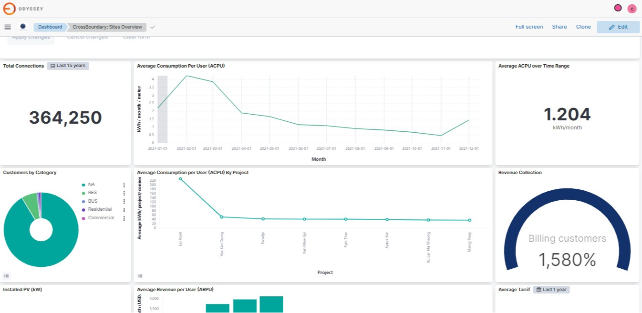
Industry analytics
Odyssey provides real-time data for developers to track project progress on several parameters

Slide 9
United States | Europe | Africa | Asia
www.odysseyenergysolutions.com
Emily McAteer, CEO
emily@odysseyenergysolutions.com

