Slide 1
IEEE Standards Development and Conformance Assessment
January 19, 2022
Mark Siira – IEEE
IEEE Standards Coordinating Committee 21 Chair
Wayne Stec –Distregen
IEEE Standards Coordinating Committee 21 Vice-Chair

Slide 2
Presentation Outline
Introductory Slides
  Why Standards are Important
  Comparison of IEEE Standards to IEC and European Standards
The Core Standards
  IEEE 1547 - 2018: IEEE Standard for Interconnection and Interoperability of Distributed Energy Resources with Associated Electric Power Systems Interfaces
IEEE Conformity Assessment
  Review of IEEE Programs
Notes:
Bolded clauses will be covered in this class

Slide 3
Why Standards Are Important
Standards provide a consensus view of requirements or guidelines based on an industry technical area or need.
Standards establish common terminology and frameworks that ensure clarity in specifications and requirements
Standards lead to modularity.
Standards develop the framework from which design rules emerge
System designs become more robust over time through iteration and improvement of designs
References:
IEEE Std 610.12-1990 IEEE Standard Glossary of Software Engineering Terminology
Managing in an Age of Modularity - Harvard Business Review; Carliss Y. Baldwin and Kim B. Clark
“Make Megaprojects More Modular- Repeatable design and quick iterations can reduce costs and risks and get to revenues faster”. - Harvard Business Review; Bent Flyvbjerg; November, 2021

Slide 4
Standards, Codes, Rules and Requirements
National Standards & Codes
State Rules
Utility Guides
Bulk Power System Settings
Many States Have Moved Forward
Detail at: http://sites.ieee.org/sagroups-scc21/standards/
IEEE 1547-2018
Most states will need to update their interconnection rules, guides, settings, etc., and harmonize with the bulk power system

Slide 5
Comparison of IEEE to IEC Standards
EU Interconnection Standards – Analogous to IEEE 1547
  EN- 50549-1: Requirements for generating plants to be connected in parallel with distribution networks - Connection to a LV distribution network. Generating plants up to and including Type B
  EN-50549-2: Requirements for ..MV distribution network - Generating plants up to and including Type B
Most Standards for Interconnection Have Requirements for:
  Voltage Regulation
  Voltage and Frequency Ride-Through during abnormal conditions
  Power Quality
  Islanding Protection
  Reference Point is PCC
IEEE 1547 has extensive discussion of Interoperability Requirements, and Verification and Testing Requirements
  IEEE 1547 uses PCC and Point of Connection due to Inverter Grounding
References:
Microgrid and Distributed Energy Resources Standards and Guidelines Review: Grid Connection and Operation Technical Requirements; David Rebollal et.al.; Department of Electrical Engineering, University Carlos III of Madrid

Slide 6
Collaboration in “Smart Energy” Standards
IEEE SCC21 is collaborating with IEC SyC Smart Energy Committee –
  IEEE P2030 Guide for Smart Grid Interoperability
  IEEE P2030.4 – Guide for Automated Systems Interoperability
  IEEE 1547.3 – Guide for Cyber Security
IEC Documents:
  IEC SRD 63200:2021 Definition of extended SGAM smart energy grid reference architecture model
  IEC SRD 62913-1 ED2: Generic smart grid requirements - Part 1: Specific application of the Use Case methodology for defining generic smart grid requirements according to the IEC systems approach.
  PWI TR SyC Smart Energy-1: Cyber Security and Resilience Guidelines for Cyber-Physical Power Systems ( Current review by IEC of the IEEE 1547.3 document)
IEEE SA has an MOU with AFSEC and are supporting standards cooperation and capacity building
  sharing relevant standards for their technical committees' review

Slide 7
The Core Standard - Interconnection
IEEE 1547 - 2018

Slide 8
IEEE 1547 evolution of grid support functions
IEEE 1547-2003
Shall NOT actively regulate voltage
Shall trip on abnormal voltage/frequency
IEEE 1547-2018
Shall be capable of actively regulating voltage
Shall ride through abnormal voltage/frequency
Shall be capable of frequency response
Notes:
¹Frequency response is capability to modulate power output as a function of frequency
²Mandatory capability for Categories II and III under high frequency conditions, Mandatory for Categories II and III under low frequency conditions, optional for Category 1
³Inertial response is capability for DER to modulate active power in proportion to the rate of change of frequency

Slide 9
IEEE 1547 Scope
IEEE P1547
Focused on distribution and bulk system
Specifications encompass the whole DER
Equipment listing as well as plant-level verification.
Includes both electrical as well as interoperability/communications requirements.
Communication
Interface
DER
Area EPS
Power Interface
Scope of IEEE 1547-2018

Slide 10
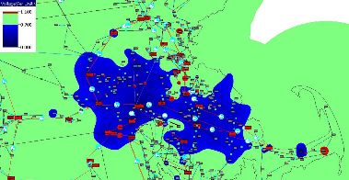
Driver for new Requirements IEEE 1547
Voltage profile for 345 kV fault in East Mass.
IEEE 1547-2018 mandates BOTH:
Tripping requirements, and
Ride-through requirements
Ride-through is not a “setting”,
it is a capability of the DER
i.e., it is the DER’s robustness
Tripping points are adjustable
over an allowable range
Range does not allow DER tripping to seriously compromise BPS security
Tripping points specified by the Area EPS Operator (utility) within constraints of the regional reliability coordinator
Source: ISO-New England

Slide 11

Categories of grid support – voltage regulation capabilities
Category A
Meets minimum performance capabilities needed for Area EPS voltage regulation
Reasonably attainable by all state-of-the-art DER technologies
Reactive power capability: 0.25 p.u. lagging, 0.44 p.u. leading
Meets all requirements in Category A plus…
Supplemental capabilities for high DER penetration, where the DER power output is subject to frequent large variations.
Attainable by most smart inverters
Reactive power capability: 0.25 p.u. lagging, 0.44 p.u. leading
Category B
Category assignment specified by Area EPS Operator

Slide 12
Active voltage regulation capability requirements
DER must possess capability – implementation is at the discretion of area EPS Operator (mode and parameters)
Capability required of all DER – (Cat A, B)
Constant power factor mode
Constant reactive power mode (“reactive power priority”)
Voltage-reactive power mode (“volt-var”)
“State-of the art” DER – Cat B
Active power-reactive power mode (“watt-var”)
Voltage-active power mode (“volt-watt”)
.

Slide 13
Voltage-Reactive Power mode

Slide 14
Performance Categories –
Abnormal Operating Conditions
Ride Through Capabilities
Category
I
Essential bulk power system needs
Attainable by all state-of-the-art DER technologies.
Category
II
Full coordination with all bulk system power system stability/ reliability needs
Coordinated with existing reliability standards to avoid tripping for a wider range of disturbances ( more robust than Category I)
Category
III
Designed for all bulk system needs and distribution system reliability/power quality needs
Coordinated with existing requirements for very high DER levels
Notes:
Category I
Foundation/Harmonization: German grid code for medium-voltage-connected synchronous generator-based DERs
Category II
Foundation/Harmonization: North American Electric Reliability Corporation (NERC) PRC-024-2, adjusted for distribution voltage differences (delayed voltage recovery), extended low-voltage ride-through duration for 65%–88% Vnom | & Based on EPRI white paper (May 2015).
*Application note: may want to consider Category II as preferred option
Category III
Foundation/Harmonization: California Rule 21 and Hawaii, minor modifications

Slide 15
Categories of abnormal performance requirements
Category | Objective | Foundation
I | Essential bulk system needs and reasonably achievable by all current state-of-art DER technologies | German grid code for synchronous generator DER
II | Full coordination with bulk power system needs | Based on NERC PRC-024, adjusted for distribution voltage differences (delayed voltage recovery)
III | Ride-through designed for distribution support as well as bulk system | Based on California Rule 21 and Hawaii Rule 14H
Category II and III are sufficient for bulk system reliability.

Slide 16
Specific performance terminology
Trip – cessation of output without immediate return to service; not necessarily disconnection
Cease to energize – no active power delivery, limitations to reactive power exchange; Does not necessarily mean physical disconnection. Can be either a momentary cessation or a trip
Permissive operation – DER may either continue operation or may cease to energize, at its discretion
Mandatory operation – required active and reactive current exchange
Momentary cessation – cessation of energization for the duration of a disturbance with rapid recovery when voltage or frequency return to defined range
Return to service – re-entry of DER to service following a trip
Restore output – DER recovery to normal output following a disturbance that does not cause a trip.
Red Text Indicates New Terms for IEEE 1547-2018

Slide 17
Structure of voltage ride-through and tripping
– Categories I and II
Category I
Category II
Shall Trip
Shall Trip
1.0 p.u.
Permissive
1.0 p.u.
Permissive
Voltage
Continuous Operation
Voltage
Continuous Operation
Mandatory Operation
Mandatory Operation
Permissive Operation
Permissive Operation
Shall Trip
Shall Trip
Time
Time
Dashed lines indicate permissible range of trip adjustment

Slide 18
Structure of voltage ride-through and tripping
– Category III
Category III introduces
momentary cessation requirement
Requires a relatively long zero voltage ride-through requirement
(in momentary cessation mode)
If feeder is faulted then tripped, DER in momentary cessation mode will not energize the islanded feeder
  Voltage will remain zero and DER will eventually trip off
Category III
Shall Trip
1.0 p.u.
Momentary Cessation
Voltage
Continuous Operation
Mandatory Operation
Momentary Cessation
Shall Trip
Time

Slide 19
DER islands in 1547-2018
Island: Condition in which a portion of an Area EPS is energized solely by one or more DER – i.e., utility source is disconnected
Unintentional island: one that is not planned
  DER must detect, trip, and clear within 2 seconds –same as IEEE 1547-2003
  Area EPS Operator (utility) can extend this to 5 seconds
  Ride through requirements do not nullify this requirement
  False detection of an island does not justify non-compliance with ride-through
Intentional island: one that is planned such that DER can carry a specific load (e.g., microgrid, emergency/standby power supply)
  1547-2018 now addresses intentional islands
  For Local EPS Islands (facility islands), standard only covers conditions of connection and disconnection
  For Area EPS Islands (includes utility system assets), connection, disconnection, and changes to DER settings required during islanding condition

Slide 20
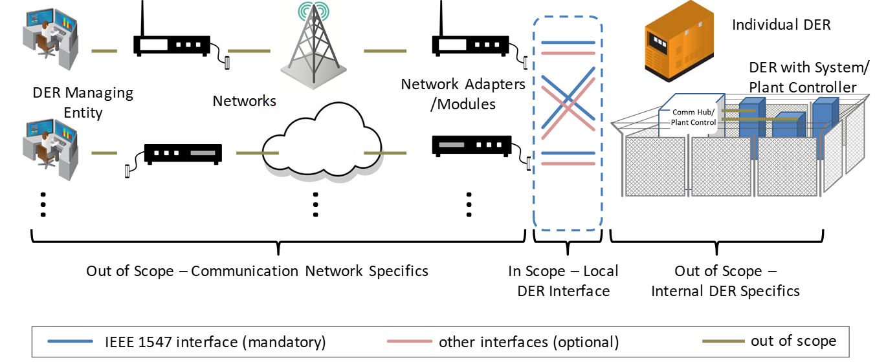
Interoperability Requirements of IEEE 1547
IEEE 1547-2018 defines communication interface

Slide 21
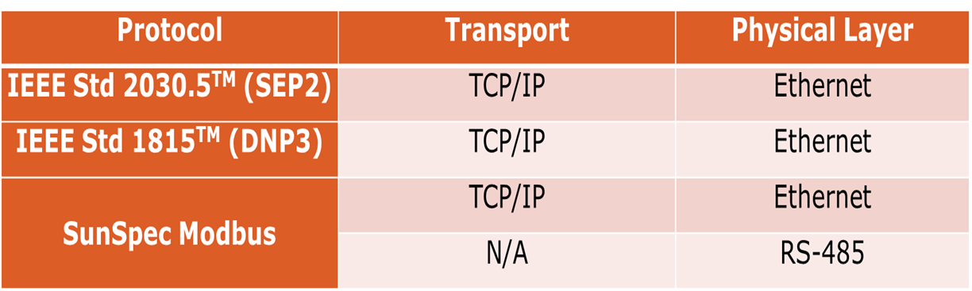
Categories of information to be exchanged
Nameplate Data – As-built characteristics of the DER, e.g.:
  Manufacturer/model
  Active and reactive power rating, etc.
Configuration Information – alternative nameplate ratings
Monitoring Information –Measured values of:
  Active and reactive power
  Voltage, etc.
Management information
  Update functional and mode settings
List of eligible protocols

Slide 22
High-Level Test and Verification Process
Maintenance
Periodic
In-service confirmation on recurring schedule
Commissioning Tests
Confirm DER functionality and interoperability on site
Post-installation
review
As-Built Installation Evaluation
Confirm DER is installed as designed
Interconnection review
Design Evaluation
Desk study prior to installation
Production Tests
Equipment conformance
testing
Test of every unit, usually in factory
Type Tests
Test in laboratory or factory of a representative DER unit

Slide 23
Standards Under development:
Interconnection
Interoperability
Microgrid

Slide 24
Standards Under Development
Interconnection
  IEEE P1547.2 - Application Guide for IEEE Std 1547(TM), IEEE Standard for Interconnecting Distributed Resources with Electric Power Systems
    Guidance for application of IEEE 1547-2018 for all DER technologies. Covers details for a wide variety of applications and technologies.
  IEEE P1547.9 - Guide to Using IEEE Std 1547(TM) for Interconnection of Energy Storage Distributed Energy Resources with Electric Power Systems
    Guidance for application of IEEE 1547-2018 for battery and other storage technologies.
  IEEE P1547.3 - Guide for Cybersecurity of Distributed Energy Resources Interconnected with Electric Power Systems
    Guidance for cybersecurity of DER and associated communications systems.
  IEEE P2800—IEEE Interconnection Standard for Large-Scale Solar, Wind, and Energy Storage Plants (Inverter Based Resources)
    Harmonizes Interconnection Requirements for Large Plants connected at High Voltage
    Performance and functional settings, Reference Point of Measurement
    EEE P2800.1&2 type of tests, plant-level evaluations, and other verifications means

Slide 25
Standards Under Development
Interoperability
  IEEE P2030 – Revision of IEEE 2030-2011
  IEEE P2030.4; Guide for Control and Automation Installations Applied to the Electric Power Infrastructure
  IEEE 2030.2-2015 Guide for the Interoperability of Energy Storage Systems
  IEEE P2030.11 Guide for DERMS (Aggregation of DER)
Microgrid
  IEEE 2030.7-2017; Standard for the Specification of Microgrid Controllers
  IEEE 2030.8-2018; Standard for the Testing of Microgrid Controllers
  IEEE 2030.9-2019 Recommended Practice for the Planning and Design of the Microgrid
  IEEE P2030.10 IEEE standard for DC Microgrids

Slide 26
Standards Under Development
IEEE 2030.5 – Smart Grid User Interface
  Designed using widely-adopted technologies for communication between utilities and outside entities (consumers)
  the integration of consumer devices into the smart grid
  Secure
  Serves two general purposes:
    Inform the consumer (e.g., energy usage, pricing)
    Request actions to assist the grid (e.g., thermostat changes, PV inverter controls, electric vehicle charging)
  Focus on communications related to efficiency, usage, price, demand response and load control, and service provider messages
  An IoT “profile”
  Optimized for embedded and battery-powered devices
  Information model aligned with SunSpec, IEEE 1547, and IEC 61850

Slide 27
Conformity assessment & IEEE 1547TM Education & Credentialing Program
IEEE Conformity Assessment Program (ICAP)

Slide 28
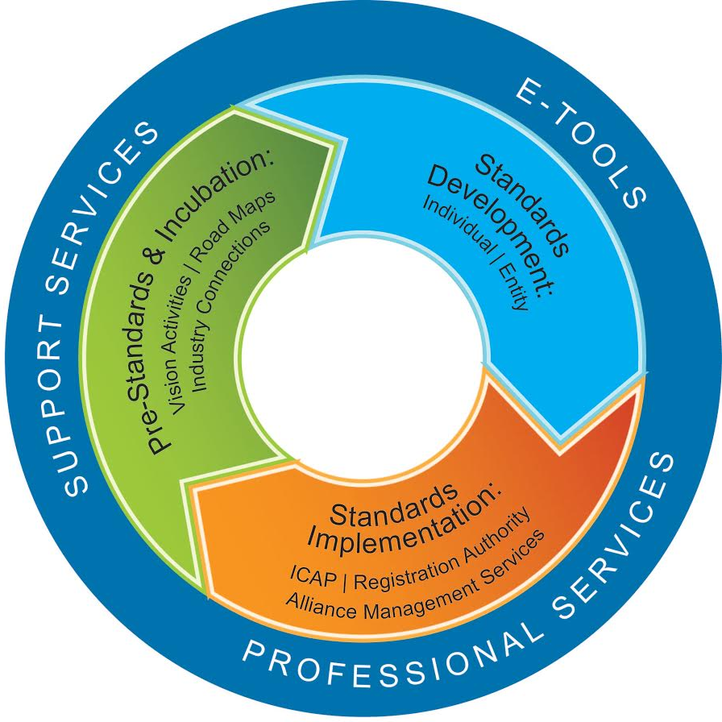
IEEE Standards Development Lifecycle
Activities and Keywords
Certifications
Lab Accreditations
Personnel Training and Accreditation
Plugfests
Testing
Interoperability
Conformity Assessment
IEC/ISO 17025
IEC/ISO 17065
Certification Mark
Product Registry

Slide 29
Understanding Conformity Assessment
What is Conformity Assessment?
    Conformity Assessment is the process or processes that are used to demonstrate that a product or service meets specified requirements (set forth in Standards, Test Plans, etc.)
Conformity Assessment Benefits
    Provides manufacturers a proven method of demonstrating compliance to the requirements
    Empowers the end-user to make better purchasing decisions
    Benefits the supplier as products can quickly gain market acceptance
    Increases the likelihood of a stable technology in the market with robust products
Conformity Assessment Activities Include:
  Conformance, Commissioning, Interoperability, Inspection, Accreditation
  Test Suite Specification development
  “Catch-all” term to address range of test-related activities

Slide 30
Types of Conformity Assessment
1st Party / Suppliers Declaration of Conformity (SDOC)
  Self Declaration ; Companies conduct their own testing
2nd Party Conformity Assessment
  Conformity assessment conducted by the end purchaser of products (e.g., Service Providers) to ensure purchased products are deemed compliant or interoperable
3rd Party Conformity Assessment
  Conformity assessment being determined by an independent body.
Related International Standards
Accreditation Bodies – ISO/IEC 17011
Certification Bodies - ISO/IEC 17065
Test Labs – ISO/IEC 17025

Slide 31
ICAP Energy Portfolio
Phasor Measurement Unit (PMU) – IEC/IEEE 60255-118-1
IEEE Nuclear Equipment Standards – IEC/IEEE P60780 – 323
Precision Time Protocol (PTP) Power Profile – IEEE C37.238 & IEC/IEEE 61850-9-3
Blockchain
Drone Payload
Cybersecurity
Distributed Energy Interconnects – IEEE 1547/1547.1
EV Ultra Rapid Charging – IEEE 2030.1.1 & 2030.1.2
Smart Energy Profile (SEP) 2.0 – IEEE 2030.5
Sensors

Slide 33
1547 CA Program Specific Activities
Summary White Paper of the IEEE 1547 Conformity Assessment Program https://ieeexplore.ieee.org/document/8305686
Commissioning Procedure outline White Paper for the assessment of DER Interconnections installed in the field https://ieeexplore.ieee.org/document/8786948
IEEE 1547 Workshops Targeted toward Regulators and DER Stakeholders
  FERC in Washington, D.C. – July 2017
  Minnesota Public Utilities Commission and the Organization of MISO – March 2018
  NERC in Atlanta, GA – Sept, 2018
  Office of Energy Policy in Frankfort, KY – April, 2019
  Ghana Energy Commission and Electricity Company of Ghana in Tema, Ghana – Nov. 2019
Pilot Commissioning Demonstrations of CA Program
  Completed 4 pilot demonstrations through North America
  Additional pilot currently be executed in Winneba, Ghana
  Pilots help assist the development of the CA Program
  Benefit partner Utilities and Developers in understanding their local jurisdictions requirements and needs
  Future pilot to take place in 2022

Slide 34
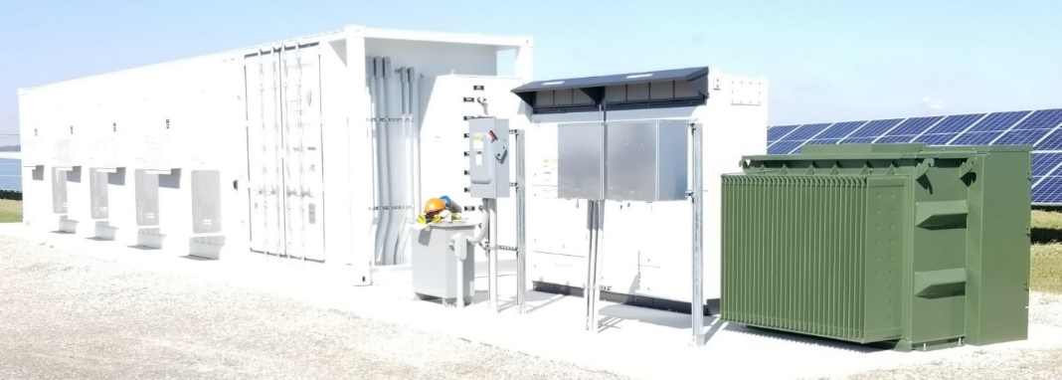
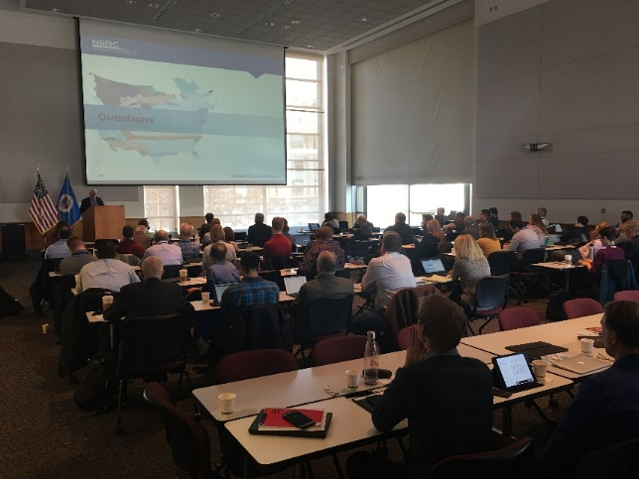
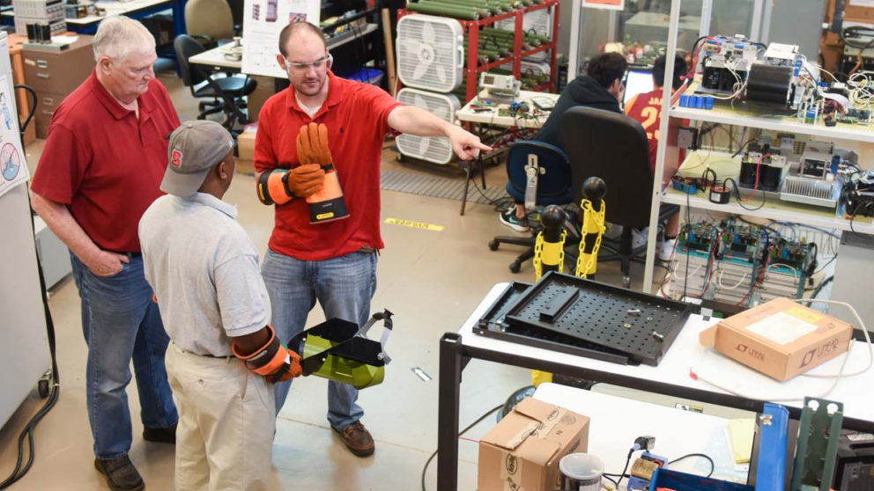
IEEE 1547 Conformity Assessment Program
  Program Objective: Develop a Site Certification [process] with respect to DER Interconnection that Emphasizes All Essential Aspects of IEEE 1547/1547.1 over the life of the Interconnection.

Slide 35

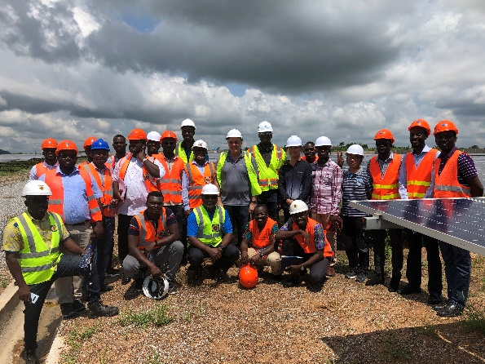
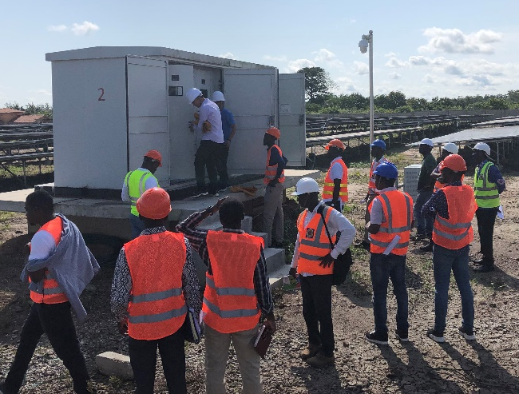
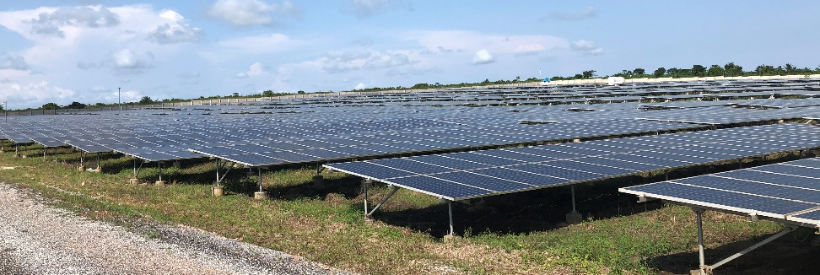


Ghana Pilot - 20 MW Solar Installation
Utility scale 20 MW Solar PV Installation with approx. 400 string inverters
Commissioning of the interconnection for its compliance with IEEE 1547 in accordance with the approved Ghana Interconnection Agreement
On-site evaluation showed that IEEE 1547 test requirements met at inverters as well as facility wide at the PCC.
On-site inspections identified some grounding issues.
IEEE 1547 Education & Credentialing Program Project

Slide 36
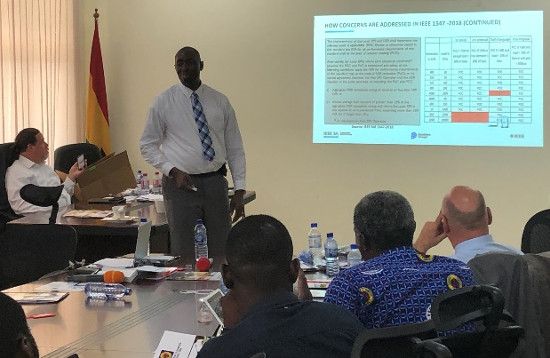
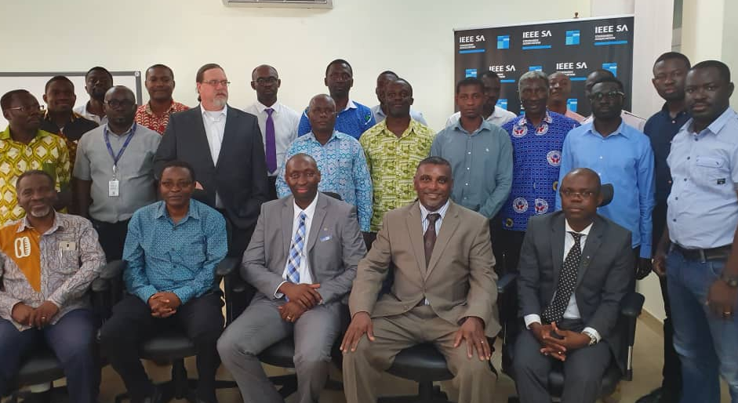
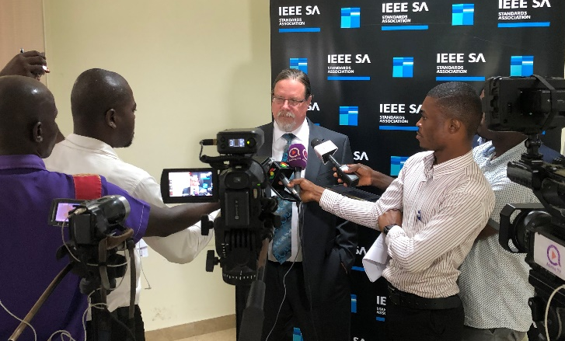
Ghana 1547 Workshop
Full day workshop covering the IEEE 1547-2018 Standard and related topics
Presentations provided by IEEE 1547 SME’s, IEEE SA, Ghana Energy Commission, Ghana Ministry of Energy, Electricity Company of Ghana as well as others
Provided an in-depth review of the importance of proper DER Interconnection and how 1547 can be leveraged
Local media present https://bit.ly/2FBIAov
Special thanks to Wayne Stec and Mamadou Diong for their participation in this effort

Slide 37
How to Participate
Utilities
Encourage commissioning contractors to get certified
Put procurement language in place for certified commissioning agents
Educators
Consider offering IEEE 1547 Education Modules
Engage with IEEE on additional 1547 and Renewable Energy Training opportunities
Engineering Firms, Electricians, Commissioning Agents
Send your engineers to get certified
Participate in the ICAP 1547 conformity assessment steering committee
Engage with IEEE on extending the 1547 Education and Credentialing Program
Engage your customers on using certified resources
IEEE 1547 Education & Credentialing Program Project

Slide 38
NeXT Steps/Contact
Outreach Webinar - Planned for November time frame with presentation from DOE on Renewable Energy Workforce Development outlook
RFI - Request for Information issued, looking for feedback from Educational Institutes on expanding the program. Email: connect_der@ieee.org
Utilities – Reach out to ICAP directly on how to leverage the credentialing program. Join UAB.
Engineering Firms - Should also reach out to ICAP for the latest information and to sign up for the training program. Visit the ICAP Website.
IEEE ISTO facilitates launch of Consortia
Publications
    IAEI Magazine – Education and Credentialing Program Addresses Industry Gaps as Demand for DERs Grow
    Energy Storage News – Understanding Interconnection of Distributed Energy Resources (DERs)
    Utility Products – Advancing Surer, Safer Interconnections
IEEE 1547 Education & Credentialing Program Project

Slide 39
Takeaways
IEEE Standards have a High level of relevance Worldwide
  IEEE 1547 is the Core for Interconnection
    Many other standards being published soon on Energy Storage, Application Guide and Cyber Security
Collaboration is acceleration among the various standards making organizations
  IEEE 2030 is the core Guide for Interoperability
    Collaboration with US NIST and IEC
If Questions Exist, Please contact IEEE

Slide 40
Contact Information
Mark Siira – IEEE
IEEE Standards Coordinating Committee 21 Chair
Email: mark.siira@ieee.org
Wayne Stec – IEEE
IEEE Standards Coordinating Committee 21 Vice-Chair
Email: wstec@ieee.org

