Slide 1
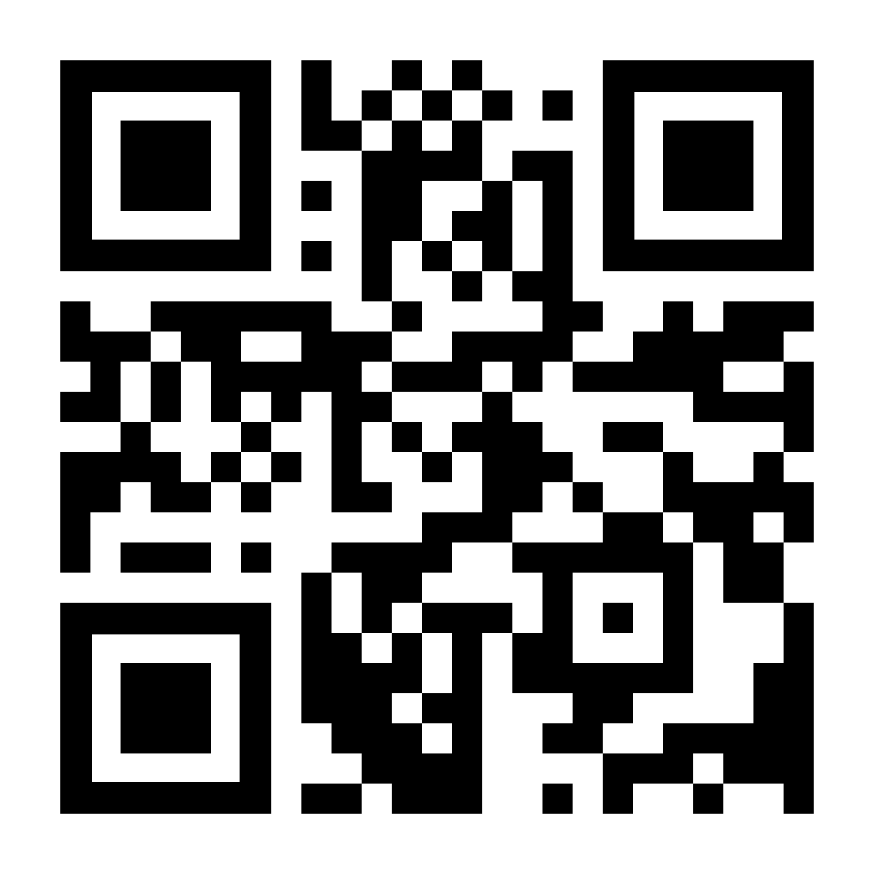
Implementation of Lightning Protection Standards Across Africa
Mitchell Guthrie
Technical Advisor, USNC/IEC TC 81
Lightning Protection Working Group, ACLENet
Blanch, NC, USA

Slide 2
Scope
Lightning Protection for Rural Electrification Applications
Focus on Renewable Energy applications
IEC and US standards considered
Will not discuss distribution system applications
Lessons learned from ACLENet
Other considerations for developing countries

Slide 3
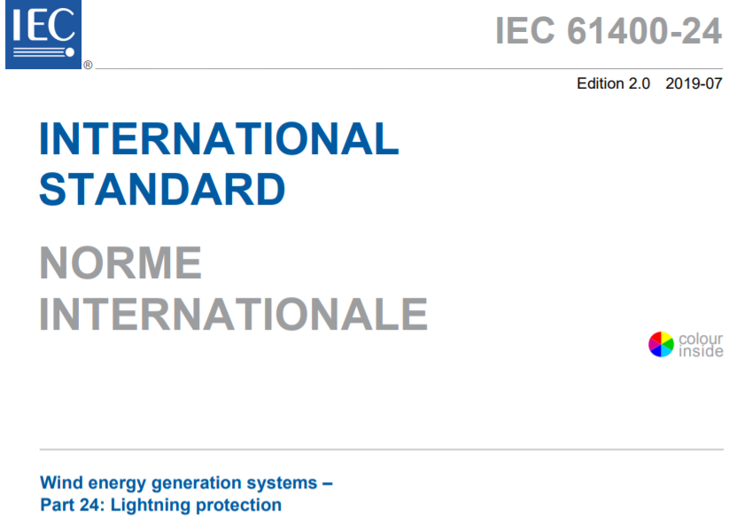
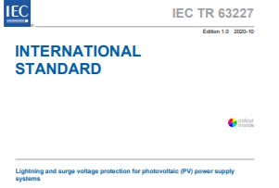
Lightning Protection for Renewable Energy Applications
Wind energy generation systems
IEC 61400-24:2019 – Lightning Protection
ACPA 61400-24:2022 (American Clean Power Association)
Solar (Photovoltaic) Lightning and Surge Protection
IEC TR 63227:2020 - Lightning and surge voltage protection for PV
NFPA 780, Chapter 12
Lightning Protection
IEC 62305 – All parts
NFPA 780

Slide 4
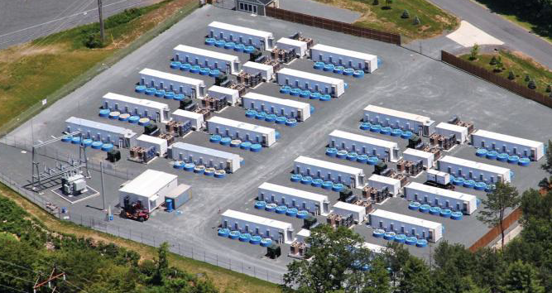
Lightning Risk Management
IEC TR 63227- Solar (Photovoltaic) Lightning and Surge Protection
IEC 62305-3 LPS Class III adequate for normal PV installations
IEC 62305-2 assessment suggested where availability is important
IEC 61400-24: Wind Turbines / Section 7 to determine:
LPL necessary for exposure, define design required + test level in Annex D
Annual occurrence of lightning events to define lifetime of components
Energy Storage Sites
Lightning risk assessment according to IEC 62305-2

Slide 5
What Lightning Protection Standards should be selected ?
IEC Standards are logical choice in Africa
Panel 1 indicated ATC adoption of IEC standards
32 countries in IEC Affiliates program – with adoptions (19) without (13)
Egypt + South Africa = P-members of IEC TC 81
ACLENet protection methods based on IEC 62305
How are they adopted ?
Adopt as is
Adopt with national changes
Incorporate requirements into national standards

Slide 6
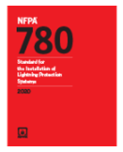
Adoption of IEC Lightning Protection Standards across Africa
Adopt as is
Typical adoption technique for AFSEC ?
Adopt with national changes
ACPA 61400-24:2022 (US) national differences in Annex
Incorporate requirements into national standards
NFPA 780 (US)
Approval of multiple standards
IEC 62305 + 62561 or ANSI/NFPA 780 + UL 96

Slide 7
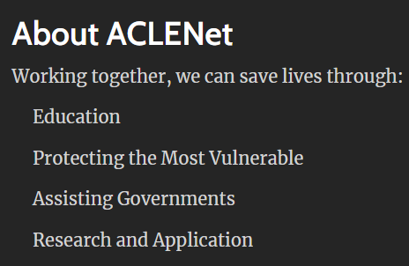

Slide 8
ACLENet chose to protect schools in Uganda
School children are the most frequent victims of lightning in Uganda
50 children to a classroom – step voltage, sideflash, touch voltage, etc.
No lightning protection, not ‘lightning safe’
Schools are the most substantial buildings in most communities.
Center of activities – ‘community center’
Provides lightning safe place for other community members.

Slide 9
ACLENet Lightning Protection Working Group
Experienced volunteer LP experts – South Africa, USA, Uganda, Denmark
Includes members of numerous National/multi-national LP Standards in US and ZA
5 members IEC TC 81, including leadership positions + members most WG / MT / AHGs
Members include Wits University faculty
Working together since Nov 2018 – Denmark added 2020
Addresses LP applications outside scope of national/international standards
Uses local materials where practicable
Develop design criteria and templates for typical structures for use across Africa/Asia

Slide 10
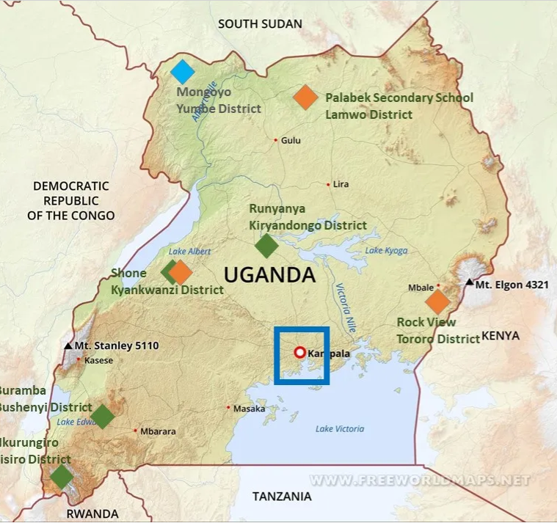
School Protection Process
Site survey by local team
LPWG discusses data package
Design team provides drawing package and identifies components
LPWG confirms design and bill of material
Sources identified + procurement
Import material and transport to site
Installation by local team with volunteers
Commissioning
Educational Seminar

Slide 11
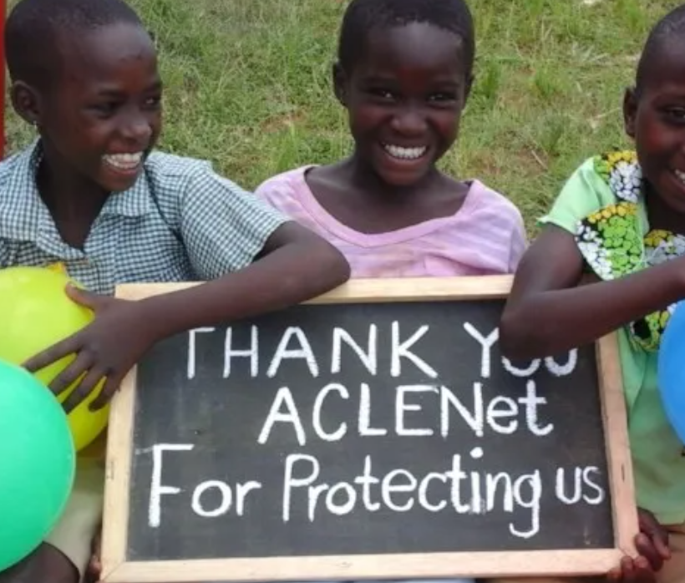
Lessons Learned
Capable in-country support team is critical to success
Links local authorities (School officials, Local government, Dept of Education)
Local logistics (finding material, securing support assets, etc.)
Communications and terminology difficult initially on both sides
Development of engineering solutions time consuming until you get on same page
All certified components must be imported
Local team has trained installer that uses local labor under his supervision
Each project creates a new challenge

Slide 12
Other Considerations
Statistics for Risk Assessments based on data from industrial nations
Data likely not valid for developing areas
Consider developing applicable criteria for local conditions to address increased threat of injury or death within a structure
In developing countries or areas within a country, IEC 62305 LPS may be cost prohibitive or not logistically feasible for homes or businesses.
Establish AFSEC minimum protection criteria or TR on acceptable methods to mitigate lightning threats where IEC 62305 protection cannot be provided
Notes:
Threat of death and injury much higher that reflected in IEC risk assessment. Shielding effectiveness much higher too

