Slide 1
Cybersecurity Policy for Operational Technology:
A Guide for
Governments

Slide 2
Contents
What is Operational Technology?
The Vulnerability of OT
A Checklist for an OT Cybersecurity Regime
Institutional Foundations
National Strategy and Policy
Implementation
Conclusion

Slide 3
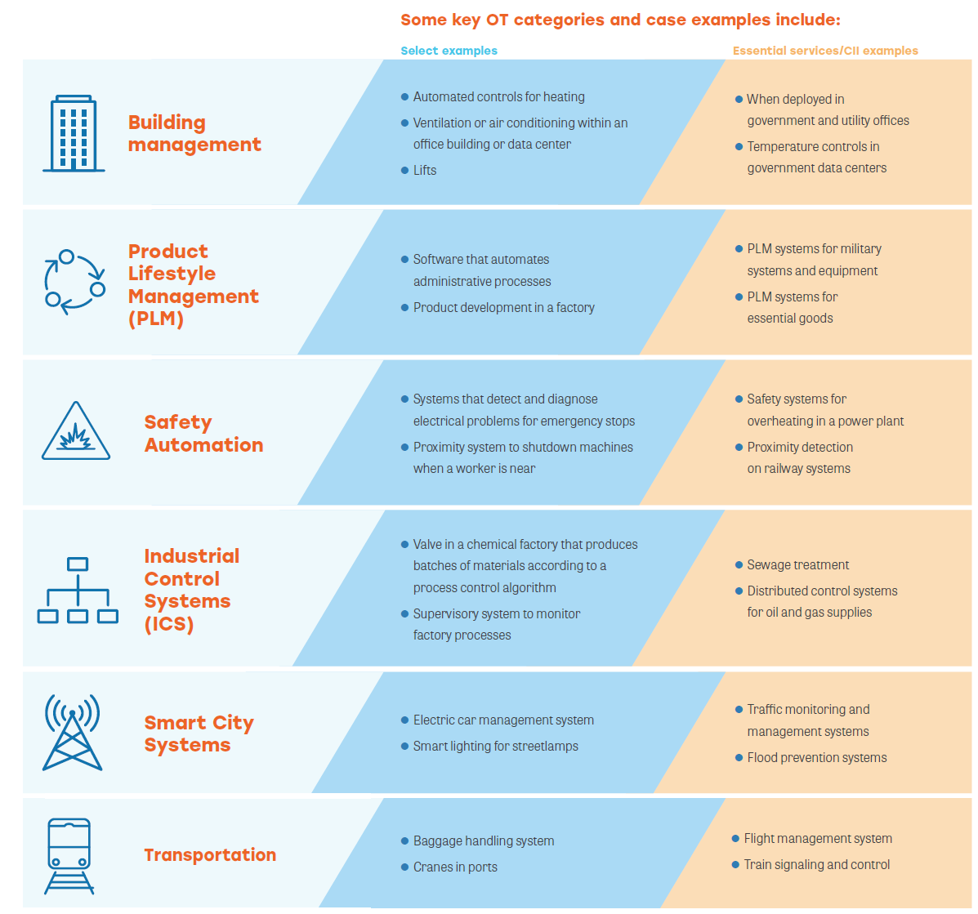
Operational Technology
Hardware/software that helps to monitor, manage, and control physical devices and their related functions and processes.
OT can used by:
Critical Infrastructures / Private Enterprises
And found in:
Notes:
OT represents the collection of hardware and software that helps to monitor, manage, and control physical devices and their related functions and processes.
The use cases of OT vary greatly across private and public sector enterprises and can include components such as valve controls at water treatment facilities, monitoring mechanisms at nuclear power plants, or robotics on manufacturing floors.
OT also comprises vital components within critical information infrastructure (CII) sectors like telecommunications, utilities, and transportation systems.

Slide 4
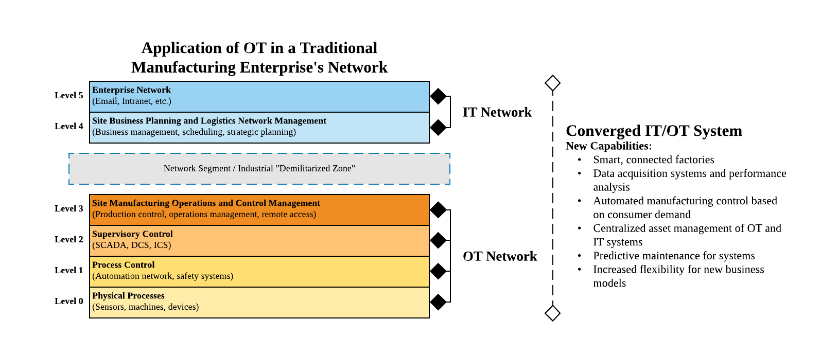
OT and IT are being integrated to unlock new capabilities
Operational Efficiency
Clarity
Cost
Safety
Cybersecurity
Agility
Notes:
Today’s rapid merging of IT/OT systems is attributable to the benefits of convergence such as:
Operational Efficiency – Increased productivity arising from seamless, streamlined operations and implementation of new IT applications into OT environments.
Clarity – Greater clarity to make smarter decisions from the use of real-time data insights.
Cost – Converged IT/OT systems allow a single, integrated system to handle what was previously a complex system of multiple and diverse devices.
Safety – Enhanced OT systems can identify potentially dangerous physical problems before they cause damage.
Agility – IT/OT convergence allows for greater accuracy and speed in making operational decisions. The increased connectivity allows OT systems to adjust production according to data and supply/demand conditions, with multiple remote operations controllable from a central command center.
Cybersecurity – Traditionally, OT cybersecurity was managed by the operations team due to the unique protocols and requirements of OT. However, the operations team specializes in operational matters, not cybersecurity. When managed correctly, smart OT cybersecurity products can be centrally controlled by the IT team, staffed with cybersecurity professionals who can strengthen the organization’s overall cybersecurity posture.

Slide 5
Risk Categories
2015 Ukraine Power Grid 225,000 homes had no power
2016 Ukraine Power Grid Industroyer/Crashoveride caused a 1-hour power loss
2017 Safety-instrumented systems for oil refineries Targeted by Triton/Trisis
2019 US Oil & Gas A natural gas compression facility was subject to a spearphishing attack to obtain initial access to the organization’s IT network before pivoting to its OT for a ransomware attack, leading to a two-day shutdown
2020 Germany Hospital The first ever death linked directly to a cyberattack occurred when ransomware disabled emergency care systems at a hospital. The hospital could no longer provide the critical care that the patient needed, and the patient died after being diverted to another hospital 30km away.
People
Enterprise staff may lack the proper skills to manage converged OT systems.
Process
Lack of investment and consideration for cybersecurity.
Use of outdated systems due to ‘lock-in’.
Technology
OT devices are becoming ‘smarter’.
Older OT protocols have known cybersecurity weaknesses.
Enterprise staff may intentionally or unintentionally compromise OT systems.
But are increasingly popular targets for cyberattacks
Notes:
people
Enterprise staff may lack the proper skills to manage converged OT systems. In converged OT systems, OT and IT teams need to understand the concerns and functions of each other, collaborating to balance cybersecurity needs with operational requirements.
Enterprise staff may intentionally or unintentionally compromise OT systems. Unintentional cybersecurity threats by staff may arise from a poor understanding of cyber risks and lack of cyber hygiene, which in turn lead to an increase in risk of OT incidents. Intentional sabotage of OT through an insider attack (such as a disgruntled employee acting alone or in concert with malicious actors) are equally problematic. Either way, people are often considered the weakest link in OT cybersecurity.
process (planning, governance, operations)
Lack of investment and consideration for cybersecurity. Cybersecurity investments may be difficult to justify in less mature organizations; both those focused on OT and connected to OT. This is often driven by short-term thinking or a lack of cybersecurity considerations in the strategic planning processes. The risk may be especially acute if or when organizations digitize (such as during the current COVID-driven phase of digitization) but focus only on the benefits and fail to manage the risks. In these cases, cybersecurity implementations for OT may lack sufficient resources or be neglected.
Use of outdated systems due to ‘lock-in’. OT systems often represent large capital investment and, as such, may have a lifetime much longer than development support for the software code base (thus losing key elements such as vulnerability patching support). For example, some legacy systems still run Windows 95 without a supportable option to upgrade a replacement or can only do so at high cost. Without enterprise lifecycle procedures to ensure that OT systems are regularly upgraded or replaced, enterprises are “locked-in” to outdated systems.
technology
OT Devices are Becoming ‘Smarter’. OT systems have also become more advanced, increasingly connected to IT infrastructure, and are less constrained by point-to-point, closed systems. This allows for greater synergies between the enterprise’s data system and business operations, becoming “smarter” with more sophisticated software and interconnectivity. However, they can be exposed to the same sophisticated threats that plague IT, such as cyberattacks and malware. That is, OT devices may have an increased attack surface due to software vulnerabilities or poor access configuration.
Older OT protocols have known cybersecurity weaknesses. OT systems were designed for their specific industrial purposes and many were not designed with cybersecurity in mind. Cyber attackers may easily target systems through such vulnerabilities if enterprises fail to harden them.

Slide 6
Developing an OT Cybersecurity Regime

Slide 7
Checklist for an effective OT cybersecurity policy regime
Institutional Foundations
Identify and align with existing laws and regulations for cybersecurity in general
Enable prosecution of cybercriminals by defining cyberattacks as illegal
Create a mechanism for designating appropriate organizations as CII and appointing them with some cybersecurity responsibilities
Notes:
These baseline foundations set the stage for a more robust national OT strategy and policy.
The cybersecurity law sets the nation’s cybersecurity approach, establishes the responsible governmental cybersecurity agency (or commission) to have national cybersecurity oversight, and defines the responsibilities of government entities.
But other elements are important for OT, such as providing the cybersecurity agency with the power and responsibility to designate the appropriate entities or functions as CII and to establish the cybersecurity requirements for those designated CIIs.
Considering the prevalence of ransomware, policies should be in place to punish and discourage such attacks, particularly by making ransomware payments illegal by any party. Rules to enable cyber insurance in line with emerging best practices are also important.
OECD: Policies should also be developed in partnership with the private sector to help gain commitment from all stakeholders.
Governments should demonstrate leadership by adopting clear policies and operating with transparency
Governments should identify which government agencies are responsible for CIIs

Slide 8
Checklist for an effective OT cybersecurity policy regime
National Strategy and Policy
Develop, with the participation of OT stakeholders, a national cybersecurity strategy for OT
Develop and publish OT cybersecurity guidelines for risk management by CII and non-CII operators, drawing from best practices and relevant international standards (both public and private)
Establish OT training and capacity building
Establish cybersecurity information-sharing networks among sector-level oversight organizations, CIIs, and OT enterprises to establish a two-way reporting system, share cybersecurity knowledge, and coordinate efforts for rapid incident response and threat intelligence – such as an OT Information Sharing and Analysis Center (OT-ISAC)
Promote OT cybersecurity innovation
Develop voluntary certification frameworks that include OT, and frameworks for reporting OT cybersecurity incidents
These may include requirements in areas such as:
Asset identification and management
Network segmentation
Vulnerability and patch management
Logging, threat detection, and forensic analysis
Data modification restrictions
Redundancy, business continuity planning, and disaster recovery
Local & remote access management
Response and containment
Notes:
These steps focus on developing the OT cybersecurity regime by establishing an overarching strategy for OT through consultations and input from stakeholders in the country.
The OT strategy sets the approach and actions that the country will take to build its cybersecurity regime around OT.
Consultation and discussion with stakeholders are also important to help draft standards and policies that are practical and not onerous. Regulators should ensure that any additional policies addressing OT cyber risks do not place undue compliance burden on stakeholders through consultations and dialogue.
Variations in cyber governance and compliance requirements across countries and sectors can result in companies focusing on compliance instead of protecting their systems.
Overly prescriptive cybersecurity regulations may not benefit organizations as cybersecurity has to be tailored to the risks and needs of the organization.
The existing global shortage of talent means that cybersecurity teams are understaffed to deal with cyber risks in their IT systems, let alone OT systems.

Slide 9
Some global best practices from governments
Singapore’s OT Cybersecurity Masterplan
US’ Guide to Industrial Control Systems Security
EU Cybersecurity Act 2019
Four key thrusts to enhance cybersecurity and resilience among Singapore CIIs and other OT enterprises:
Training and capacity building;
Developing a national threat information sharing and mitigation mechanism;
Updating existing cybersecurity policy to match new requirements;
Promoting innovation through public-private partnerships.
Provides a set of substantive best practices for a government interested in OT cybersecurity.
An example of developing best practices through a strong multi-stakeholder process.
Recommends cybersecurity implementations for enterprises involved with OT, such as network segregation, access controls etc.
Focuses on a cybersecurity certification framework for ICT products that specifically includes OT, along with other services and processes.
The EU certification is voluntary, and the EU also provides grants and subsidies to encourage enterprises to migrate from legacy or vulnerable OT systems to certified, secure OT systems.
Private and public stakeholders help develop and implement the certification scheme.
OTCSA’s “Vulnerability Management for Operational Technology” highlights known vulnerabilities in OT and recommends OT operators manage such vulnerabilities
ISACA and ISA’s “The Merging of Cybersecurity and Operational Technology” helps to secure systems/industrial Internet in a converging IT/OT environment.
Cisco Systems’s “The Evolution of Industrial Cybersecurity and Cyber Risk White Paper” helps OT enterprises embrace digital transformation through a risk management lifecycle approach.
And the private sector
Notes:
Singapore’s OT Cybersecurity Masterplan, one of the first in the world specific to OT, was published in 2019 to enhance cybersecurity and resilience among Singapore CIIs and other OT enterprises.
US National Institute of Standards and Technology (NIST), the guide helps enterprises involved with OT secure their ICS systems. NIST developed the guide in partnership with public and private ICS enterprises, compiling several recommended measures to help OT enterprises meet their cybersecurity objectives.
The EU has so far approached OT cybersecurity by focusing on a cybersecurity certification framework for ICT products that specifically includes OT, along with other services and processes through its Cybersecurity Act.
The EU certification helps enterprises and organizations that manage OT understand their risks and take necessary steps to ensure cybersecurity.

Slide 10
Checklist for an effective OT cybersecurity policy regime
Implementation
Create OT cybersecurity risk assessment mechanisms for appropriate CII and OT systems with guidelines that are continually updated and reviewed
Encourage non-CII OT operators to adopt cybersecurity guidelines voluntarily
Use the public sector to lead by example
Collaborate with other countries to share cybersecurity knowledge and threat intelligence
Notes:
Once a national strategy and policy for OT is in place, governments must implement and track the policy to ensure its operationalization.
Risk assessments (which can be self-conducted or conducted by a government agency) help evaluate on a regular basis if a designated CII has adequate cybersecurity measures in place.
Governments should encourage non-CIIs to adopt the guidelines to create a more robust cybersecurity regime in the country.
Implementation of guidance in public agencies or publicly owned infrastructure can be an important demonstration to the market. Rules conditioning government procurement or contracting on policy implementation can also facilitate quicker uptake and incentivize organizations to implement better OT security.
Governments can help establish networks to share information not just within a country, but across borders as well. Industry involvement in these networks is key to ensuring their success and industry can participate or lead in training, share expertise, best practices, and skills across cybersecurity professionals in both companies and governments.

Slide 11
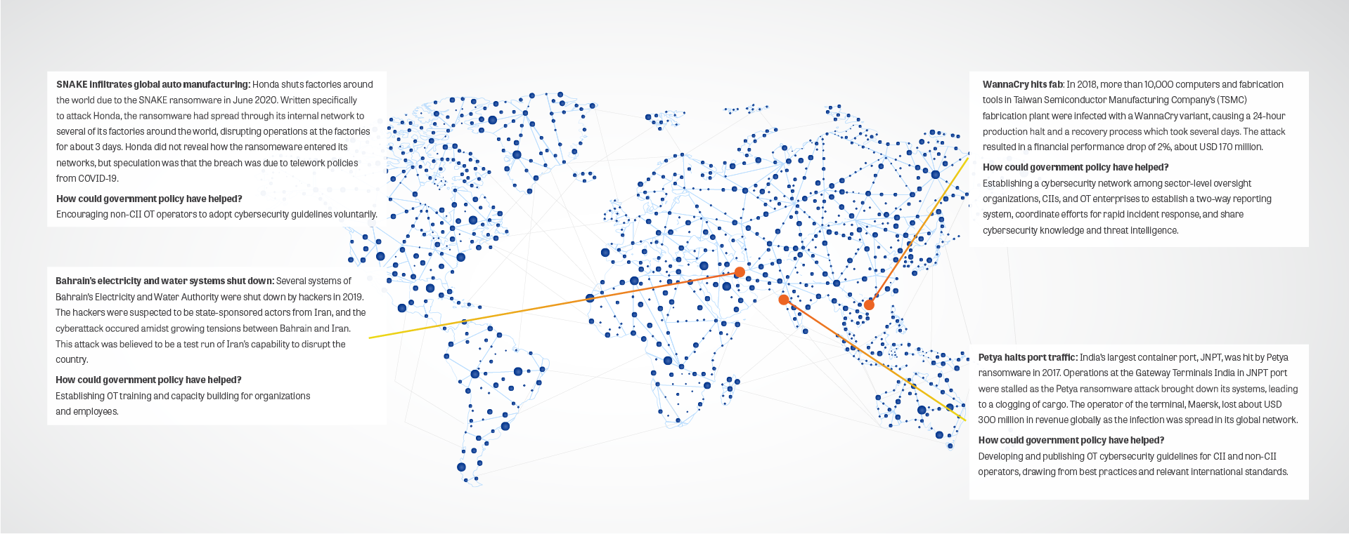
The cyber threat to OT is real.
The convergence of OT with IT has opened a whole new range of innovation and opportunities but has also drastically increased the cybersecurity threat environment for OT.
Governments seeking to establish or upgrade their cybersecurity policies to better account for OT can leverage the checklist as a useful point of departure.
Governments need to continue reviewing and updating their OT cybersecurity regime to account for shifting threats to OT.
Notes:
The cyber threat to OT is real. The figure on the right highlights some cases of cyberattacks on OT in Asia and their impact, along with a recommendation from the checklist on how the attack may have helped mitigate or reduce the impact of the attack.
The convergence of OT with IT has opened a whole new range of innovation and opportunities for businesses, organizations, and societies to leverage OT systems in ways unimaginable only a few years ago. At the same time, this convergence has drastically increased the cybersecurity threat environment for OT. Governments in Asia and globally are continually upgrading their cybersecurity policies to address evolving threats and protecting OT is rapidly rising as a priority for many regulators tasked with protecting their countries’ critical infrastructure, national economic interests, and safety of citizens.
Thus, we developed the checklist to help authorities identify which elements may already be in place, which are not, and to serve as a general guide to how authorities and OT operators can work together to improve cybersecurity for OT.
Cybersecurity for OT and the relevant policy structures to support these are continually shifting, and decisions and actions considered and undertaken by governments should be reviewed again in the future to account for the shifting threats to OT.

Slide 12
Thank you!
Christopher Martin
Principal, Policy Innovation & Head of North America
christopher.martin@accesspartnership.com
North America
Washington DC
Europe
London Brussels
Middle East
Abu Dhabi
Africa
Dakar
Asia
Singapore
Suite 512
1730 Rhode Island Ave N.W.
Washington DC 20036
USA
Tel: +1 202 503 1570
Fax: +1 202 223 2009
9th Floor, Southside
105 Victoria Street
London, SW1E 6QT
UK
Tel: +44 (0) 20 8600 0630
Fax: +44 (0) 20 8748 8572
Square de Meeûs 37
4th Floor
B-1000 Brussels
Belgium
T: +32 (0)2 791 79 50
F: +32 (0)2 535 77 00
Al Wahda City Tower, 20th Floor
Hazaa Bin Zayed The First Street
PO Box 127432
Abu Dhabi, UAE
Tel: +971 2 815 7811
Fax:+971 2 815 7888
Mermoz Extension, Lot 12, N 05
BP: 45680 Dakar –Fann,
Senegal
Tel: +221 33 827 52 54
Fax:+221 33 827 52 55
1 Keong Saik Road
Singapore
089109
Tel: +65 9145 6137

