Slide 1
Smart Metering Installation- African Context
Urenna Onyewuchi, Ph.D.
Anneru Solutions Incorporated
IEEE Power Africa Steering Committee

Slide 2
Overview
Professional introduction
Professional experience and power in Africa leadership experience
Observations of African power and energy skills gaps
Learning and development to close identified skills gaps
Meter replacements and installations
Different meters for different applications
Standards to consider during installations
Follow up with Anneru Solutions Incorporated, Community Power (Dallas TX in July 2022) and IEEE Power Africa Conference (Rwanda in August 2022)

Slide 3
Professional Introduction
Over a decade in Nigeria, West Africa: Personal experience of power unavailability and poor metering
Two decades of educational, professional and leadership experience in the United States of America and globally
George Mason University | Georgia Institute of Technology | Corning Incorporated (Smart metering) | IEEE Power Africa Conference | IEEE Smart Village
Internships: Schlumberger | GE | Orbital Sciences | Penn State University

Slide 4
Power and Energy Skills Gaps in Africa
Africa as a continent is very strong intellectually
On the continent and the diaspora, its citizens have some of the highest accomplishments in education
Gaps exist in practical (versus theoretical) applications of academic prowess and in the soft skills that power the technical skills
Biggest of all are ethics and safety
A better appreciation for following rules, codes and standards that protect human life (direct workers and customers) is NEEDED
Strictness in following safety codes including appropriate use and maintenance of personal protective equipment (PPE)

Slide 5
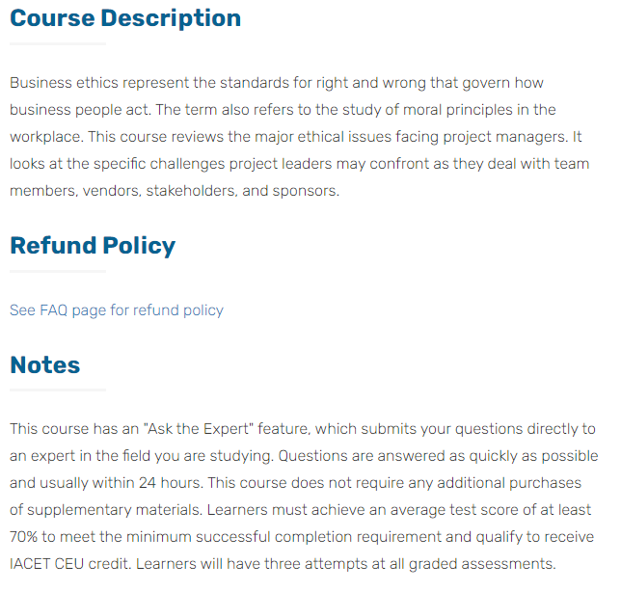
AProfessionalAfrica.com Platform

Slide 6
Solving the Ethics and Safety Gap
Live and self-paced coursework on Ethics and Electrical Safety are a must
Internationally recognized appropriate licensing and certification are needed
Too many lives have been lost to bad electrical installations from unlicensed electricians on the African continent
The US-Africa aprofessionalafrica.com platform is dedicating the next two quarters (January to July) to ethics programming

Slide 7
Other Supporting Knowledge Gaps
Business communications: The ability to communicate work done or not done (well or not)
Assessment and audit skills: Having a second person check that installations were done well
Either by inspecting work done or electrical test results and software outputs on voltage and current values following installations
Project management skills
Human resources personnel to hire licensed electricians
In the US, for industrial level meter installations, utility permissions are required

Slide 8
Metering Standards
Note that standards are constantly being updated as technologies change and knowledge grows on equipment
ANSI Code for Electricity Metering for Accuracy
ANSI C12.1-2008 for revenue metering
Includes climate performance requirement and power factor
Watthour meters should be verified by an annual test
ANSI C12.20-2010 (prevails over C12.1)
0.2 (accurate with +/- 0.2%) and 0.5 (accurate with +/- 0.5%) accuracy classes: Performance against load, power factor and voltage variation

Slide 9
More Metering Standards
ANSI C12.10
IEEE Standard 3001.2-2017
IEEE Standard 1377-2012 – IEEE Standard for Utility Industry Metering
IEEE Standard Requirements for Instrument Transformers
Voltage (potential) transformers, PTs, and current transformers CTs
Be careful not to short the CTs: Huge safety risk
Three (3) accuracy classes: 0.3, 0.6, 1.2
Provide +/-0.3% accuracy meaning 100% of the rated current, etc.

Slide 10
Meter Installations

Slide 11
Meters and Meter Manufacturers to Consider
Each meter comes with an installation manual and most manufacturers are willing to give trainings on their meters and installation guides
Some will have preferred installation vendors or providers
Schneider Electric and Merlin-Gerin
Eaton PXM
GE
Others

Slide 12
Next Steps
Contact Anneru Solutions Incorporated for workshops and coursework (online, self-paced, on-demand, in-person)
Plan to attend IEEE Power Africa Conference 2022 in Rwanda
https://ieee-powerafrica.org/
Plan to attend education-energy conference in partnership with Anneru Solutions Incorporated in Dallas in July 2022

