Slide 1
AFSEC TC 57
Presented by: Dr. Omar Gatera, ATC57 Chair

Slide 2
Content
Overview of AFSEC
ATC 57:
Standards and Power Systems Transformations
Challenges and Potential Solutions
Conclusions

Slide 3
1) Overview of AFSEC
AFSEC is responsible for:
identifying existing standards and prioritizing standardization needs in the fields of electricity, electronics and related technologies;
harmonizing existing standards, either by adopting International Standards, or, where necessary, adapting them to African conditions;
identifying the need to draft standards for adoption by AFSEC members;
Recommending harmonized standards for application by the appropriate bodies of the African Union.

Slide 4
1) Overview of AFSEC, con’t
The need for Harmonization of electrotechnical standards to ensure the reliable and safe operation of the evolving Pan-African power grid was recognized by the Top African Institutions.
This was the initial motivation for the formation of AFSEC in 2008 as a subsidiary body of the African Energy Commission (AFREC), which clearly has a major role in supporting electrotechnical industrialization of Africa with adequate quality and reliability. The scope also includes collaboration with related organizations to develop related standards and conformance assurance systems.

Slide 5
1) Overview of AFSEC, con’t
Establishment of AFSEC Secretariat offices in Cairo, Egypt.
Centers of Renewable energy & Energy Efficiency (CREEEs):
ECREEE (Western Africa (ECOWAS))
EACREEE (Eastern Africa)
SACREEE (Southern Africa)
RCREEE (Northern Africa)
AFSEC Technical committees
ATC 8 - Systems aspects for electrical energy supply
ATC 13 - Electrical energy measurement, tariff- and load control
ATC 57 - Power systems management and associated information exchange
ATC 64 - Electrical installations and protection against electric shock
ATC 77- Electromagnetic compatibility
ATC 82 - Solar photovoltaic energy systems / rural electrification systems

Slide 6
1) Overview of AFSEC, con’t
215 Standards recommended by the Council till 2020 for adoption, in addition to 35 Standards are in the voting process for adoption by National Electrotechnical Committees.
4 Guides
Collaboration platform between the 4 CREEEs and AFSEC to target the standards required in the area of renewable energy and energy efficiency.
Harmonized quality assurance programs for targeted products supported with AFSEC Conformity Assessment system.

Slide 7
2) AFSEC TC57: POWER SYSTEM MANAGEMENT AND ASSOCIATED INFORMATION EXCHANGE
Objectives:
To develop, review, adopt, harmonise, and promote information exchange standards for use in member countries of AFSEC :
Power system interconnection
Regional Control Centres
To provide technical input as AFSEC on IEC standards
To promote the use of open standards in the use of SMART GRID technologies
To promote standards for the security of data exchange in the power system
Market demand:
Power Pools
Grid code
Energy developers (Generation, Transmission and Distribution)
Regulators
Equipment vendors
Harmonisation of Standards

Slide 8
2) AFSEC TC57: POWER SYSTEM MANAGEMENT AND ASSOCIATED INFORMATION EXCHANGE
Trends in technology
Use of ICT by the energy developers
Information security in power systems using ICT Technologies
Modernising the power systems requires ICT which is matured in developed countries but still evolving in African countries
Consideration has to be given to the application of technology in terms of technical relevance, maintainability and sustainability within the context of the environment it is expected to function in.

Slide 9
2) AFSEC TC57: POWER SYSTEM MANAGEMENT AND ASSOCIATED INFORMATION EXCHANGE
Market trends
The global requirements for interoperability and compatibility are required in the African context.
The merging of data and associated information exchange from both metering and power systems
Ecological environment
Recognition of carbon footprints requirements
Nuclear safety requirements
Sound emissions requirements: EMC requirements

Slide 10
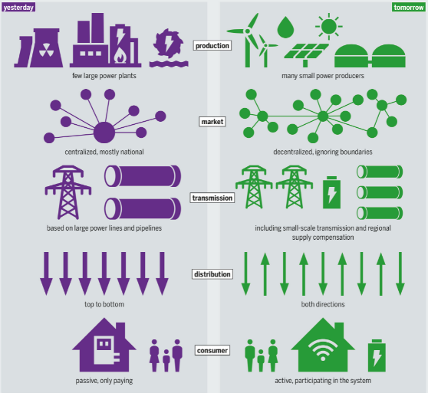
3) Standards and Power Systems Transformation
IEC 61850 Series for Communication Networks and Systems for power utility automation.
IEC/IEEE 61850-9-3 for Communication Networks and Systems for Power Utility Automation –Part 9-3: Precision Time protocol profile for power utility automation.
IEC TS 62257-9-2 Recommendations for small renewable energy and hybrid systems for rural electrification – Part 9-2: Microgrids
IEC 61400-1
Wind energy generation systems – Part 1:Design requirements
IEC 60086-1 Primary batteries ― Part 1:General

Slide 11
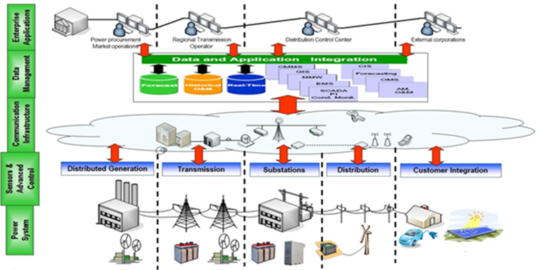
3) Standards and Power Systems Transformation, con’t
IEC 61970 Series for Energy Management System Application Program Interface.
IEC 60870 series for Telecontrol equipment and Systems.
IEC 62351 series on Data and communication security.

Slide 12
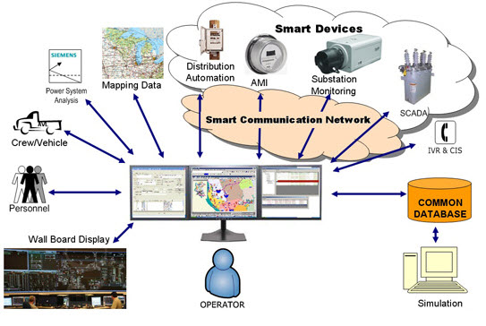
3) Standards and Power Systems Transformation, con’t
IEC 62056-4-7-Electricity metering data exchange - The DLMS/COSEM suite - Part 4-7: DLMS/COSEM transport layer for IP networks
IEC 62053-61-Electricity metering equipment (a.c.) - Particular requirements - Part 61: Power consumption and voltage requirements
SANS 474 Code of practice for electricity metering.
IEC 60870 series for Telecontrol equipment and Systems.
IEC 61850 Series for Communication Networks and Systems for power utility automation.

Slide 13
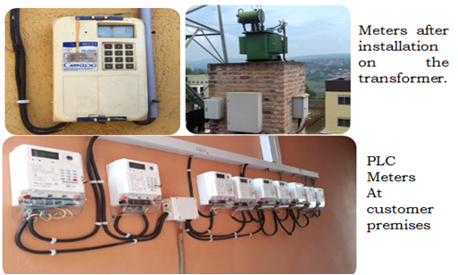
3) Standards and Power Systems Transformation, con’t
System supports various types of line loss:
Substation Loss
Substation Transformer Loss
Bus bar Loss
Feeder Loss
Transformer Area Loss
Transformer Area Transformer Loss
IEC 62053-11 Electricity metering equipment (a.c.) - Particular requirements
IEC 62056-1-0 Electricity metering data exchange
IEC 62058-11 Electricity metering equipment (AC) - Acceptance inspection
IEC 62059-11 Electricity metering equipment - Dependability

Slide 14
3) Standards and Power Systems Transformation, con’t
EE
η appliances
η equipment
Reduces overall energy consumed
Certifications
IEC 62717 LED modules for general lighting - Performance requirements
IEC 62722-2-1 Luminaire performance - Part 2-1: Particular requirements for LED luminaires
IEEE 2747-2020 - IEEE Guide for Energy Efficiency Technology Evaluation of Electric Power Fittings

Slide 15
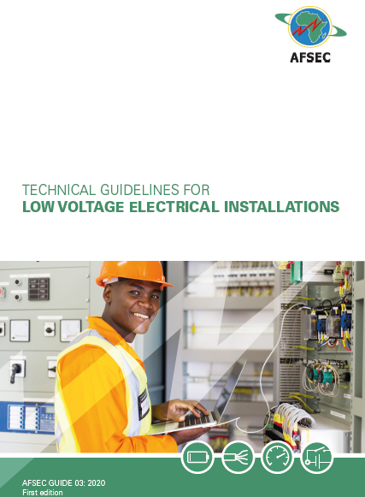
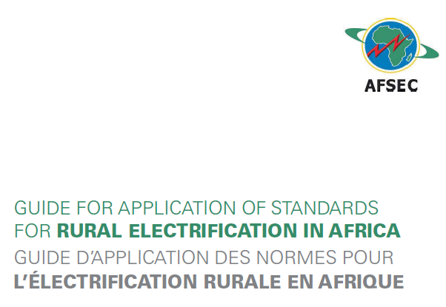
3) Standards and Power Systems Transformation, con’t

Slide 16
4) Challenges
In Africa and other developing countries, the adoption of smart grid has been very slow, and almost non-existent in some parts.
This slow adoption can be attributed to many limiting factors that can be examined from different perspectives:
Standards Development and Harmonization
Interoperability
Security and Privacy
Comprehension and applicability of standards
Regulation and Policy
Guide

Slide 17
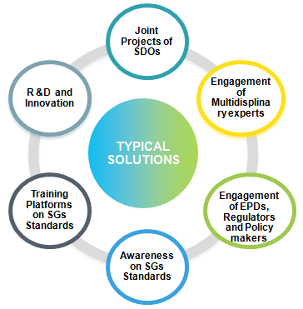
5) Typical Solutions
Research, Development and Innovation will help to improve the SGs Systems, developing new standards and new equipment or devices.
Training platform will help to explain the standards to discuss with different experts and engage the young and academician in SGs enhancement and implementation;
The awareness serves to inform the broad community about the benefits the SGs and handling of SGs Equipment and devices.
Joint Projects of SDOs will help the SGs to achieve to required interoperability, to manage the resources and speed up the services.
The engagemet of multidisplinary experts will help to put together all the skills and to came up with a helpful document which satisfy everybody;
Engagement of EPDs, Regulators and policy makers will help to buy and understand the benefits of developed standards

Slide 18
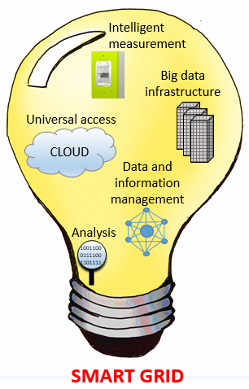
6) Conclusion
Yes, standards are the enabler of power transformation, but a number of items should be put in place such as:
Collaboration of standards development organizations (SDOs);
Reducing the time of standards development and harmonization;
Engagement of industrial and business communities in standards development and harmonization;
Enhancing the awareness/training campain to energy developers;
Setting up centre of excellences in research, inovation, development, standardization and professional development in Smart Grid.

