Slide 1
Overview of Clean Cooking Financing and Spark+
Online Capacity Building Workshop: Introduction to Bioethanol for Clean Cooking in Mali
13-14 September 2022 | Virtual Presented by Peter George

Slide 2
Historical challenges associated with clean cooking
The sector has been driven by donors
There was limited category-level demand
There has been limited “willingness to pay” by customers
There has also been limited “ability to pay”
There was historically a limited evidence base
All leading to a fragmented and early-stage pipeline, and little capital flow

Slide 3
How the sector is rapidly evolving for the better
More commercially oriented businesses with better business models/unit economics
Better products/services which integrate technology for usage monitoring, PAYG, impact monetization
More demand for alternatives from urban/higher income customers (generational change, urbanization)
More prioritization by governments on clean cooking (Paris climate commitments)
Larger potential deal sizes and better risk/return profiles for investors
Better impact cases for grant makers and philanthropists
All leading to larger capital flows into more companies who are better able to achieve sustainability
But… it’s still early days for this potentially massive market

Slide 4
Types of Financing
Equity
Commercial
Quasi-commercial/concessional (in terms of risk and/or return)
Debt
Commercial
Quasi-commercial/concessional (in terms of risk and/or return)
Results-based finance (grant-funded)
Carbon finance
Others (e.g. DIBs or RBF programs which monetize health and gender impacts)
Technical assistance (grant-funded)
Guarantees (typically for debt)

Slide 5
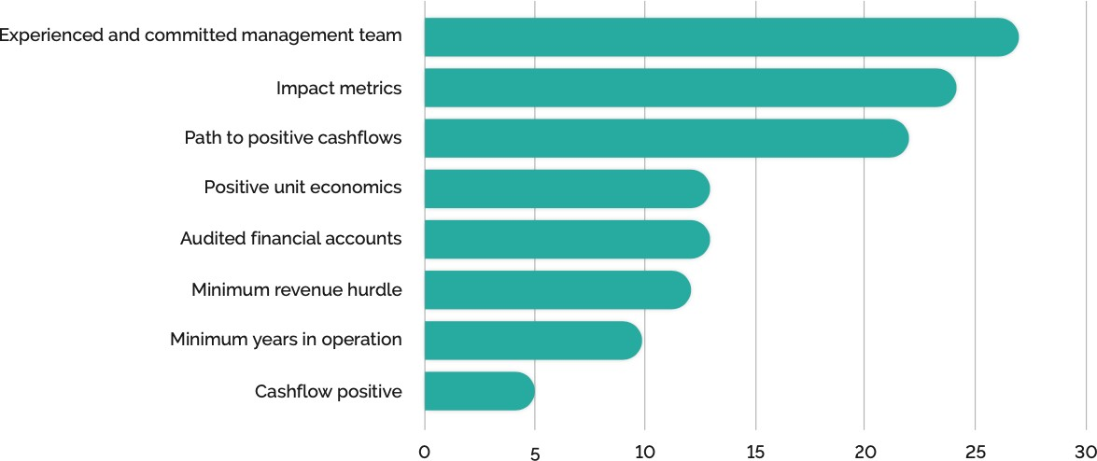
Primary Investment Criteria by Funders
Source: Modern Energy Cooking: Review of the Funding Landscape Report, February 2022

Slide 6
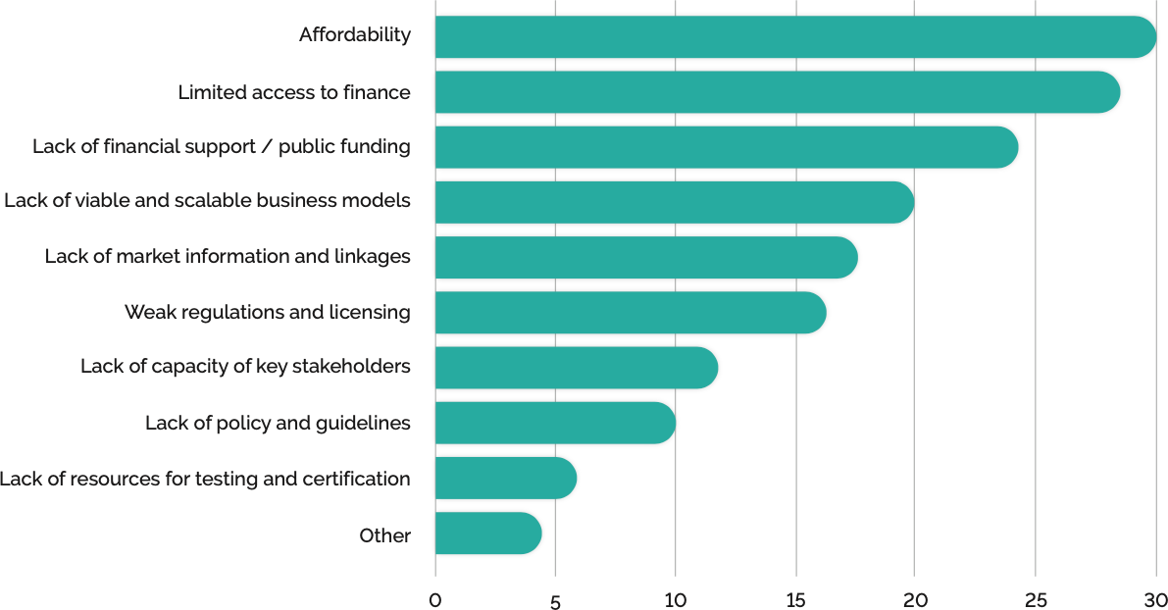
Barriers for Scale-up of Clean Cooking
Source: Modern Energy Cooking: Review of the Funding Landscape Report, February 2022

Slide 7
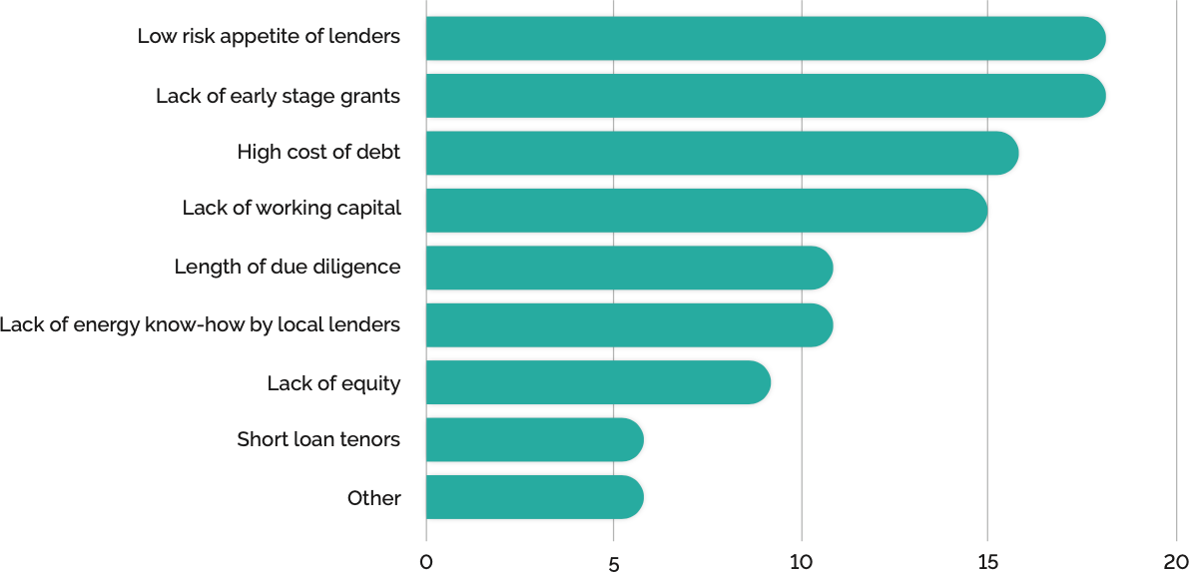
Barriers for Companies to Successfully Fundraise
Source: Modern Energy Cooking: Review of the Funding Landscape Report, February 2022

Slide 8
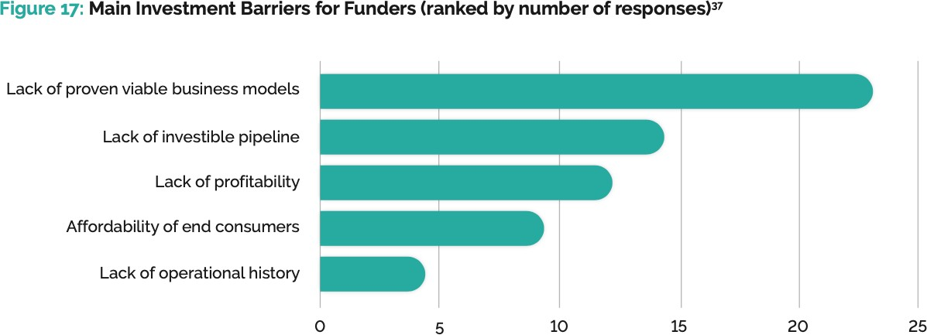
Barriers for Investors
Source: Modern Energy Cooking: Review of the Funding Landscape Report, February 2022

Slide 9
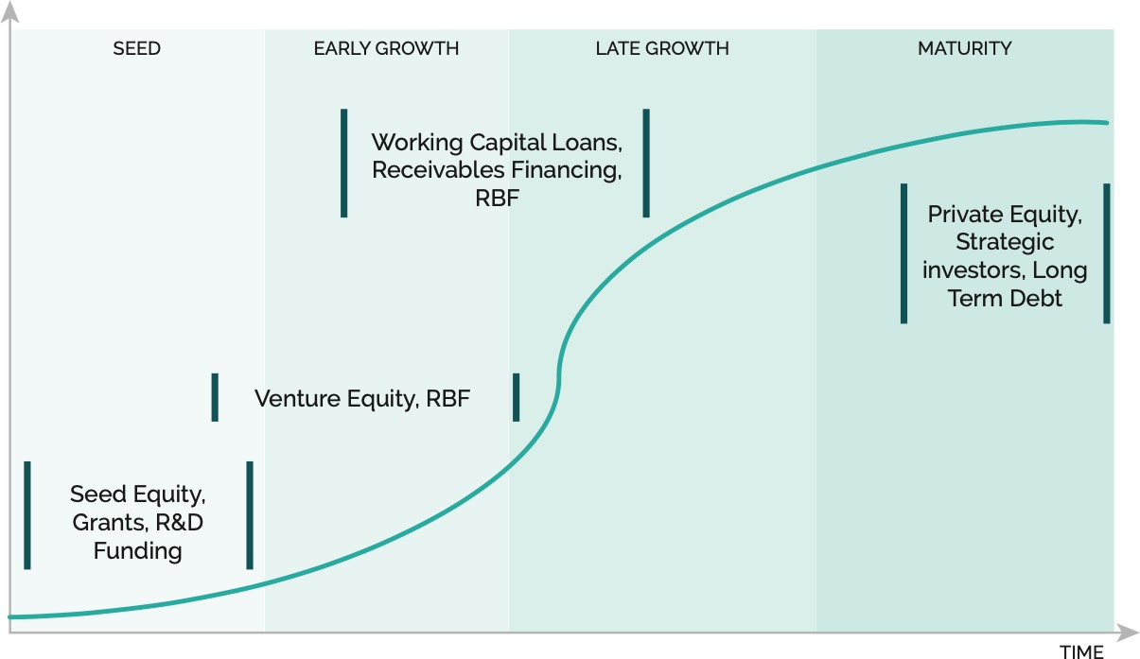
Financing by Maturity
Source: Modern Energy Cooking: Review of the Funding Landscape Report, February 2022

Slide 10
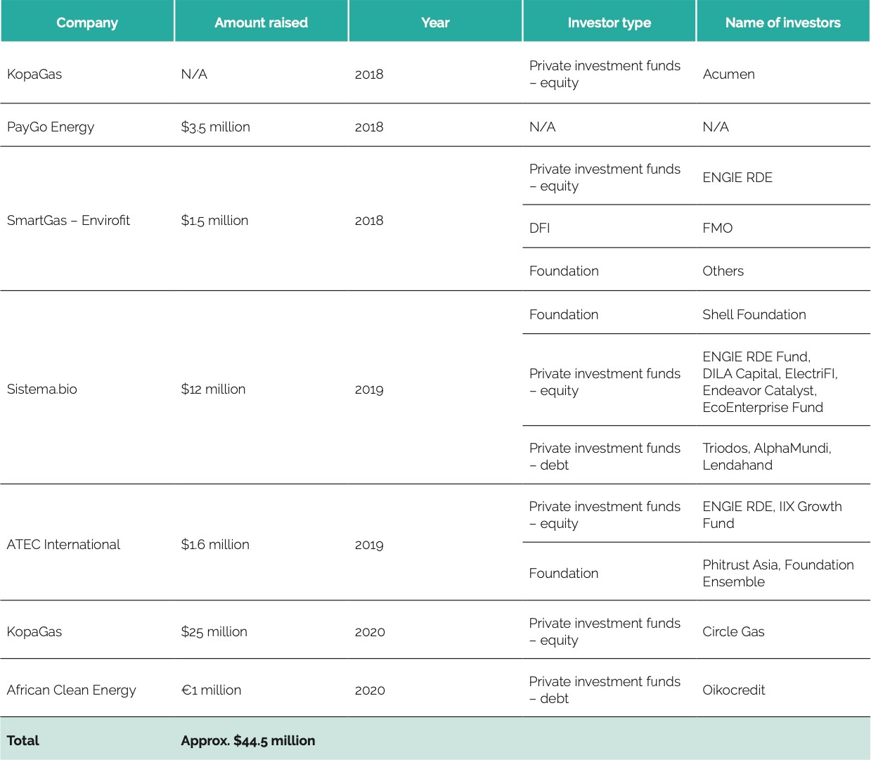
Notable Transactions
Source: Modern Energy Cooking: Review of the Funding Landscape Report, February 2022

Slide 11
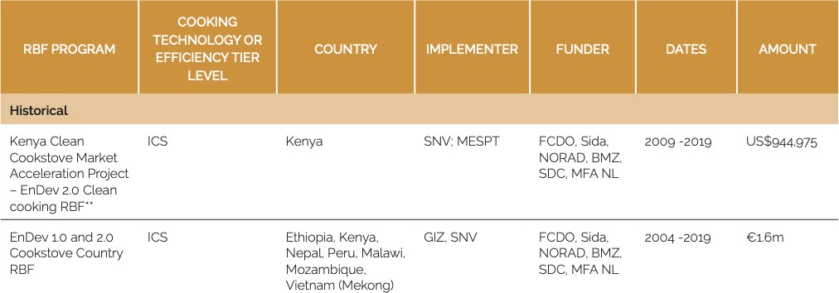
Historical RBF Programs
Source: Modern Energy Cooking: Review of the Funding Landscape Report, February 2022

Slide 12
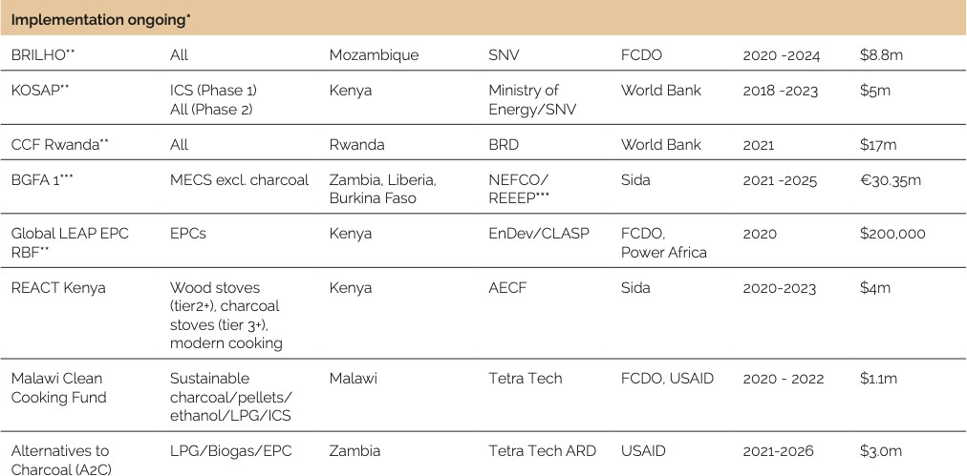
Ongoing RBF Programs
Source: Modern Energy Cooking: Review of the Funding Landscape Report, February 2022

Slide 13
Planned RBF Programs
Source: Modern Energy Cooking: Review of the Funding Landscape Report, February 2022

Slide 14
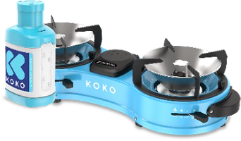
Fund Overview
Fund Size
$54m; $70m hard cap
Luxembourg GP / LP fund with first loss, mezz and senior debt tranches
Enabling Qapital
7 years
70% debt, 30% quasi- equity/equity
$500k - 7 million
March 2022 first close Oct 2022 final close
Multiple including CCA Venture Catalyst program, in-house TA resources via SMC
Overview
Partnership of 15 governments, foundations, family offices, pension funds and other investors to establish the world’s first impact investment fund dedicated to financing clean and modern cooking solutions in developing markets
Fund Structure
Fund Manager
Fund Life Instruments
Targeted Investees
Invest across sub-Saharan Africa in value chains of product/fuels incl. companies that:
Sell ethanol, pellets, or LPG fuel, on a standalone basis or together with stoves
Manufacture stoves, LPG cylinders, IoT-enabled meters, or other appliances
Produce fuels such as biomass pellets, ethanol, or briquettes
Manufacture or install biogas systems
Distribute or finance products incl. last mile retailers, off-grid solar companies, utilities, mini-grid operators, and microfinance institutions (MFIs)
Develop, finance, and/or implement carbon credit projects
Invest in companies engaged in product design and development, manufacturing, wholesaling, retail and consumer finance
Many targets are vertically integrated: where possible, Spark+ encourages
specialization to enhance profitability, economies of scale, and operating efficiencies
Ticket Size
Timing
TA Facility
Approach
Short or medium-term senior debt secured by inventory, receivables, etc.
Unsecured, subordinated debt/mezz long-term, equity-like capital
Tripartite distributor structures which enable financing for smaller, less well- capitalized/profitable distributors
Specialized carbon finance via debt secured by (carbon) Emissions Reduction Purchase Agreements (ERPAs)
Design
Manufacture
Import
Wholesale
Retail
Consumer Finance

Slide 15
Completed Investments
USD 6 million to Burn Manufacturing (Mauritius/Kenya)
On April 29, 2022, Spark+ disbursed USD 4 million to Burn Manufacturing
An additional USD 2 million tranche has been IC approved in August to be disbursed in Sep
USD 2 million to Sumac MFB (Kenya)
On May 13, 2022, Spark+ disbursed USD 1 million to Sumac
The remaining USD 1 million was disbursed in June

Slide 16
Thank you
Thank you for your interest, and I look forward to your questions.
Contact details:
Peter George Peter.George@enabling.ch

Slide 17
Disclaimer
All information contained in this document is for information purposes only and is the intellectual property of Enabling Qapital AG. Redistribution is prohibited unless consent to do so has been given by Enabling Qapital AG. Enabling Qapital AG does not accept any liability for any loss or damage, how ever it is caused, arising from any errors or omissions or reliance on any of the information contained in this material.
The information and opinions contained in this document have been derived from sources believed to be reliable and in good faith or constitute Enabling Qapital AG’s judgement as at the date of this document but no representation or warranty, express or implied, is made as to their accuracy, completeness or correctness and any opinions are subject to change and may be superseded without notice. Any information contained in this material is not to be relied upon as authoritative or taken in substitution for the exercise of judgement. Past performance is no guarantee for future performance and some positions may be subject to sudden and large movements in value. Foreign exchange rate fluctuations may also have an effect on the valuation of certain positions. This document is not, and should not be construed as, an offer or solicitation to sell or buy any investment or product. Enabling Qapital AG expressly does not provide legal or tax advice. It is recommended that you consult legal and tax advisors before making any investment decisions. The information contained herein is of a general nature, is based on various assumptions (which are subject to change) is not tailor-made and hence does not take into account your particular portfolio or financial situation. Enabling Qapital AG accepts no liability whatsoever for any loss arising from any use of the material. The material may not be reproduced, distributed or published for any purpose without the express written authorization of Enabling Qapital AG. Enabling Qapital AG and its affiliates and/or their officers, directors and employees may own or have positions in any investment mentioned herein or any investment related thereto and may from time to time add or dispose of any such investment.

