Slide 1
THE DAR-ES-SALAAM MOTO SAFI™ ETHANOL STOVE &
FUEL BUSINESS PROJECT.
By Mohammed Uhuru Kadhi
East Africa Director,
Strategy & Business
Development
CONSUMER’S CHOICE LIMITED.
Bioethanol Standardization Web-Series #5: Implementation of Bioethanol Fuel and Clean Cookstove Business.
24th February 2023

Slide 2
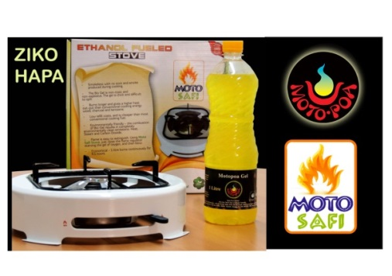
WHO ARE CONSUMER’S CHOICE LIMITED
In 2011 CCL opened a new Renewable Energy Division in Nairobi, Kenya, distributing ethanol gel stoves and ethanol gel fuel produced in Tanzania.
In 2012 CCL created its own brand of ethanol gel stoves branded – Moto Safi.
In Kenya we have sold over 20,000 ethanol gel stoves and many hundreds of thousand of litres of ethanol gel fuel.
www.motosafi.com
www.motosafi.com

Slide 3
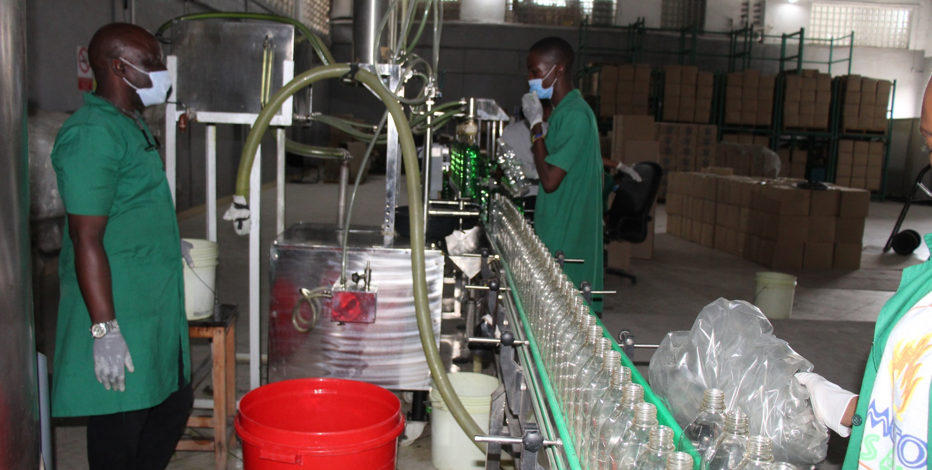
ETHANOL STOVES ASSEMBLY PLANT
ETHANOL FUEL BOTTLING PLANT
WHO ARE CONSUMER’S CHOICE LIMITED
In 2018 CCL Tanzania, opened it’s Renewable Energy Division. In January 2019, CCL won a Govt. of Tanzania & UNIDO tender to distribute 30,000 ethanol stoves in the commercial capital Dar-es-Salaam.
Between February to October 2019, we built a ethanol fuel bottling plant and an ethanol stove assembly plant.
The bottling plant can produce 200,000 litres per month and the stove assembly plant can produce 4,000 stoves per month.
To date we have sold 12,000 stoves and over 240,000 litres of fuel.
www.motosafi.com

Slide 4
What Is The Problem, We Are Trying To Address?
Households Cooking Fuel Use
1. 63.5% use firewood
2. 26.2% use charcoal 1 + 2 = 89.7%
3. 5.1% use LPG
4. 3% use Electricity
5. 2.2% use Other Alternatives
01
Over 50% of all charcoal produced in Tz is consumed in Dar-es-Salaam.
THIS IS NOT SUSTAINABLE AS IT PROMOTES DEFORESTATION.
02
03
Today hundreds of thousands of people mainly women and children suffer from IAP related ailments caused by emissions from firewood and charcoal. 33,000 deaths are attributed to HAP.
04
Consumers lack options to buy clean cooking appliances & clean cooking fuel in small affordable quantities.
www.motosafi.com

Slide 5
Why Ethanol
As A Cooking Fuel?
Cleaner than firewood and charcoal, with no smoke or soot.
Ethanol stoves are durable and last over 5 years.
It is sustainably produced and renewable.
Ethanol stove can cook most African meals.
Ethanol stoves are safe and don’t spill and canister is non-explosive.
It is affordable and available in small quantities.
Fuel is locally produced.
Cooking with an ethanol stove is comparable with a LPG stove.
www.motosafi.com

Slide 6
Our Products
MOTO SAFI ETHANOL FUEL &
CLEANCOOK ETHANOL STOVE.

Slide 7
Advantages of The Cleancook Comet 1 & 2 Ethanol Stove.
Partnership: 1.Cleancook AB Sweden own the ethanol cooking technology.
2. Burn Manufacturing, manufacture the stove in Nairobi.
3. CCL assembles the stoves in Dar-es-Salaam.
Very Portable.
Very Durable and will last atleast 5 years.
01
04
Tested and passed all emissions and safety tests globally.
Can carry pots of up to 15kg.
02
05
Canister is non-explosive.
Available as a single or double burner.
03
06
www.motosafi.com

Slide 8
Advantages of Moto Safi Ethanol Fuel.
01
02
03
04
05
06
1 litre will burn for minimum 4.5 hours continuously.
1 litre costing Tzs.2,600/- ($1.12) will last a family of 5 persons, 2 days of cooking.
While Tzs.2,000/- of charcoal once lit will extinguish after some hours.
Ethanol is made from locally grown sugarcane
molasses.
Ethanol does not produce smoke while cooking.
Ethanol fuel is readily available at local retail outlets.
Packed in 0.5, 1, and 5 litres.
www.motosafi.com

Slide 9
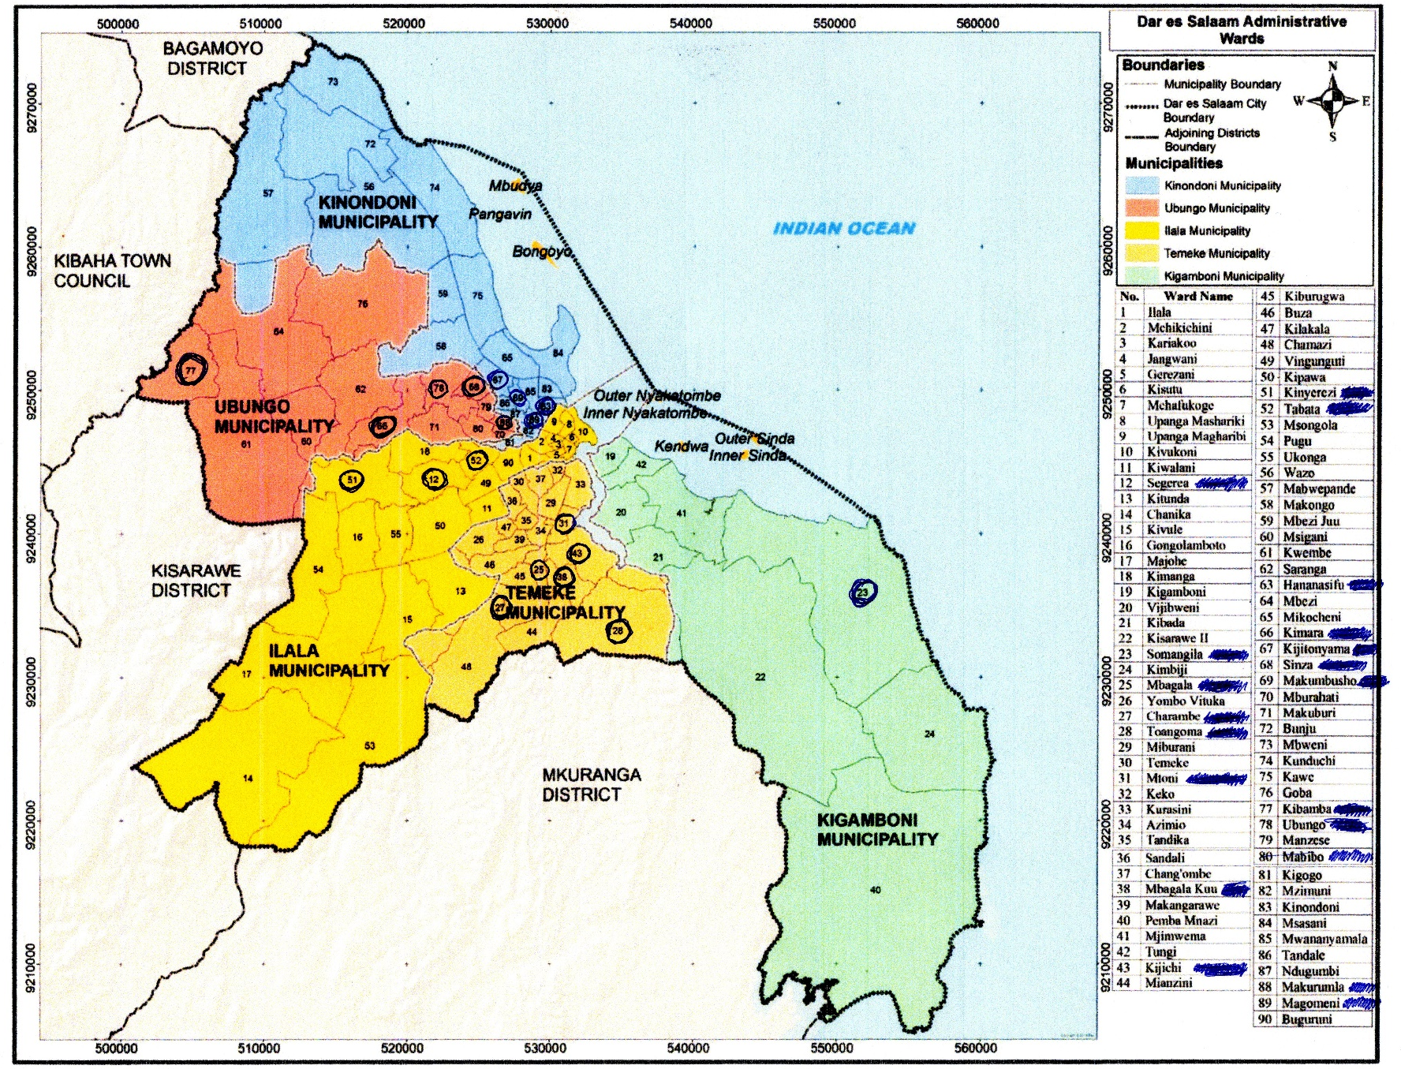
20 Wards Contracted to Distribute
www.motosafi.com

Slide 10
Route –To - Market Strategy
CLEANCOOK AB Stove Manufacturer
KILOMBERO
Ethanol
Supplier
Other
Suppliers of
Raw Materials
Future Bulk Ethanol Supplier Partnership
Up Stream Value Chain
Micro Finance Institutions MFI.
Youth & Women's Group
Retail
Outlets
Whole Sale Outlets
Media
Auction Show
Micro – Entrepreneurs Green Ambassadors
Activation & Promotion Company
Down Stream Value Chain
Retail Outlets
Intended Outcome 30,000 stoves sold and 500,000 liters of fuel sold per month after 36 months
Homesteads using Clean Cook Stove and
Moto Safi Ethanol Cooking Fuel
Collection of Bottles for Recycling
Healthier Fame especially mother and children due to reduced or no indoor air pollution
Reduced Deforestation due to lower demand for charcoal and firewood
Increased time to engage in productive work by mothers. Girl child can go to school
Growth in production of ethanol Growth of new sugarcane plantations to be self-sufficient in sugar and ethanol production
Growth in local assembly and manufacturing of ethanol stoves for local use and export to other African countries
IMPACT
CREATED

Slide 11
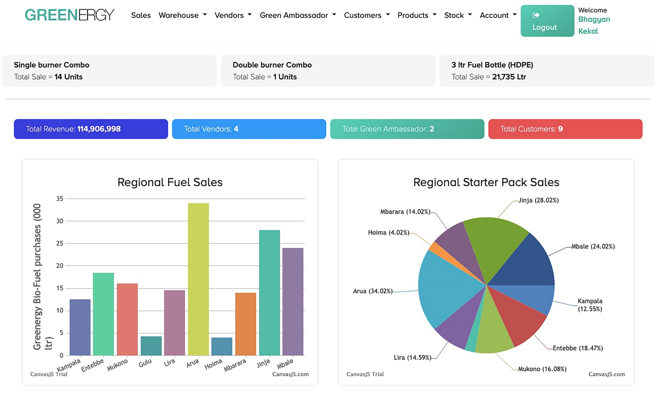
Use of Technology to Collect Data
Web Based
Application

Slide 12
Our Expected Impact after 2-3 years
Economic Impact
Social Impact
Environmental Impact
Direct employment of 30 youths in our factory
Empower 60 micro-entrepreneurs selling stoves and fuel in their communities.
650 retail outlets will selling our products earning shop keepers higher income per month.
New feedstock such as cashew apple fruit and cassava identified for ethanol production.
Positive health and well being of consumers with reduced or no indoor air pollution.
Instant lighting and extinguishing of ethanol stove will greatly reduced cooking times as opposed to using charcoal and firewood stoves.
With every 1 litre of ethanol fuel used displaces 3kg of charcoal.
On distribution of 30,000 stoves will save 8,613 hectares of forest from being harvested for charcoal production.
660,000 tons of carbon emissions will be avoided per year.
www.motosafi.com

Slide 13
What Are The Main Challenges Faced ?
SME Level
Consumer’s find it difficult to buy stoves with cash upfront.
Lack of public awareness on issues of clean cooking.
High cost of creating mass awareness campaigns.
Competing with LPG cooking technology that is VAT exempt and heavily subsidized,
Unregulated charcoal sector.
High cost of setting up an fuel bottling and stove assembly plant.
Sector Level
Lack of unity among clean cooking players and stakeholders to speak in one voice and be able to partner with various institutions to lobby Government for better working environment.
No country quality Standards for ethanol fuel and stoves, bringing danger of low quality fuels and stoves.
Lack of partnerships with MFI to avail clean cooking technologies to the public at affordable rates & PAYGO.
Lack of sector focused media campaigns to promote clean cooking technologies, to create mass awareness through bring behavior communication.
Government Level
Not promoting Clean Cooking Technologies as a National Priority.
VAT imposed on ethanol cook stoves while other technologies like LPG are exempt.
Import duty imposed on denatured ethanol sourced from international markets.
Import duty imposed on clean cooking stoves imported from international markets whether fully built or knock-down.
www.motosafi.com

Slide 14
How To Accelerate Growth & Development ?
SME Level
Sector Level
Government Level
Provision of Consumer Finance.
Removal of VAT on ethanol fuel and stoves to make them affordable to low income households
Ability to import cheap denatured ethanol from international markets in the short term to fill demand.
Open market to more players to assemble/manufacture stoves and distribution of ethanol fuel countrywide.
Access to affordable capital for businesses to scale.
Access to carbon credit to be able to subsidize ethanol stoves, making them affordable to consumer.
Formation of a clean cooking association to cater for members and stakeholders needs.
Tanzania Association of Clean Cooking Stakeholders (TACCS) will work with academia, TBS and TIRDO to create quality Standards for clean cook stoves and fuels.
TACCS will lobby Government on behalf of members and stakeholders to formulate policies that encourage growth of the sector.
TACCS and it’s stakeholders MUST undertake a new cooking sector study to asses the supply and demand of cooking solutions across the whole country.
Work with Government at inter-ministerial level to address clean cooking issues
Government together with stakeholder to prepare a long term National Clean Cooking Strategy Plan to eradicate dirty cooking within 10-15 years.
Create condusive policies that will promote the growth of the sector.
Initiate a countrywide Behaviour Change Communication campaign on importance of clean cooking and encourage behavior change in urban and rural areas.
Give incentives to businesses for local production of ethanol for self sufficiency.
www.motosafi.com

Slide 15
Basic Requirements To Open A Ethanol Fuel and Stove Business.
Deeply understand all the cooking technologies currently used in your community and all the challenges faced using them.
See if ethanol cooking technology can alleviate their current problems.
Conduct a small pilot project in the community who could benefit from the technology. From the results will let you know whether to start a business or not.
Know where to source the raw materials locally – Ethanol, dyes, denaturants, perfume, bottles..etc
Are there ethanol cooking fuel and stove standards in your country or region?
What are the legal requirements to open a ethanol cooking fuel and stove business.
Register a private limited company that will undertake the business.
Obtain all the licenses required to undertake the business.
Locate premises to undertake the business with enough space in an industrial area.
Have a good local bank behind you.
INVESTMENT: Bottling line, stove assembly, rent, office furniture and automation, safety requirements, fuel storage tanks, non-explosive pumps, flow meters, lab equipment, distribution vehicle, sales team vehicle, P.A system, uniforms.
TEAM: Hire a motivated team, beginning with a qualified Accountant who will record every investment from inception of business. An experienced head of Sales & Marketing and a qualified Production Manager.
TECHNOLOGY: Use technology to make work easier and profitable. Computers and laptops, smart phones for Sales teams. CRM Soft Ware. Accounting Software: QuickBooks.
Have partnerships with MFI’s, Government, Donor community, Carbon Credits to make stove affordable. Impact Investors.
Join a power business Association that will lobby Government on behalf of the clean cooking sector.
www.motosafi.com

Slide 16
THANK YOU
Any Question ?
Contacts :
Mohammed Uhuru Kadhi
Consumer's Choice Limited.
Email : mohammed.kadhi@motosafi.com
Cell : +255 746 477 652, +254 701 449 656
Websitosati.www.motosafi.com

