Slide 1
Overview of Clean Cooking Sector Financing Bioethanol Standardization Web-series: #5 Implementation of Bioethanol Fuel and Clean Cookstove Businesses 13:30-15:00 CET | 24 February 2023 | Virtual Presented by Peter George

Slide 2
Historical Challenges of “Clean Cooking”
Besides LPG/electric for higher income consumers, “cooking energy industry” in developing markets historically consisted of fragmented, artisanal players engaged with charcoal, wood and kerosene
Over the last 5-10 years, a limited but growing number of companies have emerged to deliver clean(er), more fuel efficient alternatives
However, many of these companies remained early-stage and unprofitable, resulting from and in:
Well-intentioned but commercially inexperienced management teams
Unhelpful/unpredictable public sector interventions (or lack thereof) related to product standards, fiscal policies, fuel subsidies, and regulatory enforcement / safety
Insufficient investment in product innovation and R&D, and in infrastructure across value chains
Limited interest, and flows, from providers of early-stage equity, as well as growth equity and debt

Slide 3
Historical Challenges of ”Clean Cooking” (cont’d)
Fundamentally, lack of investment and enterprise growth is linked to historically limited category-level demand which was the result of, and cause for:
Lack of consumer awareness and unhelpful often incorrect perceptions of alternatives, as well as their costs vs. benefits vis-à-vis incumbents (wood, charcoal and kerosene)
Poverty – BoP consumers have limited ‘ability’ to pay, both in terms of upfront (appliance or down payment) and ongoing (fuel or monthly payment) costs; perceptions further reduce ‘willingness’
While donors have played an important role, without meaningful private sector participation, only limited grant and concessional funding have flowed, due to:
Many of the aforementioned issues, since public sector funders seek private capital leverage, know they can’t go it alone, and want to avoid “building a bridge to nowhere”
In addition, limited evidence base associated with social and environmental impacts has improved in the past several years, but making certain links between theoretical impacts (not outputs or outcomes) and what happens in reality, remains a challenge for some solutions more than others

Slide 4
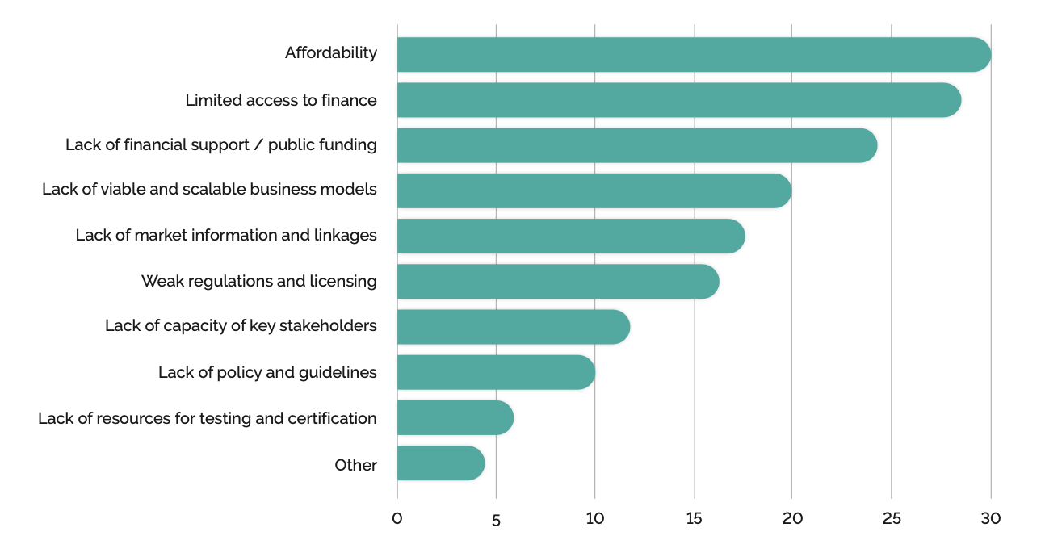
Barriers for Scale-up of Clean Cooking
Source: Modern Energy Cooking: Review of the Funding Landscape Report, February 2022

Slide 5
Fortunately, the Sector is Evolving in Promising Ways
Commercial players with viable business models/unit economics
Stronger management teams able to build profitable companies, attract investment
Carbon markets driving improved unit economics and scalability
Better products integrating technology for usage monitoring, PAYG, impact monetization
Greater demand from urban/higher income customers due to generational change, urbanization
More prioritization by governments due to climate commitments, social justice/gender issues, etc.
Larger deal sizes and better risk/return profiles for investors
More robust and demonstrable impact cases for grant makers and philanthropists
All leading to larger capital flows into companies better able to achieve scale and become sustainable…
but, still early days in a massive potential market.

Slide 6
Financing Options
Equity
Range of types of actors: angels/angel clubs, investment funds, corporate VC/impact funds, foundations, incubators and accelerators
Early-stage venture capital which takes tech/business model risk, later-stage growth equity for expansion of proven models
Spectrum from impact-driven and philanthropic to fully commercial; in between is quasi-commercial/concessional with higher risk tolerance, lower cost/return target, or both
Debt
Local and international players: commercial banks, international funds like Spark+, national/regional and foreign development banks
Similar impact vs. commercial spectrum as with equity; some lenders offer concessional terms (lower interest rates, lower collateralization ratios, etc.), some are willing to finance projects/companies others would deem not yet bankable, some do both
Results-based finance grants
Monetize carbon emission reductions and/or other impacts such as health and gender impacts
Technical assistance and other grant-funded advisory services
Guarantees, insurance, and other complementary financial instruments

Slide 7
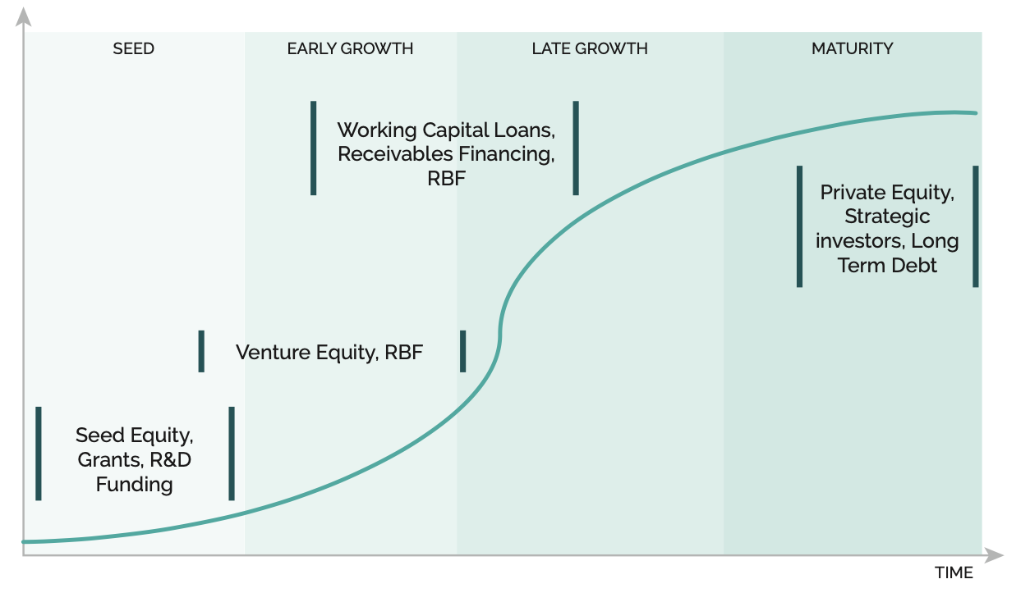
Financing by Maturity
Source: Modern Energy Cooking: Review of the Funding Landscape Report, February 2022

Slide 8
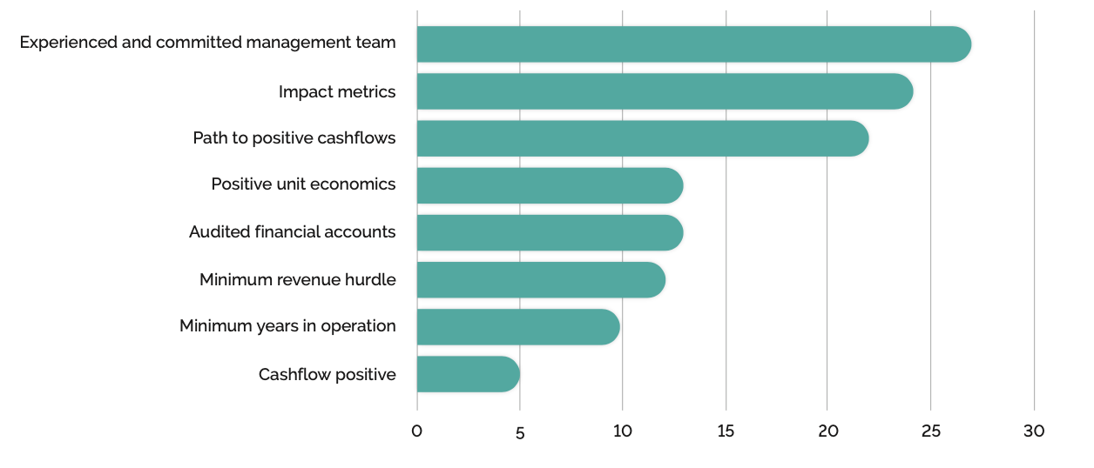
Primary Investment Criteria by Funders
Source: Modern Energy Cooking: Review of the Funding Landscape Report, February 2022

Slide 9
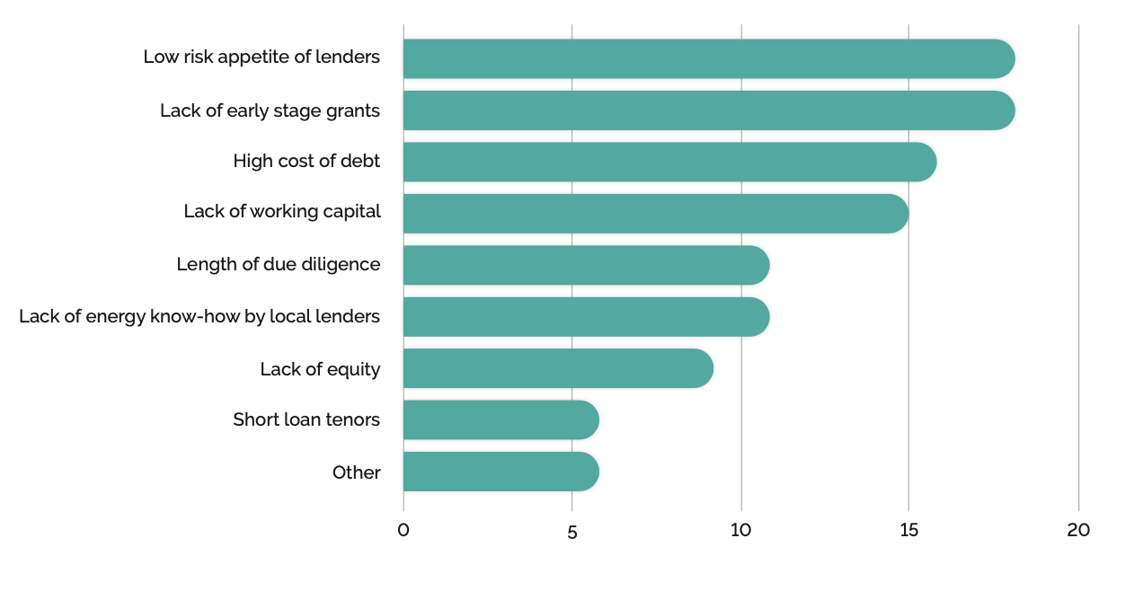
Barriers for Companies to Successfully Fundraise
Source: Modern Energy Cooking: Review of the Funding Landscape Report, February 2022

Slide 10
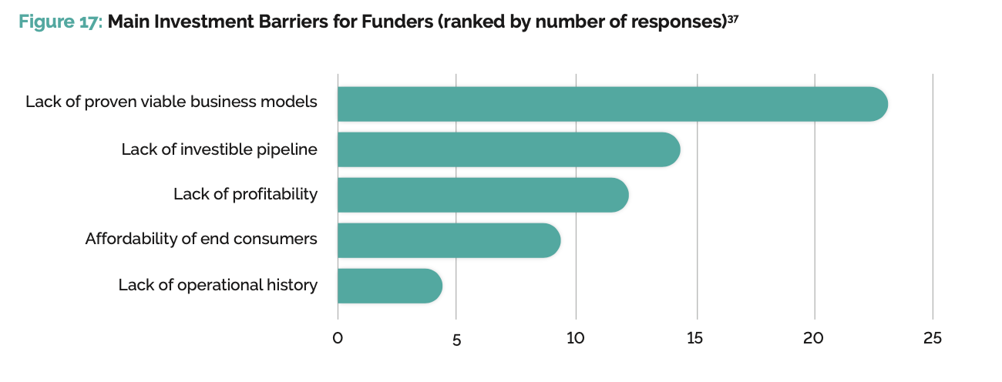
Barriers for Investors
Source: Modern Energy Cooking: Review of the Funding Landscape Report, February 2022

Slide 11
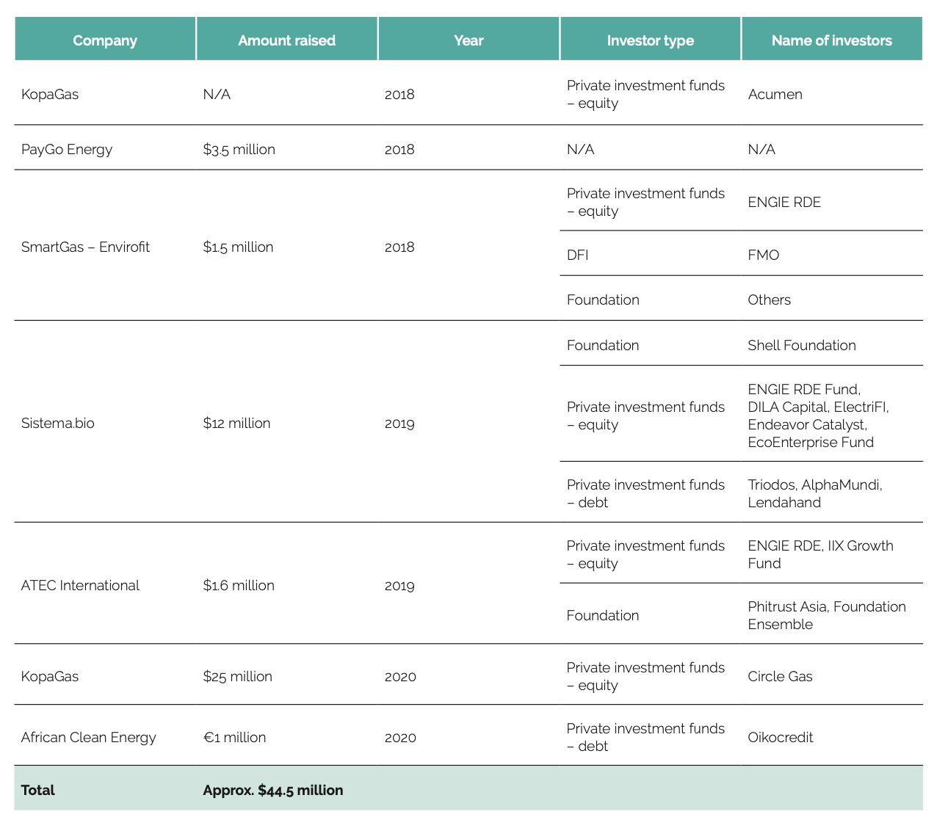
Notable Transactions
Source: Modern Energy Cooking: Review of the Funding Landscape Report, February 2022

Slide 12
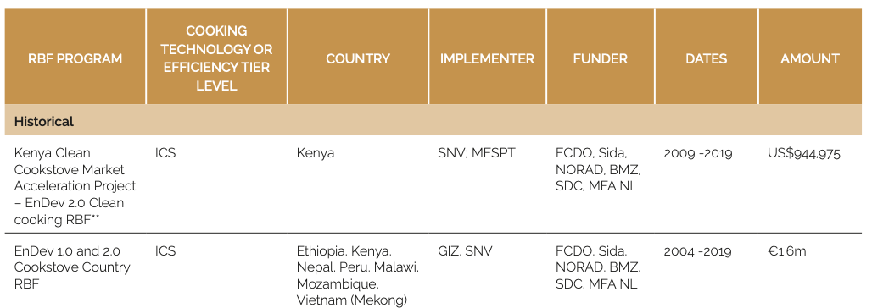
Historical RBF Programs
Source: Modern Energy Cooking: Review of the Funding Landscape Report, February 2022

Slide 13
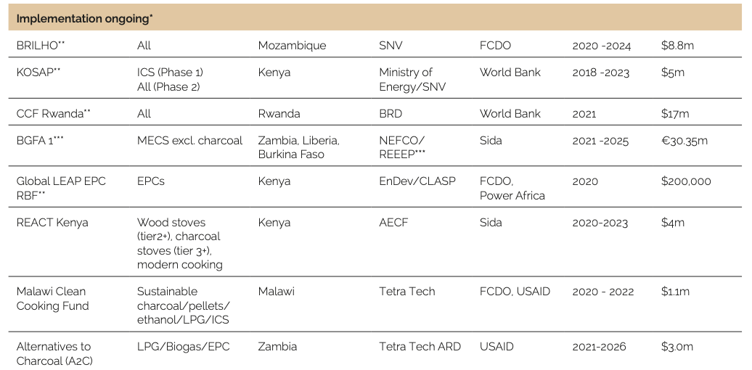
Ongoing RBF Programs
Source: Modern Energy Cooking: Review of the Funding Landscape Report, February 2022

Slide 14
Planned RBF Programs
Source: Modern Energy Cooking: Review of the Funding Landscape Report, February 2022

Slide 15
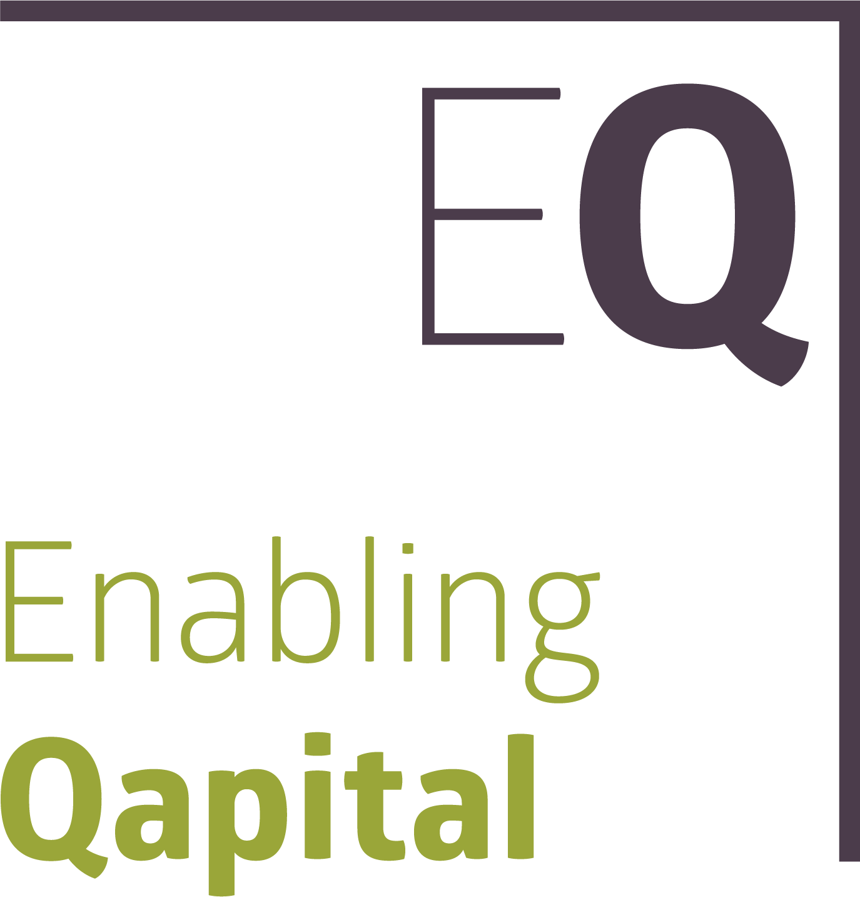
Fund Partners
Enabling Qapital: Investment Advisor and GP Shareholder
Stichting Modern Cooking: TA Partner and GP Shareholder
Woodman Asset Management: Alternative Investment Fund Manager (AIFM)
Clean Cooking Alliance: Sponsor and TA partner

Slide 16
Fund Overview
Spark+ Africa Fund is a $54 million impact investment fund financing companies that offer next-generation, distributed cooking energy solutions to the mass market in sub-Saharan Africa
Spark+ launched in March 2022 with an ecosystem-wide mandate across business models, segments of the value chain, and fuel/technology types
Spark+ makes USD 500,000 – 7 million on- or off-balance sheet investments including:
Senior debt secured by inventory, receivables, etc.
Unsecured, sub-debt/mezzanine which offer companies long-term, equity-like capital
Tripartite distributor financing to provide working capital to smaller, less well-capitalized/profitable distributors
Specialized carbon debt finance secured by Emissions Reduction Purchase Agreements (ERPAs)
Spark+ focuses on companies operating in Sub-Saharan Africa
Design
Manufacture
Import
Wholesale
Retail
Consumer Finance

Slide 17
Fund Investors

Slide 18
Fund Portfolio to Date
USD 6 million to Burn Manufacturing (Mauritius/Kenya)
In April 2022, Spark+ disbursed USD 4 million
An additional USD 2 million tranche was disbursed in September
USD 2 million to Sumac MFB (Kenya)
In May 2022, Spark+ disbursed USD 1 million
An additional USD 1 million tranche was disbursed in June
USD 500,000 to Bidhaa Sasa (Kenya)
In November 2022, Spark+ disbursed USD 500,000

Slide 19
Thank You
Thank you for your interest!
Contact details:
Peter George
Peter.George@enabling.ch

Slide 20
Disclaimer
All information contained in this document is for information purposes only and is the intellectual property of Enabling Qapital AG. Redistribution is prohibited unless consent to do so has been given by Enabling Qapital AG. Enabling Qapital AG does not accept any liability for any loss or damage, how ever it is caused, arising from any errors or omissions or reliance on any of the information contained in this material.
The information and opinions contained in this document have been derived from sources believed to be reliable and in good faith or constitute Enabling Qapital AG’s judgement as at the date of this document but no representation or warranty, express or implied, is made as to their accuracy, completeness or correctness and any opinions are subject to change and may be superseded without notice. Any information contained in this material is not to be relied upon as authoritative or taken in substitution for the exercise of judgement. Past performance is no guarantee for future performance and some positions may be subject to sudden and large movements in value. Foreign exchange rate fluctuations may also have an effect on the valuation of certain positions. This document is not, and should not be construed as, an offer or solicitation to sell or buy any investment or product. Enabling Qapital AG expressly does not provide legal or tax advice. It is recommended that you consult legal and tax advisors before making any investment decisions. The information contained herein is of a general nature, is based on various assumptions (which are subject to change) is not tailor-made and hence does not take into account your particular portfolio or financial situation. Enabling Qapital AG accepts no liability whatsoever for any loss arising from any use of the material. The material may not be reproduced, distributed or published for any purpose without the express written authorization of Enabling Qapital AG. Enabling Qapital AG and its affiliates and/or their officers, directors and employees may own or have positions in any investment mentioned herein or any investment related thereto and may from time to time add or dispose of any such investment.

