Slide 1
Business Model and Supply Chain Considerations within Bioethanol Businesses
Insights from the Clean Cooking Sector
Bioethanol Standardization Web-series February 2023

Slide 2
Agenda
01
An Overview of CCA
02
The Global Clean Cooking Challenge
03
Clean Cooking Market Perspectives
04
Bioethanol Cooking Value Chain
05
Bioethanol Cooking Business Models

Slide 3
AN OVERVIEW OF CCA
1

Slide 4
The Clean Cooking Alliance works with a global network of partners to build an inclusive industry that makes clean cooking accessible to the 2.4 billion people who live each day without it​​.

Slide 5
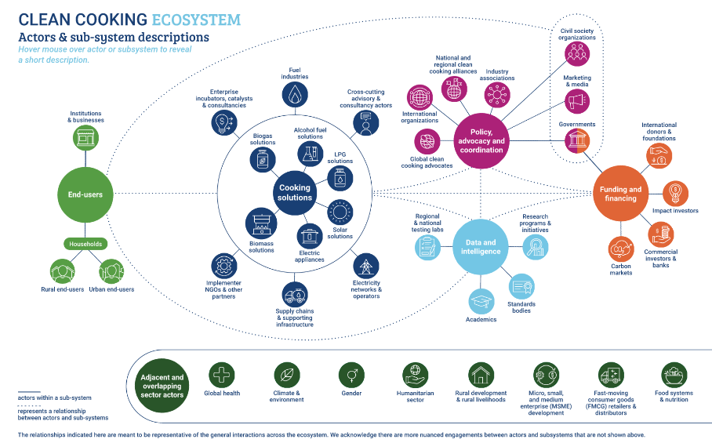
CCA fosters transformative change across the whole of a diverse and complex ecosystem

Slide 6
02
The Global Clean Cooking Challenge

Slide 7
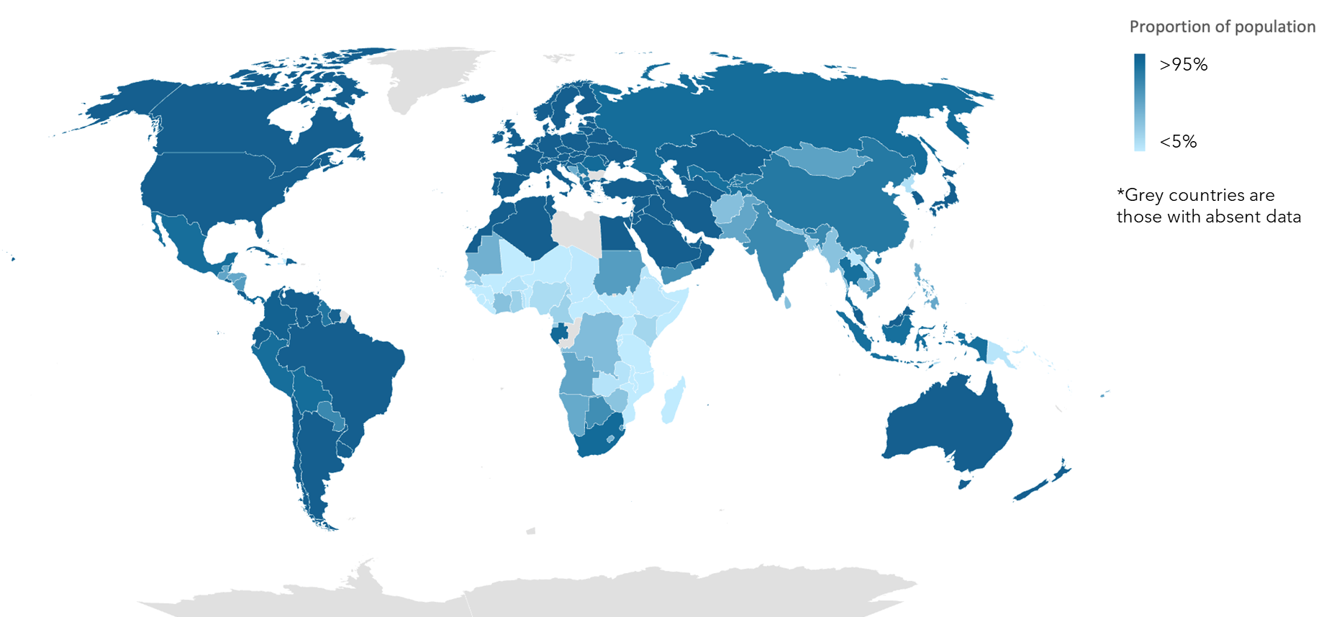
2.4 billion people globally lack access to clean cooking
The proportion of population with primary reliance on clean cooking fuels and technologies is about 30% in Sub-Saharan Africa and about 63% in Developing Asia, as of 2020.

Slide 8
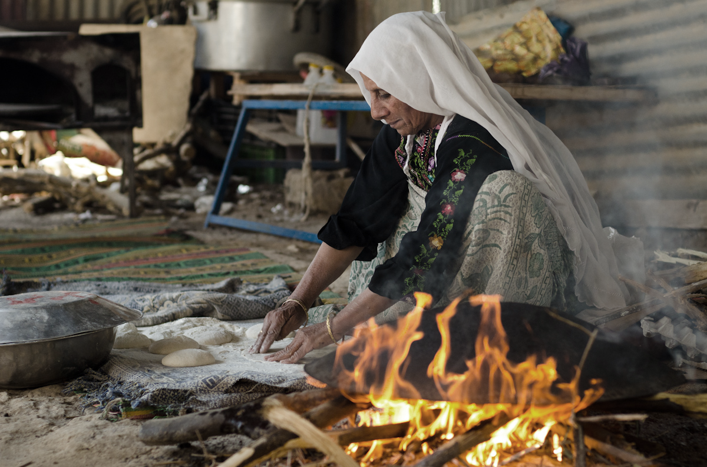
Clean cooking access can deliver health, air quality and gender & livelihood benefits
HEALTH
AIR POLUTION
GENDER & LIVELIHOODS
Up to 3.2 million people die prematurely every year from illnesses associated with exposure to smoke from polluting open fires or inefficient stoves (WHO 2022)
Household air pollution from solid biomass fuel use accounts for 16% of ambient air pollution globally and upwards of 30% of ambient air pollution in India, Nepal and other parts of Asia (McDuffie EE et al., 2021)​
Women and children spend 4 to 20 hours per week gathering fuel or spend significant household income purchasing it (WHO, 2016); 60% of deaths from household air pollution are women and children (IHME, 2020)

Slide 9
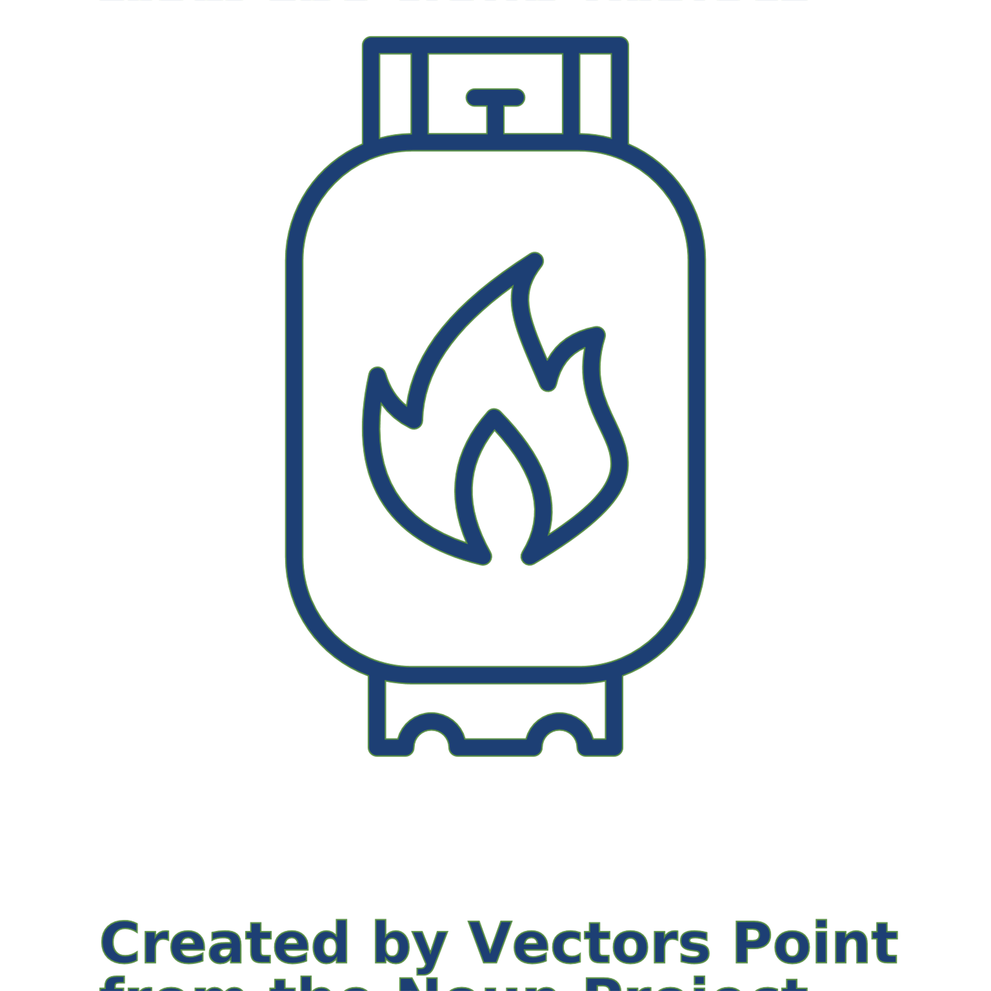
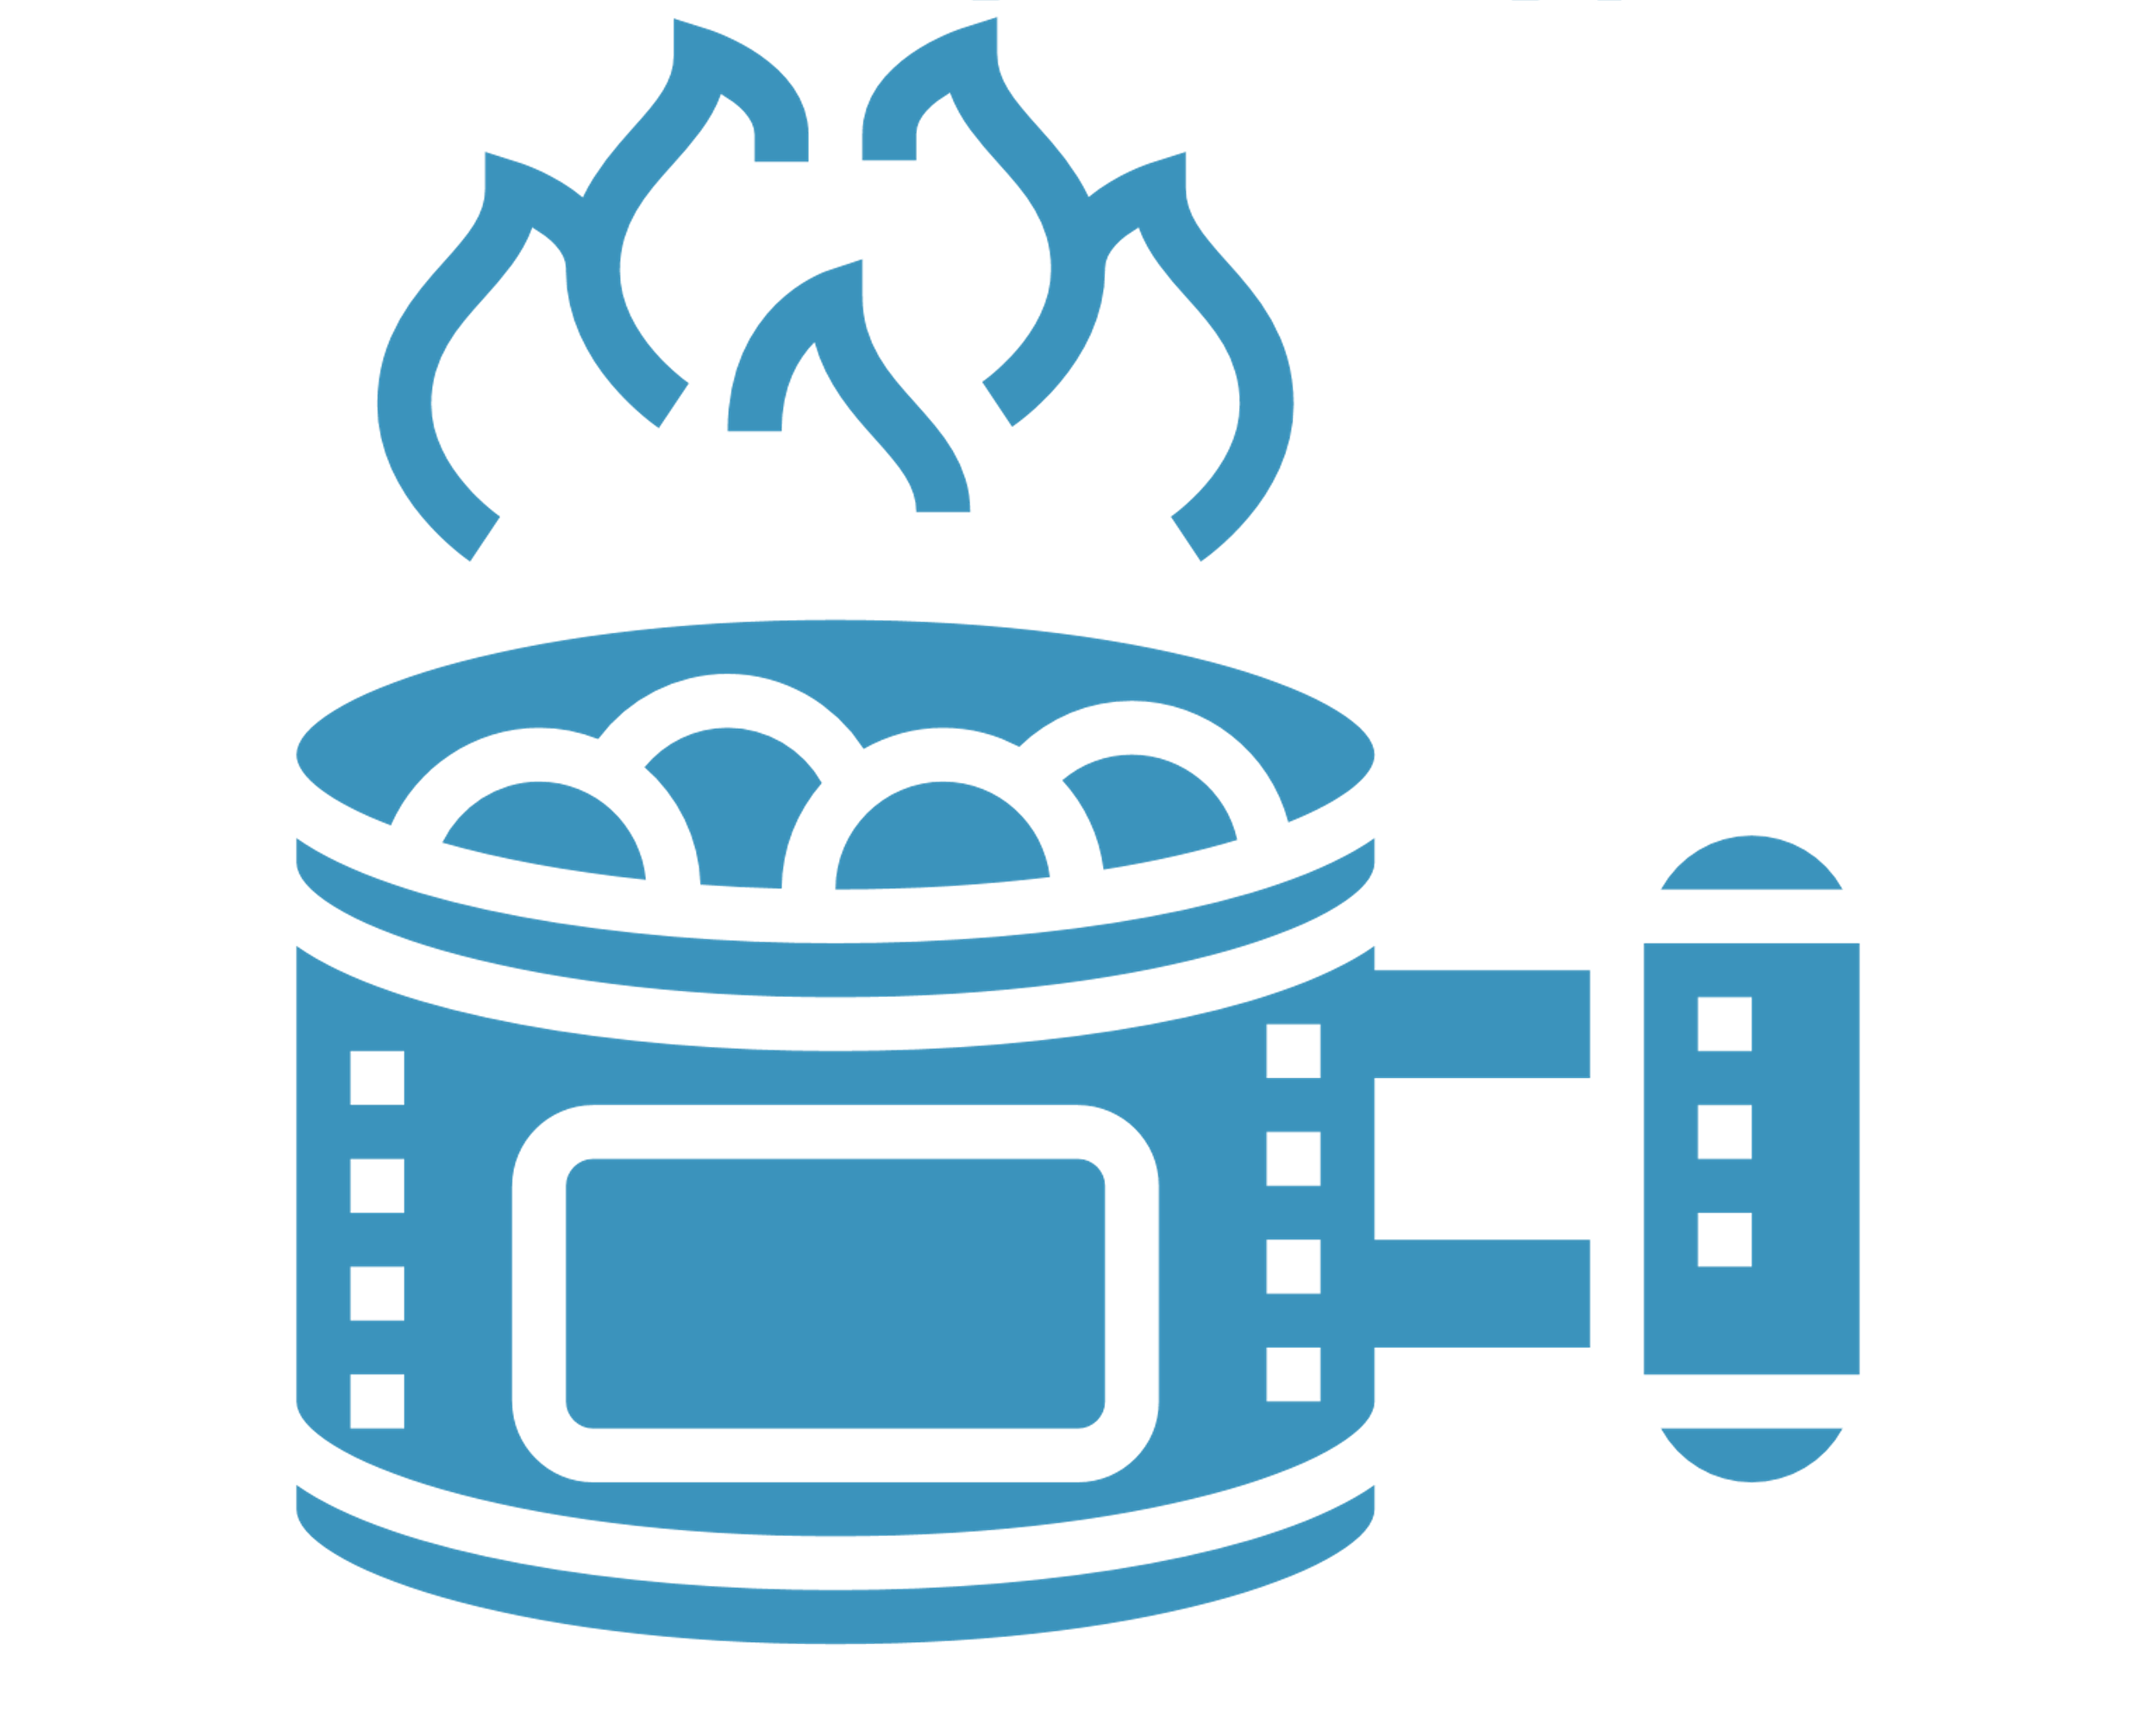
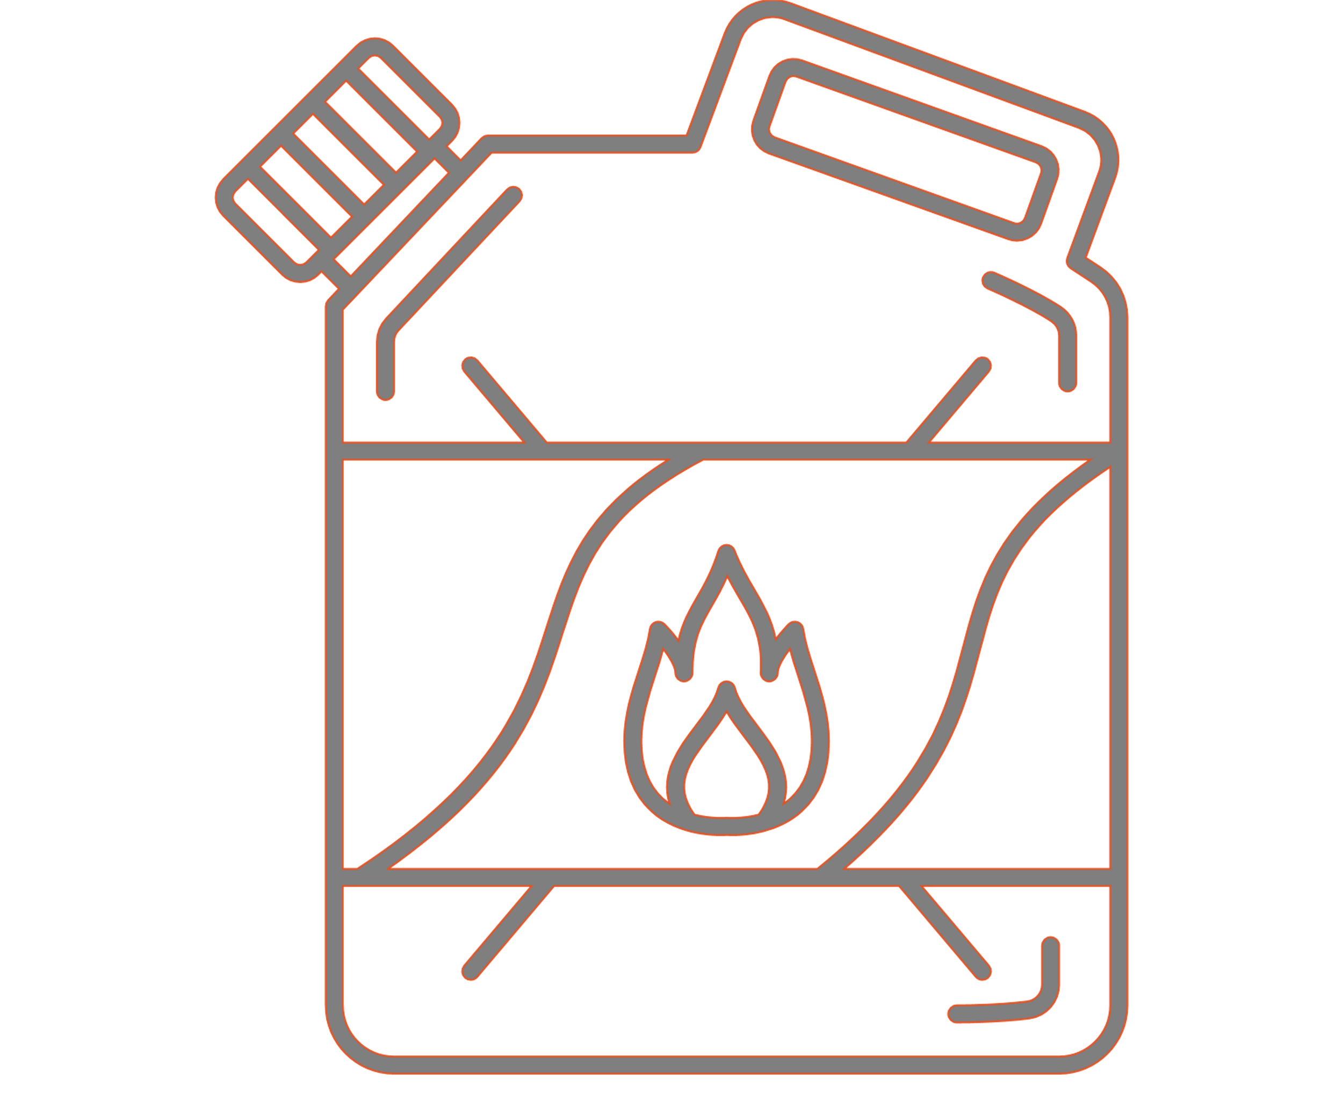
Cooking fuel categorization for health impacts
Clean
Electricity
Ethanol
LPG
Biogas
Solar
Transitional
Pellets*
Charcoal
* Clean in some cases
Polluting
Coal
Kerosene
Wood
Notes:
There are 5 ISO voluntary performance targets, namely: Thermal efficiency, carbon monoxide emission, fine particle matter emissions, safety, and durability.
Using a tiered system we can estimate the performance of a given technology/cookstove. There are 6 tiers for each performance category, ranging from 0 (poorest performance) to 5 (best performance). Ratings are based on summing the score for the individual subtests.
Carbon monoxide and fine particle matter emissions are reported separately, and lower scores are better.

Slide 10
Basic improved charcoal*
High-efficiency charcoal*
Wood*
Climate Impact
Rocket*
Electricity*
LPG
Pellet-fed gasifier
Ethanol
Health Impact
*Climate impact depends on renewability

Slide 11
03
Clean Cooking Market Perspectives

Slide 12
The clean cooking market is diversifying
Share of revenues from clean cooking sales by technology category
Source: CCA Industry Snapshot
Notes:
The Clean Cooking story used to primarily be about improved biomass cookstoves
That is changing however,
Ethanol still a very small part of the overall clean cooking sector by revenues (included in other)
We expect to see that change as we are starting to see scaling-up of bioethanol business models

Slide 13
Examples
Carbon markets
Complementary technologies
Fuel prices
Consumer tastes
Global political movements
Macro-level trends
Enabling environment
Supply
Examples
Demand
National policies & regulations
Donor funding
Infrastructure
Standards
Market drivers and inhibitors
Examples
Market density
Business model maturity
Access to finance
Enterprise capabilities
Customer base
Examples
Substitutes
Lifestyle disruptions
Perceived value proposition

Slide 14
Clean and renewable fuel option
Macro-level trends
Policy experiments with targeted incentives
Good fit with carbon finance
Concerns with land use change and food security
Enabling environment
Supply
Demand
VAT & import duties
Existing international commodity supply chain
Ethanol
Limited local supply in SSA
Similar experience as gaseous fuels
Safety concerns (spillage and burns)
Variable quality
Variable cooking performance

Slide 15
04
Ethanol Cooking Value Chain

Slide 16
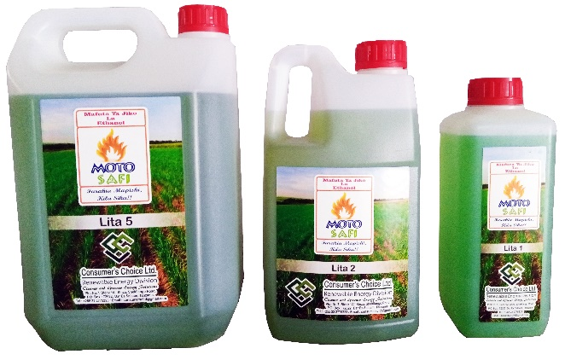
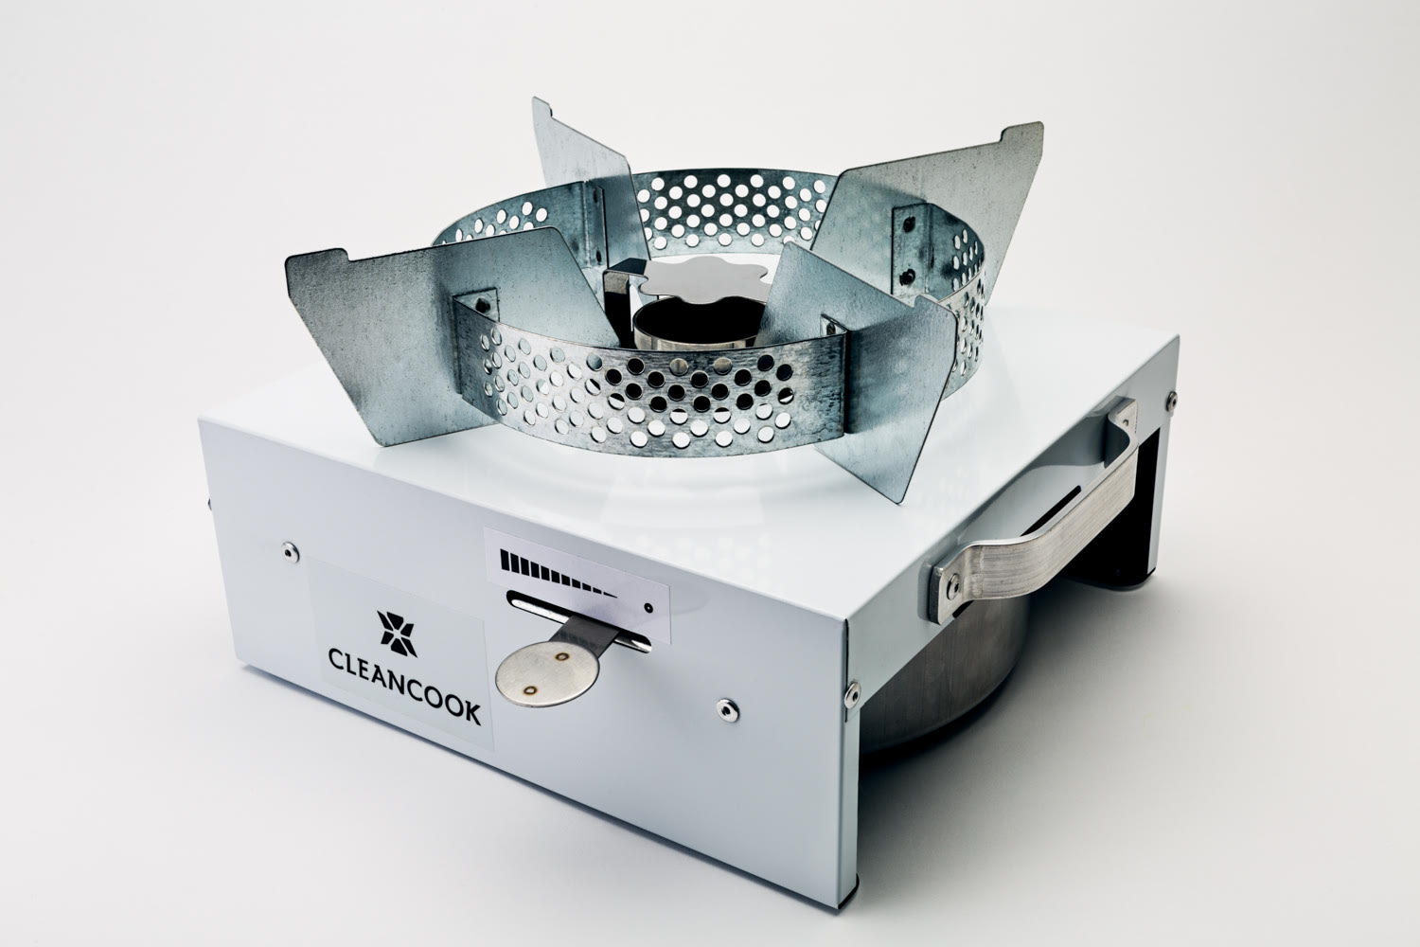
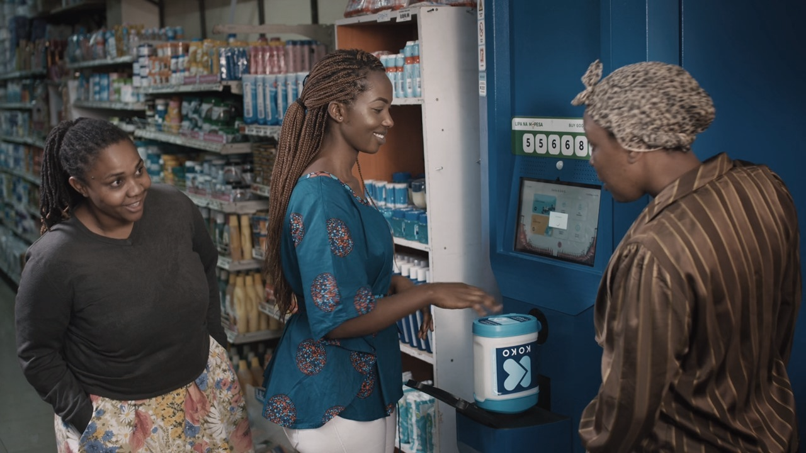
Fuel, Stoves, and Customers
Fuel
Stoves
Customers

Slide 17
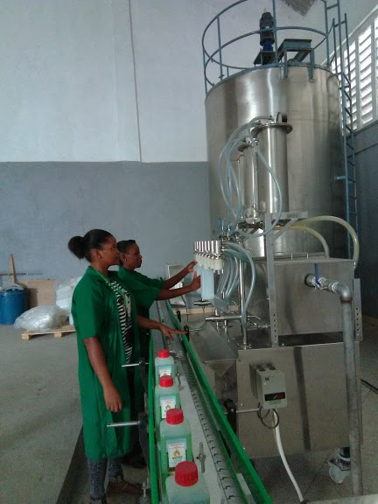
Fuel Value Chain
Production
Bulk Transport/ Importing
Retail
Urban Storage
Packaging
Distribution
Centralized Bottling
Farming bio-ethanol Crops
Processing feedstock to produce bioethanol
International shipping
Local logistics for bulk transport
Bulk storage facilities usually co-located with bottling plants
Fuel blending and bottling
Logistics operations to supply retail outlets as FMCG product
Agent networks and retail outlets
Customer education on cooking with ethanol fuel
Distributed Dispensing
Distributed bulk storage facilities located near customers
Cannisters designed for re-filling
Logistics operations to restock dispensing units

Slide 18
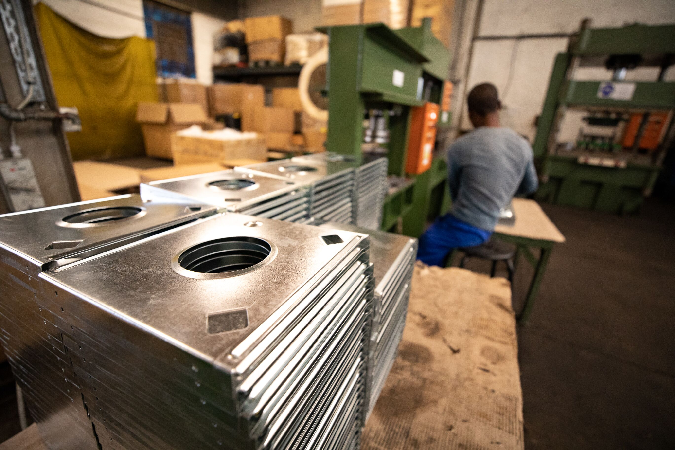
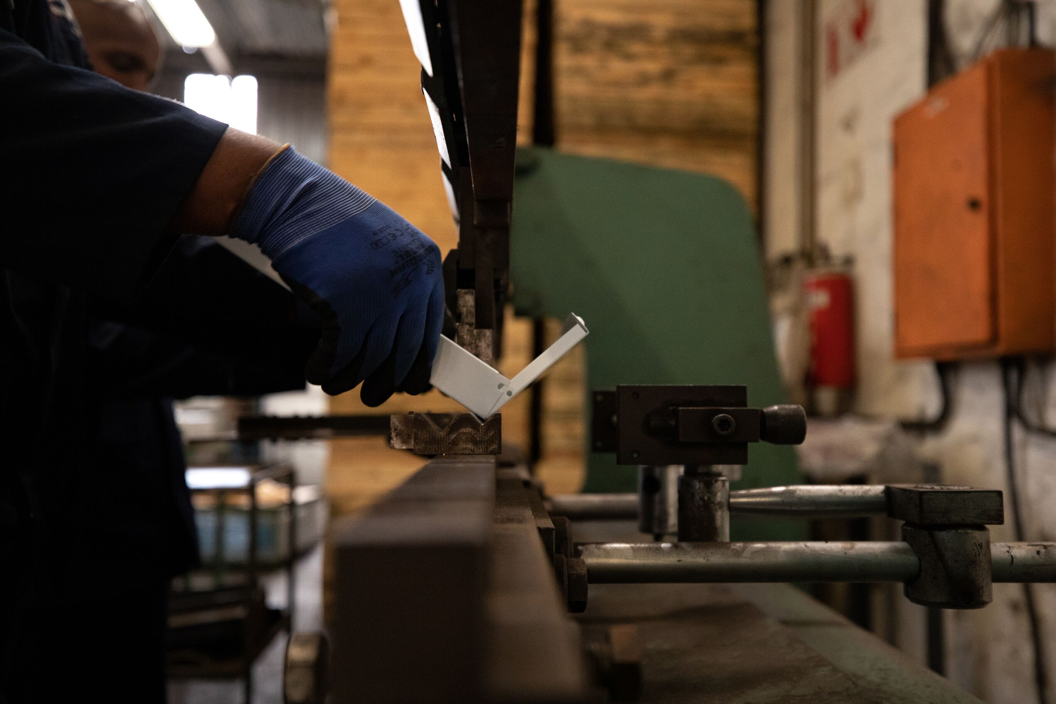
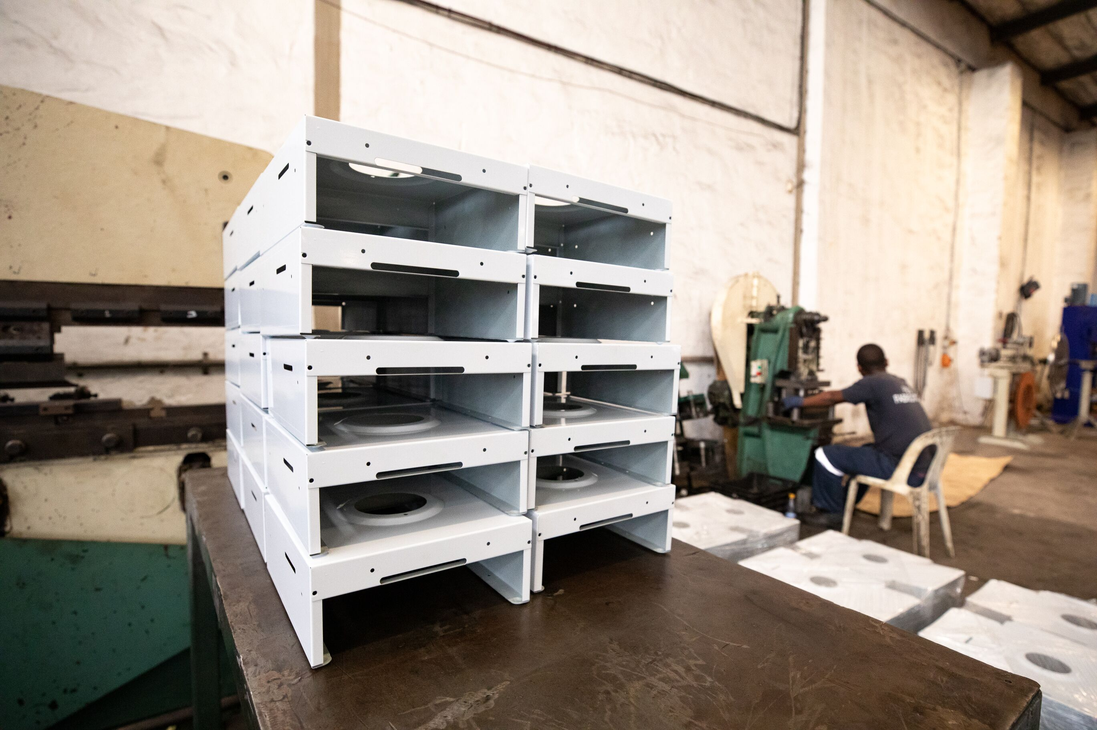
Stove Value Chain
Raw Material Sourcing
Manufacturing
Retail
Assembly
Distribution
R&D
Appliance Design
Focus on efficiency user experience and cost
International supply chain for raw materials and components
Inbound logistics
Machining of stove parts - specialized factories
Assembly of stoves to finished products
Logistics operations to supply distributors, retail outlets, and/or agents
Agent networks and retail outlets
Customer education on stove use
Consumer financing

Slide 19
05
Business Models

Slide 20
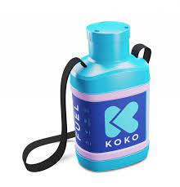
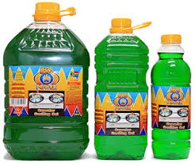
Fuel
Imported and domestically produced bioethanol fuel with localized blending and bottling
Centralized bottling model
Fuel distributed in pre-packaged bottles of various sizes e.g., 1L, 5L which are blended and packaged by distributors
Fuel distributors usually branded fuel alongside stoves purchased from original equipment manufacturers
Distributed dispensing model
Fuel sold in customer selected quantities through vending points where consumers re-fill cannisters e.g., KOKO Networks (Kenya)
Notes:
Examples of companies in centralized bottling:
Consumers Choice – Tanzania
Green Energy Biofuels – Nigeria
Green 66 Innovations – SA/Mozambique
Examples of companies with distributed Dispensing model
KOKO Networks – Kenya

Slide 21
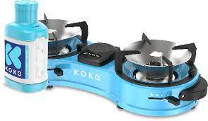
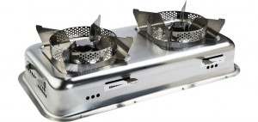
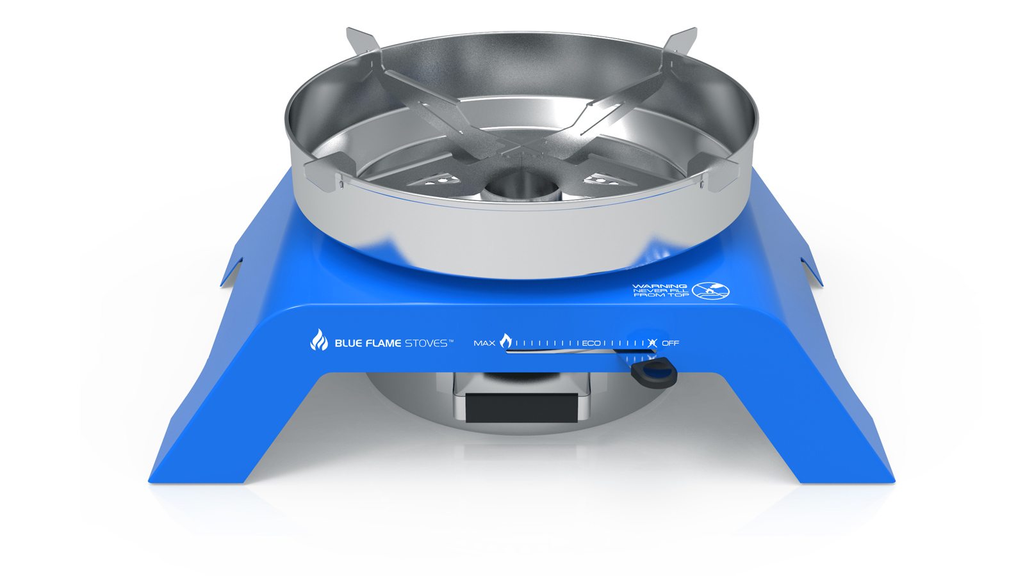
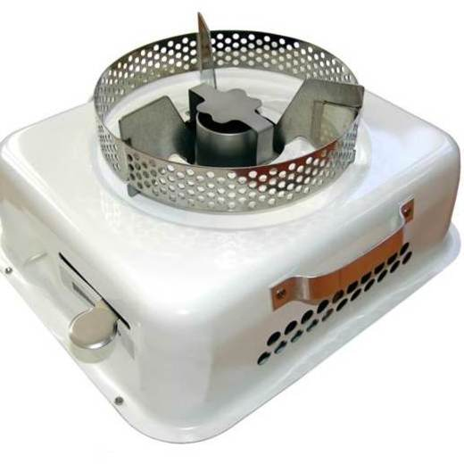
Appliances
1 burner and 2 burner stoves available in the market
‘Tool & fuel’ players
Design stoves (own IP) and
Distribute branded fuel alongside stoves
Original Equipment Manufacturers (OEMs)
Design stoves and own tooling for manufacturing and product patents.
License product IP to specialist manufacturers and/or distributors
Specialist manufacturers
Produce stoves under license or outsourcing agreements
Also produce stove kits for assembly in end-market
Notes:
Tool & fuel’ model: company designs its own stove (and owns the IP) distributing it alongside branded fuel e.g., KOKO Network's (Kenya); Green 66 Innovations ‘Yazu’ (Mozambique)
Original Equipment Manufacturers (OEMs): design stoves and own tooling for manufacturing and product patents. They license product IP to specialist manufacturers and/or distributors e.g., Cleancook (Sweden); Blue Flame (Norway)
Specialist manufacturers: produce stoves under license or outsourcing agreements. Also produce stove kits for assembly in end-market e.g., BURN Manufacturing (Kenya)

Slide 22
Challenges to Scale
Fuel cost & availability
End-user cost made up of landed supply cost, logistics & distribution costs, and taxes
Limited domestic supply in many countries
Duty and tariffs on imported ethanol affect competitiveness with other cooking fuels like LPG
Low levels of market awareness compared to other cooking fuels
High distribution costs and working capital requirements for distributors to make fuel widely available
High adoption costs for low-income households as customers need a specialized appliance in order to switch to ethanol fuel

Slide 23
Opportunities to Scale
Huge market size, every household needs to cook every day
Increased public and private sector investment in the clean cooking sector across the value chain
Increased innovation and technology integration in business models driving down operating costs and improving unit economics
Leveraging of carbon finance markets as a source of capital and a way to subsidize adoption costs e.g., by investing carbon revenue to lower stove prices
Impact monetization mechanisms (results-based finance) that pay for positive impacts allowing companies to serve hard to reach customers
Notes:
AECF REACT RBF (Kenya): provides donor funded financial incentives to companies that increase household access to clean energy; bioethanol in scope.
BRILHO (Mozambique): offers companies non-reimbursable funding and specialized support in aiming to achieve competitive commercial returns and provide off-grid energy solutions to low-income markets.

Slide 24
Thank you
The Clean Cooking Alliance works with a global network of partners to build an inclusive industry that makes clean cooking accessible to the three billion people who live each day without it. Established in 2010, CCA is driving consumer demand, mobilizing investment to build a pipeline of scalable businesses, and fostering an enabling environment that allows the sector to thrive.
Learn more at cleancookingalliance.org

