Slide 1
The Role of ASTM International Standards in Support of Clean Energy
Maria Jiverage, Manager- Global Cooperation, Training
November 9th, 2022
www.astm.org
© ASTM International

Slide 2
Background
ASTM International’s Context
ASTM’s experience offers a robust, time-tested development process delivering globally accepted and respected standards
Established 1898
30,000+ members in 155+ nations
154+ Technical Committees meeting market needs of 90+ industry sectors
Success based on responsiveness to the market – to both member and customer needs
In addition to standards, we offer training, proficiency testing, certification and an electronic platform that facilitates collaboration

Slide 3
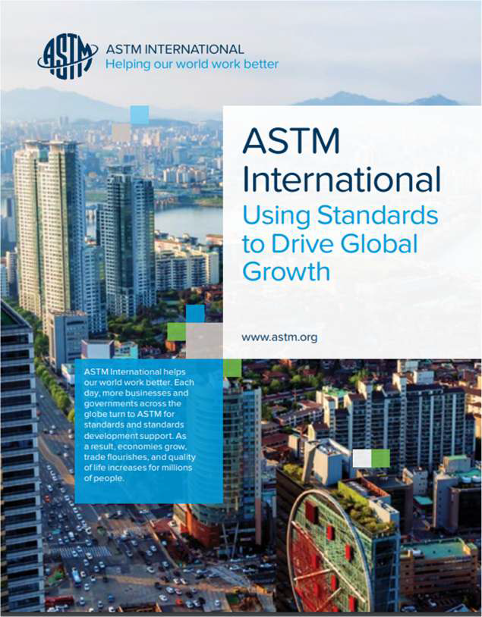
What Is a Standard?
Much more than technical documents… Documents established by consensus, and approved by a recognized body, that provide for common and repeated use, offer rules, guidelines or characteristics
Standards fuel global trade, promote health and general welfare, advance innovation
Wide range of valuable uses
Standards come in many forms:
Product specifications
Test methods
Manufacturing practices
Operational and purchasing guidelines
Classifications
Standardized terminology
And more….

Slide 4
How are ASTM Standards Developed?
A need is identified by a Committee or interested parties approach a Committee
Executive Subcommittee assigns task to existing Subcommittee or plans are made to establish a new Subcommittee
Volunteer members of Subcommittee prepare a draft standard
Draft Standard is balloted using the ASTM process
Any negative votes are resolved by the Committee and due process is reviewed by ASTM
© A⁴STM International

Slide 5
Quality Infrastructure
CERTIFICATION
Personnel
Product
Systems
STANDARDIZATION
- Technical Regulations
METROLOGY
ACCREDITATION
Scientific
Industrial
Legal
TESTING
Quality Promotions
INSPECTION
Documents
Visual
Performance
Market Surveillance
Marketing & Communications
Information
Knowledge Management
Education

Slide 6
Attributes of Standards Systems that Produce International Standards
Open and Transparent Process
Direct and equal participation to ASTM for all people and organizations
Information on ASTM International standards are transparent and readily available online
Impartial, Consensus-Based Model of Engagement
Balanced system where producer votes are equal to those of users
Impartial, inclusive, and fair to all, with appeals and protections to avoid abuses
Effective and Relevant Standards
Constantly responding to market needs, keeping pace with industry and innovation
Relevant to the global marketplace and performance-based in application
Driven by Research, Data, and Science- Based Decisions
Focus on science and technical quality, and specifically addressing risks and needs
Collaboration with Other Standards Bodies to Avoid Duplications
Collaborate with other standards organizations to avoid duplication and to pursue international standards work in a smart way

Slide 7
International Standards
 | WTO/TBT Principles
 | Transparency
 | Openness
 | Impartiality and Consensus
 | Effectiveness and relevance
 | Coherence
 | Consideration of developing nations
WTO TBT Committee Decision
The World Trade Organization (WTO) Technical Barriers to Trade (TBT) Committee Decision on Principles for the Development of International Standards, Guides and Recommendations provides guidance
in the form of six principles; does not designate SDOs
helps regulators determine which international standards may be relevant for the purposes of the TBT Agreement

Slide 8
Standards and Regulatory Objectives in Today’s Global Economy
We all want to facilitate market access
Reduce non-tariff barriers that impede the flow of goods and services
Reduce the cost of differences in regulation and standards
Increase compatibility, transparency, and cooperation
Foster innovation and technology transfer
Boost the competitiveness of SMEs and companies
We want policies that advance trade and promote greater prosperity

Slide 9
ASTM International – Global Outreach
Developing Economies Reach
Virtual
116
national standards bodies
122
partners
6
regional bodies
8800+
ASTM citations from ~75% of ASTM TCs
100 programs
3500 individuals
most in transitioning economies
Provides
No cost, online access to all 13,000
ASTM standards
Ability to adopt or use ASTM standards as the basis of national standards, reference, or consult
No cost membership in any and as many ASTM TCs to any stakeholder in partner’s geography
Capacity Building – technical/procedural
⎼ Individuals in-residence or on-site, fully or partially sponsored, delegation programs along with an extensive number of virtual sessions

Slide 10
ASTM Memoranda of Understanding
ASIA | EUROPE | CENTRAL & SOUTH AMERICA | CARIBBEAN | MIDDLE EAST & NORTH AFRICA | EASTERN, WESTERN & CENTRAL AFRICA | SOUTHERN AFRICA
BANGLADESH | ALBANIA | ARGENTINA | ANTIGUA AND BARBUDA | AFGHANISTAN | ARSO | ANGOLA
BHUTAN | ARMENIA | BOLIVIA | BAHAMAS | AIDSMO | BURKINA FASO | BOTSWANA
BRUNEI DARUSSALAM | AZERBAIJAN | BRAZIL | BARBADOS | ALGERIA | BURUNDI | eSWATINI
CAMBODIA | BELARUS | CHILE | BELIZE | BAHRAIN | CAMEROON | MALAWI
CHINA | BOSNIA | COLOMBIA | CROSQ | EGYPT | COTE d'IVOIRE | MAURITIUS
INDONESIA | BULGARIA | COSTA RICA | DOMINICA | GSO | DEM.REP. CONGO | NAMIBIA
KOREA | CROATIA | ECUADOR | DOMINICAN REPUBLIC | IRAQ | ETHIOPIA | SEYCHELLES
LAO | EASC | EL SALVADOR | GRENADA | ISRAEL | THE GAMBIA | SADC
MALAYSIA | EEC | GUATEMALA | GUYANA | JORDAN | GHANA | SOUTH AFRICA
MONGOLIA | GEORGIA | HONDURAS | HAITI | KUWAIT | KENYA | ZAMBIA
MYANMAR | KAZAKHSTAN | MEXICO | JAMAICA | LIBYA | MOZAMBIQUE | ZIMBABWE
NEPAL | KOSOVO | NICARAGUA | MONTSERRAT | MOROCCO | NIGERIA
NEW ZEALAND | MOLDOVA | PANAMA | ST. KITTS-NEVIS | OMAN | RWANDA
PAKISTAN | MONTENEGRO | PARAGUAY | ST. LUCIA | PALESTINE | SIERRA LEONE
PAPUA NEW GUINEA | ROMANIA* | PERU | ST. VINCENT - GRENADINES | QATAR | SENEGAL
PHILIPPINES | RUSSIA | URUGUAY | SURINAME | SAUDI ARABIA | SUDAN
SINGAPORE | SERBIA |  | TRINIDAD & TOBAGO | TUNISIA | TANZANIA
SRI LANKA | UKRAINE |  |  | TURKEY | UGANDA
TAIWAN | UZBEKISTAN |  |  | U.A.E.
THAILAND |  |  |  | YEMEN
VIETNAM

Slide 11
Six Ways to Adopt and Reference ASTM
Available to all Public and Private Standards’ Users
Incorporated by Reference in Technical Regulations
Normative Reference in Standards
Code Reference (i.e. Building Code)
Used as the Basis of National Standard or Consulted
Incorporated by Reference
Equivalent Adoption |  | Simple Ways to Adopt or Reference ASTM International Standards |  | Normative Reference
Available Only to MoU Partners
Identical Adoption
Equivalent Adoption
Used as the Basis of a National Standard or Consulted
Identical Adoption
Code Reference

Slide 12
Uses of ASTM International Standards
Incorporated by Reference
ASTM International standard is called out, either in whole or in part, in a regulation, law, decree, rule, act, directive, order, edict, etc. (i.e. any official government document other than a National Standard)
The content of the ASTM standard, either in whole or in part, is intended to be used as an additional requirement of the new regulation
3000
More than 3,000 ASTM standards are cited in the U.S. Code of Federal Regulations

Slide 13
Incorporated by Reference (example)
Regulations for Governing the Management of Medical Devices (Taiwan)
Taiwan Economy Notification: TPKM/372
Date issued: 3/26/2019
Agency Responsible: Food and Drug Administration, Ministry of Health and Welfare
A patient examination glove is a disposable device intended for medical purposes that is worn on the examiner's hand or finger to prevent contamination between patient and examiner. Materials of patient examination gloves should comply with the barrier property (water leak) and tensile strength requirements of ISO 11193-1, ASTM D3578, ASTM D5250, ASTM D6319, EN 455 or equivalent standards. A non-powdered (powder free) patient examination glove should comply with residual powders requirements of EN ISO 21171, ASTM 6124 or equivalent standards.
© ASTM International

Slide 14
ASTM Technical Committees
D02 on Petroleum, Liquid Fuels and Lubricants
Largest ASTM Committee, organized in 1904
Includes over 2,400 members from more than 65 countries
Developer of over 800 petroleum standards that have helped to provide heat for homes, fuel for automobiles and airplanes, and lubricants for machinery
D4806 Standard Specification for Denatured Fuel Ethanol for Blending with Gasolines for Use as Automotive Spark-Ignition Engine Fuel
Country | Citation
Mauritius | Incorporated by Reference
Mozambique | Incorporated by Reference
South Africa | Adoption
Tanzania | Basis of national standard
Zambia | Incorporated by Reference
Zimbabwe | Adoption
This specification covers nominally anhydrous denatured fuel ethanol intended for blending with unleaded or leaded gasolines for use as a spark- ignition automotive engine fuel.

Slide 15
ASTM Technical Committees
E48 on Bioenergy and Industrial Chemicals from Biomass
Newer ASTM Committee, organized in 1985
200 members and 20 standards
Develops high-quality voluntary consensus standards for industrial biotechnology and agricultural biomass/renewable energy.
ASTM E3050 Standard Specification for Denatured Ethanol for Use as Cooking and Appliance Fuel
Country | Citation
Uganda | Adoption
Tanzania | Consulted
Mozambique | Consulted
Zambia | Consulted
This specification provides requirements and corresponding test methods for denatured ethanol intended to be used as a cooking or appliance fuel, or both.

Slide 16
In Conclusion
Benefits of Incorporating By Reference
Minimizes duplication and conflicting guidance in industry
Able to stay current with most up-to-date work product generated by industry experts around the world
Reduces development time for new regulations and eliminates costs associated with developing new country specific regulations
Contributes to transparency and allows feedback on whether other standards should be recognized during the proposed rule-making
Ensures the use of a document that has already reached consensus by a broad group of stakeholders, including regulators
Regulations incorporating consensus standards are more likely to be implemented

Slide 17
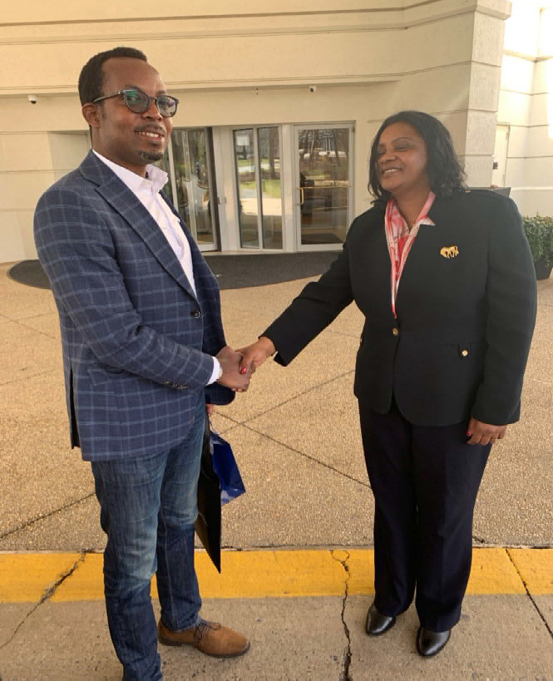
Africa Organization for Standardization (ARSO)

Slide 18
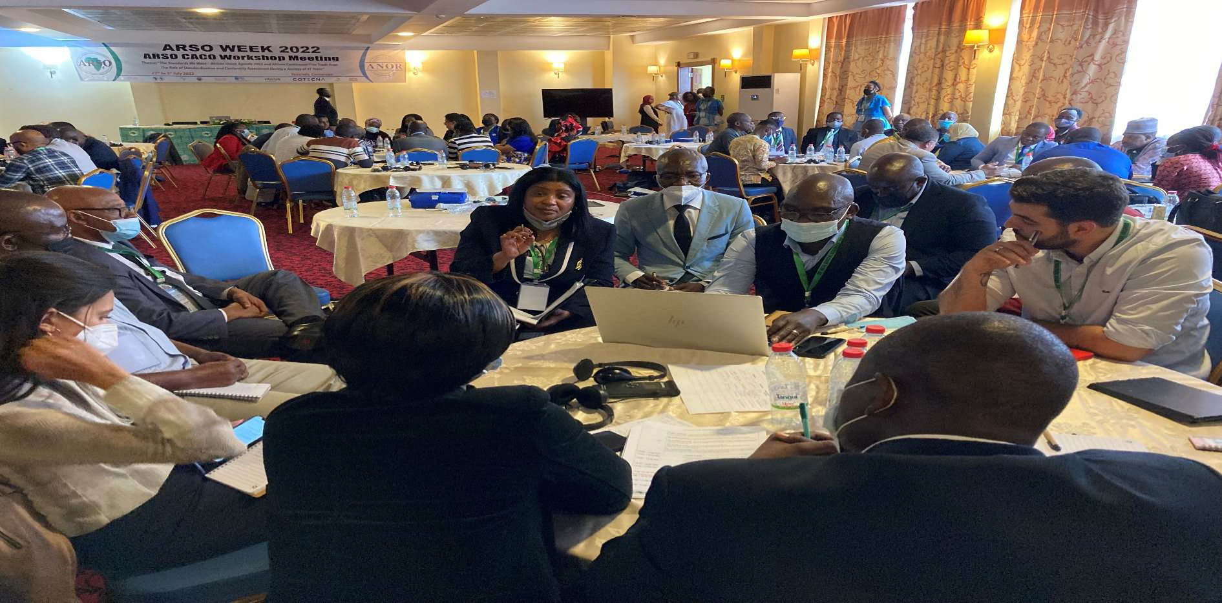
ASTM Strategic Intervention
Qatar – 2008
ARSO General Assembly – Yaoundé, Cameroon, 2022
© ASTM International
18

Slide 19
Contacts
ASTM international Headquarters Teresa Cendrowska
100 Barr Harbor Drive
P.O. Box C700
West Conshohocken, PA 19428-2959, USA
tel +1.610.832.9500
tcendrowska@astm.org
Brussel, Belgium Sara Gobbi
tel +32.0.28.405.127
sgobbi@astm.org
Singapore Elvin Chia
tel +65.877.84200
echia@astm.org
Ottawa, Canada Diane Thompson tel +1.613.751.3409
dthompson@astm.org
Lima, Peru
María Isabel Barrios tel +51.1.205.5502
mbarrios@astm.org
Beijing, China Liu Fei
tel +86.10.5109.6033
fliu@astm.org
Washington, D.C., USA Jeffrey Grove
tel +1.202.223.8505
jgrove@astm.org
© ASTM International
ASTM International Orientation Module
19

Slide 20
Thank you! Questions?
Maria Jiverage
Manager, Global Cooperation, Training mjiverage@astm.org
www.astm.org
© ASTM International

