Slide 1
ISO Standards and Clean Cooking
Christian L’Orange
Assistant Professor
Associate Director – Center for Energy Development & Health
Colorado State University

Slide 2





International performance standards support global coordination and harmonization
ISO standards…
Voluntary
Standardized
Generalizable
Identify quality
Are voluntary international performance standards developed through consensus by the clean cooking community
Standardized test procedures and reporting for the lab and field
Can be used in any country regardless of national policies and contexts
Allow countries to identify the best available technologies, specific to each context
Adapted from Jetter & Derby et al. (2022)
Notes:
What are ISO standards and why are they important?
A decade ago, we had different stakeholders all over the world testing stoves in different ways, if at all, with no easy or standardized way of reporting the results. When CCA launched, this was one of the main priorities identified by partners.
When we started developing standards in 2012, we chose to do it through the International Organization for Standardization (ISO) in the form of a voluntary international performance standard.
Outcome and process standardized-- ISO and stakeholders engage through their national standard bodies making the work more robust and widely accepted.
International standards provide a single, validated source for testing methods and performance indicators and can be used in any country with consideration of national policies and contexts.
They facilitate coordination in a global ecosystem with a broad range of stakeholders, each with differing priorities, approaches, and goals.
Sets the path for continuous improvement over time

Slide 3

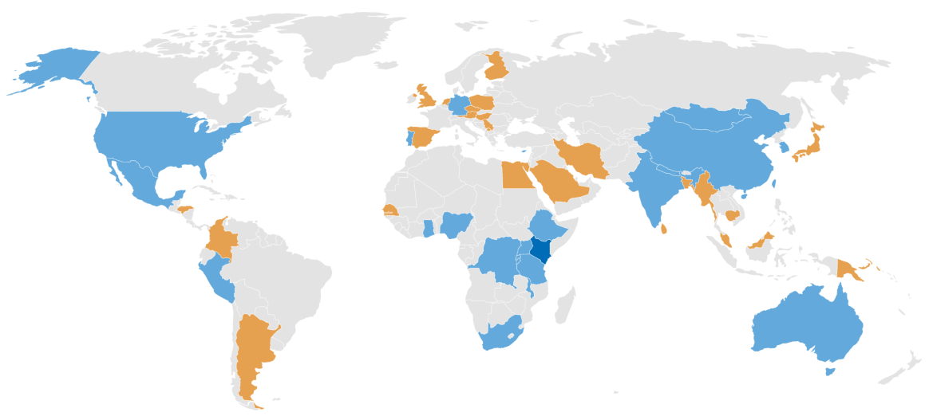
ISO Cookstoves / Household Energy Activities
ISO Process
Lima Consensus – 2011 - PCIA Forum
Tiers of Performance for multiple indicators
ISO International Workshop Agreement 11 2012 – The Hague, Netherlands
Guidelines for evaluating cookstove performance
TC285 Plenary Meetings
  Inaugural – 2014 – Nairobi, Kenya
  2014 – Guatemala, Working Groups
  2015 – Accra, Ghana
  2017 – Kathmandu, Nepal
  2019– Nairobi, Kenya
  Next Plenary is being planned
TC285 Currently -- 23 participating members/24 observing members

Slide 4
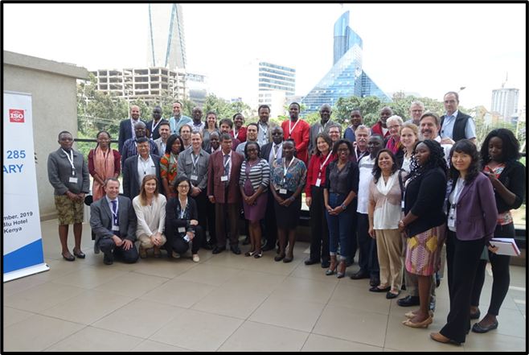
ISO Cookstoves / Household Energy Activities
ISO Process
Working Group #1 – Conceptual Framework – under development (ISO/AWI PAS 16617)
  Vocabulary – 2018 (ISO/TR 21276:2018)
Working Group #2 – Laboratory Testing
  Harmonized Laboratory Protocols – Published 2018 (in English and French) (ISO 19867-1:2018)
    Renewal begins in 2023
  Voluntary Performance Targets – Published in 2018 (ISO/TR 19867-3:2018)
  Institutional Stove Testing Standard – under development (ISO/DIS 5714)
Working Group #3 – Field Testing
  Field Testing methods for cookstoves – Published 2019 (ISO 19869:2019)
    Renewal begins in 2024
Working Group #4 – Guidelines for social impact assessment
  Expected to be published by EOY 2022 (ISO/WD TR 19915)
Nairobi Plenary Meeting - 2019

Slide 5
ISO Cookstoves / Household Energy Activities
ISO Process
Working Group #1 – Conceptual Framework – under development (ISO/AWI PAS 16617)
  Vocabulary – 2018 (ISO/TR 21276:2018)
Working Group #2 – Laboratory Testing
  Harmonized Laboratory Protocols – Published 2018 (in English and French) (ISO 19867-1:2018)
    Renewal begins in 2023
  Voluntary Performance Targets – Published in 2018 (ISO/TR 19867-3:2018)
  Institutional Stove Testing Standard – under development (ISO/DIS 5714)
Working Group #3 – Field Testing
  Field Testing methods for cookstoves – Published 2019 (ISO 19869:2019)
    Renewal begins in 2024
Working Group #4 – Guidelines for social impact assessment
  Expected to be published by EOY 2022 (ISO/WD TR 19915)
Nairobi Plenary Meeting - 2019

Slide 6

How Is Anyone Supposed to Keep These Straight!

Slide 7
How Is Anyone Supposed to Keep These Straight!
I look at the TC 285 standards as a progression from technology focused to people focused

Slide 8
Its About the Tech
Its About the People

Slide 9
Its About the Tech
How the Tech Works for People
Its About the People

Slide 10
Its About the Tech
How the Tech Works for People
Its About the People
Laboratory
Field

Slide 11
Its About the Tech
How the Tech Works for People
Its About the People
Laboratory
Field
ISO 19867-1: Harmonized laboratory test protocols — Part 1: Standard test sequence for emissions and performance, safety and durability
ISO 19869: Field testing methods for cookstoves
TR 19915: Guidelines for social impact assessment
ISO 19867-3: Harmonized laboratory test protocols — Part 3: Voluntary performance targets for cookstoves based on laboratory testing
DIS 5714: Test protocols for institutional cookstoves
PUBLISHED
IN-DEVELOPMENT

Slide 12
Its About the Tech
How the Tech Works for People
Its About the People
Laboratory
Field
ISO 19867-1: Harmonized laboratory test protocols — Part 1: Standard test sequence for emissions and performance, safety and durability
ISO 19869: Field testing methods for cookstoves
TR 19915: Guidelines for social impact assessment
ISO 19867-3: Harmonized laboratory test protocols — Part 3: Voluntary performance targets for cookstoves based on laboratory testing
PAS 16617: Guidance for Evaluation
TR 21276: Vocabulary
DIS 5714: Test protocols for institutional cookstoves
Notes:
The lab prioritizes repeatability more than an accurate representation of actual performance – great for comparing cookstoves or designing new stoves
Field testing prioritizes actual performance but it not well suited for ensuring repeatability. It tests the stove “as is.” Tested using the actual pots, foods, fuel tyeps, etc. Good for knowing how a stove will do in the real world. Typically it is much more difficult and expensive

Slide 13
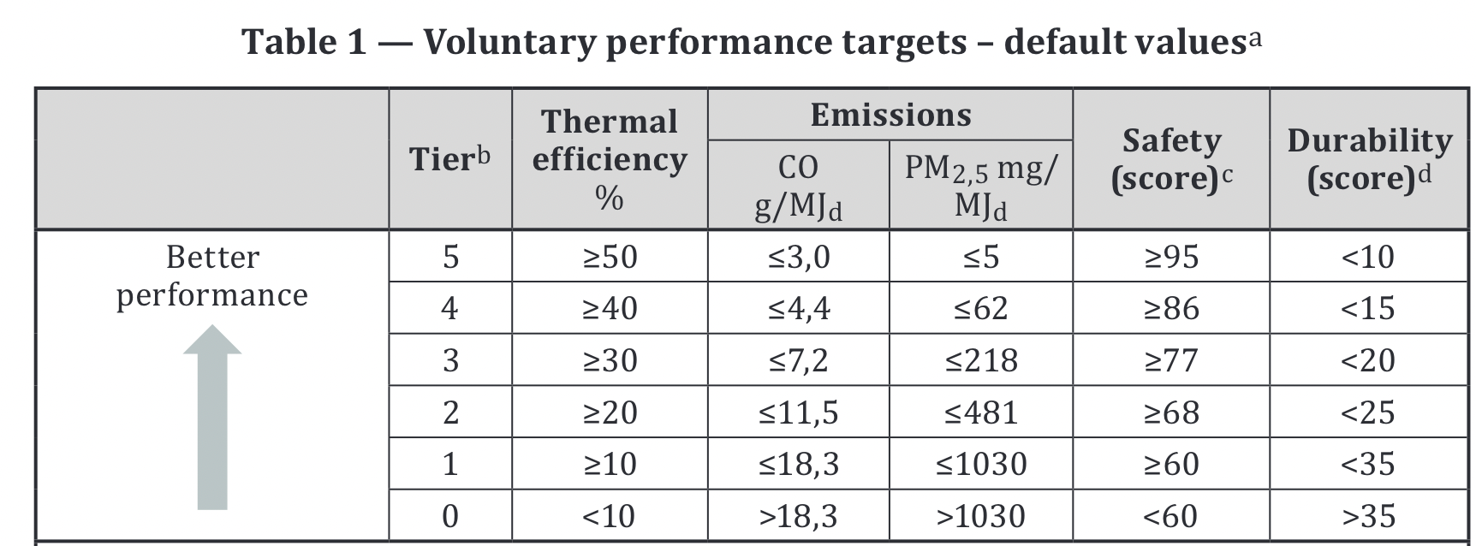
International Organization for Standardization (ISO) Voluntary Performance Targets
Voluntary performance targets (VPTs) for classifying technologies into “tiers” of performance based on thermal efficiency, CO emissions, PM_{2.5} emissions, safety, and durability
https://www.iso.org/standard/73935.html

Slide 14
International Organization for Standardization (ISO) Voluntary Performance Targets
There is no such thing as a “Tier 5” cookstove – a stove will have a tier rating for each of the five performance categories.
https://www.iso.org/standard/73935.html
Notes:
Over simplifying and saying a stove is “tier X” removes transparency and limits the ability for people/programs to appreciate the relative benefits and limitations of different cookstoves. Different people/programs will have different priorities and therefore care about different types of performance.

Slide 15
International Organization for Standardization (ISO) Voluntary Performance Targets
Voluntary performance targets (VPTs) for classifying technologies into “tiers” of performance based on thermal efficiency, CO emissions, PM_{2.5} emissions, safety, and durability
https://www.iso.org/standard/73935.html

Slide 16
International Organization for Standardization (ISO) Voluntary Performance Targets
Voluntary performance targets (VPTs) for classifying technologies into “tiers” of performance based on thermal efficiency, CO emissions, PM_{2.5} emissions, safety, and durability
https://www.iso.org/standard/73935.html

Slide 17
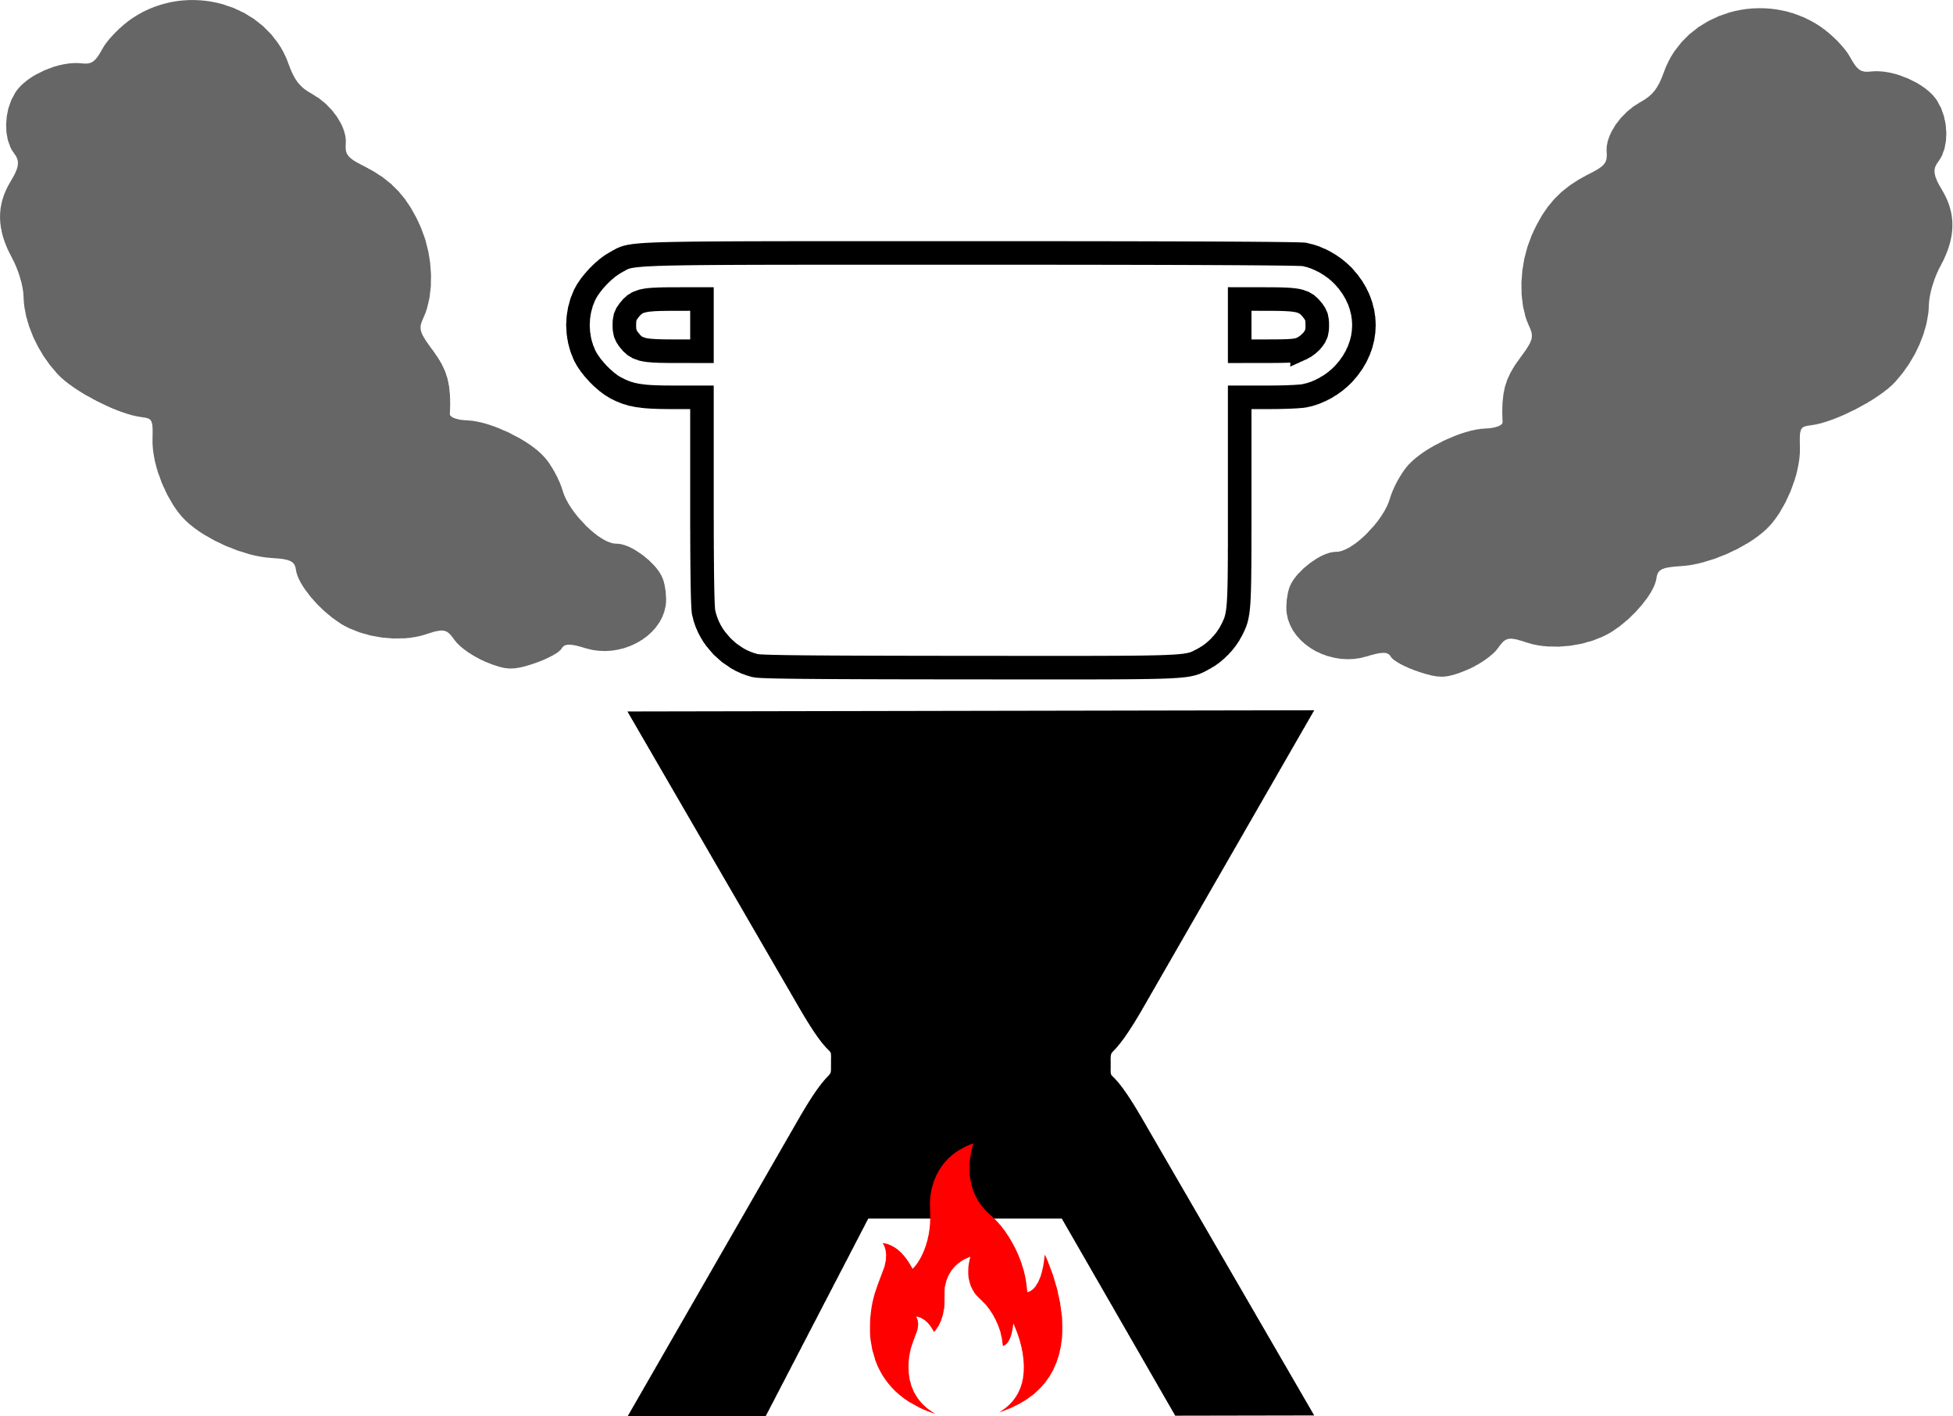
Linking Lab Based Emissions to an Estimate of Exposure
Single Zone Box-Model
Emissions Out
Clean Air In
Exhaust Out
Kitchen Volume

Slide 18
Linking Lab Based Emissions to an Estimate of Exposure
Model Default Value
Kitchen Volume
28 m³ (SD 16.8; range 5-100)
Cooking Time
4.2 hrs (SD 1.5; range 1-8)
Air Exchange
21/hrs (SD 11; range 4-100)
Single Zone Box-Model
Emissions Out
Clean Air In
Exhaust Out
Kitchen Volume

Slide 19
Linking Lab Based Emissions to an Estimate of Exposure
Model Default Value
Kitchen Volume
28 m³ (SD 16.8; range 5-100)
Cooking Time
4.2 hrs (SD 1.5; range 1-8)
Air Exchange
21/hrs (SD 11; range 4-100)
This does not represent any specific home – instead, it represents a reasonable starting point if additional information is not available
Single Zone Box-Model
Emissions Out
Clean Air In
Exhaust Out
Kitchen Volume

Slide 20
Based on relationship with risk for acute lower respiratory infections
ISO PM2.5 Targets: Link with health risk
Adapted from WHO - “VPTs for Standards Workshop”
Notes:
How much more likely are you to exhibit health issues with exposure then without exposure

Slide 21
Based on relationship with risk for acute lower respiratory infections
ISO PM2.5 Targets: Link with health risk
RR>3.15=Tier 0
Tier 1
Tier 2
Tier 3
Tier 4
RR1=Tier 5
Adapted from WHO - “VPTs for Standards Workshop”
Notes:
How much more likely are you to exhibit health issues with exposure then without exposure

Slide 22
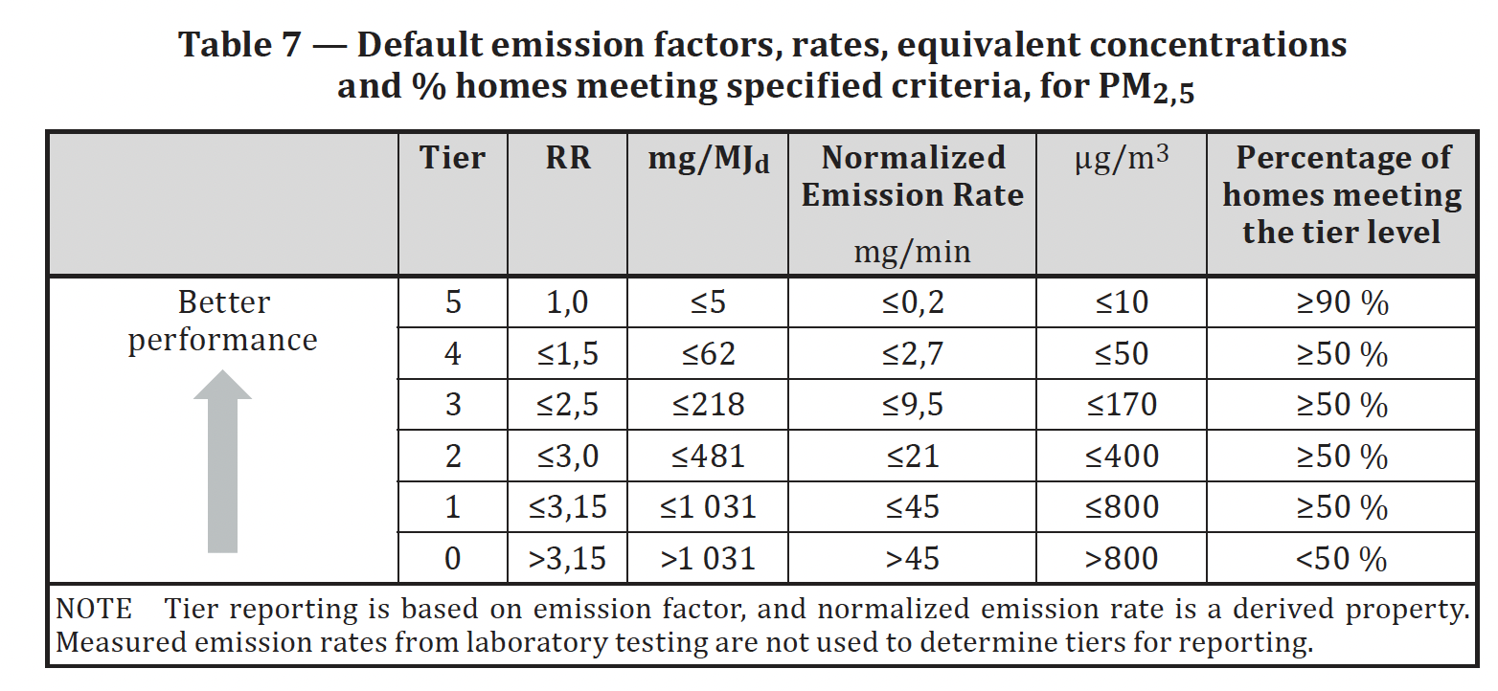
ISO PM_{2.5} Default Targets
Adapted from WHO - “VPTs for Standards Workshop”
Notes:
Note that just because a stove has an emission rate meeting a given tier, it does not mean that every household that uses that stove will achieve the exposure levels and ALRI risk associated with that tier. The emission rates indicate that 50% of households using such a device (for tiers 1-4) and 90% of households using such a device (for tier 5) will achieve the exposure levels associated with the given tier.

Slide 23
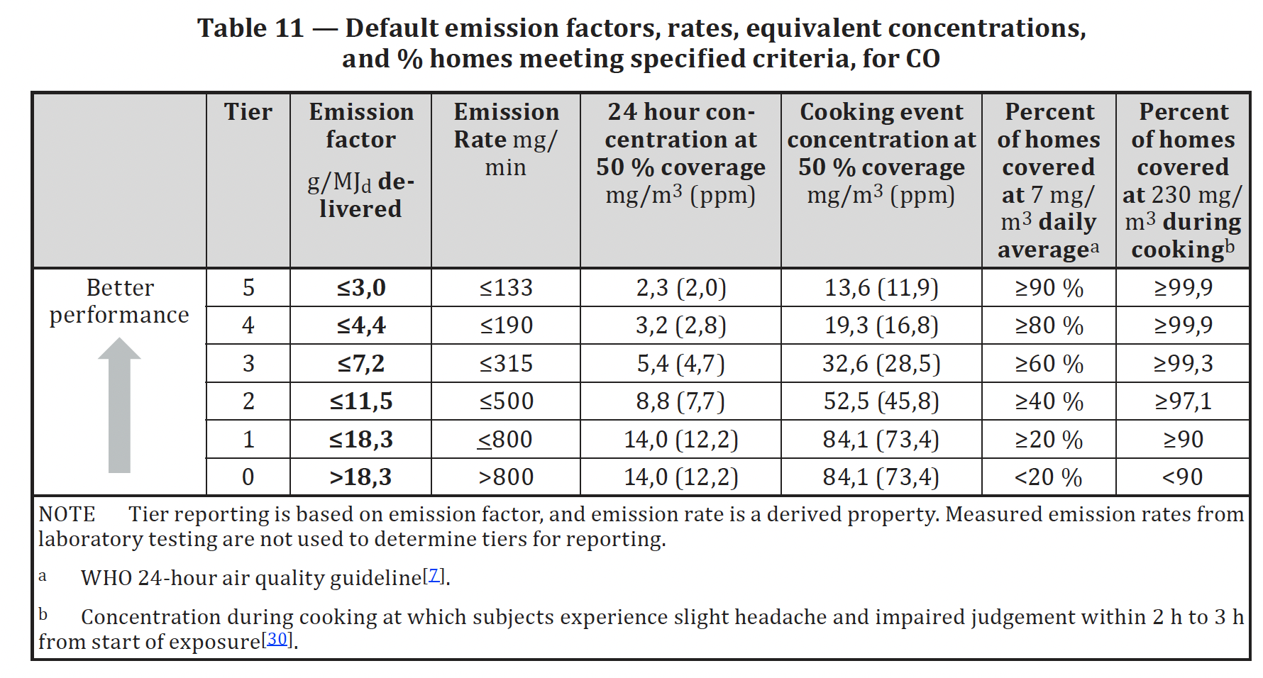
ISO CO Targets
The same exposure-response curves are not available for CO – instead, we use WHO exposure guidelines
Adapted from WHO - “VPTs for Standards Workshop”
Notes:
There is no exposure response for CO concentrations and health risk, so target levels for tiers were set such that a progressively higher percentage of households would meet the previous CO air quality guideline level (now IT-4) of 7mg/m3 averaged over 24 hours

Slide 24
If the VPTs are based on what people would be exposed to – why don’t we use field data for the tiers?!

Slide 25
If the VPTs are based on what people would be exposed to – why don’t we use field data for the tiers?!
There are simply too many uncontrollable factors in the field to establish a single set of performance metrics that are meaningful.

Slide 26





Lab testing tells us important information about the performance and quality of cookstoves
Lab testing does tell us:
Lab testing does NOT tell us:
Performance of a stove / fuel combination under controlled conditions for efficiency, emissions, safety, and durability
Whether a cookstove will meet the needs or desires of consumers
Effective screening for higher-quality products and screening out of lower-quality products
Whether a cookstove will be accepted, adopted, used correctly and exclusively by consumers
Performance potential of a stove / fuel combination in real life
Whether a cookstove will perform and be operated differently in actual use by consumers
Adapted from Jetter & Derby et al. (2022)

Slide 27
Its About the Tech
How the Tech Works for People
Its About the People
Laboratory
Field
ISO 19867-1: Harmonized laboratory test protocols — Part 1: Standard test sequence for emissions and performance, safety and durability
ISO 19869: Field testing methods for cookstoves
TR 19915: Guidelines for social impact assessment
ISO 19867-3: Harmonized laboratory test protocols — Part 3: Voluntary performance targets for cookstoves based on laboratory testing
DIS 5714: Test protocols for institutional cookstoves
Notes:
A responsible project or program does not end with the laboratory – the lab is simply one component of the puzzle.

Slide 28
Its About the Tech
How the Tech Works for People
Its About the People
Laboratory
Field
ISO 19867-1: Harmonized laboratory test protocols — Part 1: Standard test sequence for emissions and performance, safety and durability
ISO 19869: Field testing methods for cookstoves
TR 19915: Guidelines for social impact assessment
ISO 19867-3: Harmonized laboratory test protocols — Part 3: Voluntary performance targets for cookstoves based on laboratory testing
Analysis does not end in the lab or with the VPTs – this is just one piece of the puzzle. The lab can help identify stoves that could be impactful in the field.
DIS 5714: Test protocols for institutional cookstoves
Notes:
A responsible project or program does not end with the laboratory – the lab is simply one component of the puzzle.

Slide 29
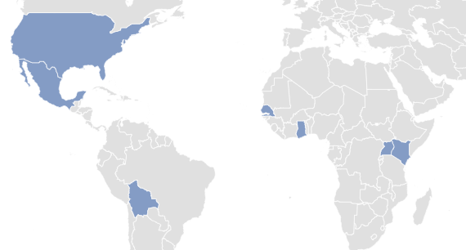
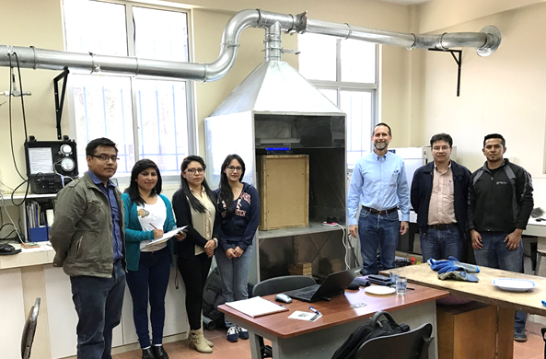
The Clean Cooking Alliance and the U.S. EPA are supporting practice and problem-solving efforts
Ensure that testing centers around the world are harmonized in their stove testing and reporting abilities
Purpose
Outputs
Round-robin testing
Harmonized results
Additional ISO data
Round robin testing: Bolivia, Ghana, Kenya, Mexico, Senegal, Uganda, and the US (Colorado and Oregon)
Adapted from Jetter & Derby et al. (2022)
Notes:
In follow-up to the training and lab equipment that testing centers received, we wanted to deepen their capacity and ensure that testing centers around the world are harmonized in their abilities, so you know that you’re going to get similar results no matter where you send your stove to be tested. To that end, we’ve organized a round-robin testing program with 8 testing labs in Bolivia, Ghana, Kenya, Mexico, Senegal, Uganda and the US.
Round-robin testing program: each lab receives the same stove, pot and fuel, and follows the ISO protocol.
As a community of practice, we all come together after each round of testing to compare results, identify inconsistencies, discuss challenges, and fill any gaps in knowledge or practice.

Slide 30
Christian – Let me tell you all the problems I have with cookstove standards…..
Great – love to hear how they might be improved: Christian.LOrange@ColoState.edu
I encourage you to become involved – the voices at the table set the direct of the standards
  Become an active participant in the renewal process
  ISO 19867-1 (Lab test) will begin renewal in 2023
  ISO 19869 (Field test) will begin renewal in 2024
Contact your national standards body to become involved https://www.iso.org/committee/4857971.html?view=participation

Slide 31
Take Away Thoughts
The standards often should be considered as a collection; a single standard may not answer all of your questions
Tier ratings should be reported separately
Standards are just one tool​
  Require monitoring and enforcement​
  Should be accompanied by comprehensive household energy policies and programmes​
A high-performing stove that people do not buy or use will not have an impact​
If you seen an area for improvement – get involved
Notes:
Tier ratings should be reported separately (e.g., Tier 3 for PM_{2.5}, Tier 5 for CO; there is no such thing as a “Tier 3 stove”)

Slide 33
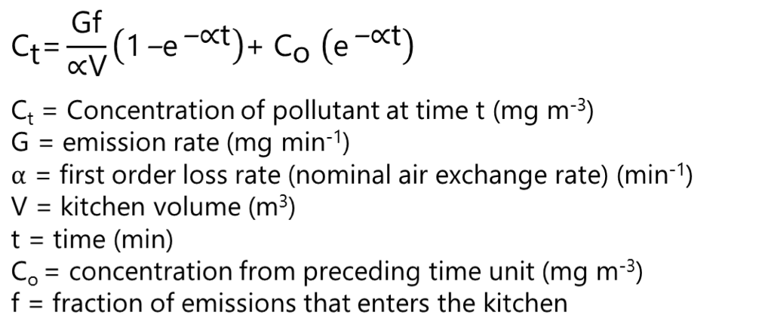
How do we link emissions with air quality or health targets?
Single zone model is a very common and simple air quality model
Used for many applications, including for the WHO Air Quality Guidelines: Household fuel combustion (2014)
Adapted from WHO - “VPTs for Standards Workshop”

Slide 34
