Slide 1
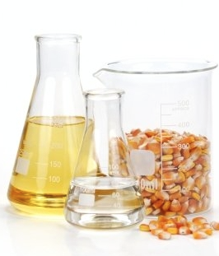
Ethanol: Cooking Fuel Standard
Kristy Moore, Scientist
KMoore Consulting LLC
Growth Energy
November 2022

Slide 2
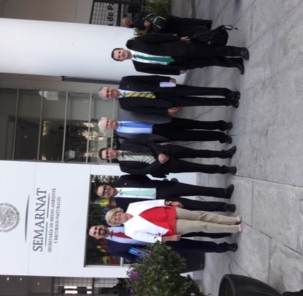
Just a bit about me…
1994: Started at largest distillery in the world.
2000: Transferred to largest corn processing plant in the world.
2007: Worked for ethanol trade association.
2015: Opened up a consulting gig to feed my family.
2018: Building markets globally…

Slide 3
Global Standards Organizations
A robust standard is developed by appropriate subject matter experts from both the public and private sectors.
The standards should have enough detail to enable the user to be educated on the product or process with both performance and safety concerns.
The standards must be accessible and not cost prohibitive to enable their use.
The standards should facilitate action, either commercial or volunteer and contain appropriate performance, safety and environmental information.

Slide 4






Examples of Standards
Development Organizations
There are several globally recognized standards development organizations.
Some of these organizations have a broad spectrum of products; others are more focused and specialize in a particular area.

Slide 5
Facilitating Business:
Standards Provide Support
Standards are important to all of us!
  Nearly every country/ state adopts process and product standards to regulate commerce and ensure an equal opportunity.
  Many government agencies are required to adopt international consensus standards when available.
Commercial contracts typically reference consensus standards for products.
Notes:
So if you are selling ethanol to customers that are blending E15, you must follow D4806-10.

Slide 6

ASTM International Standards – The Process
Stakeholder involvement
  Two face-to-face meetings per year, voting rights throughout the year.
Balanced stakeholder input
  Producer Voting category cannot out-number the User + General Interest categories.
Level of participation can vary with your availability.
Unlimited committee memberships.
Starts with $75 annual membership

Slide 7

Ethanol: Cooking Fuel Application
There is a great need to develop clean cooking fuels around the world.
  Many cooking fuels are dangerous to human health.
The cooking fuel must be:
  Readily available
  Appropriate for the use
  Cost effective, and
  Safe for humans and the environment.

Slide 8
ASTM Committee E48 Bioenergy and Industrial Chemicals from Biomass
Committee has been developing standards for over 25 years.
More than 150 members from around the world working on biomass standards.
Ethanol standards under development to support the use of renewable, natural applications.
Developed standard E3050 for Ethanol for cooking applications in 2016.

Slide 9
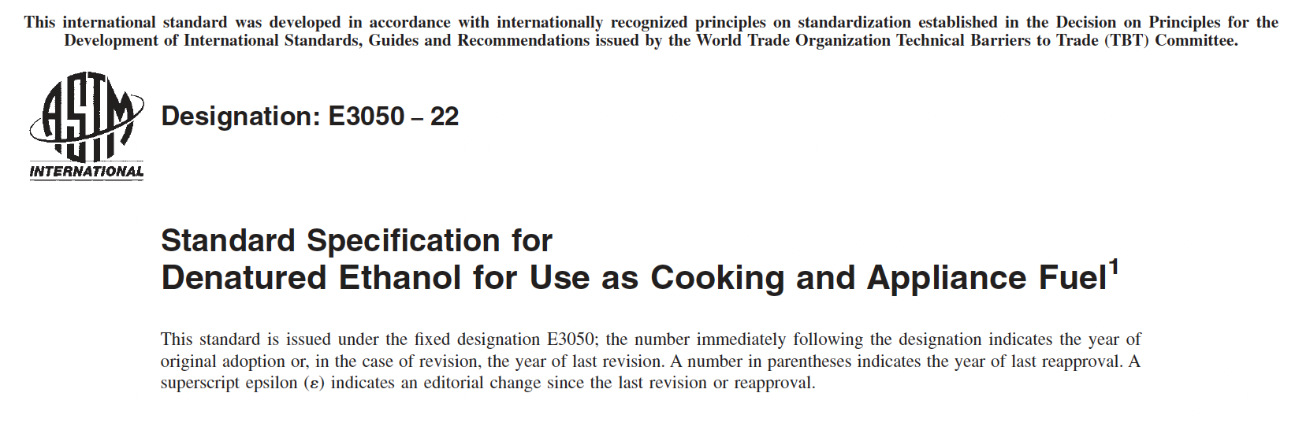
Globally Available Standard: E3050
This is the standard format for all ASTM standards, specifications and guides. This format allows for quick identification of the standard, the content as in this is a specification type of document and the year of publication.

Slide 10

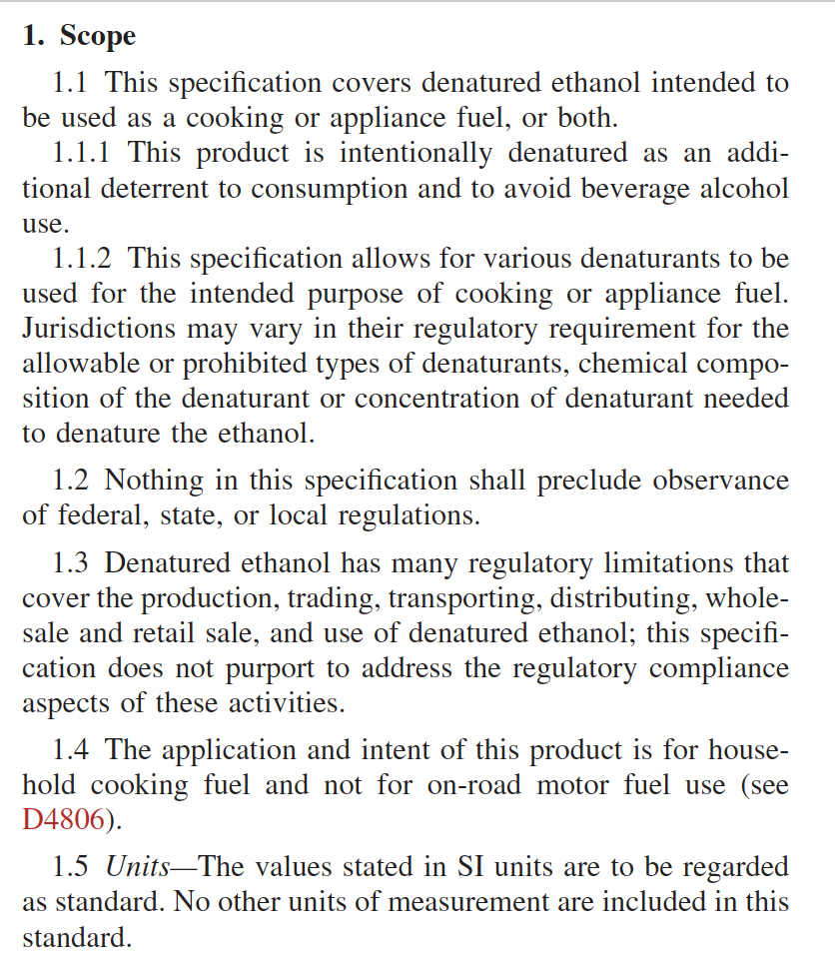
There are 4 pages of information that communicate the important details to ensure ethanol is appropriate for cooking fuel applications.
The Scope Section outlines important details for the reader to ensure selection of the proper standard.
There are important statements of identification in this section.

Slide 11
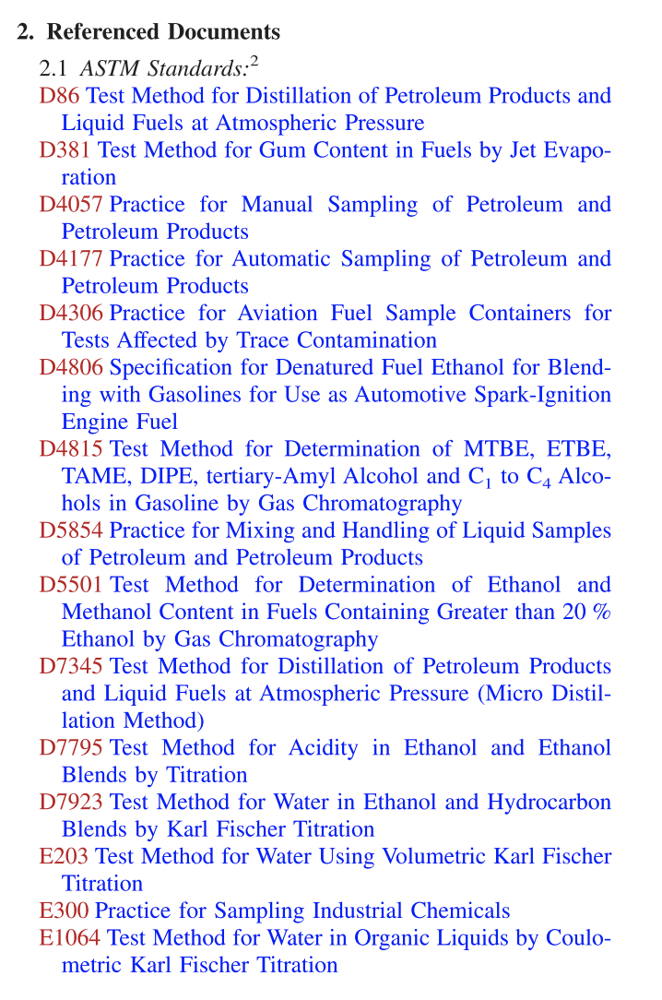
Identification of Appropriate Test Methods
Listed in numerical order.
Allows for hyperlink access to overview of method.
Allows for quick purchase of standard.
ASTM Test Methods are the most referenced analytical methods.

Slide 12
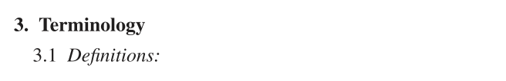
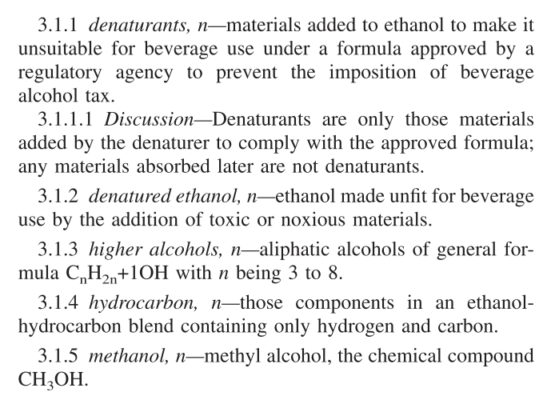
Terminology
This section is important to understand industry terms.
This section also provide the reader with context of common terms that may have industry specific.

Slide 13
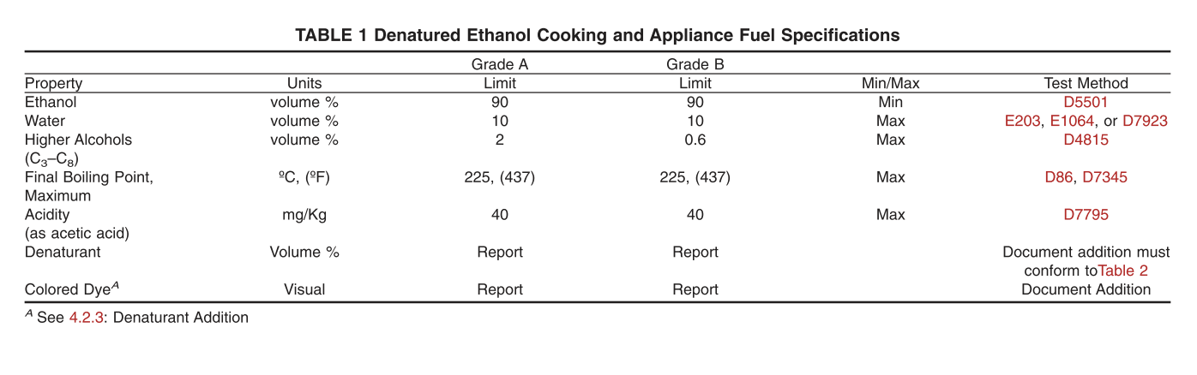
Fuel Specification Table
These are important performance parameters to ensure that ethanol will fuel a cook store, mitigate safety concerns and align product quality from multiple suppliers.
There are very important elements in this Table: The property that must be identified and controlled, the units of measurement and minimum or maximum allowable concentrations/ properties. The appropriate test methods are also identified in this Table.

Slide 14
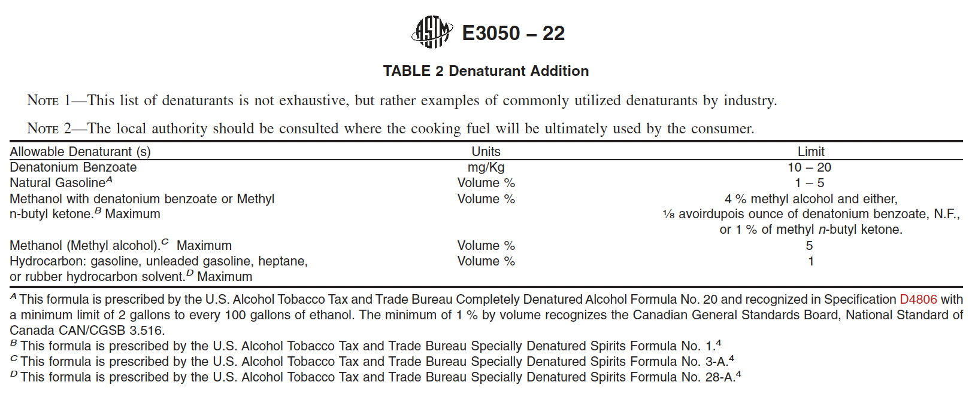
Ethanol Denaturants
Denaturants are materials added to ethanol to render the product “unsuitable for beverage use” (undrinkable) to avoid beverage taxation.
These materials are typically identified by the regulating agency and must also be appropriate for the application. For example, the government may have a list of suitable denaturants but those denaturants may be harmful to human health (an example Methanol) while also be flammable and clean burning for cooking applications.

Slide 15
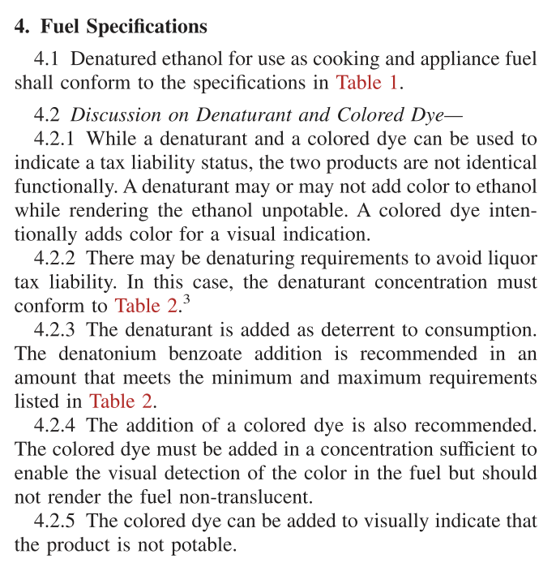
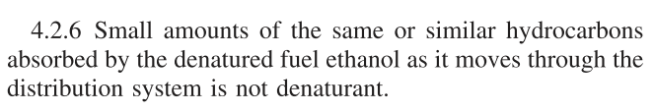
Specification: Important Discussion
This section is a detailed discussion on the parameters from Table 1, why they are important and great education for the reader.
Information here includes why a dye may be added to the product to deter taxation; the dye does not improve ethanol’s performance in a cookstove.

Slide 16
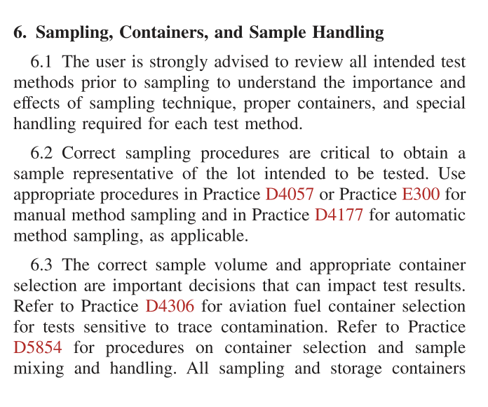
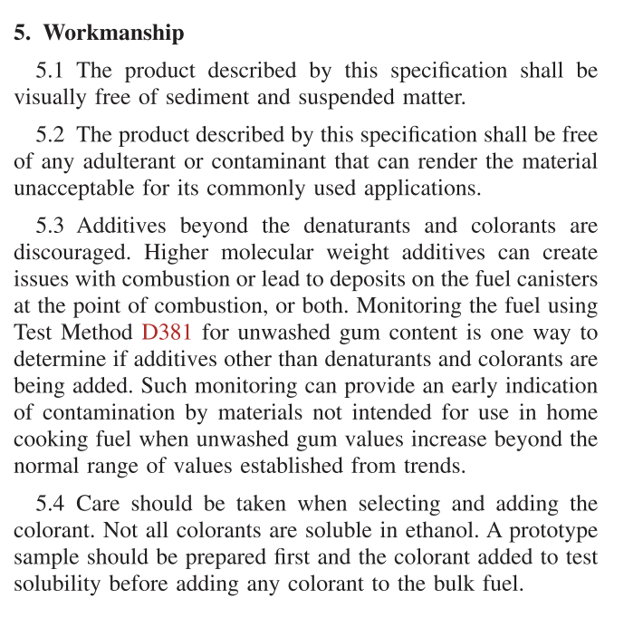
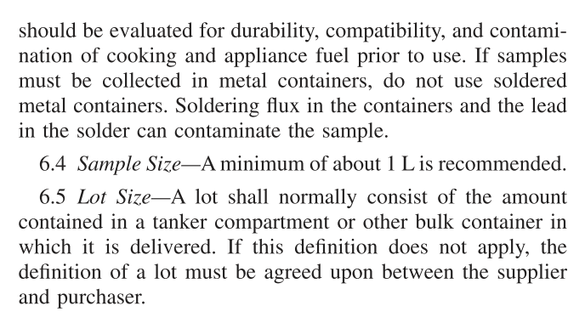
Workmanship and Sampling

Slide 17
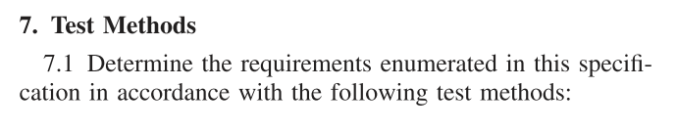
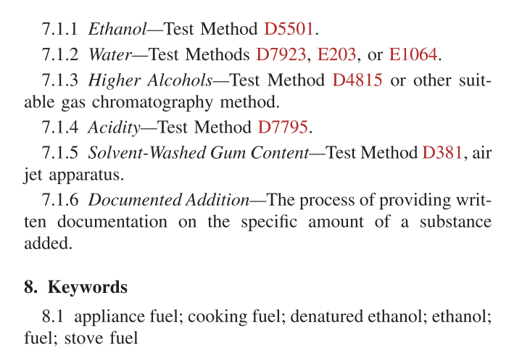
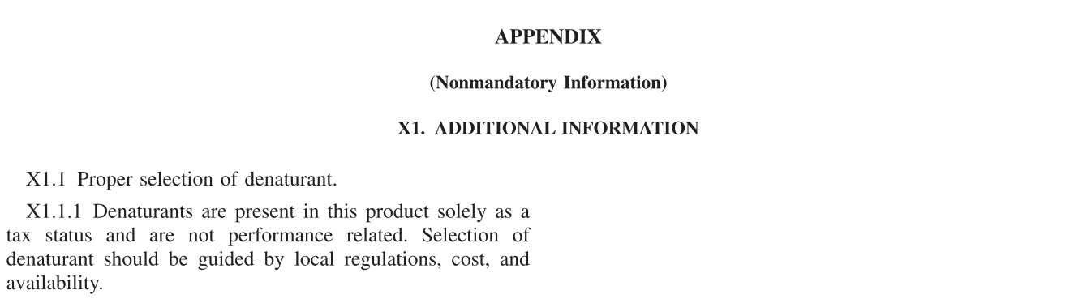
Final Sections
Some final key details about how to appropriately identify and analyze ethanol for this application.
The appendix can contain any additional details to assist with the identification and use. Industry specific information can be detailed here.

Slide 18
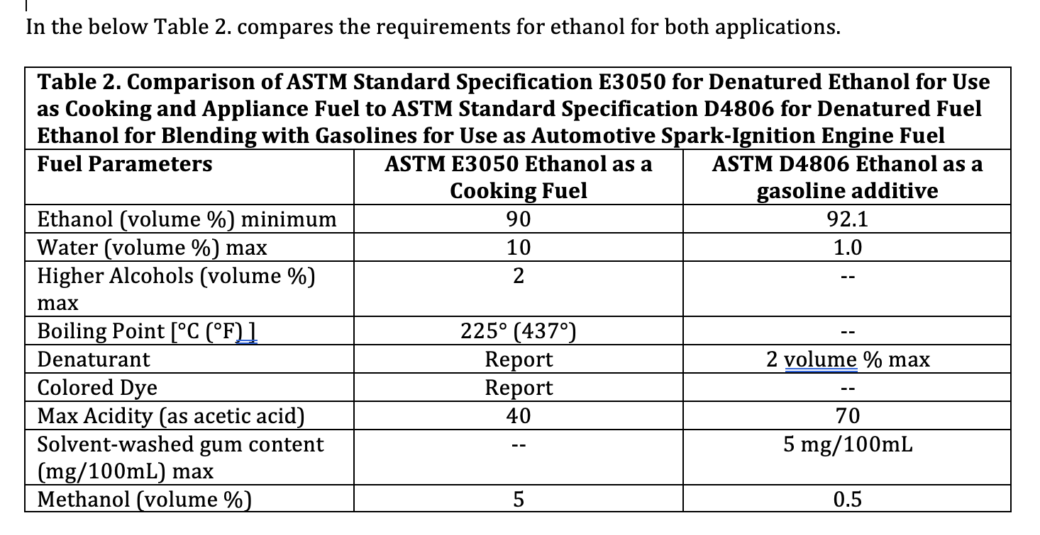
Ethanol Use Globally is Growing.
Ethanol is quickly becoming a very popular, low carbon fuel used for blending with gasoline to reduce greenhouse gases to address climate change. Ethanol for cooking applications can be the same type of fuel which brings great supply options as well as improved economics (lower price.)

Slide 19
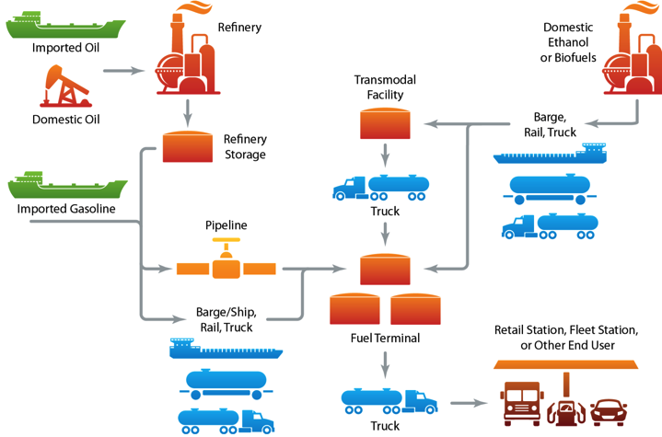
Final Thoughts: Highly recommend the adoption of ASTM International Specification E3050
This globally accepted standard has been developed over many years by global experts.
Adoption of this standard will ensure proper selection of the fuel needed by cook stoves.
This is a “living document” which means the content is always being reviewed and updated by industry experts.
Read only version of this specification is available at no cost here:
https://astm-my.sharepoint.com/:b:/g/personal/jolshefsky_astm_org/ESFgP1G9V6BCjVrqpJql2jYBZmpgBW6XyEwujatkIDaTMg?e=TZll1n
Password: ASTM2022

Slide 20

Thank you!
KMoore Consulting LLC, Email: fueltechservice@gmail.com, Phone: 309.275.9433

