Slide 1
Developing International Markets
Emily Marthaler
U.S. Department of Agriculture – Foreign Agricultural Service

Slide 2


USDA Foreign Agricultural Service
Where we are:
  Global network of 98 offices covering 177 countries.
  Offices staffed by agricultural attaches and locally hired agricultural experts
What we do:
  Removing tariff and non-tariff trade barriers
  Market development and export assistance
  Data and analysis
  Food security
How do we do it:
  Agricultural trade missions
  Partnering with cooperators
  GAIN reports (https://gain.fas.usda.gov)
  Technical assistance / exchange programs

Slide 3
Benefits of Ethanol as a clean cooking fuel
4 billion people still cook using inefficient cooking practices
  Household air pollution
  Results in 3 million related deaths annually – 600,000 African fatalities
Substantial policy adjustments needed
Cost and time savings

Slide 4
Government support and having a strong enabling environment are essential

Slide 5
Why so essential?
Entrenched interests make change and integration difficult
Without implementation / enforcement – policy is not effective
Long-term, consistent support needed for investment and consumer buy-in
Remove market barriers to entry and constraints on trade practices

Slide 6
United States
Enacted by the U.S. Congress in 2005 and expanded in 2007
Sets a statutory blend requirement by volume
Generally, allows for 15 billion gallons of conventional, corn-based ethanol
Increase in volume over time
Specific to reduction in gasoline
Renewable Fuel Standard (RFS)

Slide 7
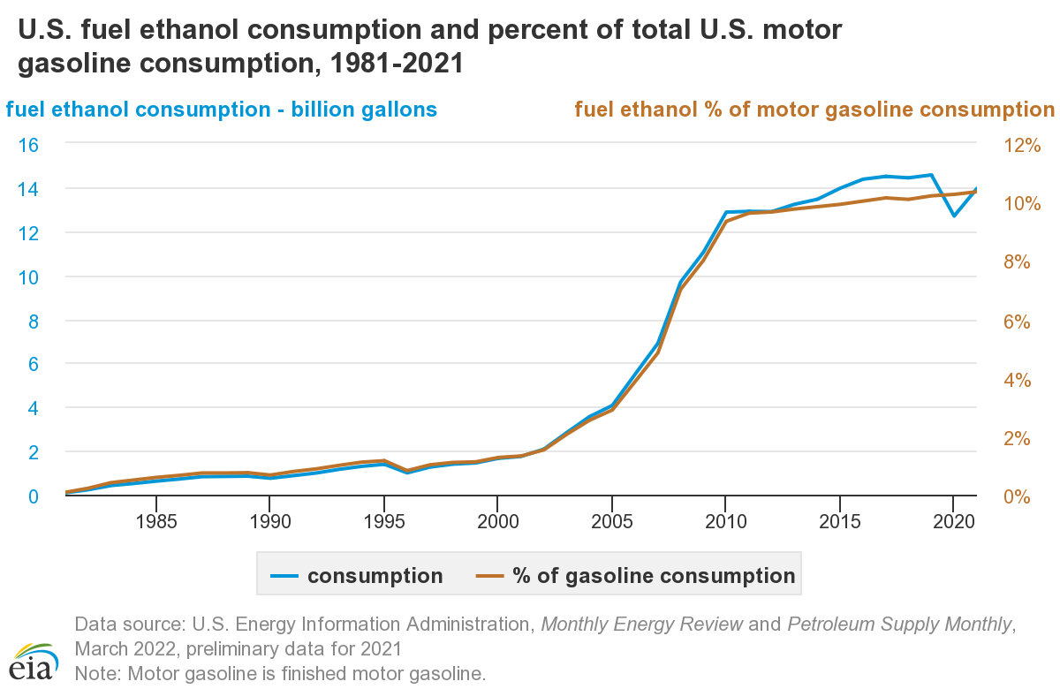

Slide 8
U.S. - California
Established in 2010, readopted in 2015
Credit generation based on emission reductions compared to fossil fuel
One of the most influential policies to improve greenhouse gas profile of U.S. fuel ethanol
Low Carbon Fuel Standard (LCFS)

Slide 9
New Zealand
Had a 2008 biofuels sales obligation requirement that was repealed
Initiated discussions in June 2021 about setting a new biofuels blending mandate to address carbon emissions
In consultation paper – New Zealand noted that if sales obligation not released, could have avoided 6 million tons of CO2 emissions by 2020.
Implementation and long-term planning

Slide 10
India
Attempting significant push to expand blending – including E20 by 2025
Currently restricts fuel ethanol imports
India’s blend level estimated at 9.3 percent
Implementation and long-term planning; yet market barriers remain

Slide 11
Trade is an important factor to meet demand

Slide 12
Trade Opportunities & Barriers
Supplement domestic production – and encourage growing domestic industry
Cost benefits
Creating reliable supply chains
Tariff / duty parity
  Instances where biofuels face similar or higher duties / tariffs then gasoline / diesel or other fuel additives
  As want to encourage increased low carbon alternatives – price competitiveness is important
Protectionist measures

Slide 13
Harmonizing standards across continent amplifies country-specific action

Slide 14
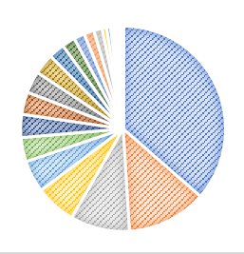
Top U.S. Ethanol Export Markets 2021
 | Global Total | $2.433 Billion
1 | Canada | $886 million
2 | South Korea | $306 million
3 | India | $228 million
4 | China | $156 million
5 | Brazil | $123 million
6 | United Kingdom | $ 93 million
7 | Mexico | $ 89 million
8 | Colombia | $ 86 million
9 | Netherlands | $ 83 million
10 | Peru | $ 79 million

Slide 15
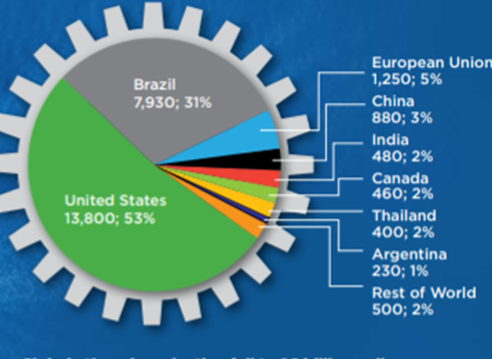
Production vs. Export
2020 Global Ethanol Production (Graph curtesy of RFA)
The United States continues to be the world’s largest producer, consumer and exporter of ethanol
Roughly 10 percent of U.S. ethanol is exported

Slide 16
Thank you!
Emily.Marthaler@usda.gov
202-708-9272

