Slide 1


Bioethanol Standardization Web-series:
#3 Policy, Trade, and Market Opportunities for Bioethanol as a Clean Cooking Fuel
Mike Lorenz /SVP of Market Development/ Growth Energy

Slide 2
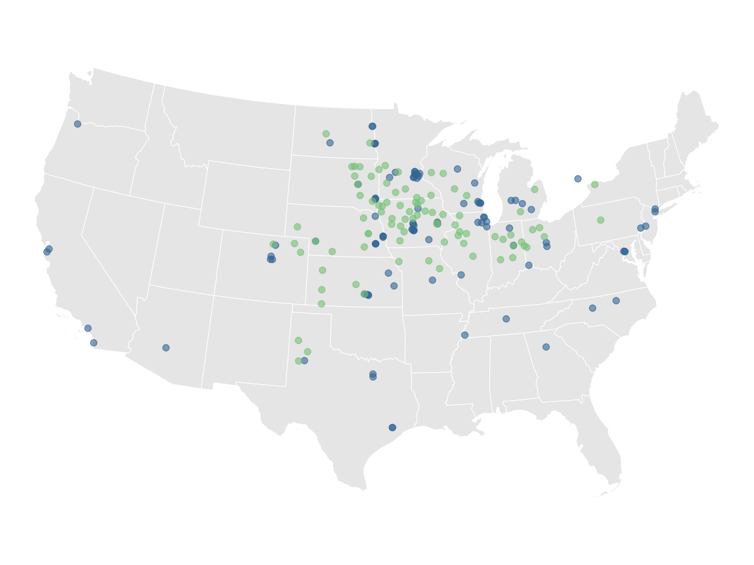




89
105
Engine Smart. Earth Kind.
PRODUCER PLANTS
ASSOCIATE MEMBERS

Slide 3
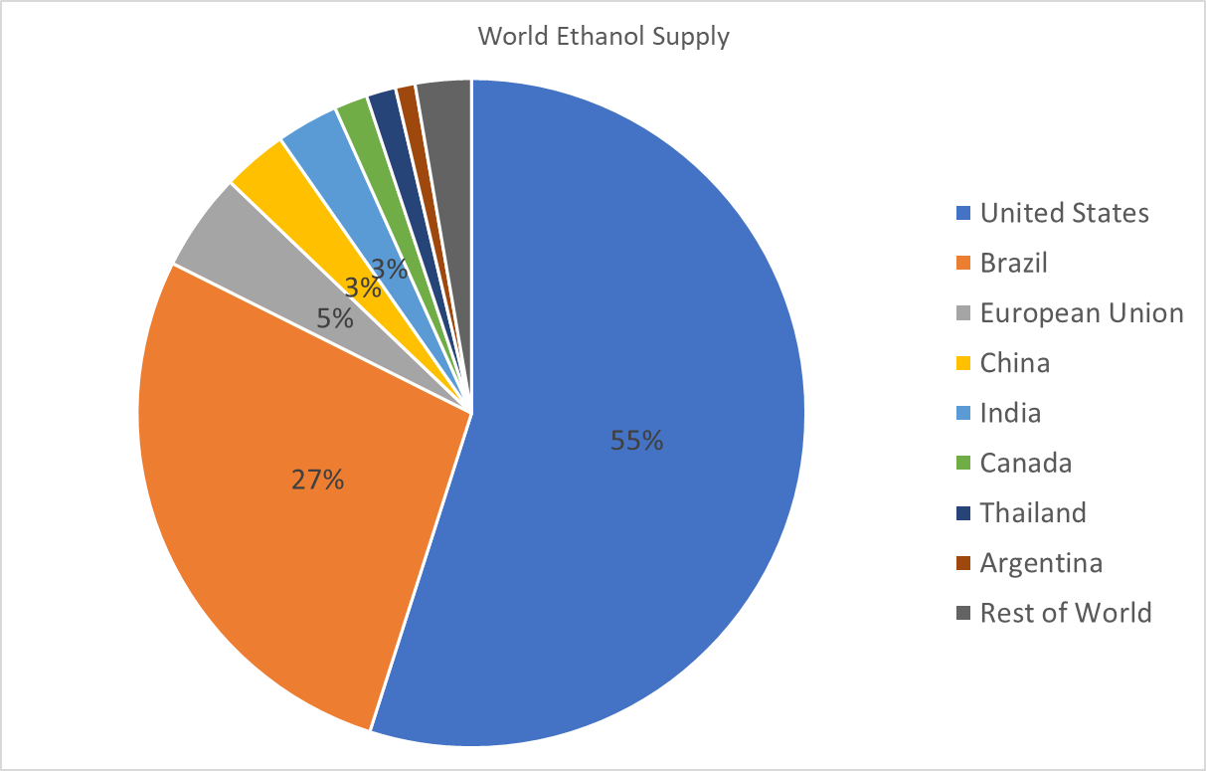

Slide 5
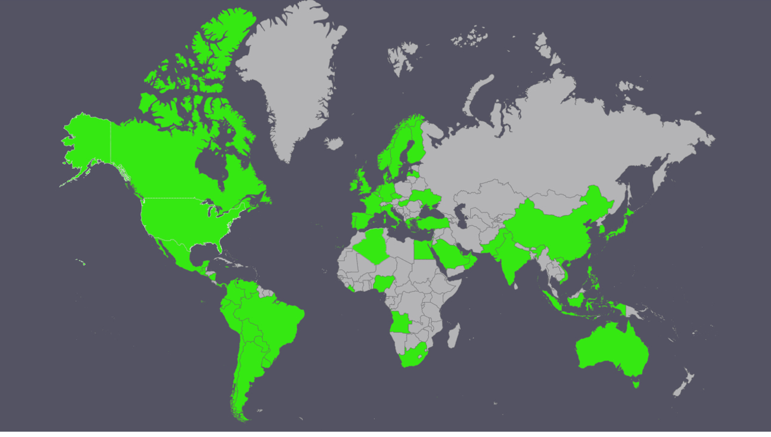
U.S. Ethanol Destinations

Slide 6

Uses For Ethanol
Beverage
Fuel
Industrial
Chemical Production
Hand Sanitizer
Windshield Wiper Fluid
Cooking

Slide 7
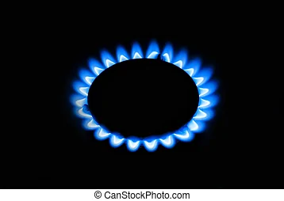
Benefits of Ethanol
Environment
Health/Safety
Renewable
Cost Effective
Efficient
Availability

Slide 8
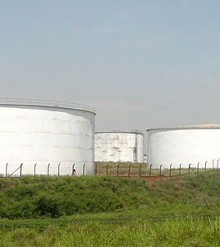
Trade: Supply Chain
Security
Flexibility
Quality
Cost
This Photo by Unknown Author is licensed under CC BY-SA

Slide 9
Imports are Critical
Jump Start program
Supply/Demand Balancing
Ensure Continuity
Provide Competitive Alternative

Slide 10

Program Goals
Reduce Emissions
Improve Health & Safe
Increase Productivity
Sustainability
Economic Growth

Slide 11

Policy: Key Factors
Education of Benefits
Phase In Period
Bans/Mandates
Incentives/Subsidies
Enforcement/Penalties
Tariffs/Taxes
Certainty

Slide 12
Policy Issues
Commitment
Compliance
Penalties
Unsustainable
Loopholes
Cost/Benefits
Short-Term Economics
Unintended Consequences

Slide 13
Conclusions
Need commitment and certainty
Stakeholder communication
Policy that drives change
Regulations that ensure and enforce compliance
Eliminate barriers to adoption and use

Slide 14
Thank You!
mlorenz@growthenergy.org

