Slide 1
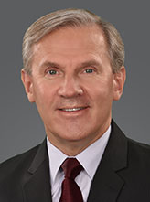
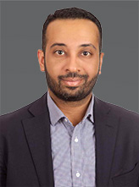
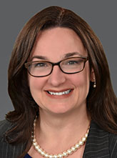
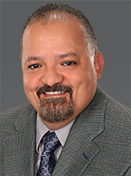

Who We Are (International Activities)
Bernie Pekor,
Director, International Business Development
Ahmad Mhanna,
Middle East Regional Director
Shannon Hale, Translation Coordinator
Mauro Saavedra. Translation Coordinator
Karen P. Smith,
Administrative Coordinator

Slide 2
International Business Development
Build and maintain international relationships in sectors related to the concrete industry (engineering, government, business, academia, etc.)
Develop international business opportunities for ACI products/services
Seek new international relationships to expand ACI’s relevance globally
Gather and analyze information on international markets to improve the implementation of the strategic plan
Engage chapters, partners, and other concrete related organizations in ACI concrete initiatives and business development activities.

Slide 3
Knowledge Sharing & Codes/Standards Adoption
Increase use of ACI’s Concrete Knowledge around the world
Work as a team with Chapters, Partners and other concrete-related organizations to customize ACI codes and standards for local use
Meet with government officials and national standards organizations to explain the benefits of utilizing ACI codes and standards
Coordinate ACI involvement and support efforts leading to code / standard adoption.

Slide 4
Additional International Responsibilities
Presidential Travel/Virtual Meetings with international partners/chapters
MENA Region development and strategic planning
Translations (Licensed, Provisional & Official)
International Events – 24 Hours of Concrete Knowledge Conference, MENA Regional Conference, ACF, Big 5, WOC-Asia, Partner events, etc.
Relationship Building – Key to International development

Slide 5
ACI Ambassador Speaker Program
Developed to promote ACI technical expertise globally and to create, strengthen and solidify ACI relations with international organizations (chapters, partners, technical societies, etc.)
ACI members participate as expert speakers in international conferences and symposiums on behalf of ACI.
Fund 8-12 “ACI Ambassador Speakers” per year.

Slide 6
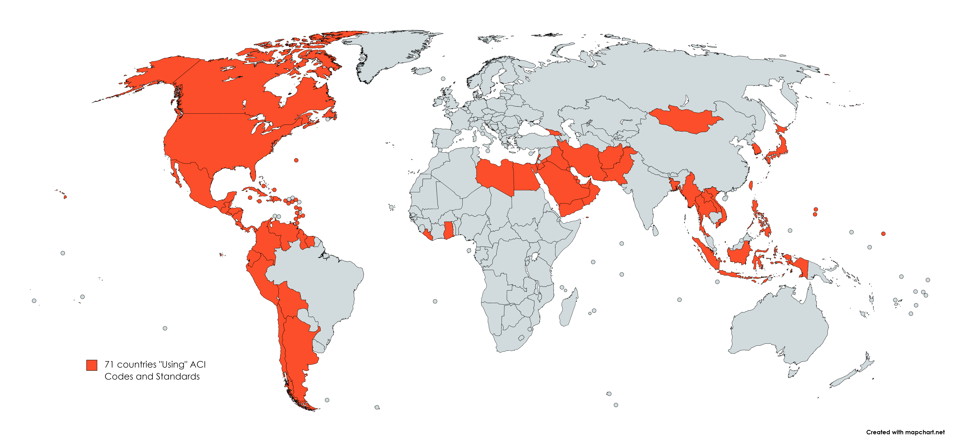
71 Countries Currently “Using” ACI Code:
Bernie Pekor,
Director, International Business Development
Ahmad Mhanna,
Middle East Regional Director
Shannon Hale, Translation Coordinator
Mauro Saavedra. Translation Coordinator

Slide 7
International Partners and Agreements
57 International Partners in Asia, Europe, North and South America, Australia, and Africa
  Purpose: Increase collaboration and cooperation and improve concrete construction by making technical expertise of the partners available through mutually agreed upon activities.

Slide 8
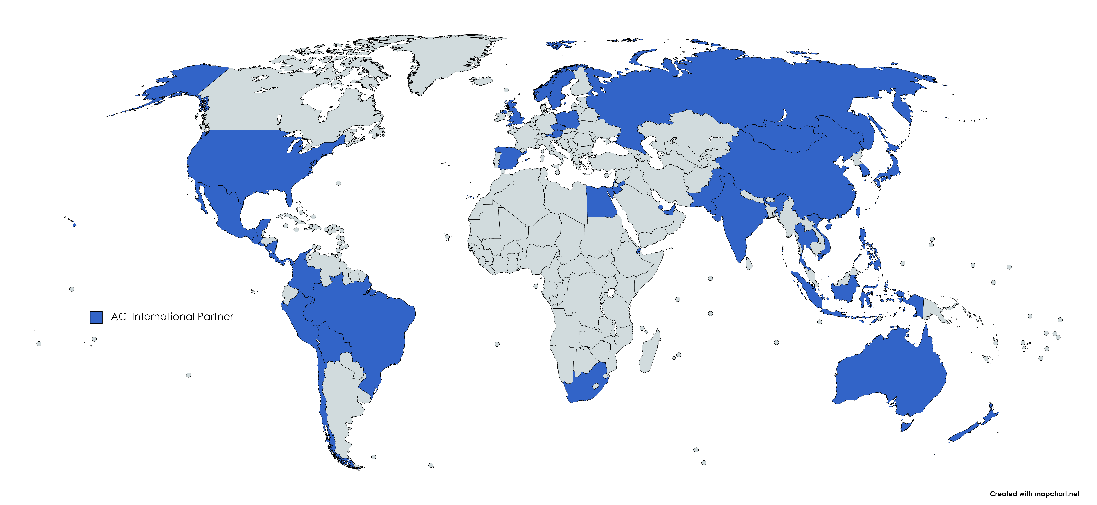
57 International Partners in 40 Countries:
Bernie Pekor,
Director, International Business Development
Ahmad Mhanna,
Middle East Regional Director
Shannon Hale, Translation Coordinator
Mauro Saavedra. Translation Coordinator

Slide 9
ACI Chapters
93 Chapters worldwide
52 Chapters in the U.S.
41 Chapters outside the U.S.
278 Student Chapters worldwide
68 Student Chapters in the U.S.
210 Student Chapters outside U.S.

Slide 10
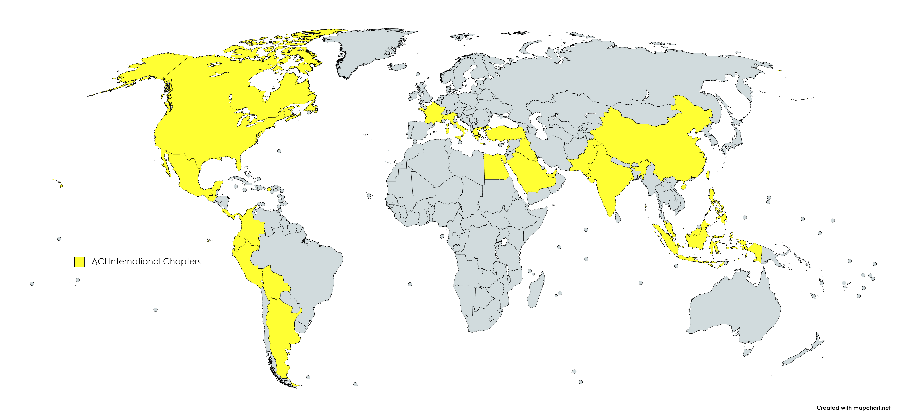
41 International Chapters in 30 Countries:
Bernie Pekor,
Director, International Business Development
Ahmad Mhanna,
Middle East Regional Director
Shannon Hale, Translation Coordinator
Mauro Saavedra. Translation Coordinator

Slide 11
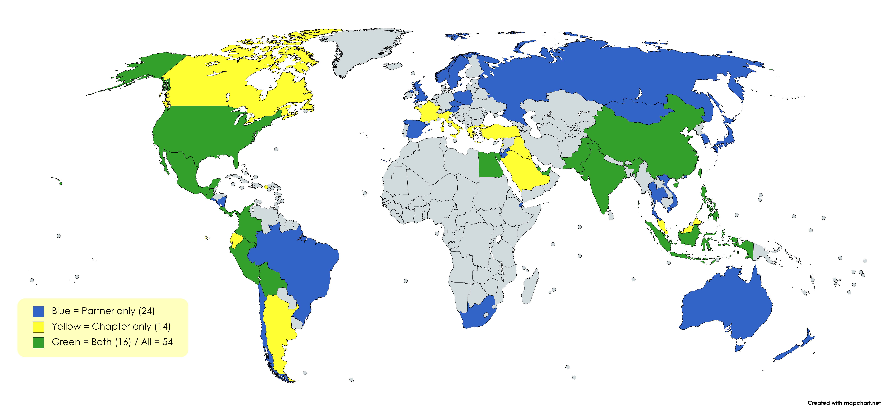
An ACI Partner or Chapter in 54 Countries:
Bernie Pekor,
Director, International Business Development
Ahmad Mhanna,
Middle East Regional Director
Shannon Hale, Translation Coordinator
Mauro Saavedra. Translation Coordinator

Slide 12
ACI Innovation:
ACI Membership
New ACI 318 PLUS and ACI Collection
NEx: ACI Center of Excellence for Nonmetallic Building Materials
neu: ACI Center of Excellence for Carbon Neutral Concrete
ACI CODE-440 Fiber-Reinforced Polymers
New Innovation Director – Dr. Rex Donahey
ACI 24 Hours of Concrete Knowledge & ACI Int. Code Summit
ACI CODE-318 & Concrete Sustainability

