Slide 1
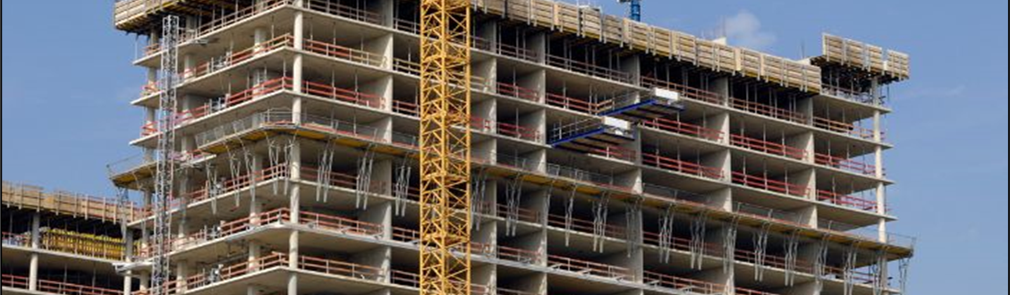
American Concrete Institute (ACI) Standards Acceptance and Use
Steve Szoke
Code Advocacy Engineer
Notes:
Hello, I‘m Steve Szoke, one of ACI’s code advocacy engineers. This program is sponsored by the standards alliance. Thus, we’d be remiss if we didn’t provide some information about ACI’s standards and the benefits of using them.

Slide 2
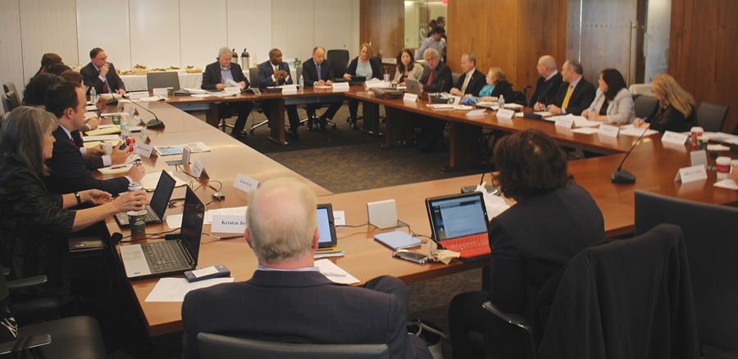
ACI Standards
Consensus ensures unbiased standards
20 to 50 members
Plus Subcommittees and
Task groups
BALANCED
Notes:
ACI standards on concrete design and construction are developed using an American National Standards Institute approved method. This requires committee work to be transparent and fair with balance amongst interest groups in various categories of users, producers, and general interest. All public comments must be adjudicated based on technical merit.

Slide 3
ACI Standards
2. Global Input
Notes:
Most standards committee have representation from a variety of countries. For example, ACI Committee 318 on building code requirements for structural concrete has representation from 15 countries.

Slide 4
ACI Standards
PART 1: GENERAL
PART 2: LOADS & ANALYSIS
PART 3: MEMBERS (beams, columns, etc.)
3. Practitioner focus
In order of design steps
In-lb or SI
PART 4: JOINTS/CONNECTIONS/ANCHORS
PART 5: EARTHQUAKE RESISTANCE
PART 6: MATERIALS & DURABILITY
PART 7: STRENGTH & SERVICEABILITY
PART 8: REINFORCEMENT
PART 9: CONSTRUCTION
PART 10: EVALUATION
PART 11: APPENDICES & REFERENCES
Notes:
ACI standards are written specifically for and with input from construction industry experts. This is reflected in the way the requirements are presented, in the order that the typical design professionals consider and develop their designs.

Slide 5
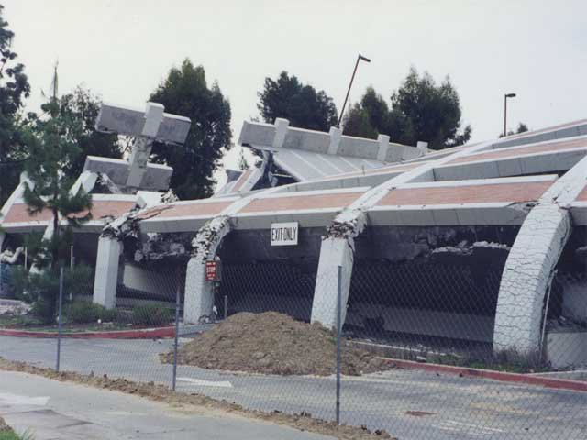
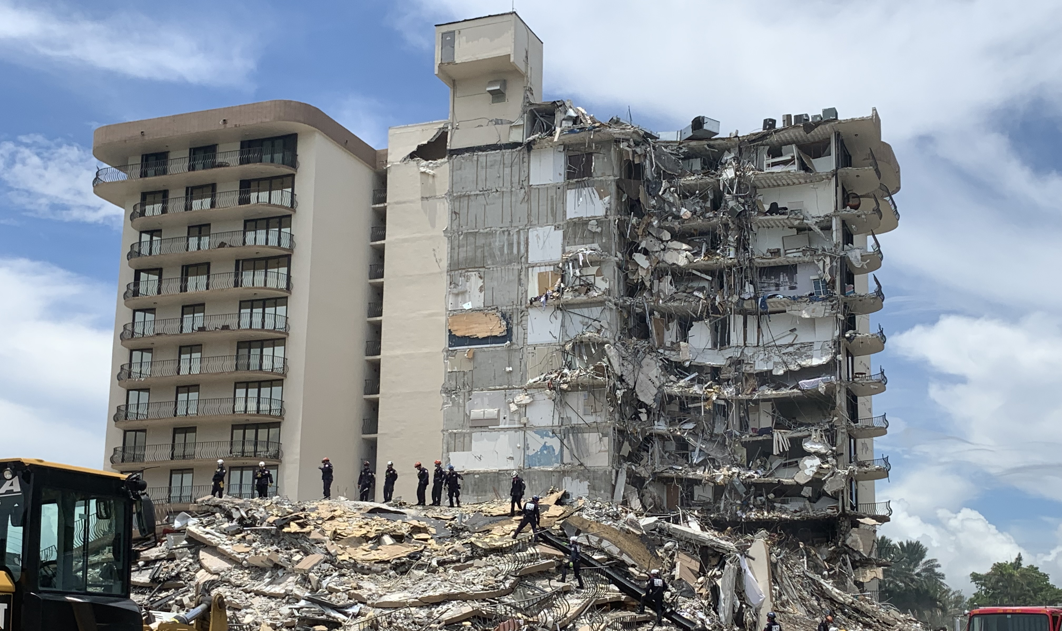
ACI Standards
4. Regular updates
New research
Construction practices
Tragic events
New materials
More powerful analytical tools
Notes:
ACI standards, like all ANSI standards, must be routinely updated to ensure new research, analysis methods, materials, and construction practices are incorporated into the standards in a way that best results in a reasonable level of life safety. These routine revisions also provide the mechanism to ensure that what is learned from disasters is appropriated integrated in minimum code requirements.

Slide 6
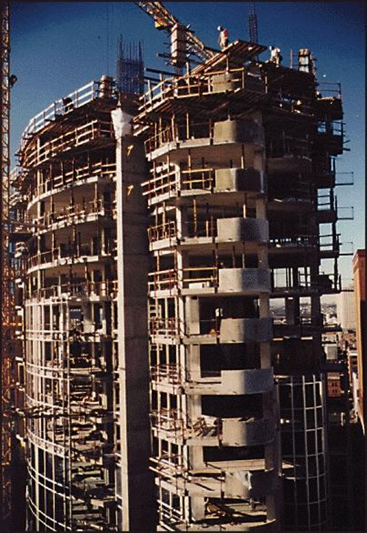
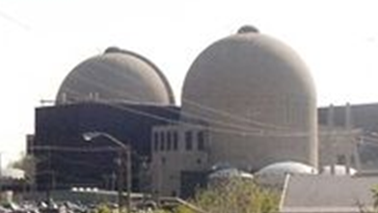
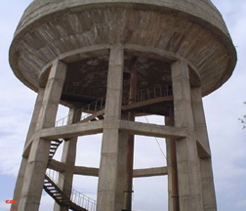
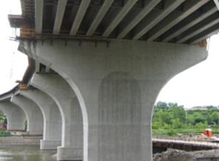
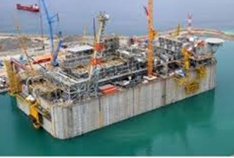
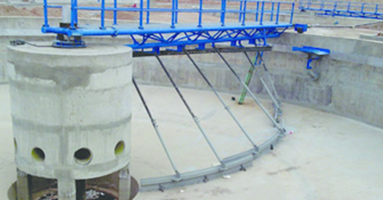
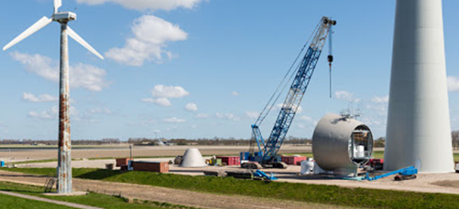
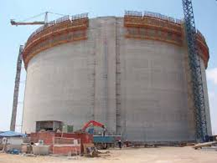
ACI Standards
5. Applicable to many structures
Notes:
ACI standards are developed for a variety of applications as stand-a-lone or companion documents. Core standards are applicable to many concrete applications, but supplementary information may be required for specific applications such as thin shells, tanks, water and waste-water treatment structures, nuclear power plant containment structures, and transmission and wind turbine towers. There may also be the need for unique requires for specific materials like glass fiber reinforced polymer reinforcing bars.

Slide 7
ACI Standards
6. Efficient use of financial and human resources
Adoption with or without modifications
Notes:
Generally, adopting authorities find it best to adopt ACI standards as published with modifications if any in separate umbrella documents. This reduces costs for development and maintaining standards. The International Code Council does this with very few modifications to ACI 318 building code requirements for structural concrete. The ICC modifications are, for the most part, to allow some relaxation in the provisions for concrete elements supporting lightweight frame structures in high seismic areas.

Slide 8
ACI Standards
AFG | BRB | ECU | HTI | KOR | MMR | PER | TTO
ARG | CAN | EGY | IND | KWT | MNG | PHL | TWN
ATG | CHL | GEO | IRN | LAO | MNP | PRI | UAE
BEL | COL | GHA | IRQ | LBN | MSR | QUT | USA
BHR | CRI | GRD | ISR | LBR | NER | SAU | VCT
BHS | CUB | GTM | JAM | LBY | NIC | SLV | VEN
BLZ | CYM | GUM | JOR | LCA | OMN | SUR | VIR
BMU | DMA | GUY | JAP | MEX | PAK | TCA | VNM
BOL | DOM | HND | KNA | MHL | PAN | THA | YEM
7. Worldwide
usage
Notes:
ACI standards are accepted in many countries and the acceptance is expanding. Generally, ACI standards are adopted as the primary method of compliance, but sometimes as a deemed to comply method. In some instances, to facilitate transition from a prior code to a more modern code, the application might be limited to certain buildings. In Vietnam compliance with ACI 318 is permitted on buildings of any height, but is required for any buildings over 75 meters in height.

Slide 9
ACI Standards
8. History of code writing
1904 - Founded
1910 - First code
Notes:
ACI has been developing standards for over 100 years. The result is a proven process that, through updates, ensures minimum requirements to reasonably safeguard the public.

Slide 10
ACI Standards
9. Educational support – PROFESSIONAL DEVELOPMENT
ACI University
Seminars
Professors’ Workshop
Free online educational presentations
ACI education documents
Notes:
As you heard earlier, ACI does not just develop standards. ACI standards are supported by a variety of programs and documents that pertain to overall concrete knowledge: numerous technical documents; a variety of education programs; and certification programs to qualify testing technicians, inspectors, and installers.

Slide 11
ACI Standards
10. Customizable (case-by-case basis)
In-lb or metric
English or translations (Spanish, Chinese…)
Hard copy or web viewable pdf
With or without modifications
Notes:
On a case-by-case basis ACI standards are customizable to reflect the needs of the adopting authorities. This is generally the types of units, language, format, and development of modifications if needed.

Slide 12
ACI Standards
11. Member technical support - ENGINEERING
Understanding - Code requirements
Matt Senecal, Director,
Engineering
Will Gold,
Engineer
Trey Hamilton,
Engineer
Khaled Nahlawi, Engineer
Andrea Schokker, Engineer
Kerry Sutton,
Code Advocacy Engineer
Greg Zeisler,
Engineer
Notes:
And finally, ACI members have access to engineers who are a resource for understanding and using ACI standards. They do not provide design services, but can help users understand the basis for the requirements, often by directing users to related technical documents.

Slide 13
Steve. Szoke@concrete.org
Notes:
Thank you for this opportunity to share some background and insight on ACI standards.

