Slide 1
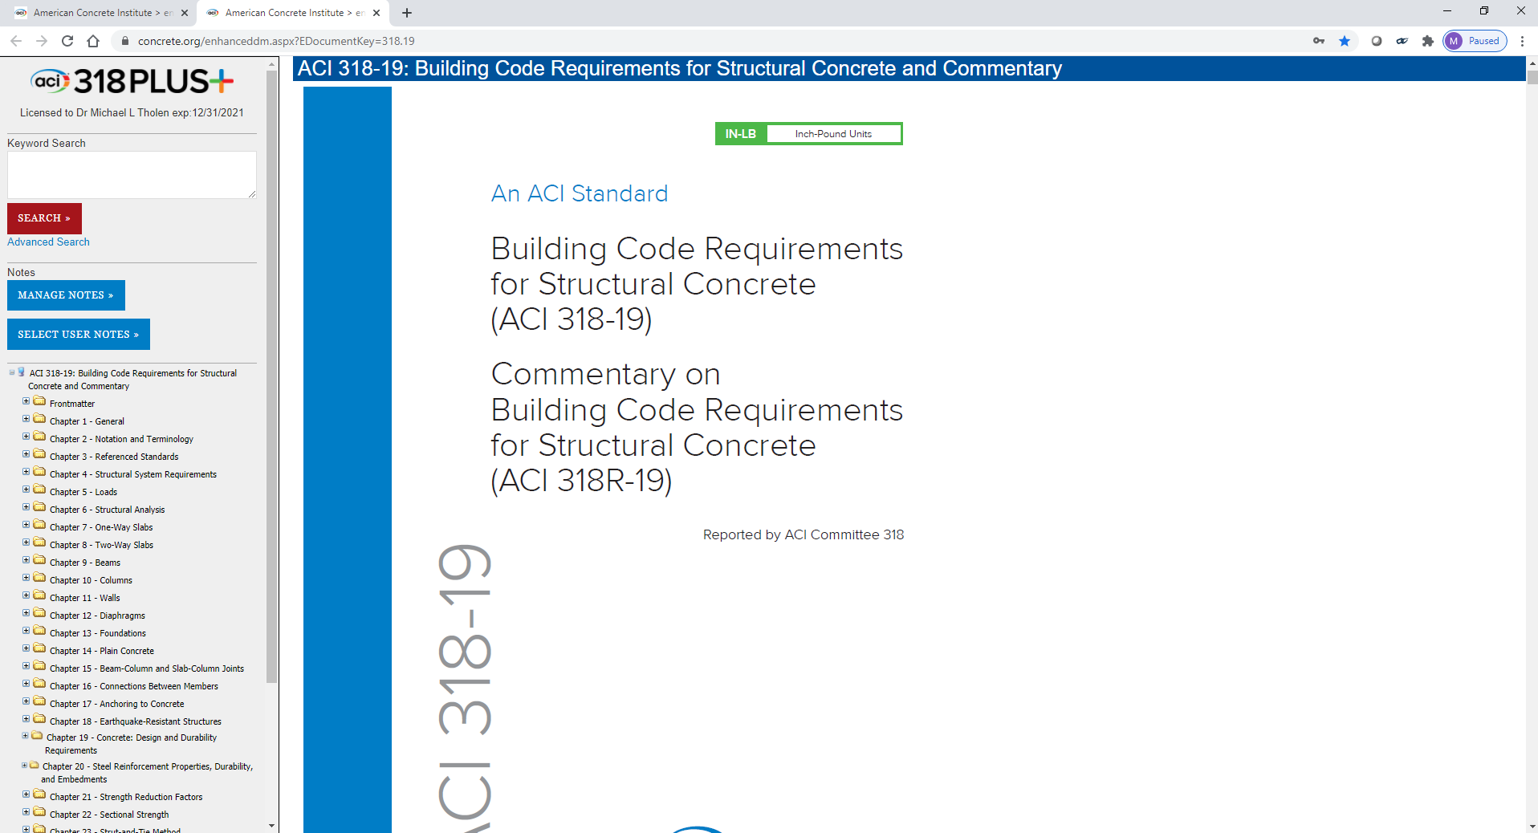

ACI 318 PLUS PLATFORM
Mike Tholen
August 24, 2022
Notes:
I’d like to introduce you to a new product that we’ve developed at ACI.
The product is built on a new, web-based platform that we believe will eventually host all of our ACI documents and even become a tool used by our committees to help develop and modify their documents.

Slide 2
ACI 318 PLUS
Needs
Product demonstration
Access
Notes
Notes:
Over the next few minutes I’ll talk about the needs that led to the initial idea for this product, the features we’re building into the platform that supports it, and give you a preliminary look at the first document we’ve set up on this platform.

Slide 3
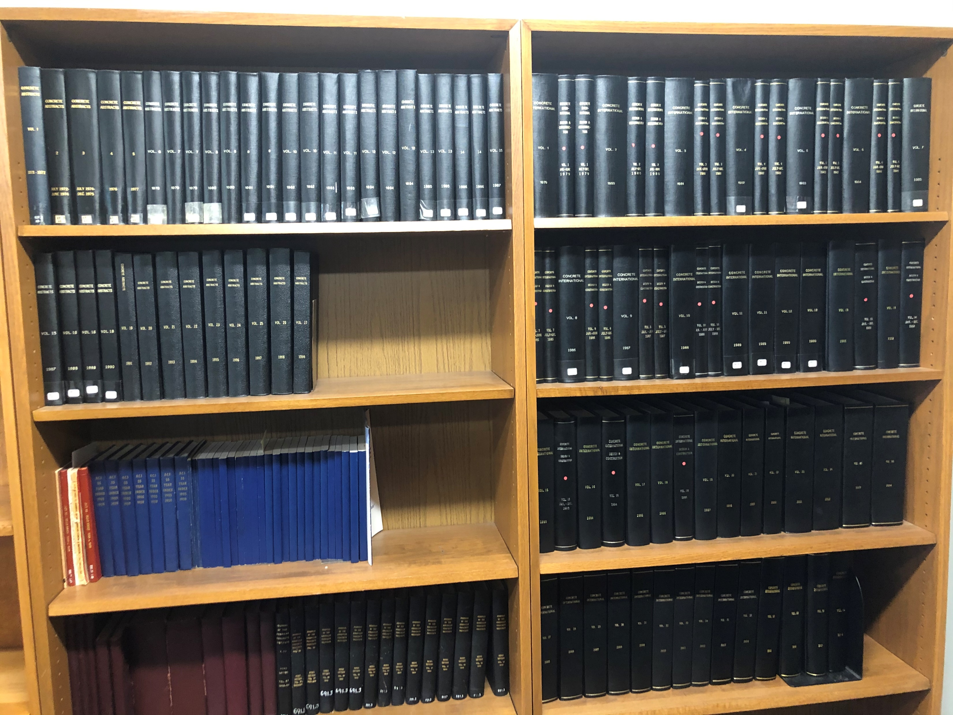

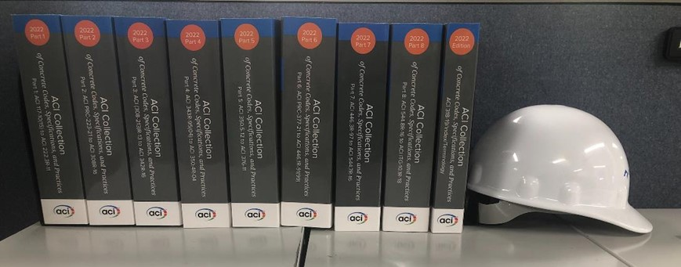
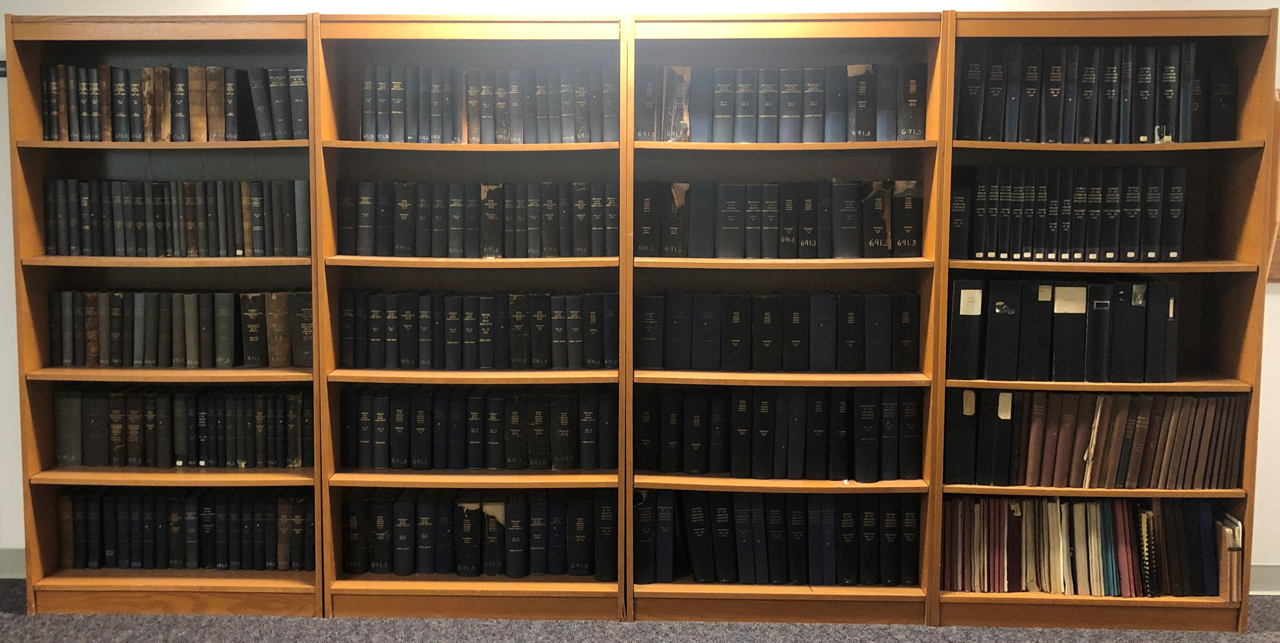
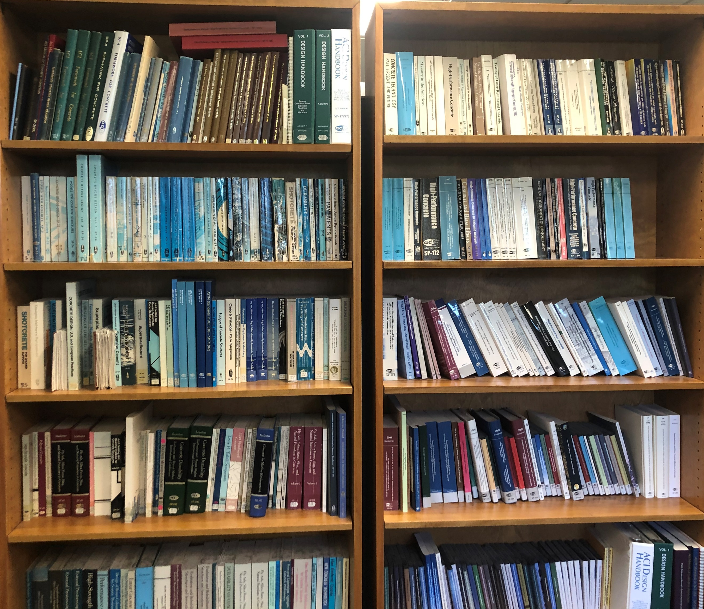
Needs
Notes:
Click through each photo
ACI has produced thousands and thousands of pages of information related to concrete and it uses
ACI continues to develop or revise thousands of pages every year. Each year we publish several new or revised committee documents, symposium publications, periodical issues, educational courses, and convention sessions. It’s all this hard work by our volunteer members that create this new information that allows ACI to be one of the world’s premier sources of concrete knowledge. What this all boils down to is that if you have a question related to concrete, ACI is very likely to have an answer for you. However, finding that information and then accessing that information can often be challenging.

Slide 4
ACI PLUS Platform
Collection
SPs
Journals/ CI
Manuals/
Prof. Dev.
ACI 318
  Most well-known document
  Terse, mandatory language
  Other documents?
Notes:
The answer we’ve developed is what we’ve termed the “PLUS platform”. As I mentioned earlier, we eventually hope to have all our documents on this platform, but we’ve initially concentrated on our most well-known document, ACI 318.

Slide 5
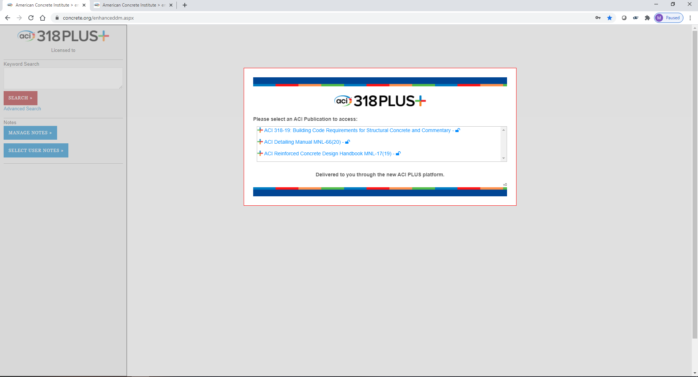
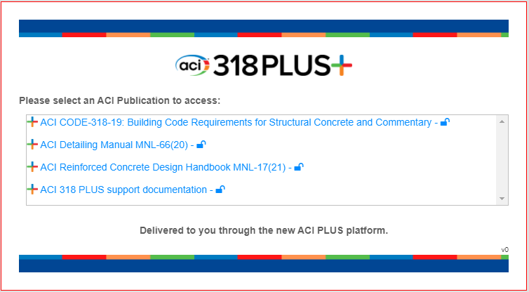
Startup
Notes:
Users enter the platform though the splash screen shown here.
<click to enlarge> As you can see, the screen lists four documents. ACI 318, the ACI Detailing Manual, the ACI Reinforced Concrete Design Manual, and a document with some 318 PLUS support information. Users will have access to each of these documents with an ACI 318 PLUS subscription (as indicated by the “unlocked” icon after each title) and can choose to go directly into any of the four documents.
Most of what I’ll be demonstrating today is shown from the 318 PLUS document. I’ll talk about the advantages of having the two manuals on the PLUS platform when we discuss those links.

Slide 6
Product Demonstration
Notes:
Layout: The appearance of the product is similar to a PDF. Tools and navigation are on the left. The document appears in the center. The notes appear on the right. I’m going to go ahead and turn off the notes for now since we won’t be using them. I’ll turn them back on when we discuss the notes features.

Slide 7
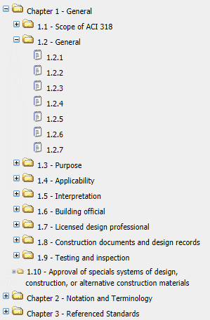
Navigation
Notes:
Navigation in the document is pretty intuitive and similar to a bookmarked PDF file.
On the left you see a list of chapters in ACI 318. Clicking on the “plus” icon expands the list to the first level of subsections. Clicking on the “plus” icon again expands to a list of the specific provisions. Clicking on any title in this list will take you to that spot in the document.

Slide 8
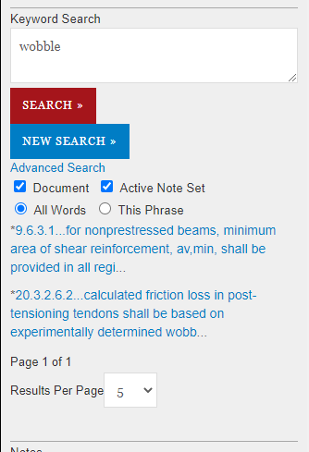
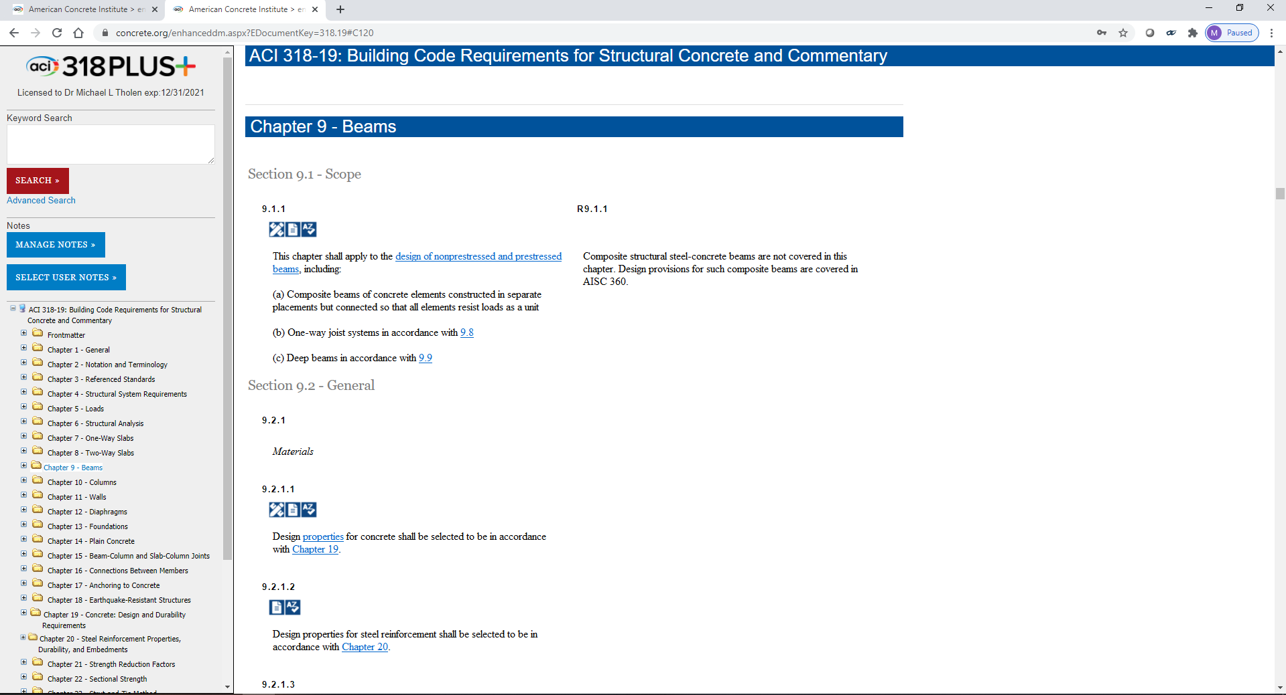
Search
Notes:
Another way to navigate in the document is through the search function.
<Click>
In this case, I’m searching for provisions that pertain to wobble coefficients for post-tensioned tendons. I type the keyword into the keyword search box and hit the search button. I can also click on “Advanced Search” and bring up some options for where I want to search (document or notes) and whether I want to search for instances of each individual word or just the whole phrase.
The results are shown here in blue and give the provision number and the first several words of the provision. Hopefully this gives me some indication of which search results are most relevant to what I’m looking for.
When I click on a search result, I’m taken to that section of the document and the term I searched for is highlighted with a yellow background.
<click>
I can scroll up or down in the document using a mouse wheel or the scroll bar.

Slide 9













Resources / Links
Terminology
Practices
3-D Graphics
Design Handbook
Education Publications
FAQs
ACI University
Videos
Internal Links
Detailing Manual
CI Articles
318 References
Standards
Notes:
When I was showing the product, you may have noticed several different icons located under each provision number. There are several different types of resources that are linked to in 318 PLUS. Each type of resource is given its own icon, and you can see those here. I’m going to talk about these in groups and highlight some of the differences between the types of resources and how each is accessed in the platform.

Slide 10
Resources / Links
Terminology
318 References
Notes:
Two of the most common links in 318 PLUS are the terminology and the 318 references.
318 references are those documents, articles, papers, etc. that the 318 committee refers to in the code or the commentary. I’ll use these to introduce you to how the links and icons work in the 318 PLUS product.

Slide 11
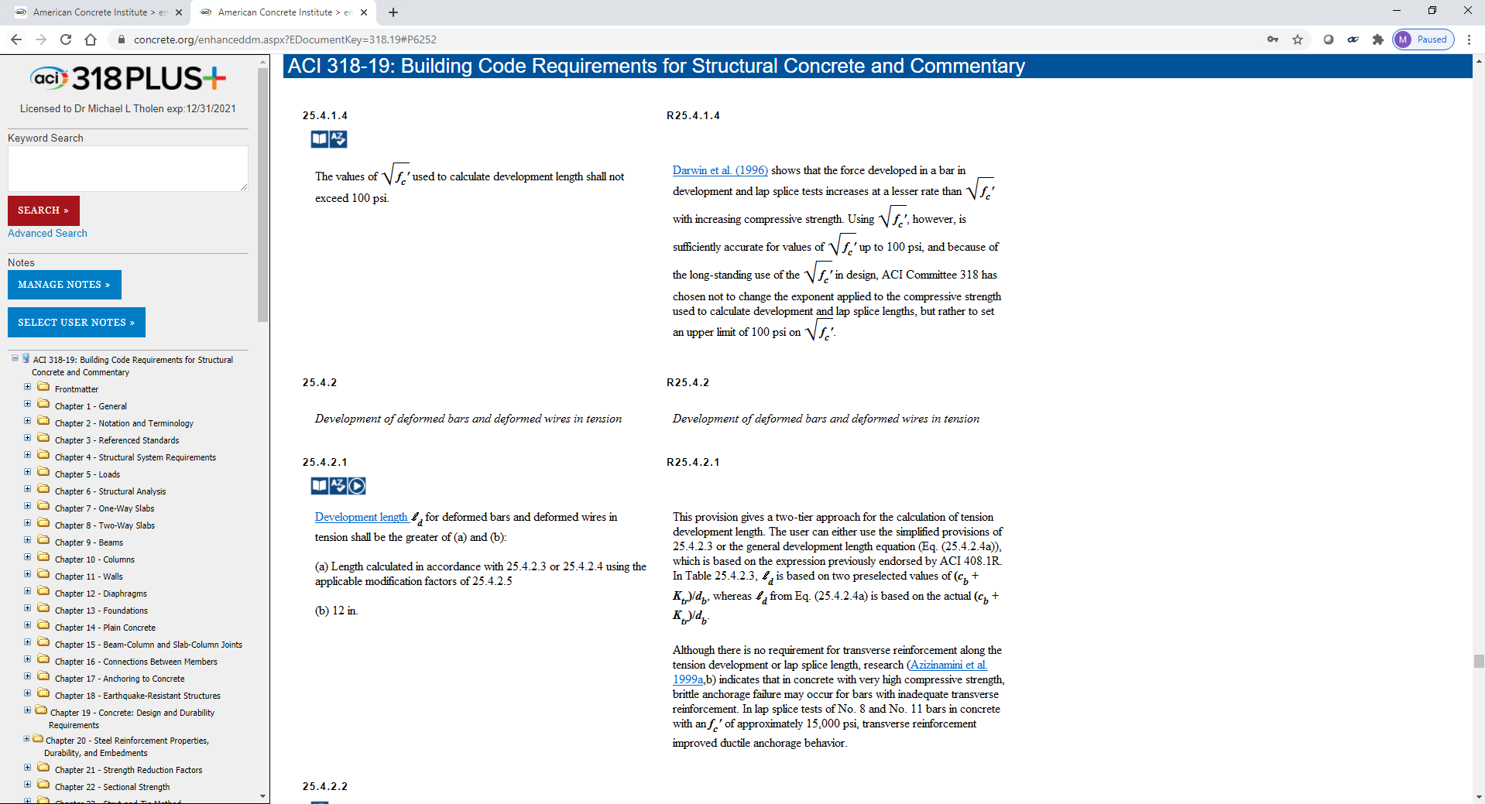
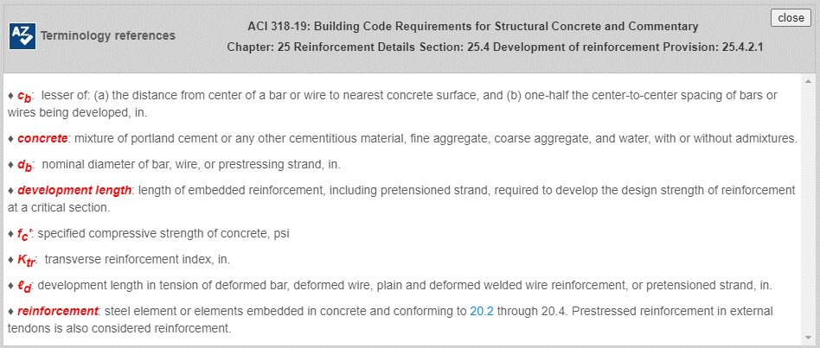
Terminology
Notes:
Terminology: One icon that appears in almost all provisions is this icon for terminology. Pressing this icon brings up a list of all the notation and defined terms from Chapter 2 of ACI 318 that appear in the provision.
<click> For example, if I go to provision 25.4.2.1 and click on the icon, I see this list of several terms and variables along with their definitions. The terms and notation that appear are those that specifically appear in that provision. This allows the user to easily pull up a list of all the terms and variables listed in that provision and see their definitions without referring back to chapter 2. It also allows you to easily see what the units for a particular variable are.

Slide 12
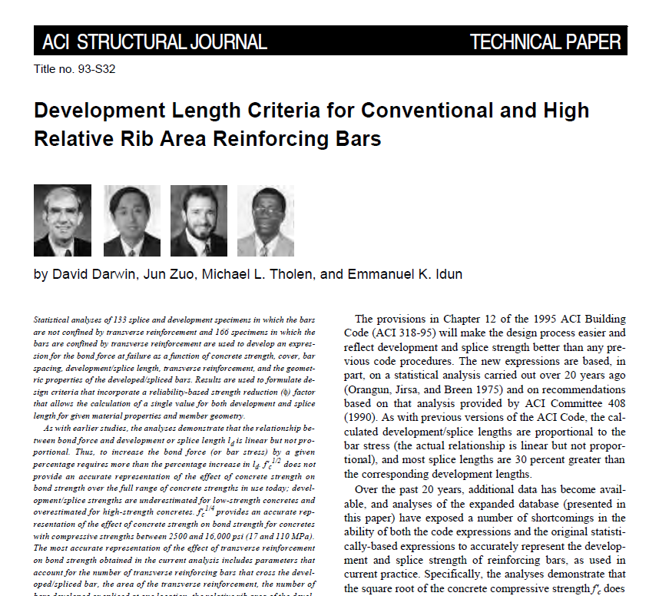
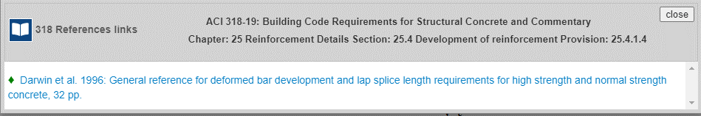
318 References
Notes:
318 references: Another very common link you will see is this 318 icon for the 318 references. These reference contain information from several different resources, such as journal articles, committee documents, CI articles, and so on. We felt it was important that we keep these reference under a separate icon because these are the resources that the committee specifically called out as background information for the provisions or for development of the code. These are the references you see in the actual text of the code. If we take a look at 25.4.1.4 I can show you an example. Here you see the committee has referenced an ACI Journal paper.
<click>
For each of these resources, we have included a comment that appears when I hover over the hyperlinked text. This note lets you know what resource you will go to when you click the link and what you will find there. It also guides you to the most relevant sections of the document as quickly as possible.
<click>
We’ve hyperlinked it so if I click on the text, a PDF of the journal paper appears in a new window. ACI has purchased rights to many of the referenced papers in 318. For those references that are 318 journal papers or CI articles or if ACI has obtained rights to the paper, the document will appear when you click on the link. Others may note that they are an external resource or not be linked at all.
<click>
That same comment will appear if I click on the icon for this category. There are a couple reasons why we put links in the text and also grouped them under different icons.
The first reason is that the icons give you a visual clue as to the type of resource we’re taking you to. For example, you may be looking for something that’s a little lighter read like a CI article or watching a video. Other times you may want to really get into the details of the research and want to straight to the journal papers. Without the icons, you would have to hover over each hyperlink individually to get the note to appear.
The second reason is that we often have more resources to show you than we have text to link to those resources. So, sometimes there may be additional resources that appear when you click on the icon than just those that are linked to text in that provision. A good example of that is the links to the design and detailing manuals, which I’ll show you next.

Slide 13
Resources / Links
Design Handbook
Notes:
The next type of resource we’ll go into is the links to the ACI Reinforced Concrete Design Handbook

Slide 14
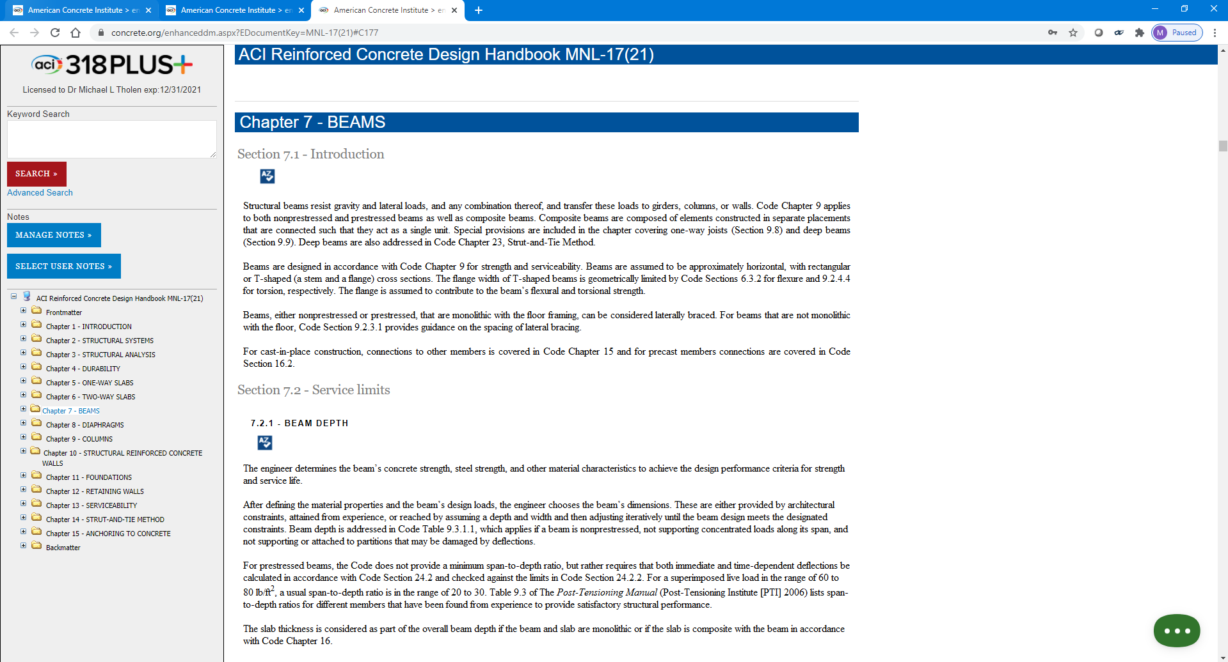
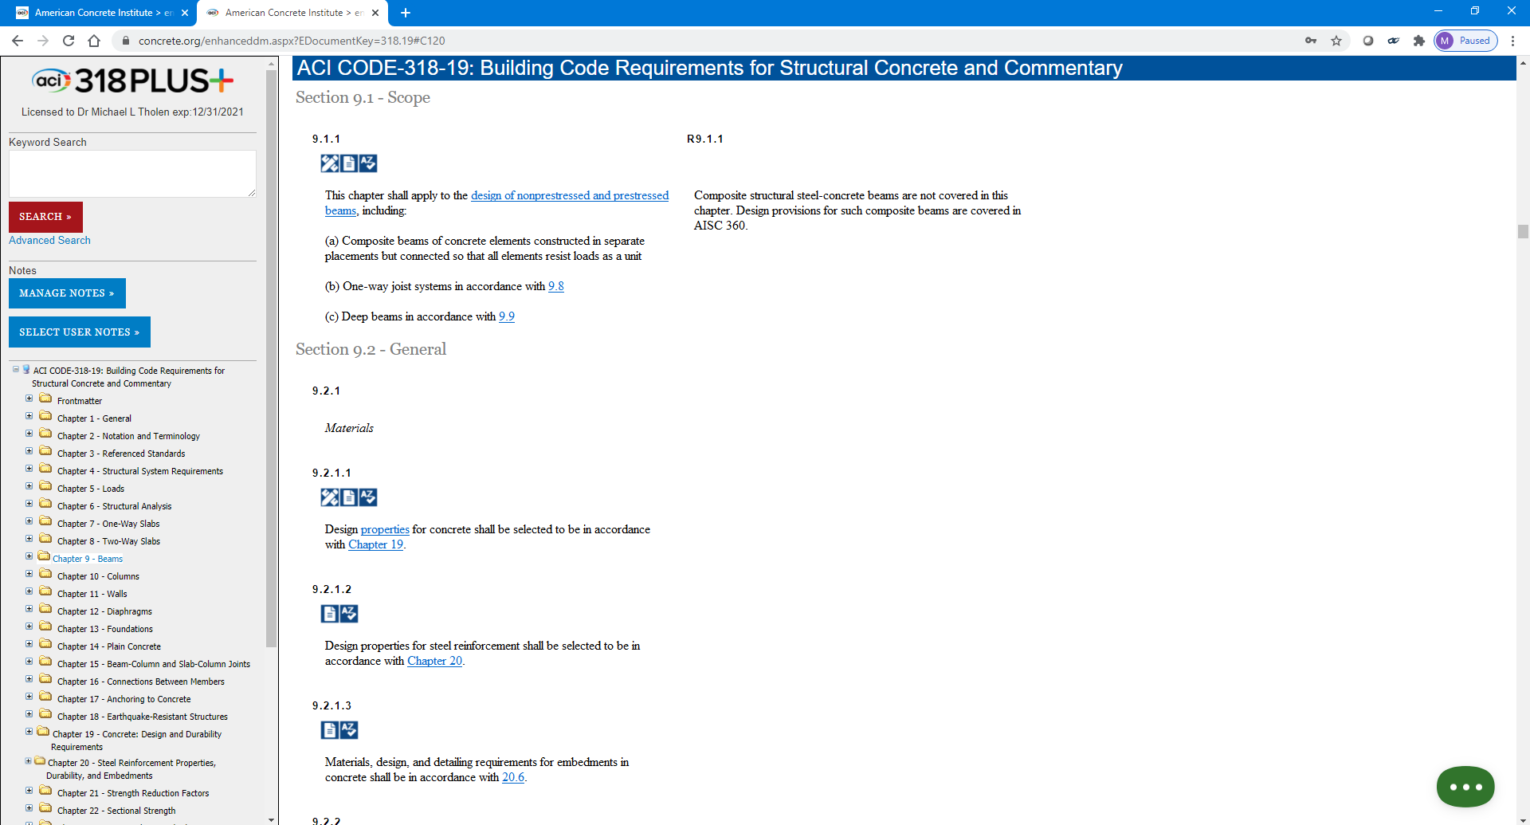
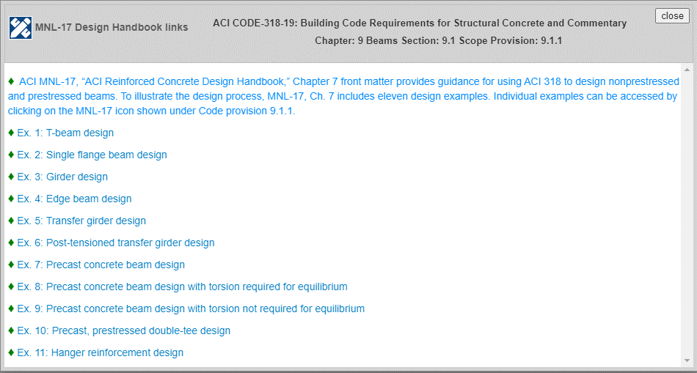
Design Handbook (MNL-17)
Notes:
Manuals: The icon for links to the ACI Design Handbook is shown here on provision 9.1.1. The Design Manual is a document with over 1000 pages of worked example problems that illustrate the use of the code for common element design scenarios. The advantage of having the Design Handbook and the Detailing Manual in the PLUS platform is that we can take the user directly to specific spots in these two documents. With other resources we only have the ability to pull up a copy of the document which automatically takes you to the first page. So, users will be able to go from the code directly into example problems and design aids that shows how to use that provision.
<click>
As I mentioned, we often have more links to put in a provision than we have room to put them in the text. This is a good example where we wanted to have easy access to each example in the Design Handbook. Only the first note appears when I hover over the linked text in this provision, but I can click on an individual example in the list below to go to a specific example I’m interested in.
<click> When I click on the top comment, the Design Handbook opens in a new window to the specific location we wanted to take you to in the document.

Slide 15
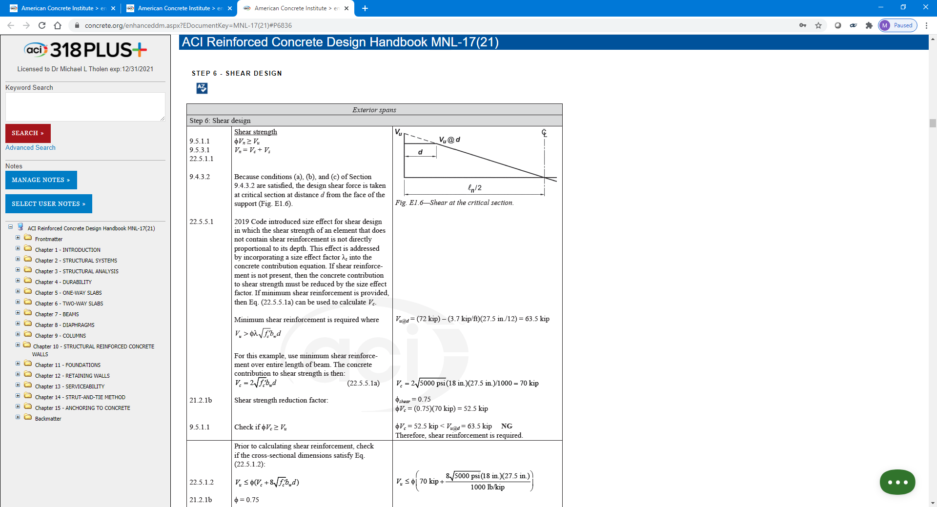
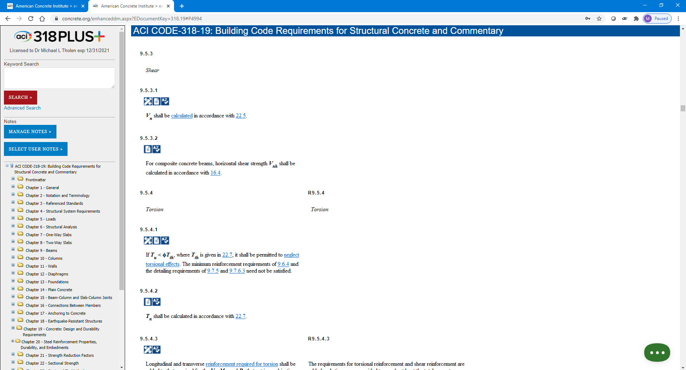
Design Handbook (MNL-17)
Notes:
Throughout the member chapters, we’ve also placed links to specific examples illustrating the implementation of design provisions. For example, if I’m designing a beam and I come to the shear calculation section here in 9.5.3, you can see that we have another link to the Design Handbook.
<click>
If I have questions about how those provisions are applied, I can hover over the hyperlinked text or click on the icon and see that there’s a comment directing me to a specific step in one of the examples.
<click>
Clicking on that link opens up the design manual and takes me directly to that step in the example.

Slide 16
Resources / Links
Videos
Notes:
For many people one of their favorite way of learning is to listen to someone talking to them and explaining a topic. That is why we have a seminar that explains the changes in each edition of ACI 318. We’ve recorded that presentation and broken it up into small chunks scattered throughout the code.

Slide 17
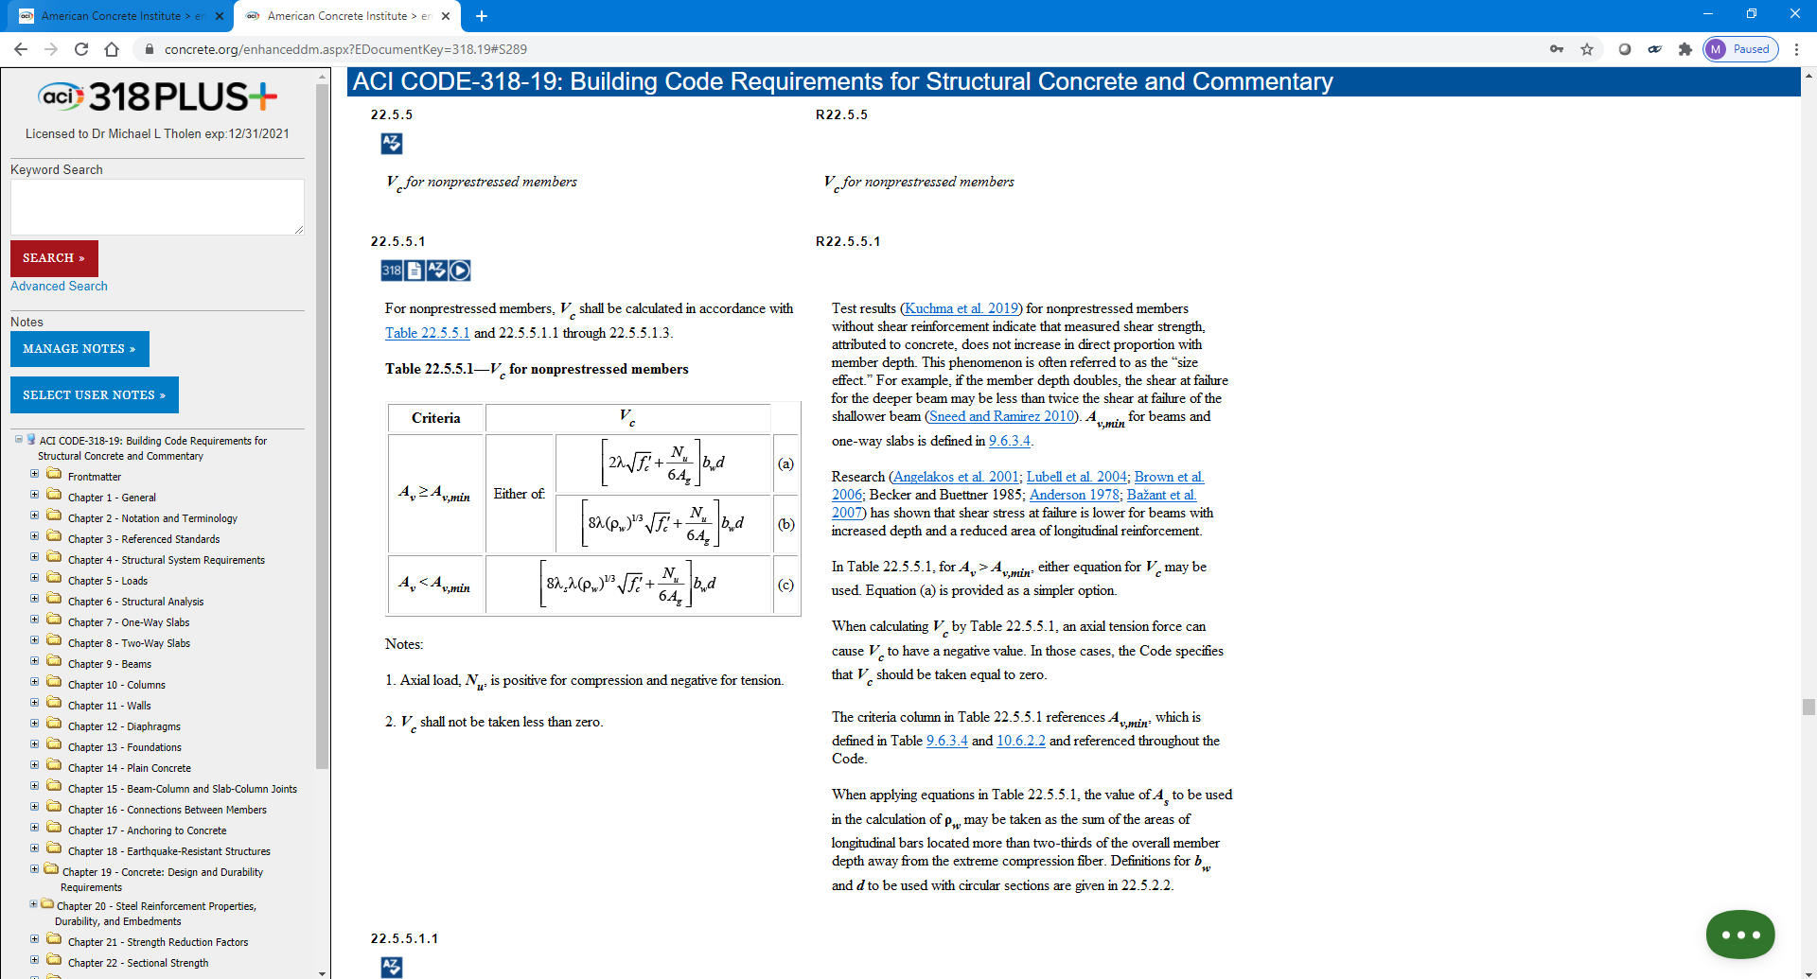
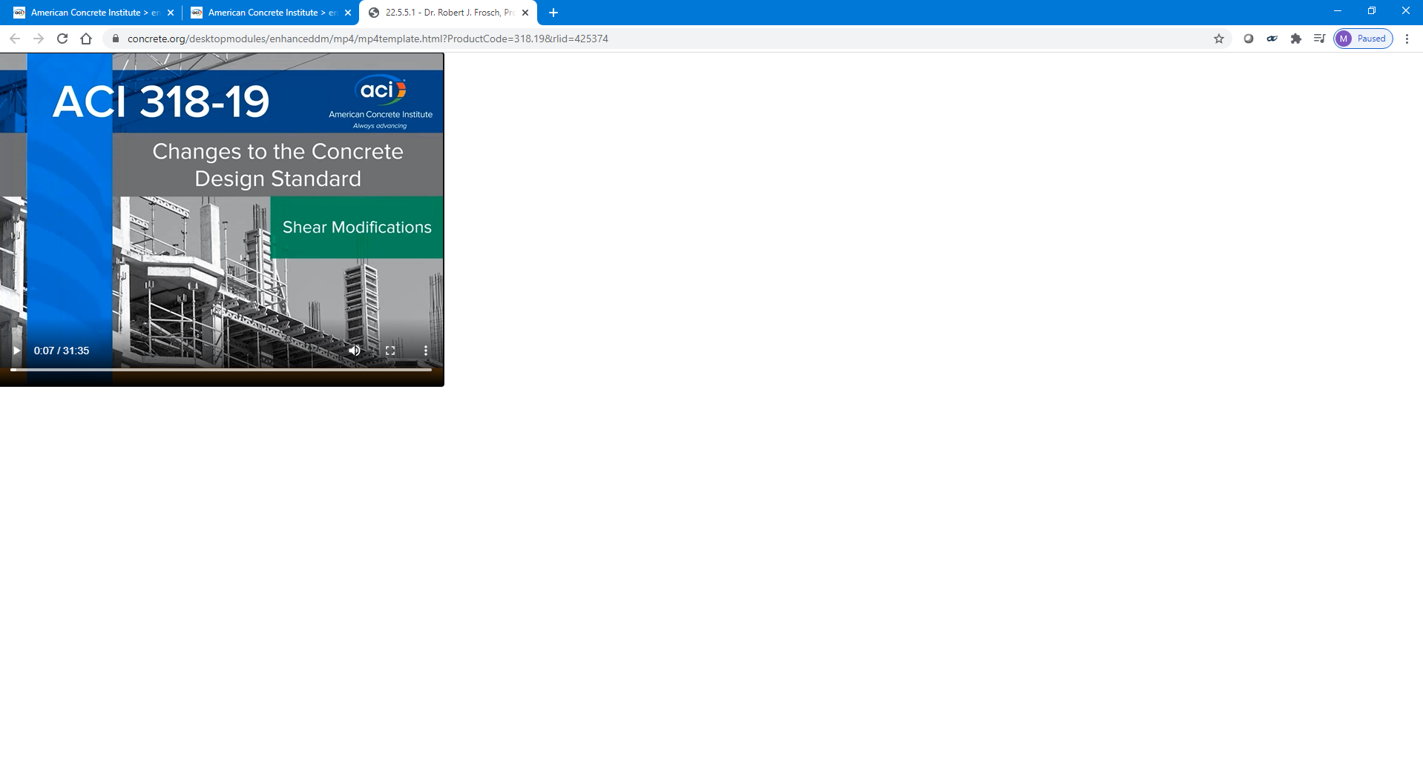
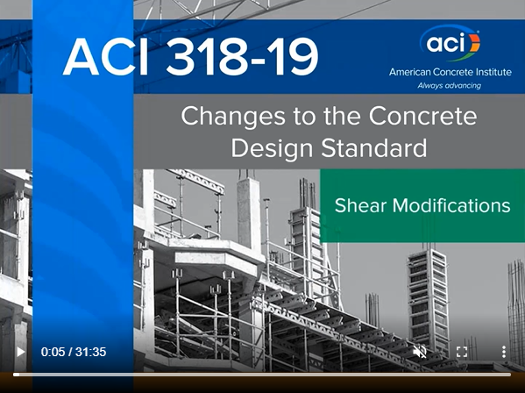
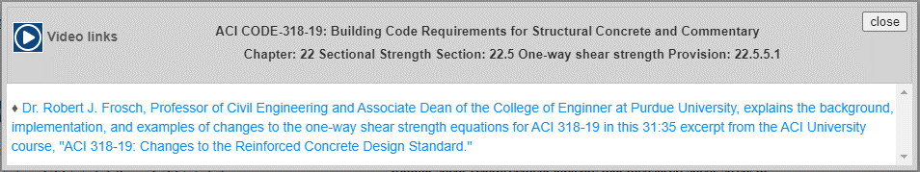
Videos
Notes:
If I follow through section 22.5 for shear strength, I come to Section 22.5.5 which covers the calculation of the concrete contribution to shear strength. Many of you may be aware that there were some significant changes to this section to address the effect of reinforcing steel ratio for beams without minimum shear reinforcement. For these sections with significant changes from 318-14, we’ve recorded the sections of the ACI 318 seminar that explain the changes.
<click>
If I click on the video icon, I can see a note that this video clip will cover the changes to the shear provisions.
<click> Clicking on that note loads the recording of that presentation that you can watch.

Slide 18
Resources / Links
3-D Graphics

Slide 19
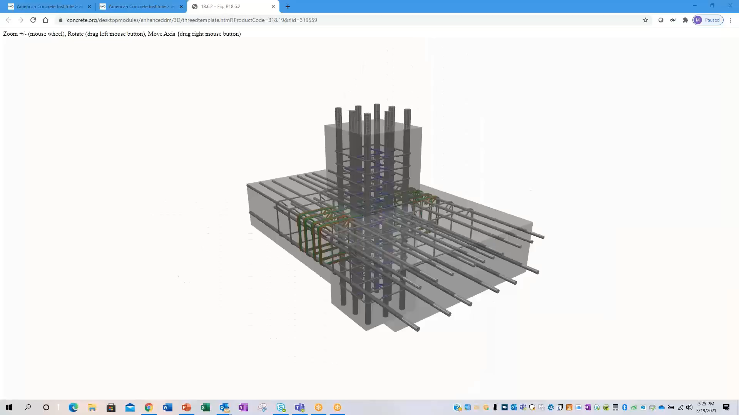
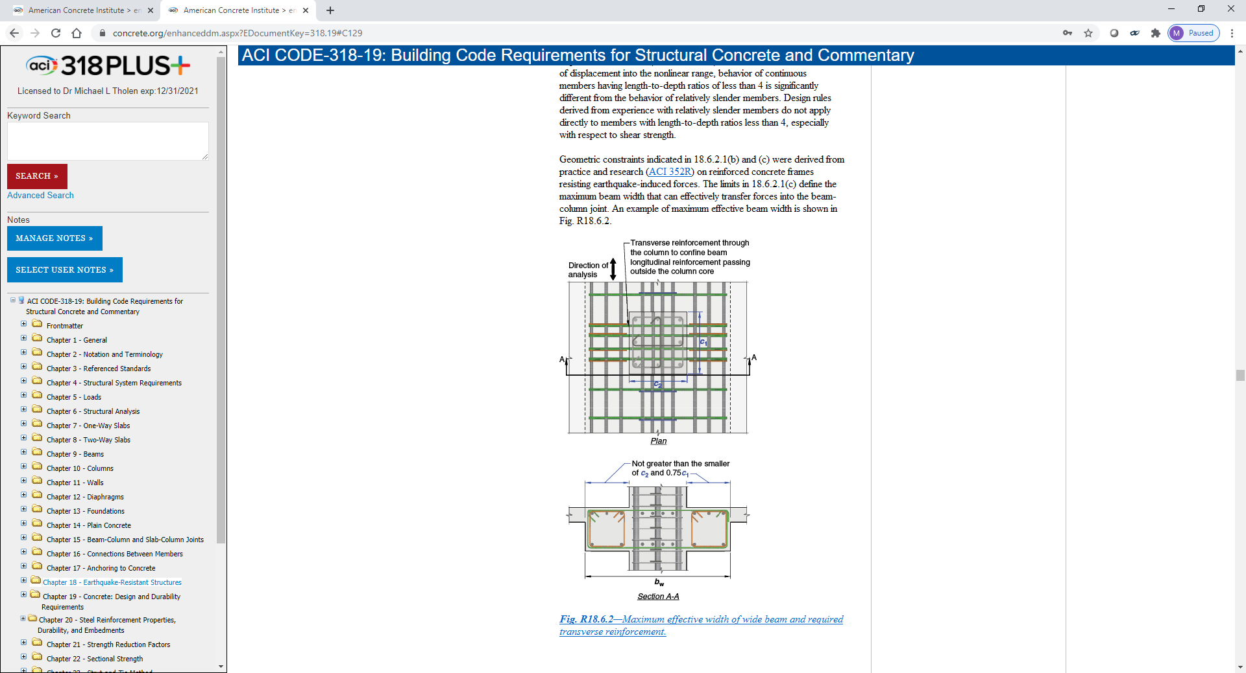
3-D Graphics
Notes:
One more feature I’d like to mention has to do with the figures in 318. I mentioned the 3-D graphics we’ve included that were what we used to develop a lot of the figures for the 2019 edition of the code. An example is found in Fig. R18.6.2. Where there is a 3-D graphic I can pull up, the figure caption is hyperlinked and the 3-D cube icon appears under the provision number.
<click>
If I click on either one of those, a separate window pops up with the 3-D graphic.
<click again to start video>
I can manipulate the graphic with my mouse.

Slide 20
Access – Free to All
Terminology
3-D Graphics
Design Handbook
FAQs
Videos
Internal Links
Detailing Handbook
318 References
Notes:
Looking again at our list of resource types, generally the ones that you see highlighted here are free to everyone with access to 318 PLUS.

Slide 21
Access – Free With Membership
Terminology
Practices
3-D Graphics
Design Handbook
FAQs
ACI University
Videos
Internal Links
Detailing Handbook
CI Articles
318 References
Notes:
The resources you see highlighted in red here are generally a part of membership.

Slide 22
Resources / Links
Terminology
Practices
3-D Graphics
Design Handbook
Education Publications
FAQs
ACI University
Videos
Internal Links
Detailing Handbook
CI Articles
318 References
Standards
Notes:
These resources (red text) generally require an additional purchase of some sort, either individually or as part of a subscription. I should note that some of the education publications are free to the public, but others require a purchase.

Slide 23
User Notes
Ability for user customization
Resources outside ACI
Up to 10 sets per user
Shareable
Allows others to build on the PLUS platform
  Engineering companies
  Professors
  Textbook publishers
Notes:
The Notes feature is an important part of the Platform because it allows each user to customize the resources available to them using text, images, and hyperlinks. We’ll look at some examples of the functionality on the next slide.
<click>
One of the ways users can customize 318 PLUS for their own needs is by adding or linking to resources that are outside of ACI resources. This could be done through text or through links to resources they have access to. The resources in ACI 318 PLUS are limited to products that have been through the ACI review process that has been deemed appropriate for that type of product.
<click>
Users are allowed up to 10 different sets or groups of User Notes. For example, some may want to construct a set of notes that is applicable to a certain type of structure that they design often. Some may want a set of notes that is common to a particular geographic area or even client.
<click>
We’ve also built in the ability to share the notes sets that you create with other users. This opens up some great opportunities for others to build upon the PLUS Platform. For example, you may want to put someone in charge of setting up a set of notes that can be shared with all the structural or civil engineers in your design firm. Professors could set up notes for a course they are teaching that they share with their students. Product manufacturers may even want to set up notes that identify the products they produce that meet certain code requirements and provide backup material for you to give to the building inspector.

Slide 24
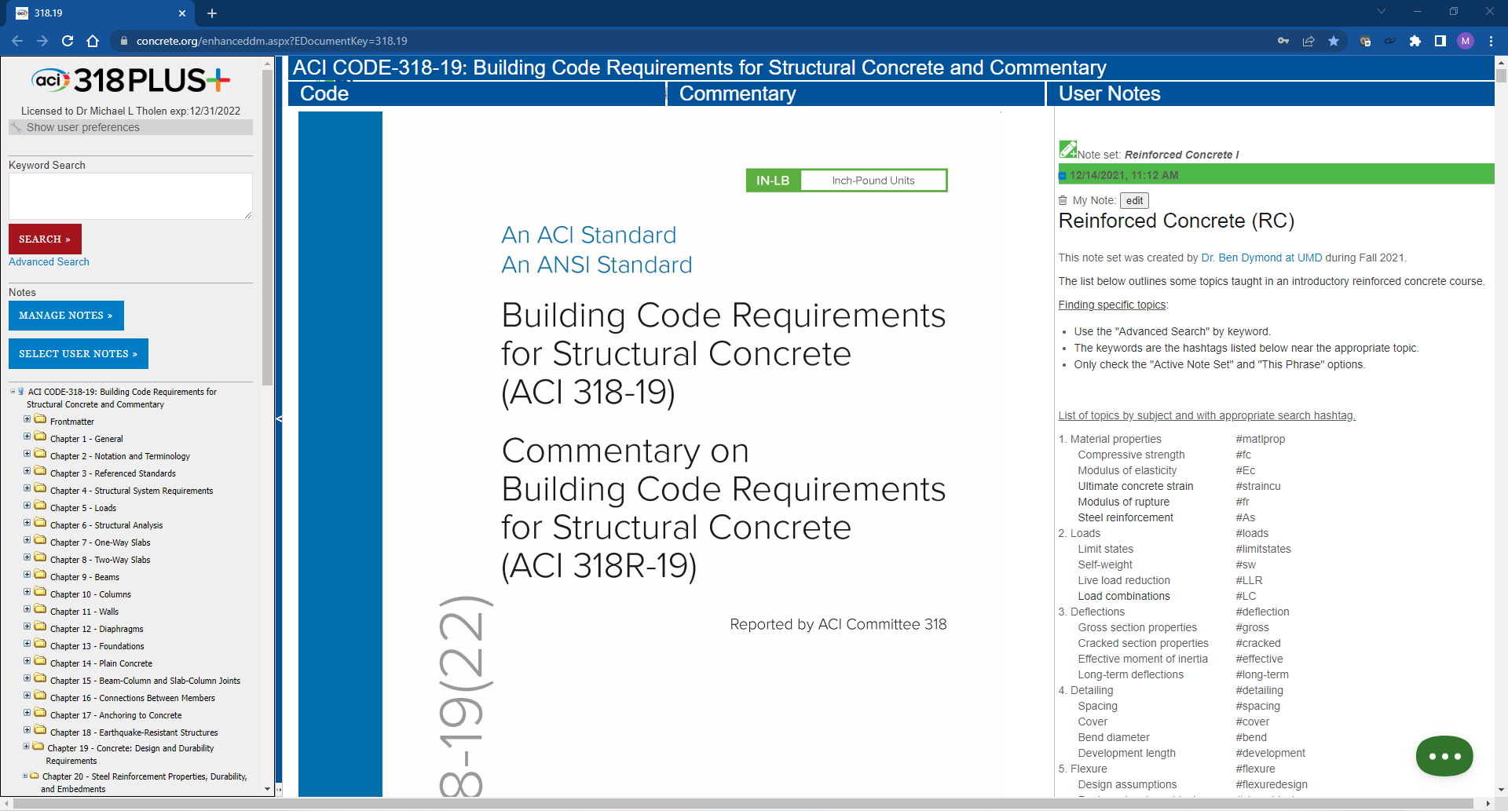
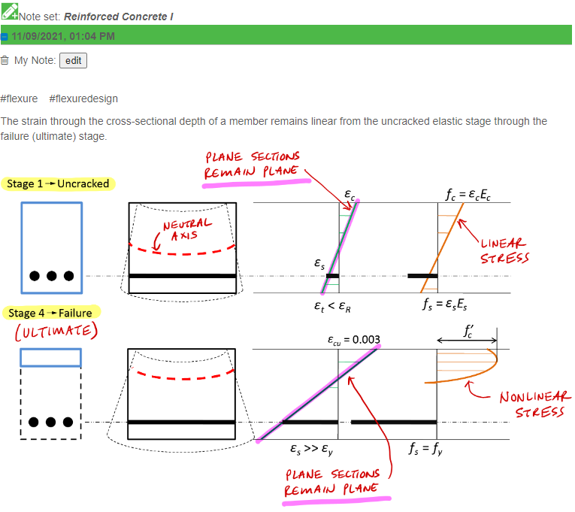
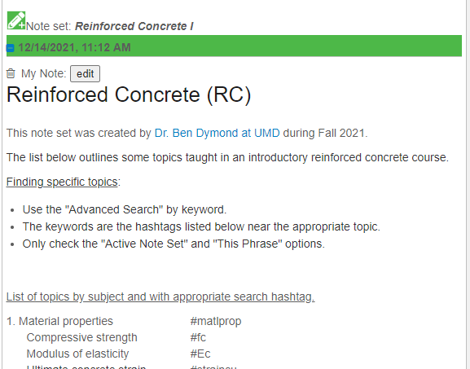
Classroom Notes
Notes:
Layout: The appearance of the product is similar to a PDF. Tools and navigation are on the left. The document appears in the center. The notes appear on the right. I’m going to go ahead and turn off the notes for now since we won’t be using them. I’ll turn them back on when we discuss the notes features.

Slide 25
Future enhancements
More documents
Company or Educator note sets
Edition comparisons
Continuous update of draft documents
SI units
Notes:
Having this product on the website gives us the opportunity to add future enhancements that can be immediately available to the current subscribers.
<click>
More documents will be added and linked similar to how 318 PLUS is linked.
<click>
We’re working on some enhancements that will make the notes easier to share for companies and educators.
<click>
When documents in the PLUS platform get updated, we want to be able to show what has changed from edition to edition, especially for code documents.
<click>
We are even considering some enhancements that would allow our committees to develop documents on the platform and then publish those changes that are successfully balloted by the committee.
<click>
We’d also like to develop a way to toggle between in.-lb and SI units.

Slide 26
Mike.Tholen@concrete.org

