Slide 1
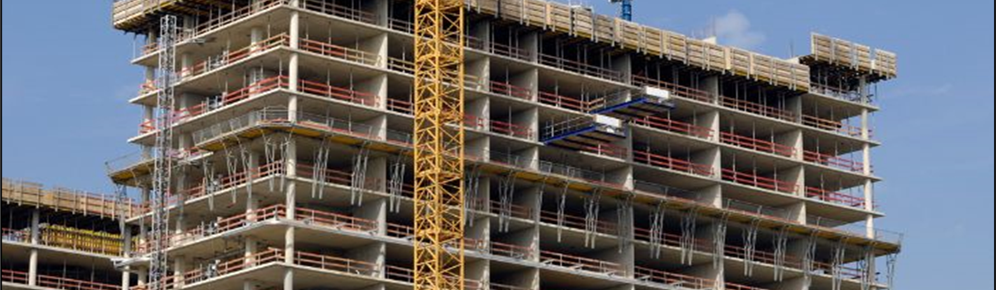
American Concrete Institute (ACI) Professional Development
Claire Hiltz
Director, Professional Development
Notes:
Hello, I am Claire Hiltz and I’m the Director of Professional Development at ACI.

Slide 2
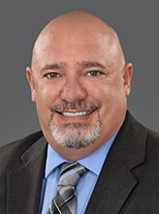
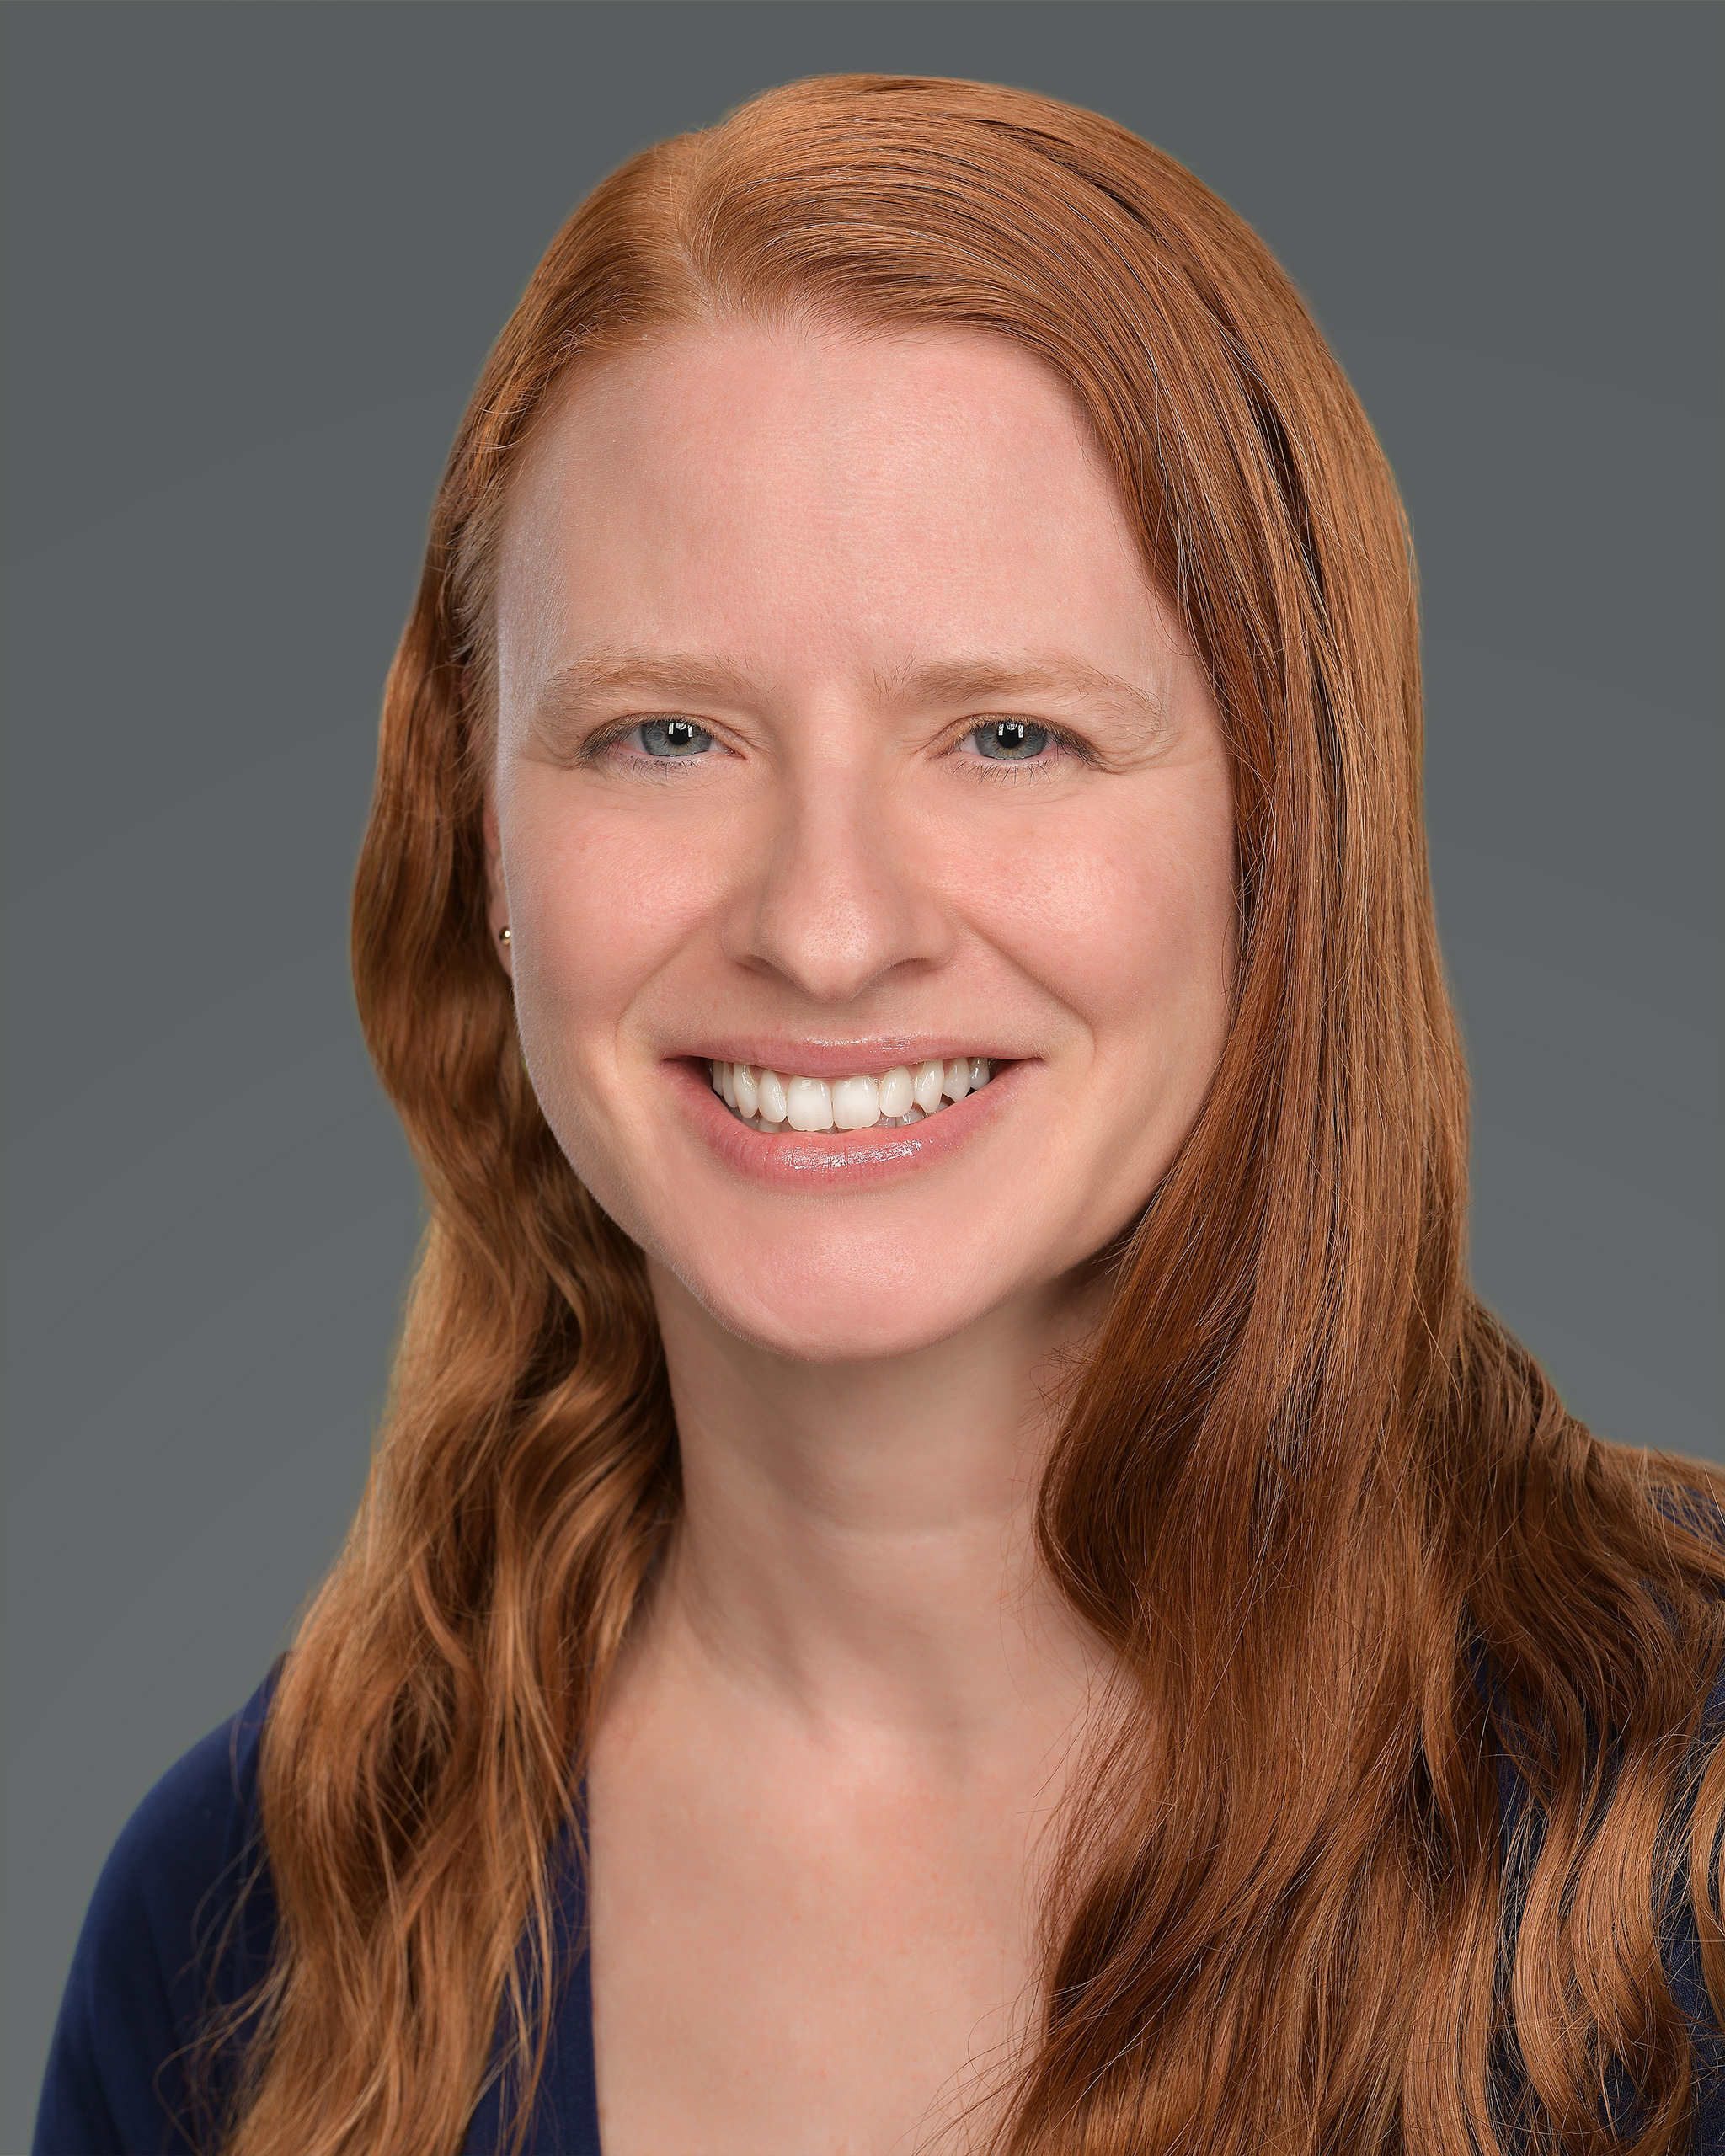
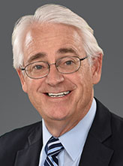
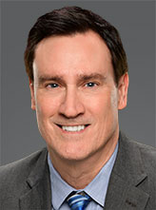
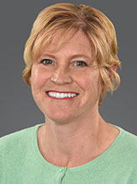
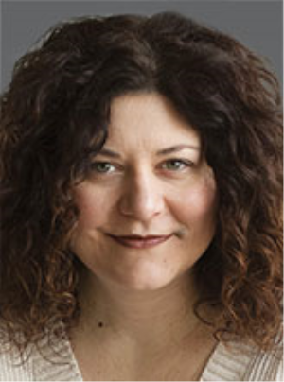
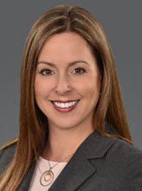
Who We Are
Michael L. Tholen
Managing Director,
Professional Development
Katie A. Amelio
Engineer
Robert M. Howell
Engineer
Bob Hogston
Professional
Development Coordinator
Aimee M. Kahaian
Professional
Development Coordinator
Aileen Castelli
Administrative Coordinator
Claire A. Hiltz
Director, Professional Development
Notes:
Our department is made up of 7 people, including Engineers, course developers and administrators.

Slide 3
Education Products
TOPICS
ACI 318
Anchorage
Certification Training
Codes/Design Examples
Concrete Fundamentals
Construction
Sustainability
Decorative Concrete
Fiber-Reinforced Concrete
Materials
Assessment & Repair
Pavements & Parking Lots
Self-Consolidating Concrete
Slabs-on-Ground
ACI University
Seminars
Professors’ Workshop
Free online educational presentations
ACI education documents
Notes:
We produce five primary product lines including ACI University, Seminars, the Professors’ Workshop, Free online education presentations, and ACI education documents. These products cover a variety of topics show in the list on the right.

Slide 4
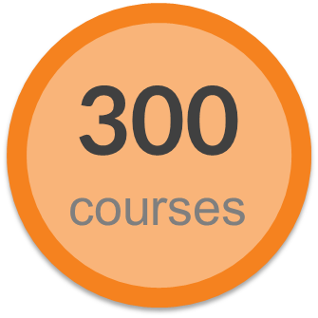
Education Products
ACI University
An online, learning resource, providing on-demand access to a wide range of topics on concrete materials, design, and construction.
Monthly webinars
Certificate programs
All-access digital subscription – FREE to ACI Members
Online certification training
Notes:
ACI University is our online learning portal that contains around 300 courses, certificate programs, online certification training, and features monthly live webinars. Access to most of the content in ACI University is free for ACI Members.

Slide 5
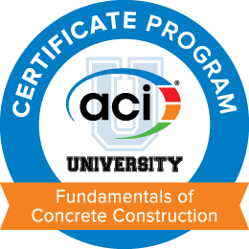
Education Products
ACI University
Certificate Programs
in-depth course of study on a particular concrete topic that will allow the user to obtain a certificate and digital badge upon completion.
Notes:
Our certificate programs are made up of a grouping of courses on a particular topic. We currently offer four certificate programs. These are free to ACI Members.

Slide 6
Education Products
ACI University
All-Access Digital Subscription
Includes all ACI monthly webinars
Includes 300 ACI On-Demand Courses
12-month subscription
FREE to ACI Members (Regular $299)
Subscribe at concrete.org/store
Notes:
The ACI University All access digital subscription includes access to all live monthly webinars, around 300 on-demand courses. It is free to ACI members and available for $299 for non members

Slide 7
Education Products
ACI University - Who can use the courses?
Students
Coursework
Assigned by Professor
Member credit eligible
Completion certificate after exam
Use of industry resource
Prepare for a career in the concrete industry
Construction personnel
Sales professionals
Engineers
Notes:
The ACI University audience can be divided into four segments. We have the academic segment that is comprised of students and professors. Professors can assign individual courses through aCI U or entire certificate programs to their students as part of their curriculum. And students can use the knowledge learned through ACI U to help prepare themselves for a career in the concrete industry.

Slide 8
Education Products
ACI University - Who can use the courses?
Students
Continuing education and certification prep
Concrete construction best practices
Improve workability
Testing and inspection requirements
Repair and rehabilitation
Coursework
Assigned by Professor
Member credit eligible
Completion certificate after exam
Use of industry resource
Construction personnel
Sales professionals
Engineers
Notes:
Construction personnel can participate in ACI U to learn about construction best practices, testing and inspection requirements as well as repair and rehabilitation. And they can also benefit from the courses for continuing education and certification preparation.

Slide 9
Education Products
ACI University - Who can use the courses?
Students
Introduction to the concrete industry
Broader knowledge
Better customer service
Demonstrate dedication to customers
Gain respect and trust of customers
Coursework
Assigned by Professor
Member credit eligible
Completion certificate after exam
Use of industry resource
Construction personnel
Sales professionals
Engineers
Notes:
And sales professionals can use the courses to help broaden their knowledge about the concrete industry and also to better support their customers.

Slide 10
Education Products
ACI University - Who can use the courses?
Students
Continuing education
Increased competency
Specialty topics
Concrete durability
New materials
Coursework
Assigned by Professor
Member credit eligible
Completion certificate after exam
Use of industry resource
Construction personnel
Sales professionals
Engineers
Notes:
And engineers can participate in ACI U for continuing education credits for their PE licenses and also to help expand their knowledge and competencies on specific topics, and to also learn about the latest materials and technologies.

Slide 11
Education Products
TOPICS
ACI 318-19 Building Code
Anchorage to Concrete
Assessment, Repair, and Rehabilitation of Existing Concrete Structures
Concrete Slabs-on-Ground
Repair of Concrete Bridges, Parking Decks, and Other Transportation Structures
Repair of Concrete Workshop
Seismic Design for Liquid-Containing Concrete Structures
Troubleshooting Concrete Construction
Troubleshooting Concrete Forming and Shoring
Seminars
Bring ACI training and education expertise right to your doorstep by scheduling a custom seminar for your employees, customers, or members.
Can be delivered virtually
Full day
Notes:
We also offer seminars, primarily in-house seminars, which are requested by an organization. We offer two expert speakers to deliver a day long seminar on a particular topic. These can be delivered in person at the customer’s office or virtually.

Slide 12
Education Products
Professors’ Workshop
For instructors in civil engineering, architecture, architectural engineering, materials science, and construction management programs
Presented by prominent, nationally known faculty and industry representatives
Resources for teaching undergraduate courses in structural concrete design, concrete materials, and pavements
Virtual and in-person
Notes:
Each year, usually at the and of July, we deliver a professors’ workshop. The intended audience of the workshop are instructors of civil engineering, architecture, architectural engineering, materials science, and construction management programs. The workshop features several sessions delivered by prominent, nationally known faculty and industry representative. The workshop offers Resources for teaching undergraduate courses in structural concrete design, concrete materials, and pavements. This year the workshop was delivered in two parts – virtually and then in-person at ACI HQ the following week.

Slide 13
Education Products
Free online educational presentations
ACI Convention session presentations
New presentation each week
Hundreds of presentations available
~20 minutes
Not eligible for PDH credit
FREE for everyone
Notes:
We also offer free online education presentation These are presentations that were recorded at ACI conventions and we feature a new presentation each week. The full library includes hundred of short presentations, around 20 minutes. They are free for anyone.

Slide 14
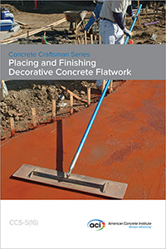
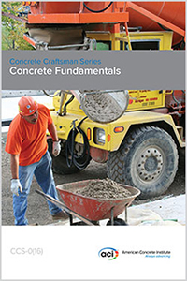
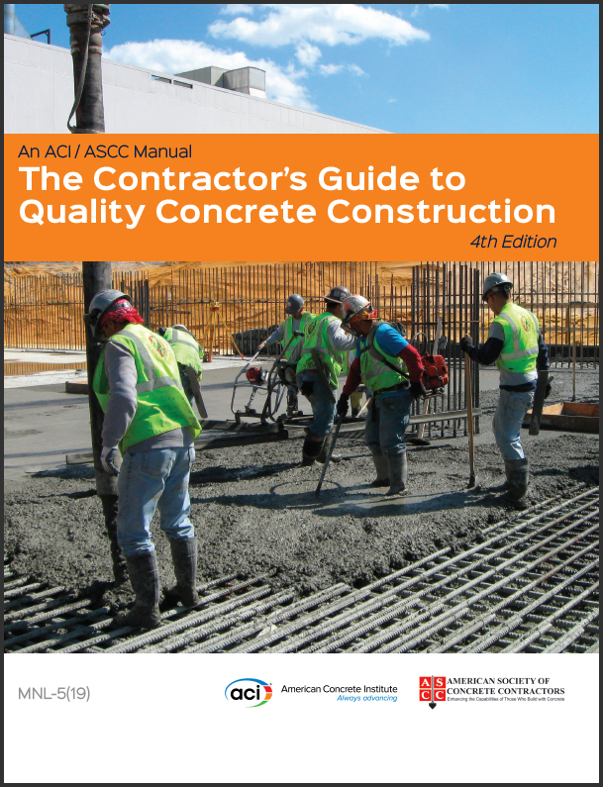
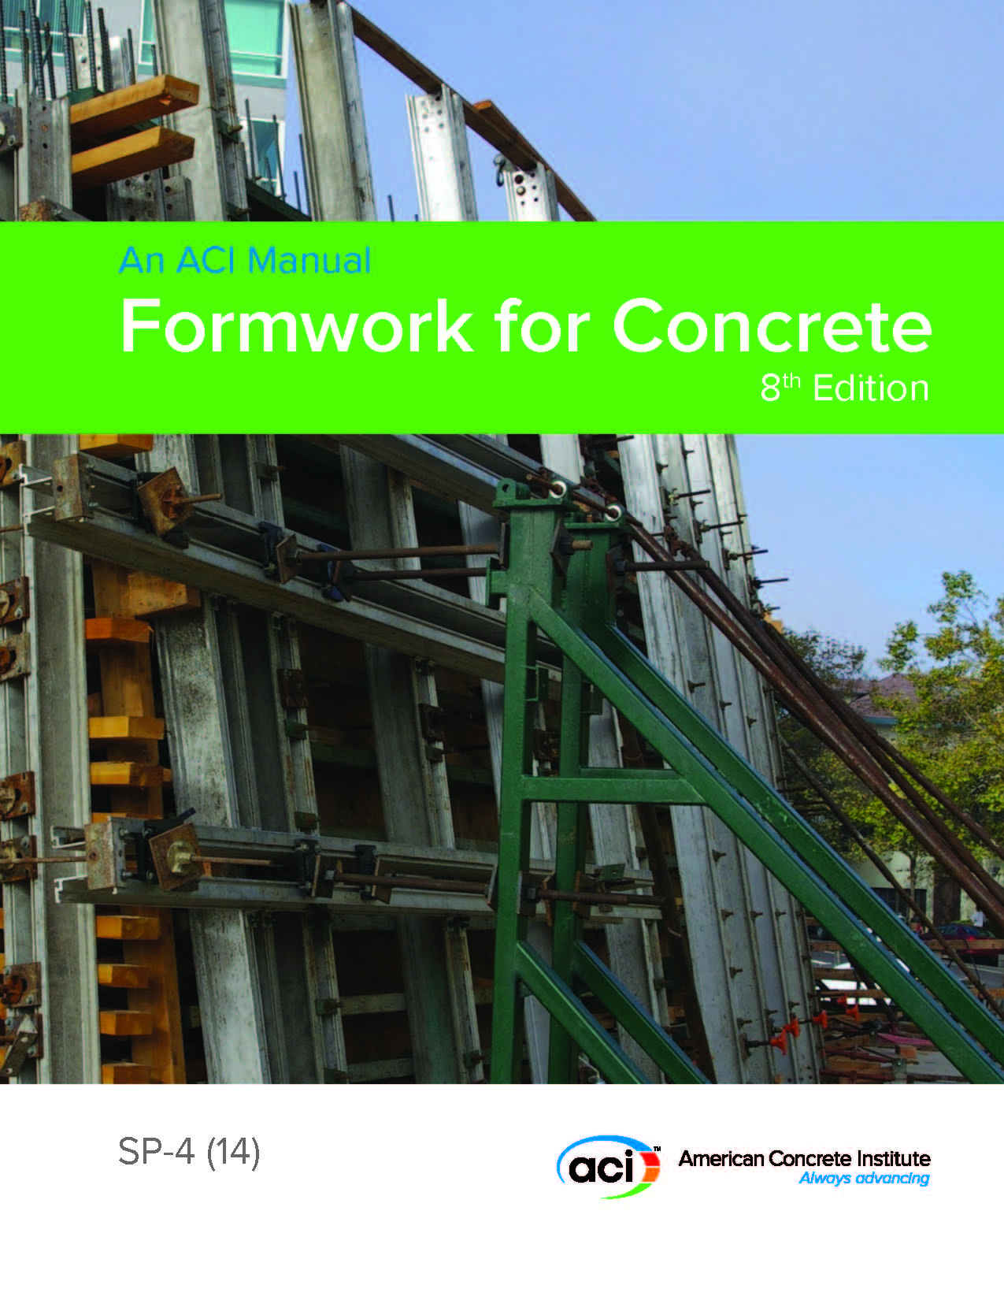
Education Products
ACI education documents
Developed by ACI Educational Committees
Concrete Craftsmen Series
Materials, Design Examples
Repair Application Procedures (RAP)
Documents, CDs, DVDs, References
Notes:
And finally we offer several education documents. These are documents that are developed by various ACI education committees. We offer the concrete craftsman series, materials and design examples, repair application procedures, and various other documents, CD, DVDs and references.

Slide 15
Claire.Hiltz@concrete.org
Notes:
So that wraps up my presentation. If you have any questions, feel free to contact me. My email is show here. Thank you for listening.

