Slide 1
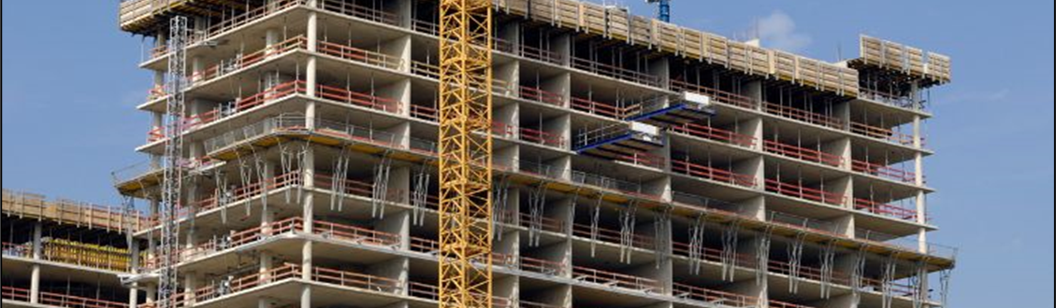
American Concrete Institute (ACI) Certification
John Nehasil
Managing Director, Certification
Notes:
Thank you for the opportunity to give you an overview of ACI Certification. ACI Certification has been serving the industry for nearly 40 years and has grown from one program in the early 1980s to over 30 today. During this time, we’ve administered over 725,000 exams.

Slide 2
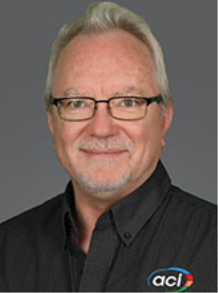
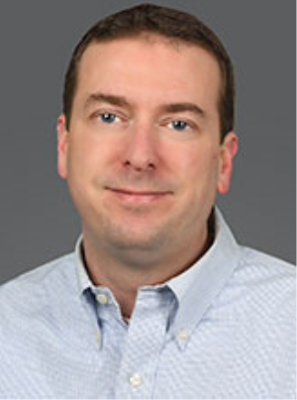
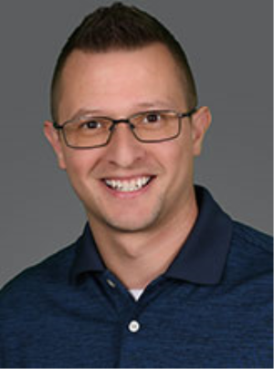
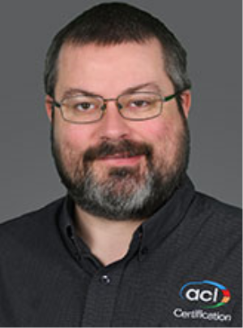
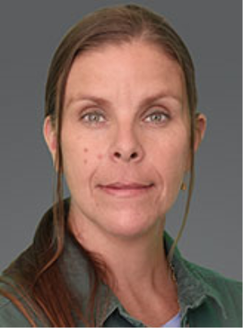
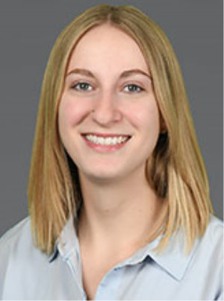
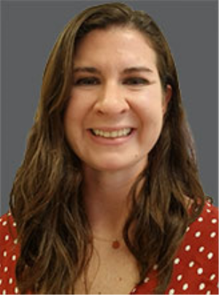
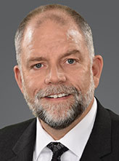
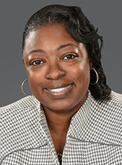
Who We Are (Certification)
John Nehasil, Managing Director,
Certification
Mark Campo,
Director, Certification
Timothy Heitzmann,
Manager, Certification
Nate Mohler, Certification Program Developer
Emily Boirum, SoCal Resource Center Manager
Breanne Coleman, Certification Coordinator
Diana Florea, Certification Coordinator
Claire Freeman, Editor
Charai Gantt, Certification Coordinator
Sarah Mauri, Technical Writer
Kathy Merlo,
Resource Centers Coordinator
Michael Morrison,
Manager,
Cert. Program Development
Rusty Owings,
Midwest Resource Center Manager
Doug Ronan, Certification Coordinator
Hannah Russey, Certification Coordinator
Kassye Smith, Certification Coordinator
Notes:
Currently, ACI Certification employs 17 Staff Members to coordinate the activities of 23 Committees and 130-plus Sponsoring Groups employing over 1500 industry professionals to develop, administer, and maintain ACI Certification programs.

Slide 3
Why Get Certified?
PUBLIC
Protects public health and safety
Helps conserve valuable resources
Meets project requirements
Contributes to the quality of the project
Improves quality of life
Notes:
Certification programs provide a critical service to the concrete construction industry by providing a mechanism to assess and identify individuals who possess specific knowledge and skills necessary to execute specific job responsibilities on concrete construction projects. Typically, certification programs relate to jobs for which education doesn’t exist, or is scarce within the formal educational system, and often the certification program targets areas in construction projects where unqualified individuals actions may have significant negative impacts on projects.
The concrete construction industry is in a constant state of improvement, with new products, processes and techniques being developed and implemented at an increasing rate. Certification programs, and recertification requirements ensure that individuals are connected and remain connected to the technical arm of the industry to facilitate effective transfer of new knowledge and skills.
Certification is important to the public because it:
• Protects public health and safety
• Helps conserve valuable resources
• Meets project requirements
• Contributes to the quality of the project
• Improves quality of life

Slide 4
Why Get Certified?
PERSONAL
Demonstrates/proves knowledge and skills
Often the sole method of learning specific processes
Provides a mechanism for continued learning
Makes the individual stand out from others
Provides a sense of accomplishment
Provides a track for career advancement
Notes:
Certification is important to individuals because it:
• Demonstrates/proves knowledge and skills
• Is often the sole method of learning specific processes
• Provides a mechanism for continued learning
• Makes the individual stand out from others
• Provides a sense of accomplishment
• Provides a track for career advancement
Certification is also important to employers as they can market their company as having workers qualified by an independent professional organization.

Slide 5
Why ACI Certification?
Globally recognized
Independent
Psychometric approach to formulate effective written and performance exams
Online verification of credentials — plus app!
Engaged administrative network (SGs)
Training, outreach, etc.
Agile, responsive to regional markets
Customized programs in multiple languages
Notes:
That explains the benefits of certification in general, but why choose ACI Certification?
• ACI and ACI Certification is globally recognized
• Since ACI is not a trade organization, we can provide unbiased, Independent assessments
• We employ a psychometric approach to formulate effective written and performance exams
• Our Website provides 24/7 online verification of credentials
• ACI has an engaged administrative network (SGs)
• ACI and its affiliates can provide training and outreach
• ACI has become more agile and responsive to regional markets
• We can customized programs and translate materials into multiple languages

Slide 6
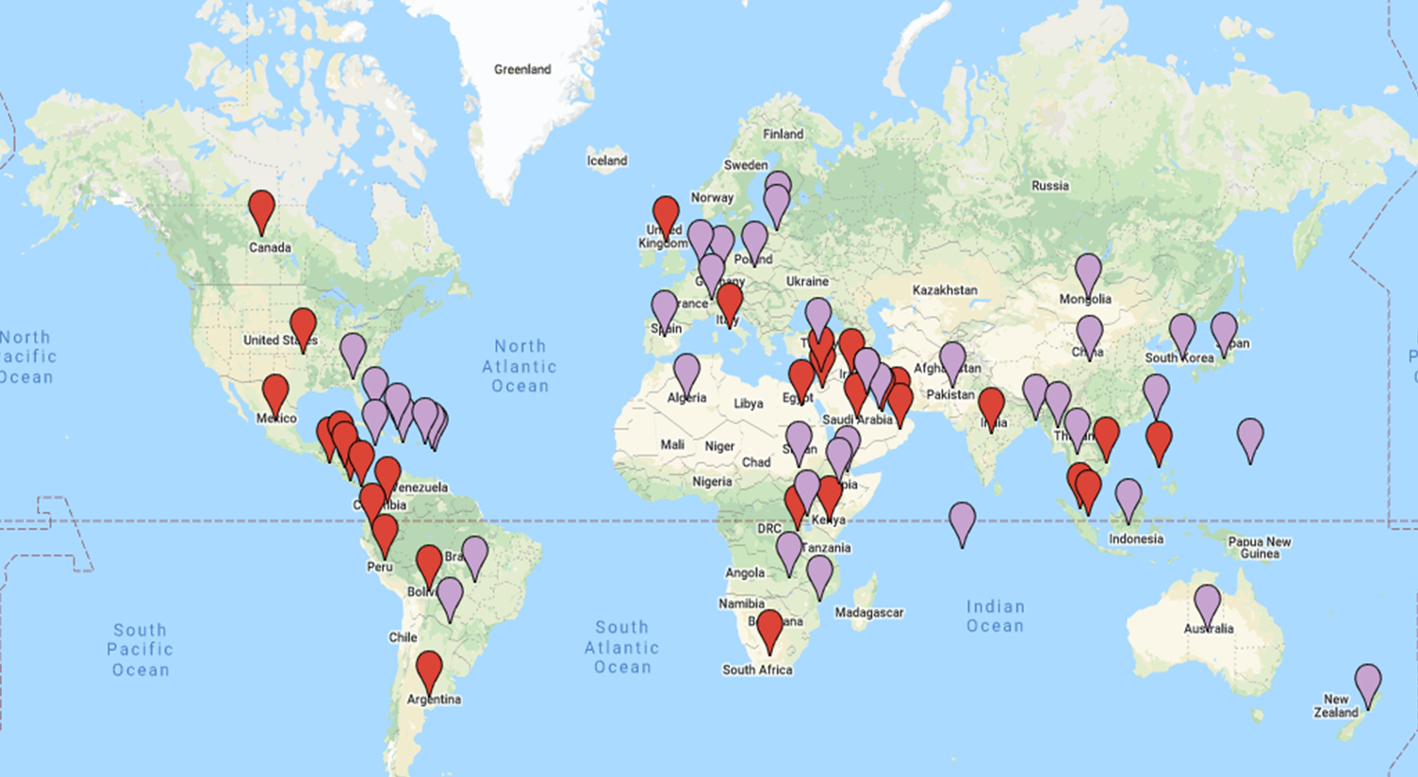
Distribution of ACI Certifications and SG’s
Notes:
In Terms of global recognition and use, this map illustrates the reach of ACI Certification, with all pins representing countries in which ACI Certified Individual live, and the red pins indicating the locations of ACI Sponsoring Groups who can deliver education and exams. ACI currently offers programs in English, Spanish, French, and Chinese, and has the capability to translate into many other languages.

Slide 7
31 Programs… and GROWING!
TESTING
INSPECTION
CONSTRUCTION
DESIGN
Field Testing (4)
Strength Testing
Laboratory Testing (2)
Aggregate & Soils/Base Testing (3)
Cement Physical Tester
Masonry Testing (2)
Self-Consolidating Concrete
Construction Special Inspector (2)
Transportation Inspector
Post-Installed Concrete Anchor (2)
Concrete Quality/Materials
Shotcrete
Nondestructive Testing
Concrete Construction Sustainabilty and Resilience Assessor
Adhesive Anchor Installer
Flatwork Finisher
Decorative Concrete Flatwork
Specialty Commercial-Industrial Flatwork
Tilt-Up
Shotcrete Nozzleman (2)
Residential Concrete Foundation
ACI 318 Design Professional
Notes:
ACI currently offers 31 programs for the Concrete Construction industry in four different categories, the newest are highlighted in yellow. I’d like to draw you attention to the ACI 318 Design Professional program…this is the first program ACI has developed for civil engineers, and it is designed to ensure they know how to navigate the ACI 318 Building Code as they are performing their design work. This program was developed exclusively for use outside of the U.S. and should not be confused with formal licensure or registration.

Slide 8
Both
Written Only
Adhesive Anchor Installer
Concrete Field Testing Technician – Grade I
Advanced Concrete Flatwork Finisher*
Specialty Commercial/Industrial Flatwork Finisher*
Self Consolidating Concrete Testing Technician
Concrete Strength Testing Technician
Concrete Laboratory Testing Technician – Level 2*
Cement Physical Tester
Aggregate Testing Technician – Level 1 & 2
Aggregate Base Testing Technician
Shotcrete Nozzleman (Wet & Dry-mix)*
Masonry Field Testing Technician
Masonry Laboratory Testing Technician
Nondestructive Testing Specialist – Concrete Strength
Performance Only
Post-Installed Concrete Anchor Installation Inspector
Concrete Flatwork Associate
Specialty Commercial/Industrial Flatwork Technician*
Concrete Construction Special Inspector*
Concrete Transportation Construction Inspector*
Concrete Quality Technical Manager*
Tilt-Up Supervisor and Technician*
Residential Concrete Foundation Technician
Shotcrete Inspector*
ACI 318 Design Professional
Concrete Flatwork Finisher*
Commercial/Industrial Flatwork Specialists*:
High Tolerance
Silica Fume
Surface Treatments
Notes:
As you can see in this diagram, many ACI Certification programs have a performance exam component; this is to ensure that successful candidates have demonstrated physical skills when appropriate. I’d also like to point out that there are programs that employ a performance exam ONLY. This assessment approach has been used in part to address literacy issues within the targeted industry segment.

Slide 9
ACI 318 Building Code required certifications
ACI Certifications required in ACI 318-19:
Shotcrete Nozzleman
Adhesive Anchor Installer
Concrete Field Testing Technician
Concrete Strength Testing Technician
Concrete Construction Special Inspector
Post-Installed Concrete Anchor Inst. Inspector
Notes:
In the current ACI 318 Building Code, Certification of personnel relating to six ACI programs is required:
• Shotcrete Nozzleman (Wet-and Dry-Mix)
• Adhesive Anchor Installer
• Concrete Field Testing Technician
• Concrete Strength Testing Technician
• Concrete Construction Special Inspector
• Post-Installed Concrete Anchor Installation Inspector
The Field Technician program is highlighted here as this program has become the industry’s entry-level program, is the most popular in terms of volume, is a prerequisite of higher-level programs, and has a significant impact on the quality of concrete in construction projects. New ACI Sponsoring Groups typically start with this program first, then add others as their capabilities and market needs increase

Slide 10
Sponsoring Groups—the Delivery Point
131 Sponsoring Groups worldwide
Chapter vs. non-chapter:
54 are ACI chapters
76 non-chapters
Domestic vs. international:
92 domestic (U.S.)
39 international
Size and resources vary greatly:
Volunteers vs. full-time paid staff
Notes:
The majority of ACI Certification exams and preparatory educational programs are delivered by ACI Sponsoring Groups; they can be ACI Chapters, but they can also be other industry organizations with the expertise and resources to conduct ACI programs.
Again, 131 SGs worldwide, about half are ACI Chapters which typically represent a wide spectrum of the industry, and half industry organizations whose constituency is typically narrower. 39 of our SGs are headquartered outside of the U.S.

Slide 11
Sponsoring Groups—Requirements
Constituency represents stakeholders
Appropriate technical expertise
Prove a legitimate need for the program(s)
Primary objective to improve concrete construction within the intended operational jurisdiction*
Maintain a Certification Committee
3 indvs - 3 diff orgs/cos – 3 diff prods or servs
Maintain control over examiners/exam process
Prepared to execute specific responsibilities (CCPOM)
Adequately service the jurisdictional area
Assist in advocacy efforts
Notes:
Through the application process, ACI ensures that each prospective SG has the following attributes:
• Constituency represents stakeholders
• Appropriate technical expertise
• Prove a legitimate need for the program(s)
• Primary objective to improve concrete construction within the intended operational jurisdiction*
• Maintain a Certification Committee
o 3 indvs - 3 diff orgs/cos – 3 diff prods or servs
o Maintain control over examiners/exam process
o Prepared to execute specific responsibilities (CCPOM)
o Adequately service the jurisdictional area
o Assist in advocacy efforts

Slide 12
Sponsoring Groups—Exam Activity
131 groups worldwide
38,000 exams administered per year
~2000 of these Int’l
~3200 per month
~3700 sessions per year
~300 per month
Session size can vary: 1~100 examinees
SGs charge a reasonable amount above ACI fees to cover expenses and generate revenue for the SG
Notes:
Although SGs sponsor ACI Certification programs to improve the industry, the additional incentive is that it can generate income for the SG. That income is typically used to hire staff and/or conduct other non-certification related activities to ensure the continued existence of the SG. ACI does NOT prohibited SGs from generating income.

Slide 13
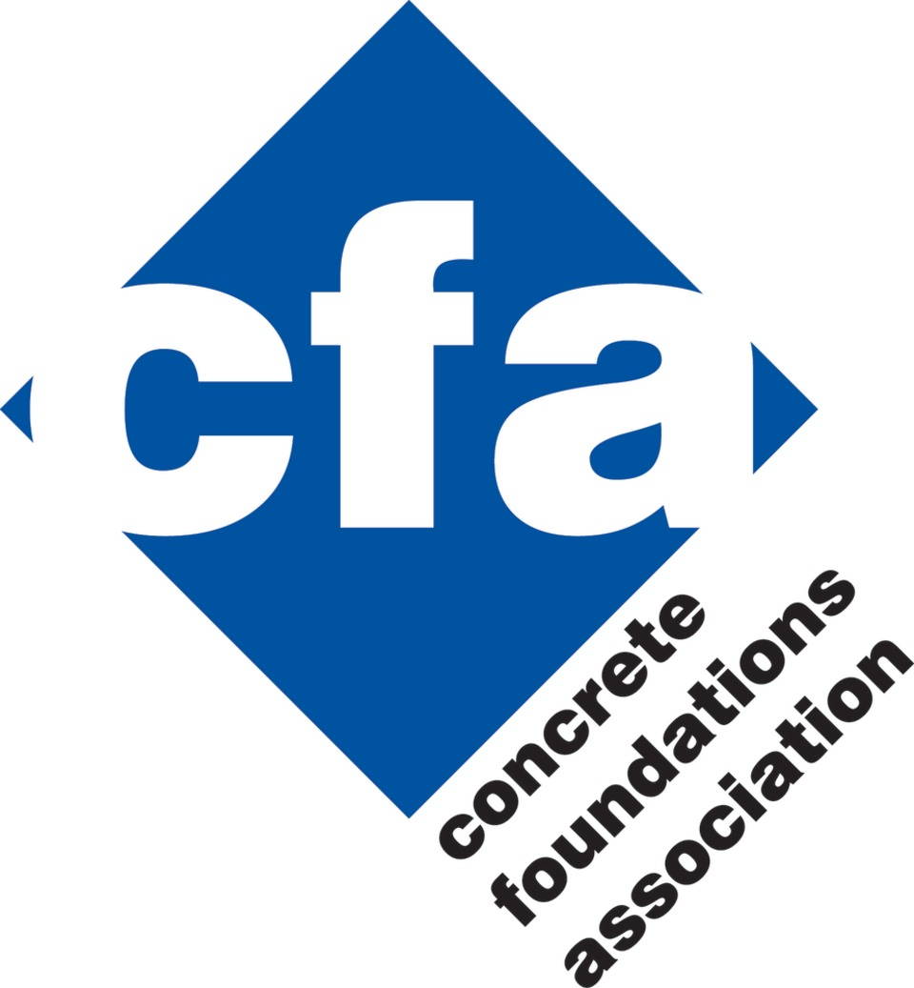
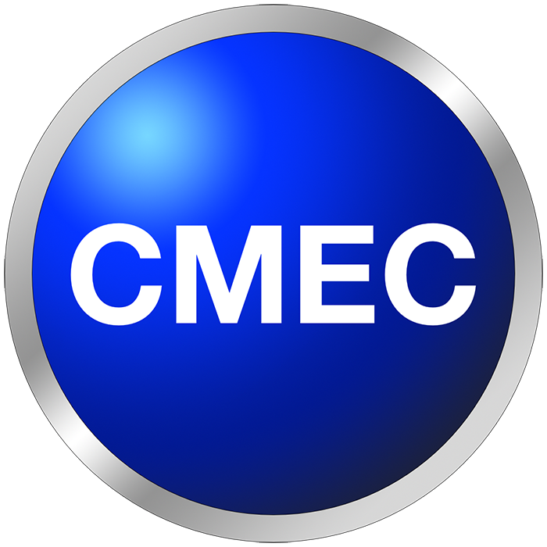
Industry Partners & Collaborators
Notes:
In the past nearly 40 years, ACI Certification has enjoyed the support of many Concrete Construction Industry organizations including those displayed here. Many of the programs use resources generated by these organizations in addition to ACI-published consensus resources.

Slide 14
John.Nehasil@concrete.org
Notes:
That concludes my overview of ACI Certification… Thank you again for your time!

