Slide 1
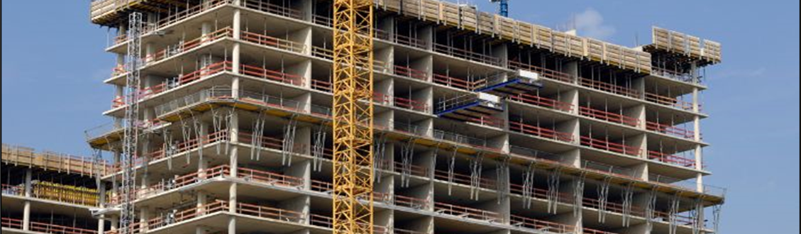
American Concrete Institute (ACI)
Engineering
Matt Senecal
Director, Engineering
Notes:
Introduce the Engineering Department
Explain what we do
What are Technical Committees
ACI 318

Slide 2
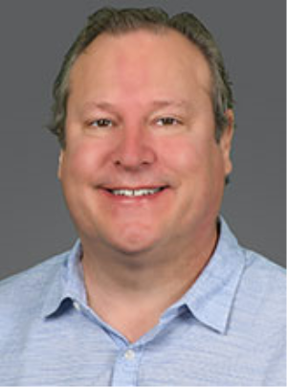
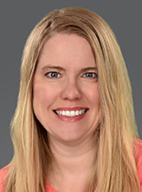
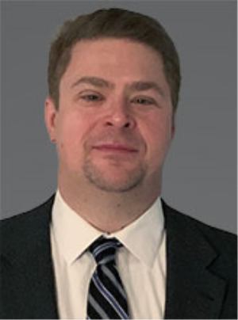
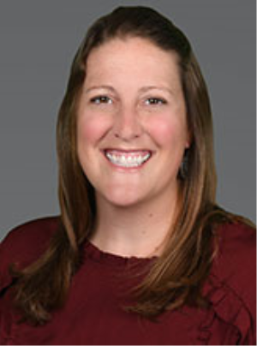
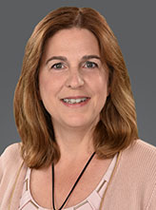
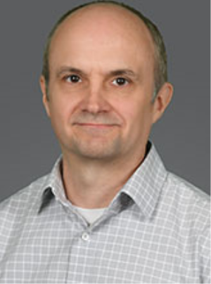

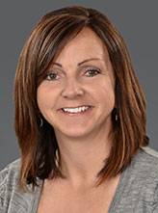
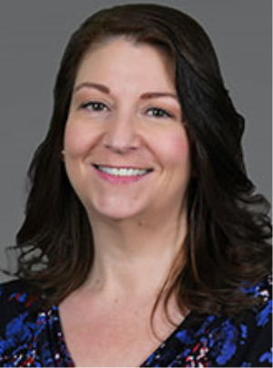
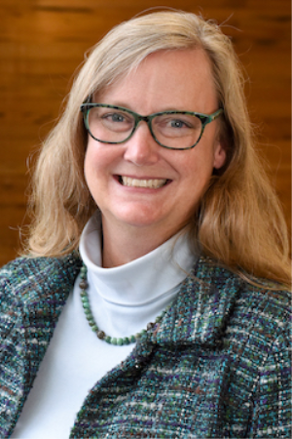
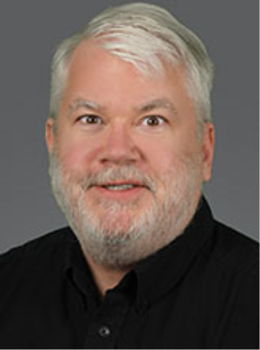
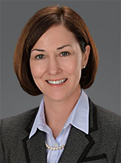
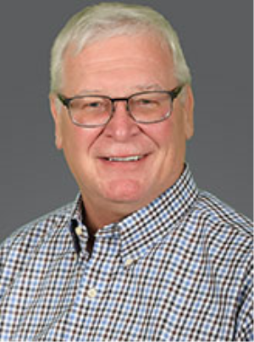
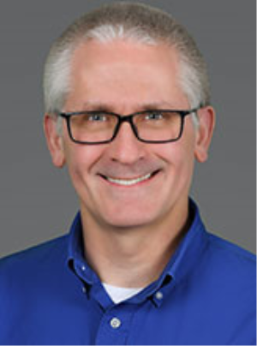
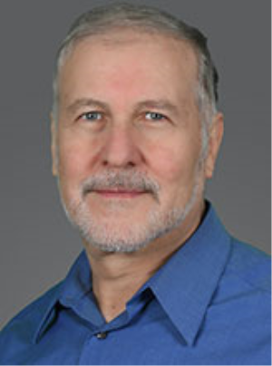
Who We Are (Engineering)
Matt Senecal, Director,
Engineering
Shannon Banchero,
Manager, Technical Documents
Carl Bischof,
Editor
Emily Bush,
Editor
Barbara Coleman, SP & Session Coordinator
Will Gold,
Engineer
Trey Hamilton,
Engineer
Khaled Nahlawi, Engineer
Kimberley Olesky, Committee Coordinator
Denise Pedersen, Technical Document Coordinator
Andrea Schokker, Engineer
Paul Sullivan, Engineering Coordinator
Kerry Sutton,
Code Advocacy Engineer
Steve Szoke,
Code Advocacy Engineer
Greg Zeisler,
Engineer
Notes:
Large department for a typical Standard Developing Organization
Most SDOs need the volunteers to do everything
Allows us to help committees
Make custom workshops, talks

Slide 3
Engineering Department’s Role
Engineering Department serves the ACI Technical Committees
  Consensus process
  Educate the public
  Circulate information
    Standard Developing Organizations
    Legal Jurisdictions
Experience
  Eight Professional Engineers
  ≈250 years in design and education

Slide 4
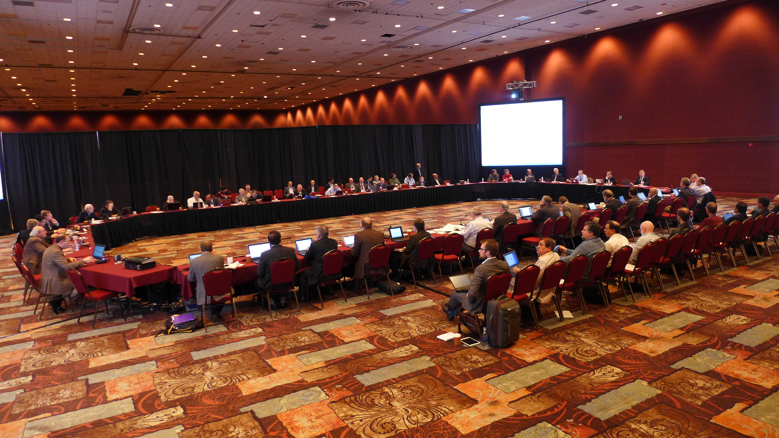
ACI Technical Committees
126 Technical Committees
  184 Subcommittees
  Consensus
    Ballance
    Ballot
  3500+ Voting members
    Engineers, Scientists, Professors, Owners, Government, Contractors, Producers, International
  In-Person meetings
    2 times a year
    Hybrid virtual/physical

Slide 5
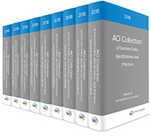
ACI Technical Committees
ACI Collection of Concrete Codes, Specifications, and Practices
300+ Documents
  Codes
  Specifications
  Reports
  Guides
  Technical Notes
ACI 318
(Main Concrete Code)

Slide 6
ACI 318 – Building Code for Structural Concrete
ACI’s Most Used Document
Basis for structural concrete design
  Equivalent to Eurocode 2: EN 1992-1-1
  ACI has other codes that cover other Eurocodes in concrete
    Ex. ACI 216 → EN 1992-1-2
Referenced by the International Building Code (IBC)
Textbook for students
Reorganized in 2014

Slide 7
ACI 318 – Building Code for Structural Concrete
Engineer (Licensed Design Professional)
Ease of use
Find the information you need quickly
  Consistent organization
  Organized in the order of design
Increase certainty that a design fully meets the Code
  A chapter for each member type
  All member design provisions in one chapter
  10 Parts
  General
  Loads & Analysis
  Members
  Joints/Connections/ Anchors
  Seismic
  Materials & Durability
  Strength & Serviceability
  Reinforcement
  Construction
  Evaluation

Slide 8
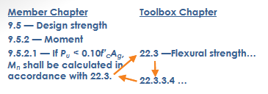
ACI 318 – Ease of Use
Typical Member Chapter
X.1 Scope
X.2 General
X.3 Design Limits
X.4 Required Strength
X.5 Design Strength
X.6 Reinforcement Limits
X.7 Reinforcement Detailing

Slide 9
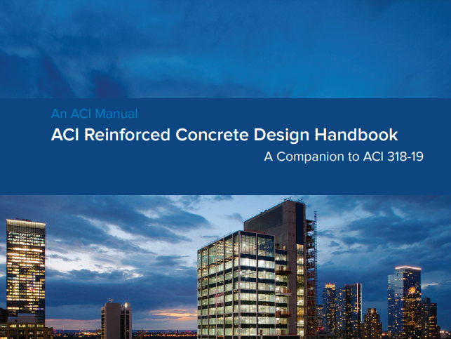
ACI 318 – Support Material
ACI Design Handbook
15 Chapters (1056 pp.)
Explanatory text
Design aids
Worked examples for One- and Two-way slabs, Beams, Columns, Walls, Diaphragms, Footings, Retaining walls, and Anchorage Design
Concrete focused discussion on structural systems, analysis, and durability

Slide 10
ACI 318 – Used Internationally
What factors do adopting countries consider?
Local building regulations: Ch.1
Design loads (ASCE 7 or ?): Ch. 5
Environmental durability effects (Local/Unique): Ch. 19
Materials (ASTMs or ?): Ch. 19 & 20
Construction practices: Ch. 26
Inspection practices: Ch. 26
GOAL
Strength and Durability
for the expected environment

Slide 11
ACI 318 – Adoption
Two common ways to adopt
A reference to the document with EXCEPTION
  Chile: 21 pages (ex. loads, seismic, walls)
    http://www.puntofocal.gov.ar/notific_otros_miembros/chl69_t.pdf
Modify the code requirements and republish as a local code
  Saudi Arabia modified durability requirements for their unique environment and reprinted the code into their suite of Saudi codes

Slide 12
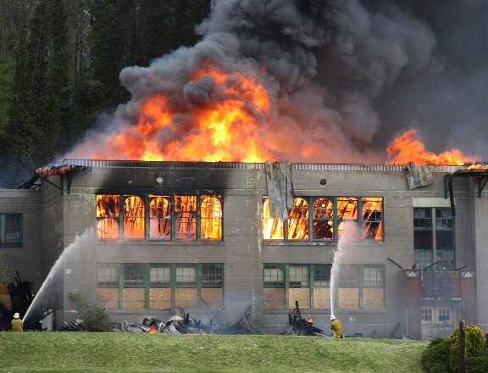
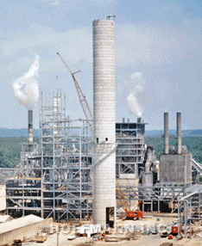
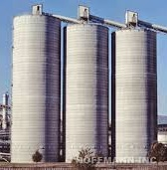
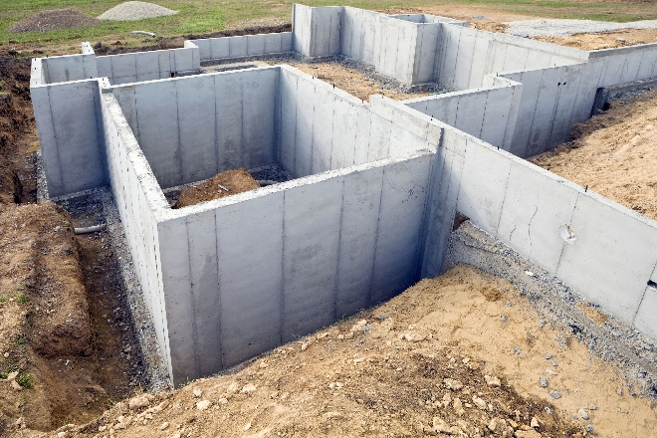

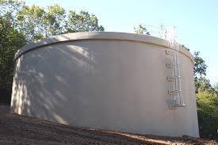
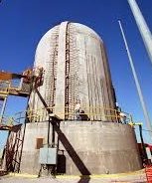
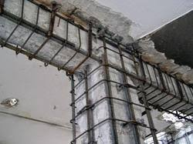
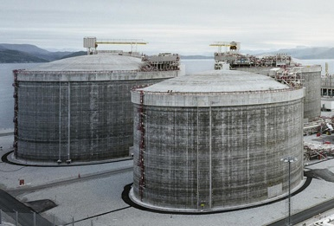
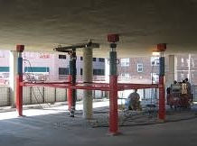
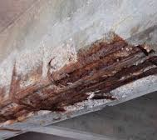
ACI 318 – Other ACI Codes
216 - Fire
307 - Chimneys
313 - Silos
332 – Residential
349 – Nuclear Facilities
350 – Environmental
359 – Nuclear Contain.
369 – Seismic Retrofit
376 – RLG Containment
440 – Glass FRP Bar
437 – Strength Evaluation
562 - Repair

Slide 13
Matt.Senecal@concrete.org

Slide 14
American Concrete Institute (ACI)
Certification
John Nehasil
Managing Director, Certification

Slide 15
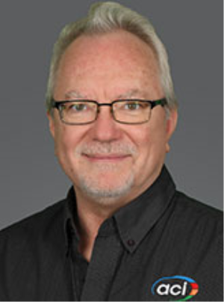
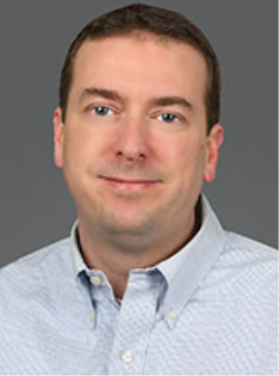
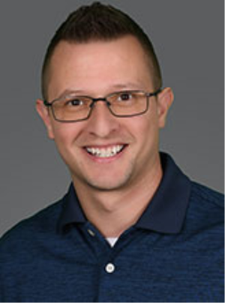
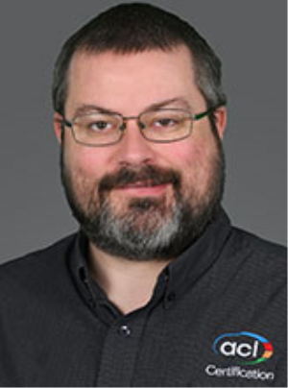
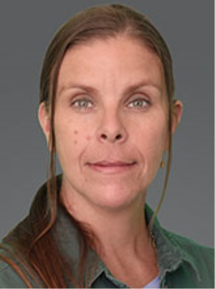
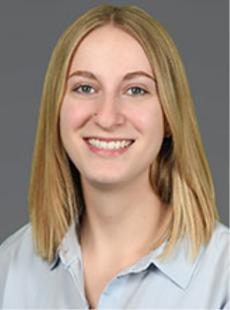


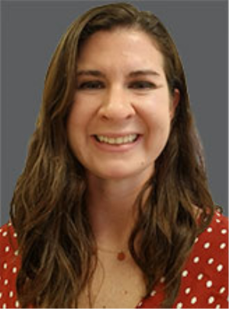

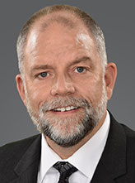


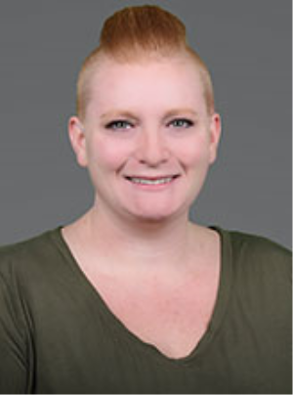
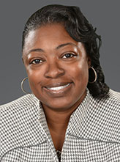
Who We Are (Certification)
John Nehasil, Managing Director,
Certification
Mark Campo,
Director, Certification
Timothy Heitzmann,
Manager, Certification
Nate Mohler, Certification Program Developer
Emily Boirum, SoCal Resource Center Manager
Breanne Coleman, Certification Coordinator
Diana Florea, Certification Coordinator
Claire Freeman, Editor
Charai Gantt, Certification Coordinator
Sarah Mauri, Technical Writer
Kathy Merlo,
Resource Centers Coordinator
Michael Morrison,
Manager,
Cert. Program Development
Rusty Owings,
Midwest Resource Center Manager
Doug Ronan, Certification Coordinator
Hannah Russey, Certification Coordinator
Kassye Smith, Certification Coordinator

Slide 16
John.Nehasil@concrete.org

