Slide 1
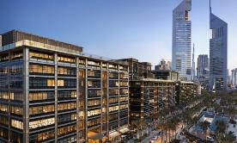
ACI Middle East & North Africa Regional Office
ACI Professional & Student Chapters, Certification, Partners, Activities & Code Acceptance
Ahmad Mhanna
ACI MENA Director

Slide 2
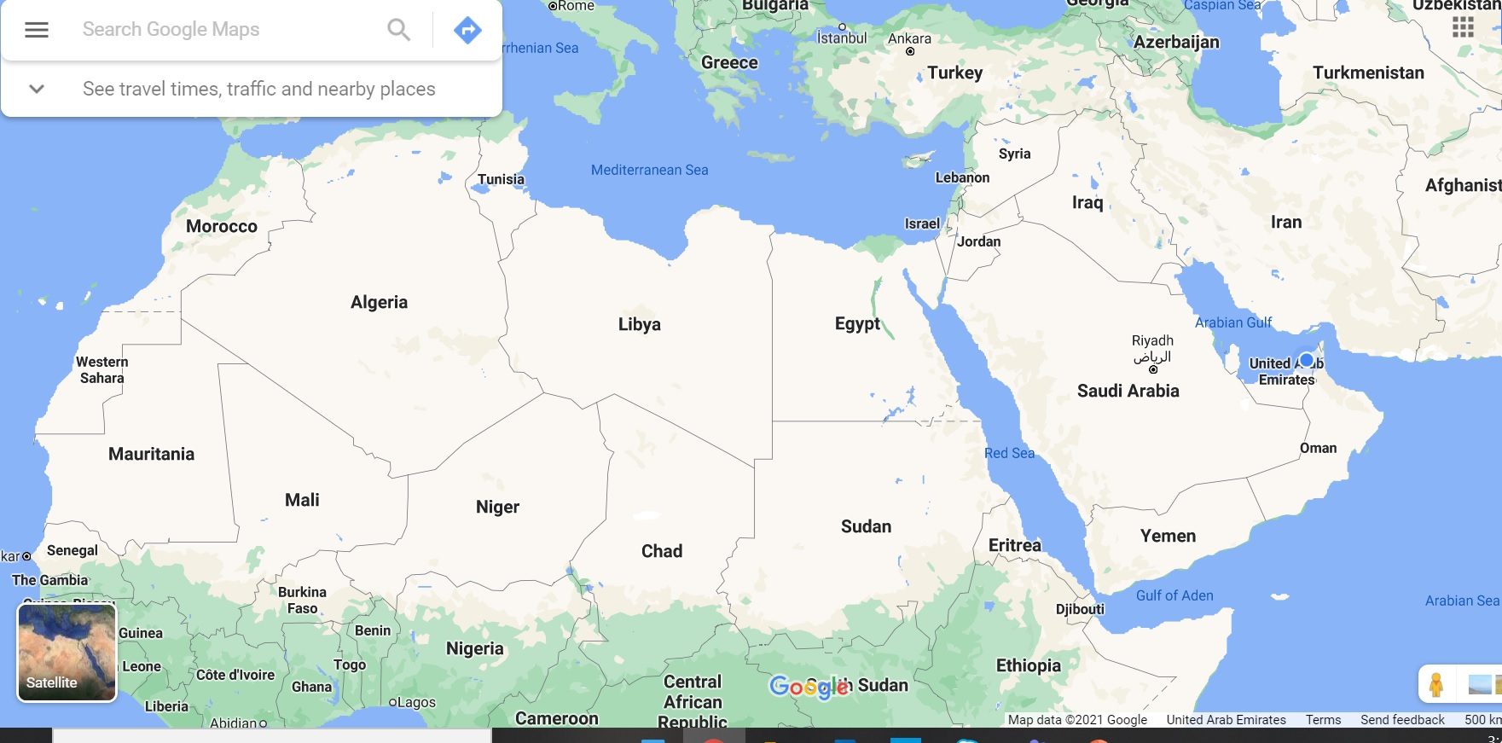
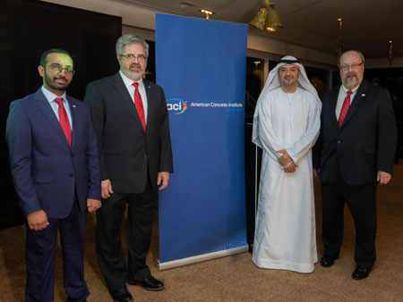
ACI Middle East Regional Office
Grand opening, January 6, 2019.
First physical presence outside of the United States.
1620 L Street, N.W.
Suite 1200
Washington D.C. 20036
ansellj@personalcarecouncil.org

Slide 3
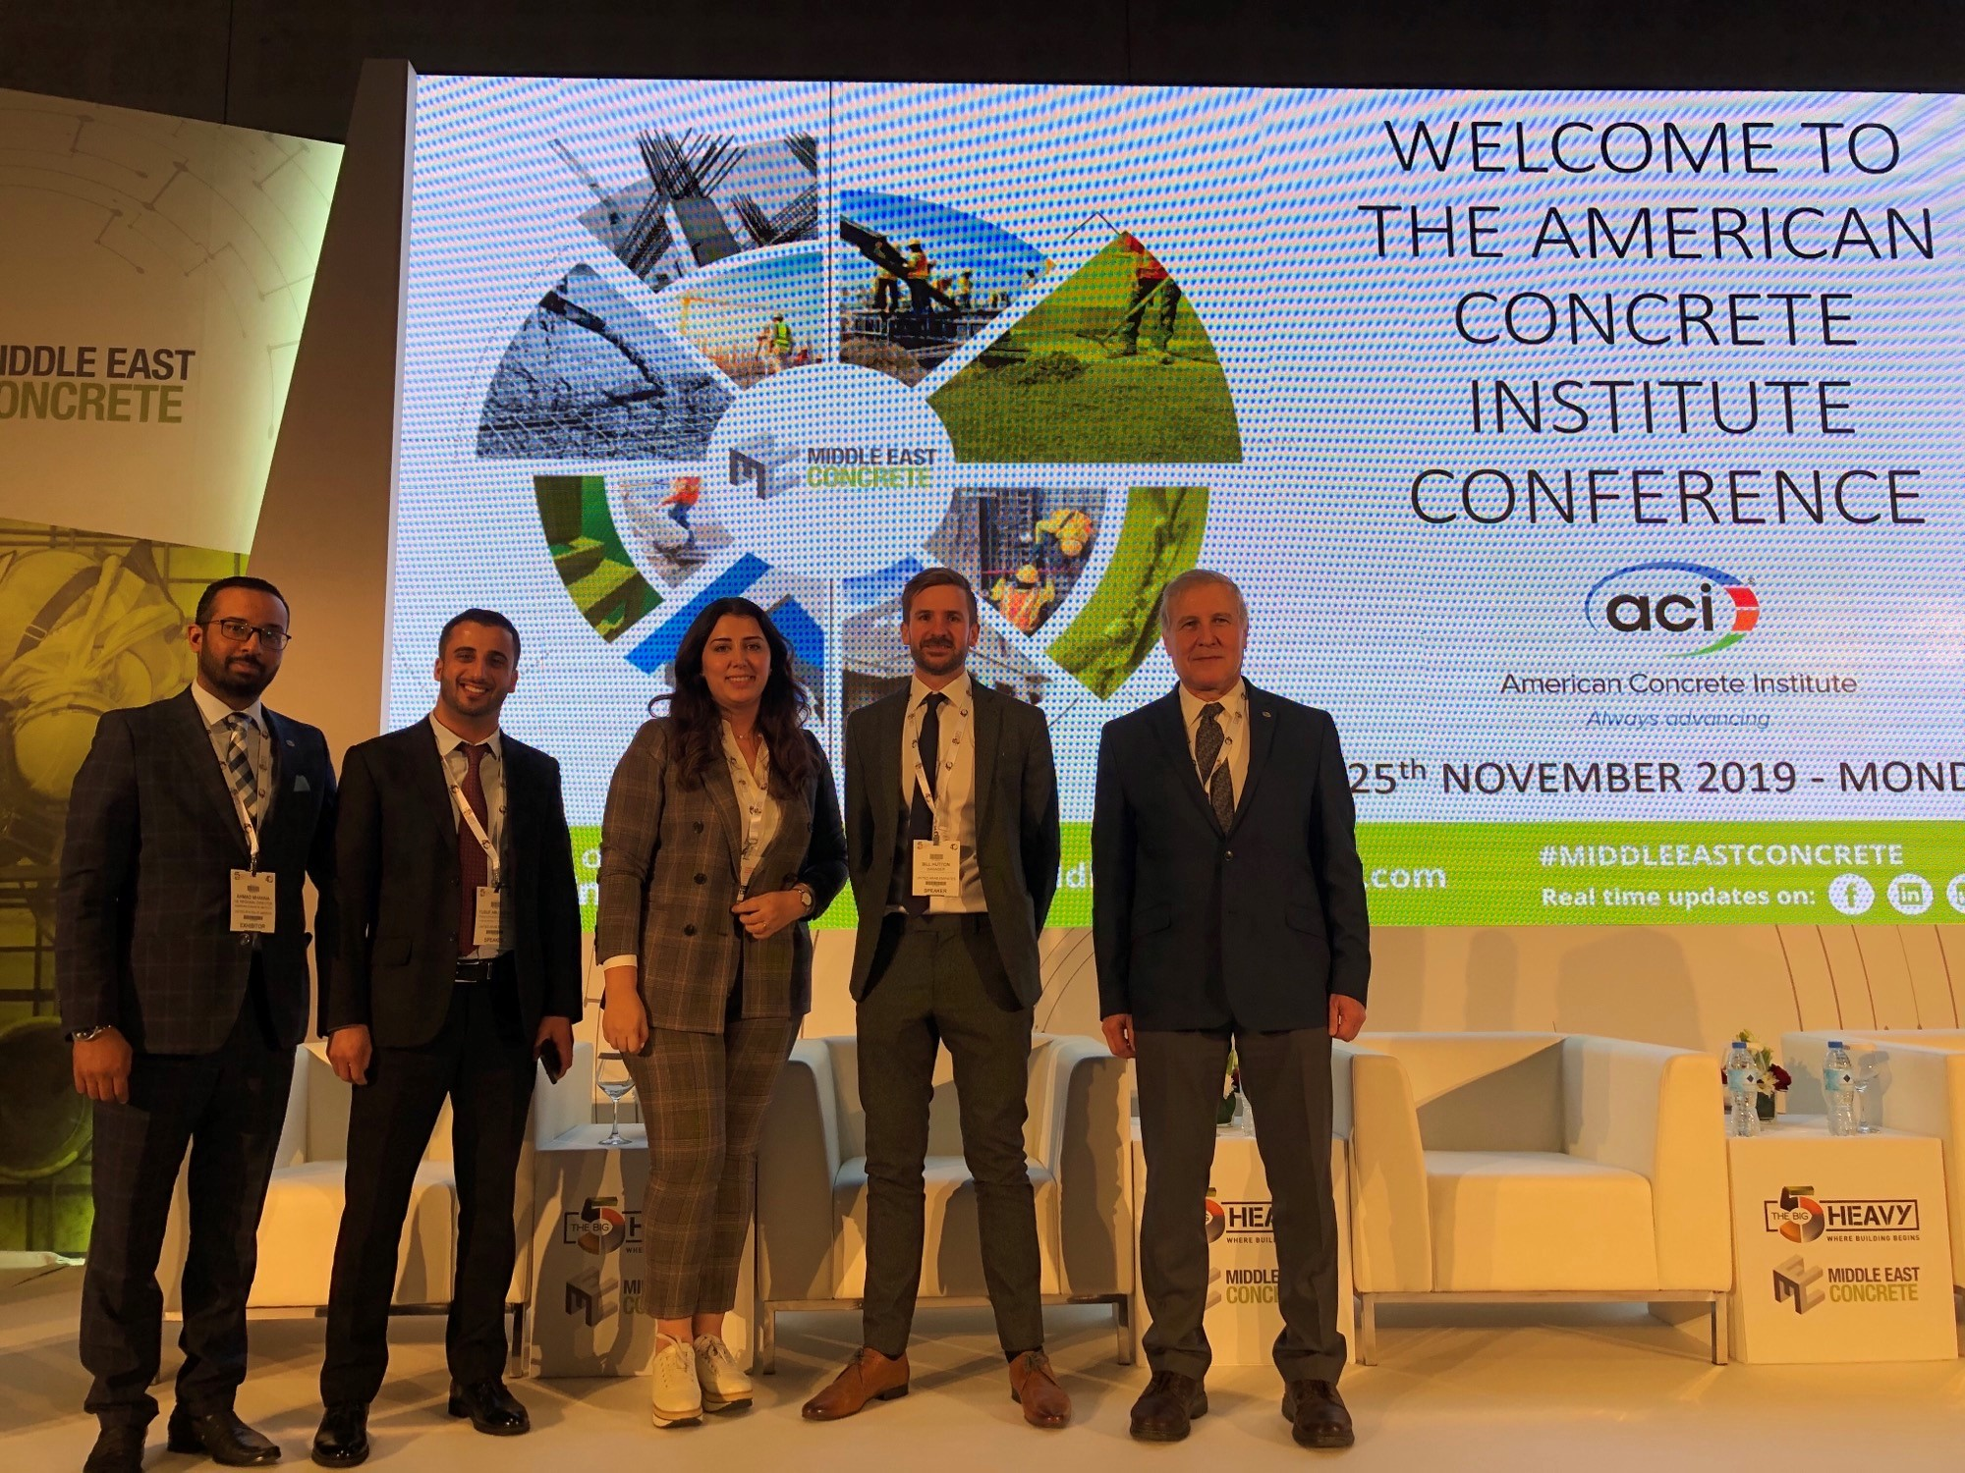
ACI Middle East Regional Office - Mission
To establish and nurture a wide range of strategic relationships between ACI members, chapters, companies, governmental bodies, educational institutions, partners, and other construction industry organizations throughout the region.

Slide 4

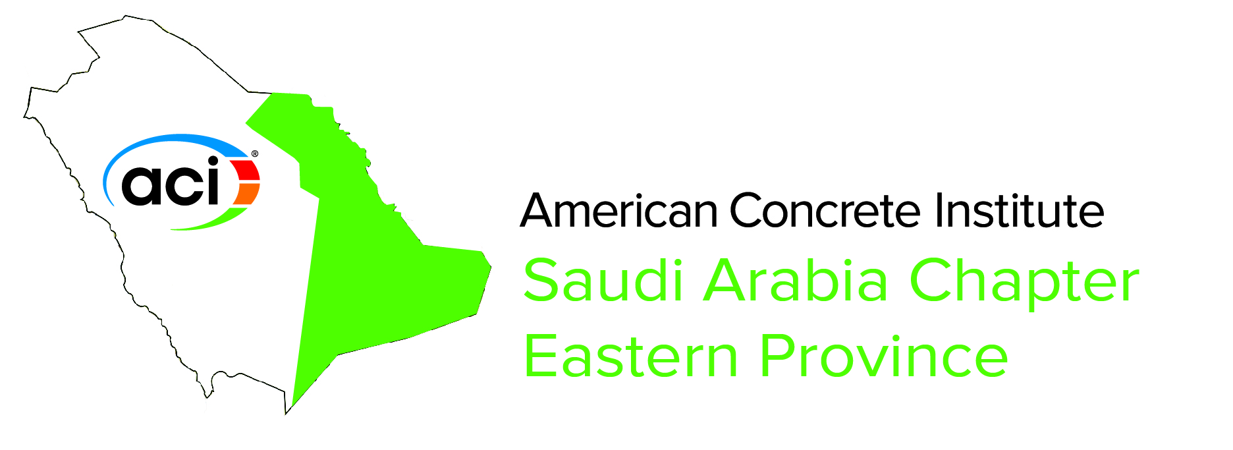


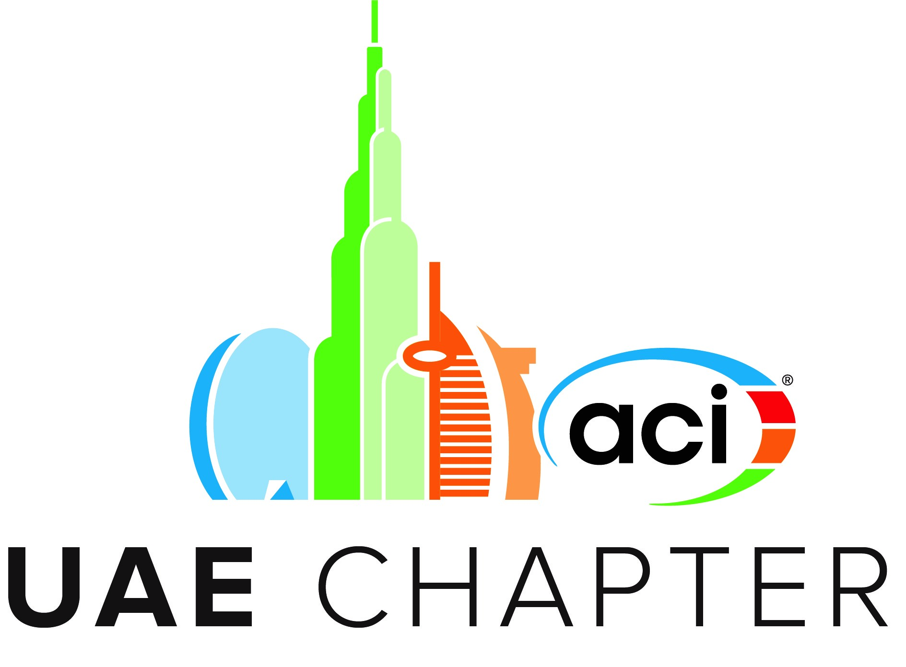
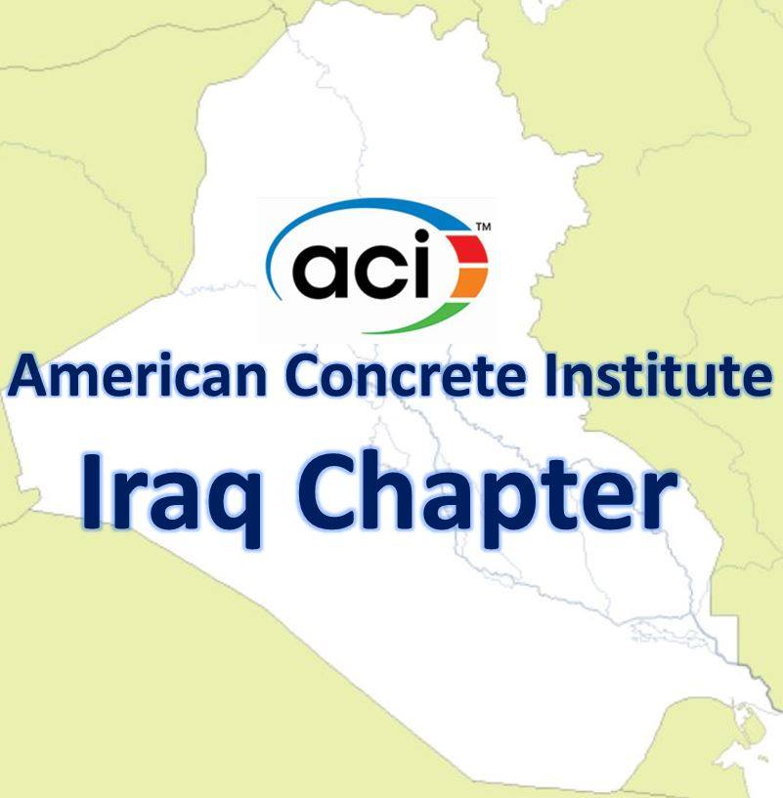

ACI in the Middle East – Professional Chapters
8 chapters
ACI Egypt Chapter

Slide 5
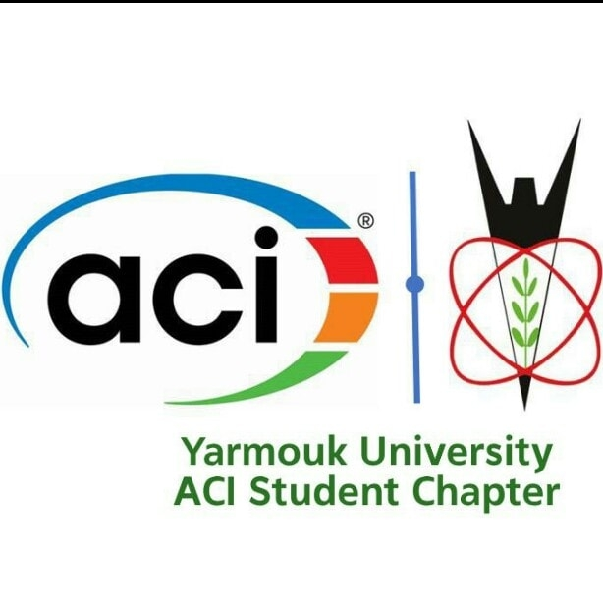
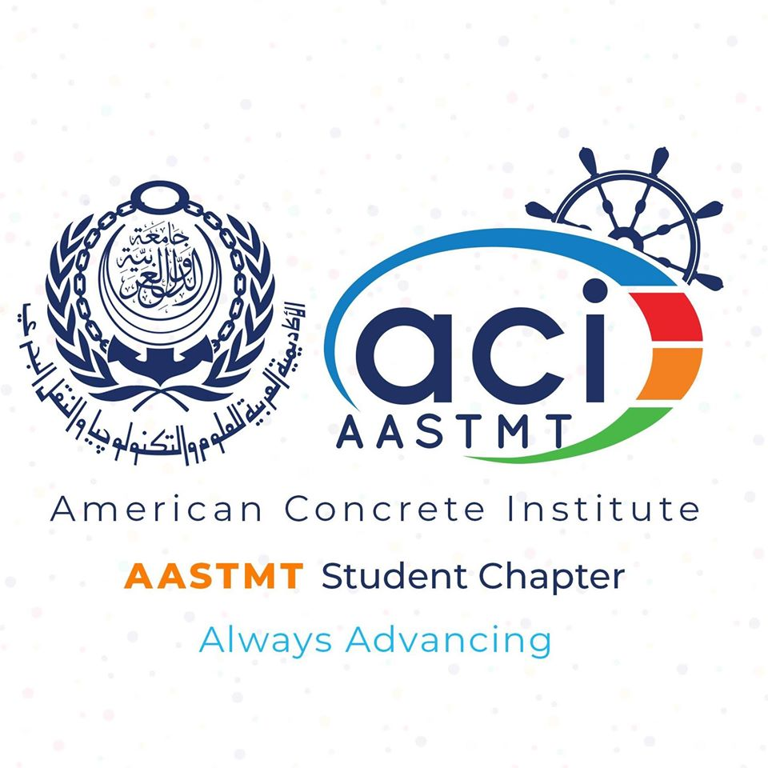
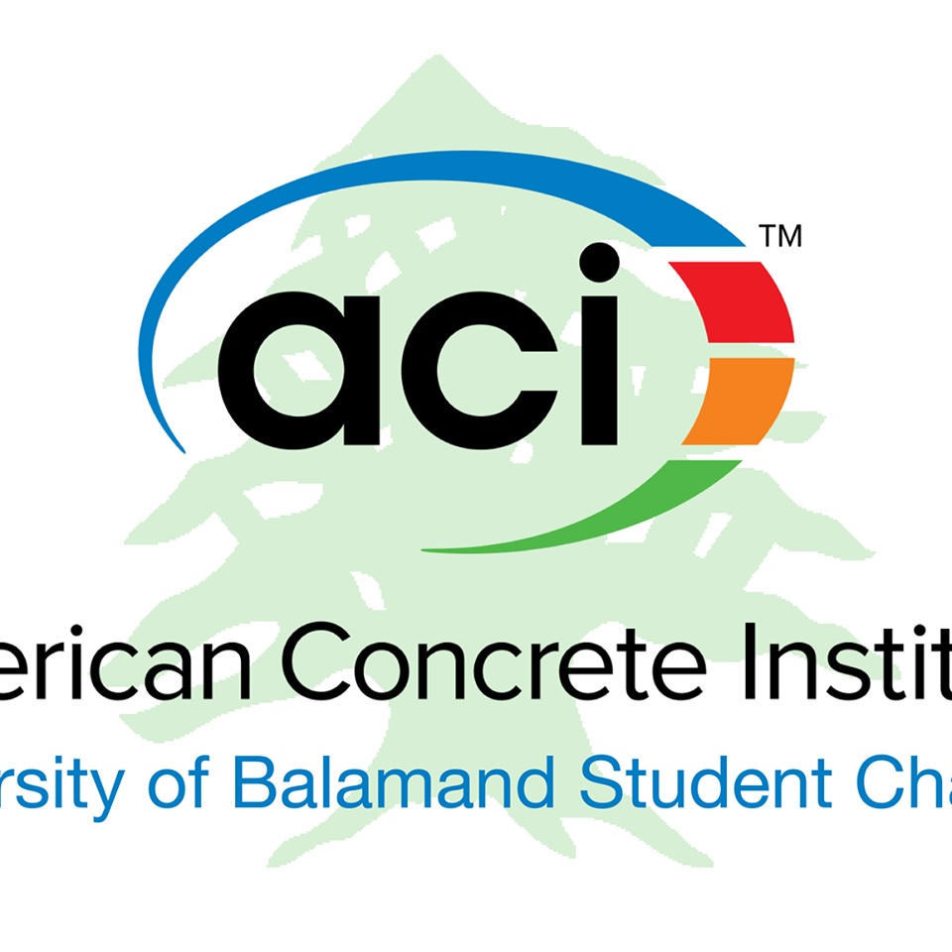
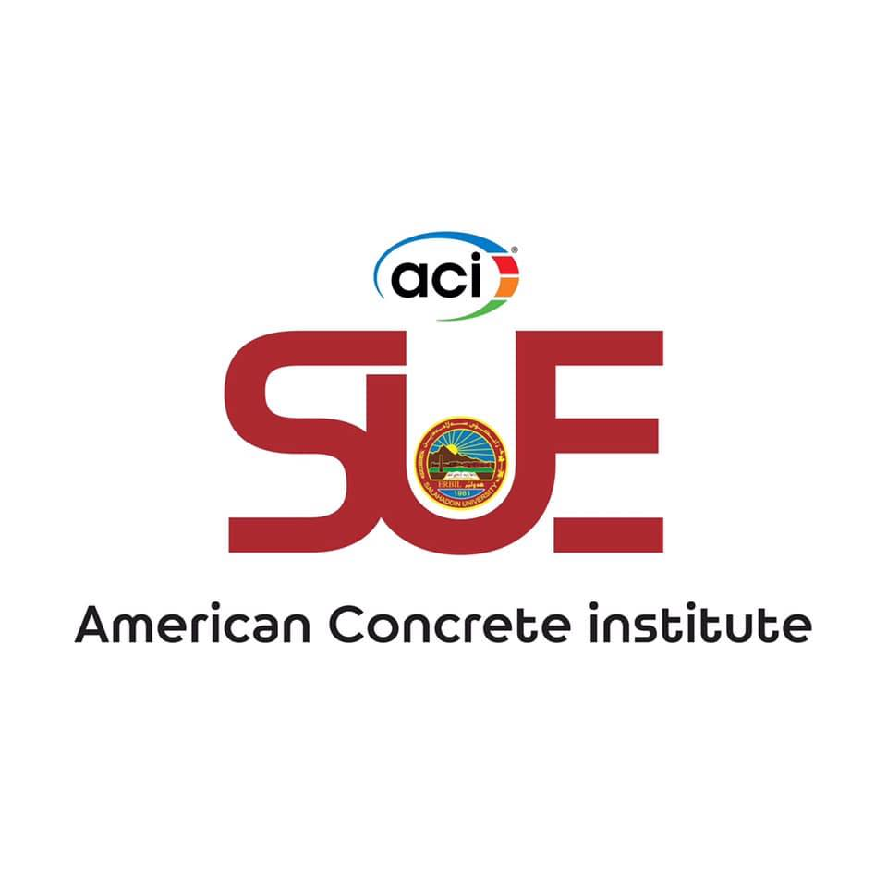


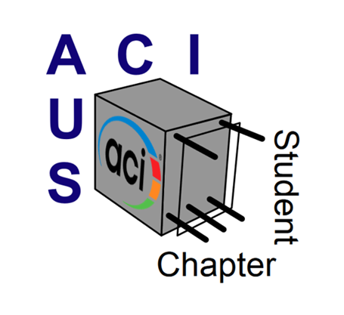
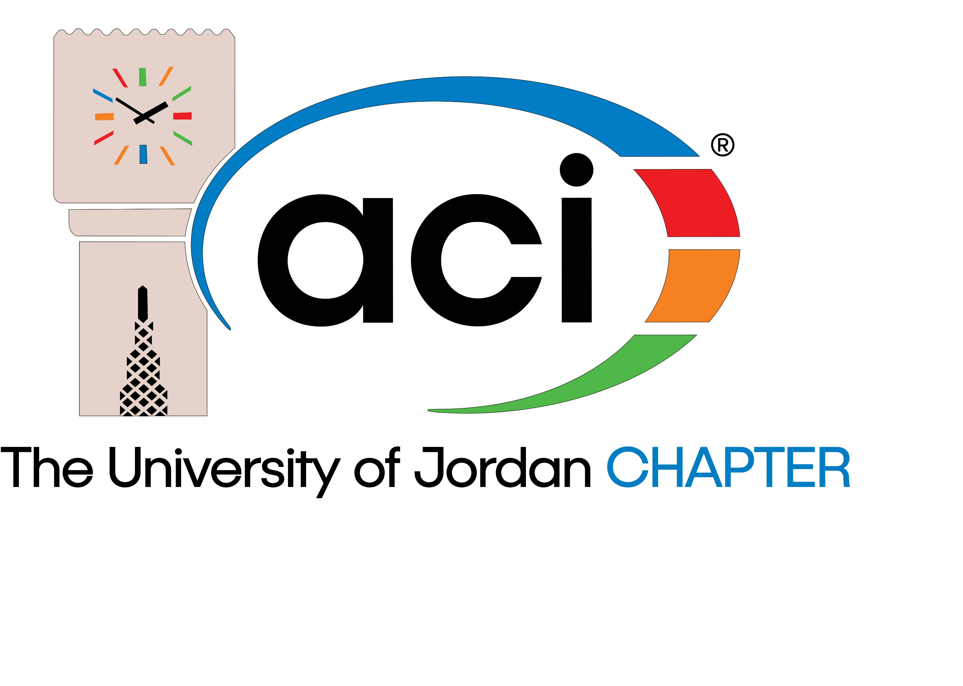



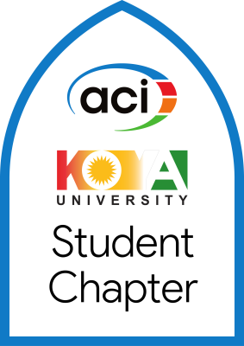
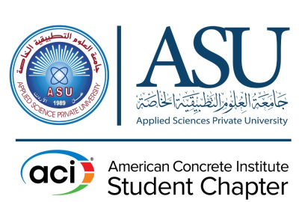
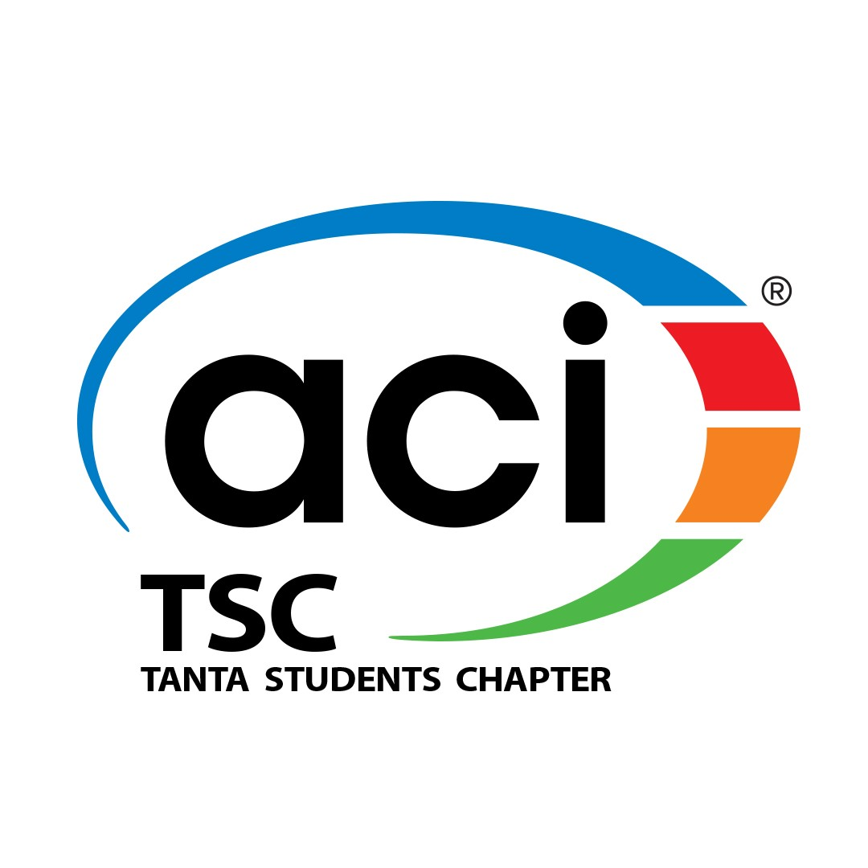


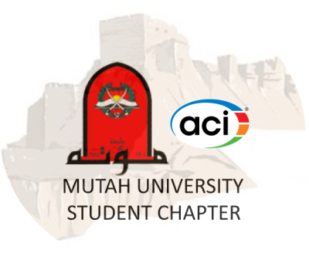
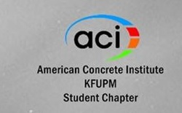
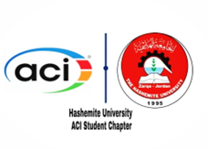
ACI in the Middle East – Student Chapters
Jordan
Egypt
Lebanon
Iraq
UAE
University of Sharjah
AUD
KSA
21 Chapters

Slide 6







ACI in the Middle East – International Partners
Notes:
There are 7 international partners , with whom ACI signed international partner agreements to increases collaboration and cooperation between organizations for the purpose of improving concrete construction by making the technical expertise of each organization available to the other through publications, meetings, conferences, internet links, committee membership, certification activities, and any other activity as mutually agreed.

Slide 7


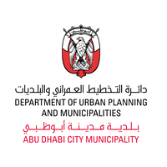



ACI in the Middle East – Acceptance of ACI 318
Libya
Oman
Qatar
Saudi Arabia
United Arab Emirates
Yemen
Lebanon
Bahrain
Egypt
Iraq
Jordan
Kuwait
Notes:
Talking about using ACI 318, well, ACI code is accepted and is being used in almost all countries in a way or another. However, ther are some countries are using ACI 318 through special agreement with ACI. as in the case of SBCNC , GSO. Also Abu Dhabi is adopting IBC which includes ACI 318. and recently Dubai Government has just approved Dubai Building Code, in which ACI 318 is the main reference for concrete design.

Slide 8
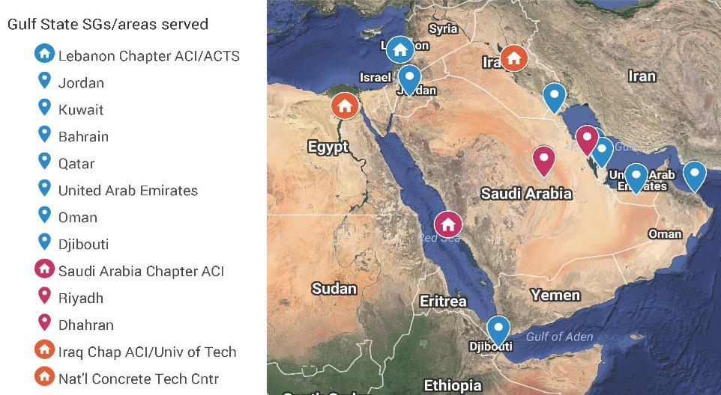
ACI in the Middle East – Certification Availability

Slide 9
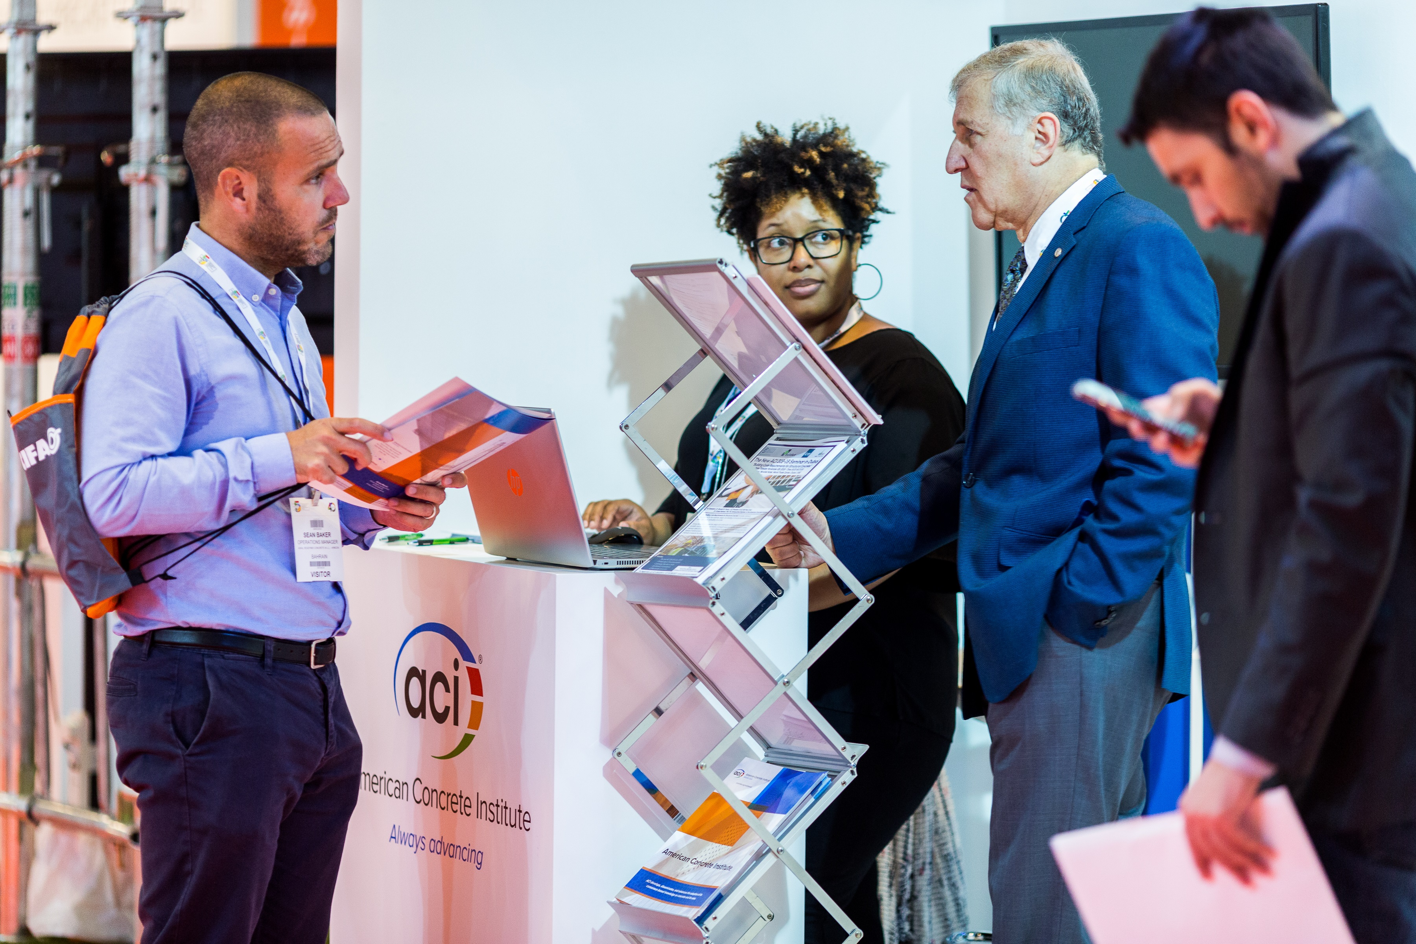
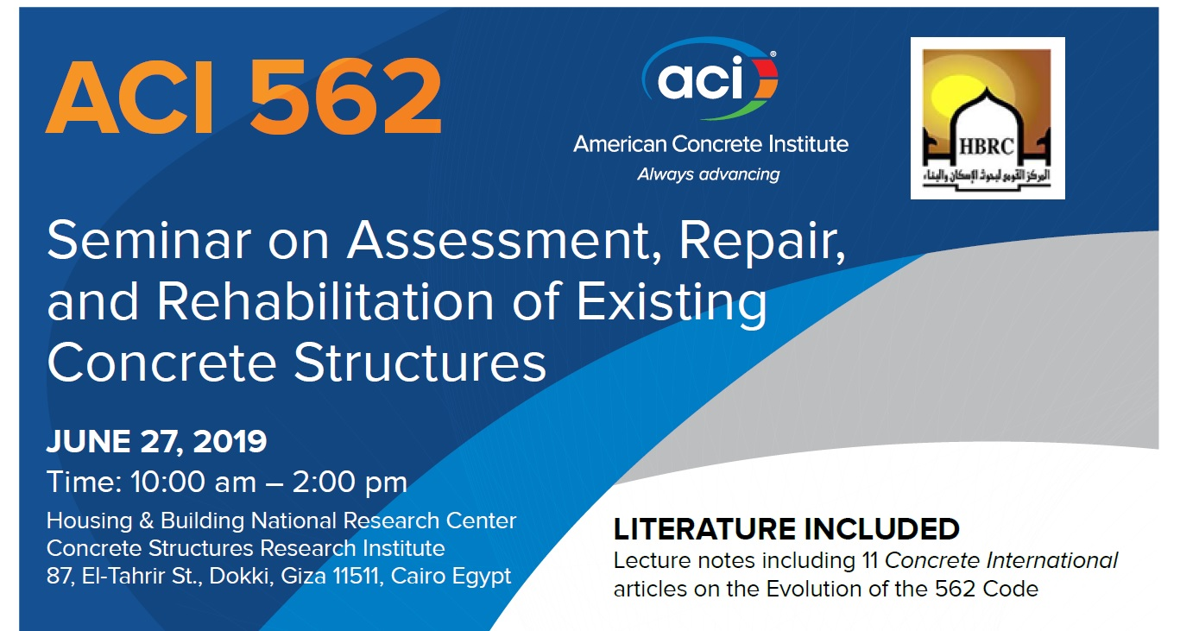
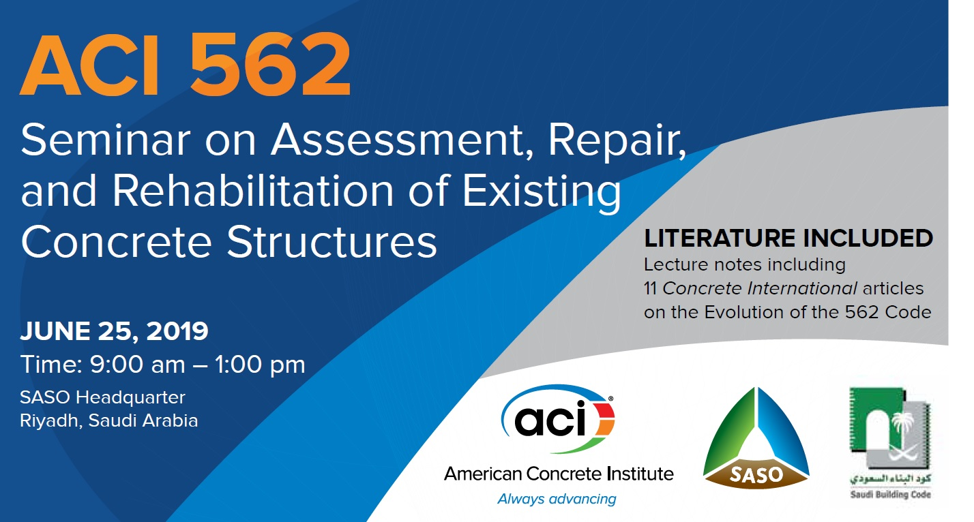
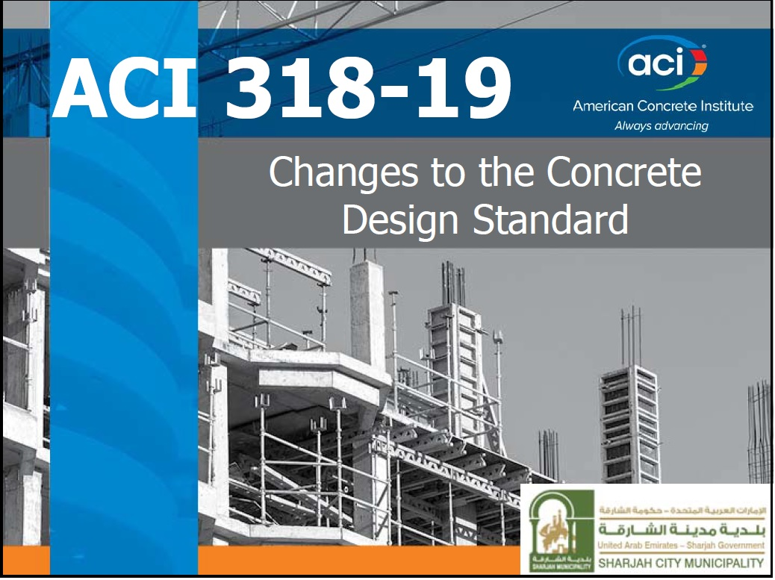
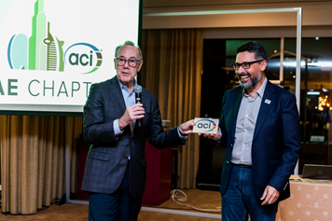
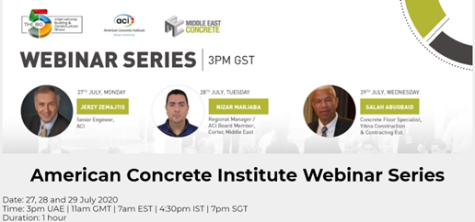
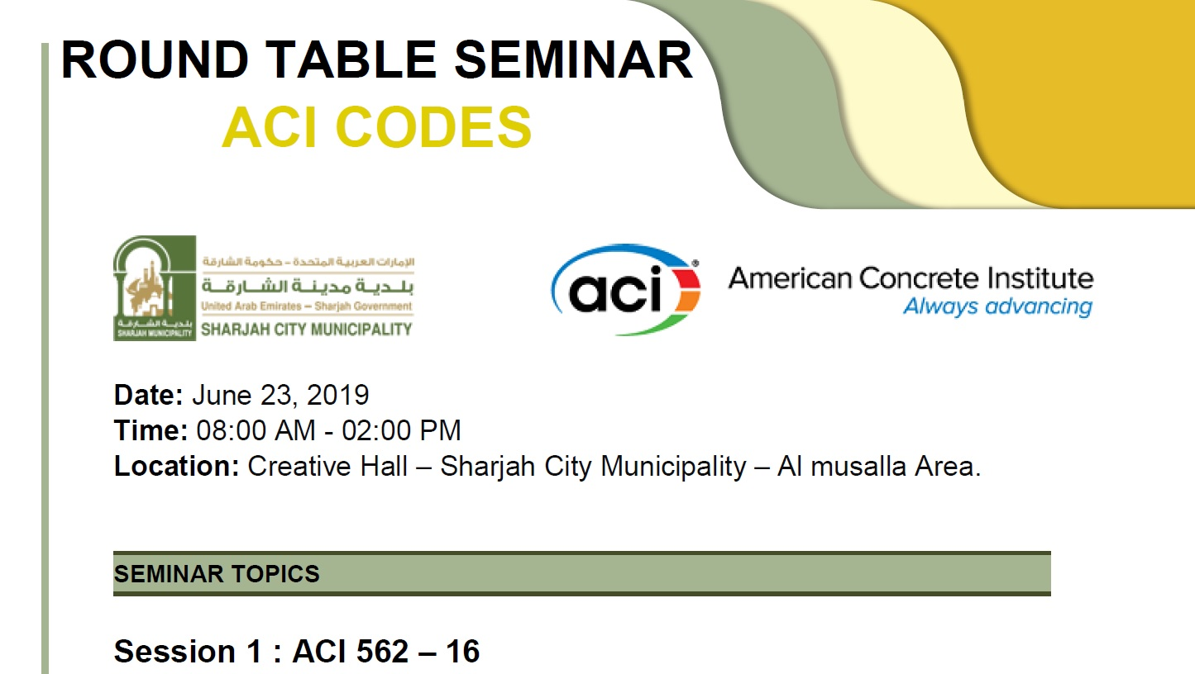
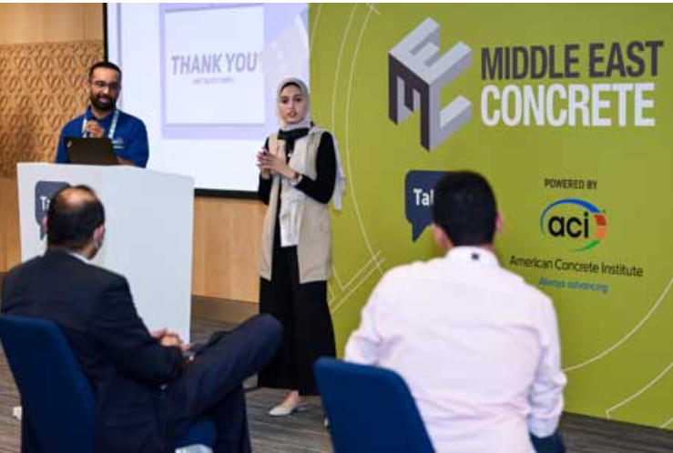
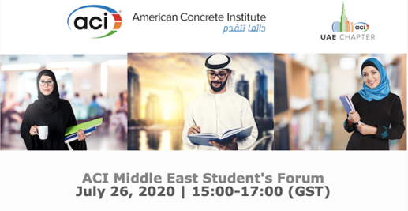
ACI in the Middle East – Events

Slide 10
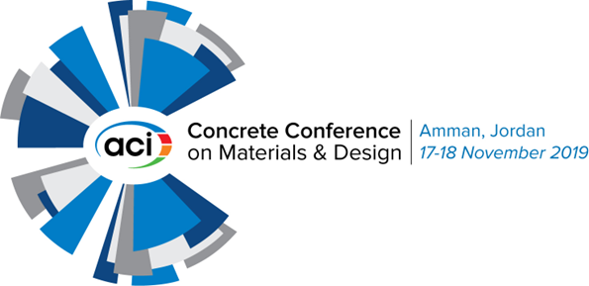
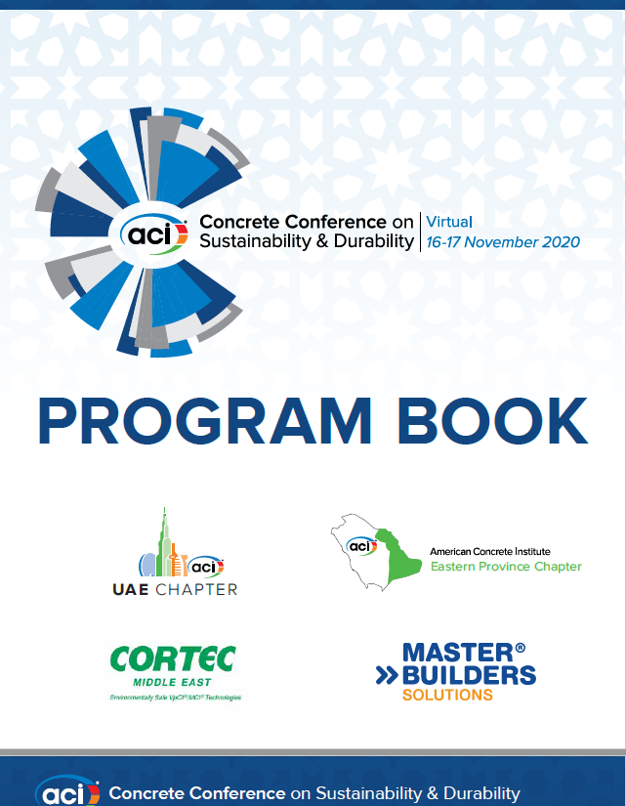
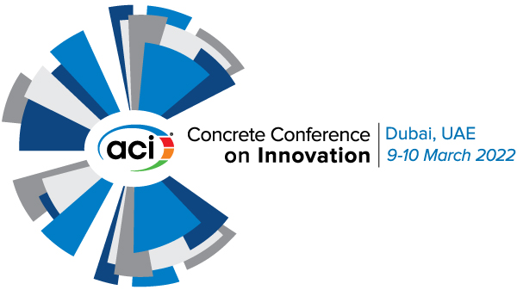
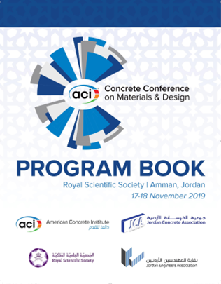
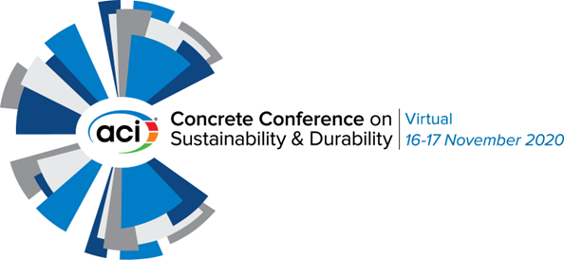
ACI in the Middle East – ACI Concrete Conference

Slide 11
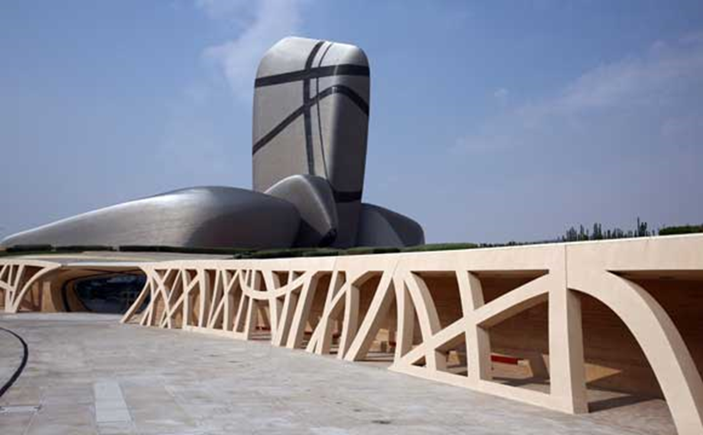

ACI in the Middle East – The ACI Excellence in Concrete Construction Awards
2019
Overall “Excellence” Award Winner/
First Place – Mid-Rise Buildings
King Abdulaziz Center for World Culture (ITHRA),
Located in Dhahran, Eastern Province, Saudi Arabia, Awarded Highest Honor

Slide 12
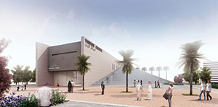
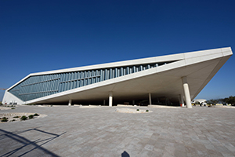
ACI in the Middle East – The ACI Excellence in Concrete Construction Awards
First Place – Low-Rise Buildings
Hamad Port Project – Design and Build of Visitors Centre – Doha, Qatar.
2019
First Place – Decorative Concrete
Qatar National Library – Doha, Qatar.

Slide 13
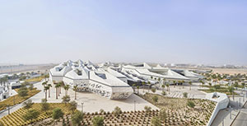
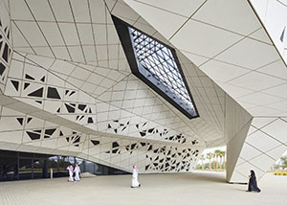
ACI in the Middle East – The ACI Excellence in Concrete Construction Awards
First Place – Decorative Concrete
King Abdullah Petroleum Studies and Research Center, Saudi Arabia
2020

Slide 14
ahmad.mhanna@concrete.org

