Slide 1
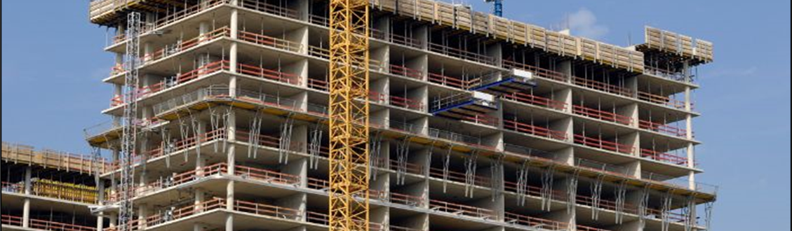
American Concrete Institute (ACI) Customer Service/Membership
Kanette Worlds, Coordinator
Student, Faculty, Young Professionals Activities
Notes:
Hello, my name is Kanette Worlds and I am the Student, Faculty, and Young Professional Activities Coordinator for the American Concrete Institute. Today, I will review some of the main resources, events, and programs we offer to educators and younger members.

Slide 2
ACI has 15,000+ student members
Membership free to university students
Digital access to ACI guides, reports, and symposium volumes
Access to ACI University monthly live webinars and on-demand courses
Subscription to Concrete International magazine and the Materials and Structural Journals
Discounts on publications and ACI Convention registration
Notes:
ACI has over 15,000 student members worldwide. ACI Membership is free to both undergraduate, master’s and PhD level students. Membership includes free access to more than 100 years of concrete knowledge including our guides and reports, symposium volumes, and journals written by experts in the concrete industry. In addition, student members can participate in live webinars every month as well as access on-demand courses. Members also receive discounts on ACI publications including classroom textbooks such as ACI 318 Building Code Requirements for Structural Concrete and 562 Code Requirements for Evaluation, Repair, and Rehabilitation of Concrete Structures and Commentary. In addition, students interested in attending the ACI Concrete Convention in-person, only pay $20 for registration. Students interested in virtual on-demand access to the convention can register for FREE.

Slide 3
ACI University
Fundamentals of Concrete Construction
Fundamentals of Concrete and Materials
Repair Application Procedures
Anchorage Design
Notes:
The ACI Certificate Program encourages concrete professionals to gain in-depth knowledge about particular topics in concrete materials, design, repair, or construction by following a defined online course of study. The Certificate Programs currently offered include: Fundamentals of Concrete Construction; Anchorage Design; Fundamentals of Concrete and Materials; and Repair Application Procedures. Upon completion of these programs, student will earn a digital certificate that they can include on their resume or CV.

Slide 4
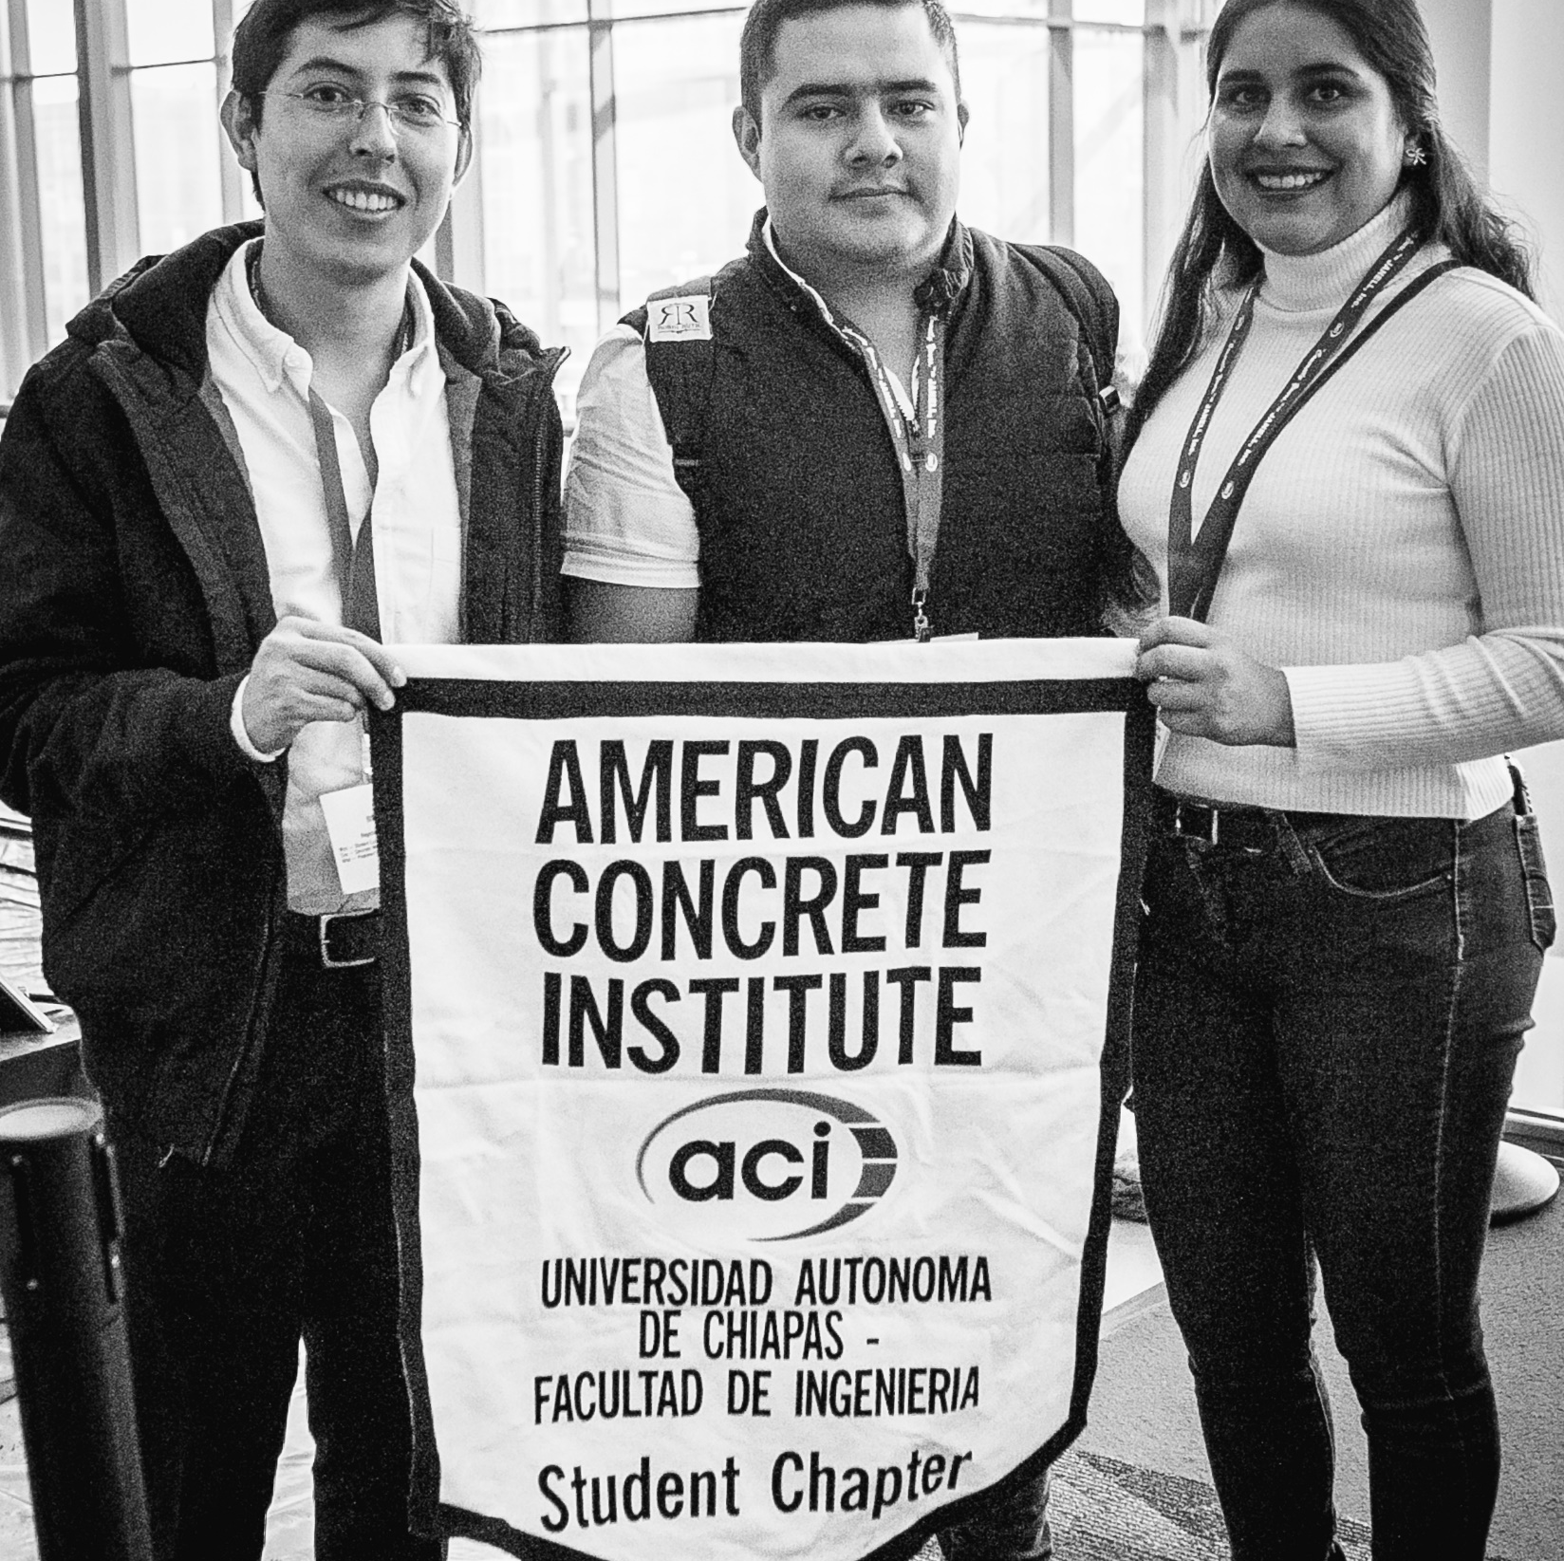
ACI Student Chapters
Monthly Meetings
Social Events
Technical Sessions
Research Presentations
Site Tours
Competitions
Notes:
ACI has 270+ Student Chapters including five in Africa. The student chapters create a space for civil engineering and construction management students to learn and exchange ideas about concrete knowledge and technology. A minimum of 15 ACI Student Members is required to form a Student Chapter as well as the support of a Faculty Advisor. Some of the student chapter activities including monthly meetings, social events, technical sessions, research conferences, site tours and local competitions.

Slide 5
ACI Student Competitions
Pervious Concrete Cylinder
Fiber Reinforced Concrete Bowling Ball
Mortar Workability
Fiber Reinforced Polymer Beam
Notes:
ACI coordinates two major team-based competitions each year. Undergraduate teams of 2 to 8 student members can compete for a chance to win cash prizes. The goal of the concrete competitions is to provide students with an opportunity to apply classroom theory to real-life concrete projects. In the process they gain valuable teamwork, cost estimation, budgeting, and project management skills. Our current roster of competitions includes Pervious Concrete Cylinder, FRC Bowling Ball, Mortar Workability, and FRP Beam sponsored by one of ACI’s 400+ technical committees. The competitions take place in-person during the ACI Concrete Convention. In addition, we now offer two virtual competitions called Concrete Solutions and Eco Concrete. There is no cost to participate in these events with the exception of expenses to pay for travel for the in-person competitions.

Slide 6
ACI Young Professionals
Members under age 28
Rate $134 USD/annually
Free Convention Registration Program
Emerging Leaders Conference
ACI Engineering Greatness Podcast
Notes:
ACI Members under the age of 28 pay a reduced member rate of $134 per year to gain access to ACI benefits and resources. Young Professionals pay the full registration fee to attend the ACI Convention however, we offer a Free Convention Registration Program to those with less than 8 years of professional experience. This program is sponsored by the Women in ACI Committee and open to both men and women. In addition, every fall, ACI selects seven young professionals to participate in the Emerging Leaders Conference. This conference is held at the end of September in Pittsburgh, PA, USA and provides professional development training in leadership, communication, and management skills. Participants receive free registration to this program. We also recently launched a podcast called Engineering Greatness. The podcast pairs young professionals from the industry and academia to discuss their careers in the concrete industry. New episodes are available monthly on all podcast platforms including Apple, Spotify, Google, and ACI’s YouTube Playlist for Young Professionals.

Slide 7
ACI Faculty Network
Free 1-Year Educator’s Membership
Quarterly eNewsletter
Complimentary Desk Copies
ACI 318 Building Code Requirements for Structural Concrete
ACI 562 Requirements for Evaluation, Repair, and Rehabilitation of Concrete Structures
MNL 17-21 Reinforced Concrete Design Handbook
And More!
Digital Subscription to ACI 318PLUS
ACI Professors’ Workshop
Faculty Network Reception
Notes:
For university educators who are teaching concrete-related courses, we offer a committee called the ACI Faculty Network. There is no cost to join this committee but you must be an ACI Member. For professor’s who have never been a member of ACI, we offer a free one year educator membership if you join the Faculty Network. After you join the Faculty Network you will occasionally receive emails from me regarding opportunities to enhance your teaching curriculum as well as resources for students. You will also receive complimentary desk copies to use in your classroom. Desk copies include titles like ACI 318, 562, and MNL 17 the Reinforced Concrete Design Handbook. Educators also receive a free annual subscription to ACI 318PLUS which gives you digital access to resources and instructional material related to our building code. Moreover, every summer, ACI organizes the Professors’ workshop which is a 2 day virtual and in-person event that features prominent, nationally known faculty and industry representatives who present information and resources to assist professors in preparing or fine-tuning their concrete-related courses. And finally, twice a year during ACI Concrete Convention, we offer the Faculty Network reception which gives educators an opportunity to network with their peers in the industry.

Slide 8
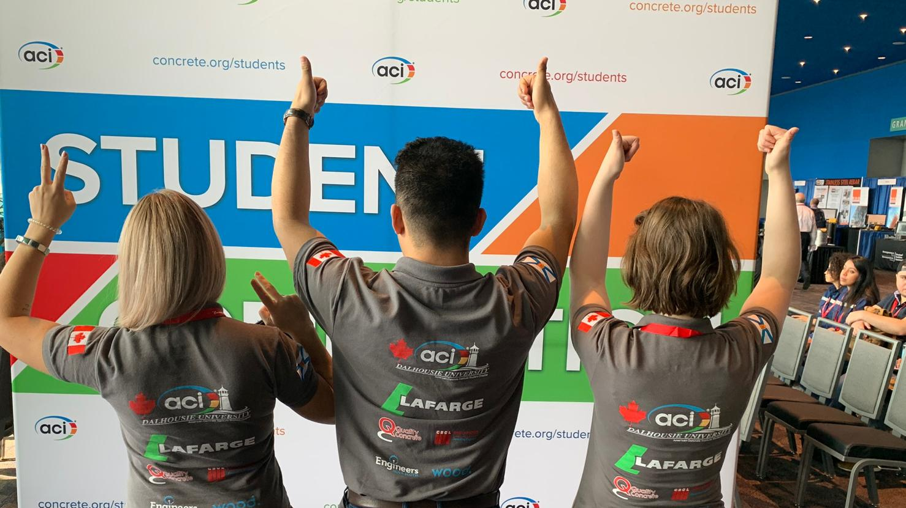
For More Info
www.concrete.org/students
www.concrete.org/educatorsandresearchers
Kanette.worlds@concrete.org
Notes:
For more information about student and educator resources visit www dot concrete dot org forward slash students or www dot concrete dot org forward slash educators and researchers. Thank you and feel free to contact me at Kanette dot worlds at concrete dot org for more information.

