Slide 1
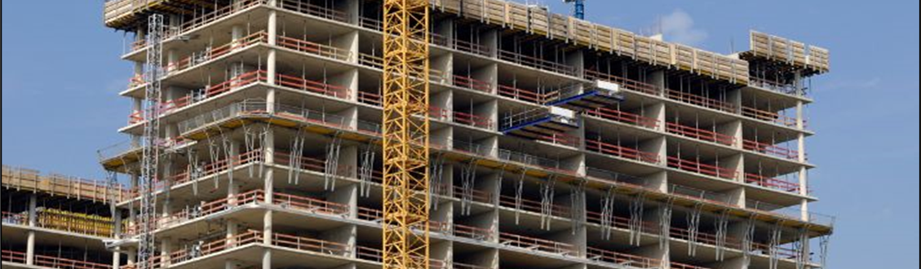
American Concrete Institute (ACI) Chapter Activities
Denesha Price
Chapter Activities Coordinator

Slide 2
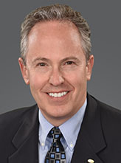
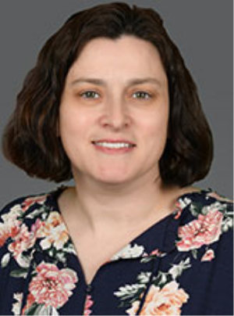
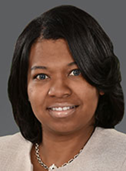
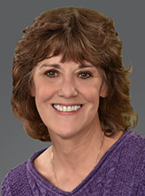
Who We Are (Chapter Activities)
John Conn,
Director,
Chapter Activities
Esther Beery
Chapter Activities Coordinator
Karen P. Smith,
Administrative Coordinator
Denesha Price,
Chapter Activities Coordinator

Slide 3
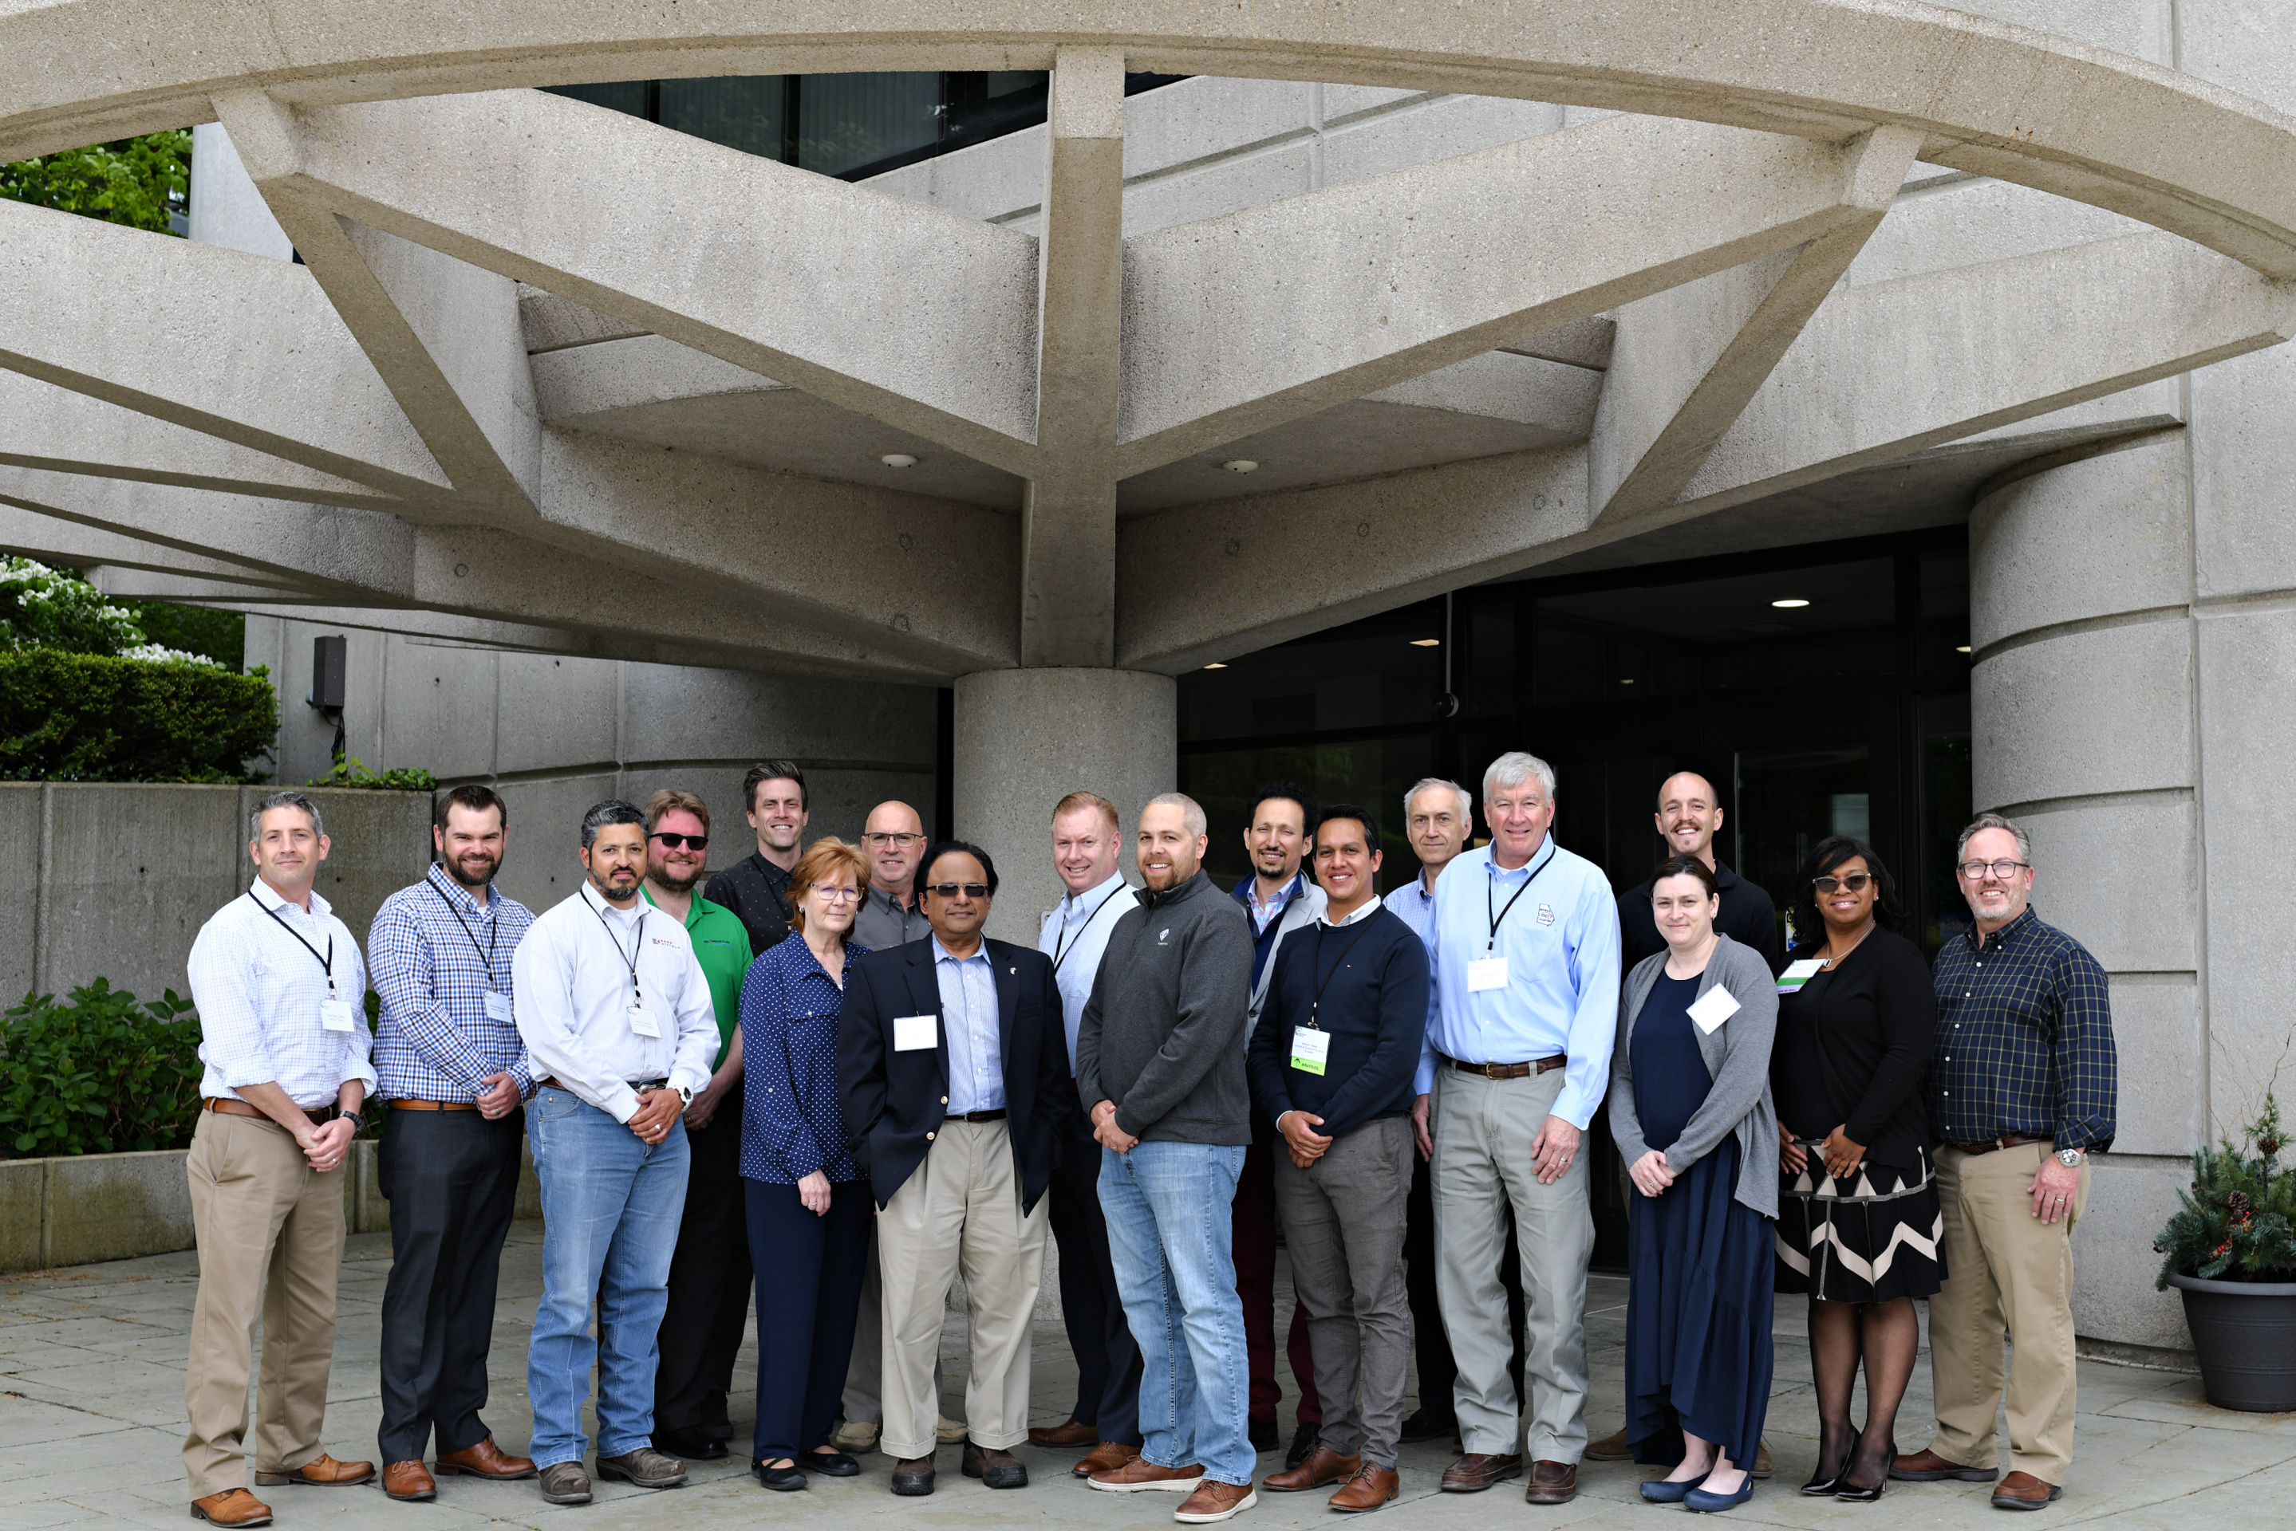
Purpose Of A Chapter
ACI Chapters provide a grassroot platform for individuals and groups to network, discuss, and disseminate technical and educational information on concrete.

Slide 4
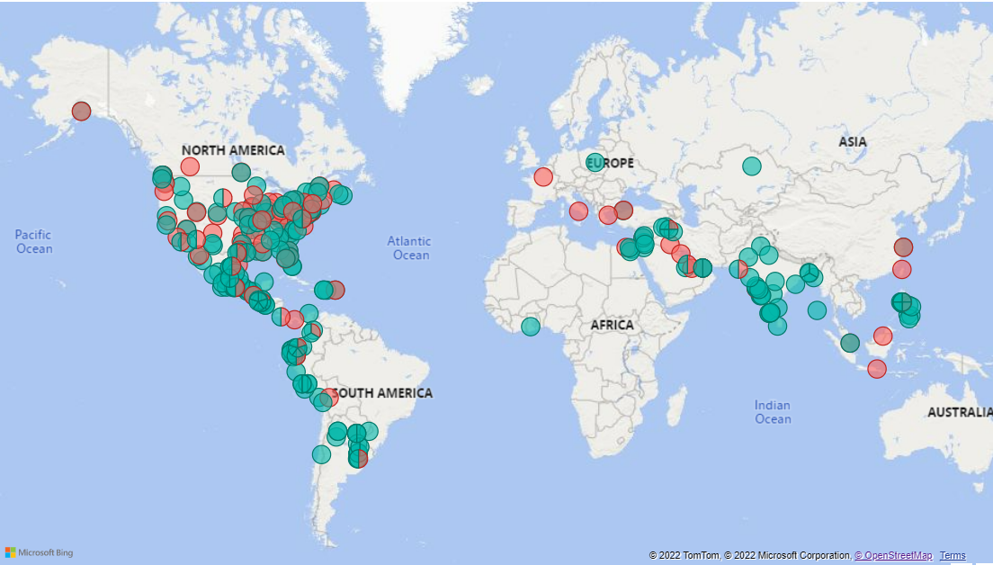
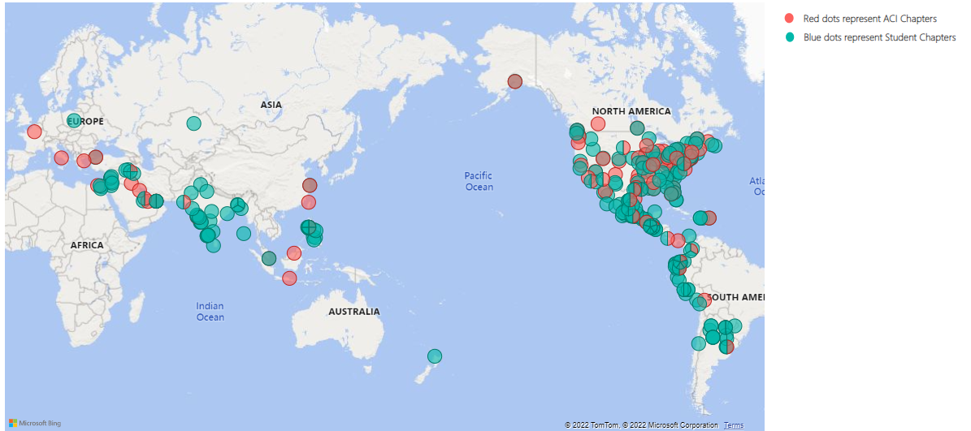
Chapters Around The World
Notes:
Professional Chapters
Total Chapters - 93
52 Domestic Chapters
41 International Chapters
1 Chapter in Africa – Egypt Chapter
Student Chapters
Total Student Chapters-278
68 Domestic Student Chapters
210 International Student Chapters
3 Student Chapters in Egypt
1 Student Chapter Ghana

Slide 5
Establishing An ACI Chapter
Organizing Petition
Bylaws

Slide 6
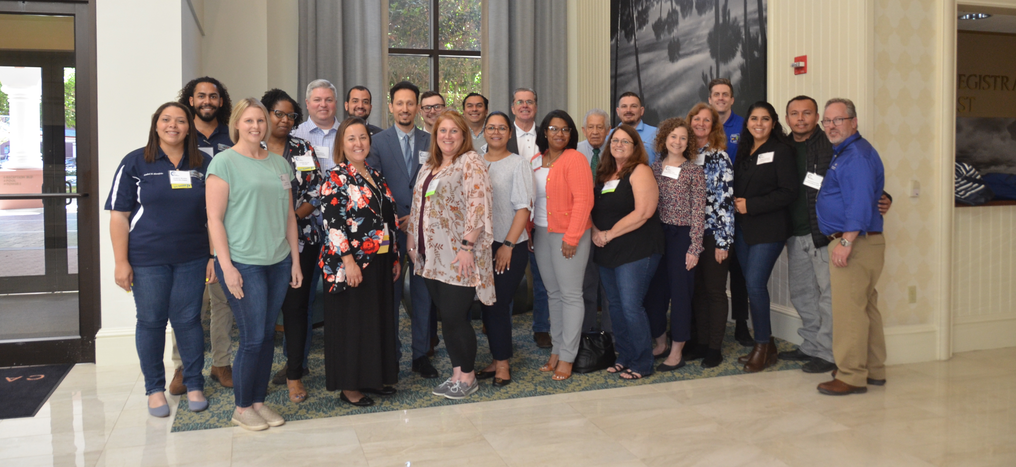
Support Available
Educational
Leadership Training
Roundtable Meetings
International Forum

Slide 7
Support Available
Social
Networking Breakfast
Chapter Recognition Program
WOC Reception
Notes:
Leadership Training – Held every spring at ACI Headquarters in Farmington Hills, MI. Leadership Training is 1.5 day event to provide incoming chapter officers with training on operational issues
Roundtable Meetings (domestic & international)-Held bi-annually during the ACI Convention. Chapter Officers from around the world come together to meet the ACI President, Chapter Activities staff and other chapter officers. Gives Officers the opportunity to exchange ideas with other chapters, provide updates on ACI activities, and improve communication. Chapter Officers come away from the roundtable with renewed energy and many new ideas to implement in their own chapter

Slide 8
Support Available
Administrative
StarChapter
Local Member Benefits
Chapter Talks Program
Officer Membership Discount

Slide 9
Activities
Membership Meetings
Educational Seminars
Multi-Day Conferences
Social Events

Slide 10
Student Chapters
The chapter may sponsor student chapters at local universities, colleges, technical and trade schools.

Slide 11
Student Activities
Student Competition
Educational Seminars
Meetings
Social Events

Slide 12
Testimonial
“Being a Local Chapter of ACI enables the Minnesota Concrete Council to more fully achieve our mission of bringing proven methods and new ideas together in order to educate our members on how to improve the quality of cast-in-place concrete, advance the techniques used to place and maintain it, and innovate the methods used to design it. Having that close partnership with ACI allows for increased collaboration via information and resource sharing.”
Margaret Mills

Slide 14
Denesha.Price@concrete.org

