Slide 1
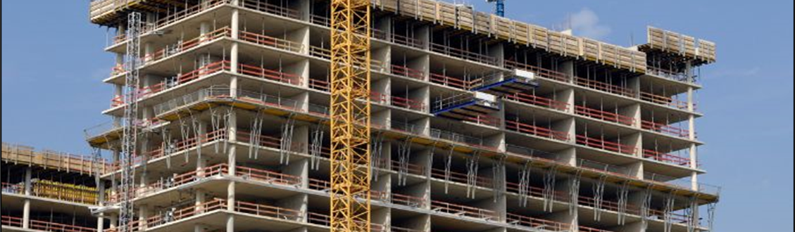
American Concrete Institute (ACI) A Brief Introduction
Charles Nmai
ACI President

Slide 2
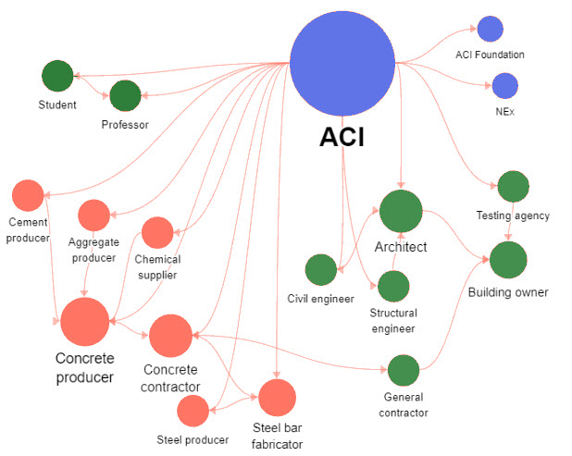
The Essence & Connectivity of ACI…
Founded in 1904, ACI is a professional society, not a trade association
Vision:
ACI envisions a future where everyone has the knowledge needed to use concrete effectively to meet the demands of a changing world.
Mission:
ACI develops, disseminates, and advances the adoption of its consensus-based knowledge on concrete and its uses.
Notes:
This slide emphasizes ACI has a long history and is not a trade association. Our motives are making the world better through the appropriate use of concrete.

Slide 3
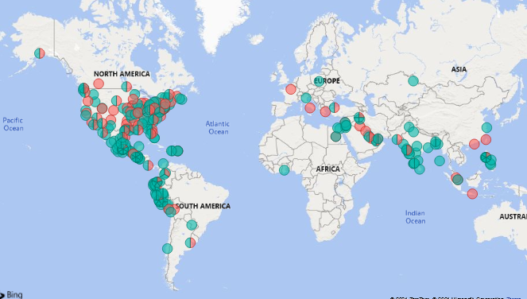
ACI’s Footprint…
30,000+ Members Worldwide
15,000 Students
93 Chapters
250+ Student Chapters
57 International Partners
Building Code used in over 60 countries
Credentialed over 600,000 individuals in the concrete industry
Select Documents available in 15 languages

Slide 4
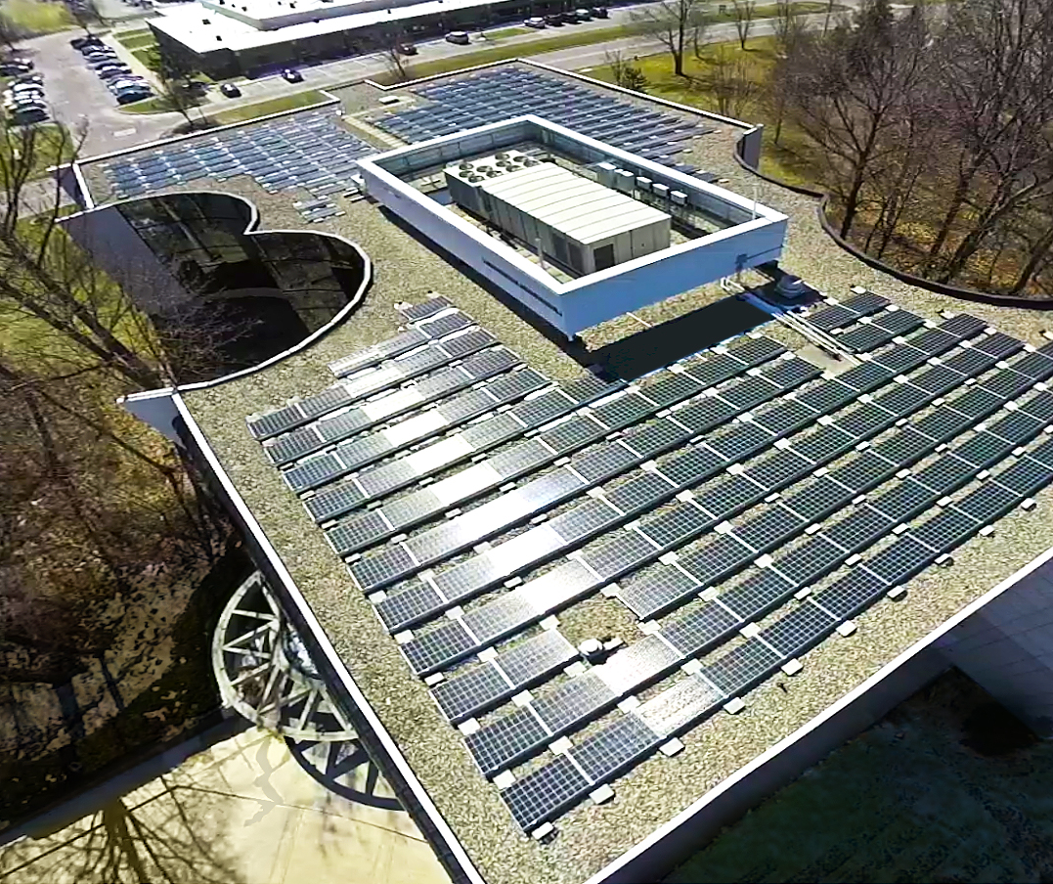
ACI’s Resources…
4000 Active Technical Volunteers
~ $100,000,000 Annual Effort
Headquartered in Farmington Hills, MI with 135 Staff
International Office in UAE
Regional Offices in CA, IL, and one planned for the Northeast
140+ Technical & Educational Committees
1000+ Technical & Educational Documents
Collaboration with Industry Groups – PCA, CRSI, PTI, ACPA, etc.

Slide 5
Some recent advancements at ACI…
Notes:
Recent advancements at ACI include the opening of two resource centers – one in southern California & the other in Chicago – and the establishment of two Centers of Excellence.

Slide 6
Centers of Excellence
Collaborate globally on the use of nonmetallic building materials to drive research, education, awareness and adoption
Notes:
ACI formed NEx CoE in 2021
Founding Partner: Saudi Aramco
Other Sustaining Partner: ExxonMobil; MST Rebar, Inc.

Slide 7
A Call to Action…
According to some studies, the concrete industry is responsible for approximately 7% of greenhouse gases worldwide. Therefore, concrete must play a significant role in a sustainable future. Consistent with its vision, ACI is uniquely positioned to take on this challenge.

Slide 8
ACI’s Commitment – Position Statement
Be it resolved that: ACI staff and leadership are empowered to support policy positions; and state, federal, and international programs, rules, regulations, and agreements that encourage or establish criteria related to carbon neutrality of the built environment; and…
Be it further resolved that: ACI staff, leadership, and, where appropriate, subsidiaries are empowered to assist in the development of information, processes, and procedures and dissemination of information to transform the concrete industry into a carbon neutral industry.
Notes:
This is a new Position Statement that was approved on August 30, 2021.

Slide 9
ACI’s Second Center of Excellence
Collaborate globally to drive research, education, awareness, and adoption of the use of carbon-neutral materials and technologies in the built environment.
Notes:
A wholly-owned ACI subsidiary incorporated as a Michigan-based, 501 (c)3 non-profit, professional organization. ACI houses, staffs, and manages the Center. The Center has a Board of Directors (BOD) including ACI members and Center Sponsors.

Slide 10
NEU Vision
The Center envisions a concrete industry where all stakeholders have access to technologies and the knowledge needed to effectively and safely produce and place carbon-neutral concrete and concrete products in the built environment.

Slide 11
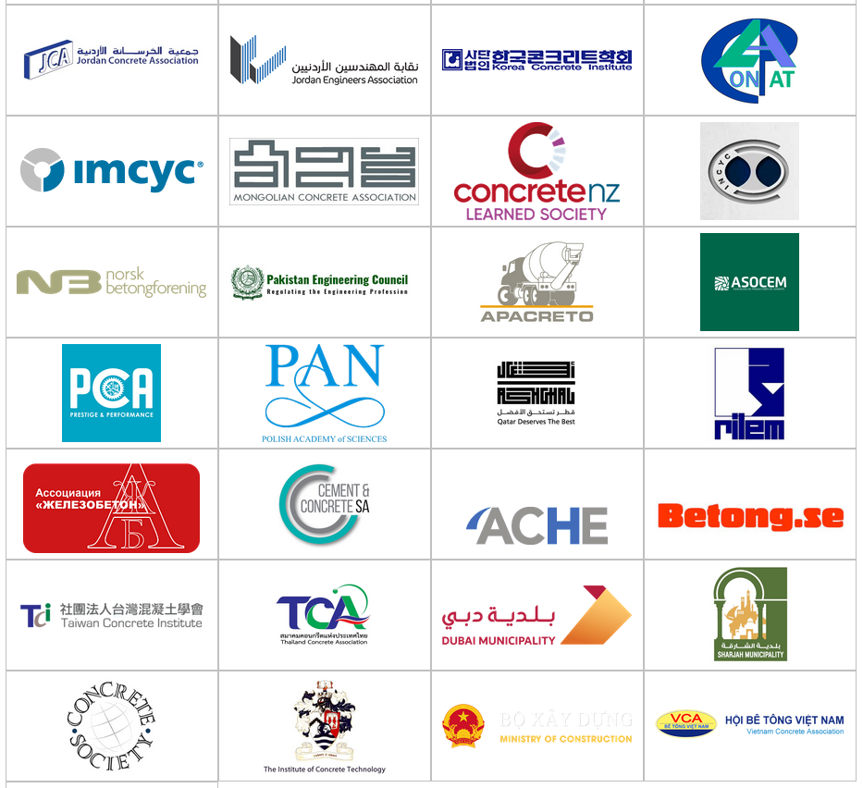
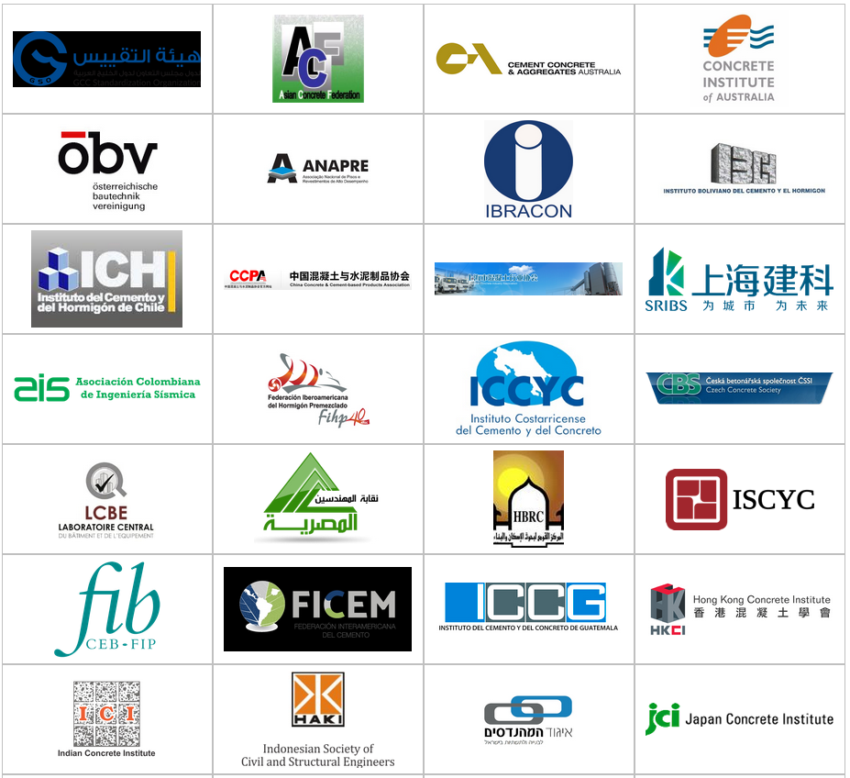
Center of Excellence on Carbon-Neutral Concrete
Core functions will include:
Technology acceleration
Coordination with ACI Committees
Technology Transfer & Professional Development
Technology Assessment & Validation
Research
Advocacy & Technical Support
International & Student Outreach
Change the Concrete Construction Culture
Notes:
Technology Assessment & Validation proving to be very important to partners!

Slide 12
NEU Sponsors and Partners
Owners and Developers
Standards development organizations (SDOs)
Government agencies involved in standards-setting and adoption, construction, environmental protection, or workforce development
Environmentally focused non-governmental organizations (NGOs)
Technical societies/institutes
Universities/research centers/training centers/trade schools
Architects/engineers/designers
Cement Producers
Ready mixed concrete producers
Manufacturers of concrete products
Construction companies

Slide 13
Current NEU Partners
Sustaining Members
Supporting Members
Affiliate Members
Notes:
FICEM (Allied Organization MOU)
ICC-ES (Allied Organization MOU)
ASTM (working on Allied Organization MOU)

Slide 14
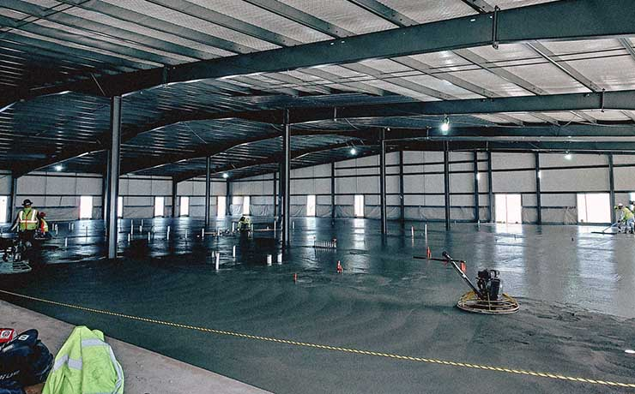
Walking the Talk! Meta Pilot Low-Carbon Concrete Project
Owner: Meta (DeKalb, IL data center)
40% lower carbon emissions
Notes:
Published April 2022: A low-carbon concrete formula was poured at the DeKalb, IL data center location in the construction personnel office space. 40% lower emissions compared to regional benchmark.
The Meta-UIUC research using AI sought to reduce the carbon footprint of concrete by reducing the amount of cement and replacing it with other materials like fly ash, slag, and ground glass, all of which have a lower carbon intensity than cement.

Slide 15
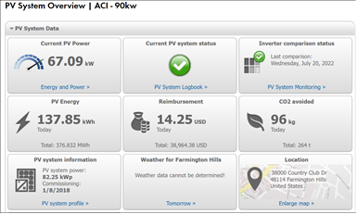
ACI Solar Panels Hard at Work Converting Sunshine into Clean Energy!
@ 2:45 PM on July 21, 2022
Notes:
Solar panels on top of ACI building are hard at work converting sunlight into electricity to offset power from the grid. Snapshot at 2:45PM on July 21, 2022 - panels produced over 65,000 watts of power. Through 2:45PM that day, the panels had supplied over 135,000 watt/hours of energy. To put that in perspective, the average house uses about 30,000 watt/hours of energy per day. In addition to saving ACI on utility costs, we are also reducing our carbon footprint!

Slide 16
President@concrete.org

