Slide 1
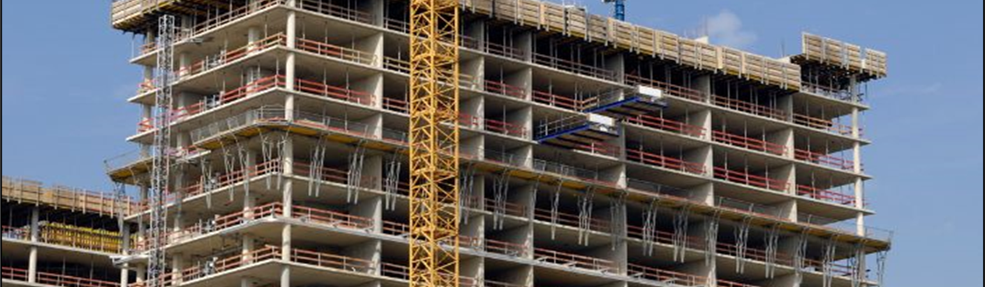
Now Introducing, American Concrete Institute (ACI)
Enhancing Quality Infrastructure through
Modern Reinforced Concrete Building Codes

Slide 2
Housekeeping Announcements
All participants are muted. Please use the Q&A function to submit your questions. We will also have a few minutes at the end to take spoken comments and questions–submit via the chat box.
For technical issues, send Agostina Ntow a direct message in the chat function.
The session will be recorded, and presentation slides will be emailed to participants following the webinar..
1620 L Street, N.W.
Suite 1200
Washington D.C. 20036
ansellj@personalcarecouncil.org

Slide 3
Standards Alliance (SA Phase 2) Welcome
Sharon Okello
Program Manager, International Development
American National Standards Institute

Slide 4
ANSI
Private, Non-profit Organization.
ANSI is NOT a standards developer.
Work with U.S. private and public sectors to administer and coordinate the development of U.S. voluntary standards and conformity assessment system.
Sole due-paying member at ISO and IEC.
Implements donor-funded programs to provide capacity-building assistance in area of standards.

Slide 5
Standards Alliance Partnership
Standards Alliance is a public-private partnership between ANSI and USAID.
The overall objective is to improve and build capacity in quality infrastructure.
This particular project activity focuses on the building/ construction sector.
We are piloting the activity in Kenya, Tanzania, and Uganda.

Slide 6
Standards Alliance Partnership
Funding Structure:
 | USAID | ANSI/private sector
2019 – 2024 | $5.5 million | $5 million

