Slide 1
Blockchain & Standards
ANSI SPRING
Heather Kreger, CTO International Standards
V5.0

Slide 2
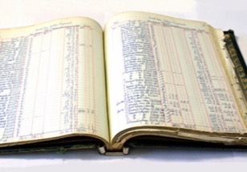
Requirements of blockchain for business
Shared ledger
Smart
contract
Append-only distributed system of record shared across business network
Business terms embedded in transaction database & executed with transactions
Ensuring appropriate visibility; transactions are secure, authenticated & verifiable
Transactions are endorsed by relevant participants
Privacy
Trust
Its about business – not just finance

Slide 3
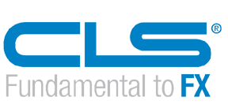
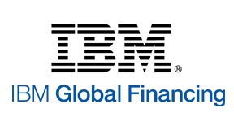
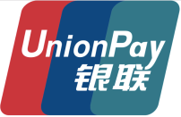
Block chain applies across industries - Client Examples
Trade logistics
Credit default swaps
Diamond provenance
FX netting
Settlements through
digital currency
Identity management
Food safety
Trade finance
Dispute resolution
Low liquidity securities
trading and settlement
Rewards points
management
Contract management

Slide 4
Digital Identity
SecureKey and Canadian Banks found digital identity verification network
How it works:
Consumers use an app to verify their identity.
Service provider only sees what it needs to see. All personal information is kept private.
Consumer Digital Identity
Bank 1
Consumer Identity App
Benefits
Customers: Convenience, simplified experience, full control and consent over identity usage, privacy, security, trust
Businesses: Reduced costs and risks of data breach/theft, efficient compliance management and monitoring, new revenue streams, rapid on-boarding, personalized customer services
Regulators/Auditors: Standardized process, rapid auditing, increased efficiency in compliance control, monitoring and quality
Bank 2
Service Provider
Bank N
… using NIST Digital Identity standards!
http://securekey.com/press-releases/ibm-securekey-technologies-deliver-blockchain-based-digital-identity-network-consumers/

Slide 5
Use Case: Blockchain Solution for IBM Global Financing (IGF)
Our Commercial Financing business provides working capital to IT suppliers, distributors and partners through financing of inventory and accounts receivables
What?
Improve the efficiency of our commercial financing business by sharing data in a secure and transparent manner on Blockchain
How?
Blockchain enables Comprehensive View of key operational data:
Purchase Order > Transaction Approval > Shipments > Invoices > Remittances
Benefits
Fewer disputes & faster settlement
Reduction in dispute resolution time: 40+ days to under 10 days
Improved capital efficiency; freer flow of capital
orders
Partners
IGF
Suppliers
products and services
IGF world-wide statistics
4000+ Partners and Suppliers | 2.9M Invoices / year |  | $44B Financed / Year
$100M Capital tied up any time! | 25,000 Disputes / year | $31K Avg. disputed invoice value | 44 days Avg. time to resolve a dispute
Notes:
https://developer.ibm.com/tv/blockchain-in-ibm-global-financing/

Slide 6
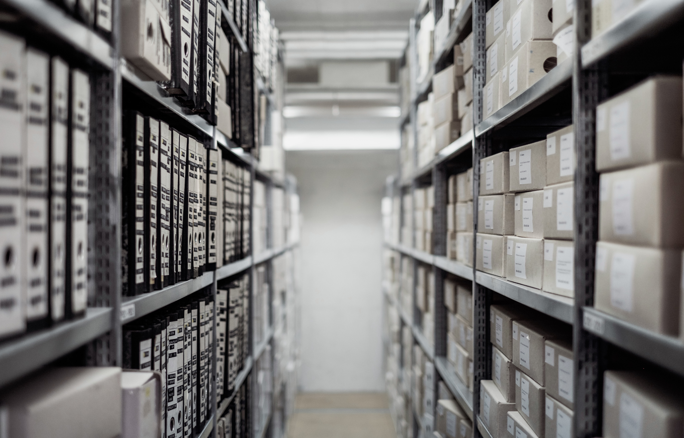
Why you may invest in blockchain
Unlock New Revenue
Optimize Your Business
Transform Markets
define new business models
Maximize operational efficiency
THRIVE IN the NEW ECONOMY
Blockchain expedites transactions and reduces reliance on intermediaries, driving growth with new business models to free up capital and increase revenue
Blockchain enables process and risk optimization by removing duplicative reconciliation and collapsing already digitized processes through real-time sharing of trusted data
From providing real-time visibility to mitigating risk, blockchain will revolutionize how future businesses operate, create partnerships and drive growth across more secure and transparent ecosystems
$
176B
10
%
7%
30
%
$3T
New business value by 2025 in Financial Services
Projected global GDP stored on Blockchain by 2027
Increase in supply chain provenance
Decrease in back office costs
Estimated business value
unlocked by blockchain globaly

Slide 7
IBM Strategy: Transforming Industries with Blockchain
IBM Blockchain
Ecosystem
Support
Education, support and partner services to create a thriving ecosystem for Blockchain
Blockchain Solutions
Provide
Solutions to transform business processes and industries by creating and operating Blockchain Business Networks with enterprise participants
Build
Operate
Invest
IBM Blockchain
Platform
Provide
Secure Blockchain Platform on the Cloud with developer services and production grade capabilities to enable the creation and management of Blockchain business networks
Invest
With The Linux Foundation community to ensure the best possible foundation for Blockchain in a commitment to open standards, open source and open governance
Project
Hyperledger -collaborative effort to advance cross-industry blockchain technologies for business
www.hyperledger.org
*Hyperledger Fabric is a blockchain framework implementation and Hyperledger Composer is a tooling environment for blockchain and two of the projects hosted by The Linux Foundation.

Slide 8
Looking at blockchain and finance
Blockchain is new. It requires a fresh look to see how it relates to finance industry standards.
Blockchain
Technology
Financial
Applications
What are the use cases for blockchain in the finance industry?
Where do current standards fail to cover those use cases adequately?
Write new standards and modify existing standards to fill the gaps.

Slide 9
Blockchain and Finance standards
Dimension | Direction
Data | Data standards are important when transacting blockchain assets in business networks Consider open collaboration to accelerate innovative outcomes
Process | Shared public processes are going to fundamentally change in how they are executed
Intermediaries | Whole new classes of intermediaries are going to arise in the value chain, we think their value add is going to be mostly data driven
Smart contracts | Domain specific languages and domain vocabularies are going to gain importance
Many standards orgs are exploring standards for blockchain – ISO TC307, ANSI X9, SWIFT, …

Slide 10
Some relevant Blockchain standards work in progress
ANSI X9 - financial standards body has a blockchain study group which is identifying areas where new standards must be developed or existing standards must be modified in order to support the use of blockchain in financial services.
SWIFT – Society for Worldwide Interbank Financial Telecommunication – hosts standard secure messaging platform for financial institutions - exploring DLT for banking secure network
ISO TC 307 – Blockchain and Distributed Ledger Technology – International Standards Organization working on global standards, just starting, Currently Terminology

Slide 11
Regulatory View
Canada
United States
The Bank of Canada participated in Project Jasper a POC for DLT-based wholesale payment system. Conclusion: A pure stand-alone DLT system is unlikely to match the net benefits of a centralized wholesale payment system. However, there are benefits to DLT based in its interaction with broader FMI ecosystem through integrating other assets on the same ledger as payments greatly simplifying collateral pledging and asset sales, reaping economies of scope and reducing costs to participants.
The state of Delaware has passed amendments to state law that make explicit the right to trade stocks on a Blockchain (Jul 2017)
Legislators of the state of Illinois, have officially advanced a bill to establish a government task force to regulate the Blockchain industry and sector (Q1 2017)
The Security and Exchange Commission created the Distributed Ledger Technology Working Group (DLTWG) dedicated to protecting its users and investors from fraud in the sector (Jan 2017)
Nevada has become the first state to ban local governments from taxing Blockchain use (Jun 2017)
Arizona approves a bill seeking to enshrine signatures recorded on a blockchain and smart contracts – self-executing pieces of code – under state law. Specifically, the bill aimed to make those types of records "considered to be in an electronic format and to be an electronic record“ (Mar 2017)
Vermont allows "a fact or record" verified through blockchain technology as "authentic“ (May 2016)
International
The European Commission plans to set up an observatory and forum on distributer ledger technology to help it understand what role public authorities should play in developing and helping uptake of the technology.
Dubai’s financial regulator has revealed its vision to embrace Blockchain development by setting up the required infrastructure and facilitates for testing of Blockchain technology innovations
Russia's government is said to be moving ahead with plans to introduce rules for blockchain use by 2019
The Bank of England has an active working group studying the benefits of blockchain technology. Published several whitepapers on this topic. Member of Hyperledger Project.

Slide 12
What Role Can Regulators Play
Encourage Responsible Innovation
Open Frameworks and open source approaches
Sandbox Exploration
Model contract structures
Proactive Participation
Participate in emerging Blockchain networks – reviewer, approver
Security, privacy and transparency controls on Blockchain
Openness to support technologies (e-signature, e-filings)
Starter policies
Cognition + Blockchain = Reactive Contracts
Infuse transparency (and compliance) into the process
Spur industry dialogue to craft future regulatory framework

