Slide 1
Healthcare Interoperability: Simplified Health Data Standard
Andrew Gregorowicz
Beth Halley
Joy Keeler
HITSP Foundations Committee
May 18, 2009

Slide 2
Who is MITRE and Why Are We Here?
Independent, not-for-profit organization
Chartered to work in the public interest
Free from organizational and personal conflicts of interest
Five decades of technology architecture, acquisition, and integration oversight experience
Center for Transforming Health with deep healthcare and technical expertise
Here to address unique opportunities and challenges facing the healthcare industry with regards to standards

Slide 3

MITRE Experience
Project Laika
Open source tools for testing Health IT standards
Partnered with CCHIT
Software currently being used for EHR Interoperability Certification
Experience
HITSP Specs on Continuity of Care
IHE Specs on Document Exchange
Notes:
3

Slide 4
Call to simplify
To address the American Recovery and Reinvestment Act of 2009 (ARRA) requirements, HITSP has been asked by ONC to provide a simplified version of their standards.
No later than December 31, 2009, the Secretary shall, through the rule making process, adopt an initial set of standards, implementation specifications, and certification criteria (these items that were adopted by the National Coordinator, before enactment of the legislation may be applied towards meeting the requirement).
The standards will provide guidelines EHR companies must meet in order for their product to be considered an “approved” EHR. Although EHR adoption will not be required, “meaningful use” of an approved EHR will be required in order for providers to qualify for, and continue to receive, benefits from HITECH.
http://www.himss.org/content/files/HIMSSSummaryOfARRA.pdf
“Meaningful Use” of EHRS is required through ARRA for providers to receive benefits from Health Information Technology for Economic and Clinical Health (HITECH) funding.
My prediction of meaningful use is that it will focus on quality and efficiency. It will require electronic exchange of quality measures including process and outcome metrics. It will require coordination of care through the transmission of clinical summaries. It will require decision support driven medication management with comprehensive eRx implementation (eligibility, formulary, history, drug/drug interaction, routing, refills).
http://geekdoctor.blogspot.com/2009/04/what-is-meaningful-use.html John Halamka blog entry May 13, 2009

Slide 5
Philosophical Approach
Current Health IT standards can be used to create interoperable systems
However, the fine grained and modular approach taken tends to lead to point-to-point negotiation of rules for data exchange
Existing standards can be refined to allow for greater interoperability
Tools can be created to lower the barrier to entry
Notes:
5

Slide 6
hData
Simple to exchange, consume and store data
Simple to build
A redesign of information standards
Continuity of Care data (extensible for different use cases)
Exchange of Health Data
Key Concepts
Simple Data Format: hData Schema
Simple Information Exchange: hData Transport
Notes:
6

Slide 7
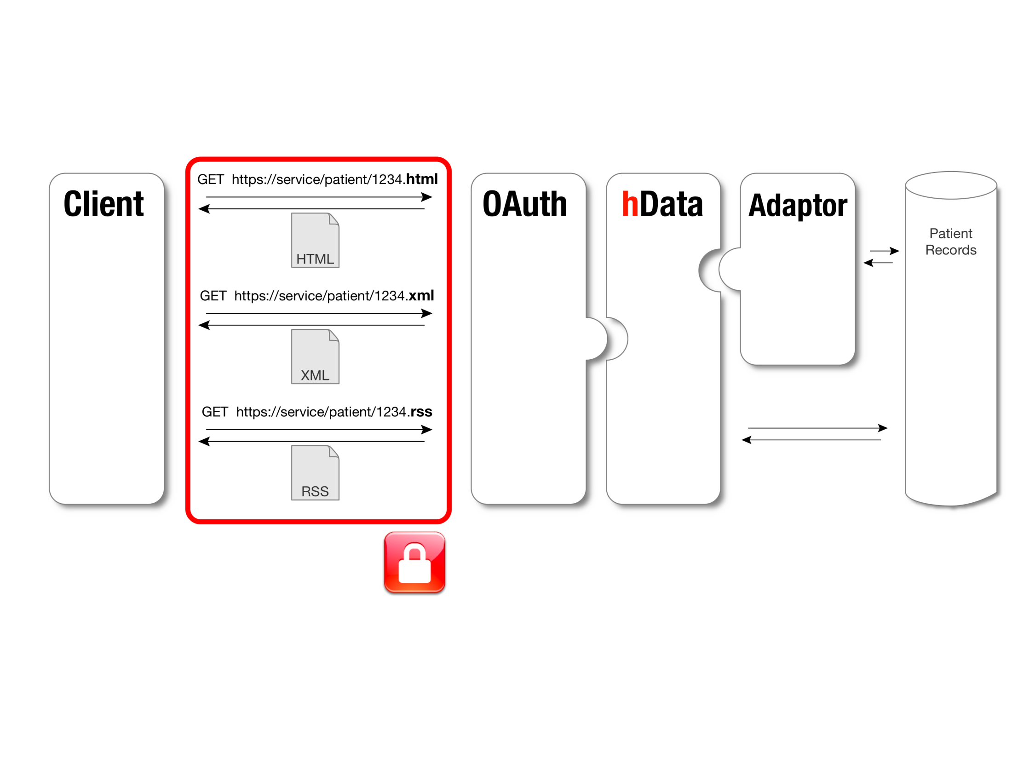
hData Architecture
Open standard for access control
RESTful Interface
TLS Encryption
TLS = Transport Layer Security
18
Notes:
7

Slide 8
Another MITRE Funded Initiative Parallel Approach to Speed VA/DoD Interoperability
Today
Assist Current
C32
XML Schema
Easier to build & translate to C32
To NHIN
Current C32
Complex
Many versions
Test both cases
Use VA &/or DoD test data
Test both cases
Provide feedback iaw stimulus timeline
Translate
hData
Simple
Low barrier to adoption
NHIN = Nationwide Health Information Network
To new method for data exchange
Try New
Parallel approach offers alternatives to speed interoperability

Slide 9
Steps in the HITSP Harmonization Process
I
II
III
IV
V
VI
VII
VIII
IX
Receive Request to Harmonize
Identify Candidate Standards
Begin Inspection Testing
Select Standards
Begin Support
Identify and Resolve Gaps, Duplications and Overlap
Release and Disseminate Interoperability Specification
Conduct Requirements Analysis
Develop Interoperability Specification
HITSP Program Management

Slide 10
Questions

