Slide 1
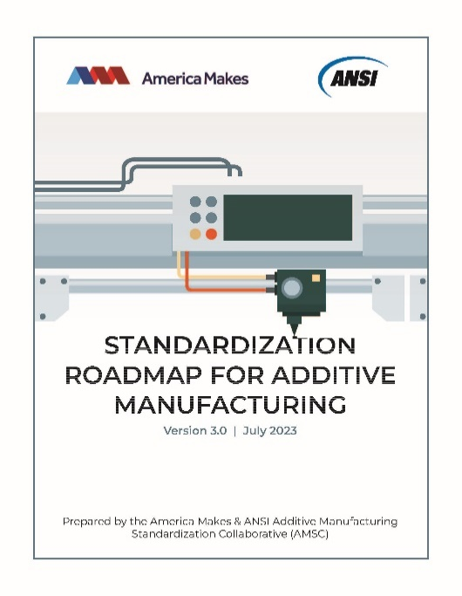
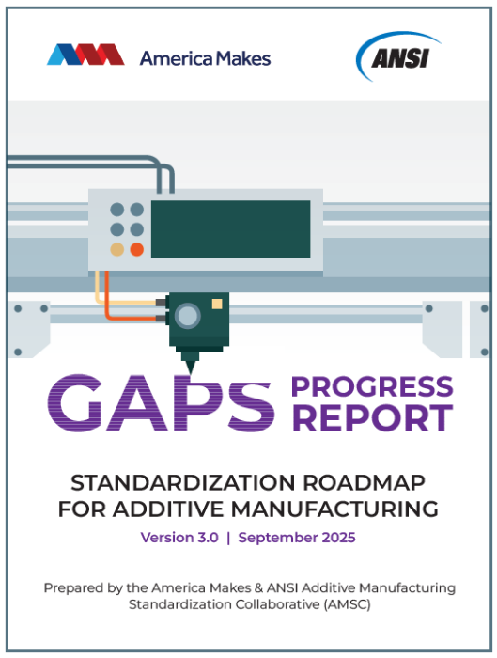
AMSC Roadmap v.3
Launched: | March 2016, to coordinate and accelerate AM standards development, avoid duplication, and inform decision-making for resource allocation
AM Lifecycle Areas: | Design Precursor Materials Process Control Post-processing Finished Material Properties | Qualification & Certification (Q&C) Nondestructive Evaluation (NDE) Maintenance & Repair Data
Background Information: | AM issues, standards, specifications, codes, regulations (etc.) that are published or in development
Industry Sectors: | Aerospace (spaceflight/aviation) Defense | Medical Electronics Energy (oil & gas, nuclear)
141 Gaps: | Recommend: New / revised standards, organizations that can do the work, and priority levels Identify: Captures any pre-standardization research & development (R&D) needs Suggest: Intended applicability to sectors, materials, lifecycle, Q&C areas, process categories
Participation: | Approximately 300 individuals representing 150 organizations
Gaps Progress Reports: | Reports: Research, standards, regulations, qualification & certification activity related to the Gaps in v3. Published: April & September

