Slide 1
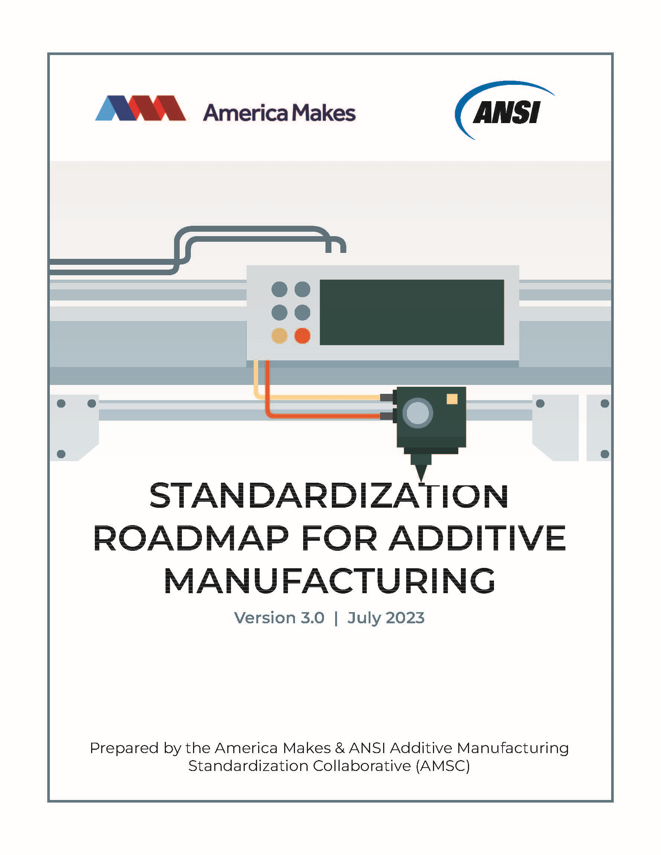
Accelerating Standards Development
America Makes and ANSI Additive Manufacturing Standardization Collaborative (AMSC)
Christine DeJong Bernat
Associate Director, Standards Facilitation
ANSI

Slide 2


American National Standards Institute
Standardization Collaboration
One way ANSI coordinates and supports the standardization system is through standards collaboratives and workshops, which:
Bring together the public and private sector in a neutral forum
Identify current and in-development standards, where gaps exists, and recommend solutions
Identify organizations that can perform the needed work
ANSI does NOT write standards
Founded in 1918, ANSI is a private non-profit membership organization whose mission is to enhance U.S. global competitiveness and the American quality of life by promoting, facilitating, and safeguarding the integrity of the U.S. voluntary standardization system.
AMSC Overview | www.ansi.org/amsc
Notes:
ANSI is a non-profit organization which supports the U.S. private sector led voluntary standardization system.
One of our roles in that capacity is to support standards coordination. We execute this through standards workshops and collaboratives (some referred to as panels). These efforts typically result in a standards landscape, strategy, roadmap, or technical workshops reports.
Ultimately, the goal is to create a neutral forum where the public and private sectors can exchange ideas and make decisions about standards needs. One work product of these collaborative efforts is Standards Roadmaps. ANSI, nor our collaboratives are writing the standards. That charge is left with the SDOs. Instead we are developing recommendations, increasing awareness of what issues industry faces and what standards activities are out there.
In those efforts we also aim to inform about existing regulations, policies, codes, and research for example. It can be slightly different depending on a sectors needs.

Slide 3
AMSC Mission and Goals
Launched in March 2016
Drive coordinated standards activity among AM Standards Developing Organizations (SDOs)
Avoid duplication of effort
Encourage liaisons between SDOs
Provide subject matter experts to help SDOs develop the standards
Better inform decision-making on resource allocation for standards participation and R&D needs
Clarify the current and desired future standardization landscape
Establish a common framework of AM standards and specs
AMSC does not develop standards
PURPOSE: To coordinate & accelerate the development of industry-wide additive manufacturing (AM) standards and specifications, consistent with stakeholder needs, and thereby facilitate the growth of the additive manufacturing industry
Notes:
One such collaborative is the Additive Manufacturing Standards Collaborative (AMSC). AMSC was first formed in March 2016 in partnership with America Makes. The primary objective of the AMSC is to coordinate and accelerate standards development for the AM industry to enable growth in the marketplace.
To reiterate, the AMSC does not develop the standards, but instead develops roadmaps and gaps progress reports which help inform standards development. Stakeholders participating in standards development organizations, or SDOs, ultimately decide which aspects of the AMSC recommendations they have the expertise and resources to work on. Our goal is to better inform that decision-making –
decision-making on what is needed - and how the broader industry can effectively allocate their resources and avoid duplication.

Slide 4
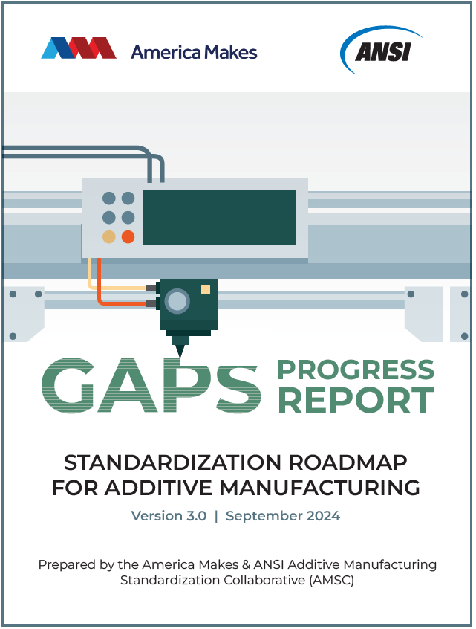
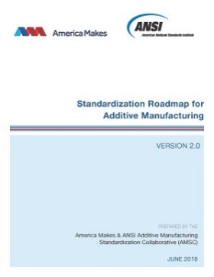
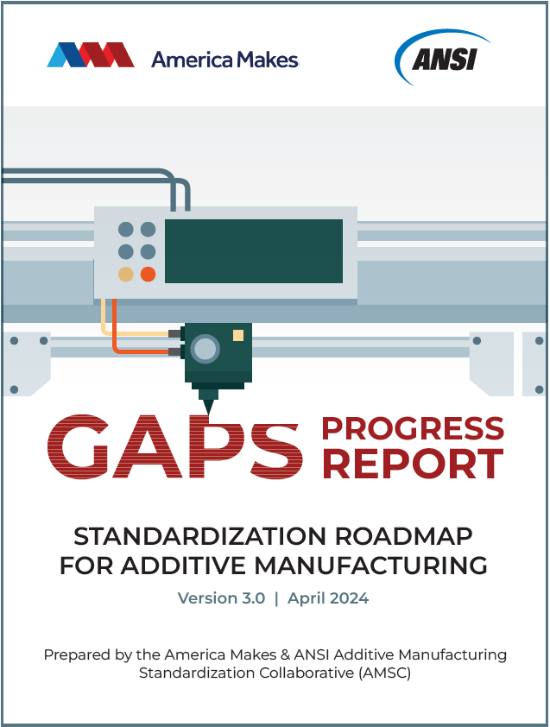
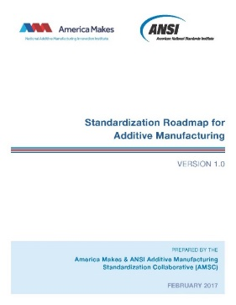
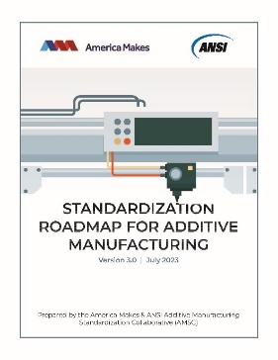
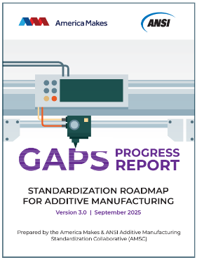
Evolution of Roadmap
March 2016
Additive Manufacturing
Standards Collaborative
(AMSC) formed
Feb 2017
July 2023
Roadmap v1 Published
Heavy focus on metallic AM for aerospace, defense and medical industries
Roadmap v3 Published
Added data WG, industry sectors, gaps metadata to augment filtering capabilities, current alternatives being used, R&D descriptions
April / Sept 2024
Gaps Progress Reports
Published
April /Sept 2025
June 2018
Roadmap v2 Published
Added polymer content, electronic
and electrical products industry
Gaps Progress Reports Published
April & Sept 2026
Scheduled Future Gaps Progress Reports
Notes:
This is visual of the evolution of the AMSC work. In February 2017 the first roadmap was published. It had a heavy focus on metallic AM for aerospace, defense and medical sectors.
In June 2018 the 2nd roadmap was published and incorporated some polymer content as well as the electronic and electrical products industry.
In July of 2023 the current roadmap, version 3, was published. A new chapter on Data was added, the meta data in the gaps was expanded and more industry sector information was incorporated where we had participation, such as nuclear.
AMSC is currently publishing Gaps progress reports which provide updates on the research standards and conformity assessment activities against the gaps identified in version 3. We also receive comments about the maturity of the technical discussions so the SDOs can continue to get updates about current needs.

Slide 5
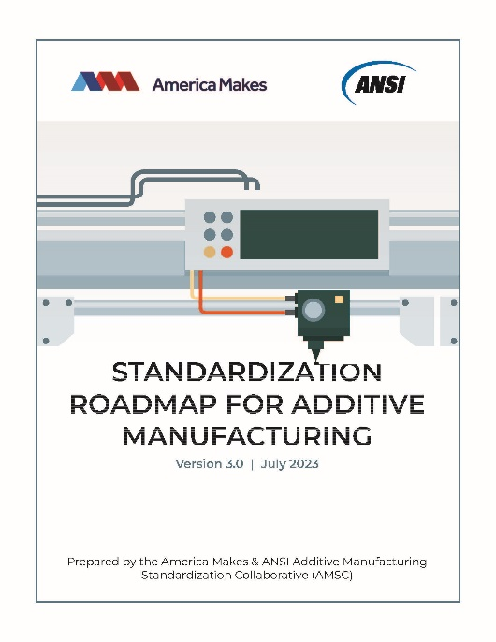
AMSC Roadmap v.3
AM Lifecycle Areas:
Design, Precursor Materials, Process Control, Post-processing, Finished Material Properties, Qualification & Certification (Q&C), Nondestructive Evaluation (NDE), Maintenance and Repair, Data
Background Information: AM issues, standards, specifications, codes, regulations, etc. that are published or in development
141 Gaps:
Recommend: New / revised standards, organizations that can do the work, and priority levels
Identify: Captures any pre-standardization research & development (R&D) needs
Suggest: Intended applicability to sectors, materials, lifecycle/Q&C areas, process categories
Participation: Approximately 300 individuals / 150 organizations
Notes:
The Roadmap is organized by the AM life cycle areas. (SLIDE)
Each topic is summarized, existing standards activities are listed and then gaps identified.
Each gap includes a description, a recommendation, identified R&D needs, potential organizations to help fill the gaps and also assigns attributes to those gaps which outlines which sectors, materials, process categories, or life cycle area the gaps applies to.
These gaps were developed by industry experts, not ANSI staff. The overall activities had approximately 300 people representing 150 different organizations – including SDOs, government, academia as well.

Slide 6
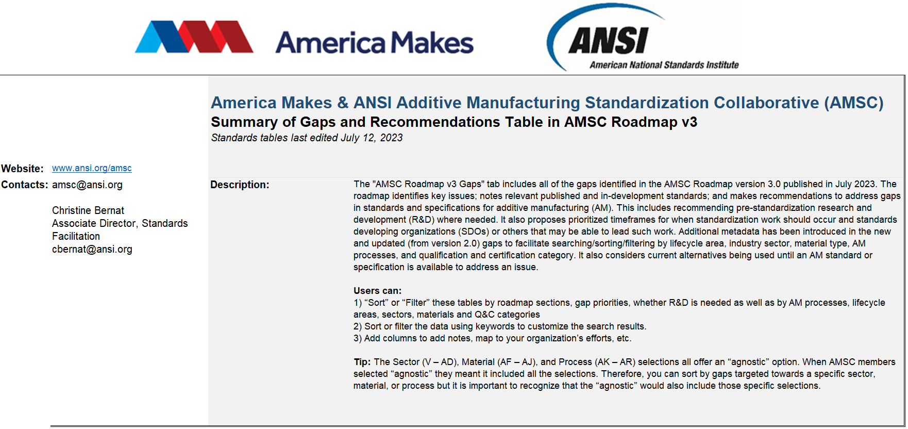
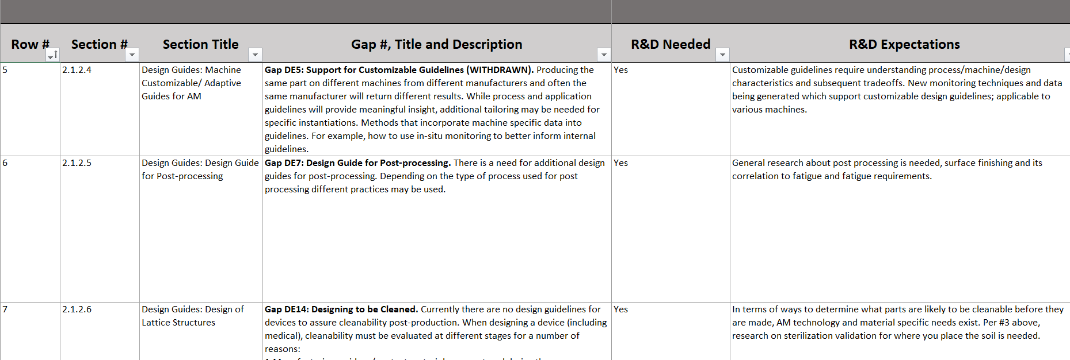
Gaps and Recommendations Table
Notes:
The AMSC Roadmap is published as a PDF report. However, the 141 gaps include a lot of technical information and supporting meta data which can be better leveraged in an excel format. An excel allows users to more easily search and filter the gaps information. This is particularly important when trying to identify R&D needs, standards gaps for particular sectors, materials, or even by recommended SDO, etc.
Roadmap users will need to toggle between the PDF and the Excel in order to find the correlated standards information related to gaps in the excel.
The excel helps with developing a task list of potential work by SDO – therefore supporting agenda development.

Slide 7
Breakdown of Open Gaps
Section | High Priority (0-2 years) | Medium Priority (2-5 years) | Low Priority (5+ years) | Total
Design | 8 | 11 | 2 | 21
Precursor Materials | 2 | 9 | 8 | 19
Process Control | 2 | 8 | 3 | 13
Post-processing | 1 | 4 | 3 | 8
Finished Material Properties | 9 | 0 | 1 | 10
Qualification & Certification | 13 | 10 | 3 | 26
Nondestructive Evaluation | 5 | 6 | 1 | 12
Maintenance & Repair | 1 | 4 | 2 | 7
Data | 13 | 12 | 0 | 25
Total | 54 | 64 | 23 | 141
91 Gaps Require R&D / 60 New Gaps
Notes:
Here is a breakdown of the AMSC gaps by chapter. There are a total of 141 gaps, 91 of which identified R&D was needed to help fill the gaps.
60 new gaps were developed in this iteration, 25 of which were from a brand new chapter on Data.
Progress has been made on the past gaps, including some being closed.

Slide 8
New Gaps in AMSC Roadmap v3
*High Priority
Design (3)
DE29: Best Practices for Design for Anti-counterfeiting
DE30: STEP Based 3D PDF
DE31: Feature-based Support for STEP
Precursor Materials (8)
PM11: Segregation of Powder
PM12: Requirements for Large Storage and Transport Vessels of Powder Feedstock
PM14: Test Method to Assess Hydrogen Content in Aluminum Powder Feedstocks
PM15: Identification and Quantification of Impurities in Chemical Compositions
PM16: Universal Reference Standard on Size Distribution
PM17: Error Quantification of PSD Measurement Methods
PM19: Terminology Related to Reuse of Feedstock Materials
PM20: Recycling the Polymeric Structures to Fabricate Filaments
Notes:
Design – Anti-counterfeiting and STEP
Precursor Materials – Segregation of powder, large storage and transport, identification & quantification of impurities, reuse of feedstock materials terminology

Slide 9
New Gaps in AMSC Roadmap v3
*High Priority
Process Control (1)
PC18: Powder Blending and Powder Mixing Terminology
Post-Processing (1)
P8: EHS Hazards Related to Post-Processing Tasks.
PM11: Segregation of Powder (jointly developed with PM WG, moved & rescoped)
Finished Material Properties (6)
FMP6: Finished Material Properties Terminology
FMP7: Material Properties: Specification Content Requirements
FMP8: Material Properties (Non-Metals)
FMP9: Material Properties: Test Methods (Metals and Non-Metals)
FMP10: Catalogs of Process Specific Defect Types
FMP11: Assessment of models linking defect structures and material performance
Notes:
FMP – material properties standards for metals and nonmetals, catalog of defect types, terminology

Slide 10
New Q&C Gaps in AMSC Roadmap v3
*High Priority
Civil & Defense Aviation Industry (5)
QC17: AM Part Material Development Timeline
QC18: OQ/PQ Process Know-How
QC19: Workforce Training
QC20: Certifying agency KPV Checklist
QC21: Detailed Requirements Integration Document
Electronics and Electrical Products Industry (1)
QC22: Additively Manufactured Electronics (AME)
Oil & Natural Gas Industry (1)
QC28: Susceptibility of AM Products to Corrosion and Environmental Cracking Mechanisms
Nuclear Industry (5)
QC23: Production and Incorporation of AM Parts in Nuclear Applications and Facilities
QC24: Nuclear AM Component In-service Performance
QC25: Nuclear Industry Use of Artificial Intelligence (AI) and Machine/System Learning Technologies to Qualify AM Parts
QC26: Nuclear Industry Use of Material and Production Data Combined with Digital Analysis and Diagnostic Informed Qualification of AM Components
QC27: Use and Qualification of AM Non-metallic Advanced Materials in Support of New or Advanced Nuclear Fuel and High-temperature Reactor Applications
Notes:
There were 12 new gaps in the Qualification and Certification chapter. 9 of which are high priority. They are related to the civil & defense industry, electronics, oil & gas and nuclear industries. There are other industry sectors explore in this chapter – such as medical and aerospace.

Slide 11
New Gaps in AMSC Roadmap v3
*High Priority
Nondestructive Evaluation (NDE) (5)
NDE9: Effect-of-Defect of AM Defects Detectable by NDE
NDE10: In-service Inspection
NDE11: Reliability of NDT
NDE12: 3D Image Quality Indicator for determining the sensitivity of a CT system
NDE13: Reference Radiographic Images and Standards for Additive Manufacturing Anomalies
Maintenance and Repair (1)
M10: Best Practices on Repair using Additive Manufacturing
Notes:
NDE – Effect of Defect, in-service inspection, 3D IQI….
M&R – Best practices on repair using AM

Slide 12
New Data Gaps in AMSC Roadmap v3
*High Priority
DA1: Standard Data Format for Material Characterization
DA2: Process Specific Common Data Dictionary
DA3: Digital Format for In Process Monitoring Data
DA4: Data Capturing for Machine Logs During a Build
DA5: Extended Design Specifications for Meta-Data Format Standardization
DA6: Specifications and Representations for AM Big Data
DA7: Additively Manufactured Electronics (AME) Data Transfer Format
DA8: Customizable Standard AM Data Collection Templates
DA9: Best Practices and/or Specifications for Registering and Fusing Data Sets During the AM Manufacturing and Inspection Process
DA11: Best Practices for Anomaly Characterization and Localization for Part Defect Prediction Purpose
DA12: Consistent Part Traceability and Provenance (Digital Twin)
Notes:
Data and Meta-Data Formats, collection, capturing, transfer, registering and fusing, traceability & provenance

Slide 13
New Data Gaps in AMSC Roadmap v3
*High Priority
DA13: Data Visualization
DA14: Best Practices and Guidance for AM Data Collection
DA15: Data Aggregation of Time Series and Object Data
DA16: Data Retention Guidelines
DA17: Assessment and Specifications of AM Data Quality
DA18: Reference Workflow (Digital thread) for AM Part Fabrication
DA19: Context and Scenario-specific Data Selection
DA20: AM-Specific Security Guidance
DA22: Technical and IP authentication and protection
DA23: AM Machine Data Framework and Guideline for Automated AM Data Integration and Management
DA24: Medical AM design file retention
DA25: Quality Management of Medical AM Files
Notes:
Visualization, aggregation, retention, assessment, authentication and protection, integration & management.
Basically – everything.

Slide 14
Gaps Statistics v1 to v3
Version | # Gaps | # New Gaps | # Closed Gaps | # Withdrawn Gaps | # Gaps Require R&D
Roadmap v1.0 (2017) | 89 | 89 | n/a | n/a | 58
Roadmap v2.0 (2018) | 93 | 11 | 2 | 5 | 65
Roadmap v3.0 (2023) | 141 | 60* | 4 | 12 | 91
*22 of 60 new gaps were from a new chapter on Data, not previously addressed in v1 or v2

Slide 15
Standards Statistics v1 to v3
 | All Identified Supporting Standards & Guidance |  |  | AM Specific Identified Supporting Standards & Guidance
Roadmap | Published Standards | Draft Standards | Total | Published Standards | Draft Standards | Total
Roadmap v1.0 (2017) | 242 | 39 | 281 | 24 | 25 | 49
Roadmap v2.0 (2018) | 456 | 80 | 536 | 47 | 61 | 108
Roadmap v3.0 (2023) | 513 | 155 | 668 | 144 | 126 | 270
+/- 5x
*Standards identified focus on the technical areas outlined in the AMSC Roadmaps. Additional related and specific standards may be available to additive manufacturing stakeholders.
**Data does not reflect the number of revisions that may have occurred between AMSC document iterations.

Slide 16
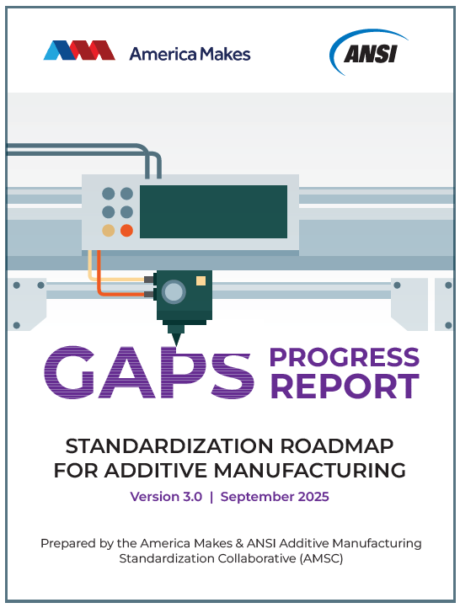
September 2025 Gaps Progress Report
Gap Updates
28 gaps have new research and/or standards activities / feedback in this version
104 of 141 gaps have published updates since Roadmap was published
Proposed Gap Closure(s):
DE17: Contents of a Data Package
DA15: Data Aggregation of Time Series and Object Data
DA18: Reference Workflow (digital thread) for AM Part Fabrication
New Gaps:
Q&C: Manufacturing method and material equivalency
Q&C: Parts-based or situational (life-limited / limp home) use guides
NDE: Characterization of surface inspection shown to relate as-printed fatigue specimens
Data: Quality Management of Medical AM Files
General: Assessment of electrical, mechanical, thermal, and combustible safety of industrial additive manufacturing equipment

Slide 17

Standards-Driven Public-Private Partnerships
2024 Project Objective:
Inform the NIST implementation plan for the USG NSSCET (May 2023)
Implementation Roadmap for USG National Standards Strategy for CET (July 2024)
Supported through a cooperative agreement with NIST
ANSI Gathered Private-Sector Feedback:
Identify existing and past public-private partnerships (PPPs)
Learn approaches, best practices, different mechanisms for convening stakeholders
Discuss what role PPPs can play to support CETs
Determine if/where a PPP is appropriate during standards readiness phases
Brainstorming Sessions Summarized in Report:
Standards Readiness Phases & 5 Standards-Driven Public-Private Partnerships (SD-PPPs)
Common challenges and solutions in standards development
Best practices for effective PPPs
AI/ML in healthcare and manufacturing– July 17, 2024
Automated and Connected ground vehicles & aircraft – July 30, 2024
ansi.org/pppforcets

Slide 18
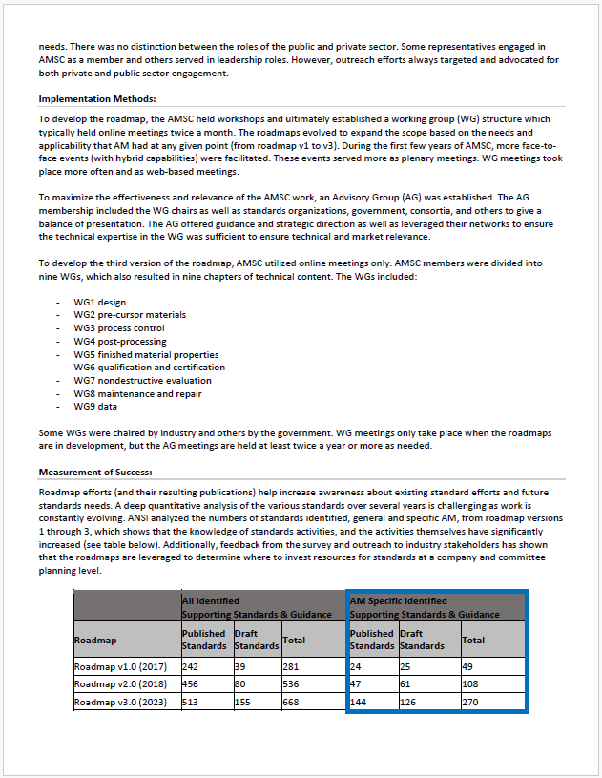
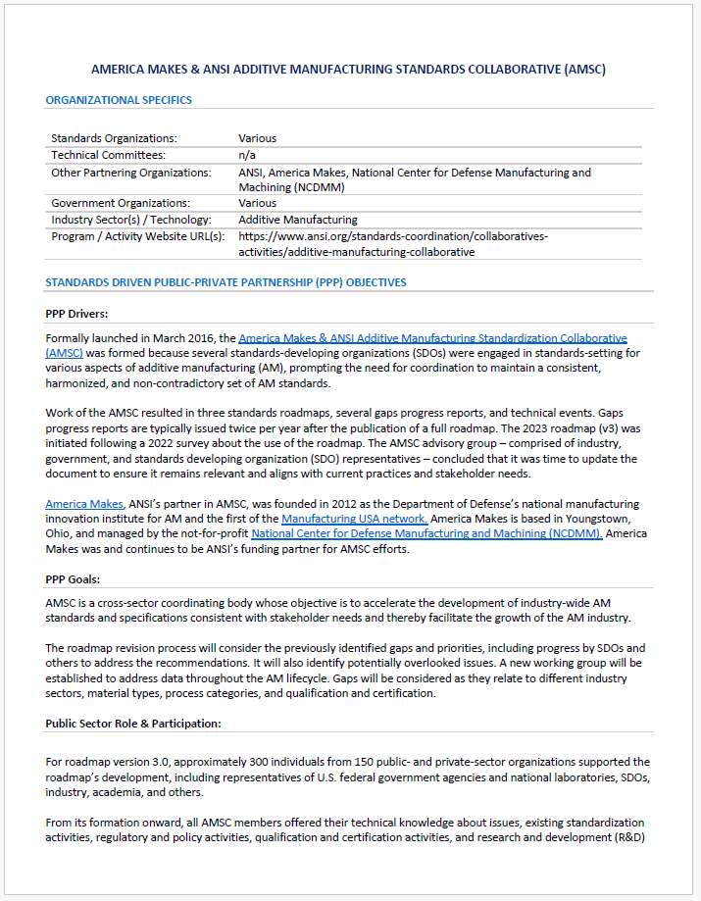
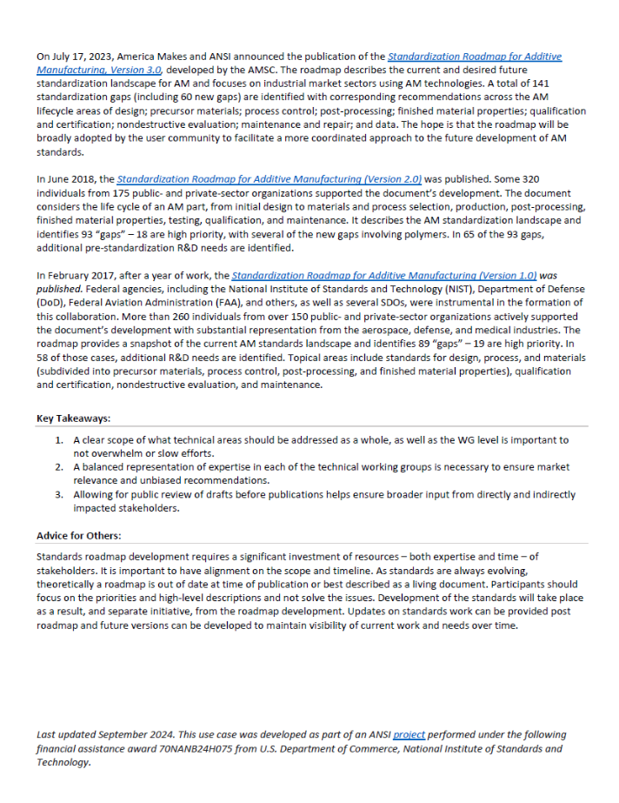
SD-PPP Use Cases
America Makes and ANSI AMSC
Standards Acceleration SD-PPP
Effort Resulted in 19 Use cases
Various technologies/sectors
Various work products (research, roadmaps, coordination, standards)
Formal / Informal
ANSI SD-PPP Webpage
Additional Use Cases Underway
Contact Christine Bernat to submit
Actual SD-PPP use cases often include the characteristics of more than one model. For example, a SD-PPP may be a “standards acceleration” and a “policy & conformance driven.”
Flexibility to meet industry’s needs is important.

Slide 19
Next Steps
Increase awareness about roadmap availability and recommendations, especially to recommended organizations listed in the gaps
Add to agendas to standards developing organizations technical committee meetings
Use the Gaps & Recommendations Table!
Brief research organizations during project development phases
Outreach to AM stakeholders / individual organizations and related government bodies
Social media and other communication channels
Roadmap (freely available / direct link)
September 2024 Gaps Progress Report
April 2025 version will be published next week!
Publish Gaps Progress Reports (2x per year)
Collaborate to close gaps!

Slide 20

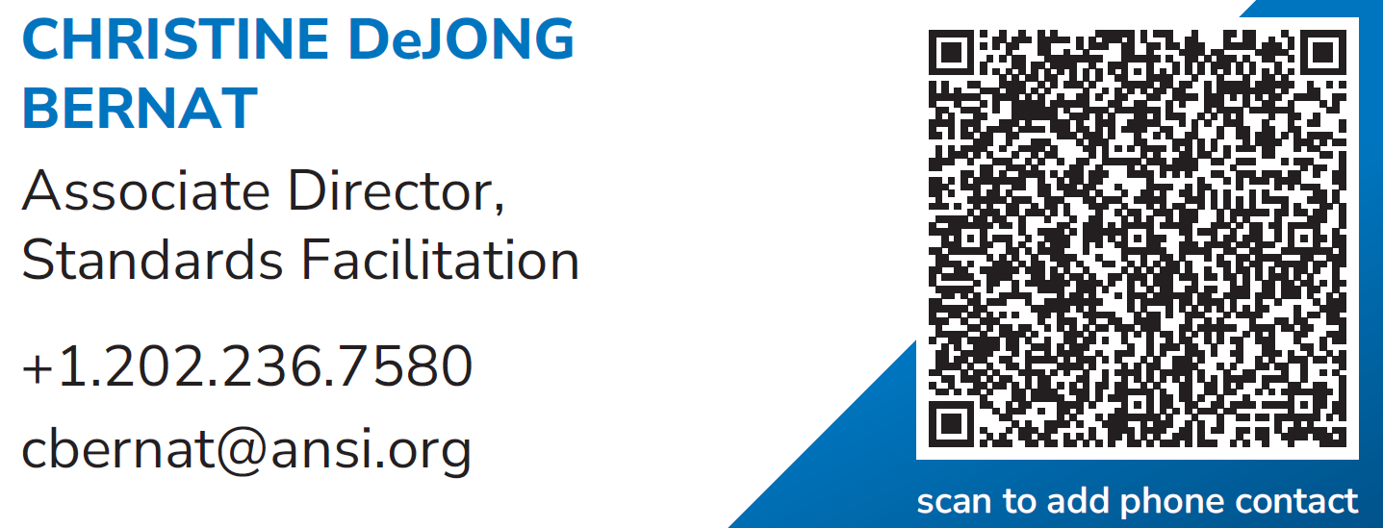
Contact Information

