Slide 1
ANSI’S ROLE IN THE U.S. STANDARDIZATION SYSTEM
AN OVERVIEW

Slide 4
Did You Know?
- U.S. Department of Commerce, International Trade Administration

Slide 5
Standards
are the building blocks of innovation.
They establish the size, shape, or capacity of a product or system. They specify performance of products, processes, or personnel. They may also define terms.

Slide 6
Conformity Assessment
Assures that standards are properly implemented.
By assuring implementation of a standard or other requirements, conformance activities boost consumer trust and confidence in goods, services, people, and systems.

Slide 7
Standards Aren’t Regulations
Regulations are mandatory, top-down rules.
U.S. Standardization is voluntary and relies on private-sector solutions

Slide 8
The U.S. System is Unique
Most countries (top down)
Standards development priorities are driven by government or national standards bodies
U.S. system (bottom up)
Standards development priorities are driven by users and markets

Slide 9
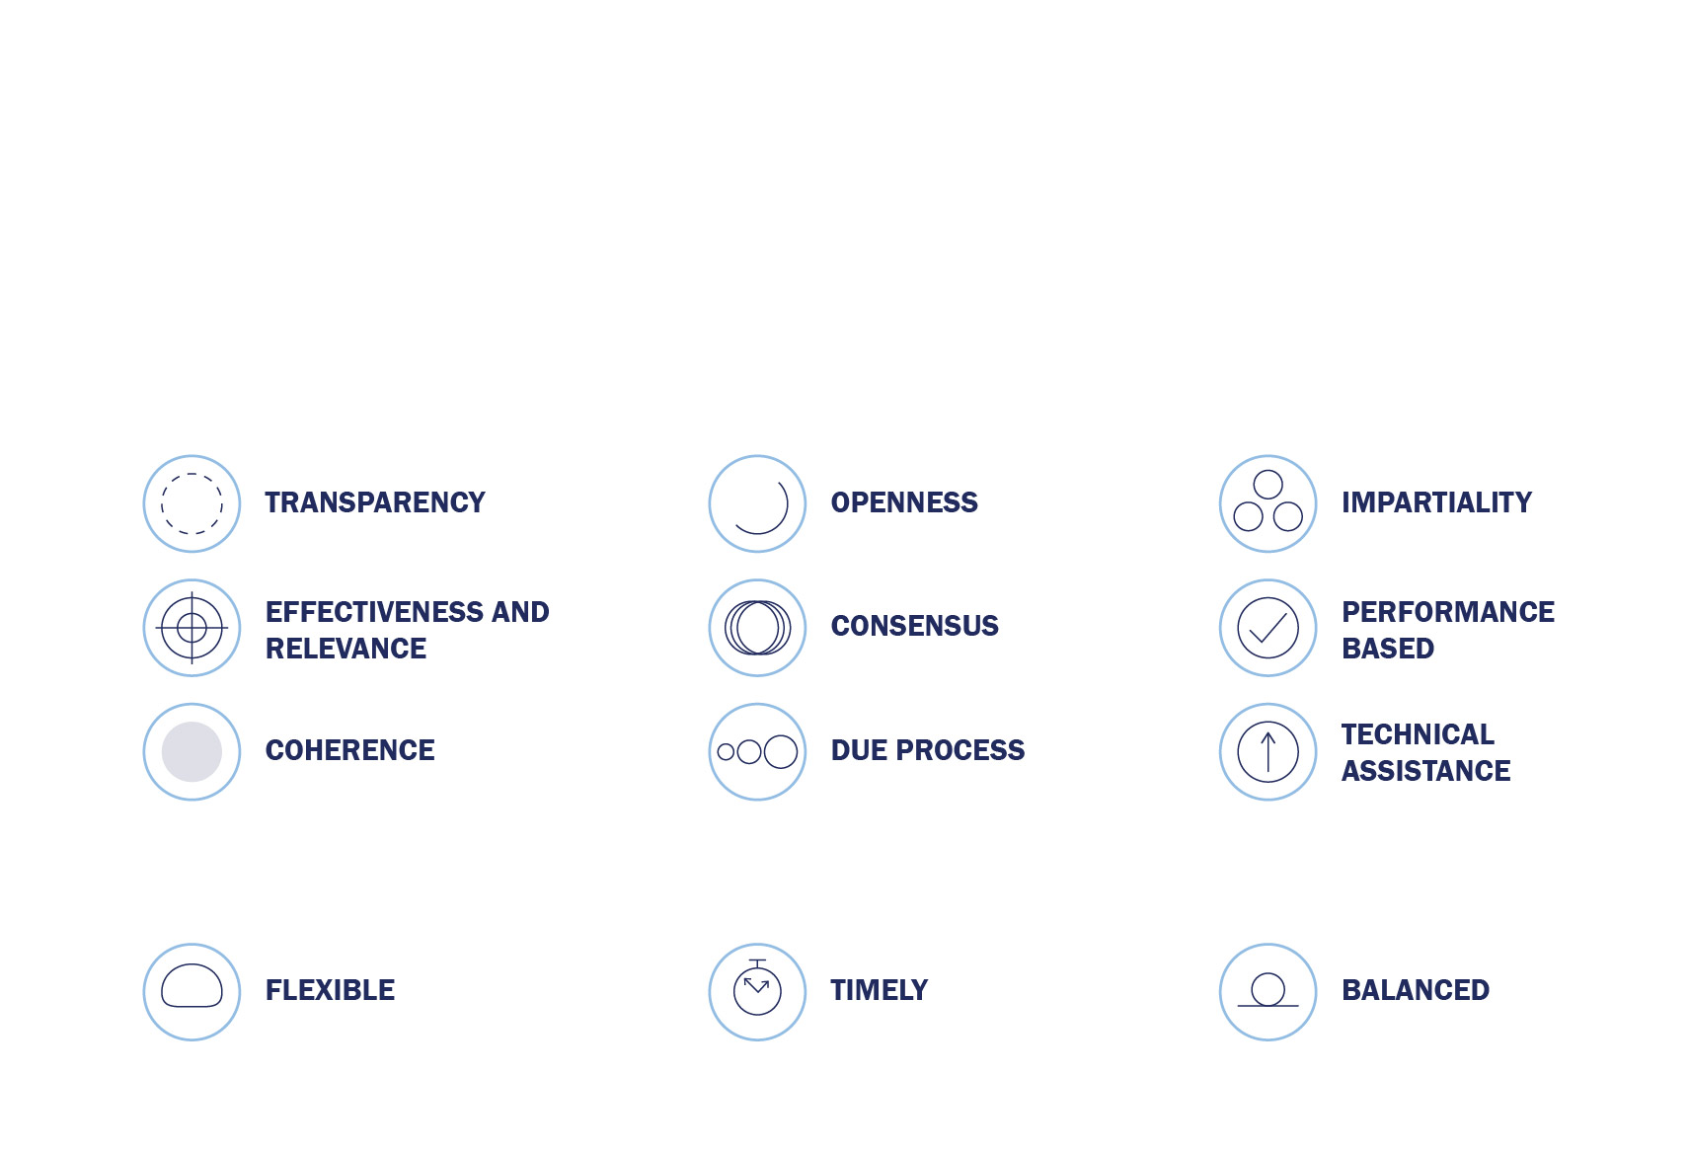
The 12 Principles of Standardization
According to the World Trade Organization (WTO), standards should meet societal and market needs and should not be developed to act as barriers to trade. The U.S. standards system is based upon the following set of globally accepted principles:
In addition, U.S. interests strongly agree that the standardization process should be:

Slide 10
There are more than 100,000 standards in the U.S…
…developed by hundreds of SDOs and consortia…
…with over 13,000 approved as American National Standards.

Slide 11
Standardization: A Global Community
Standards developers and conformity assessment bodies
Commercial and consumer acceptance
Government acceptance

Slide 12
The Public/Private Partnership
The cornerstone of the U.S. standardization system
Government and industry together develop standards to achieve policy objectives.

Slide 13
The Public/Private Partnership
1995 National Technology Transfer and Advancement Act (NTTAA) and
1998 OMB Circular A-119
Encourage government agencies to rely on existing private-sector standards whenever possible

Slide 14
The Public/Private Partnership
Outlines ANSI’s and NIST’s responsibilities in standardization
Recognizes the value of the public/private partnership
Confirms ANSI’s coordinating role in the U.S. standardization system
ANSI has a memorandum of understanding with:

Slide 15
For More Information on the U.S. System
United States Standards Strategy
www.us-standards-strategy.org
United States Conformity Assessment Principles
www.ansi.org/uscap

Slide 16
ANSI AT A GLANCE

Slide 17
ANSI’s Mission
“”
To enhance both the global competitiveness of U.S. business and the U.S. quality of life by promoting and facilitating voluntary consensus standards and conformity assessment systems, and safeguarding their integrity.
“”

Slide 18
ANSI represents and serves the diverse interests of more than 270,000 COMPANIES AND ORGANIZATIONS and 30 MILLION PROFESSIONALS worldwide.

Slide 19
What Does ANSI Do?
Coordinates and ensures the integrity of the standards and conformity assessment system
Represents the U.S. globally
Serves as a bridge between public and private sectors
Provides a neutral forum for coordination
Accredits standards developing organizations and approves American National Standards
Serves as a clearinghouse for information on standards, conformity assessment, and related activities in the U.S. and abroad
Serves as the official U.S. representative in regional and international non-treaty standardization forums
Facilitates access to these forums and programs by U.S. experts, organizations, and industry
Coordinates standards capacity-building programs in developing countries
Promotes U.S. interests

Slide 20
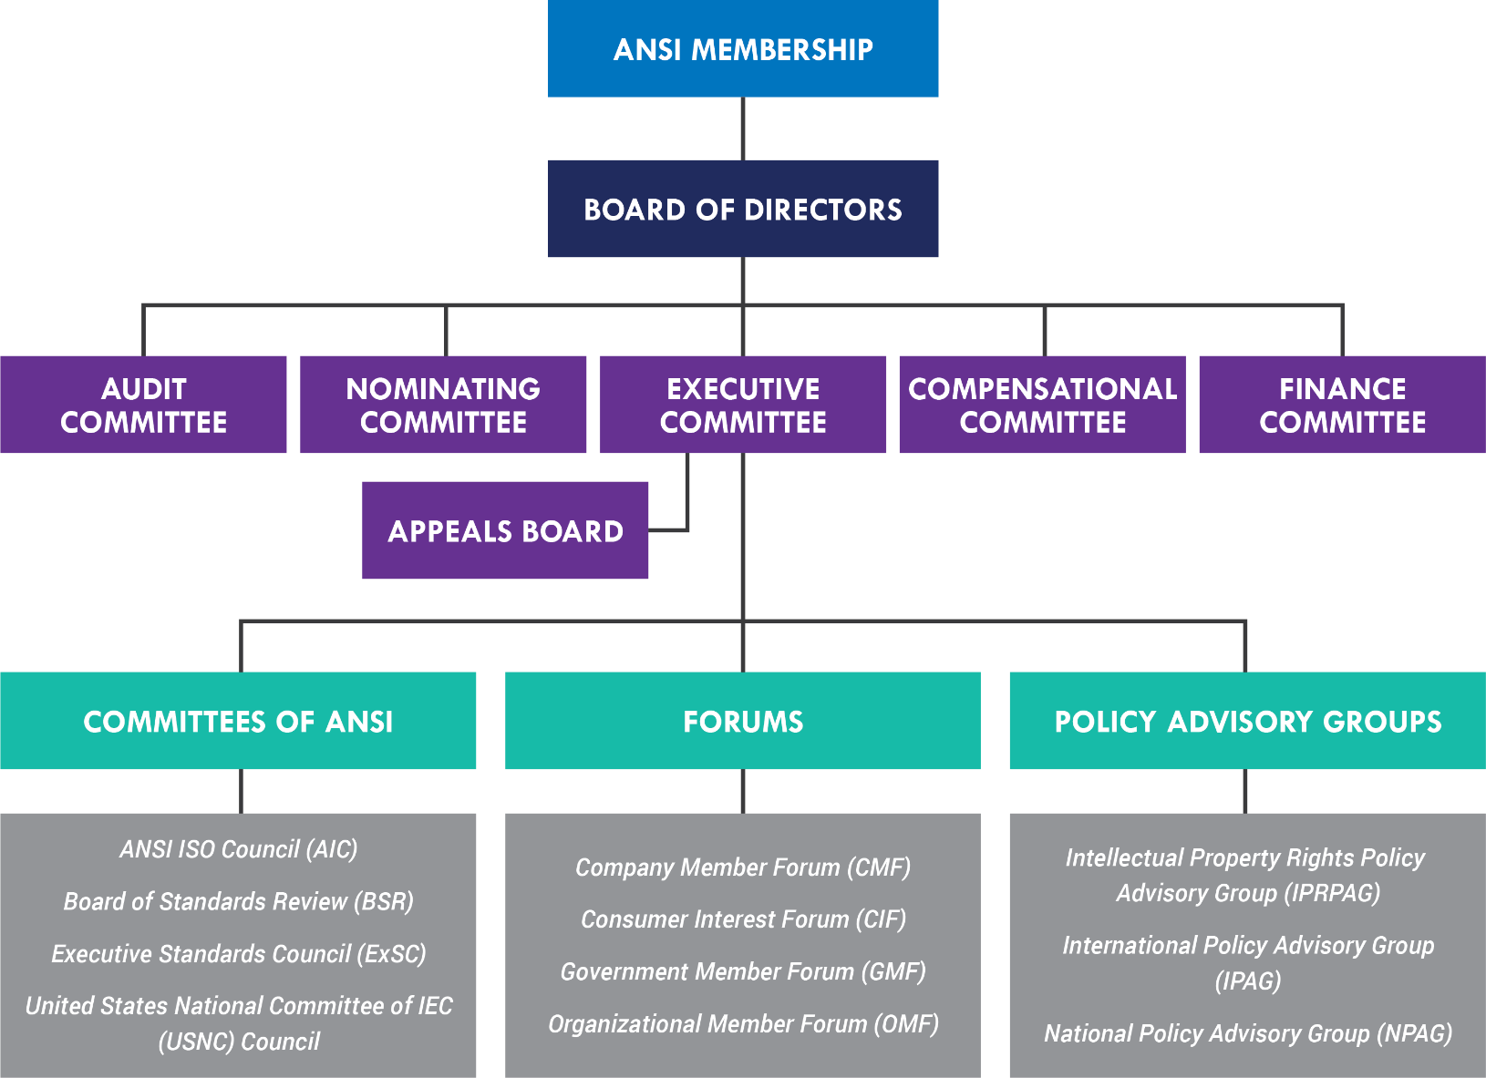
ANSI’s Organizational Structure

Slide 21
ANSI Quick Facts
130+ staff
70+ staff

Slide 22
ANSI Affiliate Organizations

Slide 23
ANSI’S DOMESTIC ROLE

Slide 24
ANSI’s Role as Coordinator
ANSI coordinates, supports, and safeguards the U.S. standards ecosystem.
(We don’t write standards.)

Slide 25
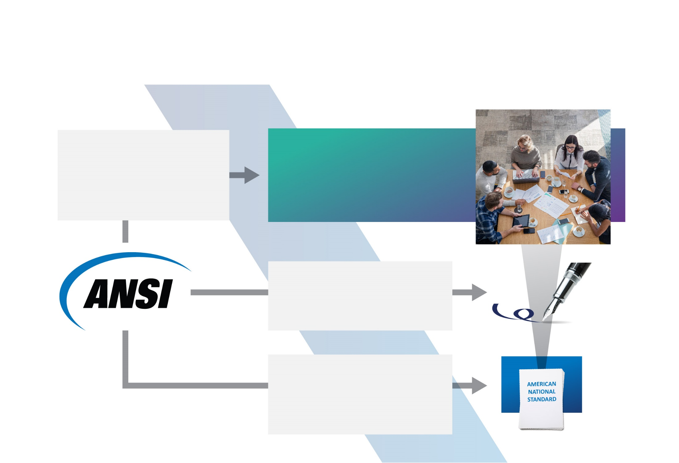
How is an American National Standard (ANS) Developed?
…accredits standards developing organizations (SDOs) as ANSI-accredited standards developers (ASDs)
ANSI-Accredited Standards Developers
…bring together experts to develop the actual standards.
…assures fairness in the standards development process.
…approves standards that follow ANSI’s Essential Requirements as American National Standards (ANS).

Slide 26
What is an ANSI-accredited Standards Developer (ASD)?
An ASD is a standards developing organization that submits to ANSI’s oversight, audit, and an annual compliance review.
Only an ASD can have a standard approved as an ANS.
There are about 240 ANSI-accredited ASDs.

Slide 27
What is an American National Standard?
Standards that are developed by an ANSI-accredited standards developer (ASD) according to ANSI’s Essential Requirements for due process, openness, and consensus can be approved as an ANS.
There are over 13,300 approved ANS.

Slide 28
Standardization Collaboration
One way ANSI coordinates and supports the standardization system is through standards collaboratives and workshops, which:
Bring together the public and private sector in a neutral forum
Identify current and in-development standards, where gaps exists, and recommend solutions
Identify organizations that can perform the needed work

Slide 29
Standardization Collaboratives and Workshops
Collaboratives: Advance cross-sector coordination in the standards and conformance programs needed to support and grow emerging technologies and markets
Workshops: Convene stakeholders for targeted workshops to identify potential areas for standards coordination and propose appropriate activities (which may evolve into a collaborative)

Slide 30
Previous Collaboratives and Workshops

Slide 31
Education and Training
ANSI’s education and training services are designed to:

Slide 32
Education and Training

Slide 33
ANSI’s Role in Conformity Assessment
ANSI plays a coordinating role in conformity assessment.
—an affiliate of ANSI—plays a performing role in conformity assessment.

Slide 34
Access to Standards
ANSI’s online store provides access to over half a million active and historic standards from more than 130 publishers: webstore.ansi.org
Individual Standards
Standards Packages
Standards Connect
Order an electronic PDF or hard copy of a single standard
Order a pre-bundled collection of standards with over 350 packages to choose from
A custom, multi-user service that offers easily managed, online access to standards, quick collaboration, and sharing

Slide 35
Still Have Questions?
You can find the answers to many of your questions about ANSI and the standardization system on the ANSI FAQ page.

Slide 36
ANSI’S INTERNATIONAL ROLE

Slide 37
Representing the U.S. Globally
ANSI serves as the official U.S. representative in regional and non-treaty international standardization forums,
coordinates capacity-building programs in developing nations,
and promotes U.S. interests abroad.

Slide 38
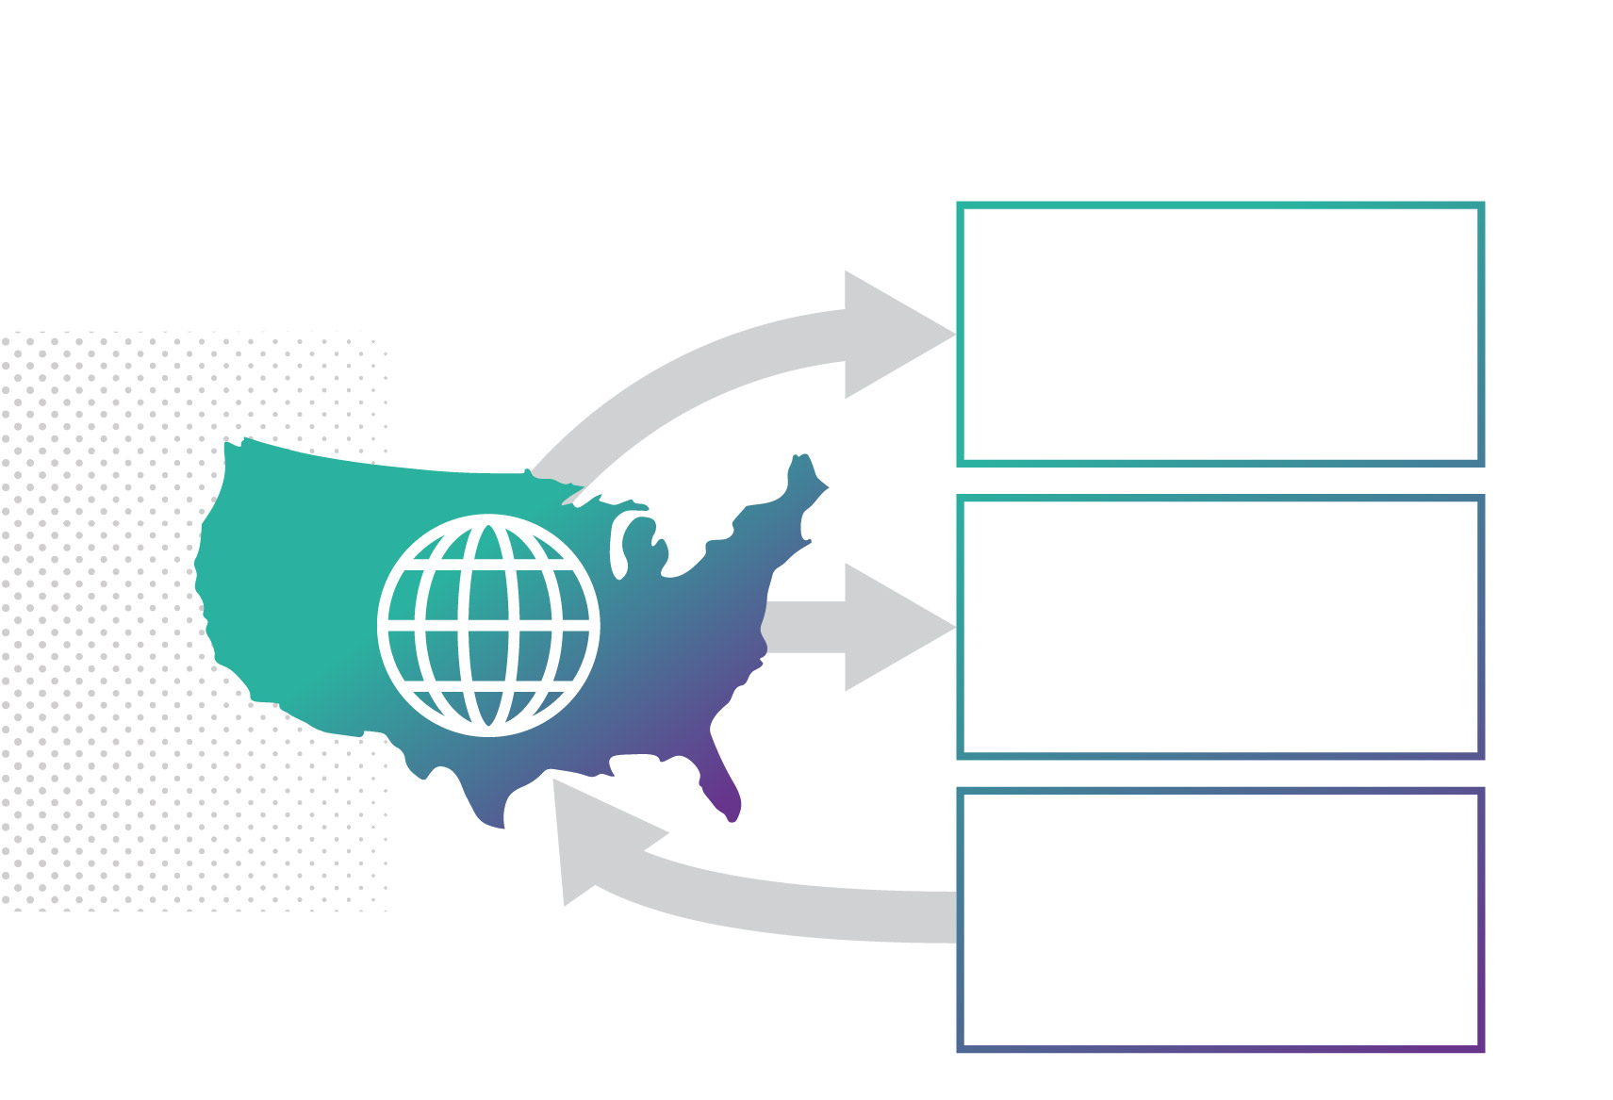
The U.S. Role in International Standardization
ASSURE that U.S. policy and technical positions are accepted by international and regional standards organizations
SUBMIT standards for adoption as regional or International Standards
ADOPT International Standards as American National Standards when they meet the needs of U.S. users

Slide 39
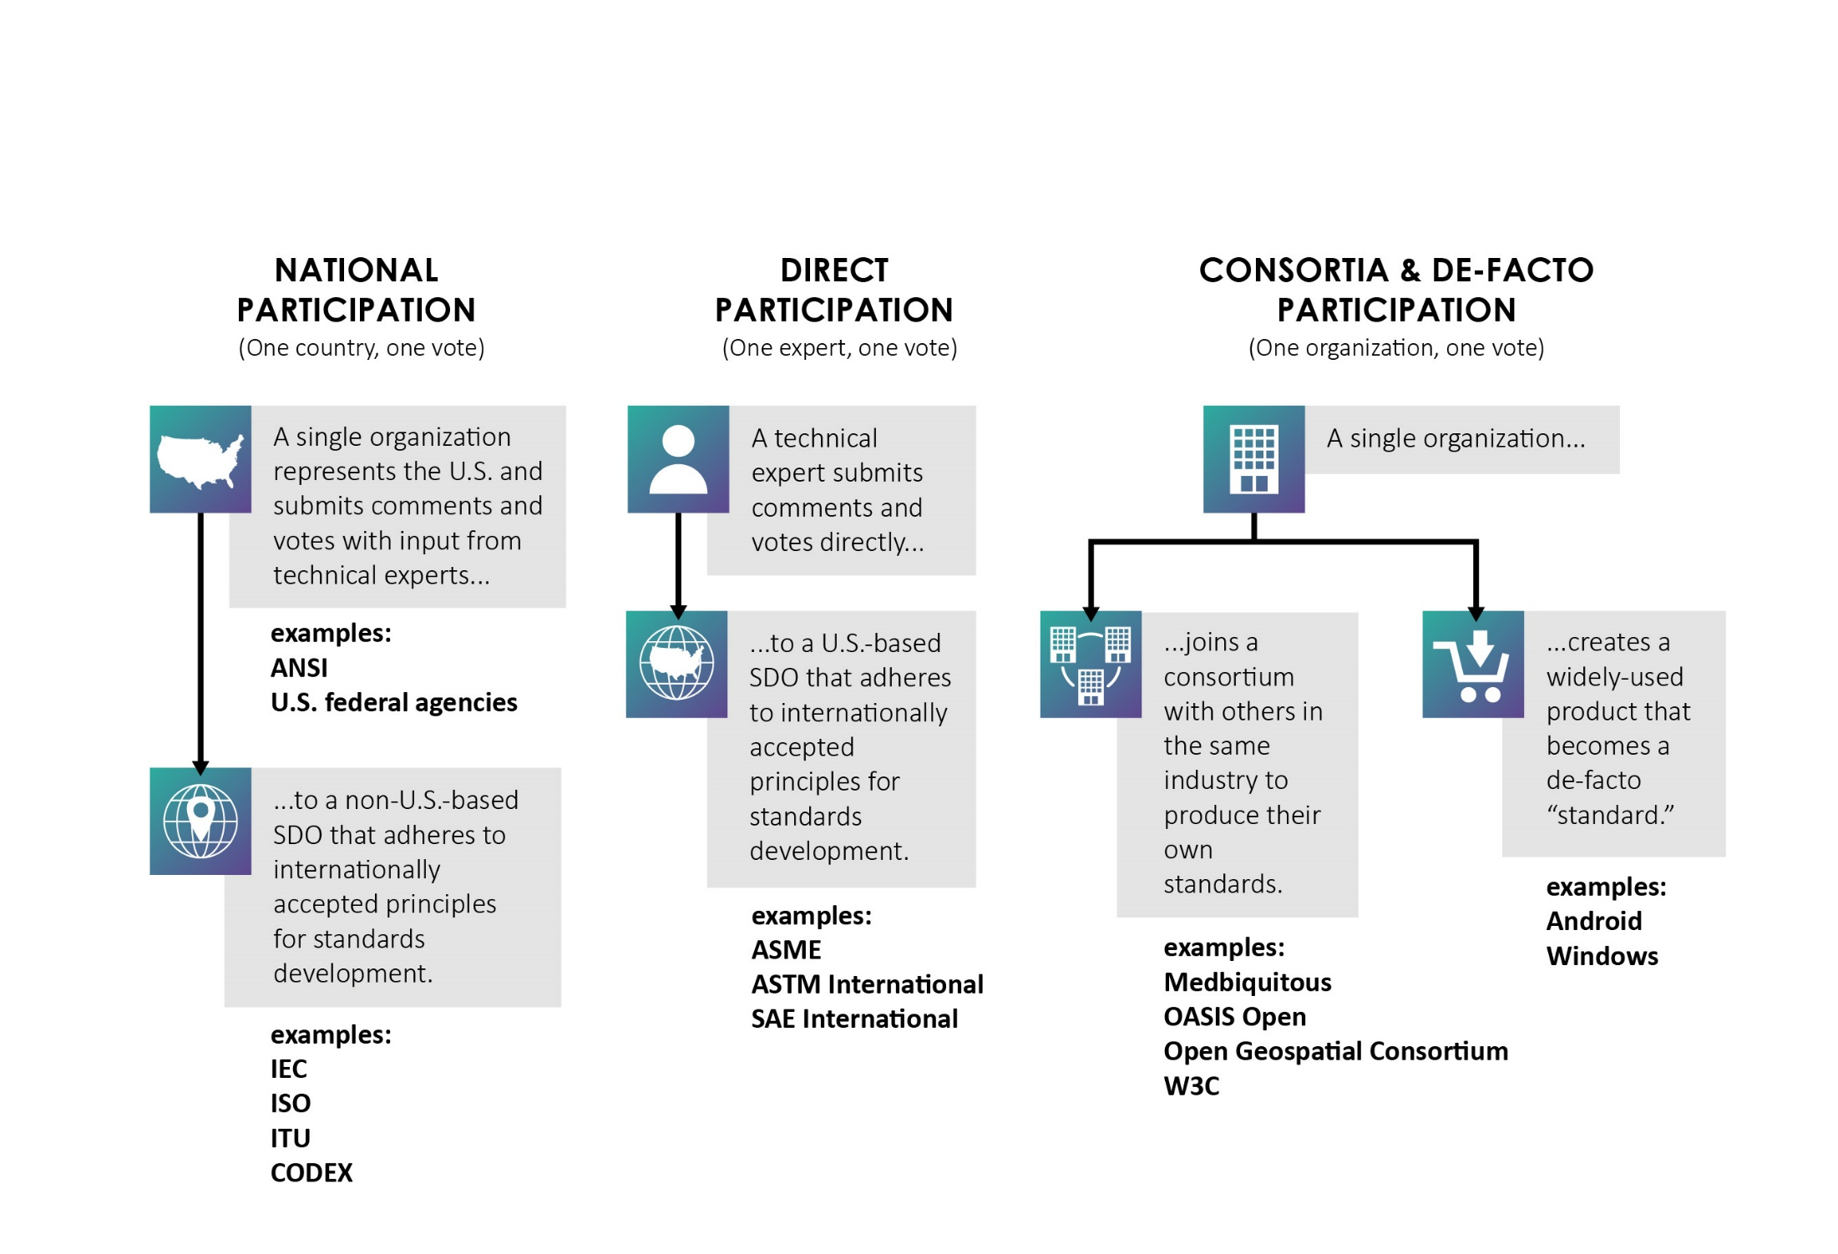
Pathways to Globally Relevant Standards

Slide 40
National Participation
IEC and ISO are global organizations whose members are national standards bodies. ANSI serves as the U.S. national member body to ISO and to IEC via the U.S. National Committee

Slide 41
National Participation
ANSI represents the U.S. in a “one country, one vote” system:
Participates in nearly 75% of total ISO Technical Committees and Subcommittees
One of 6 permanent members to the ISO Council of 20
One of 6 permanent members to the Technical Management Board of 15

Slide 42
National Participation
ANSI represents the U.S. in a “one country, one vote” system:
Participates in 90% of total IEC Technical Committees/Subcommittees
One of 6 permanent members of the IEC Board of 15
One of 7 permanent members of the Standardization Management Board of 15

Slide 43
National Participation
Joint Technical Committee 1 (JTC 1) is the only joint technical committee between ISO and IEC. It develops standards that support information and communications technology advancement and has published more than 3,300 standards.
ANSI serves as the JTC 1 Secretariat, with 37 other national bodies participating

Slide 44
Participating (“P”) Memberships
“P” Members of ISO and IEC committees can:
Propose new work items
Submit votes and/or comments on all matters coming before the committee
Offer candidates for leadership positions
Send delegations or accredited experts to meetings
Host meetings of the committee

Slide 45
Observer (“O”) Memberships
“O” Members of ISO and IEC committees can:
Monitor the technical work
Attend meetings and receive and comment on documents
All national bodies irrespective of their status within a TC or SC have the right to vote on enquiry drafts and on final draft International Standards. It is generally ANSI's policy, however, not to vote on enquiry drafts if there is no U.S. TAG.

Slide 46
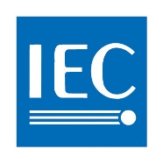
ANSI Engagement with non-U.S. Standardization Bodies
International Bodies
National Bodies (ANSI Peers)
Regional Bodies
European Standardization Organizations (ESOs)
… among others
… among others

Slide 47
Capacity Building
ANSI’s international development work helps nations throughout South America, Africa, and Asia build capacity in sanitation, telecommunications, clean energy, healthcare, and more.

Slide 48
Capacity Building

Slide 49
U.S.-China Program
Provides insight to ANSI members about key standards developments in China
Advances the public/private partnership in U.S.-China commerce
Empowers ANSI members to engage effectively with their Chinese counterparts
Addresses concerns common to the U.S. and Chinese markets together

Slide 50
ANSI MEMBERSHIP

Slide 51
Why ANSI Membership?
Standardization decisions impact your entire industry.
ANSI membership gives you a seat at the table.

Slide 52
Benefits of ANSI Membership
Engagement and partnership across the standards community
Opportunities to influence U.S. and ANSI positions and policies
Access to market intelligence, news, and standardization guidance
Recognition and promotion as an ANSI member

Slide 53
Who’s an ANSI Member?
View a complete, up-to-date roster of ANSI members on our website
Every month, ANSI hosts an overview webinar for those interested in becoming a member.

Slide 54
Learn more
ansi.org ansi.org/membership ansi.org/usnc webstore.ansi.org
workcred.org
anab.org

