Slide 1
The Importance of Robust U.S. Participation in Standardization Activities
FOR GOVERNMENT STAKEHOLDERS

Slide 2
Standardization, in a Nutshell
STANDARDIZATION = Standards + Conformity Assessment
Product, service, management system, etc.
INCREASED TRUST AND VALUE
STANDARDS
Voluntary guidelines on how to design, manage, or create materials, products, processes, and services
Created by experts from industry, government, consumers, academia, and others—all working together
CONFORMITY ASSESSMENT
Verification that the standard was actually met
Instills confidence in the widespread use of products, personnel, services, and systems

Slide 3
Why is Standardization Important?
Standardization is essential to growing the national economy, and vital to:
U.S. innovation
Competitiveness
National security
Public health and safety
†Source: U.S. Department of Commerce, International Trade Administration

Slide 4
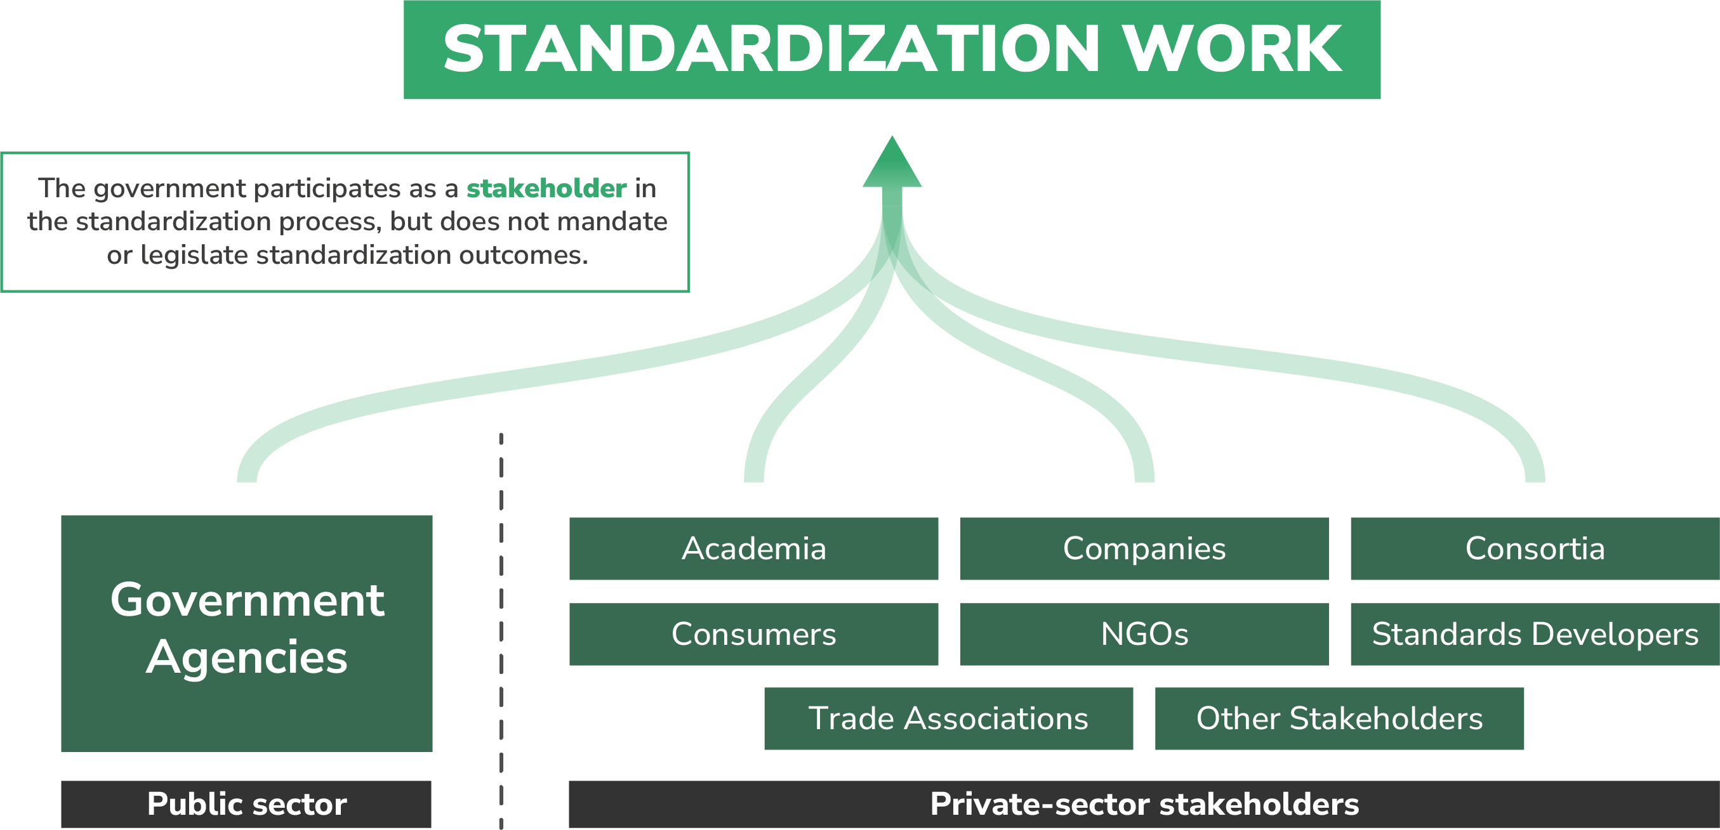
U.S. Standardization System
The U.S. system is market driven and private-sector led, with active participation from all affected stakeholders, including government.
The public/private partnership is the cornerstone of the U.S. standardization system.
Government policy directs agencies to rely on and participate in the development of private-sector standards whenever possible.†
†National Technology Transfer and Advancement Act (NTTAA) and OMB Circular A-119

Slide 5
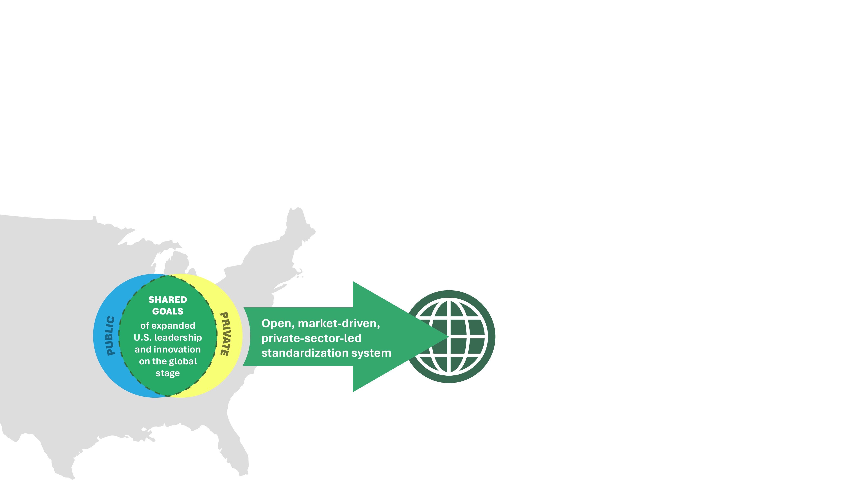
Our Common Goals
Our nation’s open, market-driven, and private-sector-led system is critical to achieving the widely shared policy goals of expanded U.S. leadership and innovation on the global stage.
This enables the U.S. to deliver responsive, globally relevant solutions in new and innovative technologies.

Slide 6
How Standards Boost Business

Slide 7
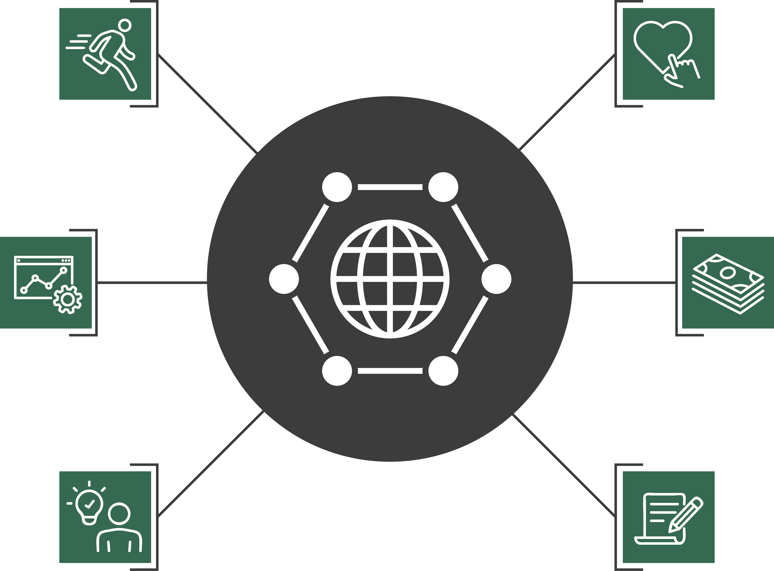
How Can Standards Boost Business?
Consumer confidence, trust, and loyalty
Competitiveness
Market access and trade
Efficiency and cost savings
Inform, complement, or serve in lieu of regulation
Innovation and R&D

Slide 8
Competitiveness
Organizations participating in standards development….
Gain critical knowledge, information, and professional skills
Proactively shape standards’ technical content
Collaborate with public and private stakeholders whose input impacts our sector
Position products, services, and technologies for access to new and existing markets

Slide 9
Efficiency and Cost Savings
Standardization saves time and money by:
+
IMPROVING
–
REDUCING
Safety
Duplication of efforts
Operational efficiency
Errors
ROI
Time to market
Reliability
Cost
Quality
Risk
Supply-chain management

Slide 10
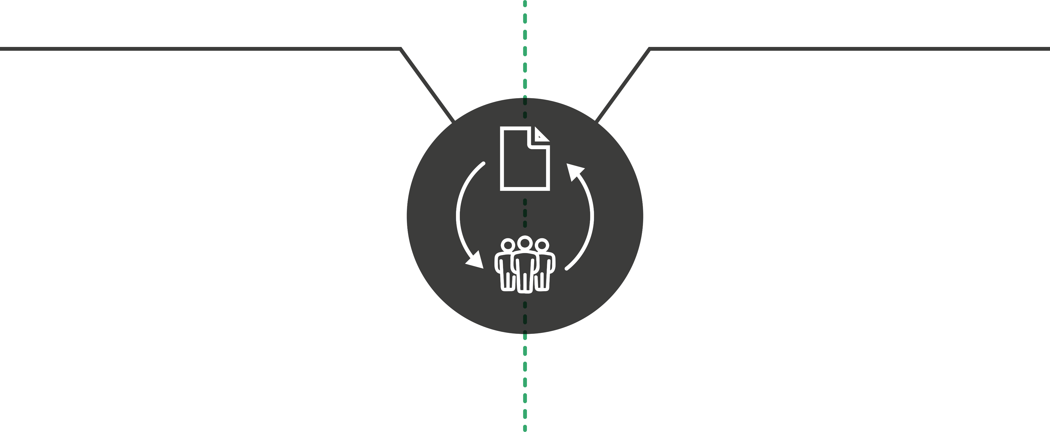
Innovation and R&D
INCORPORATING EXISTING STANDARDS INTO OUR ORGANIZATION
GETTING INVOLVED IN THE STANDARDIZATION PROCESS
Reduces time for introducing new products to market by building on previously standardized technologies and methodologies
Lowers some R&D costs
Shortens the cycle of product development
Builds on the foundation for innovation that standards provide
Gains knowledge to inform new and evolving products, services, and technologies
Directly influences the requirements and guidelines for new products
Increases awareness about additional R&D needs

Slide 11
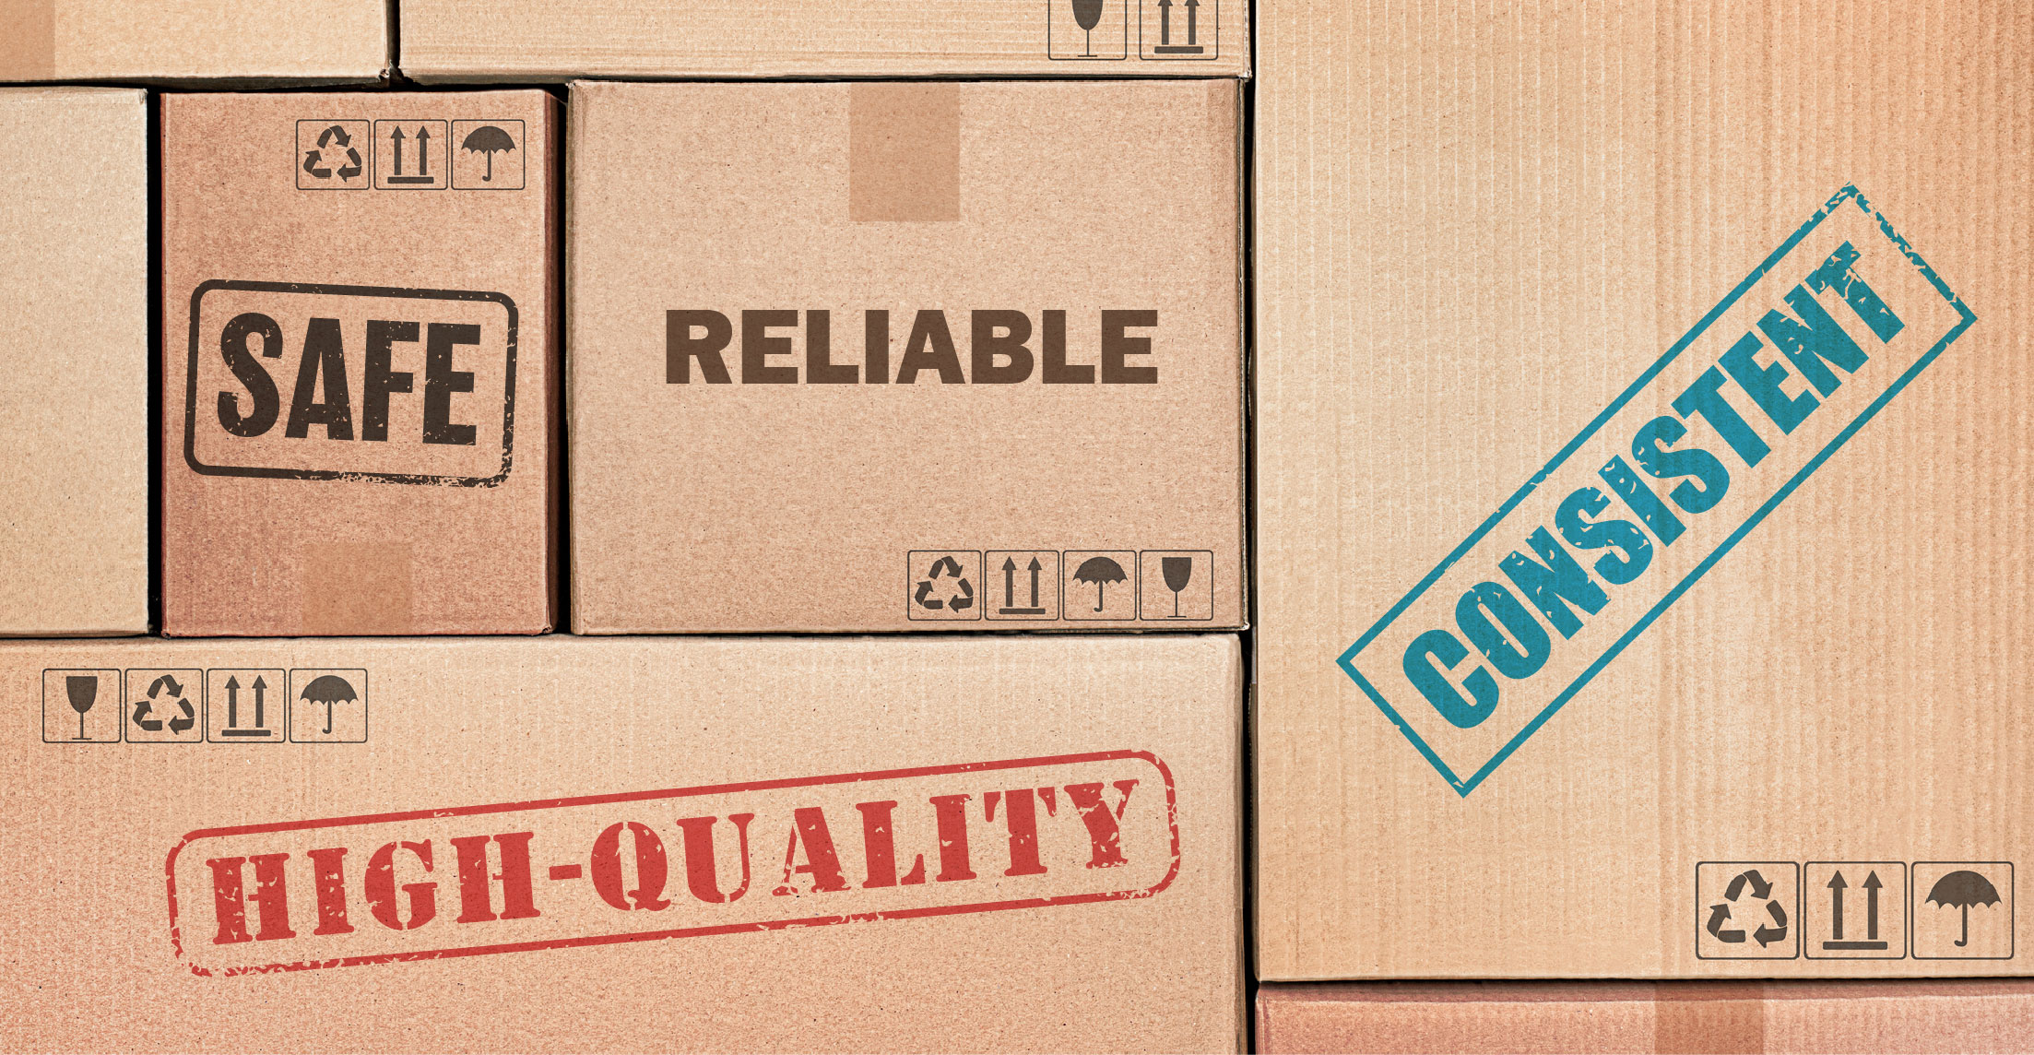
Consumer Confidence, Trust, and Loyalty
Consumers want products that are…
…with a greater selection and at lower cost.
Standardization helps make this possible!
Standardization benefits public health, safety, and the environment, and gives customers confidence in the products they purchase.
Products that take these needs into account are more likely to be accepted into the marketplace.

Slide 12
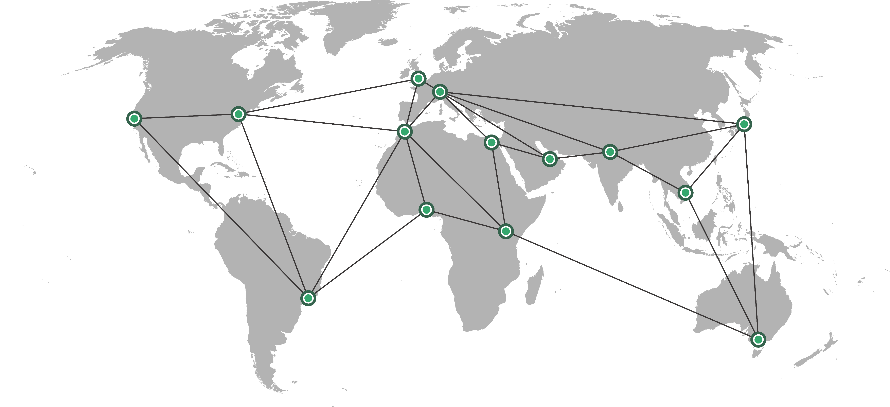
Market Access and Trade
Standardization is inextricably linked to all levels of the supply chain.
Standardization enables interoperability, the backbone of globalized trade.
Standardization fosters innovation and shortens the cycle from concept to global market access.
Standardization breaks down technical barriers to trade when following WTO principles.

Slide 13
Inform, complement, or serve in lieu of regulation
Standards can be an alternative to, inform, or supplement regulation.
The U.S. private-sector-led system:
saves the government time and money,
fuels U.S. competitiveness in critical and emerging technologies, and
protects the health and safety of the American people.

Slide 14
Supporting Participation in the U.S. Standardization System

Slide 15
How the USG Can Support Robust Participation
Encourage and support participation of government subject matter experts in private sector standards development work, especially in priority areas
Enhance communication and coordination with the private sector on standards-related matters
Designate clear points of contact within each relevant agency to liaise with the private sector
Enhance standards coordination across the federal government at both the technical and policy levels
Provide education and training to staff on private sector standards processes and the importance of engaging as stakeholders
Maintain commitment to the multiple path approach to global standards
Provide strong and sustained funding for R&D
Champion the open, rules-based system and adherence to WTO TBT principles

Slide 16
Appendix

Slide 17
Case Study: Bentley Motors
Challenge: Modernizing their procedures in the historic building that has housed their entire operation since 1938.
Solution: Implemented ISO 50001, Energy Management Systems and ISO 14001, Environmental Management Systems
Impact: Reduced energy use by 66% for each car produced, and 14% for the entire plant. Saved enough energy to power 11,500 houses for a year.
Source: Bentley and ISO

Slide 18
For More Information
<Employee name>
<Employee title>
<email>@ansi.org
www.ansi.org
webstore.ansi.org

