Slide 1

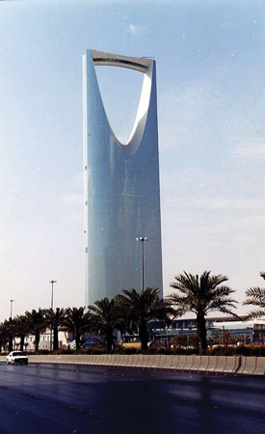
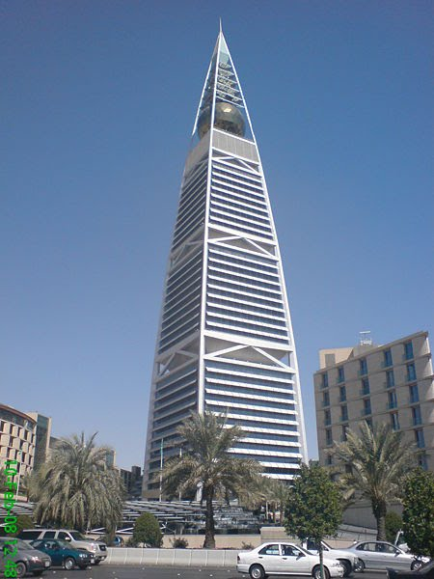

Presentation to ANSI

Slide 2

Saudi Standards, Metrology
and Quality Organization
Meeting between SASO and ANSI
Washington D. C. - Fri Oct 22, 2010
SASO and its Role
in Saudi Arabia
By: Nabil A. Molla - SASO Governor

Slide 3
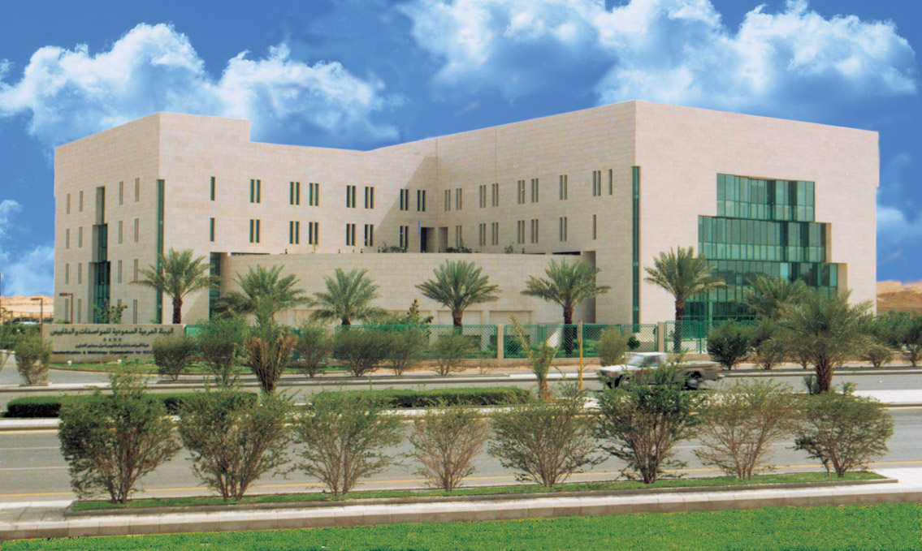

Saudi Standards, Metrology
and Quality Organization
SASO Headquarter in Riyadh, Saudi Arabia

Slide 4
Brief History
SASO was established in 1972 as an Independent Governmental Body Responsible for all Standardization Activities, under the Name of Saudi Arabian Standards Org. (SASO)
In Feb, 2009, SASO Name has been changed to Saudi Standards, Metrology, and Quality Org.(SASO), by a Ministerial Council Decision. As well as the title of the Director General of SASO to Governor of SASO.

Slide 5
SASO Organization Chart
Board of Directors
King Abdul Aziz
Quality Award
SASO Governor
- - - -
Saudi Accreditation
Committee (SAC)
Quality Control G.D.
Vice Governor
Standards G.D.
*In addition to some Supportive Depts
Adm. and Finance G.D.
Laboratories G.D.
Info. Technology G.D.
Conformity Assessment G.D
National Measurement & Calibration Center (NMCC)
Int’l Cooperation G.D.
Makkah Province Branch
Eastern Province Branch
Jizan Province Branch
Tubook Province Branch

Slide 6
Board of Directors
SASO Board of Directors , is chaired by H.E. the Minister of Commerce and Industry (MOCI), Composed of (14) Representatives from the major Concerned Government and Private Sectors

Slide 7
Board of Directors Responsibilities
Outlines the general policy of SASO.
Approve all the procedures needed to ensure efficient performance of SASO assignments.
Approve the National Standards and Technical Regulations (TR’s).
Approve the National Conformity Assessment Procedures.

Slide 8
Vision and Mission
SASO Vision
To be a Distinguished Body in all fields of Standardization and Quality at the National, Regional and International levels.
SASO Mission
To Protect the Consumer and to Ensure the Public Interest by Issuing and Applying the Standards and Quality Systems.

Slide 9
SASO Responsibilities
Preparation, approval and Publishing of National Standards and Technical Regulations relating to products, measurement, metrology, calibration, marking, sampling, inspection, testing, symbols, definitions, etc.
Promoting awareness for standardization.
Setting up rules for implementing & granting Certificate of Conformity, Quality Mark, QMS, Conformity Assessment, according to its applicable regulations, etc.

Slide 10
SASO Responsibilities – Cont.
Operate King Abdulaziz Quality Award (KAQA)
Operate the National Measurement & Calibration Center (NMCC)
In Charge of Notifications to the WTO/TBT.
Enquiry Point for WTO/TBT.
Participation in the Regional and International Organizations.

Slide 11
SASO at the Regional and International Level
Full Member of the following Orgs. :
GSO Gulf Standardization Organization for (GCC).
AIDMO Arab Industrial Development and Mining.
ISO International Organization for Standardization.
IEC International Electrotechnical Commission.
IECEE Conformity Assessment arm of IEC, CB Scheme.
CAC Codex Alementarious Commission.
OIML International Organization of Legal Metrology.
BIPM Int’l Committee for Weights and Measures
(Meter Convention)
** SASO is an Affiliate Member in ILAC

Slide 12
SASO and the IEC & IECEE
SASO became a full member in IEC in 1998
and SNEC was formed.
SASO Adapted most IEC relevant standards.
Saudi Building Code adopted IEC Standards.
SASO became an IECEE Member Body in Nov. 2007.
Saudi NCB was accepted in the IECEE CB Scheme to operate as a Recognizing NCB, in Aug. 2009.

Slide 13


Saudi NC of the IEC

Slide 14

SNEC in Brief
Saudi Standards, Metrology and Quality Org. (SASO) joined the IEC in 1998, which lead to the formation of the Saudi National Electrotechnical Committee (SNEC).
SNEC is active in the international and national standards development.
Coordinate the concerned national bodies interest and involvement in the activities of local and International Electrotechnical standards development and follow up.
Challenges:
  Enhancing the influence of concerned stakeholders and experts, to actively be involved in the standards development, locally and internationally.
  Effectively Communicate of standardization projects to capture broader stakeholder views.

Slide 15
Saudi Technical Council
Of Standards
Headed by SASO Governor
To be a member of the Technical Council of Standards, must be:
  Enjoying a sound technical background in the electrotechnical field.
  Have a management position in his organization.
  Have a decision-making power in matters addressed by the Council.
  Able to transfer the point of view of his organization.
Technical Council of Electrotechnical Standards Consists of (16) sixteen members, Gov. & Private Sector, plus the President .

Slide 16
Saudi Technical Council
Of Standards - Tasks
Follow-up activities and procedures for Standardization in KSA
To approve budgets and plans and comprehensive programs proposed by SNEC secretariat.
Follow-up SNEC programs and performance to ensure proper implementation by the Secretariat.
Organizing and coordinating the planning and management of all activities especially the following:
  The adoption of the formation of technical committees and subcommittees
  Presidents and Trustees the adoption of the technical committees and subcommittees
  Adoption of the field work, programs and plans of the technical committees and subcommittees

Slide 17
Saudi Technical Council
Of Standards – Tasks- Cont.
Review and approve the long-term plans and annual reports of the standard specifications projects submitted by SBEC Secretary.
Follow-up technical achievements and the work of all committees to take the right decision to improve the performance of the functions of these committees.
Adoption of standard specifications projects, to be approve by SASO’s Board of Directors.
Adoption of the regulations and procedures of standard specifications for electrical products to be approve by SASO’s Board of Directors.
Suggest to participate in the national, regional bodies or international cooperation programs related to standardization.
The implementation of tasks assigned by the president of SNEC.

Slide 18
Categories
of memberships
SNEC developed and established working relation with concerned parties in the Government and Private sector and others to encourage their experts participation in the activities of national and international standardization.
There are three main categories of memberships in SNEC:
    Founding member
    Participant Member
    Affiliate Member

Slide 19


Saudi Quality Mark
SASO Issue its license to use the Saudi Quality Mark on product by product basis. Interested manufacturers, local
or international, must meet certain criteria and will be periodically inspected. Products must comply with relevant SASO standards or TR’s. Such mark will ease & speed clearance at the KSA ports of entrées.
Old Logo
New Logo
Notes:
19

Slide 20
SASO in Figures
About 650 Employees working in SASO.
Developed and adapted More than 20,500 Standards and Technical Regulations.
230 factories granted the Saudi Quality Mark (20 in the gulf region, 10 in Egypt, one in china).
38 Laboratories. have been Accredited by the Saudi Accreditation Committee ( SAC).
Testing about 6,000 samples annually.

Slide 21
SASO in Figures – Cont.
Issuing about 400 food products Validity Certificates for Export purposes.
14 Mutual Recognition Programs, signed.
5 Recognition Programs (of CoC’s), signed.
About 23 Technical Cooperation Programs, signed with different Standards Orgs.
P-member or O-member of Several International ISO/IEC TC/SC.
Organize/participate in Conferences, Workshops, Seminars and Training Courses at National, Regional and International Levels.

Slide 22
SASO cooperation with
US Standards Org.’s
SASO cooperation with US Standards Organizations, goes back to more than 20 years.
As SASO used to host GSO (Formally GSMO), an MOU was signed with NIST in March 1996; one of the achievements of this MOU was organizing 6 training courses in the US.

Slide 23
SASO cooperation with
US Standards Org.’s – Cont.
SASO established a good working relation & cooperation with key US private organizations and Government agencies in several aspects of standardization and related technologies & activities.
Several MOU’s were signed and put into effect which assisted SASO in its various programs including experts visits, training, jointly sponsored workshops, etc. SASO signed MOU’s with NIST, ASTM, ANSI, NFPA, ASHRAE, ASME, UL, AHRI and more to come.

Slide 24
SAUDI Building Code (SBC)
& US Standards
First Saudi Building Code (SBC), was based on the International Code Council (ICC) set of Codes.
Most of the adopted standards & codes (about 1000) were issued by around 80 US Standards Developing Organizations (SDO’s), about 13 of them are US Government Agencies.
SASO is pleased with the great and direct interest shown by most of US SDO’s
SBC applied IEC Standards for all Electrical installations, which are adopted by SASO.

Slide 25
Further Cooperation with
US Standards Organizations
SASO is always welling to consider and welcome any opportunity to cooperation with US standards organizations
This is of course depends on the added value introduced, which can be realistically integrated and applied in SASO activities and programs.

Slide 26
SASO Role in Certification
Based on our mission, one of SASO major concerns is to ensure the safety of the users of Electrical and other products, imported or locally manufactured.
To achieve this goal, standards and TR’s were developed in house, based on some Int’l Standards (e.g. ISO/IEC, UL, IEEE) and adopted many IEC, ISO and U.S. Standards in various fields.

Slide 27
Who are involved?
SASO is in close contact and coordination with other concerned Government Org.’s. as far as Conformity Assessment Procedures, including Clearance of imported Products.
MOCI role is in setting up the importing regulations and Market surveillance.
The Customs has a key role in inspection and clearance of imported products.

Slide 28
Who are involved? & How?
The Customs is responsible about applying the measures and programs set up by SASO in coordination with MOCI, regarding certification and mechanism of goods clearance at the points of entrees.
SASO Labs is involved in testing imported and local products.
Private Labs are utilized in testing and verifying that CoC’s are accurate, before products clearance.

Slide 29
Who are involved? & How?- Cont.
Following the WTO Rules, all concerned parties will not reject any shipment unless there are enough justifying evidence.
If a shipment arrives KSA without a CoC or accompanied with non-trustable CoC, will not be rejected, unless it fails local full scale testing.
The Customs accepts and treat imported Products through 5 Mechanisms.

Slide 30

Saudi Customs Clearance Mechanisms
(1) Saudi Quality Mark
If the electrical Products bears The Saudi Quality Mark, the Customs will review the accompanied documents and check the validity of SASO license, if the Mark proved to be original, the Customs will clear the shipment without local testing.
In some cases the Customs might apply random testing, as they see appropriate.

Slide 31
Saudi Customs Clearance Mechanisms
(2) CoC issued by Accredited Lab/Certifier
If the Products accompanied by CoC based on the form, published in the MOCI website, the Customs will review the CoC and if proved to be original and accurate, the shipment will be cleared.
In some cases the Customs might apply random testing, as they see appropriate.

Slide 32
Saudi Customs Clearance Mechanisms
(3) CoC issued under a valid Mutual Recognition Program (MRP)
If the Products accompanied by CoC issued under a current MRP, the Customs will examine the CoC and have SASO verify that it is real and if proved to be original and accurate, the shipment will be cleared.
In some cases the Customs might apply random testing, as they see appropriate.

Slide 33
Saudi Customs Clearance Mechanisms
(4) CoC issued under a valid Recognition Program of CoC (RP)
If the Products accompanied by CoC issued under a current RP, the Customs will examine the CoC and have SASO verify that it is real and if proved to be original and accurate, the shipment will be cleared.
In some cases the Customs might apply random testing, as they see appropriate.

Slide 34
Saudi Customs Clearance Mechanisms
(5) CBTR & CBTC issued under IECEE CB Scheme – Only for Electrical products.
If the electrical Products accompanied by CBTR & CBTC, the Customs will examine the document and have Saudi NCB verify that it is real from IECEE website and the CBTR is acceptable, the shipment will be cleared.
In some cases the Customs might apply random testing, as they see appropriate.

Slide 35
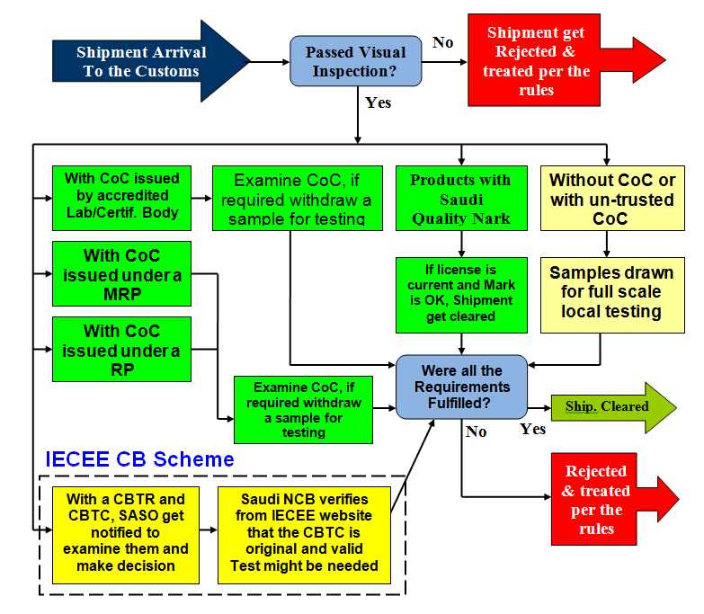
Saudi Customs Clearance Mechanisms, Summarized
1
0
2
1
3
1
4
31
5
31

Slide 36
SASO
Mutual Recognition Programs
Mechanism to Facilitate Trade
Saudi Standards, Metrology
and Quality Organization

Slide 37
Conformity Assessment (CA) through MRP’s & RP’s
CA gives confidence to users, that goods & services meet all requirements in relevant standards or Technical Regulation.
WTO encourages members to sign Mutual Recognition Agreements and the acceptance of one another's conformity assessment procedures.
SASO established its own Programs to implement CA Procedures which achieve the confidence needed by the Consumers and to fulfill WTO/TBT requirements.

Slide 38
Conformity Assessment (CA) through MRP’s & RP’s
These Recognition and Acceptance Programs can be based on:
  Government-to-Government (G2G) – MRP’s
  Government-to-Private Bodies (G2P) – RP’s
  Multilateral Agreements - IECEE CB Scheme
As now days testing & certification are normally done by specialized Bodies outside the importing countries, these Countries spent every effort to ensure that CoC’s are not fake.

Slide 39
Why MRP’s & RP’s ?
MRP’s and RP’s are increasingly popular mechanisms worldwide, for satisfying both sides of the manufacturer/buyer equation.
Lack of confidence in CoC’s
Spread of fake CoC’s.
Presuming & Ideally products tested somewhere according to MRP or RP are accepted and cleared without retesting.

Slide 40
Benefits
Enhance and support the economical and commercial relation between countries.
Protect the consumer, and the local market from non-conforming and fraud products.
Reduce Cost of Testing and certification.
Reduce cost of trade.
Reduce/Avoid cross border multiple Conformity Assessment.
Gain confidence and Trust of the consumers.

Slide 41
SASO Experience, Requirements and Plan in MRA
Challenge Faced: Due to the huge amounts of imported products and commodities, government labs were not able to coop with the increasing demand for local testing .
  MOCI authorized the use of private labs in local testing and inspection.
A CoC and related documents from accredited Testing/Certification body, in the country of origin, must accompany each consignment.
Board of Directors authorized SASO to sign MRP’s and RP’s (of CoC’s) with counterpart Standardization Bodies and independent Testing/Certification bodies.

Slide 42
SASO Experience, Requirements and Plan in MRA
SASO signed MRP's with Certification Bodies and some standardization organization in the following 14 countries:
  Turkey , Malaysia,Tunisia, South Africa, Jordan, Egypt, Argentina, South Korea, China, Germany, Philippines, Indonesia, Singapore and Pakistan.
SASO signed RP’s of CoC's with well known International Testing and Certification bodies, like Intertek ,TUV Sud ,SGS, NEMKO and VDE.
SASO is working on signing more of such programs in the near future with other international reputed Testing Labs/Certification Bodies.

Slide 43
SASO Experience, Requirements and Plan in MRA
SASO prepared and approved guideline for the procedures of issuing CoC’s for commodities and products to be exported to KSA.
SASO organize and conduct awareness programs (lectures, seminars, workshops) about MRA's locally and internationally.
SASO holds periodical meetings with the Surveillance Authorities in the Kingdom (MOCI, Customs), for coordination and follow-ups.

Slide 44
Results
Improvement in quality of imported goods.
Easy and quick clearance of goods.
Positive Contribution to the efficiency of the international trading system.
Decrease in consignments rejections.
Importers trust in CoC issued by CB's, accepted and recommended by SASO.
Recognizing the capabilities of qualified testing Labs and Certification bodies.
Understanding the Regulations and Conformity Assessment Systems (CAS’s) of all parties involved.

Slide 45
Results
Importers trust in CoC issued by CB's accepted and recommended by SASO.
Recognizing the capabilities of qualified testing Labs and Certification bodies.
Understanding the Regulations and Conformity Assessment Systems (CAS’s) of all parties involved.

Slide 46


T
hank You

Slide 47
Any Questions ?

