Slide 1
Bioethanol Standardization for Household Energy in Africa
Strategic Cooperation in Mozambique

Slide 2
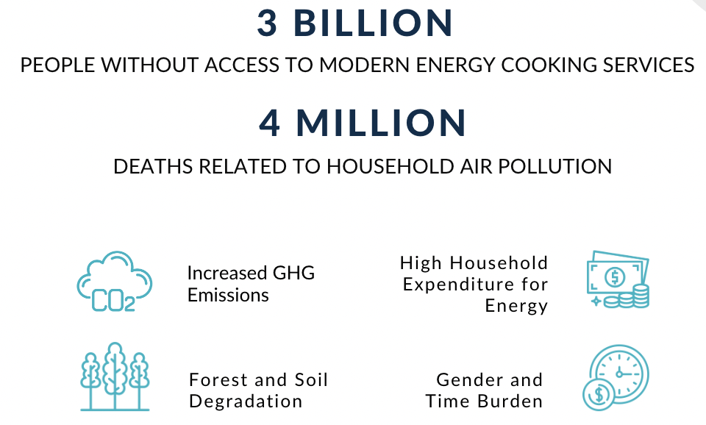
CONTEXT - CLEAN ENERGY CHALLENGE

Slide 3
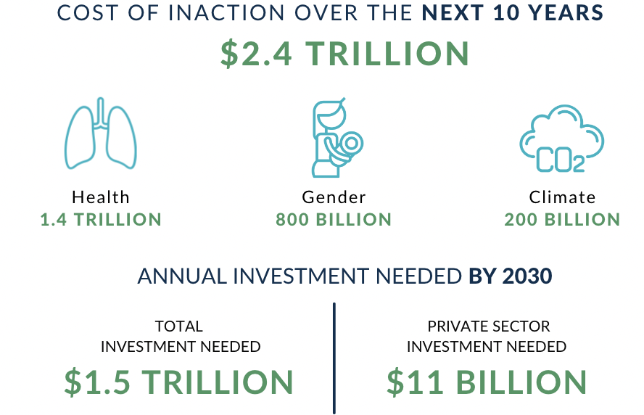
CONTEXT - GLOBAL COST

Slide 4
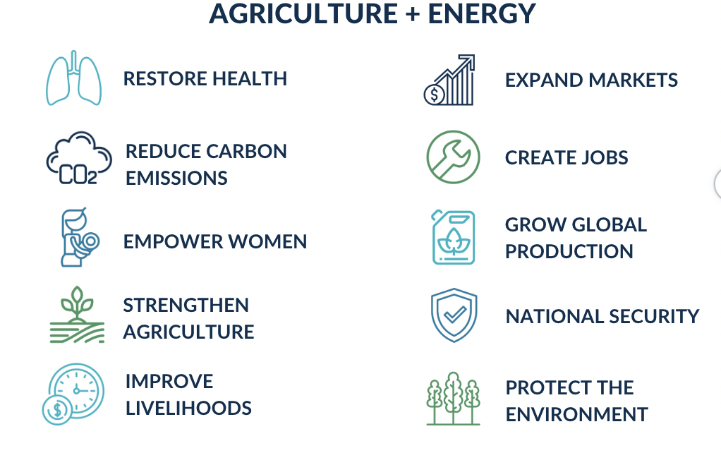
CONTEXT - THE BIOETHANOL SOLUTION

Slide 5
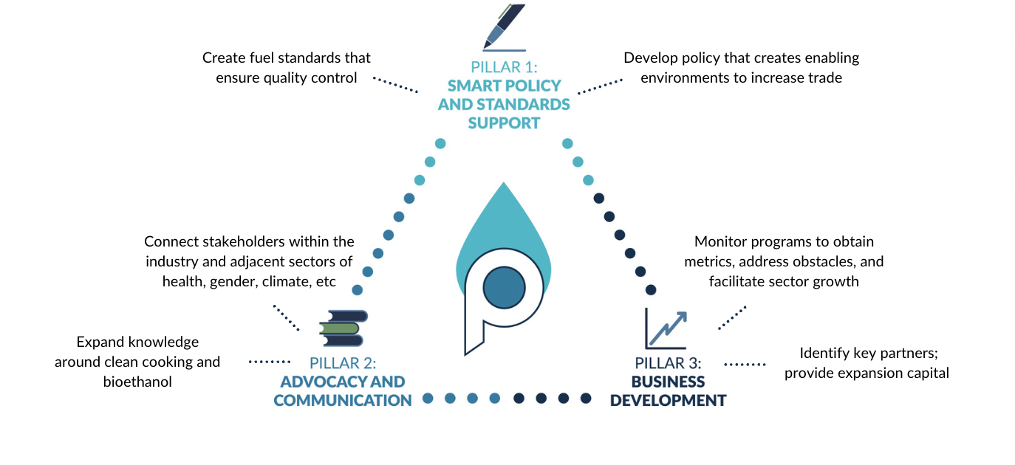
CONTEXT - PIVOT’S WORK

Slide 6
USAID & STANDARDS ALLIANCE COLLABORATION
Pivot has worked in collaboration with USAID and ANSI since 2020 and conducted the following standardization activities targeting Sub-Saharan Africa:
Virtual webinar including all member states of ECOWAS
Two hybrid workshops (2 days each) in Togo and the Gambia
Included representatives from the ECOWAS Centre for Renewable Energy and Energy Efficiency (ECREEE), multiple ministries, local NGOs, and private sector stakeholders
Five-part webinar series in collaboration with the African Organization for Standardisation (ARSO)
Virtual 2-day workshop in Mali
Included representatives from multiple ministries, private sector, and NGO stakeholders.
Follow-up after this event resulted in a signed MoU between ASTM and AMANORM, the Malian Standards Agency
Virtual participation and presentation by Pivot at the USAID Alternatives to Charcoal (A2C) workshop in Zambia

Slide 7
ACTIVITY SCOPE - MOZAMBIQUE
Pivot and the U.S. private sector look to further establish contacts and build a supportive ecosystem in Mozambique by engaging targeted stakeholders to secure policy and regulatory commitments.
Prime opportunity with the introduction of the Economic Acceleration Stimulus Package that includes biofuels and agricultural incentives
Includes virtual and in-person activities that include key decision-makers and operators already invested in business endeavors or government
Focal point will be built around a 2 day physical forum in Maputo featuring expert speakers, US private sector and in-country collaborators
Include stakeholders in agriculture, energy, bioethanol production, government agencies and invested businesses
Once this stakeholder dialogue has been accomplished, it will be followed by ad-hoc consultations and meetings to ensure that the end goals are achieved
Goals include:
Foster an enabling environment through standards and policy dialogue and adoption
Implement applicable regulations, and continued support and resources to maintain momentum in expanding bioethanol.
Engagement and discourse between stakeholders to create interactions that open the door for future knowledge-sharing and trade opportunities

Slide 8
KEY OBJECTIVES
Ensure Mozambique can further the development of its NQI and remove trade barriers to facilitate market access
Educate on the benefits of bioethanol and the impact on adjacent sectors (climate, gender, etc)
Create networks for local partners/interested parties that opens collaboration for moving toward clean and improved energy options and encourage business implementation
Introduce the need for standards adoption and plan concrete steps forward for implementation
Focus on quality control, approvals from local standards bodies, taxation, import/exports
Introduce newly amended and ratified standards such as ASTM E3050 - Bioethanol Cooking and Appliance Fuel Standard and seek adoption.
Assess and evaluate any actions already taken within clean cooking or bioethanol policy and standards
Evaluate existing bioethanol activities operating in Mozambique; inform on future activities through learnings from the dialogue, or build policy collaboration through existing networks
Link investment opportunities to developing enterprises to demonstrate the market potential for bioethanol business potential - including agriculture and supply chains

Slide 9
USAID CLIMATE STRATEGY GOALS
Mitigation
Potential reduction of 5.4 million kgCO2 annually from a transition of 5% of the population to clean cooking; this would grow dramatically if bioethanol was also blended for transportation use
Natural and Managed Ecosystems
Prevent the harvesting of forest for wood and charcoal use. Each year, 222,000 hectares of forest are harvested; if prevented, a potential 3.5 million tons of CO2 annually can be mitigated.
Adaptation
Capacity building will inform policymakers on appropriate and protective measures to support clean fuels, as well as technical assistance and social campaigns to educate the general population, fostering behavior change.
Job creation through bioethanol businesses adds economic stability and allows families to absorb challenges that come through climate change or natural disaster impacts.
Increased agricultural support builds a feedstock supply chain that also ensures national energy security in the event of a global crisis or supply constraints.
Country Support
`Through the working relationships already developed with counterparts on the ground, productive dialogue toward enabling policy frameworks has begun; this activity will support the foundation for clean fuels to build on.
Critical Populations
Women and children are exposed 2-4 times more than male counterparts, and usually responsible for fuel collection and cooking, placing them at greater risk for Gender-Based Violence, health complications, and removed from educational opportunities.
Women are the primary demographic of the sales teams for bioethanol businesses, which offers opportunities for gainful employment.

Slide 10
EXPECTED OUTCOMES
Establish partnerships between entities involved in the stakeholder dialogue that can foster further harmonization and unified policies regionally
i.e. an MoU between ASTM and the local standards body
Begin adoption process and early-stage implementation of ASTM E3050, Standard for Denatured Bioethanol Fuel for Cooking and Appliance Fuel
Facilitate and support regional or local efforts on pilot and feasibility studies for bioethanol stoves and fuel use, including further dialogue with the U.S. Trade and Development Agency (USTDA) and other agencies that have expressed willingness to engage in this area
Develop committees that continue dialogue, including the introduction and implementation of new policies. Inter-ministerial committees can be key in accomplishing the establishment of favorable environments for renewable energy.
Establish a template for engagement on bioethanol fuels transition that can be adjusted and introduced to additional countries throughout sub-Saharan Africa, building efficiency into future programs and dialogue
Outline a follow-up plan for local public sector to utilize and help facilitate the development of bioethanol enterprises and support existing bioethanol businesses in a meaningful way, including trade relationships or connections to outside investment

Slide 11
THANK YOU!
CONTACT US!
Alicia ElMamouni
Executive Director | Pivot Clean Energy Co
alicia@pivotcleanenergy.org
+1 605 368 0091

