Slide 1
Technology Standards: How Do They Support Public Policy Goals?
November 2, 2023 Organized by the U.S. Celebration of World Standards Day Planning Committee

Slide 2
Agenda
Standards 101: Understanding the Development Process and Relation to the WTO TBT Principle Muhammad Ali, Sr. Standards Strategy and Policy Leader, HP Inc.
Case Study: Advanced Manufacturing Standards Brian Meincke, Vice President, Global Business Development and Innovation Strategy , ASTM International
Promoting U.S. Standards Leadership Mary Saunders, Vice President, Government Relations and Public Policy, ANSI
Q&A

Slide 3
Why Should Congress Care?
The health and resilience of the economy is directly related to investment by public and private sectors in the development of standards.
A standards-literate workforce with demonstrated competencies is better prepared to compete for skilled job opportunities as they emerge.
The national interest in emerging areas of standardization demands that public- and private-sector stakeholders work together to address national priorities.

Slide 4
Standards 101: Understanding the Development Process and Relation to WTO TBT Principles

Slide 5
The U.S. System is Unique
Most countries (top down)
Standards development priorities driven by government or national standards bodies
U.S. system (bottom up)
Standards development priorities driven by users and markets

Slide 6
The Public/Private Partnership
The cornerstone of the U.S. standardization system
Government and industry together develop standards to achieve policy objectives.

Slide 7
The Public/Private Partnership
1995 National Technology Transfer and Advancement Act (NTTAA) — Public Law 104-113
Encourages government agencies to rely on existing private-sector standards whenever possible

Slide 8
The Public/Private Partnership
Federal Participation in the Development and Use of Voluntary Consensus Standards and in Conformity Assessment Activities— OMB A-119
Encourages government agencies to use voluntary consensus standards

Slide 9
There are more than 100,000 standards in the U.S…
…developed by hundreds of SDOs and consortia…
…with over 13,000 approved as American National Standards.

Slide 10
What is a technology standard?
A document that describes requirements, specifications, guidelines, or characteristics of a technology, process, or practice
Precise and detailed – implementers can determine if their implementations meet the standard
Voluntarily adopted
Standardization
Certification
Legislation
Regulation

Slide 11
What do standards enable?
Interoperability | Define interfaces such that hardware, software, and systems produced by different entities can work together | Examples: Most standards produced by 3GPP, IEEE 802, IETF, Bluetooth SIG, USB-IF
Performance, Quality, and Process | Encapsulate established best practices; facilitate assurance that a product or service will behave predictably or at a certain level or threshold | Examples: ISO/IEC 27001, ISO 9001, ISO/IEC AI standards-in-progress
Measurement | Define how to measure parameters, enabling a consistent, repeatable approach for measurement of products and services from various companies and testing labs | Examples (computer server efficiency): ISO/IEC 21836, SERT suite
Notes:
Standards landscape goes beyond standards for interoperability
Performance and quality standards – often incorporated into industry guidance, self-regulatory, and regulatory regimes
[Anything in particular to say about measurement standards?]

Slide 12
Standards Development Process
Example: ISO/IEC Development Process

Slide 13
Standardization: A Global Community
Standards developers and conformity assessment bodies
Commercial and consumer acceptance
Government acceptance

Slide 14
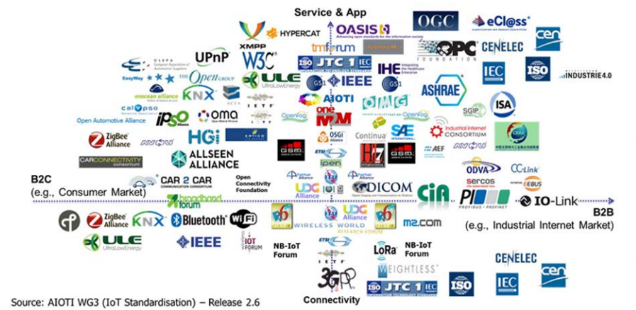
Diverse landscape of standards organizations
Example: Internet of Things standards orgs and alliances

Slide 15
Diverse landscape of standards organizations
Representation | Decisionmaking | Membership
Individual experts Individual orgs National bodies or committees National governments | Consensus or no voting One expert, one vote One org, one vote Weighted or proportional voting One country, one vote | Open to any individual or org Open to any paying member Limited to certain classes of members (industry sectors, governments)

Slide 16
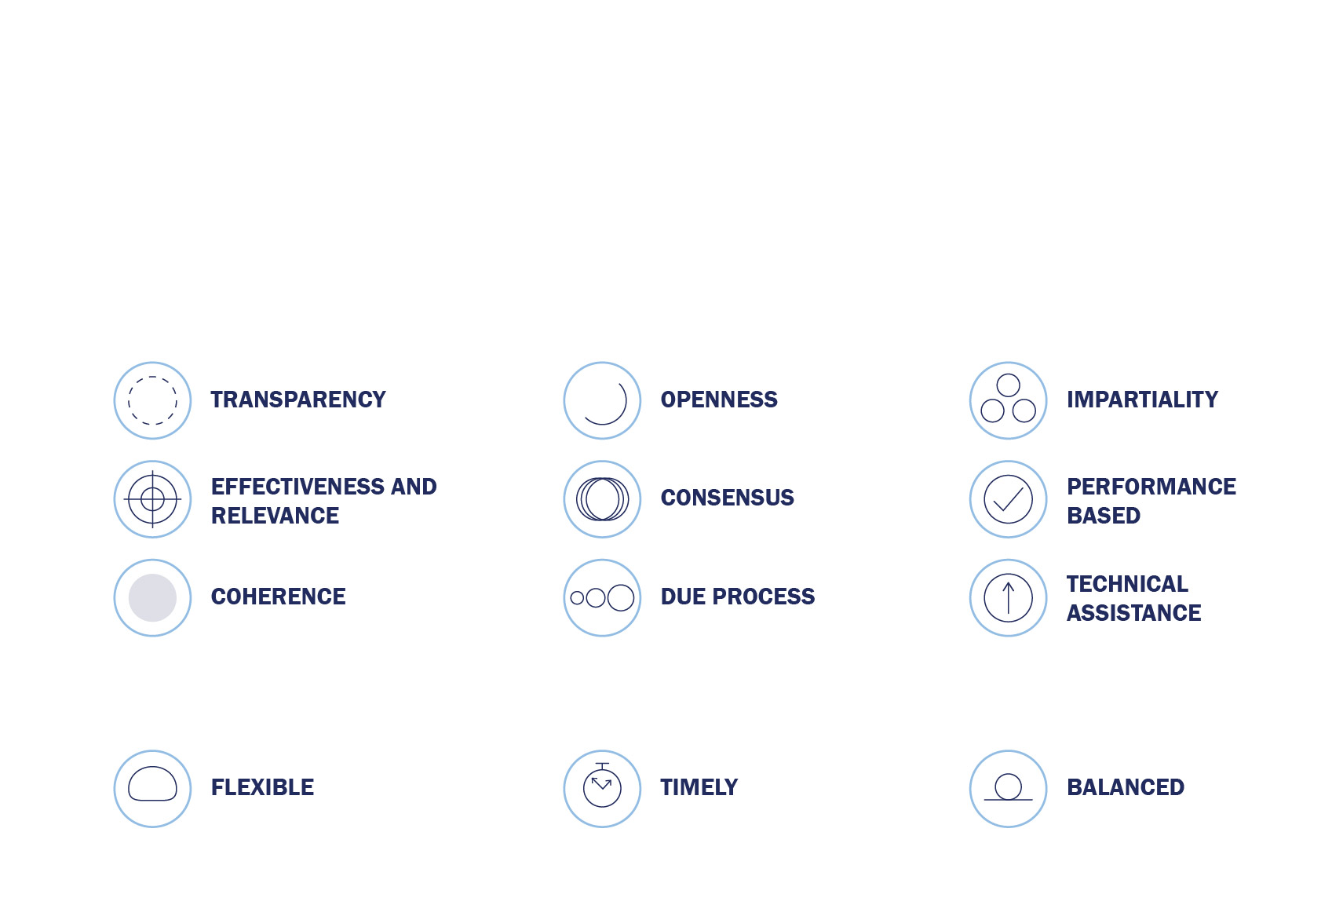
The 12 Principles of Standardization
According to the World Trade Organization (WTO), standards should meet societal and market needs and should not be developed to act as barriers to trade. The U.S. standards system is based upon the following set of globally accepted principles:
In addition, U.S. interests strongly agree that the standardization process should be:

Slide 17
Case Study: Advanced Manufacturing Standards Brian Meincke ASTM International Vice President, Global Business Development and Innovation Strategy

Slide 18
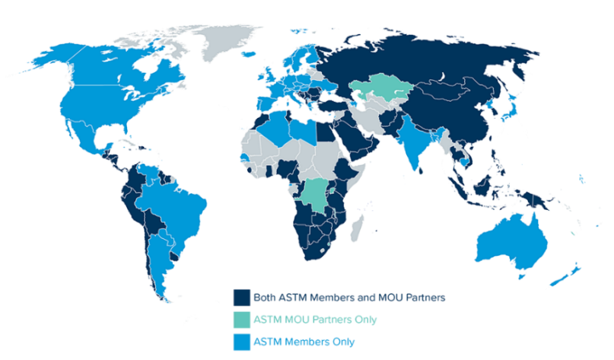
About ASTM International
Leading Independent Partner for Agile, Global Standards and Testing Programs that Help Solve Complex Challenges and Improve Lives by Making Products and the Environment Better for All
Established in 1898
147 Committees
13,000+ Standards
90 industry sectors from aviation to construction to advanced manufacturing
A leading global standards organization with more than 30,000+ members
A highly agile, independent, non-governmental, non-profit, member-led standards body
Uniquely positioned to help society solve challenges and seize opportunities
Globally recognized for quality and relevance
Notes:
This year marks our 125th anniversary. Since 1898 we have brough technical experts together from industry, governments, research and testing communities to help them reach a global consensus on technical challenges through the development of world class standards which includes specifications, guides and test methods. These ASTM standards and supporting services enhance the safety and quality of products and materials used in commerce or by mission-related organizations such as NATO.
Today, more than 12,000+ ASTM standards from 150 technical committee - some of which are referenced in 90 countries around the world – including all NATO ally nations.
In our open and transparent standards development processes, individual technical experts participate and vote directly – there are no national delegations.
With members from over 100 countries in every region of the world, our Consensus based approach results in Globally relevant technical solutions
That’s important because Technical Quality and Global Relevance are two of the main attributes that underpin ASTM’s brand promise -which is to Help our World Work Better.

Slide 19
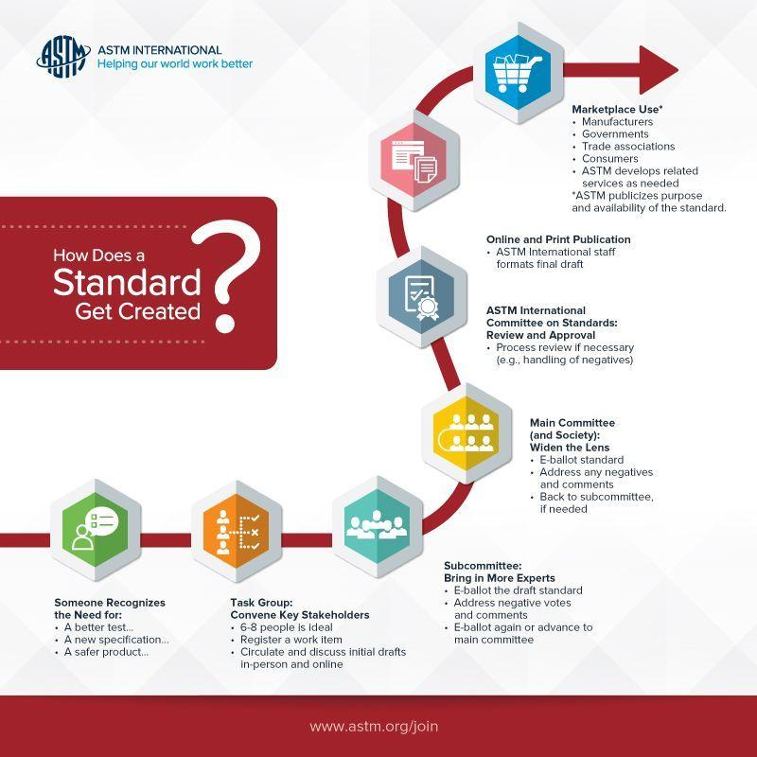
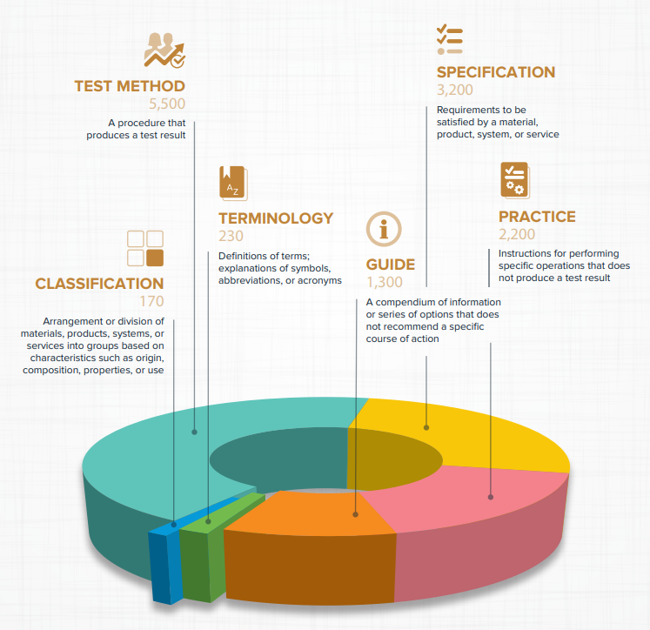
Standards Development Process

Slide 20
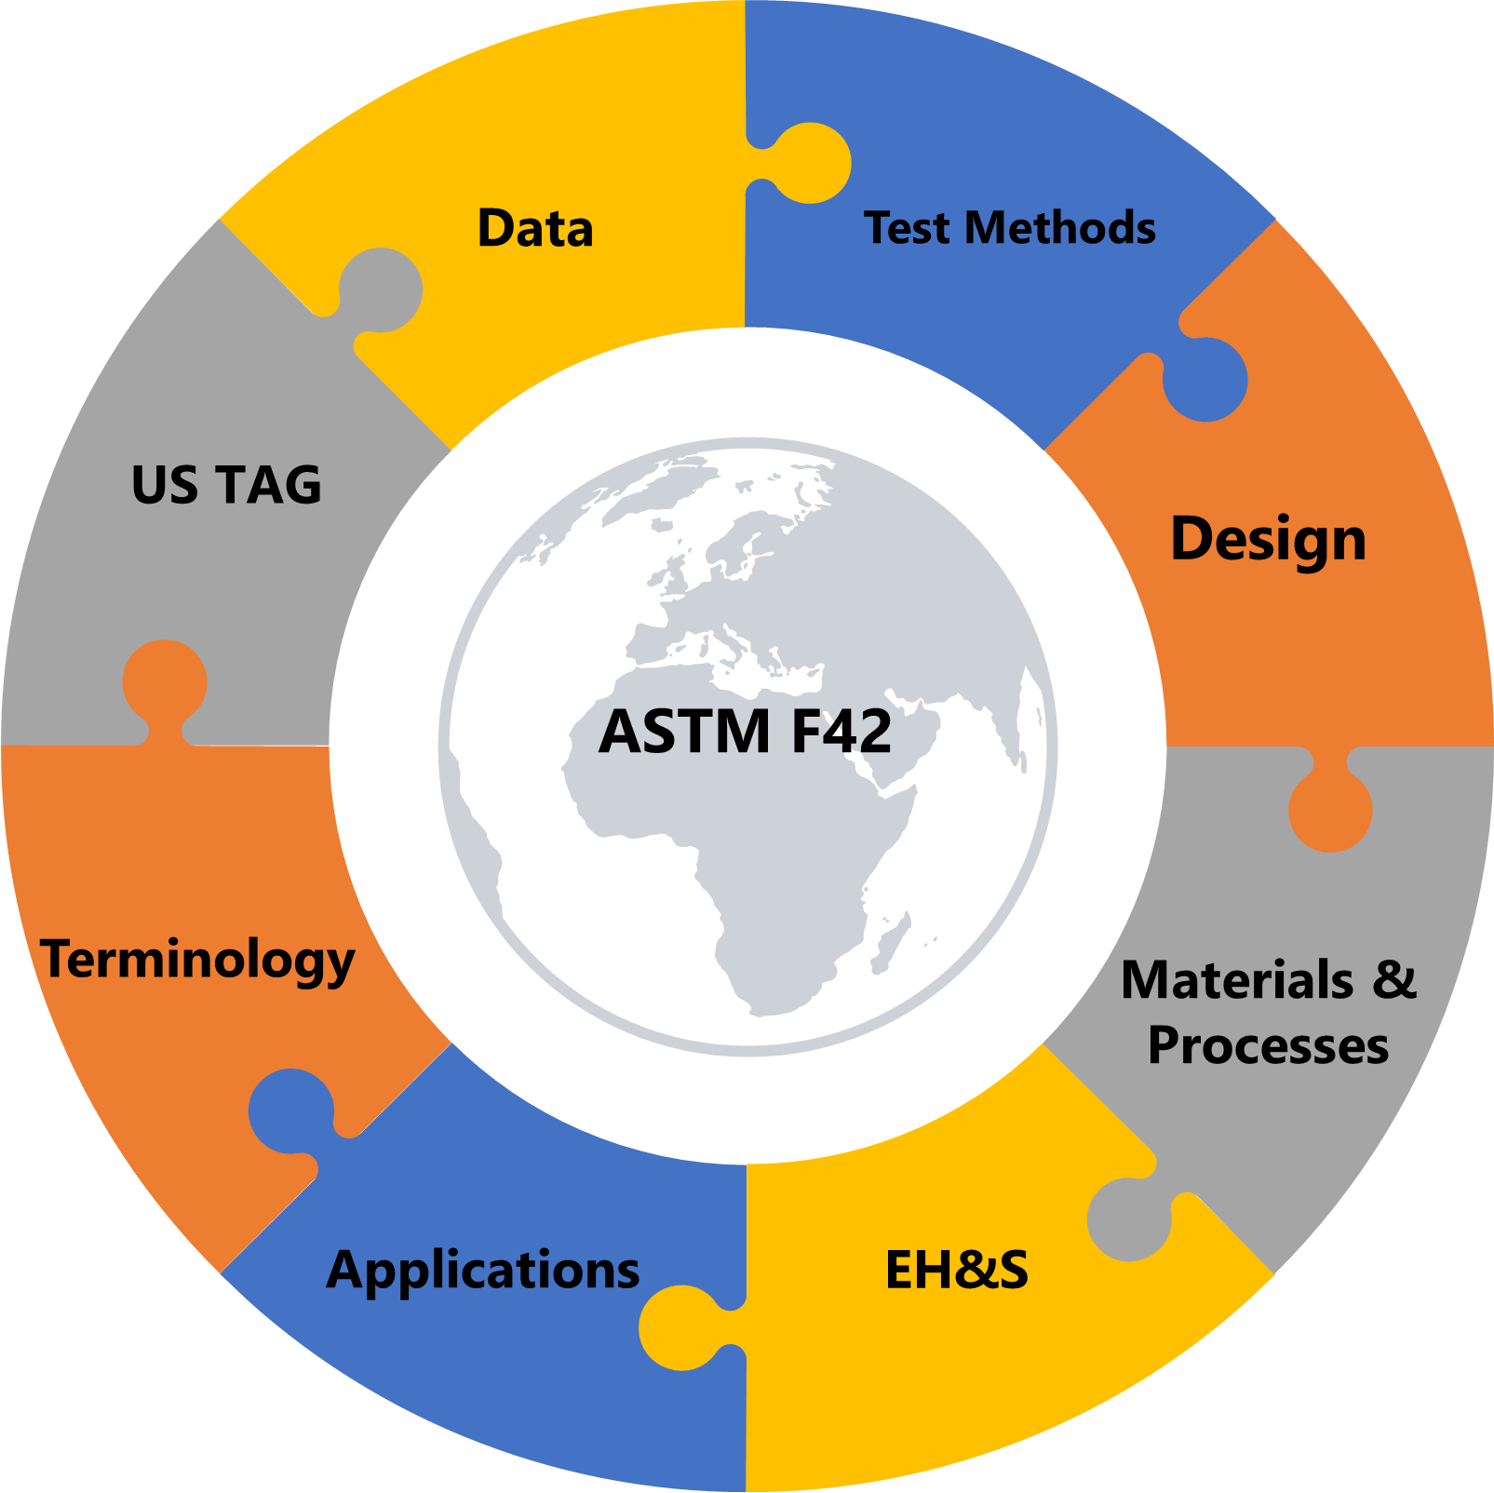
ASTM Committee F42 on Additive Manufacturing
Established: 2009
Current Membership: About 1,000 members
Standards: 55 approved, 60+ in development (Half jointly with ISO)
Global Representation: 38 countries involved
Partnership: ISO TC261 (& CEN TC438): Agreement since 2011
Strategic Relationships:
America Makes: Agreement since 2013
Government agencies: NIST, NASA, FAA, FDA, DoD, U.S. NRC, etc.
Other groups: MMPDS (MoU), CMH17, etc.

Slide 21
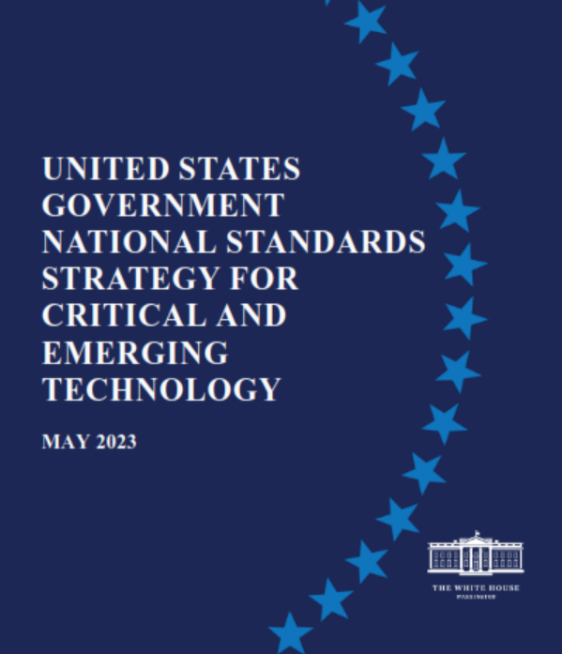
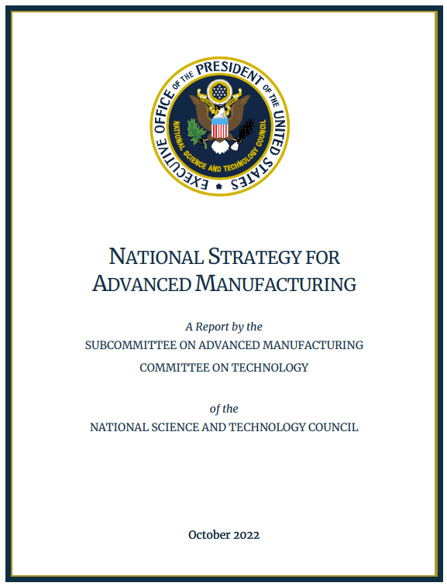
Advanced Manufacturing Evolution
Establishment of ASTM AM CoE to bridge standards gaps through research
May 2023: US National Standards Strategy on Critical Emerging Technologies
Jul 2023: Manufacturing Sustainability
Funded project by ARM on Robotics
ICAM is now Advanced Manufacturing
2018
Funded project on AM Cybersecurity training
Expanded scope of F45 to include Robotics and Automation
Acquisition of Wohlers Associates; advisory service
Establishment of ASTM F42 to develop Additive Manufacturing standards
Subcommittee F42.07 on Applications
2023
2009
2019
2021
2011
2022
Signing of PSDO with ISO to harmonize the development of AM standards
Robotics domain expert joining the team
May 2022: ASTM Advanced Manufacturing Division was established
Oct 2022: US National Strategy on Advanced Manufacturing
Funded project by NIST on Advanced technologies for digitalization of construction industry
2020
Subcommittee F42.08 on AM Data

Slide 22
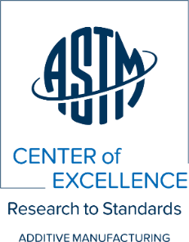
ASTM AM CoE – Research to Standards
ASTM formed Additive Manufacturing Center of Excellence (AM CoE) in 2018
Mission
Vision
The Center bridges standards development with R&D to better enable efficient development of:
Standards
Education and training
Certification and proficiency testing programs
The Center facilitates collaboration and coordination among government, academia, and industry to:
Advance AM standardization
Expand ASTM International’s and our partners’ capabilities.
ASTM Committee F42 is dedicated to AM and has technical subcommittees focused on the development of consensus-based standards. This is happening in partnership with ISO TC261.
ASTM AM CoE is a collaborative partnership among ASTM and organization representing government, industry, and academia that conducts strategic R&D to advance standards across all aspects of AM in addition to create E&WD and Certification Programs.

Slide 23
Center of Excellence (CoE) Model Ecosystem
Advisory, Intelligence
Consortium
Develop and standardize the requirements and best practices for AM material data generation and create high-pedigree datasets for use by members to support design and rapid qualification.
Offered via Wohlers Associates in addition to Wohlers Report, Wohlers Specialty Reports, DfAM training and others.
Stds & Cert
E&WD
Supports development of the AM standards roadmap, transitioning R&D to standards and technical
publications, proficiency testing and certification programs.
Develops comprehensive education and training programs built on standardization and certification expertise that prepares the AM workforce of the future at all levels.
R&D
Conducts R&D identified and prioritized by the top minds in the field to significantly accelerate standards development.

Slide 24
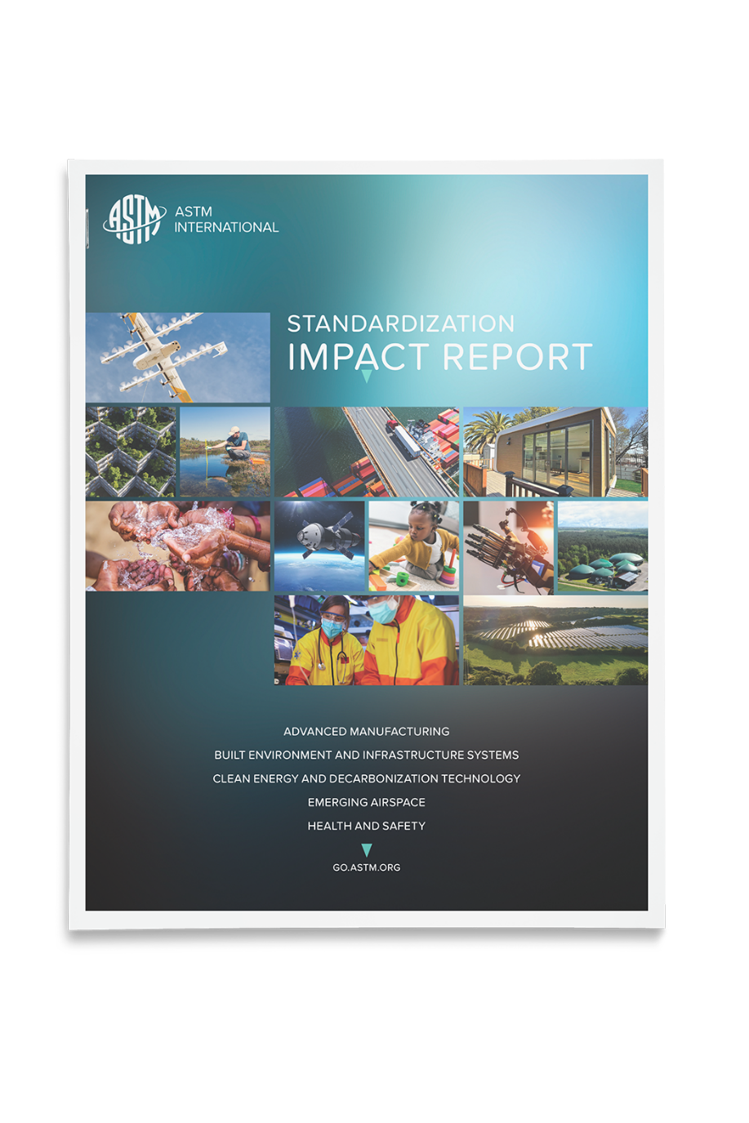
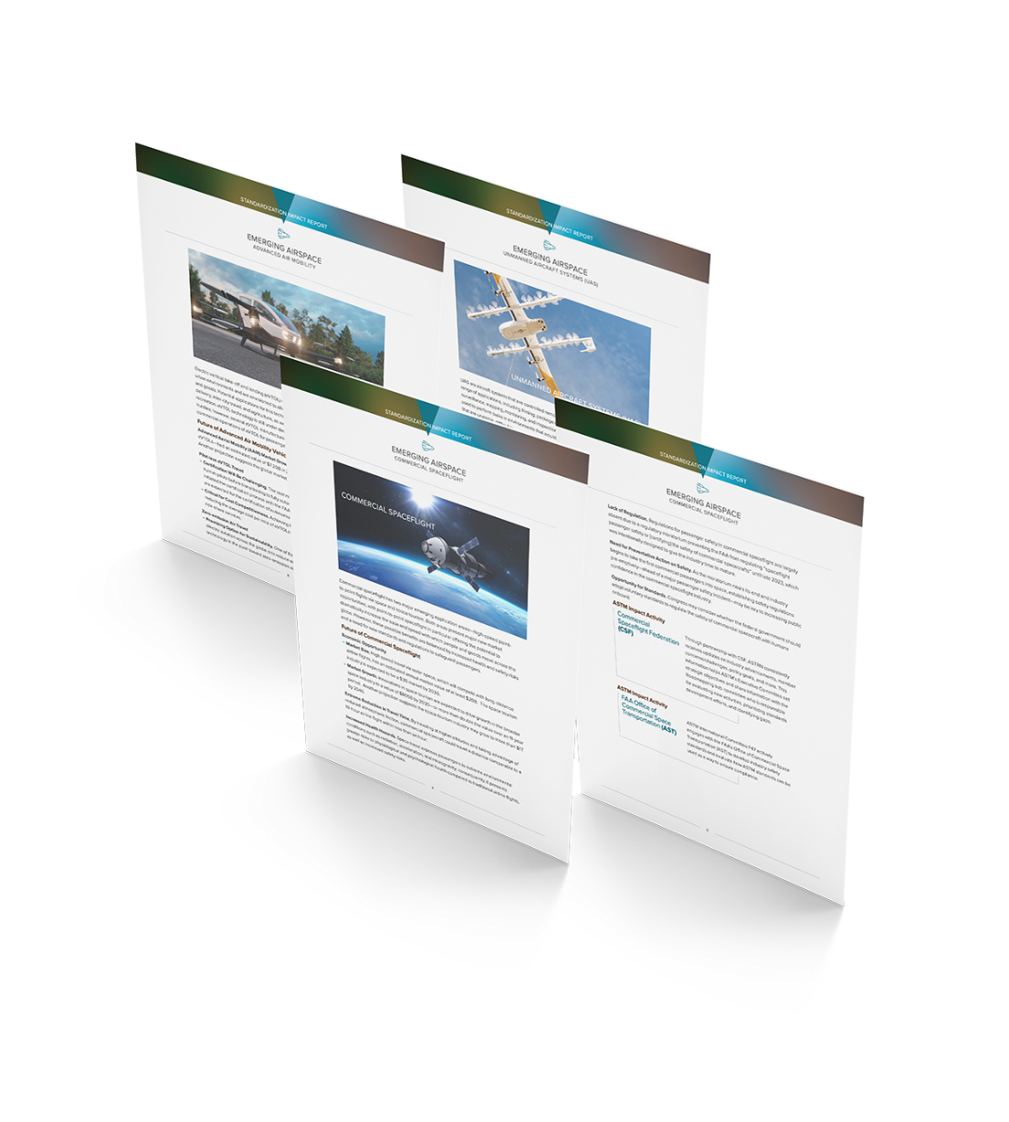
Standardization Impact Report
Advanced Manufacturing
Built Environment & Infrastructure Systems
Clean Energy & Decarbonization Technology
Emerging Airspace
Health & Safety

Slide 25
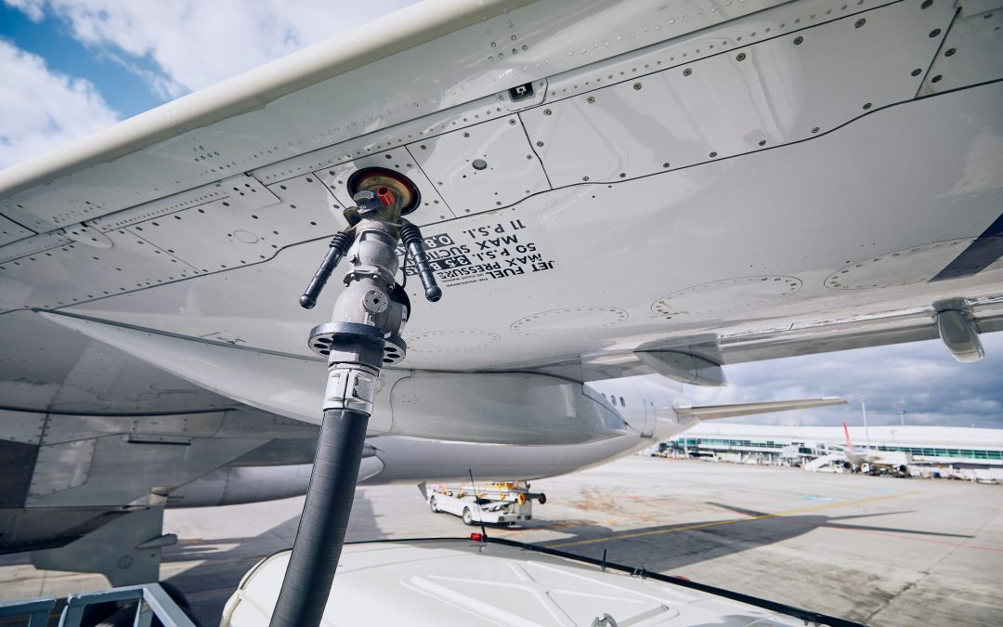
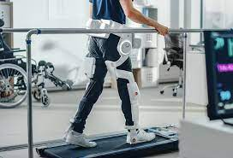
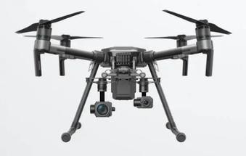
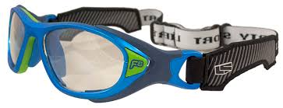

Slide 26
Promoting U.S. Standards Leadership

Slide 27
Promoting U.S. Leadership in International Standards
Allocate increased R&D funding for critical and emerging technologies
Encourage the USG to broadly promote the voluntary, private sector led standards development model domestically and in dialogues and agreements with other countries
Encourage greater participation by federal agency staff in mission-relevant international standards development activities

Slide 28
Promoting U.S. Leadership (cont.)
Raise awareness of treaty organizations that engage in standards development activities and the role of the USG in ensuring that these activities are rules-based, open, transparent, and consensus-based
Support efforts to grow a standards literate workforce
Support more international standards development meetings taking place in the U.S.

Slide 29
Key Points to Remember
Rules-based processes for international standards establish guard rails and create value
Seeking to bar some participants from global standards processes will create fragmentation
Diversity in standards venues is a feature (not a bug)
Avoiding prescriptive legislative language in the area of technology policy and standards allows for rapid changes and innovation

Slide 30
Q&A

Slide 31
Contact Information
Muhammad Ali muhammad.ali1@hp.com
Brian Meincke bmeincke@astm.org
Mary Saunders msaunders@ansi.org

